Slide 1





US Territories Water Operator Training Series
Session 19: Distribution 2: Valves, Hydrants, Meters, and Service Connections
4/2/2026
www.efcnetwork.org
This program is made possible under a cooperative agreement with US EPA.

Slide 2


Matt Ziegler
Program Director
Your trainer for today

Slide 3



This training series is funded by the US EPA

Slide 4


Slide 5
Schedule for 2026:
Date | Topic
1/22/26 | Alternative Treatment Processes (e.g. flouridation, ion exhange, RO…)
2/5/26 | Drinking Water Treatment Math & Concept Review
2/19/26 | Safety Program Basics (including personal safety, equipment safety, facility safety)
3/5/26 | Lead & Copper Rule, Corrosion Control
3/19/26 | Distribution Systems 1: Hydraulics, Pipe Types, Selection, Installation, and Water Quality
4/2/26 | Distribution Systems 2: Valves, Hydrants, Meters, and Service Connections
4/16/26 | Distribution Systems 3: Storage and Booster Pumping
4/30/26 | O&M: Pumps, Main, and Appurtenance Maintenance (including pressure monitoring, valve exercising, and flushing)
5/14/26 | O&M: Cross Connection Control
5/28/26 | O&M: Distribution System Math and Concept Review
6/11/26 | Sampling & Lab Procedures/Analysis/Interpretation
6/25/26 | Management Overview (including organization, communication, PR & record keeping)
7/9/26 | Drinking Water Practice Exam and Review
Links to recordings and material are available on our website at https://swefc.unm.edu/home/op-cert-trainings/

Slide 6

https://swefc.unm.edu/home/op-cert-trainings/

Slide 7

Sign in for every session to ensure you get credit for attending

Slide 8
Valves
Drinking Water Distribution Systems

Slide 9
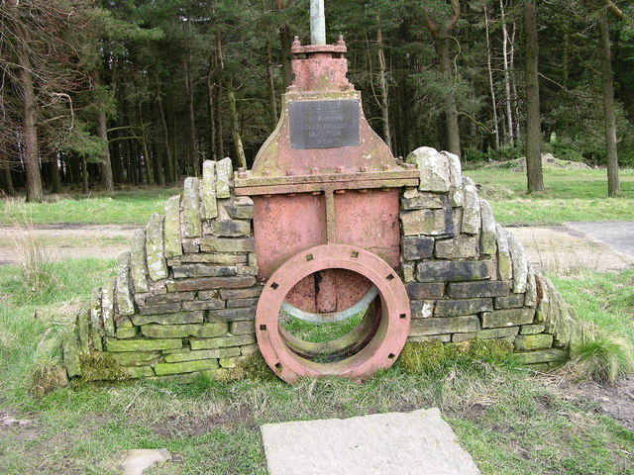
Valves
Uses
Types
Operation
Maintenance
Affect on Water Quality
"20' gate valve - Calf Hey dam 1856 - geograph.org.uk - 363562" by liz dawson is licensed under CC BY-SA 2.0.

Slide 10
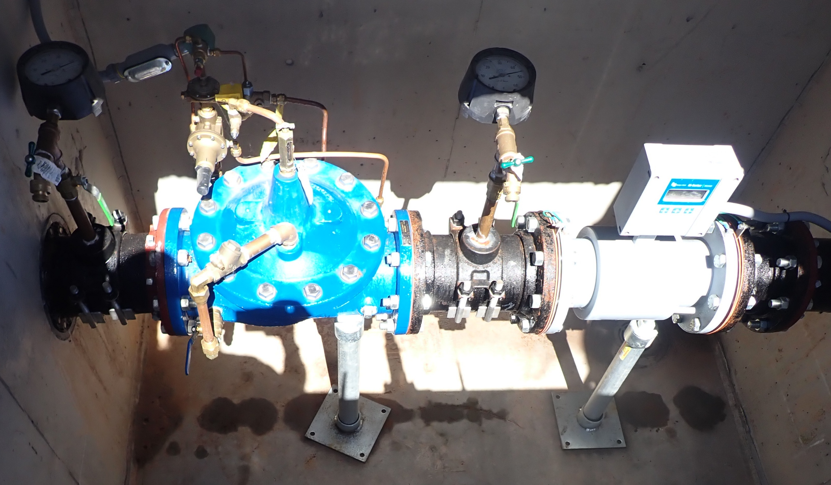
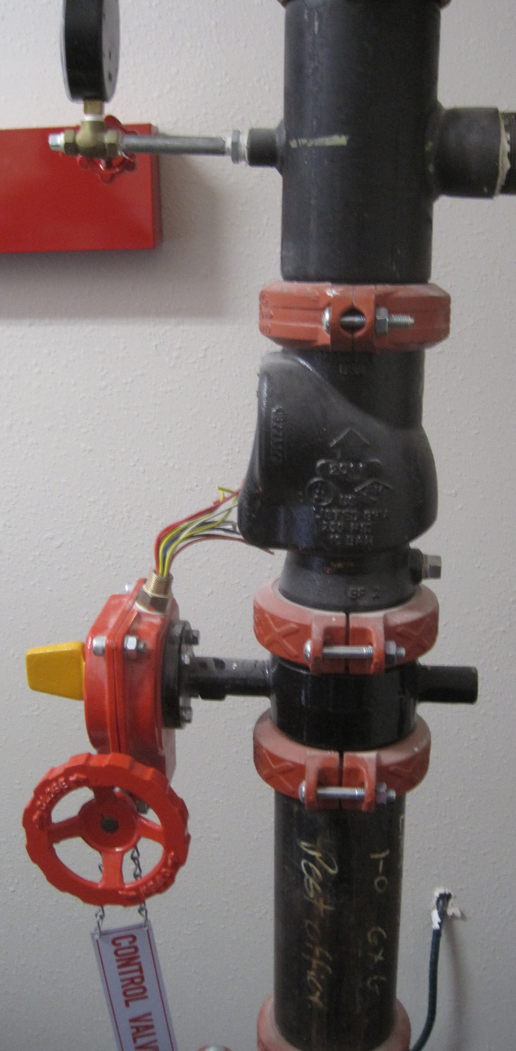
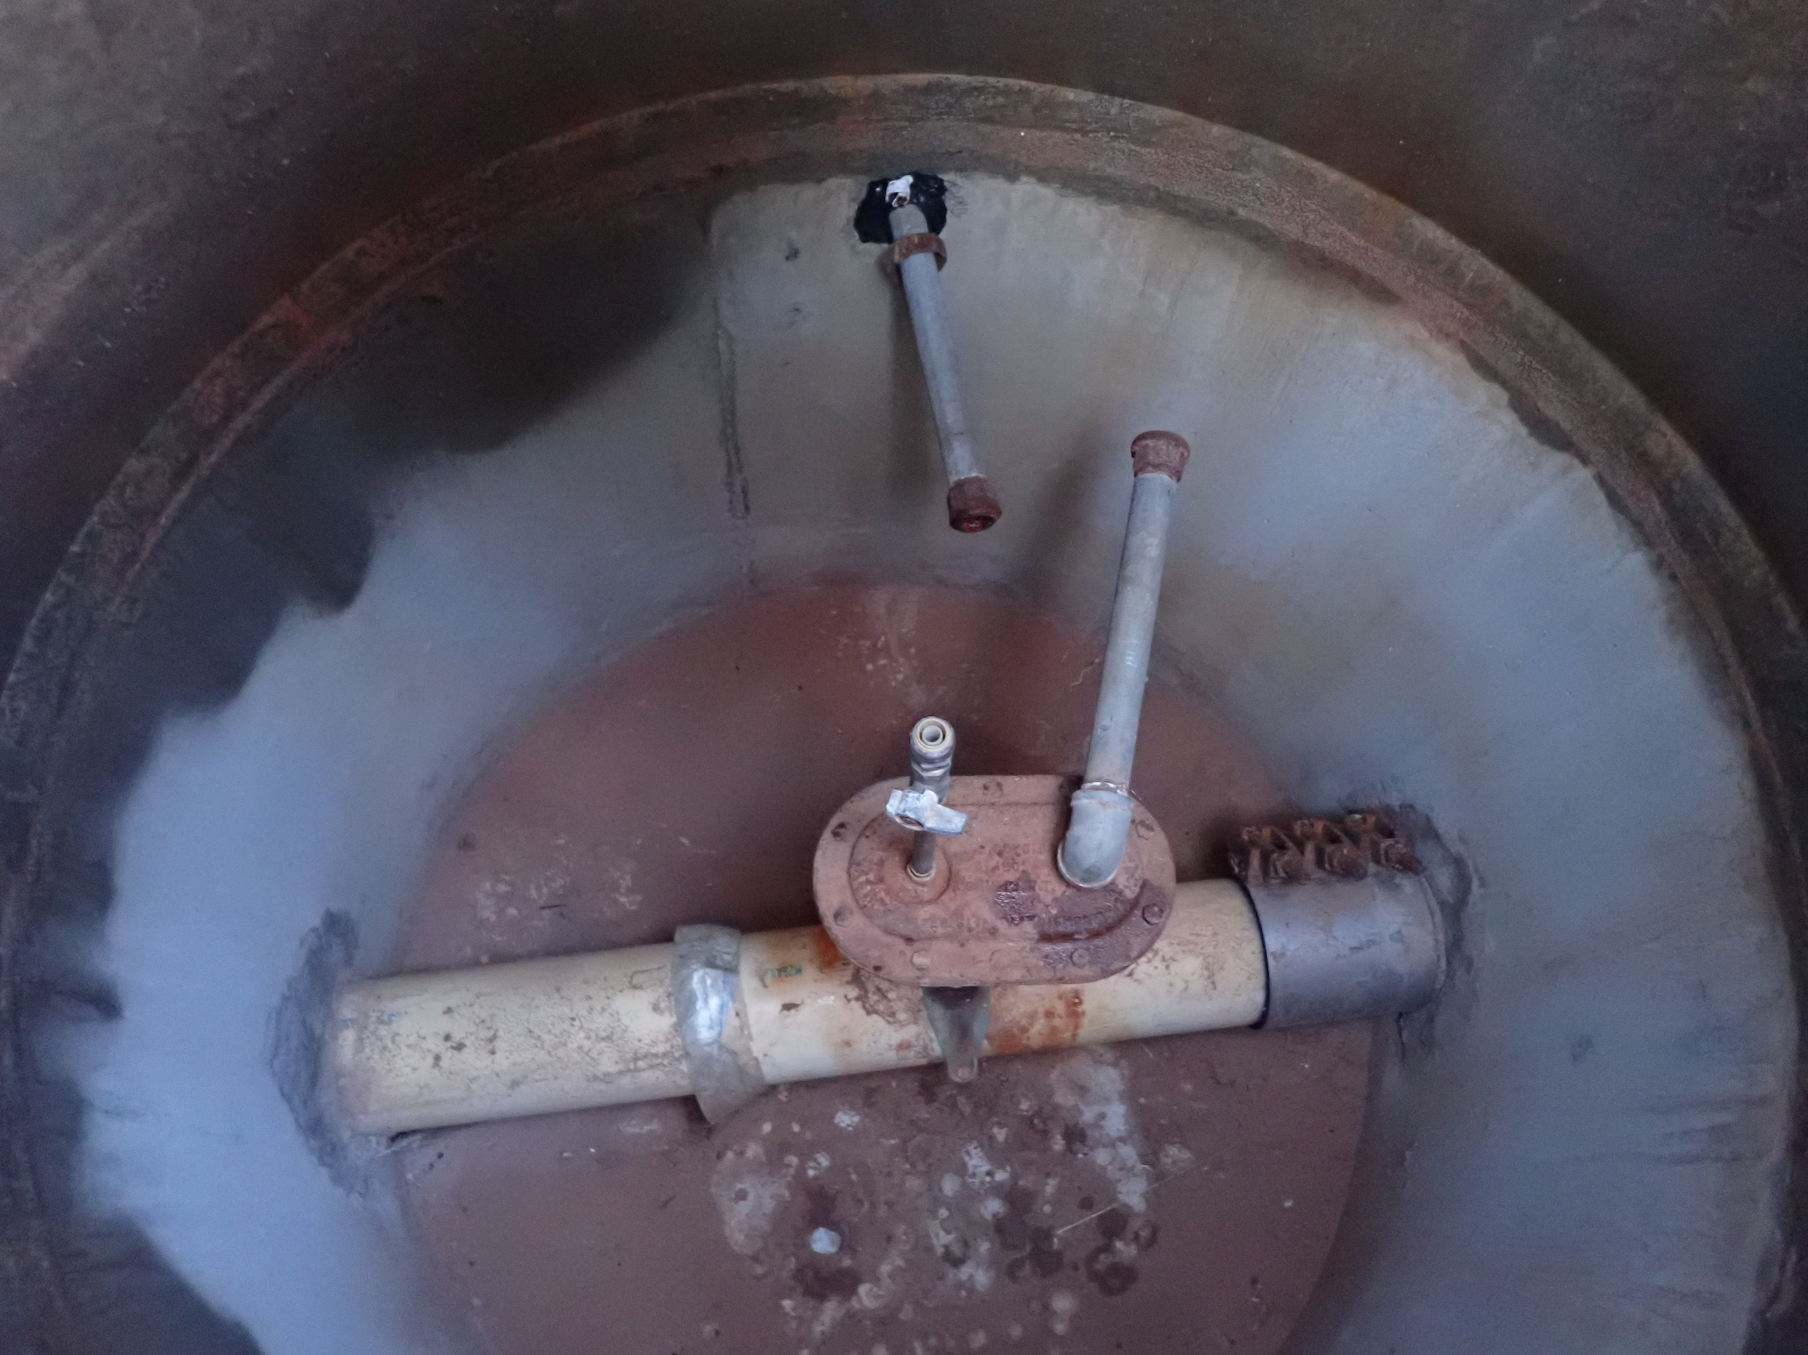
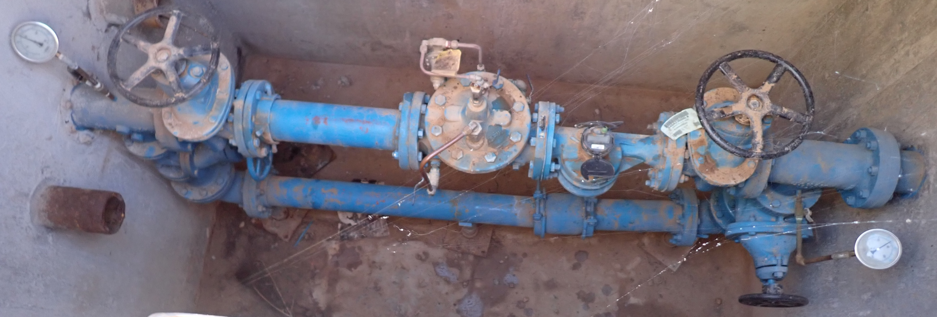
Valves – Uses
Flow Control
Isolation
Pressure Control
Air Relief
Vacuum Relief
Backflow Prevention

Slide 11
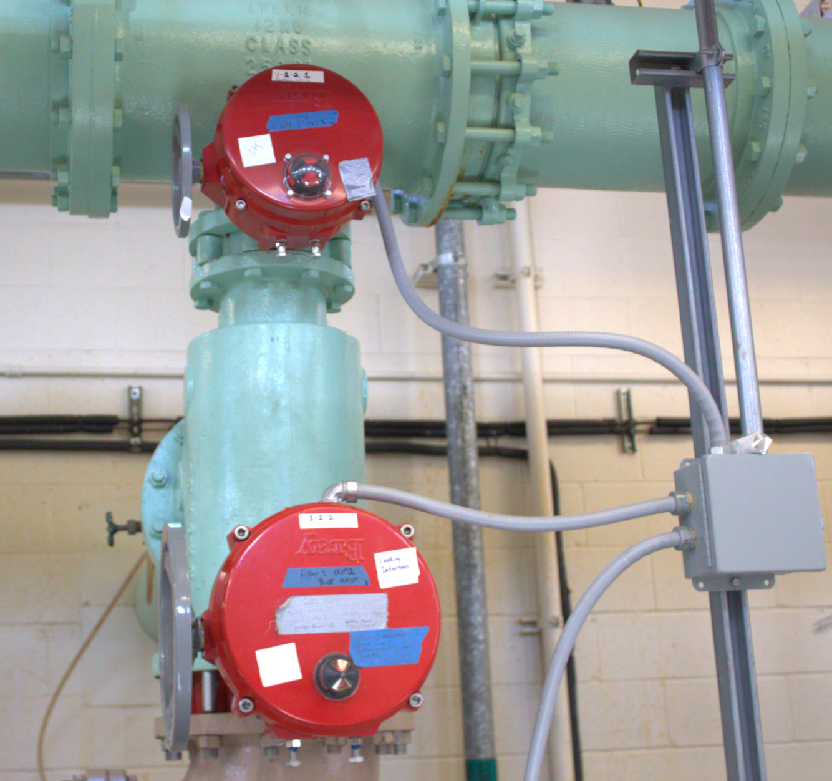
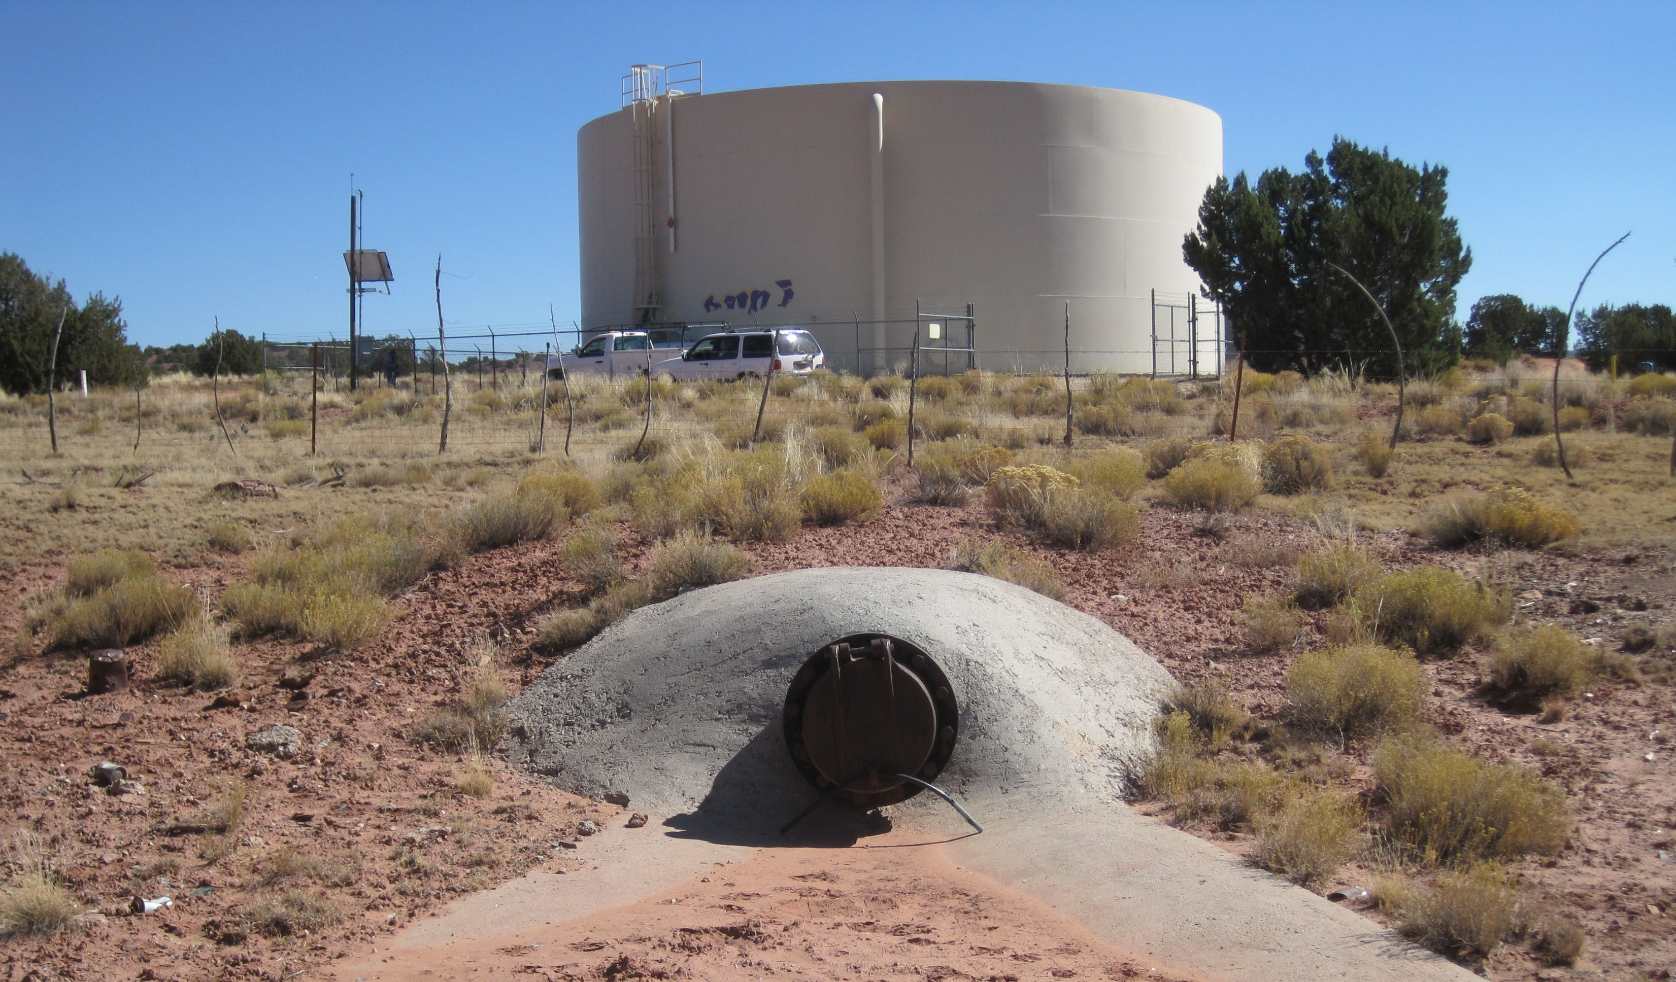
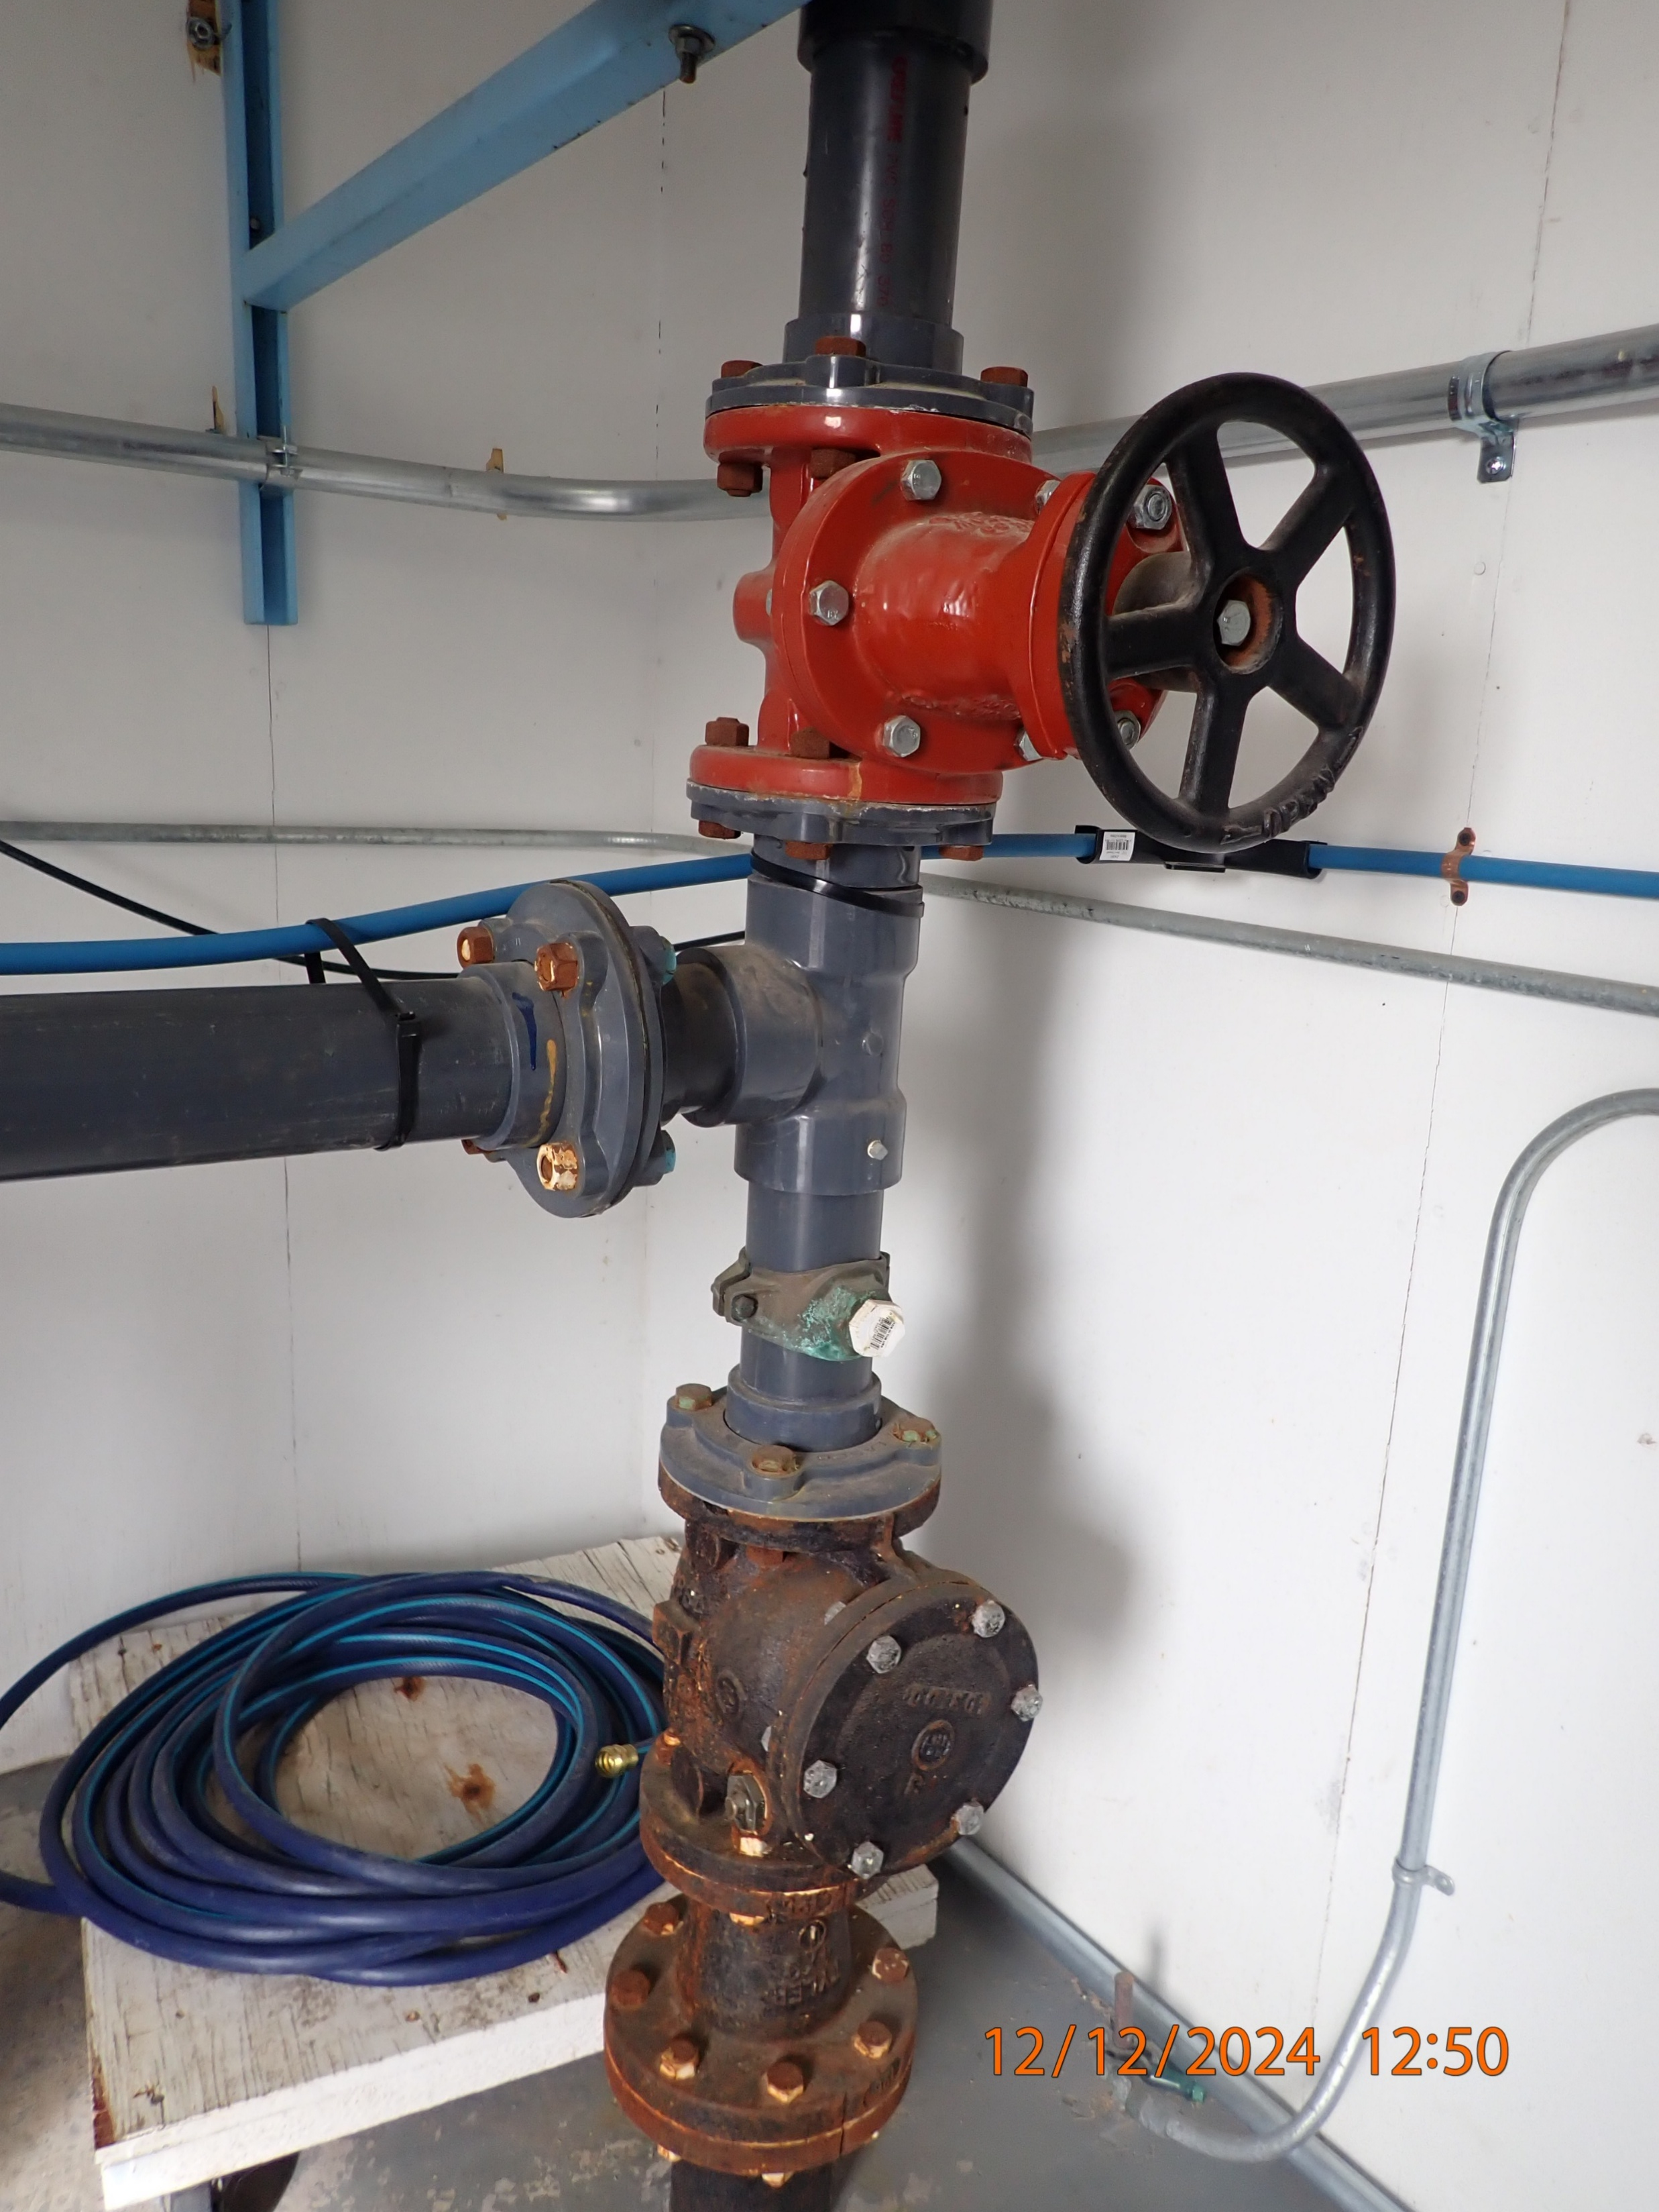
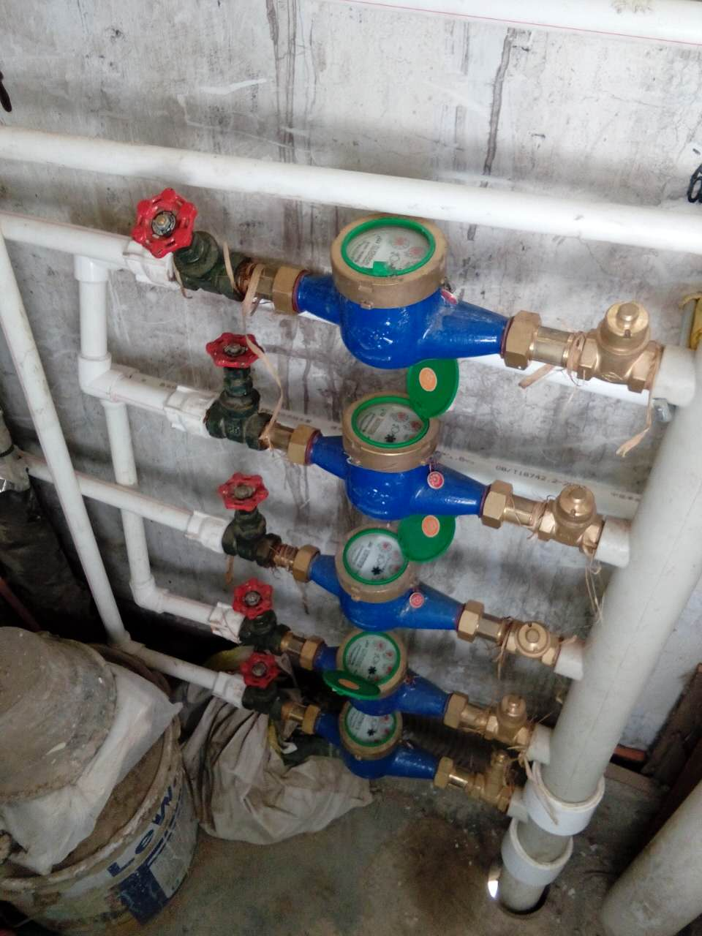
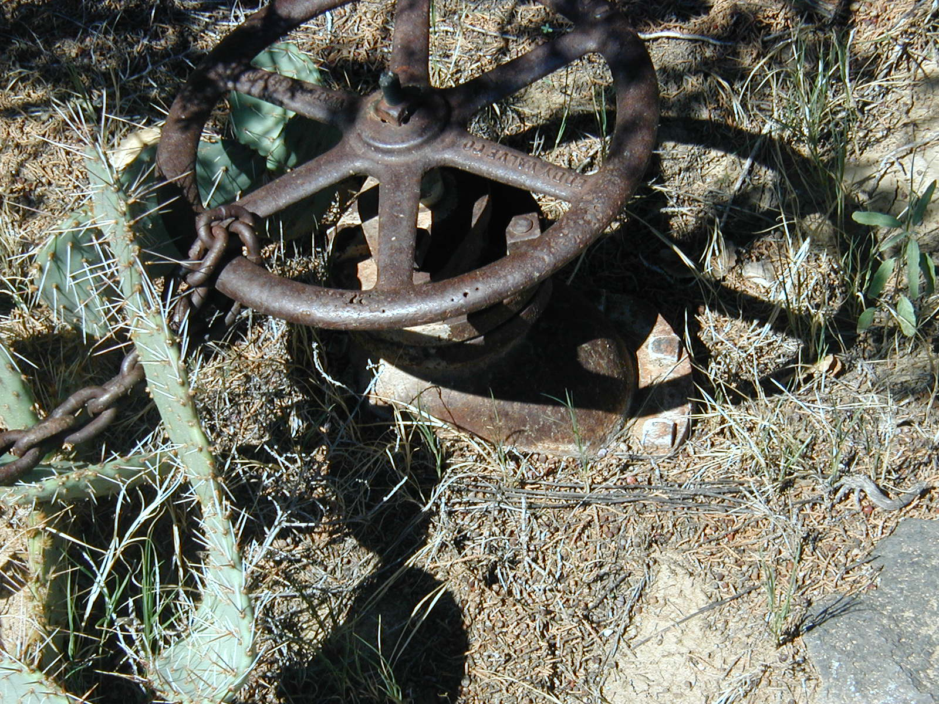
Valves – Uses in Drinking Water
Storage
Treatment
Sources
Distribution
Service Connects

Slide 12
Valves – Types
Rotary Valves
  Quarter turn valves
  Plug valves, ball valves, butterfly valves
Linear Stroke Valves
  Valve stem must be rotated several times to open and close – more rotations for bigger valves
  Gate valves, globe valves
Air/Vacuum Relief
  Allow air into or out of system
Check Valves
  Keeps flow in only one direction

Slide 13
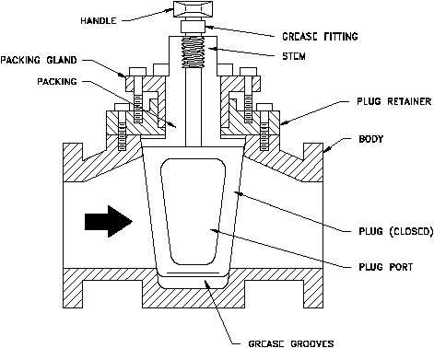
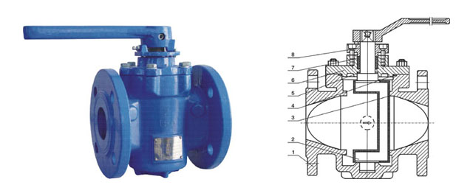
Valves – Rotary
Plug Valves
  Used in curb and corporation stops
  ¼-turn to open, restrict, or stop flow
  Usually ¾”-2”
  Standard plug valve with opening in center
  Eccentric/solid plug valve with plug off-center
Notes:
The bottom photo is of an eccentric valve from www.valvemade.com/eccentric_plug_valve.html

Slide 14
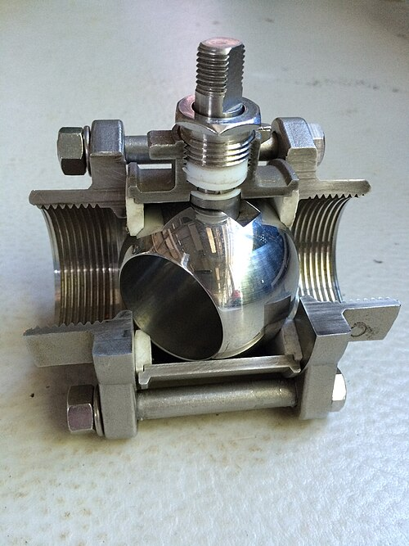
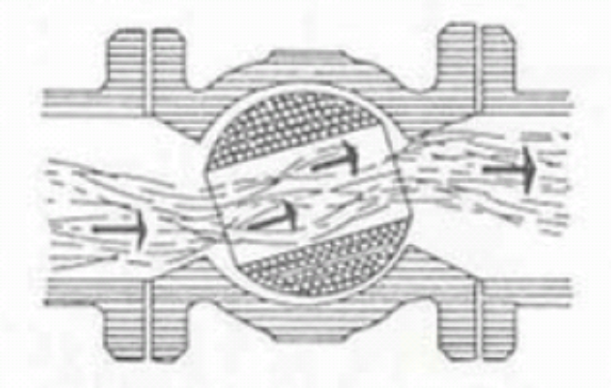
Valves – Rotary
Ball Valves
  Similar to plug valve
  ¼-turn to open
  Small diameter pipe ≤2”
  Operate fully open or closed
"Ball Valve" by Bitjungle is licensed under CC BY-SA 4.0.
Notes:
Photo of cutaway ball valve from creative commons https://commons.wikimedia.org/w/index.php?curid=41064308

Slide 15
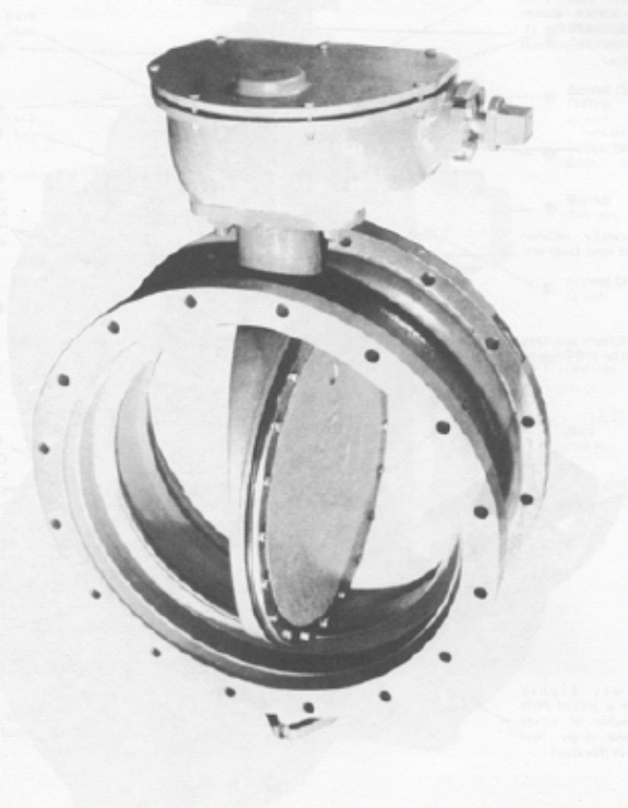
Valves – Rotary
Butterfly
  ¼- turn to open
  Best for throttling flow under low flow/pressure conditions
  4”-120”
  Easier to open
  Open automatically with actuators
  Used in treatment systems to automatically change between filter, backwash, and filter to waste

Slide 16
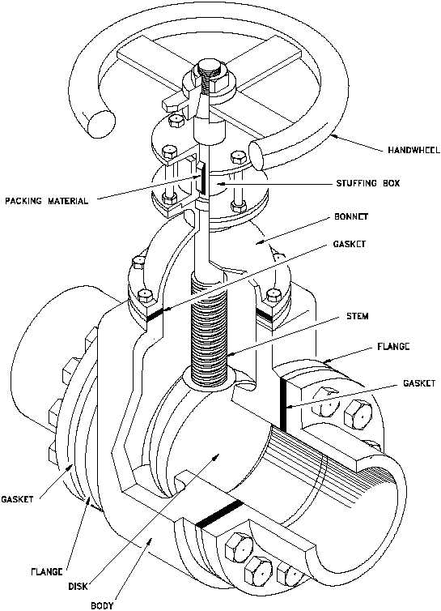
Valves – Linear Stroke
Gate
  Best for isolation in distribution
  Operate 100% open or 100% closed (don’t throttle flow)
  ½”-24” in diameter
  Least friction loss when open
  Rising or non rising stems
  Must overcome force against valve face
Number of turns to open/close = 3 x diameter (inches) + 1 to 3 turns
Notes:
Rising stems are threaded to the valve body, non-rising stems are threaded to the gate assembly. Non-rising stems are found on all large buried valves.
Rising stems provide a visual indication of valve position because the stem is attached to the gate such that the gate and stem rise and lower together as the valve is operated. Nonrising stem valves may have a pointer threaded onto the upper end of the stem to indicate valve position, since the gate travels up or down the stem on the threads without raising or lowering the stem. Non-rising stems are used underground or where vertical space is limited.
Can have a bypass to help with pressure against valve face. Can also have an assist like a powered valve operator or a cheater bar.

Slide 17
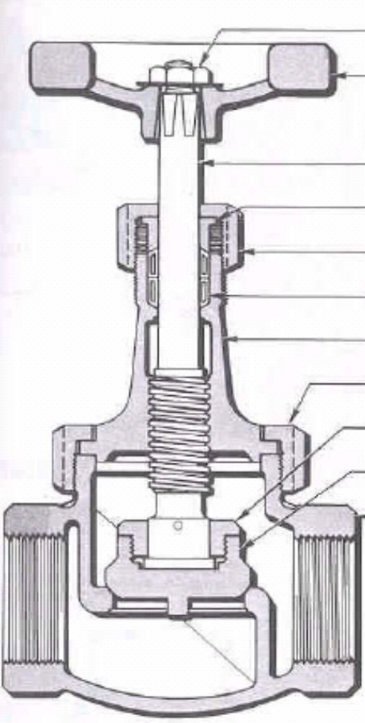
Valves – Linear Stroke
Control Valves
  All globe valves
  Automatically react to changes in the system by opening or closing
  Used for flow control, pressure regulation
  Include altitude valves, pressure reducing valves, pressure relief valves, pressure sustaining valves, pump control valves, and check valves

Slide 18
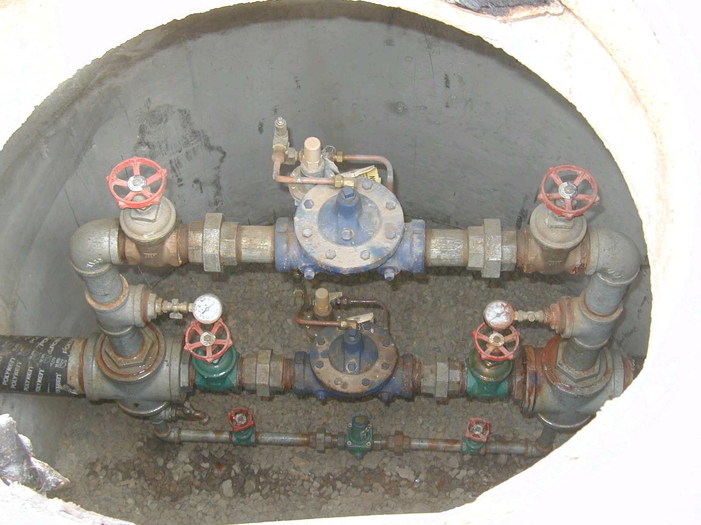
Valves – Control
Pressure Reducing Valve
  Differences in elevation create high pressure at lower elevations
  Installed at locations where static pressure is too high
Notes:
Explain pressure differences and why that is dangerous

Slide 19
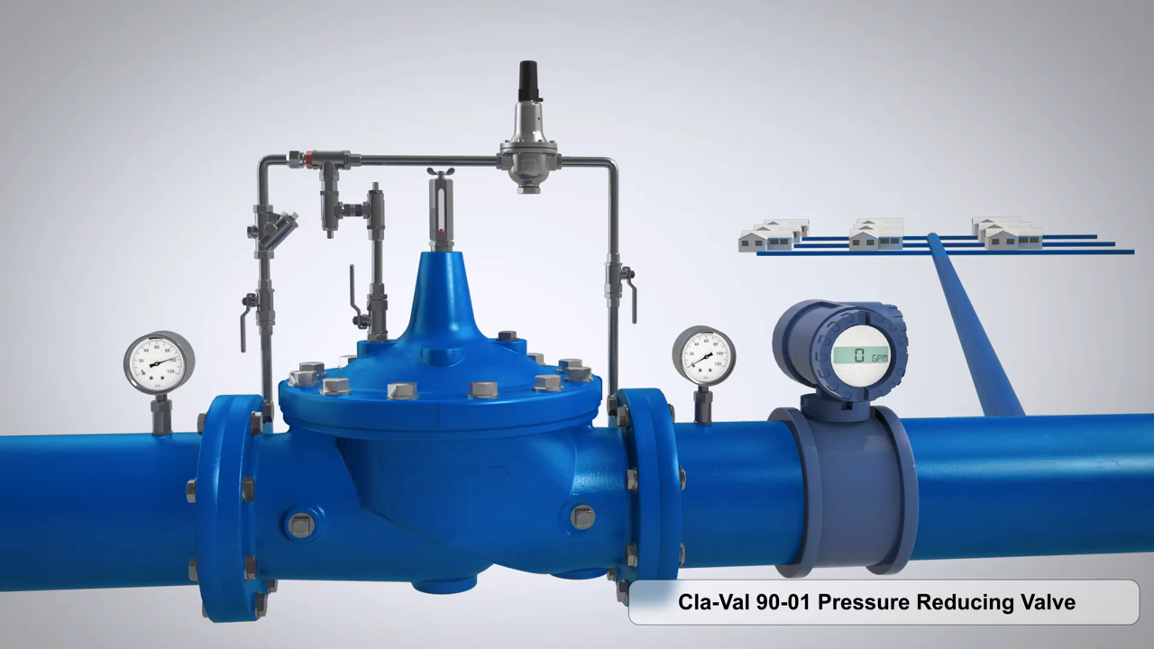

Slide 20
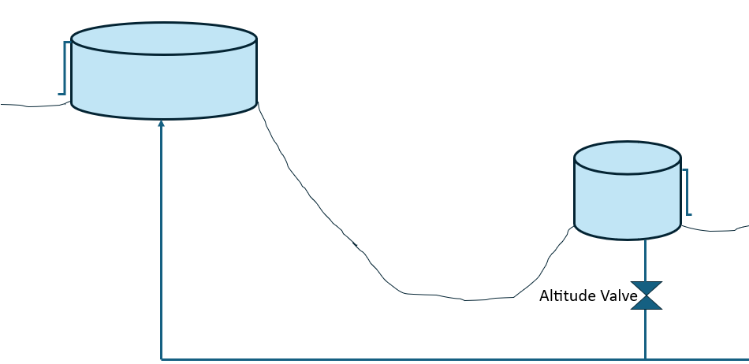
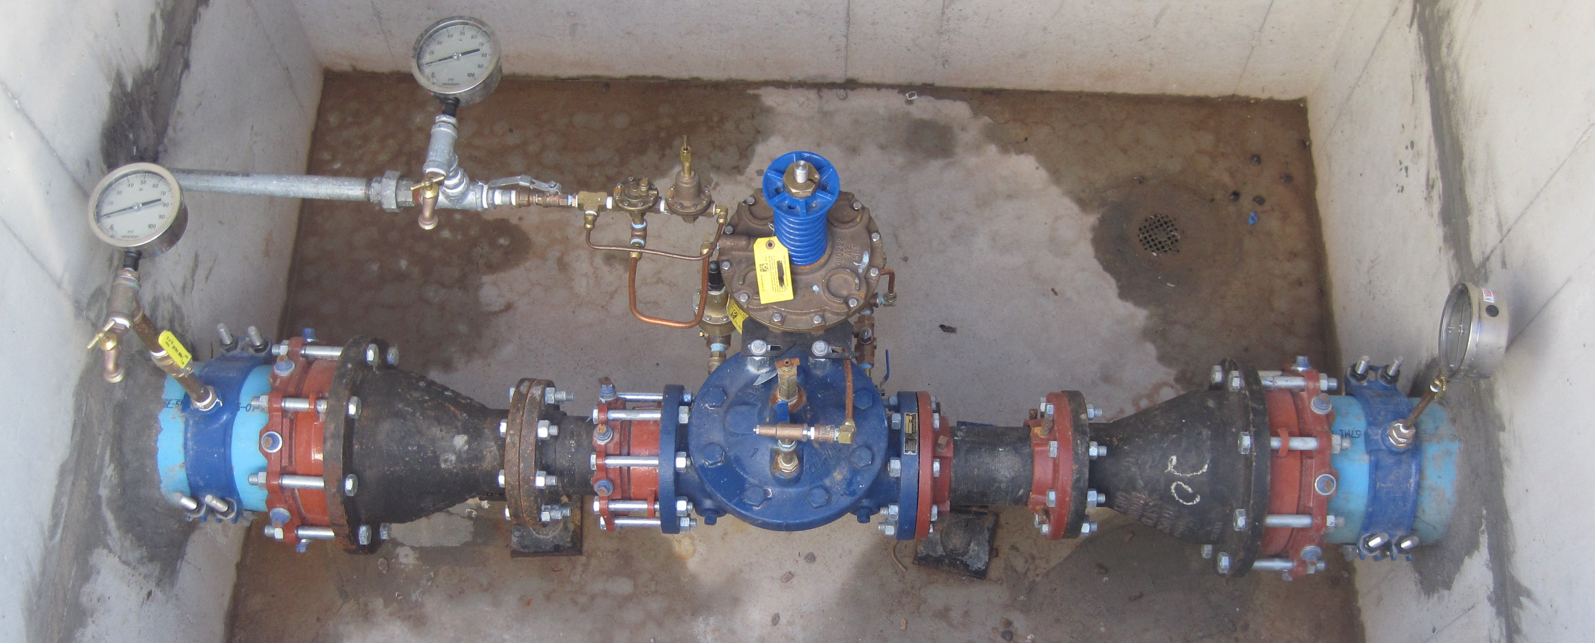
Valves – Control
Altitude Valves
  Used when storage tanks are at different altitudes
  Placed on lower tank that is below the hydraulic gradient
  Closes when full to prevent overfilling

Slide 21
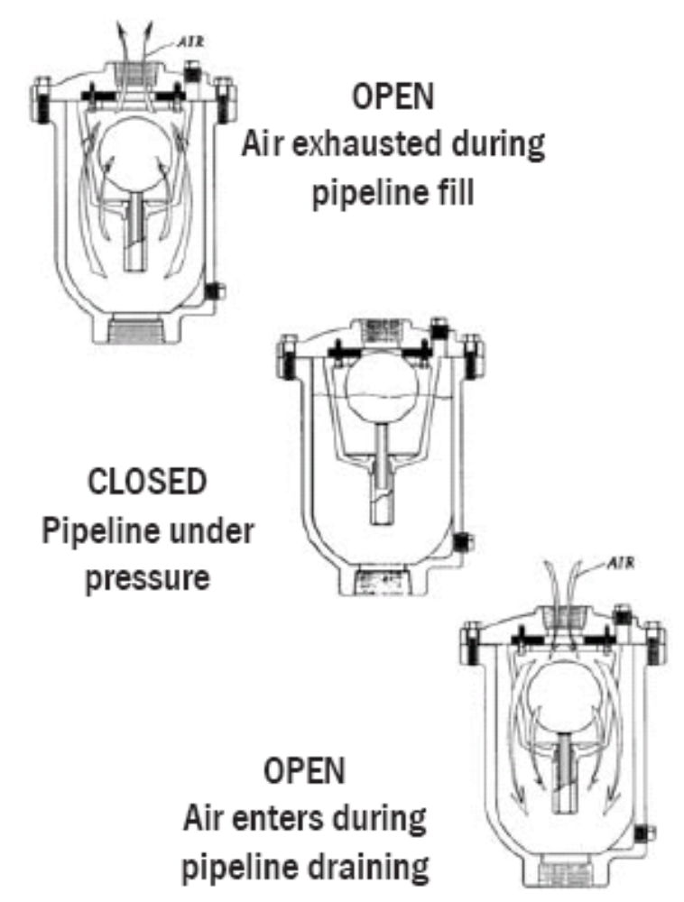
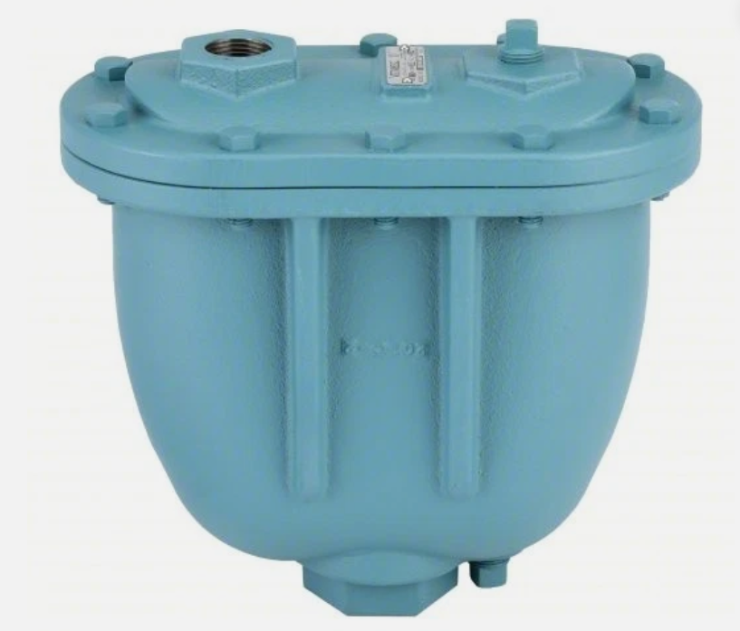
Valves – Air Vacuum Relief
Allows trapped air to escape
Allows air to enter when a vacuum occurs
Notes:
Talk about air relief valves at high elevations

Slide 22
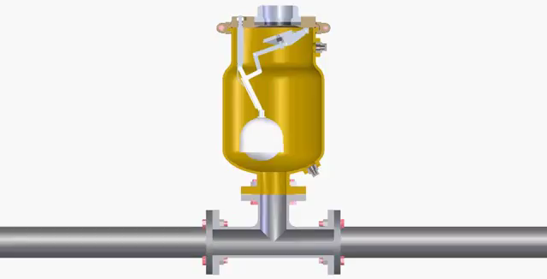

Slide 23
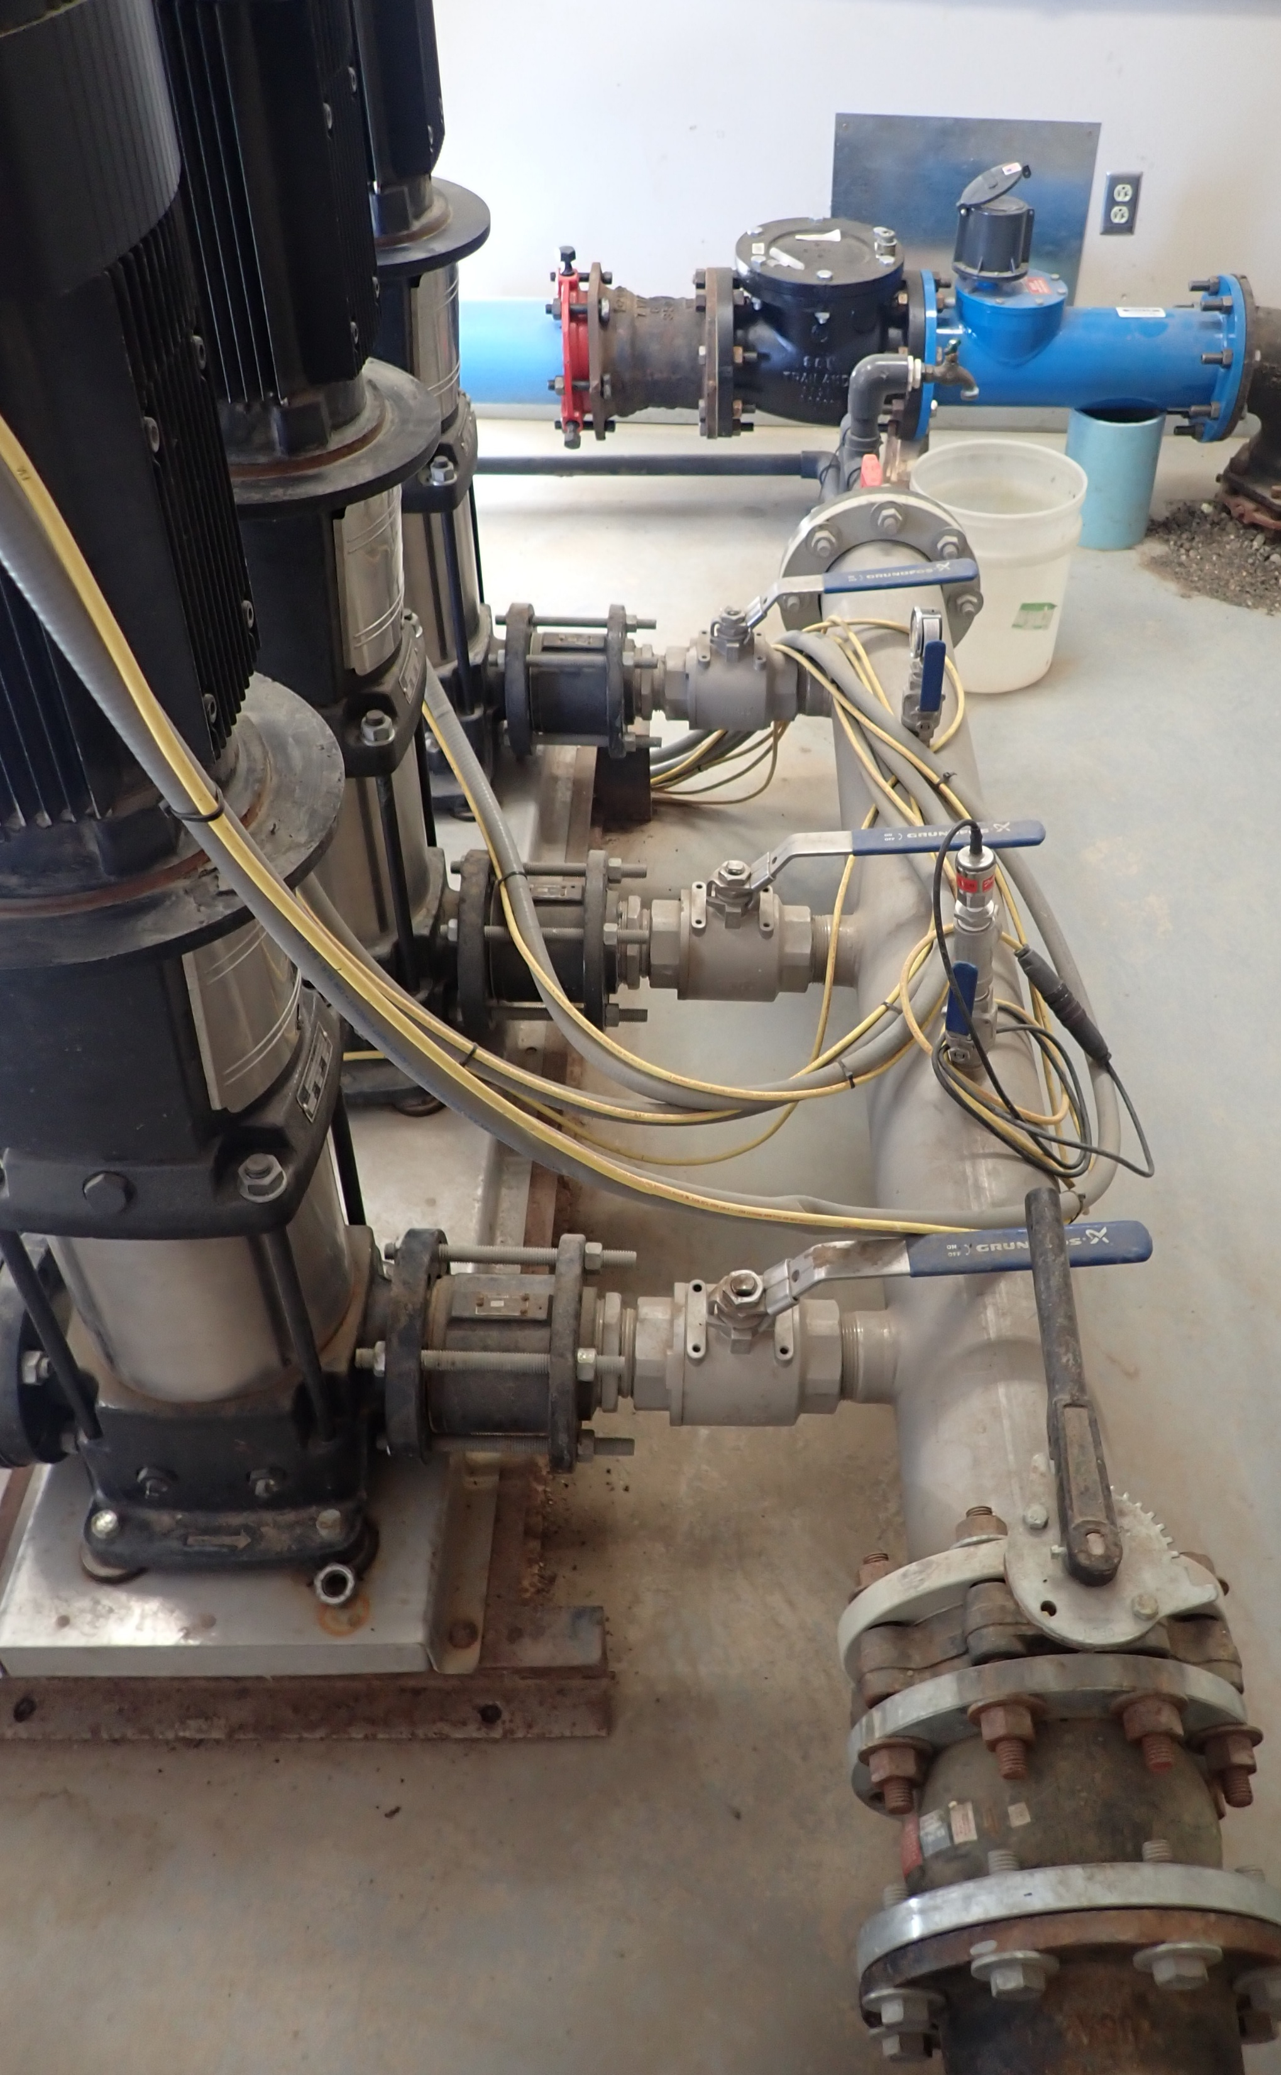
Valves – Check
Purpose
Only allow flow in one direction
Include:
  single check
  double check
  reduced pressure zone backflow preventer
Prevent non-potable water from mixing with potable water
Prevent damage to pumps (check valve)
If testable must be checked every year

Slide 24
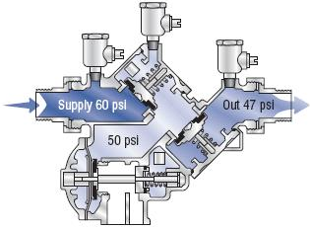
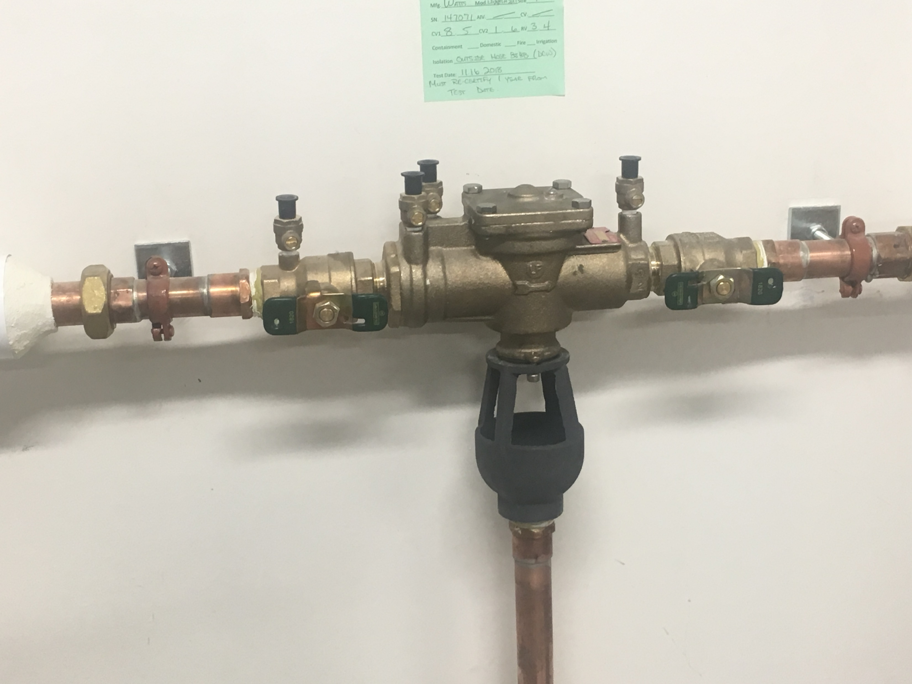
Valves – Check
Reduced Pressure Backflow Preventer (RPZ)
  The best/most protective mechanical solution but air gap is still the best non-mechanical cross connection control
  Check valves act independently
  Must be tested every year
  Must be installed at least 12-inches above grade
  Will spit when operating
Notes:
RPZs “are essentially modified double check with an atmospheric vent capability placed between the two checks and designed such that this “zone“ between the two checks is always kept at least two pounds less than the supply pressure. With this design criteria, the reduced pressure principle backflow preventer can provide protection against backsiphonage and backpressure when both the first and second checks become fouled”. From EPA “Cross Connection Control Manual”
Emphasize why it is important to check every year: it is a public health concern

Slide 25
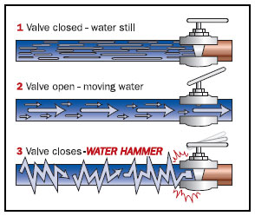
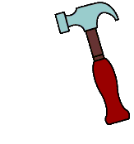
Valves – Operations
Water Hammer
  A pressure wave in a pipe caused when closing or opening valves
  Occurs when opening or closing valves too quickly
http://www.plumbingmart.com/images/water-hammer-valve.jpg

Slide 26
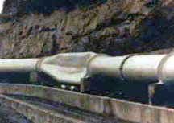
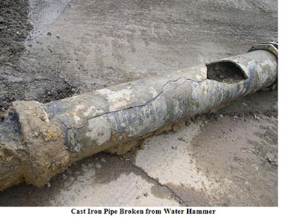
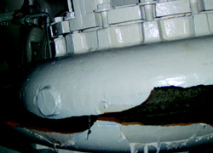
Valves – Operations
Water Hammer
  Sounds like hammering on the pipe and can cause damage
  Can reduce water hammer by slowly opening the valve and letting the pipe fill before opening it all of the way
Notes:
The bottom left picture is of a cracked pump bowl. Photo PBS&J from pwmag.com

Slide 27
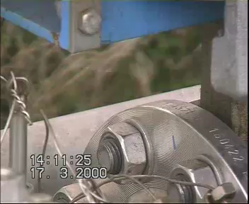

Slide 28
Valves – Operations
Water Hammer
  Can be calculated
dp = 0.070vl/t
dp = increase in pressure (psi)
v = flow velocity (ft/s)
l = upstream pipe length (ft)
t = valve closing time (s)

Slide 29
Valves – Operations
dp = 0.070vl/t
Water Hammer When Closing Solenoid Valve
Flow = v = 6 ft/sec
100 feet
Example 1 – What is the pressure increase if the solenoid valve closes in 0.1 seconds?
  dp = 0.070(6 ft/s)(100 ft)/0.1 s = 420 psi
Example 2 – What is the pressure increase if the solenoid valve has a damper and closes in 1 seconds?
  dp = 0.070(6 ft/s)(100 ft)/1 s = 42 psi
Notes:
Use suppressors, arrestors, and dampers to deal with water hammer. Also open valves only partway and let pipe fill before opening all of the way.

Slide 30
Valves – Maintenance
Location/Mapping
  Where, type, date of install, maintenance done and date completed, direction of flow, how many turns to open and close gate valves
  Utilize permanent landmarks to establish permanent ties to assist in location of valve
Inspection
  Exercise, inspect for leakage, housekeeping around valve and valve box, clean and oil screw on stem of gate valves
Exercising
  Every valve, every year

Slide 31
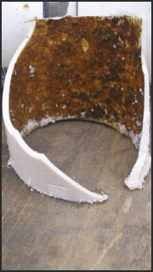
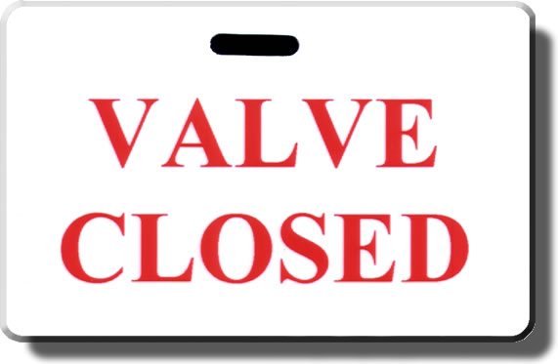
Valves – Affect on Water Quality
Closed valves create dead ends in distribution
  Increased water age
  Sediment build up
  Possible biofilm growth
Notes:
Right photo from http://www.dutriclean.com/images/biofilm/biofilm01.png
Valve closed sign from http://www.idman4u.com/images/cards/ValveClosedTag.jpg

Slide 32
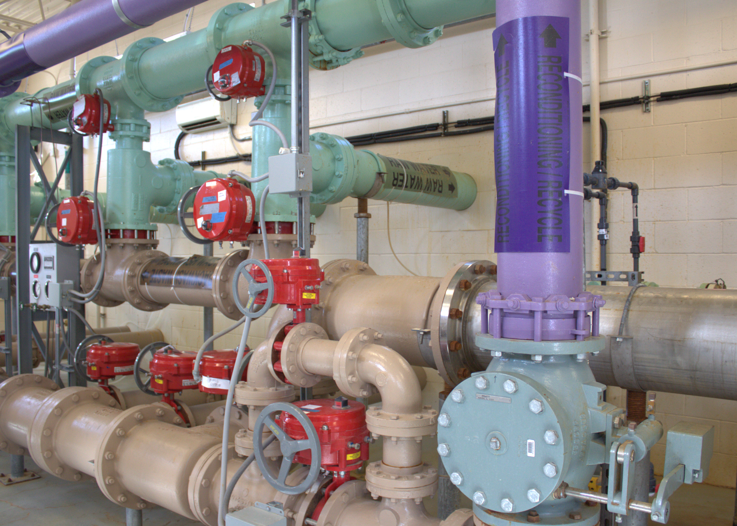
How many valves do you see?
3
Poll
1
4
2
11
8
5
6
7
9
10
12?

Slide 33
Hydrants
Drinking Water Distribution Systems

Slide 34
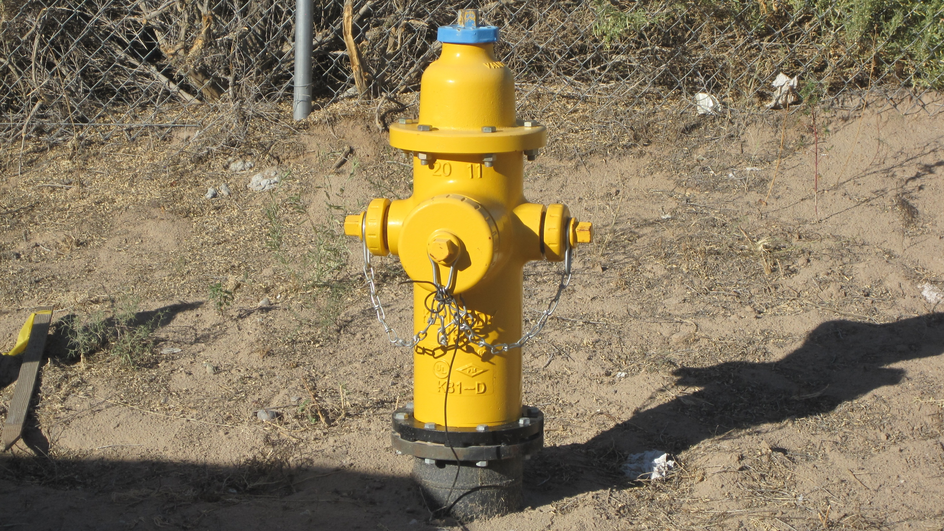
Hydrants
Uses
Types
Components
Operations & Maintenance

Slide 35
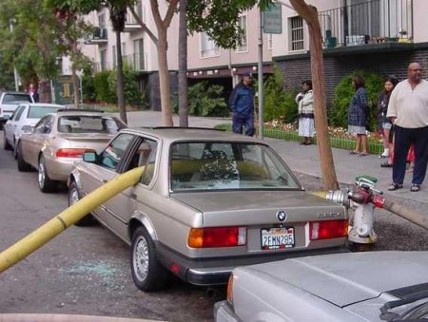
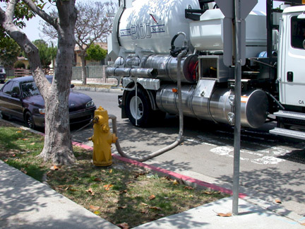
Hydrants – Uses
Provide large water flows to fight fires and flush the distribution system
Provide large quantities of water for water trucks and for construction
Notes:
Top image with car from frogview.com
Bottom photo from http://www.cityofhawthorne.com/images/Departments/PWorks/Maintenance/pwks_sdrain-truk.jpg

Slide 36
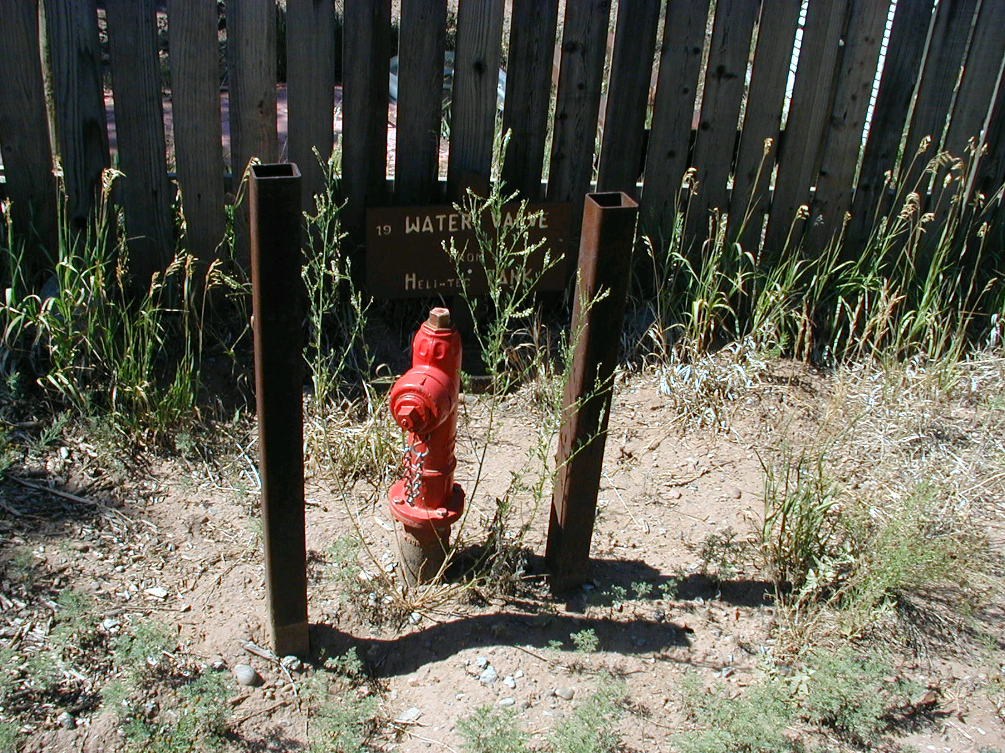
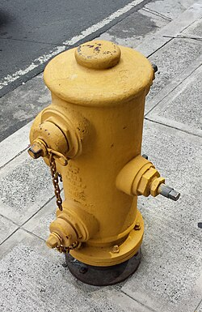

Hydrants – Types
Flush Hydrants
Fire Hydrants
  Wet barrel
  Dry barrel
Notes:
Wet barrel hydrant picture from https://en.wikipedia.org/wiki/Fire_hydrant

Slide 37
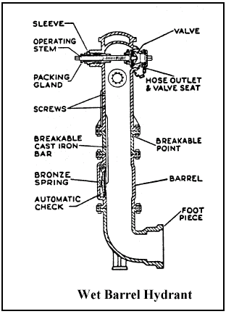
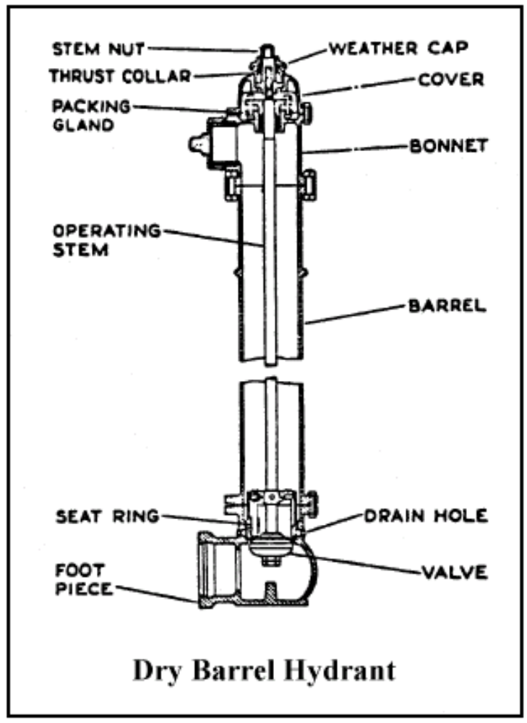
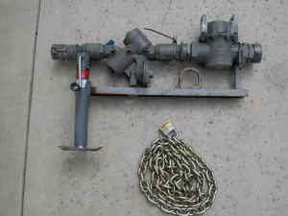
Hydrants – Components
Inlet (base)
Valve
Barrel
Head
Gate valve
Backflow protection
Notes:
Bottom photo of metering rig is one for sale at http://www.iclassifieds.com/forsale/tools/600579262/3-fire-hydrant-water-meter-w-2-backflow-valve-stand-lock-chain.html on 10/18/2010 in Sacramento, CA. Asking price $650.

Slide 38
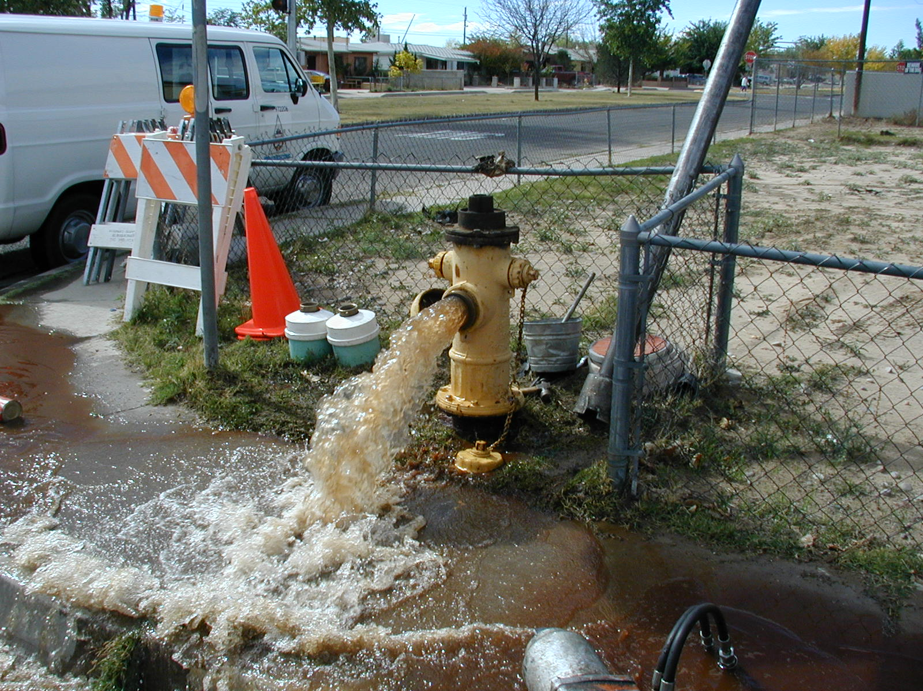
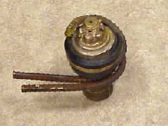
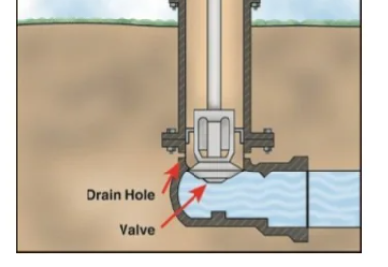
Hydrants – Operations & Maintenance
Do not throttle flow on dry barrel hydrants, only operate fully open
Close slowly to avoid water hammer
Keep clear and free from obstructions
Flush regularly to ensure operation
Do not force hydrant to close
Notes:
Operating a dry barrel hydrant with the main valve cracked to throttle flow should not be done. If this is done, the drain hole will be open and water will be jetting out and possibly undercut the sidewalk and hydrant anytime the main valve is not completely open.
Bottom right picture is of a valve that was cut out of a new hydrant. Someone tried to force the valve closed on a piece of rebar that was in the main. From firehydrant.org

Slide 39
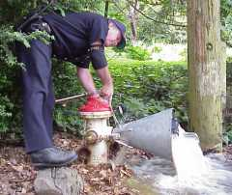
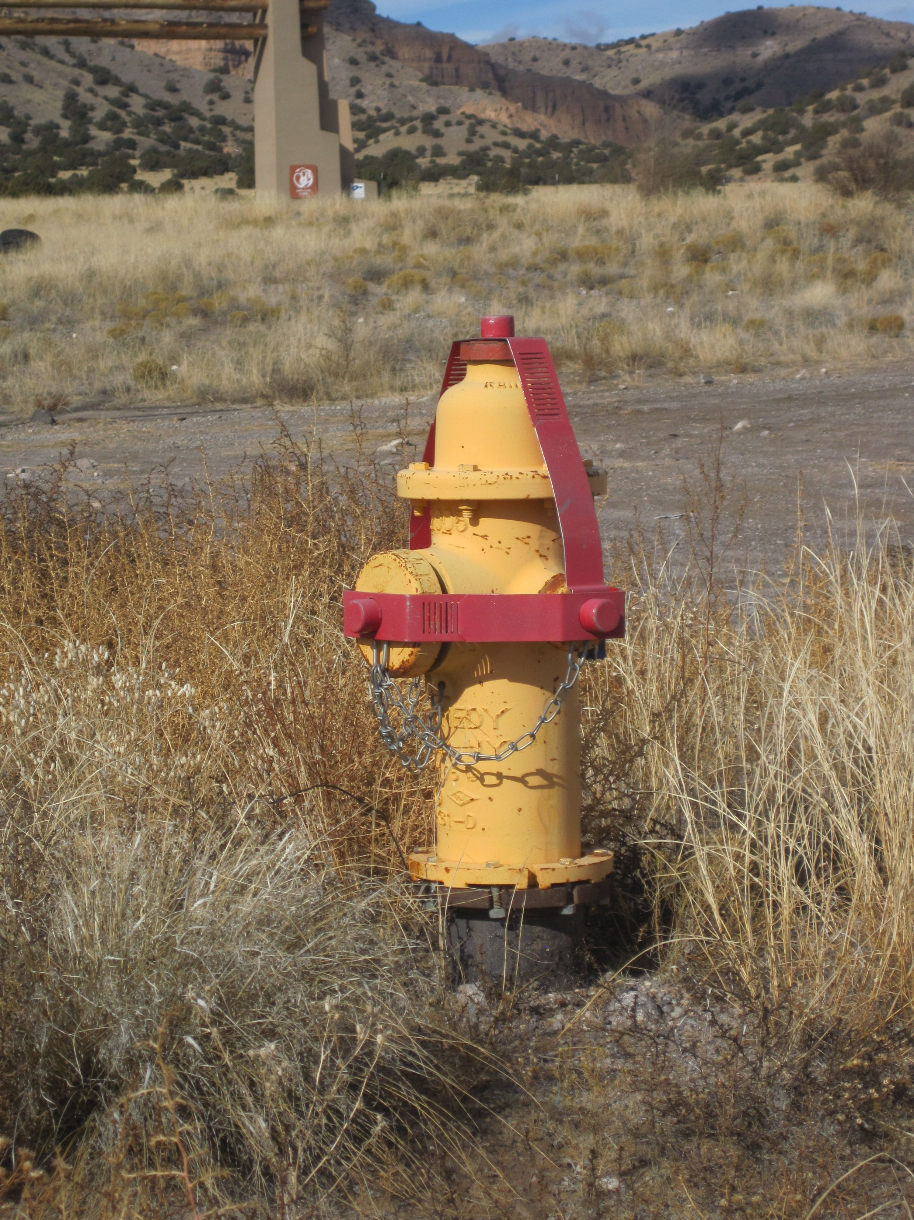
Hydrants- Operations & Maintenance
Perform flow tests to determine capability
Inspect regularly and keep detailed information
Locations should be properly mapped and identified
Control their use
Repair if leaking
For more information – http://firehydrant.org
Notes:
Flow test photo from firehydrant.org

Slide 40
Service Connections
Purpose – To connect customers to distribution piping/water mains
Drinking Water Distribution Systems

Slide 41
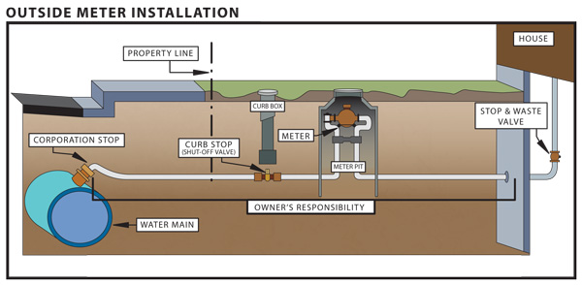
Service Connections – Components
Meter
Meter box
Meter setter
Service line
Curb Stop
Corp Stop

Slide 42


Service Connections - Installation
Tapping machine drills into main and connects a corporation stop to the main (cuts out a coupon)
Typically done while main is under pressure so service to other customers is not interrupted (“Hot” Tap or “Wet” Tap)

Slide 43

Service Connections - Installation
Corporation Stop (Corp Stop) can be inserted directly into main or installed on a saddle that is strapped to the pipe
Taps made at 45 angle from horizontal to avoid damage from backhoe

Slide 44

Service Connections – Service Line
Copper, PVC or polyethylene
Older galvanized and lead services can be problematic (corrosion and contamination) – must replace as part of Lead and Copper Rule Revisions
Include a bend near the corp stop to allow for some flexibility during backfill, settling or shifting
Installed below the frost line
Notes:
Graphic from https://ldh.la.gov/page/LSLI

Slide 45


Service Connections – Curb Stop
Shut-off valve, copper
Installed in easement so that the service can be isolated.
Meter stop can be used in place of a curb stop
Notes:
Bottom picture from: http://www.kitchenerutilities.ca/en/programsservices/water-and-your-driveway.asp
Picture on left from: http://www.fordmeterbox.com/products/productview.php?catSec=GA

Slide 46


Service Connections – Corp Stop vs Curb Stop
Directly on main
Joins customer service to main
Designed for installation under pressure
Buried
Between corp. stop and new service
Accessible
Easy shutoff
Notes:
Pictures and from: https://redhedri.com/post?id=13&everything-you-need-to-know-about-curb-and-corporation-stops

Slide 47

Service Connections – Meter Setters
Brass and copper device
Allows service line to be buried at a safe depth and still have the meter within reasonable reach of the top of the meter box
One way to maintain proper distance between meter fittings when replacing a meter

Slide 48


Service Connections – Meter Box
Made from cast iron, concrete and plastic
Gives access to the meter for the meter reader
"Ford Meter Box, Wabash, Indiana, Water Meter Cover from New Iberia, Louisiana" by Uncommon Fritillary is licensed under CC BY-SA 2.0.

Slide 49

Service Connections – Meters Purpose
Encourage conservation
Distribute the cost of service fairly, in proportion to how much is used
Allow system to know how much water is being pumped, used and lost to leaks and other uses

Slide 50

Service Connections – Residential Meters
Standard sizes 5/8” to 1”
Provide 20 to 30 gpm at 40 psi
Consist of following components
  Register that records water used
  Magnetic connection to a rotating device
  Strainer
  Measuring Chamber
  Body
  Some cases, bottom plate that will break when frozen to prevent damage to the meter
Notes:
Image from https://www.researchgate.net/profile/Monica-Crainic/publication/283045954/figure/fig3/AS:286930295767043@1445420921334/b-Components-of-multijet-water-meter-4-e-Optimizing-the-shape-and-the-arrangement-of.png

Slide 51


Service Connections – Residential Meters
Positive Displacement Meters – measuring chamber with a fitted disc or piston, chamber fills and empties, predetermined amount of water is displaced as disc or piston makes one rotation
Piston
Nutating Disk

Slide 52

Service Connections – Residential Meters
Turbine Meters
  Vaned wheel that is rotated by the flow of water
  Wheel attached to register, indicating water use

Slide 53
Service Connections – Commercial Meters
Usually considered to be any services serving more than a single household, having a service line one inch or larger in size
  Compound Meter – two measuring chambers, one for low flow, one for high flow
  Turbine Meter – pinwheel mounted on a vertical shaft, usually a bypass meter, small amount of flow diverted to pass through chamber
  Propeller Meter – use a prop blade mounted on a horizontal shaft
  Venturi Meters – pressure differential meter
  Magnetic Flow Meter – uses electromagnetic fields, no head loss created, high cost

Slide 54

Service Connections – Reading Meters
Poll
Circular Register Face
Start with the scale with the highest number (100,000)
Then read each of the lower scales until you reach the last scale (10)
When the hand is between two numbers record the lower number
When the hand is directly on a number, look at the next scale to see if it is in front of or behind the 0
80,632 cubic feet

Slide 55


Service Connections – Reading Meters
Dial Face Meter
Typically, just read the number listed
Might have to add a zero or two if it says “hundreds of gallons”

Slide 56

Service Connections – Detail Drawing

Slide 57
Next time:
Date | Topic
1/22/26 | Alternative Treatment Processes (e.g. flouridation, ion exhange, RO…)
2/5/26 | Drinking Water Treatment Math & Concept Review
2/19/26 | Safety Program Basics (including personal safety, equipment safety, facility safety)
3/5/26 | Lead & Copper Rule, Corrosion Control
3/19/26 | Distribution Systems 1: Hydraulics, Pipe Types, Selection, Installation, and Water Quality
4/2/26 | Distribution Systems 2: Valves, Hydrants, Meters, and Service Connections
4/16/26 | Distribution Systems 3: Storage and Booster Pumping
4/30/26 | O&M: Pumps, Main, and Appurtenance Maintenance (including pressure monitoring, valve exercising, and flushing)
5/14/26 | O&M: Cross Connection Control
5/28/26 | O&M: Distribution System Math and Concept Review
6/11/26 | Sampling & Lab Procedures/Analysis/Interpretation
6/25/26 | Management Overview (including organization, communication, PR & record keeping)
7/9/26 | Drinking Water Practice Exam and Review
Links to recordings and material are available on our website at https://swefc.unm.edu/home/op-cert-trainings/

Slide 58
CONTACT INFORMATION
SW EFC email: swefc@unm.edu
Department of Civil Engineering MSC01 1070
1 University of New Mexico
Albuquerque, NM 87131
505-277-0644
swefc@unm.edu
http://swefc.unm.edu

