Slide 1





US Territories Water Operator Training Series
Session 17: Lead & Copper Rule and Corrosion Control
03/05/2026
www.efcnetwork.org
This program is made possible under a cooperative agreement with US EPA.

Slide 2


Michelle Olson
Water Utility Trainer and Specialist meolson@unm.edu

Slide 3

Tucker Colvin
Research Scientist tcovin@unm.edu

Slide 4



This training series is funded by the US EPA

Slide 5


Slide 6
Schedule for 2026:
Date | Topic
1/22/2026 | Alternative Treatment Processes (e.g. fluoridation, ion exchange, RO…)
2/5/2026 | Drinking Water Treatment Math & Concept Review
2/19/2026 | Safety Program Basics (including personal safety, equipment safety, facility safety)
3/5/2026 | Lead & Copper Rule, Corrosion Control
3/19/2026 | Distribution Systems 1: Hydraulics, Pipe Types, Selection, Installation, and Water Quality
4/2/2026 | Distribution Systems 2: Valves, Hydrants, Meters, and Service Connections
4/16/2026 | Distribution Systems 3: Storage and Booster Pumping
4/30/2026 | O&M: Pumps, Main, and Appurtenance Maintenance (including pressure monitoring, valve exercising, and flushing)
5/14/2026 | O&M: Cross Connection Control
5/28/2026 | O&M: Distribution System Math and Concept Review
6/11/2026 | Sampling & Lab Procedures/Analysis/Interpretation
6/25/2026 | Management Overview (including organization, communication, PR & record keeping)
7/9/2026 | Drinking Water Practice Exam and Review
Links to recordings and material are available on our website at https://swefc.unm.edu/home/op-cert-trainings/

Slide 7

https://swefc.unm.edu/home/op-cert-trainings/

Slide 8

Sign in for every session to ensure you get credit for attending

Slide 9
Lead and Copper Rule

Slide 10
What are the Lead & Copper Rules?
The OG Lead & Copper Rule (LCR)
The Lead & Copper Rule Revisions (LCRR)
The Lead & Copper Rule Improvements (LCRI)
Notes:
Prior to LCR:
Lead standard in drinking water was 50 ppb
Measured at treatment plant
1991 LCR:
Established a maximum contaminant level goal (MCLG) of zero for lead.
No enforceable standard (MCL) for lead or copper.
Set an action level of 15 ppb for lead and 1.3 ppm for copper based on 90th percentile values measured at consumer taps.
An action level is the concentration of lead or copper in drinking water that triggers regulatory actions. So, unlike an MCL, an action level is not a health-based standard but, rather, a screening tool for determining whether treatment technique actions are required.
Established treatment techniques that are triggered when the rule's "action levels" are exceeded. Treatment techniques include (1) corrosion control treatment, (2) source water treatment, (3) lead service line (LSL) replacement, and (4) public education.
2021 LCRR
Strengthened health protections and clarified requirements to improve LCR’s effectiveness and enforceability by focusing on planning, inventory development, and public education.
Retained LCR’s lead and copper action levels of 15 ppb and 1.3 ppm, respectively.
Established a new lead "trigger level" at 10 ppb, based on 90th percentile values.
Trigger Levels: The concentration of lead or copper below the action level but high enough that water systems are required to take a progressive set of actions to reduce lead levels prior to an action level exceedance and to have a plan in place to rapidly respond if there is an action level exceedance. These actions depend on the size of the system.
Required water systems to identify LSLs within their distribution system and to test for lead at schools and child care programs to better monitor LSLs.
Required water system operators to develop an LSL replacement plan and to replace its portion of an LSL within specific timeframes.
Enhanced public notification and public education requirements to include 1) tier 1 PN for action level exceedances, 2) providing customers with sample results, 3) providing public education in event of ALE, 4) and providing information about the health effects of lead and copper, information about lead service lines, and how to reduce lead exposure on Consumer Confidence Reports.
2024 LCRI
Got rid of lead trigger levels.
Set 0.010 mg/L (10 ppb) as new lead action level.
Establishes requirements for full lead service line replacement, updated sampling protocols, and enhanced public education efforts.

Slide 11
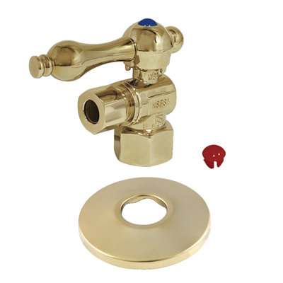
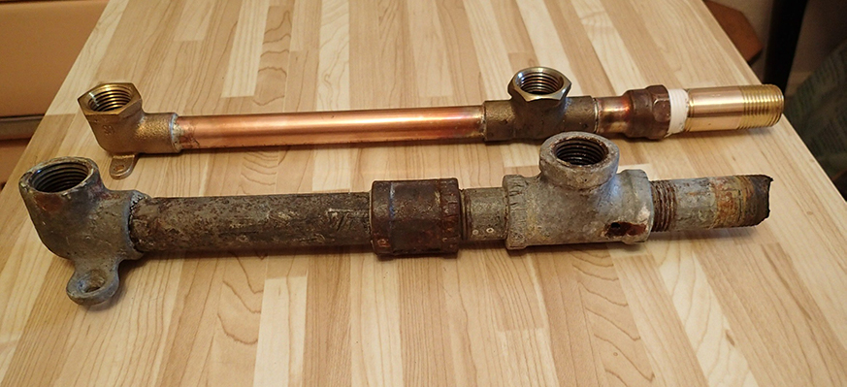
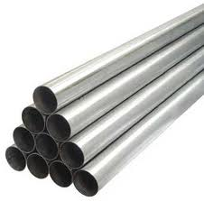
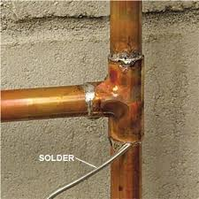
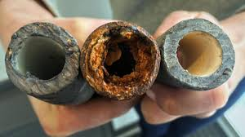
Sources of Lead & Copper in Drinking Water
The corrosion of household plumbing and fixtures
Brass Fittings
Lead and Copper Pipes
Galvanized Pipes
(in downstream locations of LSLs)
Lead Solder at Pipe Joints

Slide 12
Lead (Pb)
Health Effects
Copper (Cu)
Health Effects
Chronic Health Effect
High Blood Pressure
Attention Deficit Disorders
Physical & Developmental Problems
Central Nervous System Disorders
GI Distress
Wilkinson’s Disease Issues if above AL
Liver or Kidney Damage
Chronic Health Effects
Acute Health Effects

Slide 13


The Lead & Copper Rule
Which Systems Have to Sample?
Community
Non-Transient Non-Community
13

Slide 14
Monitoring Requirements
Frequency of sampling:
  Monitoring schedules:
    Standard
    Reduced

Slide 15
Standard (Baseline)
Reduced
Standard (Increased)
New Systems
New Water Sources
Change in Treatment
Two consecutive 6-month periods
Systems with no lead or copper concerns
Reduced frequency:
  yearly
  every 3 years
Reduced number of samples (half)
Types of LCR Compliance Monitoring Schedules
Exceed lead or copper action level
Increased to every 6 months
Notes:
Reduced monitoring requirements:
Annual:
Any system that does not exceed the lead and copper action levels for two consecutive six-month tap monitoring periods.
Triennial:
Small to medium systems that don’t exceed the lead and copper action levels for three consecutive years.
Any size water system that demonstrates that for two consecutive monitoring periods their 90th percentile lead levels are less than or equal to 0.005 mg/L (5 ppb) and copper levels are less than or equal to 0.65 mg/L (0.65 ppm).

Slide 16
Monitoring Requirements
Frequency of sampling:
  Monitoring schedules:
    Standard
    Reduced
Number of samples based on:
  Population size
  Monitor schedule

Slide 17
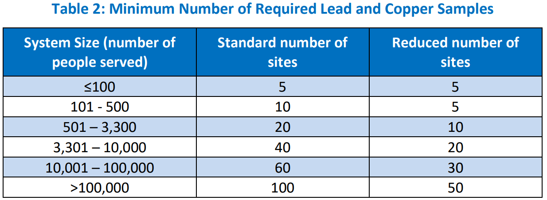
How Many Lead & Copper Samples Do I Need to Take?

Slide 18
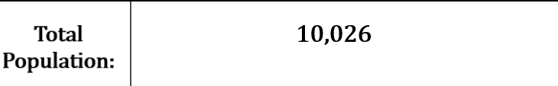
How Many LCR Samples Does this Community System Have to Take on Standard Monitoring?

Slide 19
How Many LCR Samples Does this Community System Have to Take on Standard Monitoring?
60

Slide 20
How Many LCR Samples Does this Community System Have to Take on Reduced Monitoring?

Slide 21
How Many LCR Samples Does this Community System Have to Take on Reduced Monitoring?
30

Slide 22
Monitoring Requirements
Frequency of sampling:
  Monitoring schedules:
    Standard
    Reduced
Number of samples based on:
  Population type and size
  Monitor schedule
Seasonality
  Monitor schedule

Slide 23
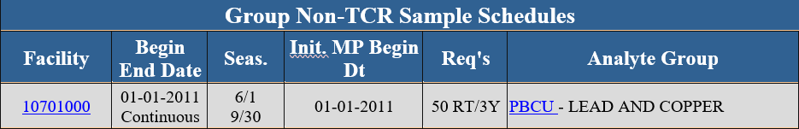
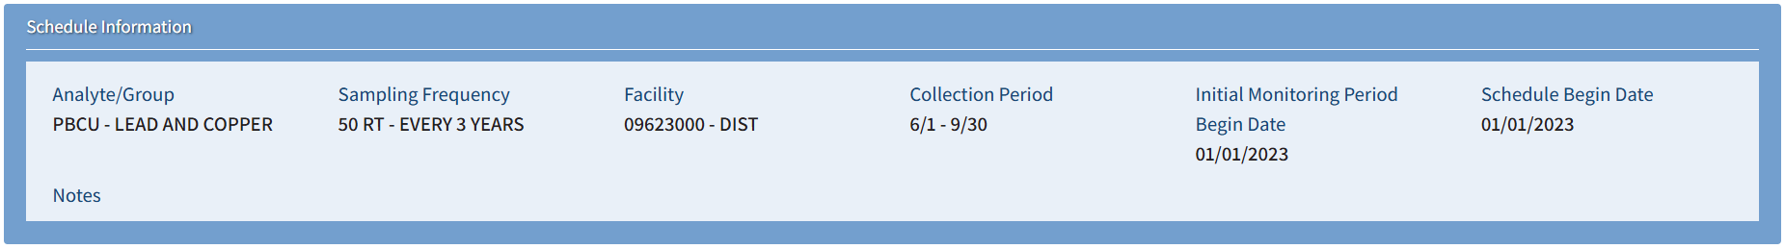
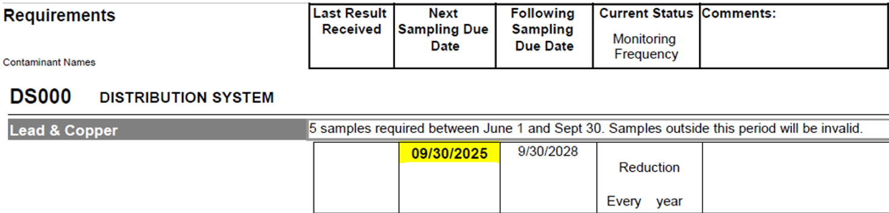
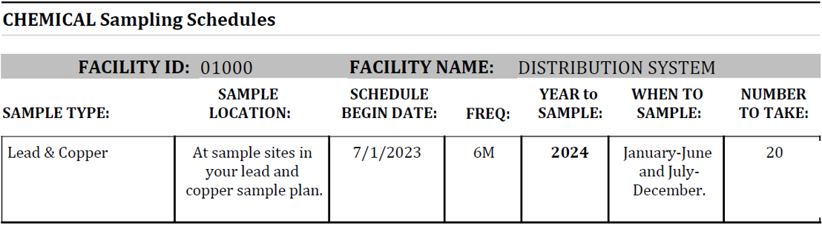
Notes:
Examples of samples schedules.
1: NMED Drinking Water Watch
2: NMED Drinking Water Viewer
3: EPA DIME database
4: EPA from the SDWIS database

Slide 24
Monitoring Requirements
Frequency of sampling:
  Monitoring schedules:
    Standard
    Reduced
Number of samples based on:
  Population type and size
  Monitor schedule
Seasonality
  Monitor schedule
Sample site locations

Slide 25
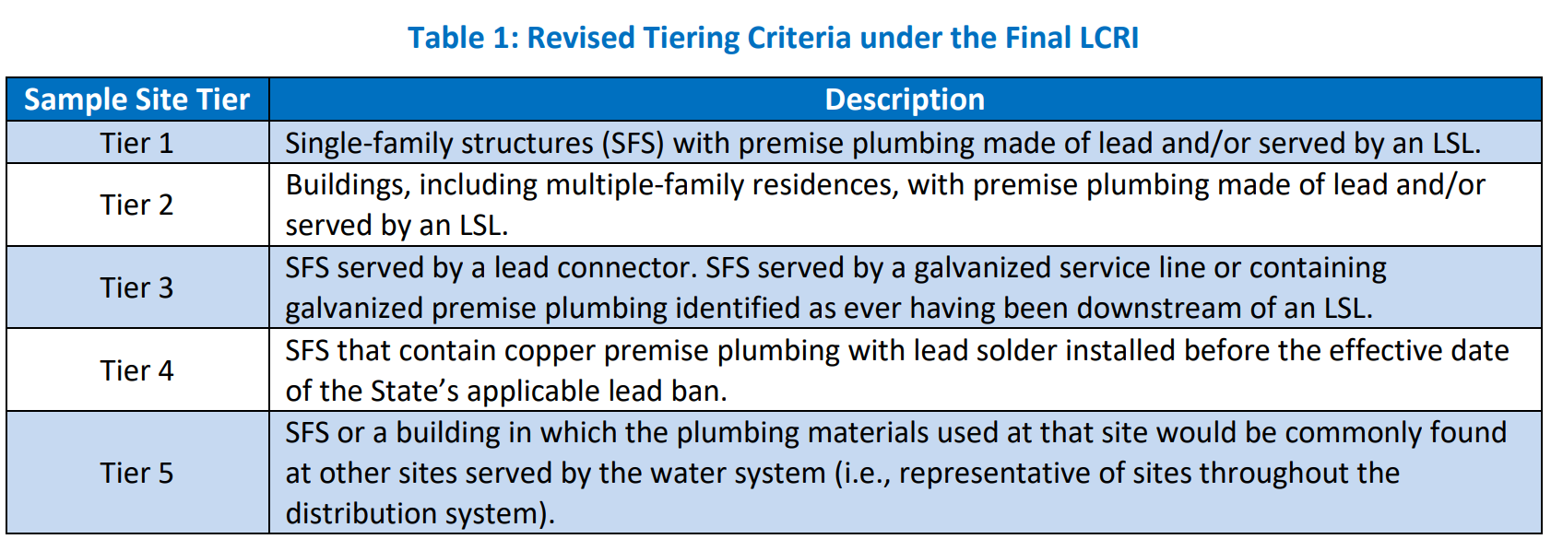
LCR Site Criteria

Slide 26
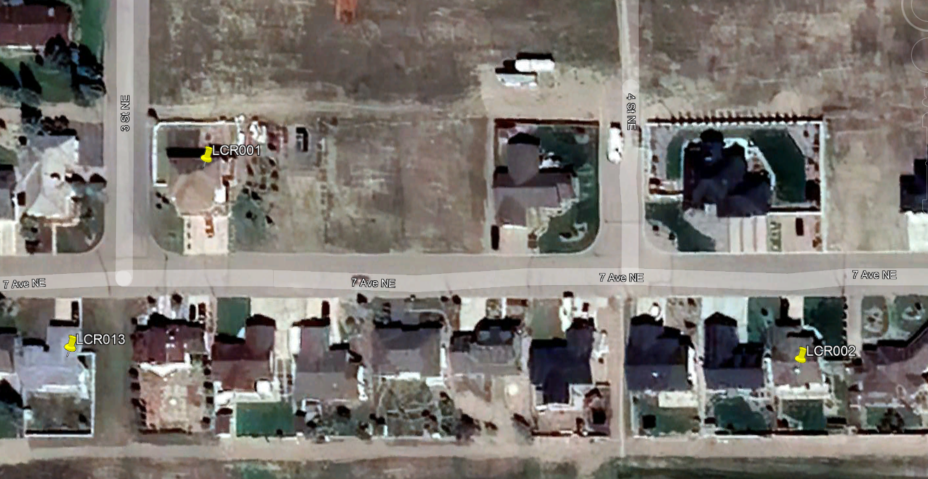
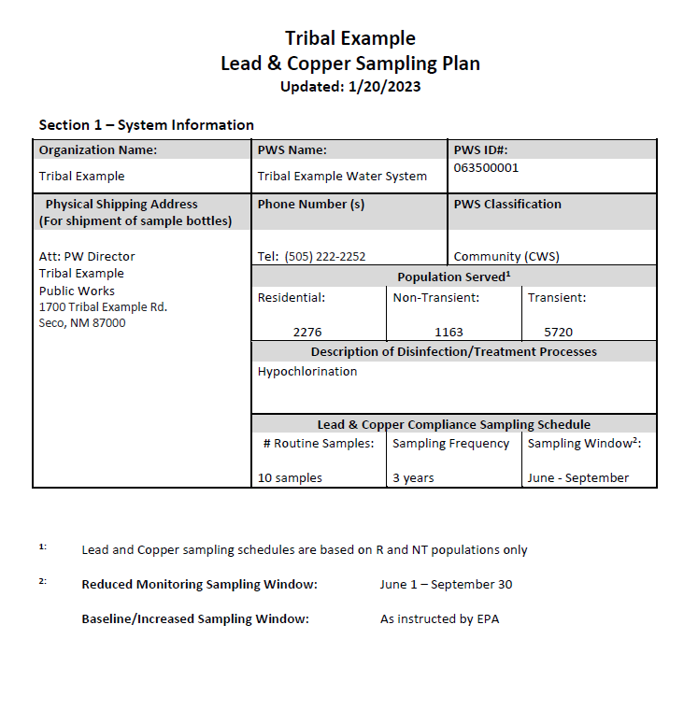
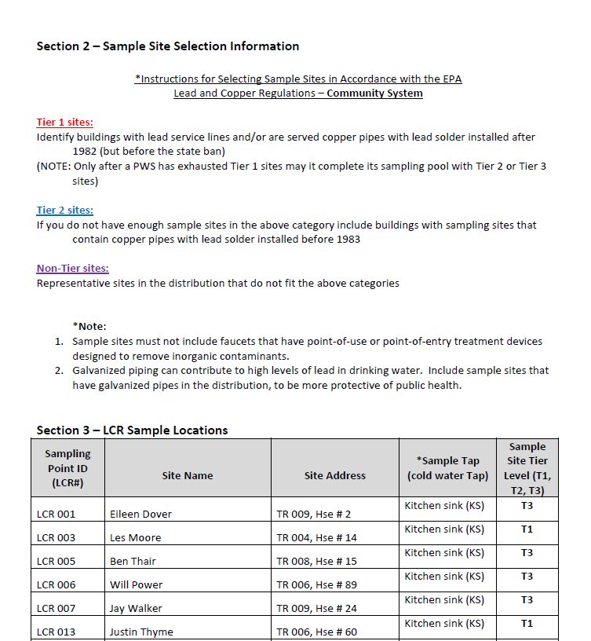
LCR Sampling Plan

Slide 27
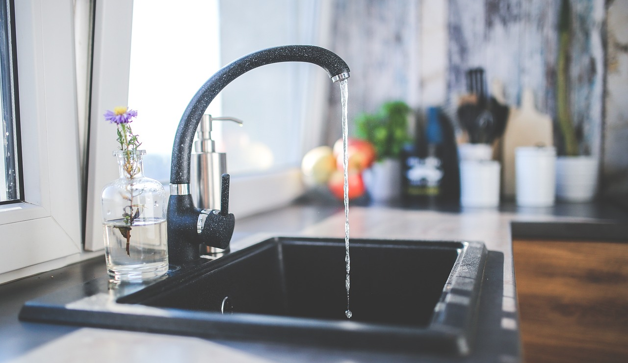
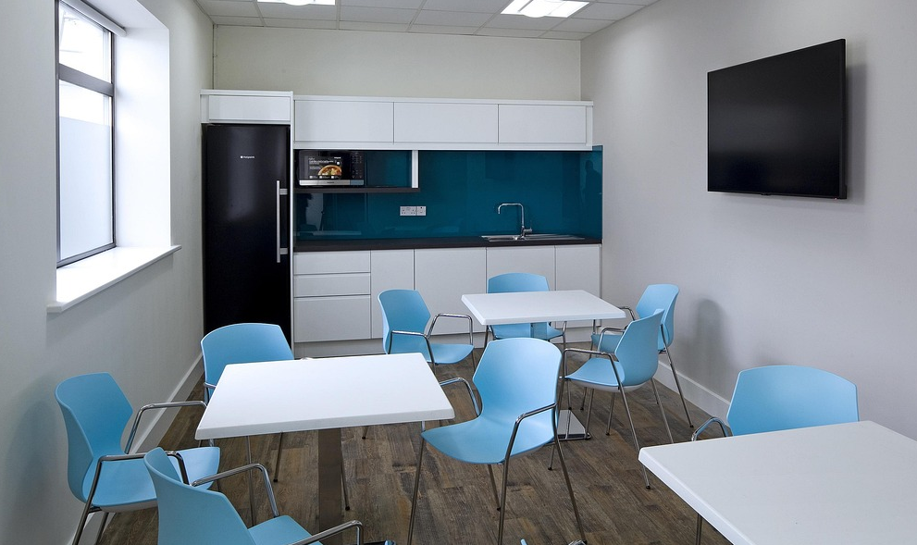
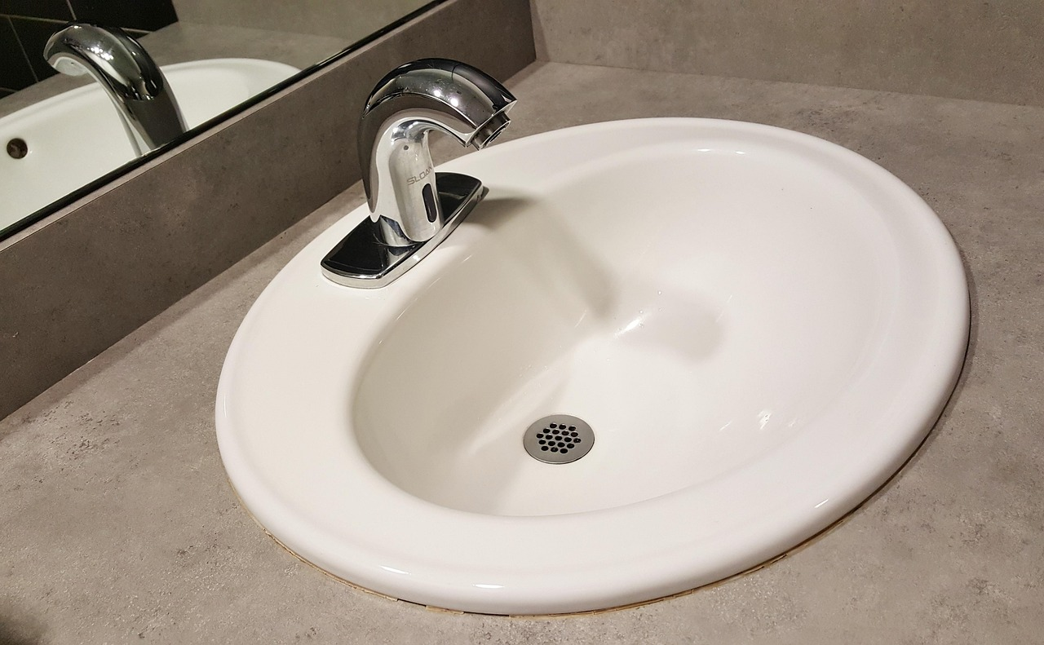
Where do we collect Lead & Copper samples?
Consumers Taps:
- kitchen sinks
- breakroom sinks
- bathroom sinks

Slide 28

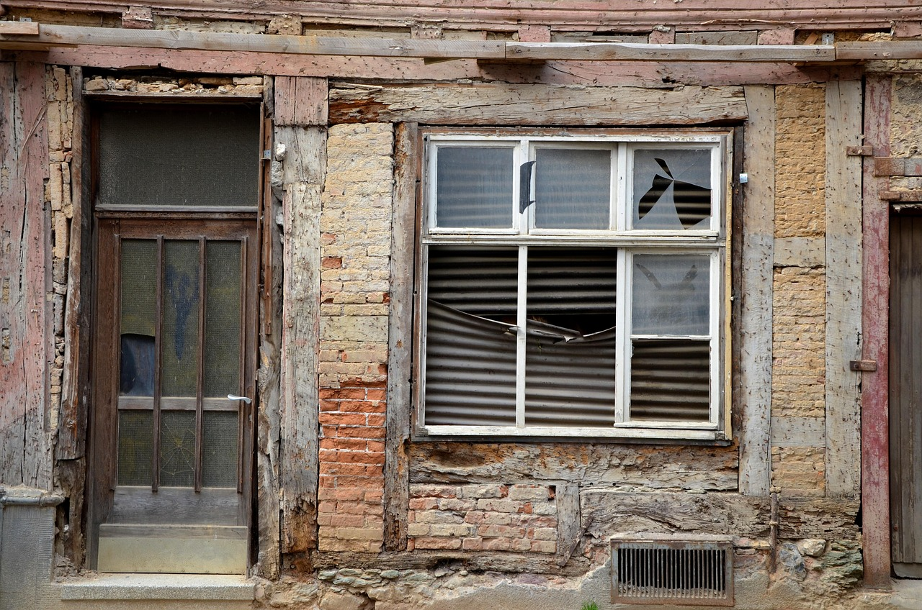
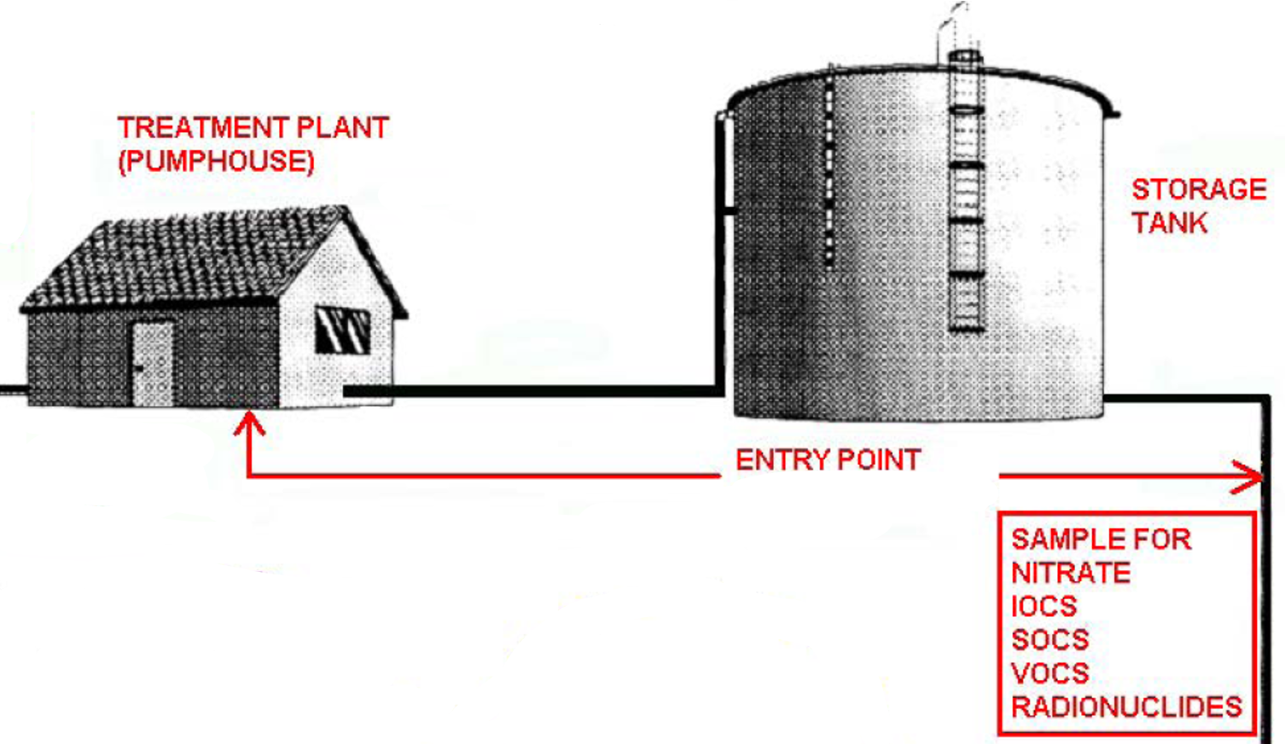
Where NOT to collect LCR samples
When sample locations are inactive
Abandoned Homes
Entry Points

Slide 29
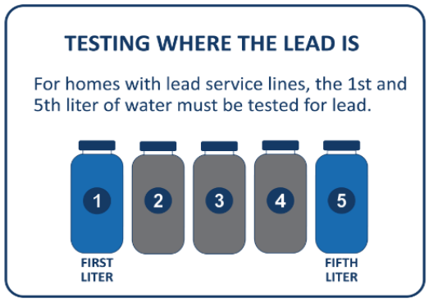
LCR Sampling
Use interior customer cold-water taps
First draw where the water has stood in the pipes for at least 6 hours
For NTNC systems ensure sample tap shutdown
Do not flush taps
Do not remove aerator
Notes:
If samples are being collected in homes with lead service lines, then the first and fifth liters of water must be collected and tested for lead. The fifth-liter sample increases the likelihood that samples capture water that has been sitting in contact with LSLs.
To collect a first-liter- and fifth-liter-paired sample, the sample collector (e.g., water system or consumer) must:
Fill the first numbered wide-mouth sample bottle with tap water.
Immediately slide the second bottle under the tap without turning the water off and repeat the process for bottles three through five in consecutive order.

Slide 30
Understanding Lead & Copper Sample Results
Action Levels (AL) - based on 90th percentiles
  Lead - 0.010 mg/L (10 ppb)
  Copper - 1.3 mg/L (1.3 ppm)
  *If 90% of sample results are at
  or below the AL value, no exceedance.
GOAL = Zero for Lead

Slide 31
Understanding Lead & Copper Sample Results
Original Lead Results
Site A | 0.001 mg/L
Site B | 0.003 mg/L
Site C | 0.002 mg/L
Site D | non-detect
Site E | 0.006 mg/L
Site F | 0.001 mg/L
Site G | 0.001 mg/L
Site H | 0.002 mg/L
Site I | 0.022 mg/L
Site J | 0.001 mg/L
Lead = 0.010 mg/L

Slide 32

Understanding Lead & Copper Sample Results
1. Order the results from highest to lowest
Original Lead Results
Reordered Results
0.001 mg/L
0.003 mg/L
0.002 mg/L
non-detect
0.006 mg/L
0.001 mg/L
0.001 mg/L
0.002 mg/L
0.022 mg/L
0.001 mg/L
0.022 mg/L
0.006 mg/L
0.003 mg/L
0.002 mg/L
0.002 mg/L
0.001 mg/L
0.001 mg/L
0.001 mg/L
0.001 mg/L
non-detect
Highest Value
Lowest Value

Slide 33
Understanding Lead & Copper Sample Results
2. Number the results with 1 being the lowest value, 2 being the next higher value on up
Reordered Results
10 | 0.022 mg/L
9 | 0.006 mg/L
8 | 0.003 mg/L
7 | 0.002 mg/L
6 | 0.002 mg/L
5 | 0.001 mg/L
4 | 0.001 mg/L
3 | 0.001 mg/L
2 | 0.001 mg/L
1 | non-detect
Highest Value
Lowest Value

Slide 34
Understanding Lead & Copper Sample Results
3. Find the 90th percentile value
Reordered Lead Results
Highest Value
10 | 0.022 mg/L
9 | 0.006 mg/L
8 | 0.003 mg/L
7 | 0.002 mg/L
6 | 0.002 mg/L
5 | 0.001 mg/L
4 | 0.001 mg/L
3 | 0.001 mg/L
2 | 0.001 mg/L
1 | 0.001 mg/L
>
Lead = 0.010 mg/L
(# of samples) x 0.9
Example: 10 x 0.9 = 9
9th sample
  If 10 samples = 9th highest sample
  If 20 samples = 18th highest sample
  If 5 samples = avg 4th & 5th samples
Lowest Value

Slide 35
Collecting Lead & Copper at the Source After an ALE
Source water monitoring for Lead & Copper
Water quality parameter (WQP) monitoring at EP & DS (compliance monitoring):
  pH and Temperature (field)
  Total Alkalinity (lab)
  Calcium (lab)
  Conductivity (lab)
ALE

Slide 36
What if an Action Level is Exceeded?
Public notification within 24 hours (Tier 1 PN)
Public education
Lead service line replacement
Under-sink fixture replacement
Determine optimal corrosion control treatment
ALE

Slide 37
Corrosion Control

Slide 38
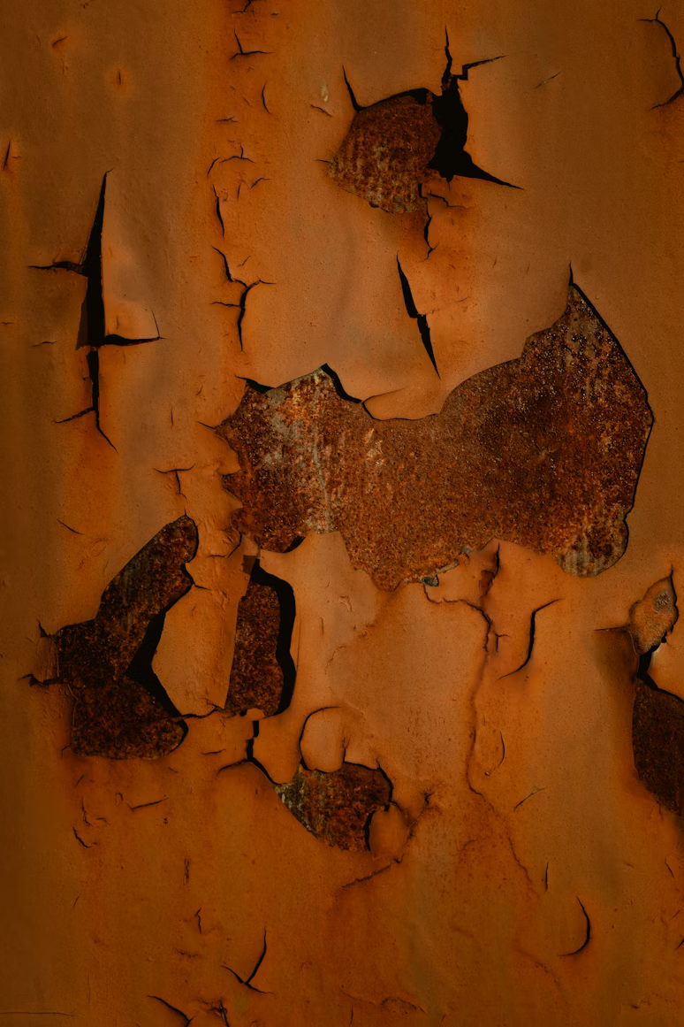
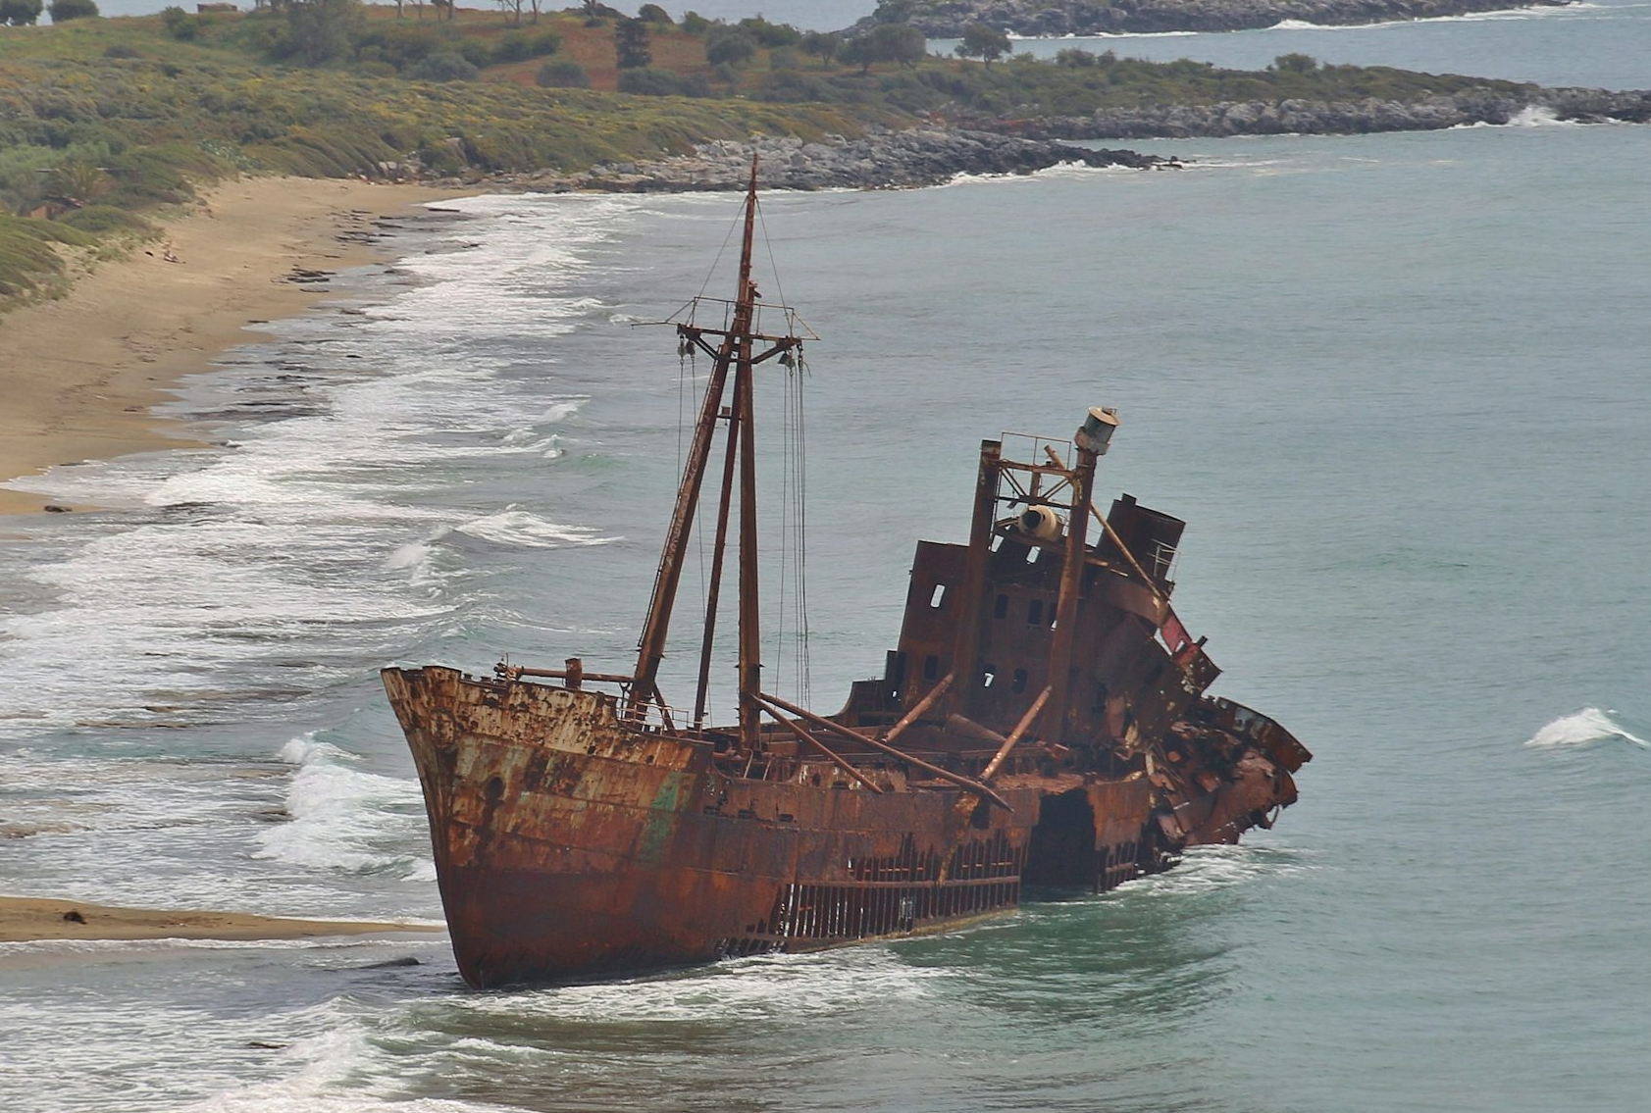
Corrosion - Corrosion is a natural process that converts a refined metal into a more chemically stable oxide. It is the gradual deterioration of materials by chemical or electrochemical reaction with their environment. (Wikipedia)
Notes:
Photo: Uta Scholl, unsplash.com
Photo: Drazen Nesic, unsplash.com

Slide 39
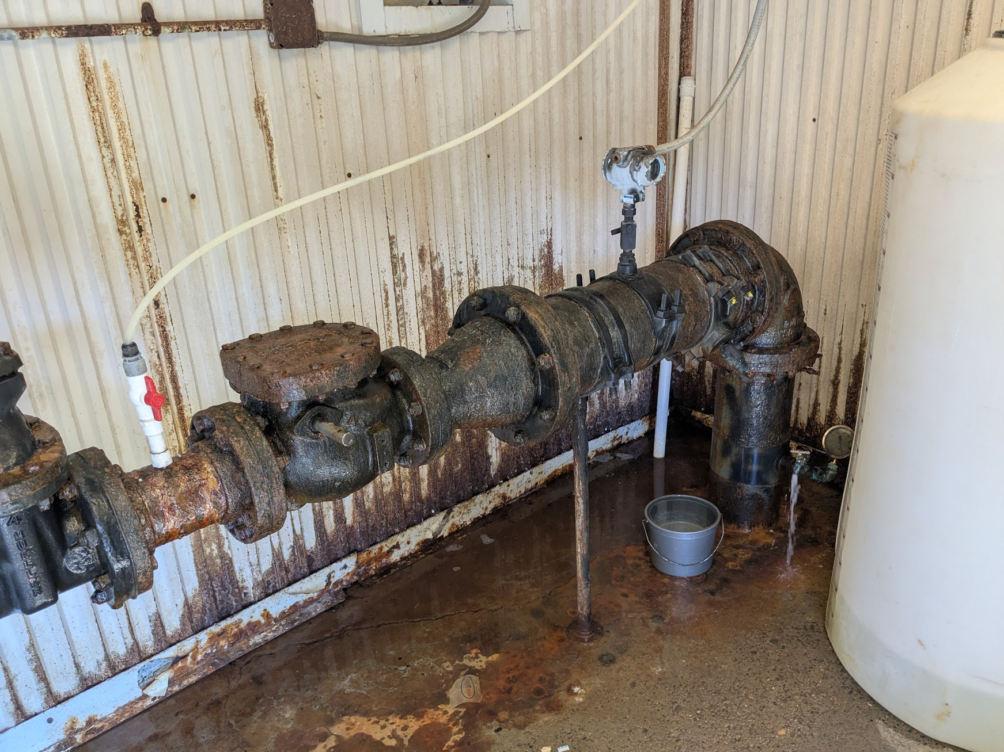
Why is corrosion a concern for water systems?
Water quality issues (e.g., lead or copper in drinking water)
  Creates health concerns
  Taste and odor issues
Material degradation
  Additional replacement and maintenance costs
Water loss
  Through leaks caused by degradation

Slide 40


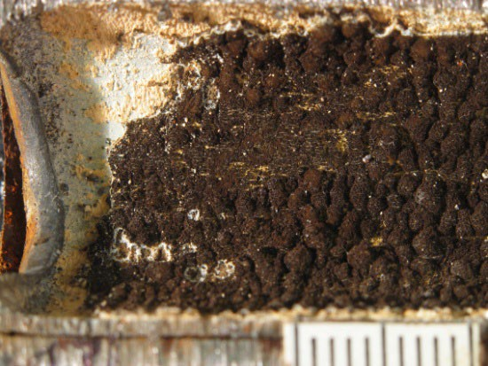
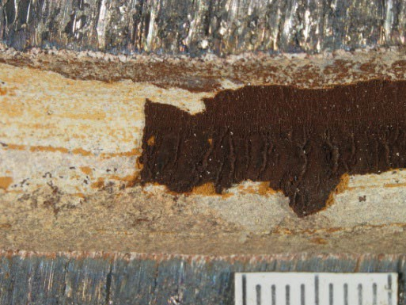
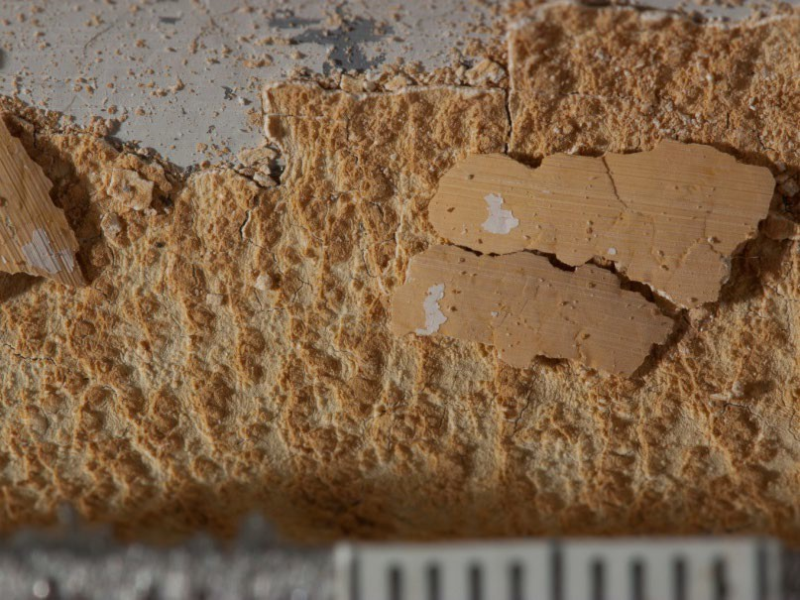

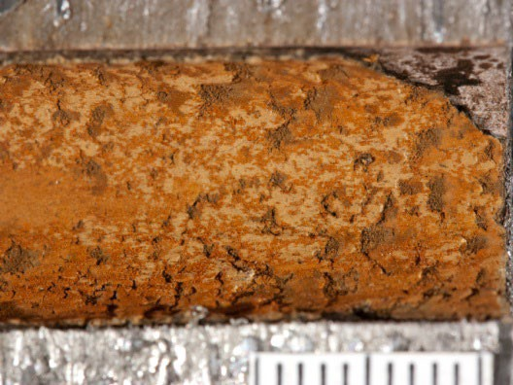
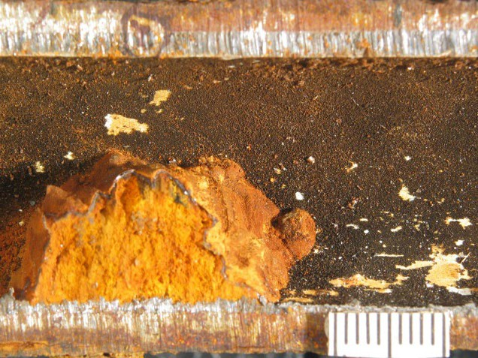
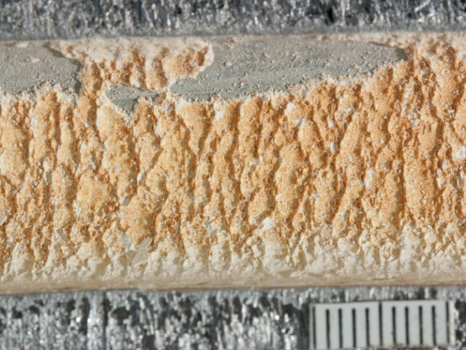
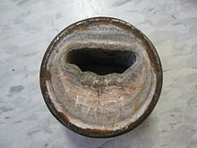


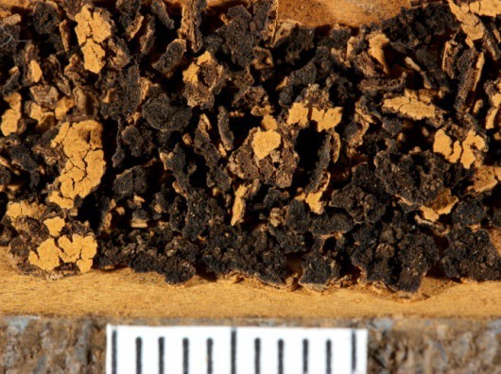
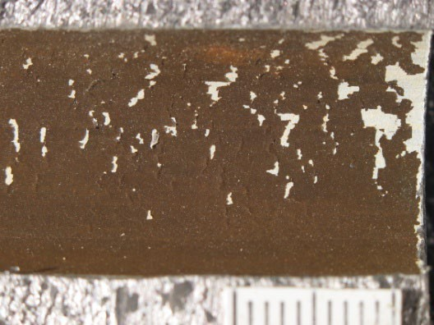
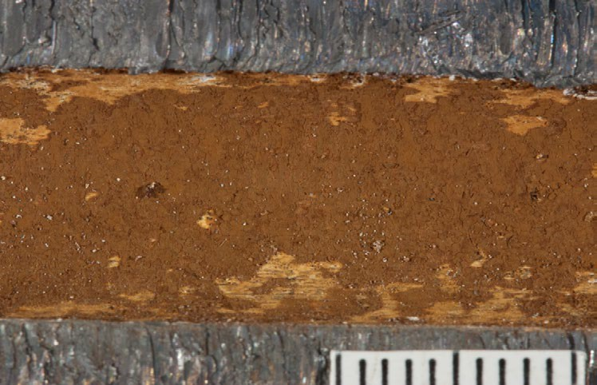
Scale in drinking water
Scale forming water
  Deposition of dissolved minerals onto pipe / appurtenances
  Decreased lifespan and flow
Notes:
Photo 1: Wikipedia

Slide 41
Corrosion is an oxidation-reduction reaction (redox)
Oxidation examples: Lead metal losing electrons at anode
Pb ↔ Pb2+ + 2e-
Pb ↔ Pb4+ + 4e-
Reduction examples: Oxidant gaining electrons at cathode
OCl- + H+ + 2e- ↔ Cl- + OH-
2OCl- + 2H+ + 4e- ↔ 2Cl- + 2OH-
Oxidant is dissolved oxygen, free chlorine, chloramine, chlorine dioxide, etc.
Notes:
Discuss overview of redox reaction.
Source: EPA Lead Chemistry 101

Slide 42
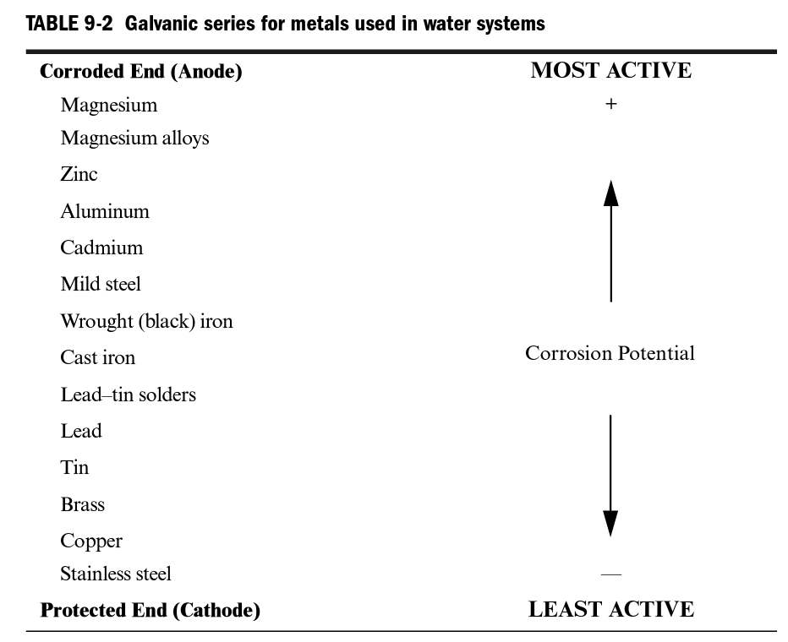
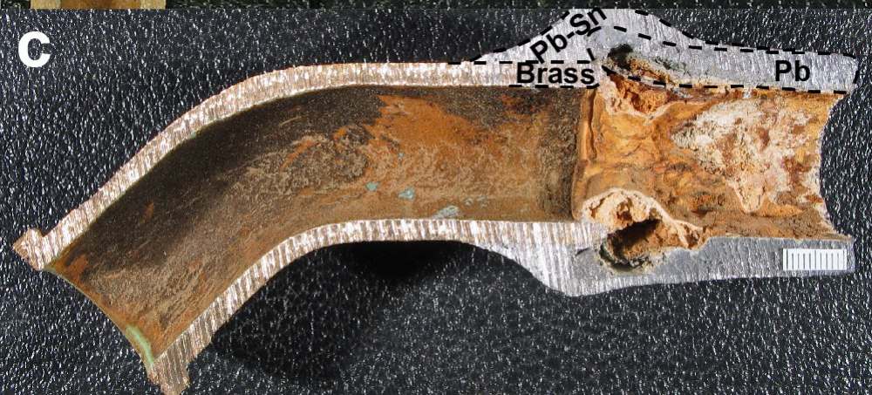
Galvanic Corrosion
Galvanic corrosion – caused by use of dissimilar metals
DeSantis et al., 2018
Notes:
Photo: DeSantis et al., 2018

Slide 43
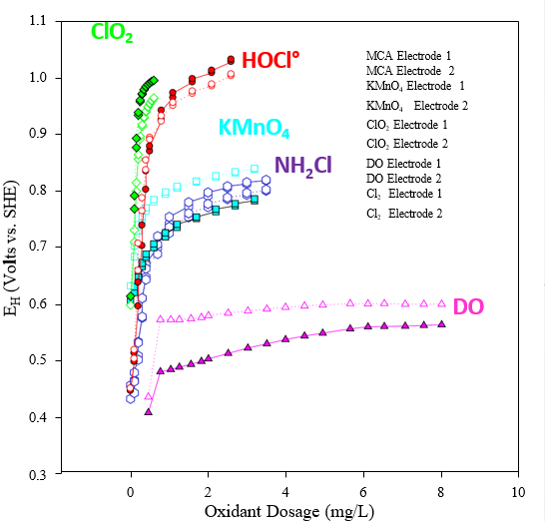
Factors affecting corrosion and scale
Presence of oxidants (e.g., oxygen, chlorine)
Total dissolved solids
Chloride and sulfate
Alkalinity and pH
Corrosion inhibitors
Temperature
Flow velocity
Type of metal
Electrical current
Bacteria
Oxidation-Reduction Potential of several disinfectants in experiment
James et al., 2004
(pH 7, 10 mg C/L, 25°C)
Notes:
Different factors affect corrosion and scale formation.
Presence of oxides: Graph shows different oxidants and their Oxidation-Reduction Potential.
Dissolved solids contributes to both corrosion and scale formation. Water with a higher salt content has increased conductivity which increases corrosion. Or minerals can precipitate out of the water and deposit as scale on the surface of pipes and fixtures which reduce corrosion.
Chloride and sulfate: Higher ratios of chloride to sulfate contribute to galvanic corrosion and may inhibit the formation of protective scale by keeping those ions in solution.
Alkalinity and pH: Alkalinity is the capacity of water to neutralize acids and is mostly caused by the water’s content of carbonate and bicarbonate. pH: is a measure of the concentration of hydrogen atoms. Water with a low pH level is more acidic than that with a high pH level. Generally speaking, low pH, acid water, tends to be corrosive and high pH water is more protective of pipes.
Corrosion inhibitors are chemicals that are added to the water to prevent corrosion. Orthophosphate or polyphosphate form a protective layer around the inside of the pipes to prevent corrosion.
Temperature: Molecules are more active at higher temperatures which cause chemical reactions to happen faster. Warmer water is more corrosive.
Flow velocity. Stagnant water contributes to pitting and tuberculation while highly oxygenated water becomes even more corrosive in higher flow conditions because it increase the contact of oxygen with the pipe walls. Also, corrosion inhibitors can be scoured off the pipe walls under high flow conditions. On the other hand, moderate flow rates tend to be less corrosive allowing calcium carbonate and other corrosion control film formation to develop.
Types of metals: When dissimilar metals are used in plumbing, they can contribute to galvanic corrosion.
Electrical current can increase corrosion. Sometimes in homes and other buildings copper or galvanized water pipes are used as a grounding path for the structure’s electrical system. Electrical current increases corrosion.
Bacteria can eat away at the metals themselves or cause changes in water chemistry that contribute to corrosion.

Slide 44
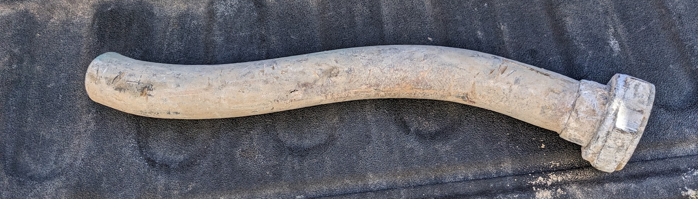
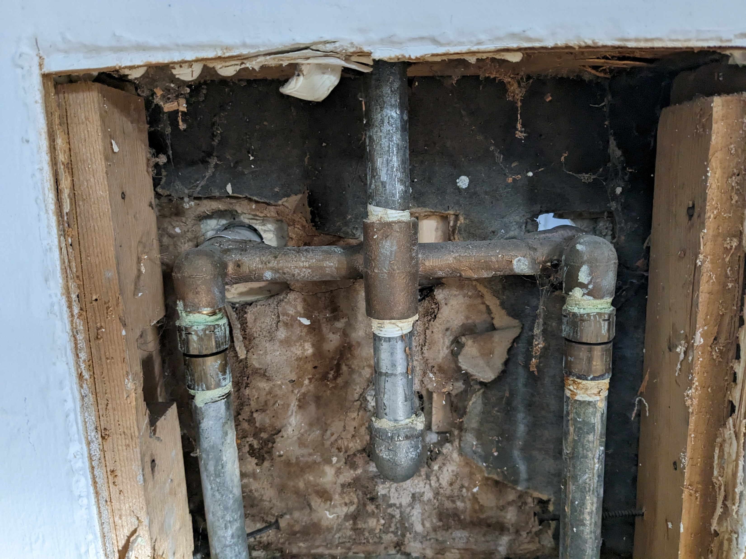
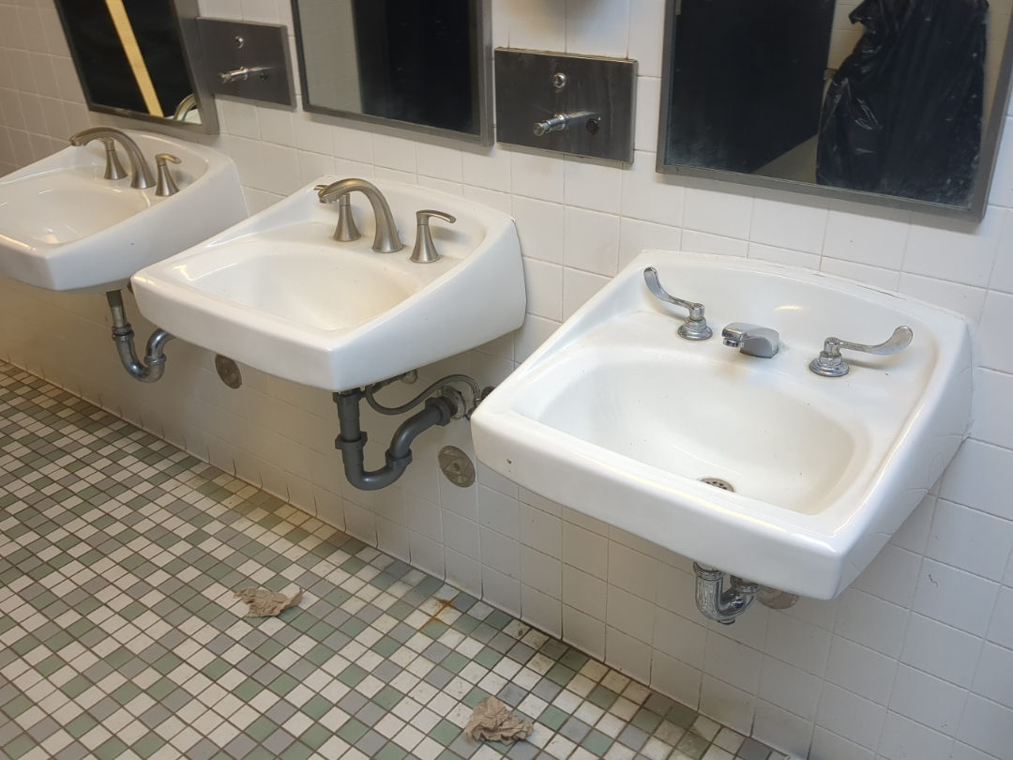
Corrosion applicability
Service lines
Plumbing
Fixtures

Slide 45
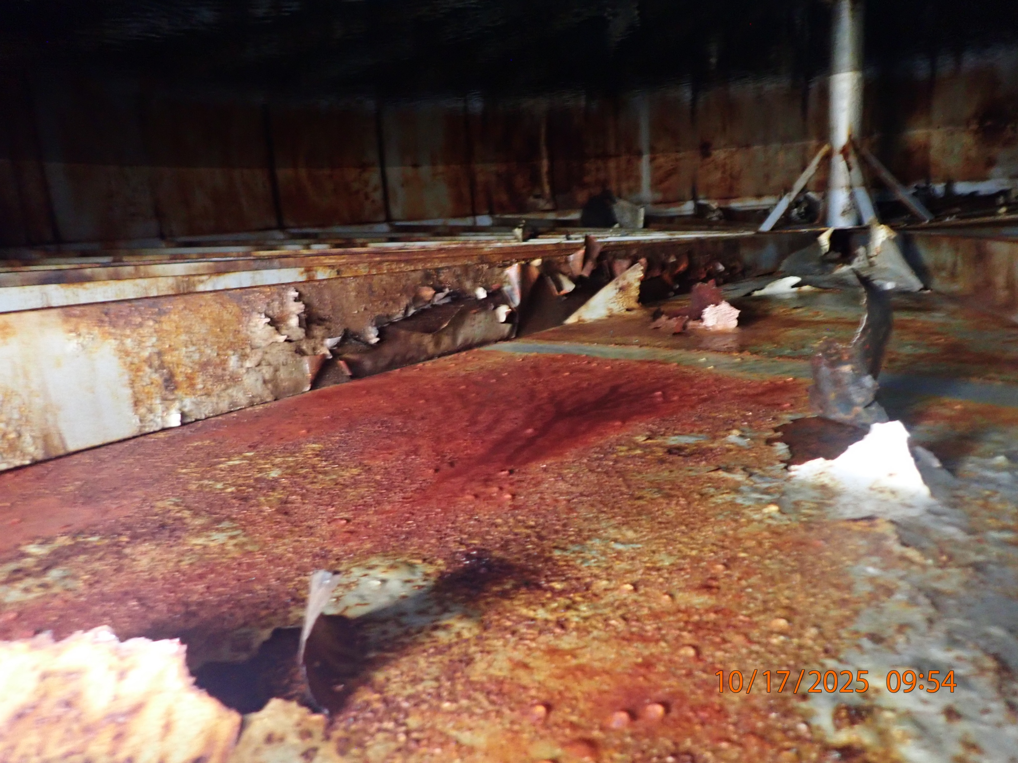
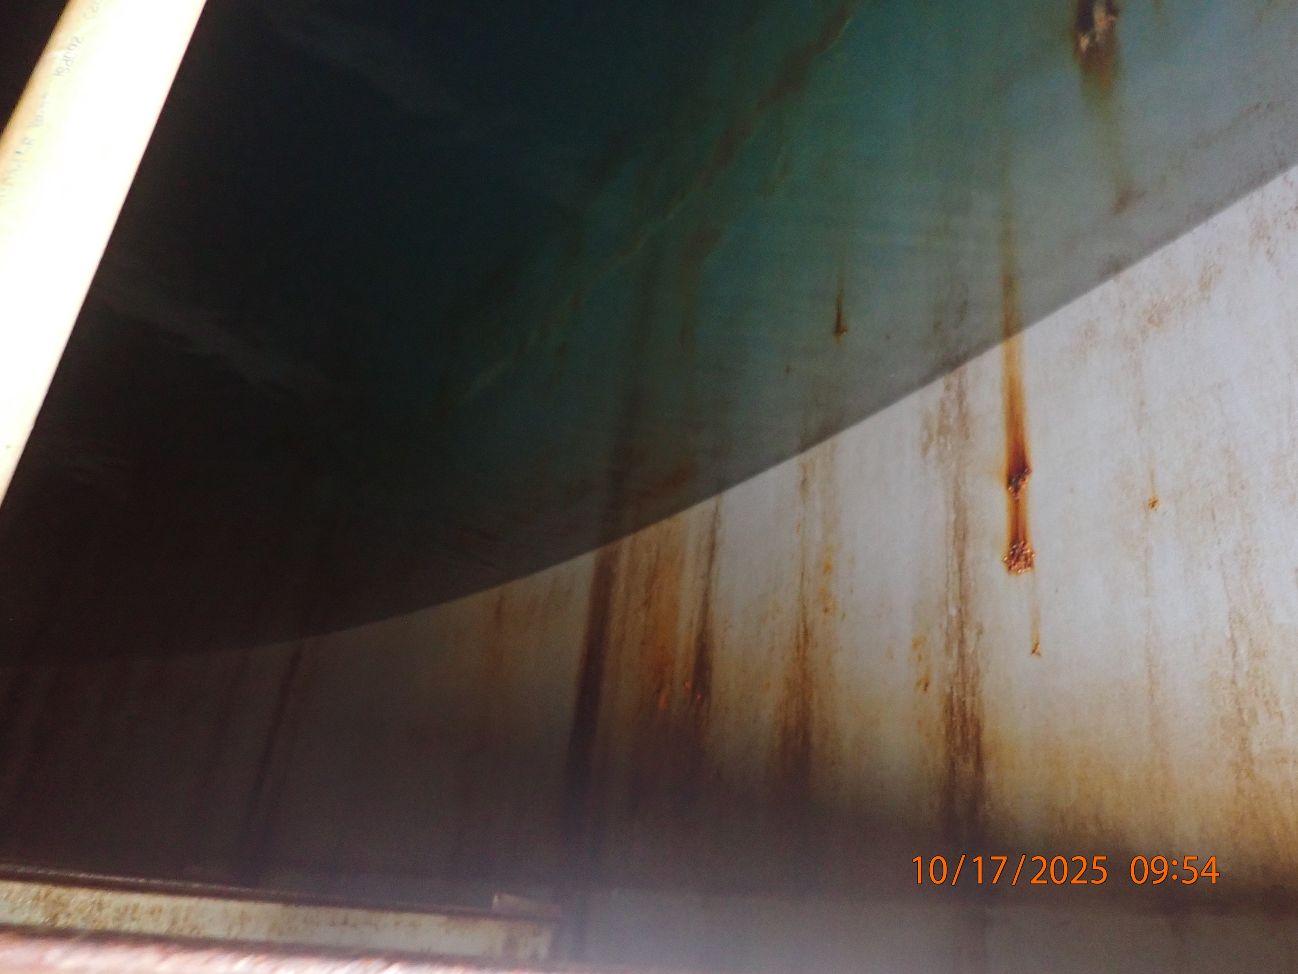
Corrosion applicability
Storage tanks

Slide 46
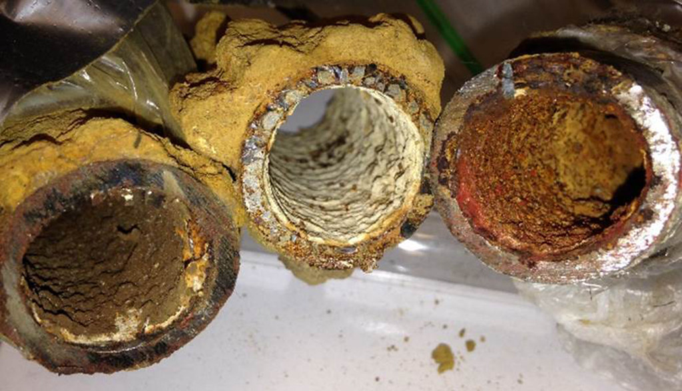
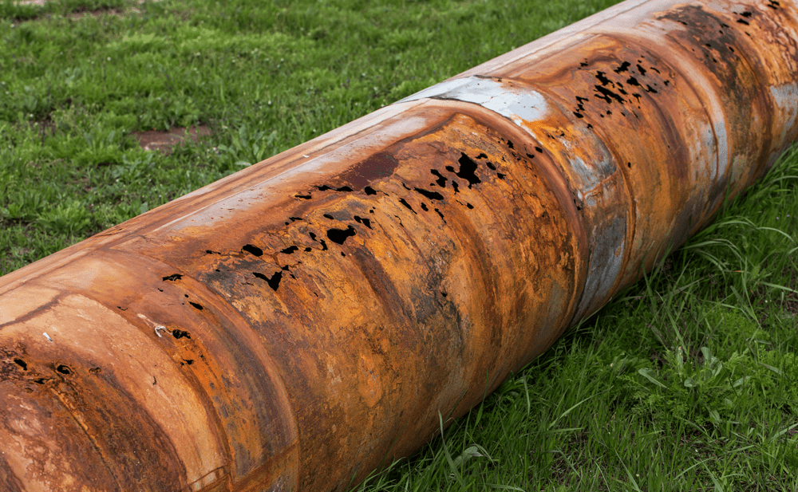
Corrosion applicability
Distribution lines and components
Notes:
https://scapeconsulting.com.au/corrosion-control/
https://www.flickr.com/photos/vcucns/34118541443/

Slide 47
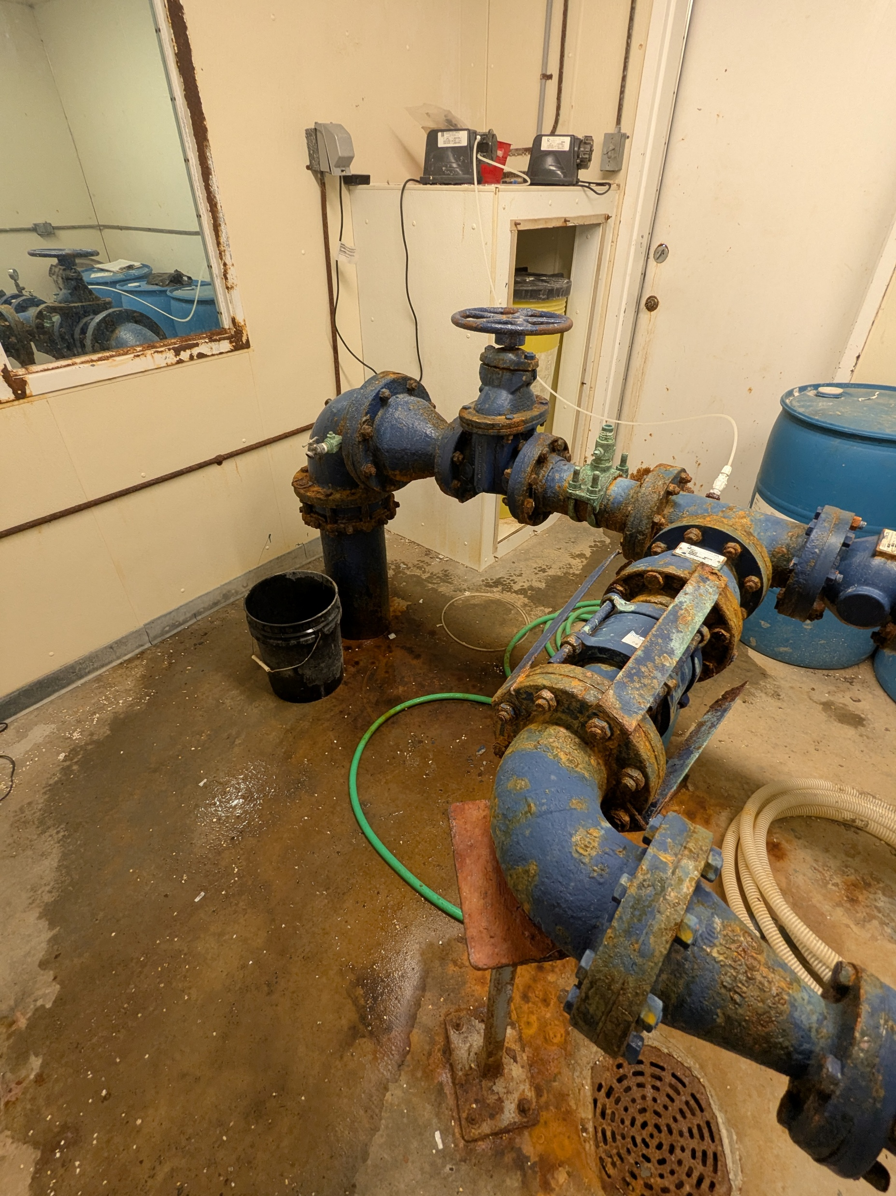
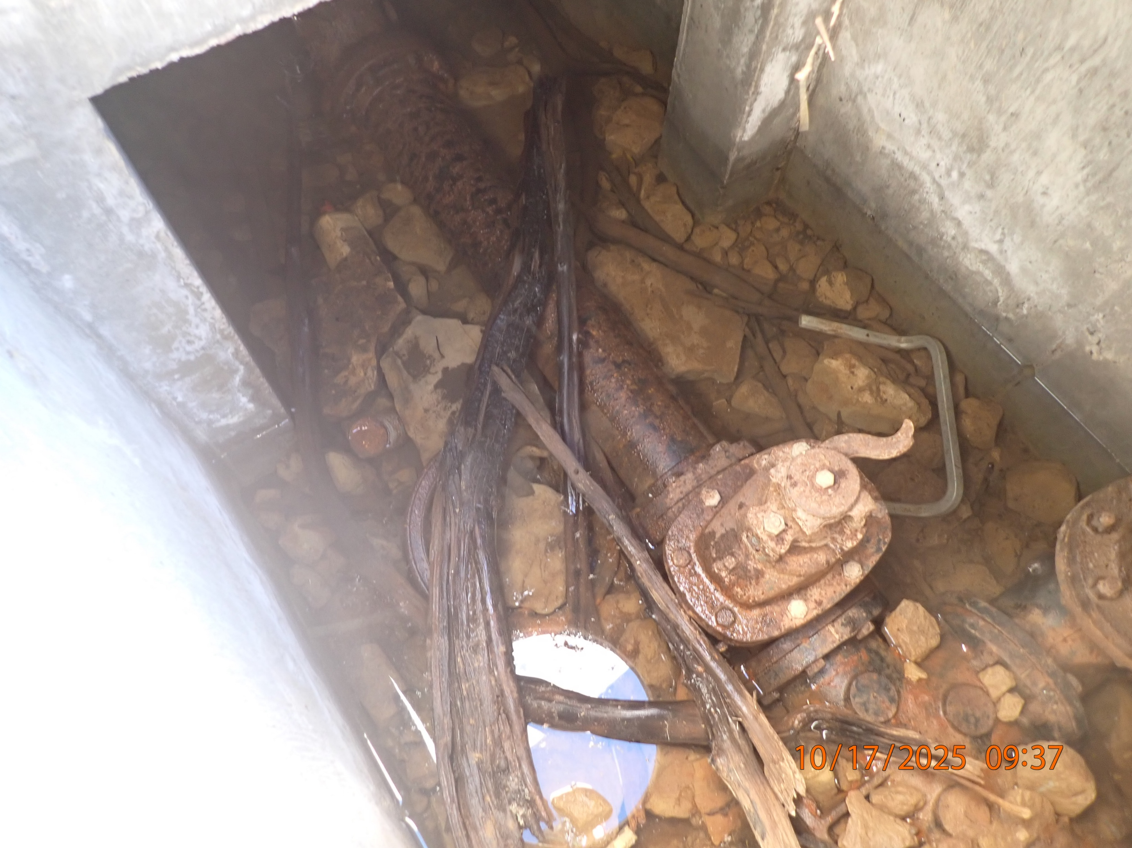
Corrosion applicability
Anything metal
Notes:
Corrosion of pipes sitting in water in a pit
Corrosion of plumbing tree where it’s missing paint due to the moist environment and sodium hypochorite in unvented building

Slide 48
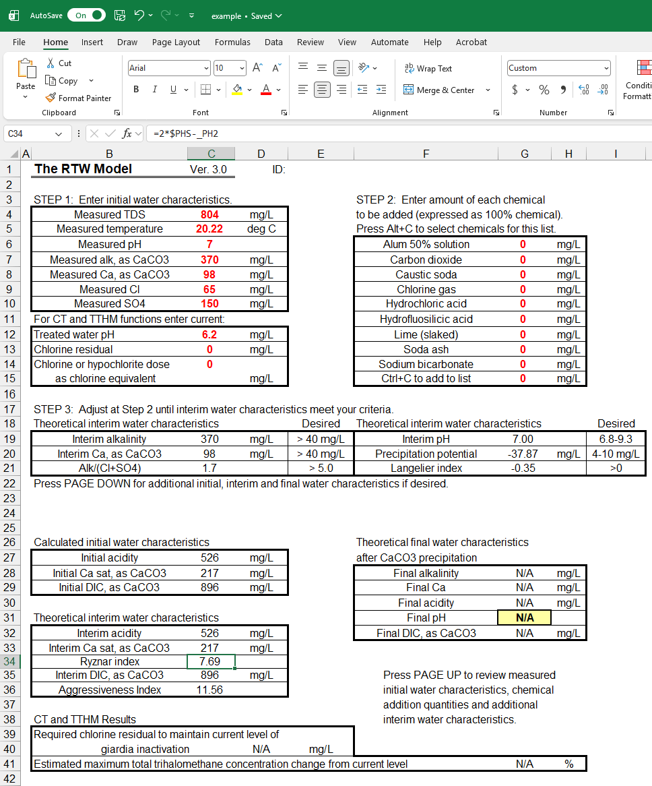
Models to predict corrosivity
Based on water quality parameters, predict if water is more likely to cause corrosion or deposit scale
Langelier Saturation Index
Ryznar stability index
Free online tools or more advanced models for purchase
Notes:
Langelier Saturation Index is used to calculate the scaling potential of water.
Ryznar stability index is used to predict the likelihood of calcium carbonate scale formation.

Slide 49
Control of corrosion and scale
Removing metallic materials from system
  Lead and copper pipe, old fittings and fixtures
Alteration of water chemistry
  pH/alkalinity

Slide 50
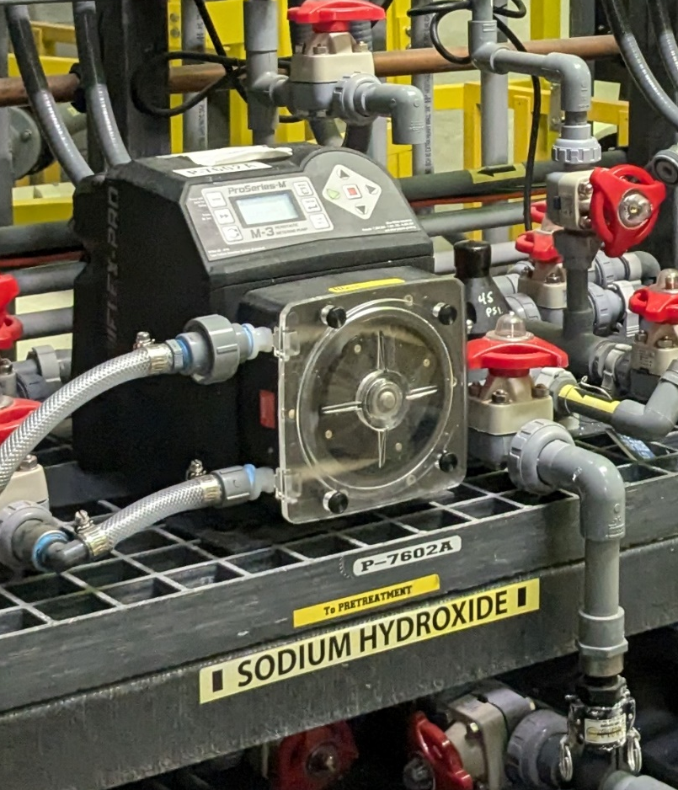
pH/Alkalinity Adjustment
Sodium Hydroxide (caustic soda) – increase pH
Carbon Dioxide – decrease pH
Muriatic Acid (HCl) – decrease pH
Calcium Carbonate – increase alkalinity
Sodium Carbonate (Soda ash) –increase alkalinity
Notes:
Photo: Tucker Colvin, Bozeman WTP

Slide 51
Control of corrosion and scale
Removing metallic materials from system
  Lead and copper pipe, old fittings and fixtures
Alteration of water chemistry
  pH/alkalinity
  Addition of corrosion inhibitor

Slide 52
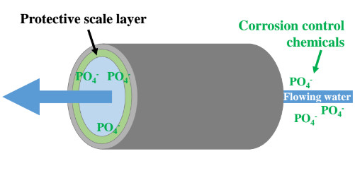
Corrosion inhibitor
Reduce corrosivity of water by forming a protective film on pipes due to corrosive water
Addition of orthophosphate or polyphosphate
Notes:
Table source: AWWA Water Treatment

Slide 53

Corrosion Control Treatment under the LCR
Action Level Exceedance
Corrosion control study
Determination of corrosion control treatment
Follow up monitoring
Optimized or re-optimized corrosion control treatment
Notes:
Corrosion control treatment under the LCR:
If a system has had an action level exceedance, they may have to implement corrosion control treatment.
A system may be required to conduction a corrosion control study to determine optimal corrosion control treatment.
After the study the system’s regulating agency will determine which type or types of CCT need to be implemented. System has 24 month to implement CCT. Regulating agency may set optimal water quality parameters that the system then has to demonstrate compliance with. OWQP are specific values or ranges of key water quality parameters for optimal corrosion control treatment.
Follow up monitoring: Systems must then conduct 2 consecutive 6-month periods of follow up tap and WQP sampling.
System must demonstrate tap samples are less than or equal to the lead practical quantitation limit (LPQ). LPQ limit is the lowest concentration of lead that can be reliably measured under routine laboratory operating conditions. The practical quantitation level for lead is 0.005 mg/L. This helps ensure that water systems is in compliance with Lead and Copper Rule. If the 90th percentile lead levels are less than or equal to the lead practical quantitation level of 0.005 mg/L for two consecutive six-month monitoring periods and it does not exceed the copper action level for two consecutive six-month monitoring periods, it is deemed to have optimized or re-optimized corrosion control treatment.
Photo: https://pixabay.com/photos/water-glass-liquid-wet-refreshment-3853492/

Slide 54
Schedule for 2026:
Date | Topic
1/22/2026 | Alternative Treatment Processes (e.g. fluoridation, ion exchange, RO…)
2/5/2026 | Drinking Water Treatment Math & Concept Review
2/19/2026 | Safety Program Basics (including personal safety, equipment safety, facility safety)
3/5/2026 | Lead & Copper Rule, Corrosion Control
3/19/2026 | Distribution Systems 1: Hydraulics, Pipe Types, Selection, Installation, and Water Quality
4/2/2026 | Distribution Systems 2: Valves, Hydrants, Meters, and Service Connections
4/16/2026 | Distribution Systems 3: Storage and Booster Pumping
4/30/2026 | O&M: Pumps, Main, and Appurtenance Maintenance (including pressure monitoring, valve exercising, and flushing)
5/14/2026 | O&M: Cross Connection Control
5/28/2026 | O&M: Distribution System Math and Concept Review
6/11/2026 | Sampling & Lab Procedures/Analysis/Interpretation
6/25/2026 | Management Overview (including organization, communication, PR & record keeping)
7/9/2026 | Drinking Water Practice Exam and Review
Links to recordings and material are available on our website at https://swefc.unm.edu/home/op-cert-trainings/

Slide 55
CONTACT INFORMATION
SW EFC email: swefc@unm.edu
Department of Civil Engineering MSC01 1070
1 University of New Mexico
Albuquerque, NM 87131
505-277-0644
swefc@unm.edu
http://swefc.unm.edu

Slide 56
Corrosivity and Water Stabilization
Complicated chemical interactions
Models used to predict corrosivity (Langelier Saturation Index, Ryznar Stability Index)
Factors that affect corrosivity
  Dissolved oxygen
  Total dissolved solids
  Alkalinity and pH
  Temperature
  Flow velocity
  Type of metal
  Electrical current
  Bacteria
Remedied through altering of pH or alkalinity, sequestering agents, formation of protective coating
Notes:
Table source: AWWA Water Treatment

Slide 57
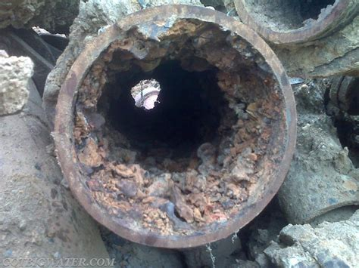
Types of scale
Tuberculation in iron pipe
Scale in lead pipe
EPA ORD’s Advanced Materials and Solids Analysis Research Core, 2021

Slide 58
Corrosion Control and Scale
Corrosive / aggressive water
  Dissolves material into water
  Health concerns – lead and copper
  Deterioration of pipe and appurtenances
Scale forming water
  Deposition of dissolved minerals onto pipe / appurtenances
  Decreased lifespan and flow
Notes:
Photo 1: Tucker Colvin, lead service line goose neck removed in Albuquerque
Photo 2: Wikipedia

Slide 59

Pipes Affect on Water Quality
Corrosion
Corrosion leads to decreased water quality
  Higher demand in the distribution – more chlorine needed to effectively treat water
  Lead and copper increases
  Changes in pH affects corrosion in the pipes
Tuberculation
  Increased water pressures
  Reduced water flows (friction)
  Bottlenecks in the distribution

