Slide 1




US Territories Wastewater Operator Training Series
Session 18: Wastewater Math Part 4 – Advanced Wastewater Math
03/17/2026
www.efcnetwork.org
This program is made possible under a cooperative agreement with US EPA.
Notes:
Welcome to all of our participants from CNMI, Guam and American Samoa to session 17 in our wastewater operator training series. Today we will be focusing on calculating flow, detention time and loading.

Slide 2

Your trainers for today:
A.J. Barney
Research Engineer
Valeria Cortes-Mora
Professional Intern

Slide 3



This training series is funded by the EPA

Slide 4


Slide 5
WPI/ABC Operator Certification
Notes:
This series is designed to supplement and reinforce the ABC Need to Know Criteria for the Wastewater Operator level 1 and 2 exams though there will be some higher level topics covered, and we won’t always follow the exact order listed in the NTKs
https://www.gowpi.org/services/abc-testing/standardized-exams/standardized-wastewater-treatment-operator-exams/

Slide 6
Use all your resources

Slide 7
Schedule for 2025:
Date | Topic
1/20/26 | Concept and Math Review Session
2/3/26 | Disinfection Part 1 (chlorination/dechlorination) + related math
2/17/26 | Disinfection Part 2 - UV and other methods
3/3/26 | WW Math Part 3 (Flow, Detention Time)
3/17/26 | WW Math Part 4 (BOD Math /Advanced WW Math)
3/31/26 | Solids Handling Part 1 (Mechanical Solids Separation)
4/14/26 | Solids Handling Part 2 (Solids Handling)
4/28/26 | Sampling
5/12/26 | Regulations (NPDES Permits and Discharge Limitations)
5/26/26 | Treatment System Maintenance
6/9/26 | Lab Procedures/Analysis/Interpretation or alternate topic
6/23/26 | Using Technology in daily operations (SCADA, Computer, Tablets, CMMS, AI, etc.)
7/7/26 | Course Review Session - Short sample exam?
Notes:
26 sessions total
1 hour each
This is the schedule for the remainder of this year,
The trainers will vary depending on the topic
We’re now on session 15

Slide 8
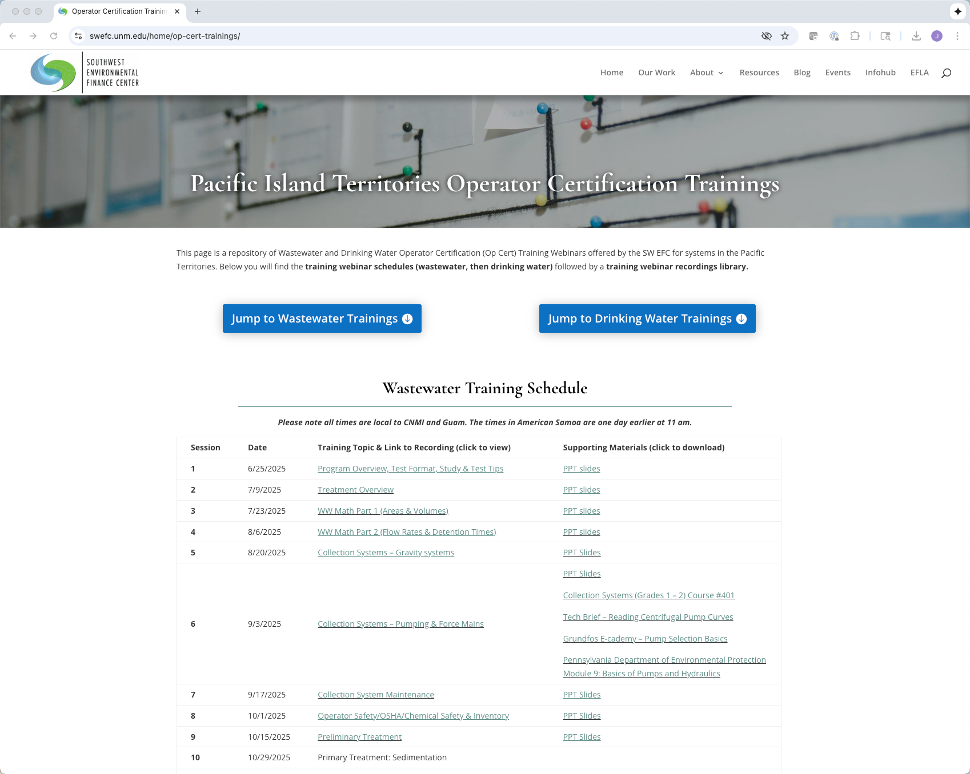
https://swefc.unm.edu/home/op-cert-trainings/
Notes:
The sessions are all being posted to our website so that you can go back and review them. I checked yesterday and all of the sessions 1-9 are posted, and this session should be posted in a day or two.

Slide 9
Sign in for every session to ensure you get credit for attending
Notes:
Be sure to sign in if you are attending in a group. The facilitator at your location will forward these to us and we will keep track of your attendance hours for credits;
With that lets get to today’s content!

Slide 10
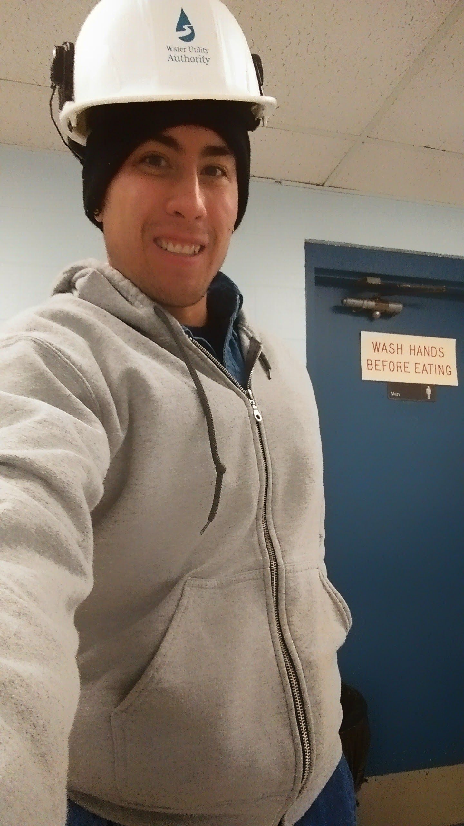
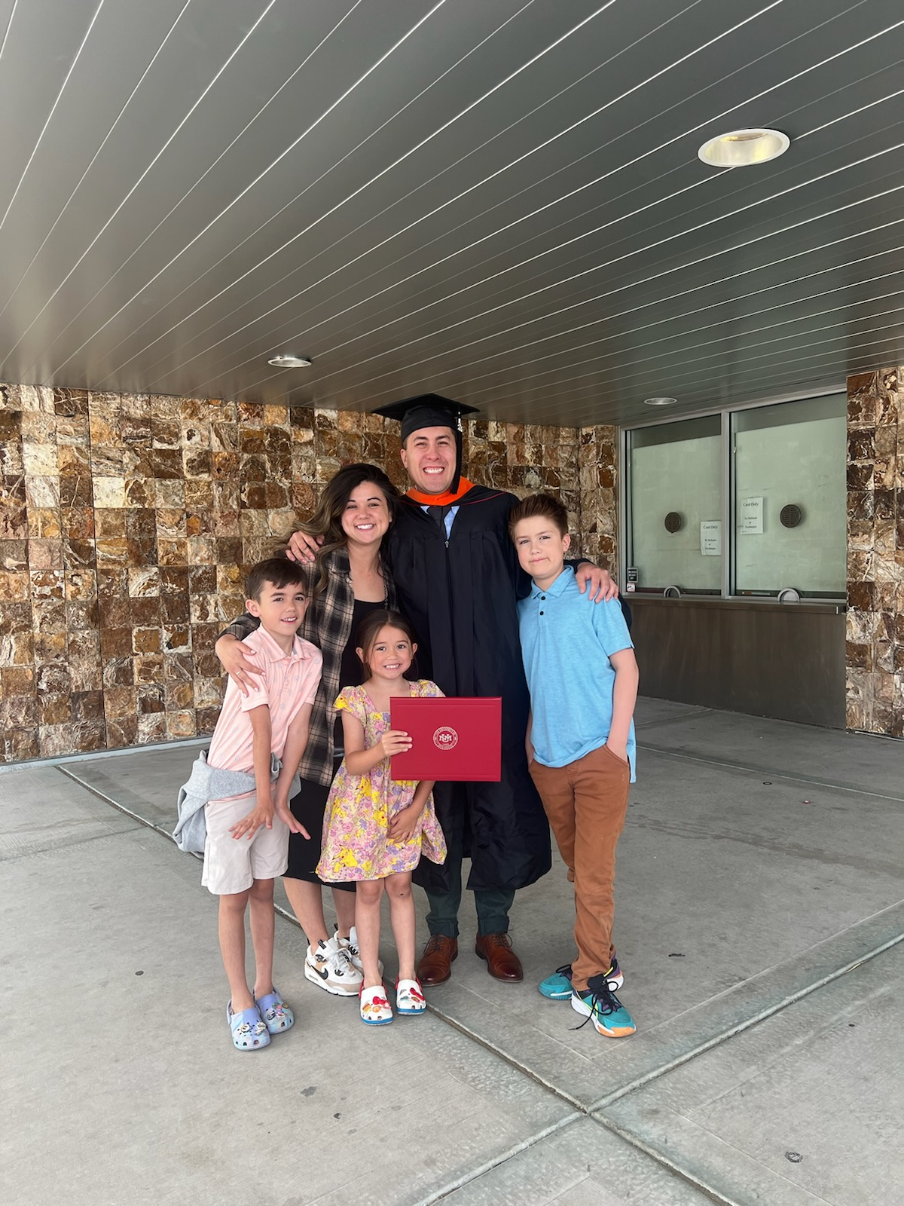
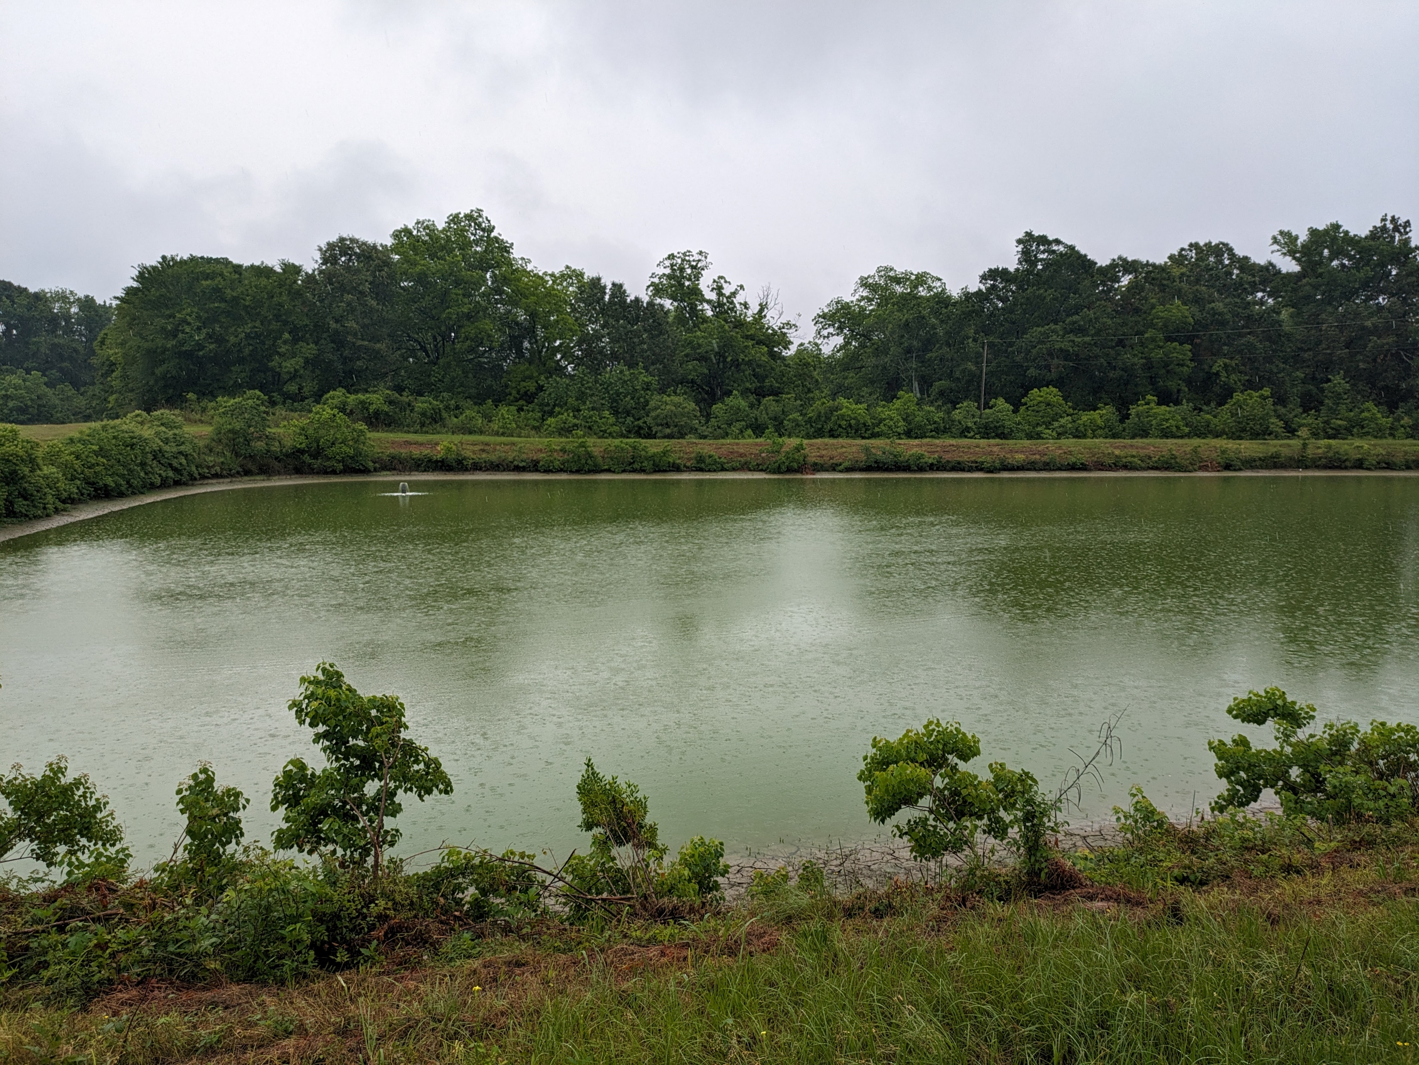
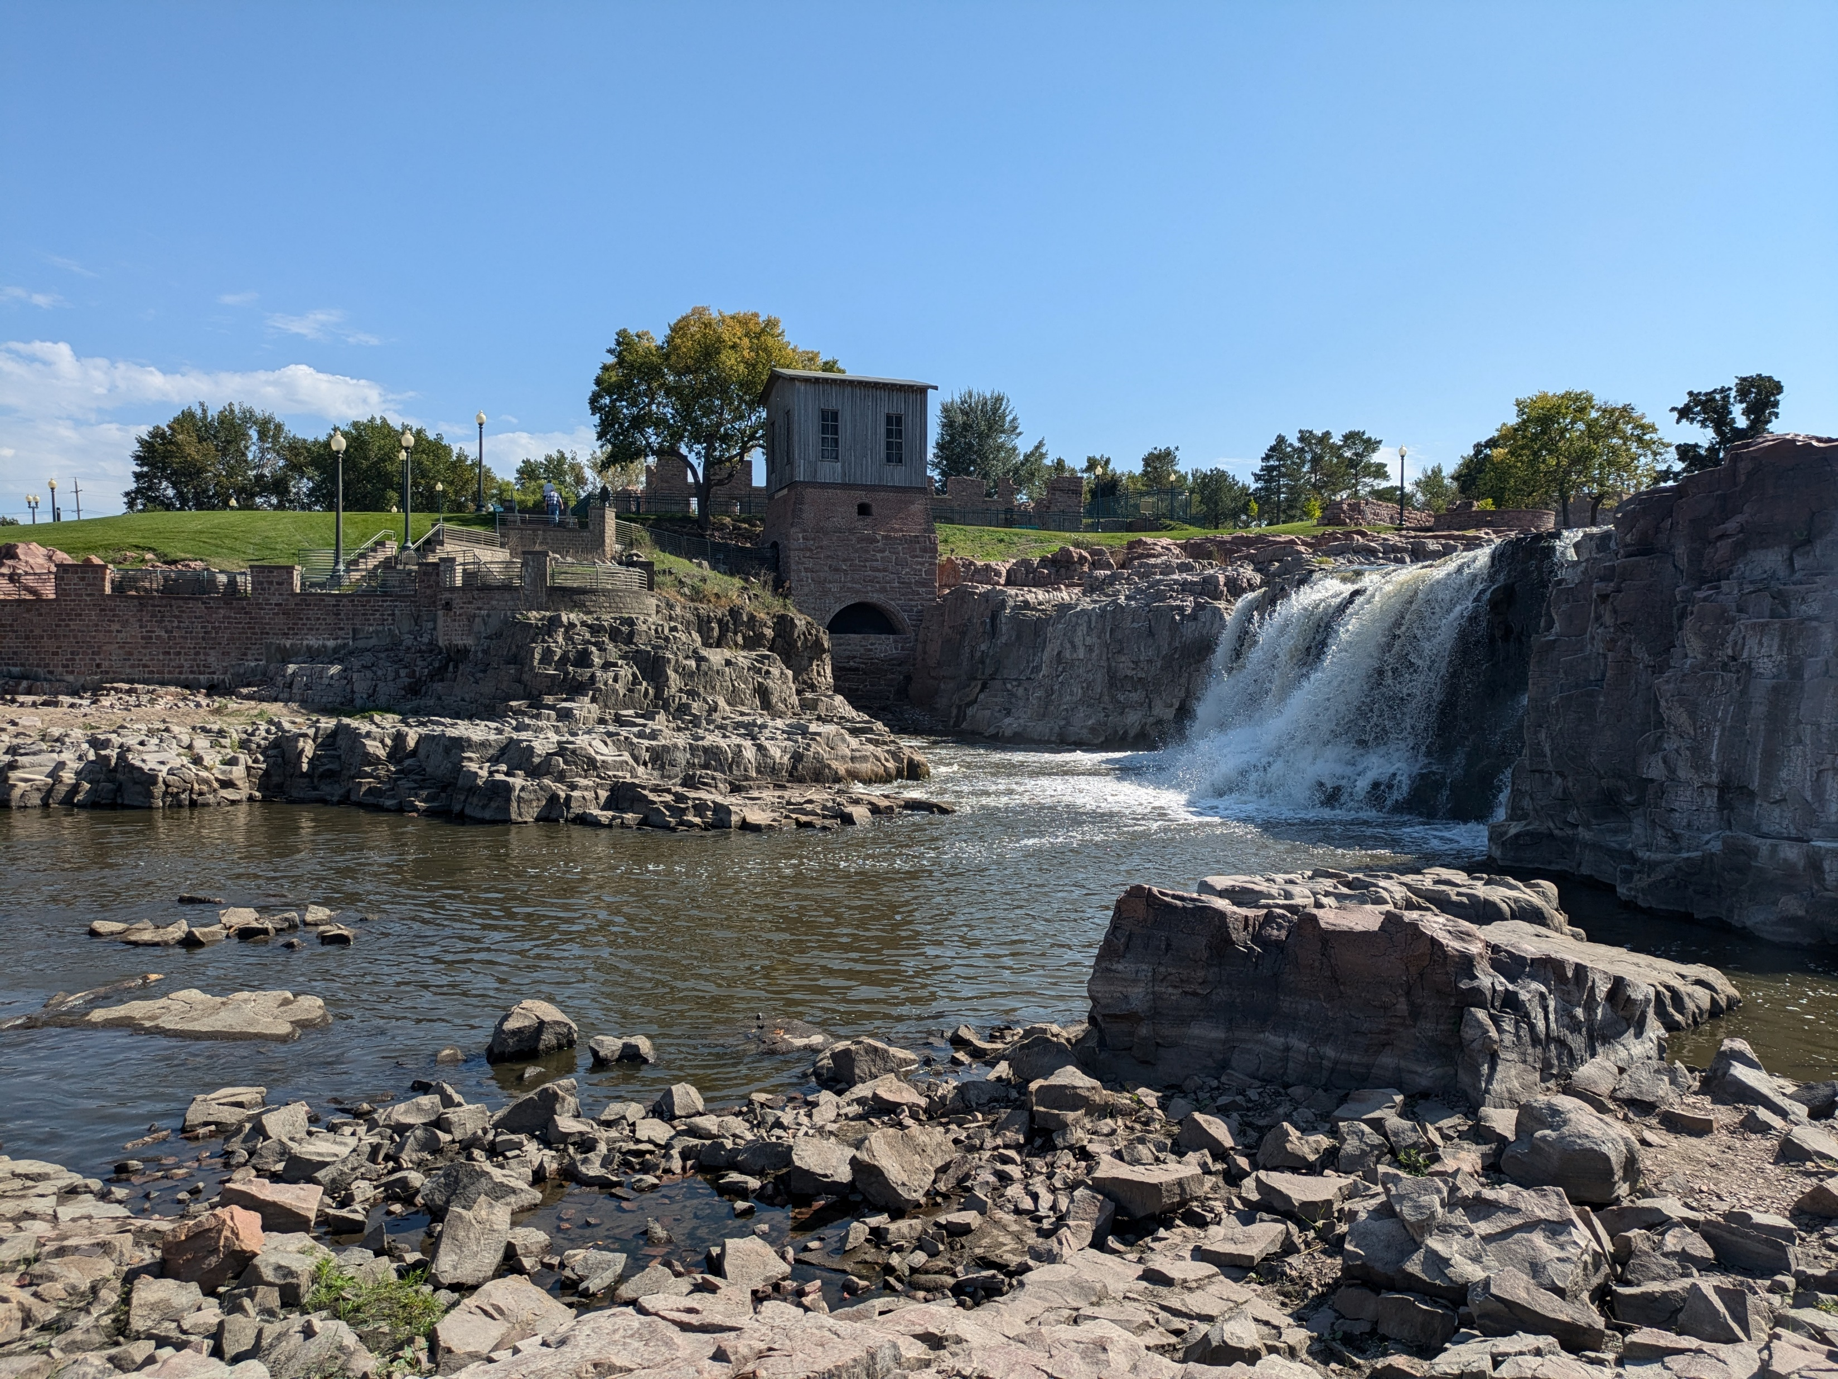
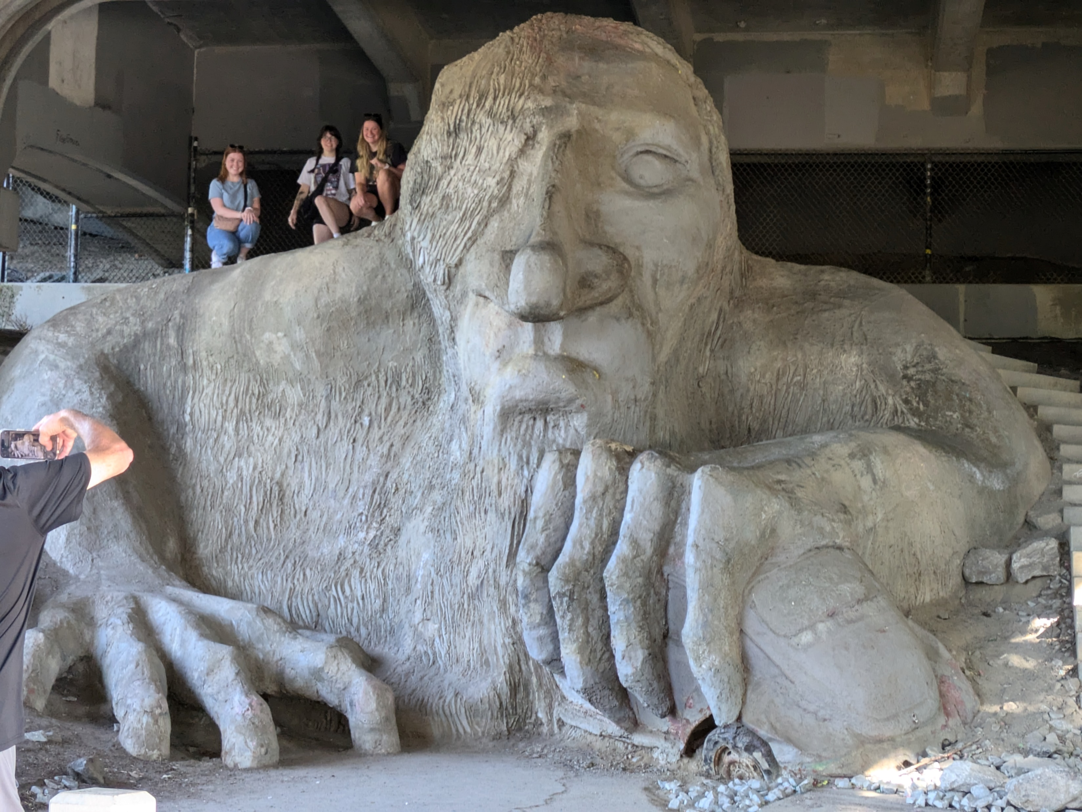
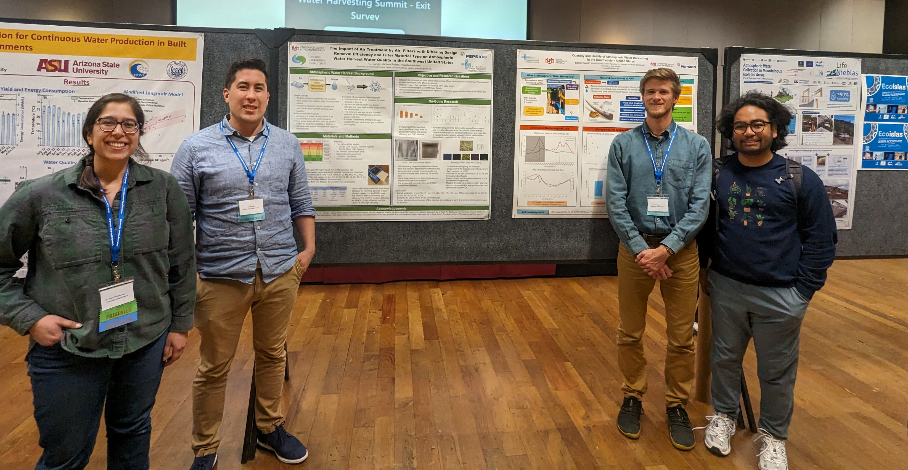
Who am I??
A.J Barney- Environmental Engineer, Biologist, NM Certified WW Operator
Notes:
11 SWEFC Team members

Slide 11
BOD
Notes:
60 Min
Likely 45 Minutes
SVI, F:M, MCRT/SRT, Return Sludge Rate
Optional Recirc Rates etc.

Slide 12
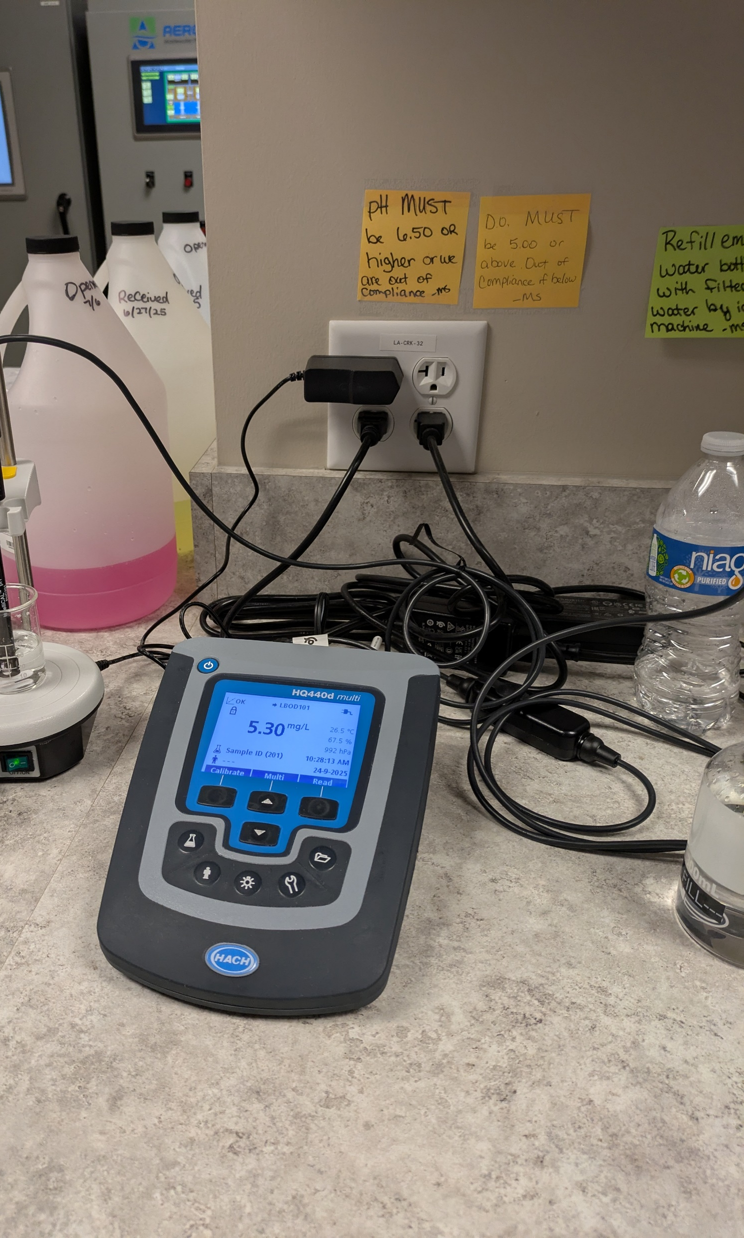
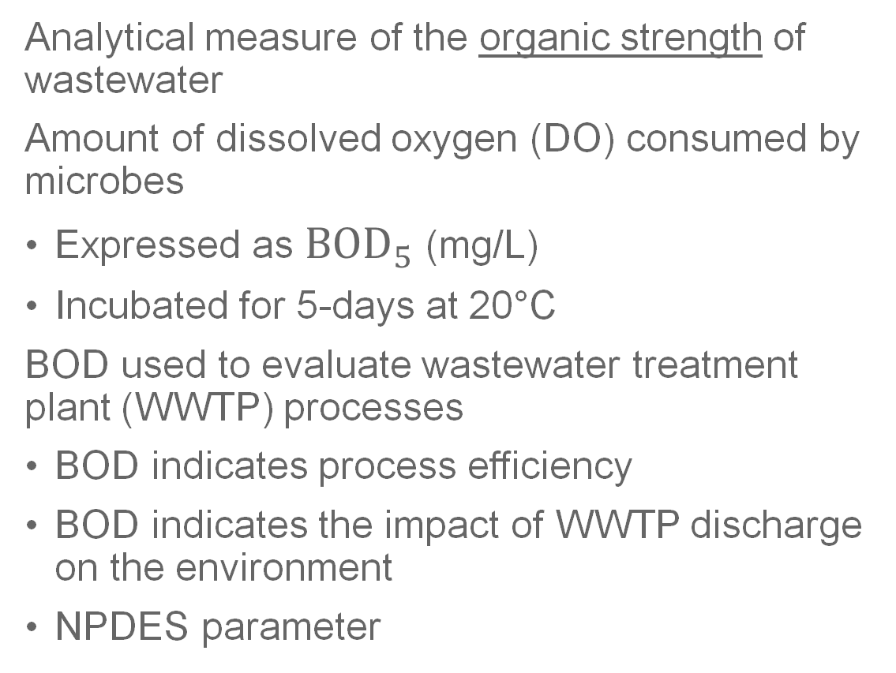
Biochemical Oxygen Demand (BOD)
Analytical measure of the organic strength of wastewater
Amount of dissolved oxygen (DO) consumed by microbes
Expressed as ${BOD}_{5}$ (mg/L)
Incubated for 5-days at 20°C
BOD used to evaluate wastewater treatment plant (WWTP) processes
BOD indicates process efficiency
BOD indicates the impact of WWTP discharge on the environment
NPDES parameter
Notes:
The first thing we’ll review in this training is biochemical oxygen demand or BOD for short.
BOD is commonly referred to as the organic strength of wastewater
and is one of our core targets for removal through wastewater treatment along with solids, pathogens, ammonia and nitrogen
Now the definition of biochemical oxygen demand is that it is the analytical measure of the amount of oxygen consumed during the decomposition of organic material.
Specifically measures the amount of dissolved oxygen consumed by aerobic microorganisms in 1 L of wastewater
Expressed as ${BOD}_{5}$ and measured in mg/L
Samples are incubated for 5-days at 20°C
BOD aids in evaluating wastewater treatment plant and processes performance
Applies to all biological processes
BOD levels indicate the efficiency of organic pollutants removal
BOD levels help anticipate impact treated wastewater may have on the environment
Used as design parameter for plants to meet NPDES permit requirements

Slide 13
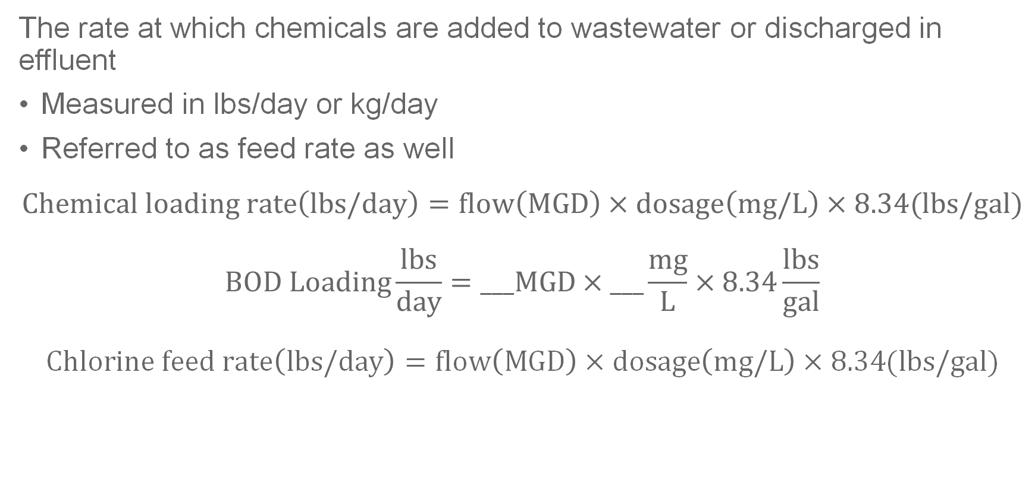
Loading Rate
The rate at which chemicals are added to wastewater or discharged in effluent
Measured in lbs/day or kg/day
Referred to as feed rate as well
$$Chemical loading rate\left(lbs/day\right)=flow\left(MGD\right)×dosage\left(mg/L\right)×8.34(lbs/gal)$$
$$BOD Loading\frac{lbs}{day}=___MGD×___\frac{mg}{L}×8.34\frac{lbs}{gal}$$
$$Chlorine feed rate\left(lbs/day\right)=flow\left(MGD\right)×dosage\left(mg/L\right)×8.34(lbs/gal)$$
mg/L=ppm
Notes:
For application to wastewater treatment, BOD loading refers to the rate at which mostly organics and some other pollutants are introduced to wastewater.

Slide 14
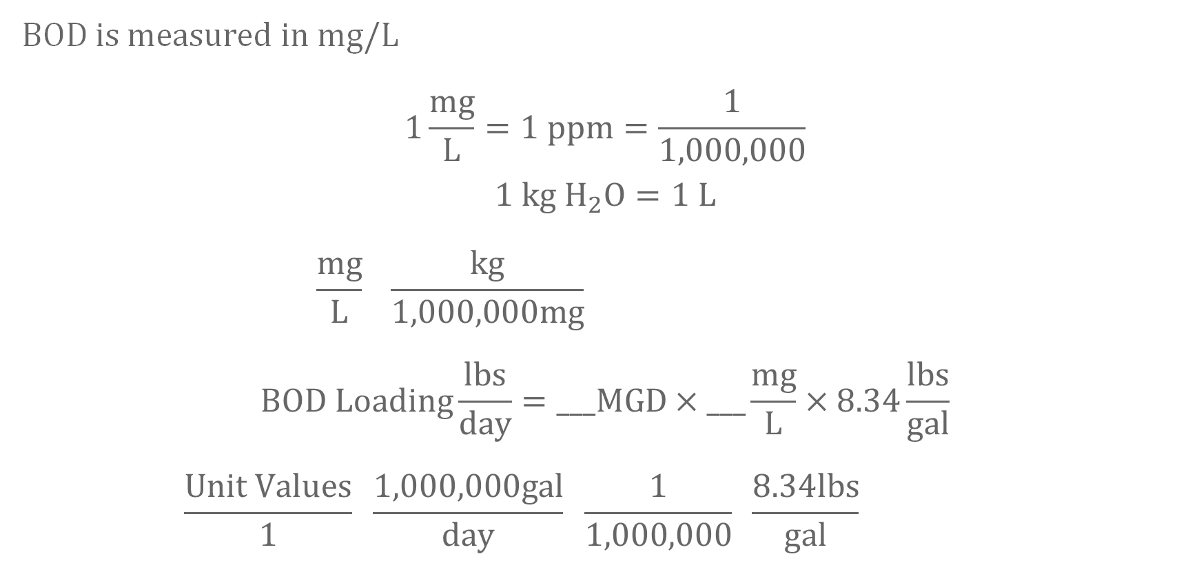
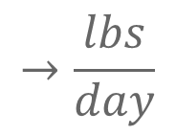
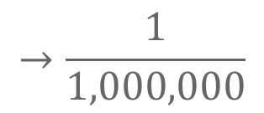
BOD Units
BOD is measured in mg/L
$$1\frac{mg}{L}=1 ppm=\frac{1}{1,000,000}$$
$$1 kg H_{2}O=1 L$$
$$\frac{mg}{L} \frac{kg}{1,000,000mg}$$
$$BOD Loading\frac{lbs}{day}=___MGD×___\frac{mg}{L}×8.34\frac{lbs}{gal}$$
$$\frac{Unit Values}{1} \frac{1,000,000gal}{day} \frac{1}{1,000,000} \frac{8.34lbs}{gal}$$
$$→\frac{1}{1,000,000}$$
=ppm=1mg/L
$$→\frac{lbs}{day}$$
Notes:
Real quick I want to expand on that concept that 1 mg/L is = to 1 ppm
We demonstrate this by first explaining that 1 Liter of water is = to 1 kg
So if we perform a unit conversion on a mg/L using the fact that 1 kg of anything is also equal to 1,000,000 mg
So we
I keep reiterating this concept, because I think it’s very important to get in the habit of cancelling our units, which is a good practice to ensure you performed your calculations in the correct order.

Slide 15
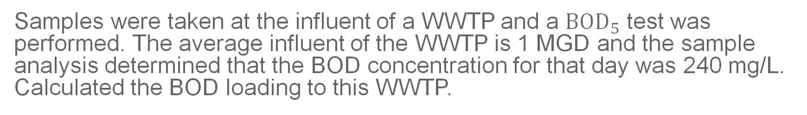
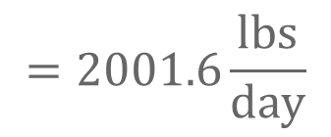
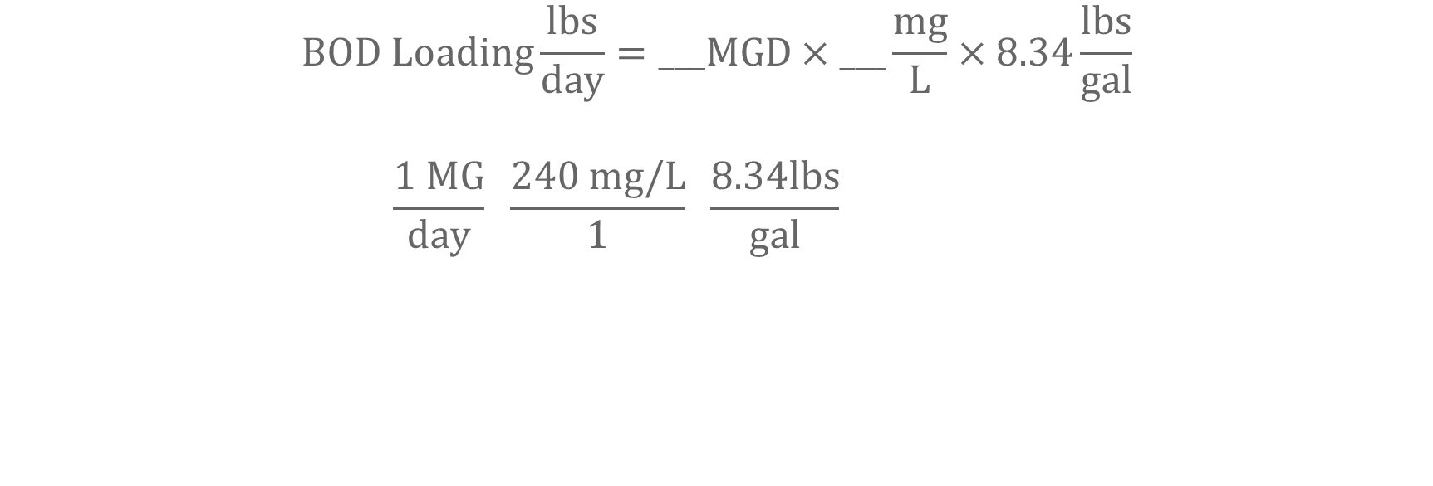
BOD Loading Example
Samples were taken at the influent of a WWTP and a ${BOD}_{5}$ test was performed. The average influent of the WWTP is 1 MGD and the sample analysis determined that the BOD concentration for that day was 240 mg/L. Calculated the BOD loading to this WWTP.
$$BOD Loading\frac{lbs}{day}=___MGD×___\frac{mg}{L}×8.34\frac{lbs}{gal}$$
$$\frac{1 MG}{day} \frac{240 mg/L}{1} \frac{8.34lbs}{gal}$$
$$=2001.6\frac{lbs}{day}$$
Notes:
Notice in the first term of my bracket I have my MG on the top and my days on the bottom, but I didn’t do that to my second term.
This is because I’m gong to cancel out the mg/L.
This is not always intuitive, but the more you practice understanding what these math problems want and how to find it in word problems the more you can be familiar with how to save yourself some time adjusting your mathematical operations and doing things like cancelling out terms easier. The only way I know how to do this for most people is lots of practice.

Slide 16

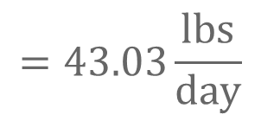
BOD Loading Practice
You work at a WWTP with a primary clarifier and a tricking filter and want to determine the current organic loading to your process, but first you need to calculate the BOD loading to the trickling filter. You collect a sample of the primary effluent and determine the average BOD is 129 mg/L. The flow to the trickling filter is 0.04 MGD. What is the average BOD loading to the trickling filter in lbs/day?
$$BOD Loading\frac{lbs}{day}=___MGD×___\frac{mg}{L}×8.34\frac{lbs}{gal}$$
$$\frac{.04 MG}{day} \frac{129 mg/L}{1} \frac{8.34lbs}{gal}$$
$$=43.03\frac{lbs}{day}$$
Notes:
Poll 1
40,000 gpd
43 lbs/day
This is a longer form than usual. We’ll leave this survey up and wait for a decent amount of the group to respond, but while we work this out if anyone is stuck please turn on your mic or ask for some clarification through the chat. This goes for all of today’s polls.

Slide 17
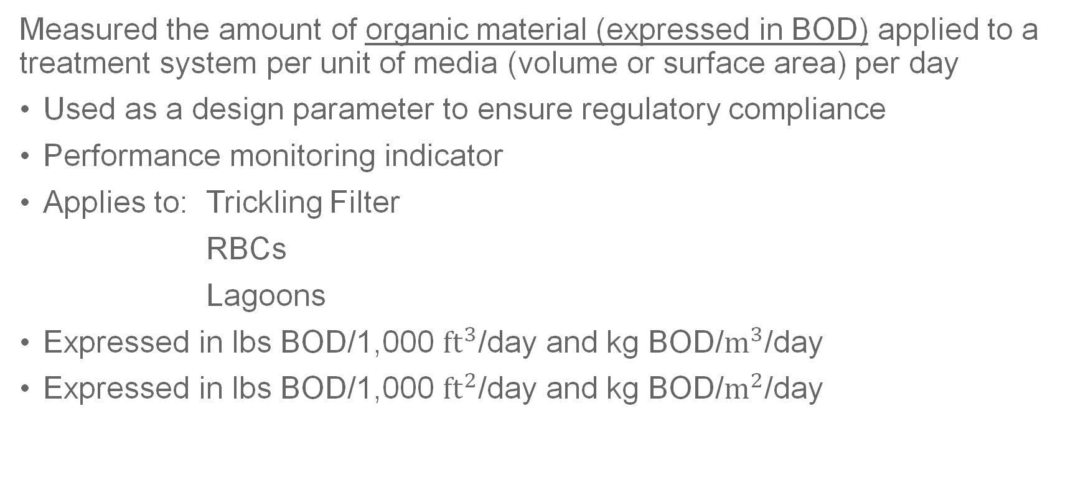
Organic Loading Rate
Measured the amount of organic material (expressed in BOD) applied to a treatment system per unit of media (volume or surface area) per day
Used as a design parameter to ensure regulatory compliance
Performance monitoring indicator
Applies to: Trickling Filter
RBCs
Lagoons
Expressed in lbs BOD/1,000 ${ft}^{3}$/day and kg BOD/$m^{3}$/day
Expressed in lbs BOD/1,000 ${ft}^{2}$/day and kg BOD/$m^{2}$/day

Slide 18
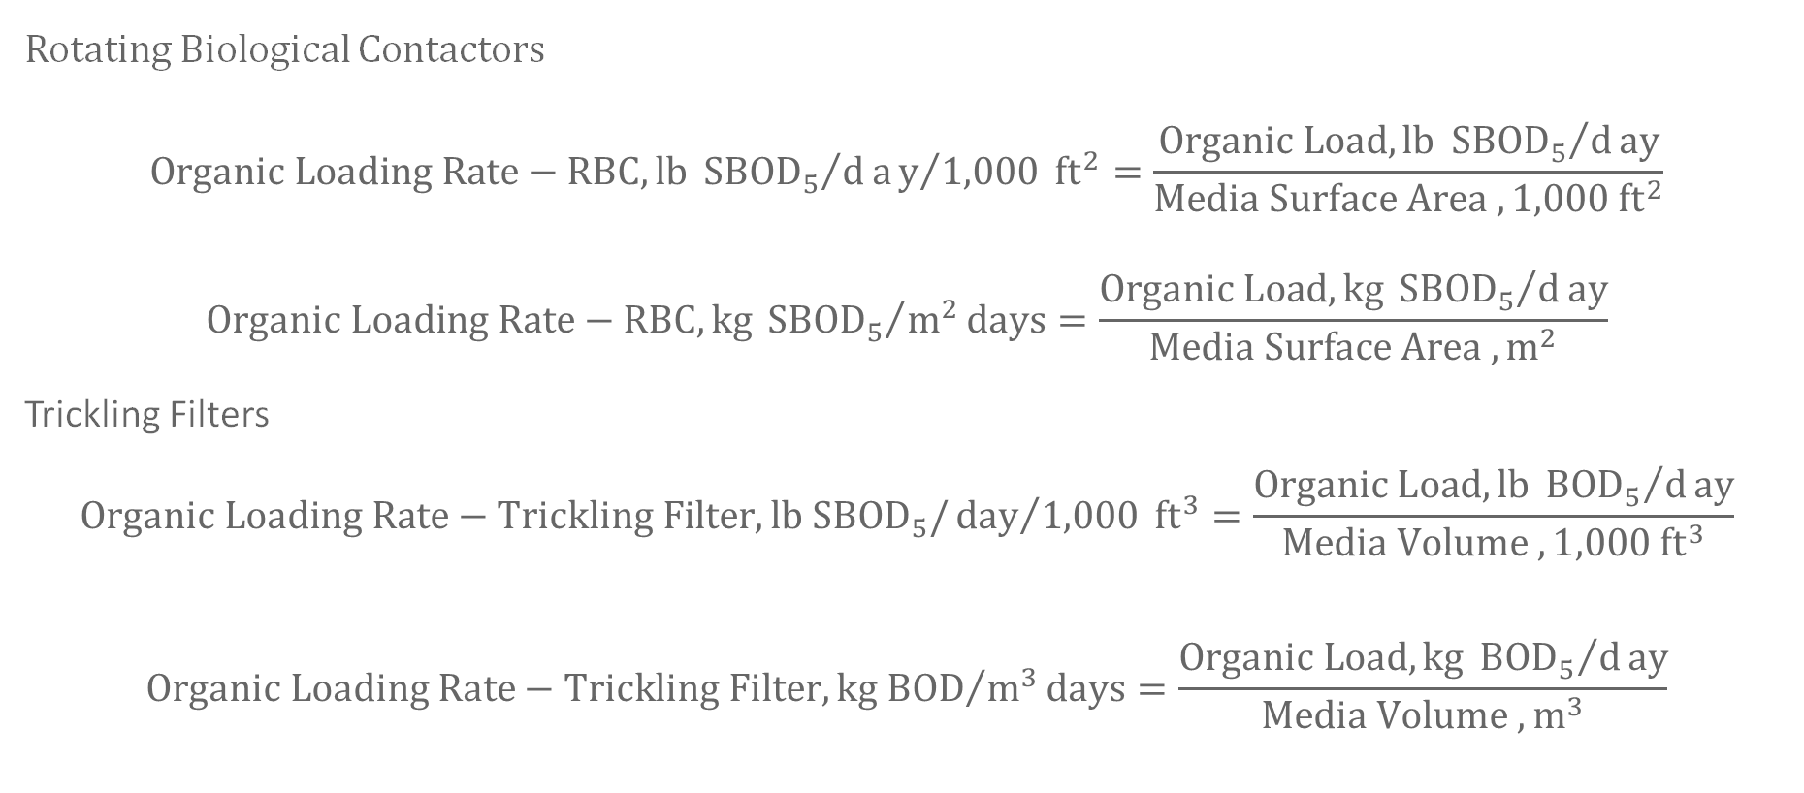
Organic Loading Rate Equations
Rotating Biological Contactors
$$Organic Loading Rate−RBC,lb {{SBOD}_{5}}/day/{1,000} {ft}^{2}=\frac{Organic Load,lb {{SBOD}_{5}}/day}{Media Surface Area ,1,000 {ft}^{2}}$$
$$Organic Loading Rate−RBC,kg {{SBOD}_{5}}/{m^{2}}days=\frac{Organic Load,kg {{SBOD}_{5}}/day}{Media Surface Area , m^{2}}$$
Trickling Filters
$$Organic Loading Rate−Trickling Filter,lb {SBOD}_{5}/{day}/{1,000} {ft}^{3}=\frac{Organic Load,lb {{BOD}_{5}}/day}{Media Volume ,1,000 {ft}^{3}}$$
$$Organic Loading Rate−Trickling Filter,{kg BOD}/{m^{3}}days=\frac{Organic Load,kg {{BOD}_{5}}/day}{Media Volume , m^{3}}$$

Slide 19
Process Control Calculations
Notes:
60 Min
Likely 45 Minutes
SVI, F:M, MCRT/SRT, Return Sludge Rate
Optional Recirc Rates etc.

Slide 20
F:M Ratio
Represents the ratio of organic material (food) to the amount of microorganisms in a bioreactor
BOD concentration represents the food
MLVSS concentration represents the microorganisms
Monitoring the F:M ratio is essential to ensure that bioreactors are treating wastewater correctly and permit requirements are met
Low F:M ratios limit microbial populations and decrease wastewater treatment
High F:M ratios lead to excessive sludge production
The F:M ratio inversely correlates with the SRT/MCRT
Notes:
Represents the amount of organic material (food) entering a bioreactor compared to the mass of microorganisms available to consume the organic material
BOD concentration represents the food in the reactor
And MLVSS concentration represents the microorganisms in the reactor
Monitoring the F:M ratio is essential to ensure that bioreactors are treating wastewater correctly and permit requirements are met
Low F:M ratios limit microbial populations and decrease wastewater treatment
High F:M ratios lead to excessive sludge production, which can lead to treatment issues and contribute unwanted solids
The F:M ratio inversely correlates with the SRT/MCRT

Slide 21
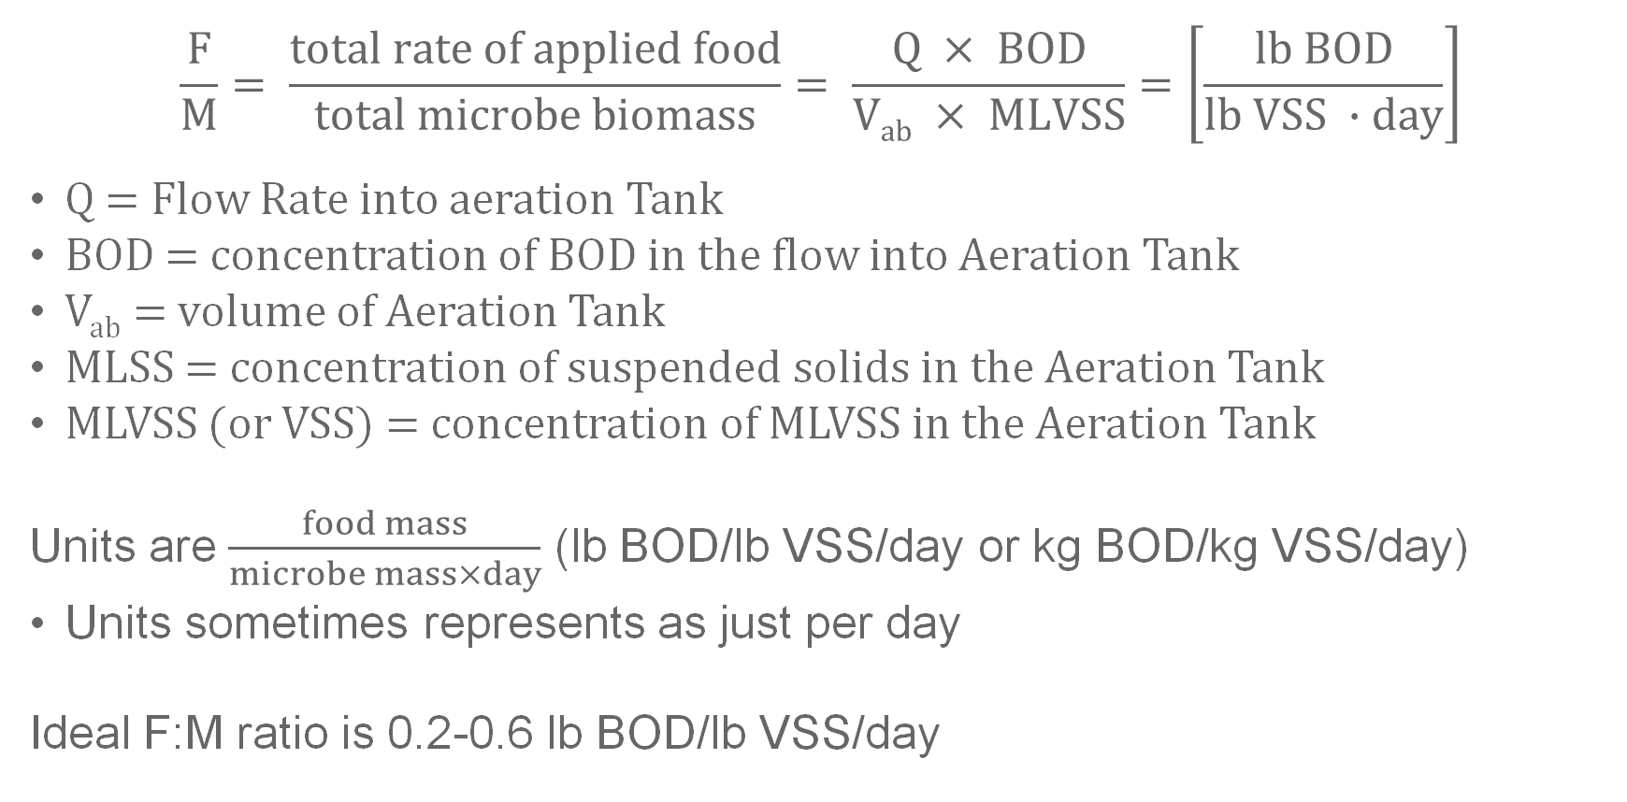
F:M Ratio Equation
$$\frac{F}{M}= \frac{total rate of applied food}{total microbe biomass}= \frac{Q × BOD}{Vab × MLVSS}=\left[\frac{lb BOD}{lb VSS ∙day}\right]$$
Q = Flow Rate into aeration Tank
BOD = concentration of BOD in the flow into Aeration Tank
V_{ab} = volume of Aeration Tank
MLSS = concentration of suspended solids in the Aeration Tank
MLVSS (or VSS) = concentration of MLVSS in the Aeration Tank
Units are $\frac{food mass}{microbe mass×day}$ (lb BOD/lb VSS/day or kg BOD/kg VSS/day)
Units sometimes represents as just per day
Ideal F:M ratio is 0.2-0.6 lb BOD/lb VSS/day
Notes:
V
Mixed liquor suspended solids
Mixed liquor volatile suspended solids
We don’t always know what the MLVSS is.
In the field you can collect sample and during analysis the lab will volatize the MLSS solids to determine the MLVSS concentration
But in the testing environment this should be provided.
MLVSS is usually 60-80% of the MLSS

Slide 22
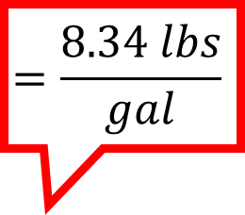
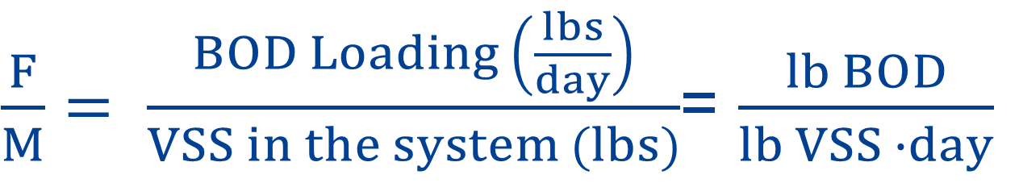
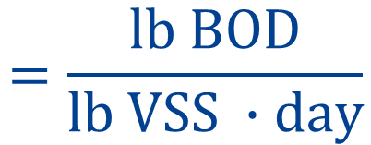
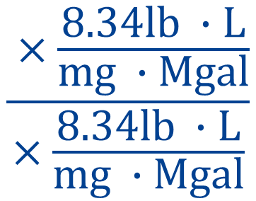
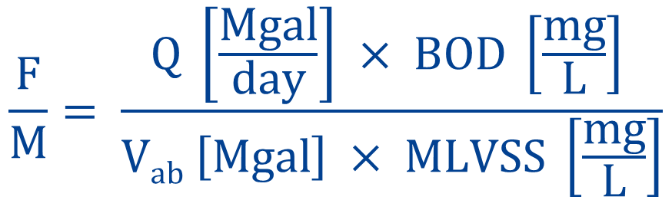
F/M Ratio Units
$$\frac{F}{M}= \frac{total rate of applied food}{total microbe biomass}= \frac{Q × BOD}{Vab × MLVSS}=\left[\frac{lb BOD}{lb VSS ∙day}\right]$$
$$=\frac{8.34 lbs}{gal}$$
$$\frac{F}{M}= \frac{Q \left[\frac{Mgal}{day}\right] × BOD \left[\frac{mg}{L}\right] }{Vab \left[Mgal\right] × MLVSS \left[\frac{mg}{L}\right]}$$
$$\frac{ ×\frac{8.34lb ∙L}{mg ∙Mgal}}{×\frac{8.34lb ∙L}{mg ∙Mgal}}$$
$$=\frac{lb BOD}{lb VSS ∙day}$$
$\frac{F}{M}= \frac{BOD Loading \left(\frac{lbs}{day}\right)}{VSS in the system (lbs)}$= $\frac{lb BOD}{lb VSS ∙day}$
Notes:
These calculations seem a little complicated because we’re dealing with a lot of different units. BOD and MLSS are going to be measured in mg/L. but flow will typically be in gallons or MG/day and tank volume will also be in Gal or MG.
As you can see here the equation resembles that BOD loading right off the bat, but it seems like the unit conversion is more complicated. I think this is a little extra work for no reason, but it is notable since it is how the F/M equation is presented in the sacremento guide.
I honestly don’t know why they do this, because it is the same thing as 8.34 lbs/ gal but with more steps.
The Liter over milligrams is the reciprocal to ppm and just cancels the million in the million gallon or MG.
And in the rest of the equation everything cancels out. The MG at top and bottom and mg/L at the top and bottom.
You can do the math using the conversion factors, but you’ll have the same factors it the top and bottom of the fraction so they cancel out and all we’re left with is days.
The end result is expressed as lbs/lbs, or kg/kg or ton over ton – we’re just using lbs here because it’s the most common unit we’ll see in the US, but that tends not to matter as those units canel out.
And really really what we get is a unitless ratio per day.
Finally this is what the equation looks like in our most common formula sheet associated with ABC testing

Slide 23

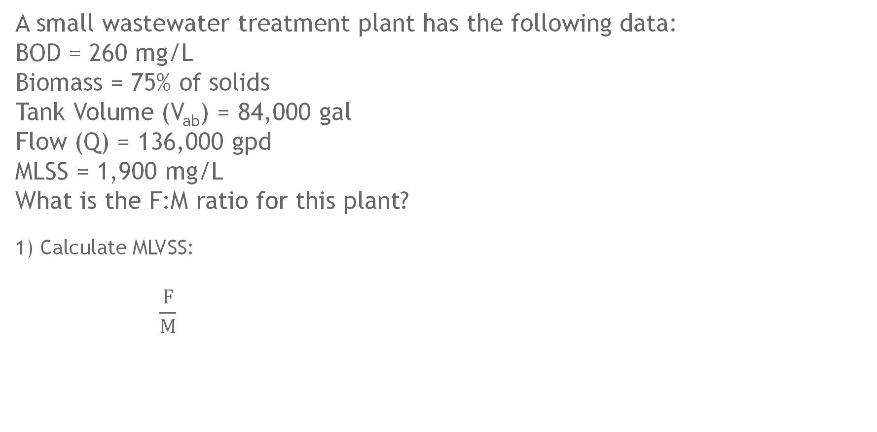

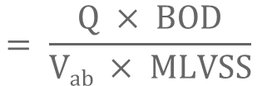

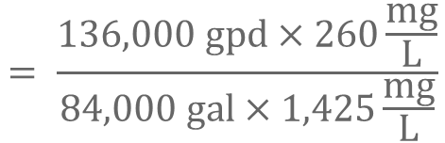

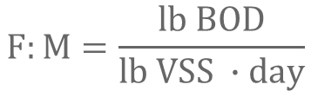
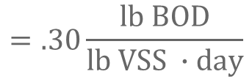

F:M Ratio Example
A small wastewater treatment plant has the following data:
BOD = 260 mg/L
Biomass = 75% of solids
Tank Volume (V_{ab}) = 84,000 gal
Flow (Q) = 136,000 gpd
MLSS = 1,900 mg/L
What is the F:M ratio for this plant?
1) Calculate MLVSS:
$$\frac{F}{M}$$
$$F:M=\frac{lb BOD}{lb VSS ∙day}$$
$$=75\% × MLSS concentration$$
$$=75\% ×1,900\frac{mg}{L}$$
$$=1,425\frac{mg}{L}$$
$$MLVSS$$
$$=?$$
$$= \frac{Q × BOD}{Vab × MLVSS}$$
$$= \frac{136,000 gpd×260\frac{mg}{L}}{84,000 gal×1,425\frac{mg}{L}}$$
$$=.30\frac{lb BOD}{lb VSS ∙day}$$
Notes:
point out gallon and MG

Slide 24
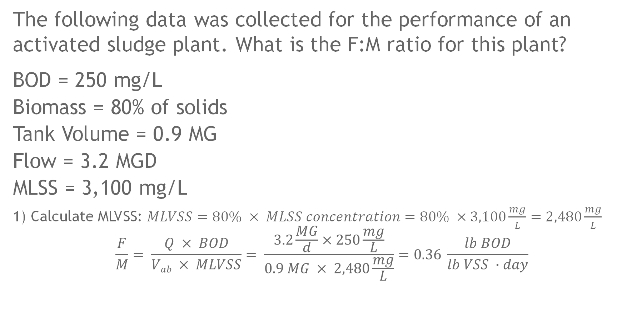
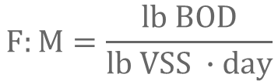
F:M Ratio Practice Problem
The following data was collected for the performance of an activated sludge plant. What is the F:M ratio for this plant?
BOD = 250 mg/L
Biomass = 80% of solids
Tank Volume = 0.9 MG
Flow = 3.2 MGD
MLSS = 3,100 mg/L
1) Calculate MLVSS: $MLVSS=80\% × MLSS concentration=80\% ×3,100\frac{mg}{L}=2,480\frac{mg}{L}$
$$\frac{F}{M}= \frac{Q × BOD}{Vab × MLVSS}= \frac{3.2\frac{MG}{d}×250\frac{mg}{L}}{0.9 MG × 2,480\frac{mg}{L}}=0.36 \frac{lb BOD}{lb VSS ∙day}$$
$$F:M=\frac{lb BOD}{lb VSS ∙day}$$
Notes:
3.2 MGD
The numerator
2,480 mg/L
0.36

Slide 25
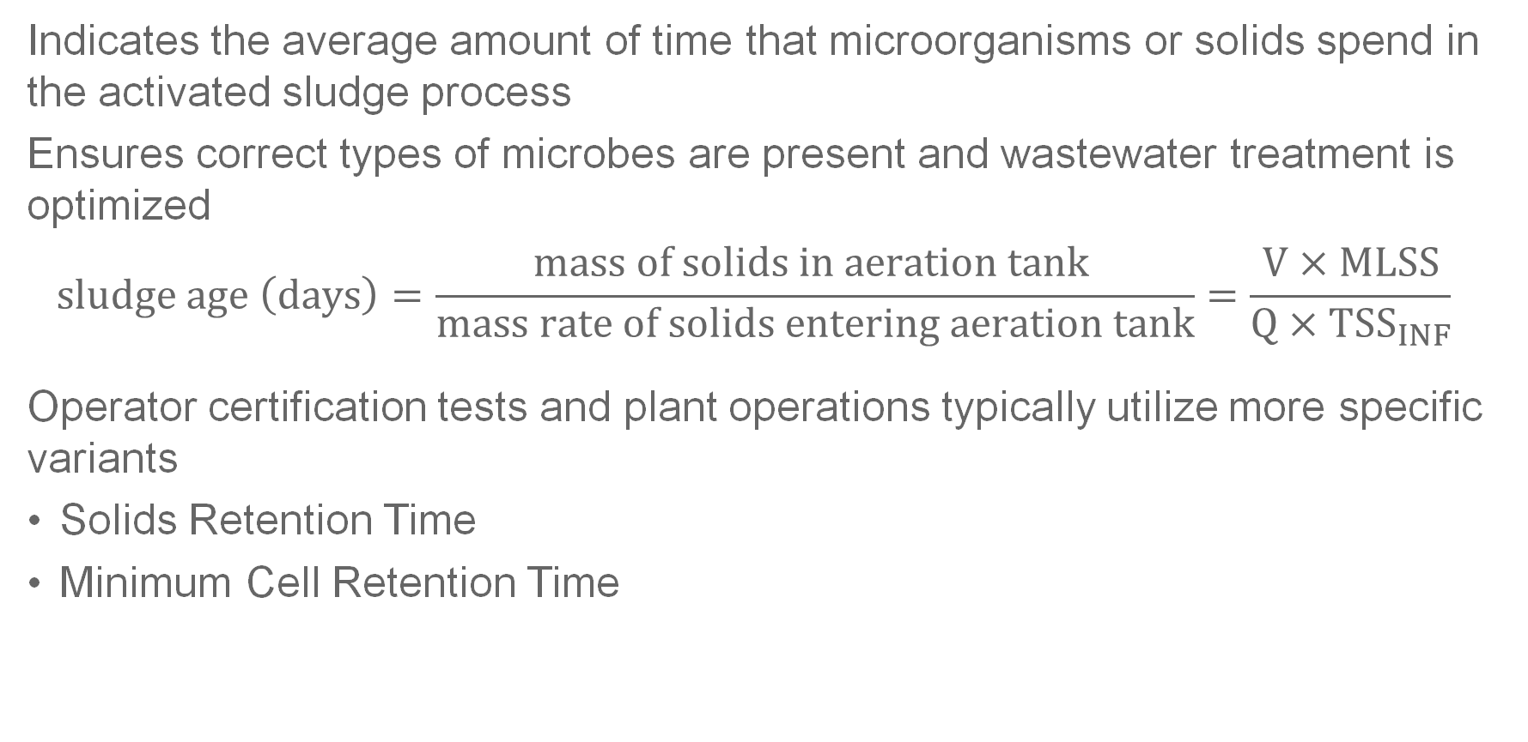
Sludge Age
Indicates the average amount of time that microorganisms or solids spend in the activated sludge process
Ensures correct types of microbes are present and wastewater treatment is optimized
$$sludge age \left(days\right)=\frac{mass of solids in aeration tank }{mass rate of solids entering aeration tank}=\frac{V×MLSS}{Q×{TSS}_{INF}}$$
Operator certification tests and plant operations typically utilize more specific variants
Solids Retention Time
Minimum Cell Retention Time

Slide 26
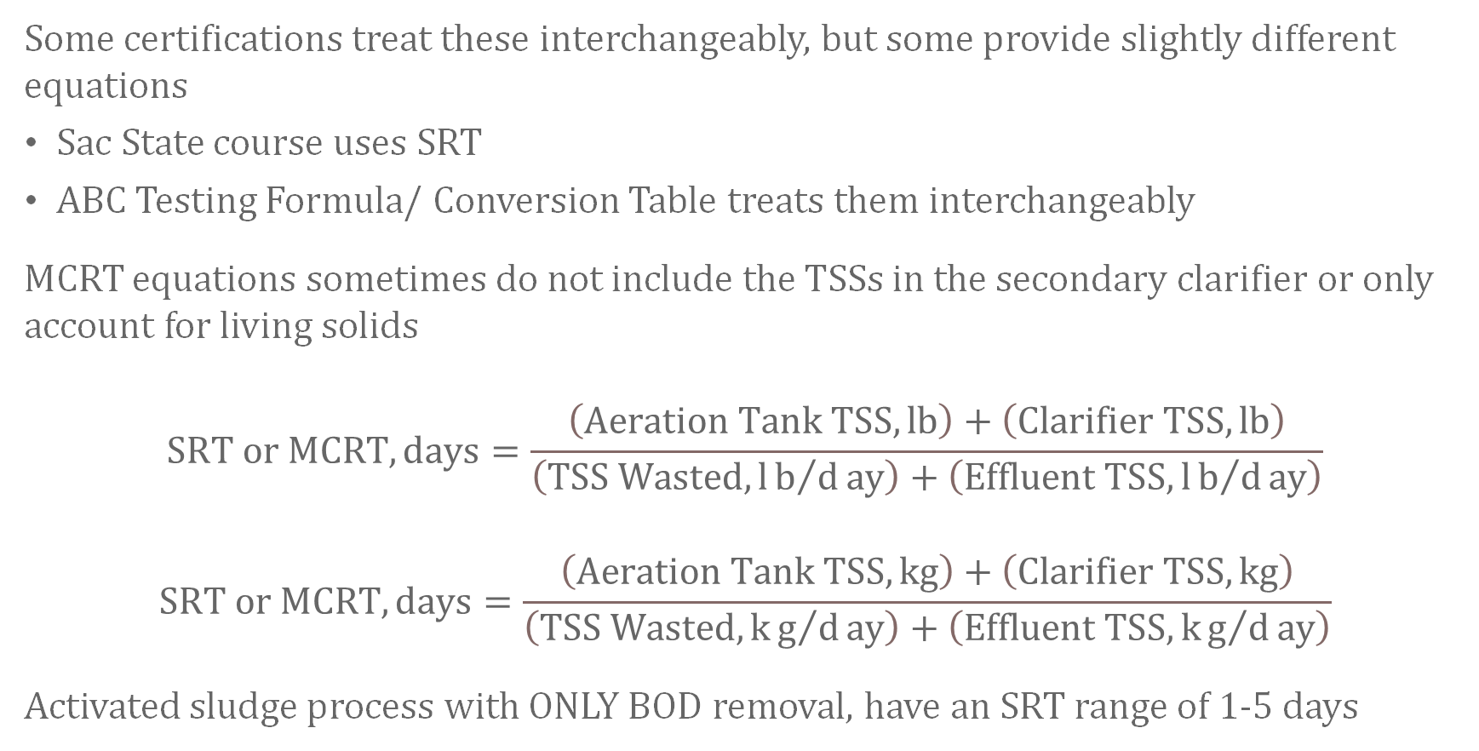
SRT vs MCRT
Some certifications treat these interchangeably, but some provide slightly different equations
Sac State course uses SRT
ABC Testing Formula/ Conversion Table treats them interchangeably
MCRT equations sometimes do not include the TSSs in the secondary clarifier or only account for living solids
$$SRT or MCRT,days=\frac{\left(Aeration Tank TSS,lb\right)+\left(Clarifier TSS,lb\right)}{\left(TSS Wasted,lb/day\right)+\left(Effluent TSS,lb/day\right)}$$
$$\text{S}\text{RT} \text{or} \text{MCRT},days=\frac{\left(Aeration Tank TSS,kg\right)+\left(Clarifier TSS,kg\right)}{\left(TSS Wasted,kg/day\right)+\left(Effluent TSS,kg/day\right)}$$
Activated sludge process with ONLY BOD removal, have an SRT range of 1-5 days

Slide 27
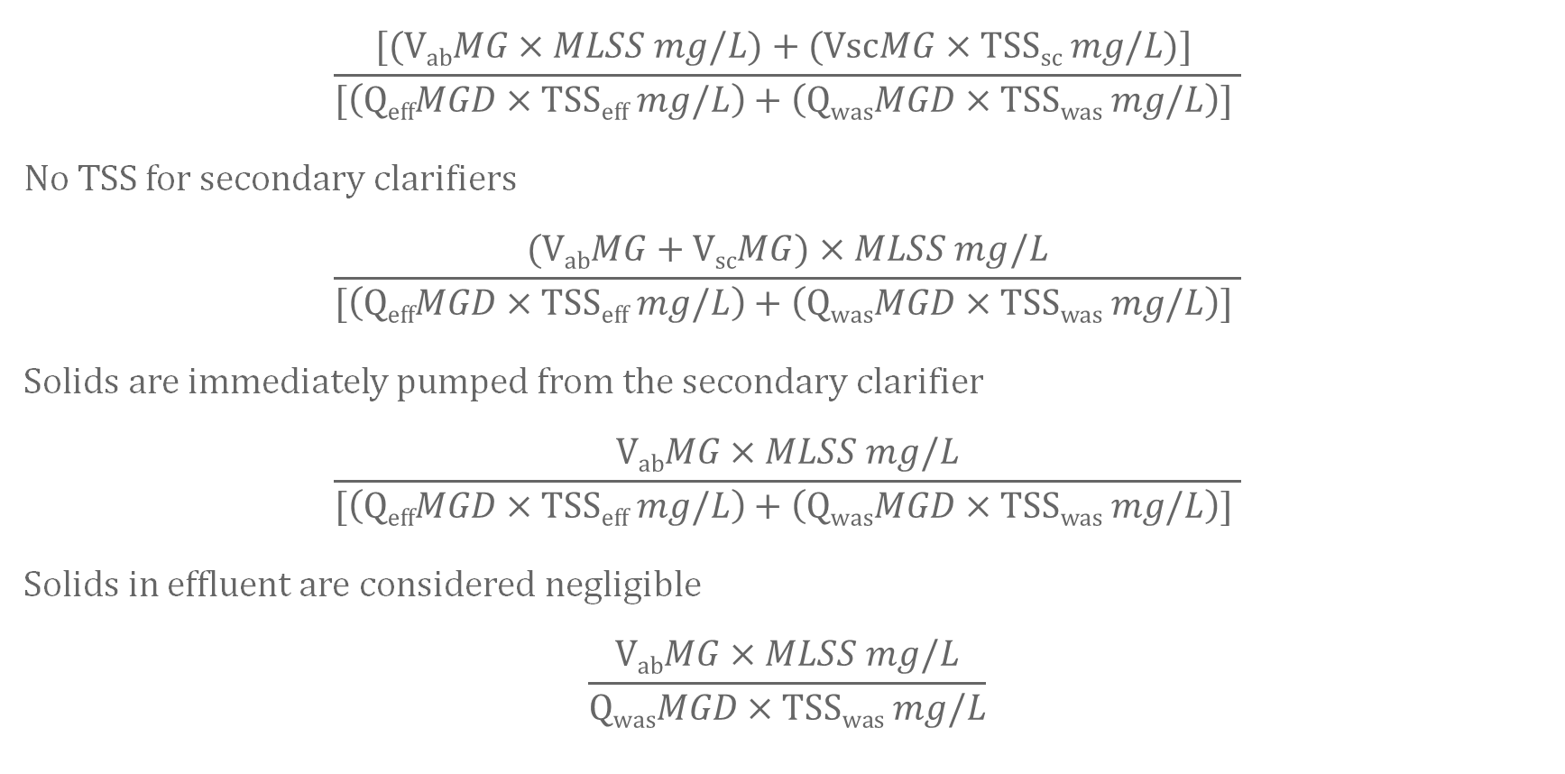
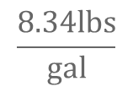
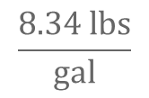
SRT Equation Adjustments
$$\frac{8.34 lbs}{gal}$$
$$\frac{[\text{(}\text{V}\text{ab}MG×MLSS mg/L)+\text{(}\text{Vsc}MG×\text{TSS}\text{sc} mg/L)] }{[\left(\text{Q}\text{eff}MGD×\text{TSS}\text{eff} mg/L\right)+\left(\text{Q}\text{was}MGD×\text{TSS}\text{was} mg/L\right)] }$$
No TSS for secondary clarifiers
$$\frac{\text{(}\text{V}\text{ab}MG+\text{V}\text{sc}MG)×MLSS mg/L}{[\left(\text{Q}\text{eff}MGD×\text{TSS}\text{eff} mg/L\right)+\left(\text{Q}\text{was}MGD×\text{TSS}\text{was} mg/L\right)] }$$
Solids are immediately pumped from the secondary clarifier
$$\frac{\text{V}\text{ab}MG×MLSS mg/L}{[\left(\text{Q}\text{eff}MGD×\text{TSS}\text{eff} mg/L\right)+\left(\text{Q}\text{was}MGD×\text{TSS}\text{was} mg/L\right)] }$$
Solids in effluent are considered negligible
$$\frac{\text{V}\text{ab}MG×MLSS mg/L}{\text{Q}\text{was}MGD×\text{TSS}\text{was} mg/L}$$
$$\frac{8.34lbs}{gal}$$

Slide 28
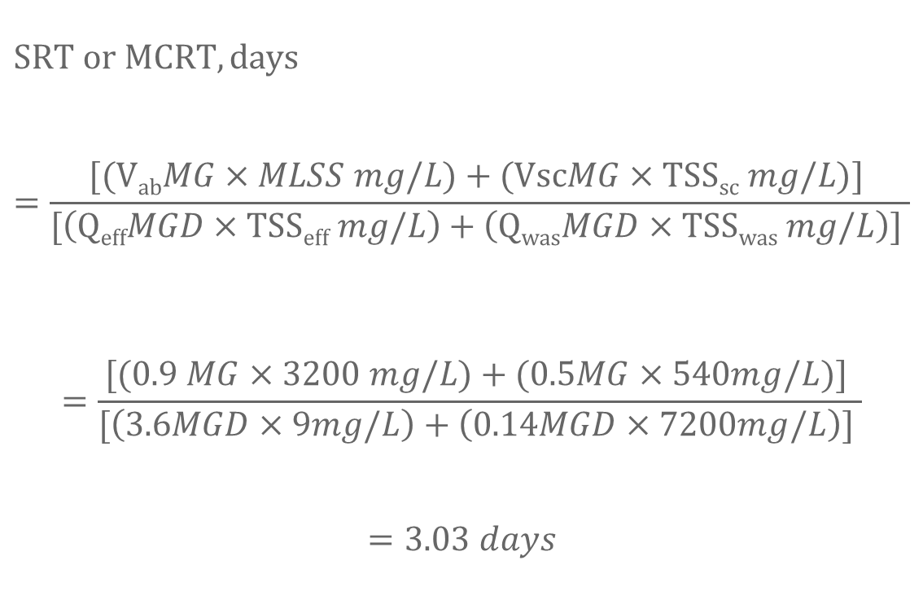
SRT Example 1
Given the following data for an activated sludge process, calculate the SRT.
$$SRT or MCRT,days=\frac{[\text{(}\text{V}\text{ab}MG×MLSS mg/L)+\text{(}\text{Vsc}MG×\text{TSS}\text{sc} mg/L)] }{[\left(\text{Q}\text{eff}MGD×\text{TSS}\text{eff} mg/L\right)+\left(\text{Q}\text{was}MGD×\text{TSS}\text{was} mg/L\right)] }$$
$$=\frac{[\text{(0.9 }MG×3200 mg/L)+\text{(0.5}MG×\text{540}mg/L)] }{[\left(\text{3.6}MGD×\text{9}mg/L\right)+\left(\text{0.14}MGD×\text{7200}mg/L\right)] }$$
$$=3.03 days$$
Aeration Basin Volume | V_{ab} | 0.9 MG
Secondary Clarifier Volume | V_{sc} | 0.5 MG
Influent Flow | Q | 3.6 MGD
Waste Sludge Flow | Q_{WAS} | 0.14 MGD
Mixed Liquor Suspended Solids | MLSS | 3200 mg/L
Waste Sludge Suspended Solids | TSS_{WAS} | 7000 mg/L
Final Effluent Suspended Solids | TSS_{eff} | 9 mg/L
Secondary Clarifier Suspended Solids | TSS_{sc} | 540 mg/L

Slide 29
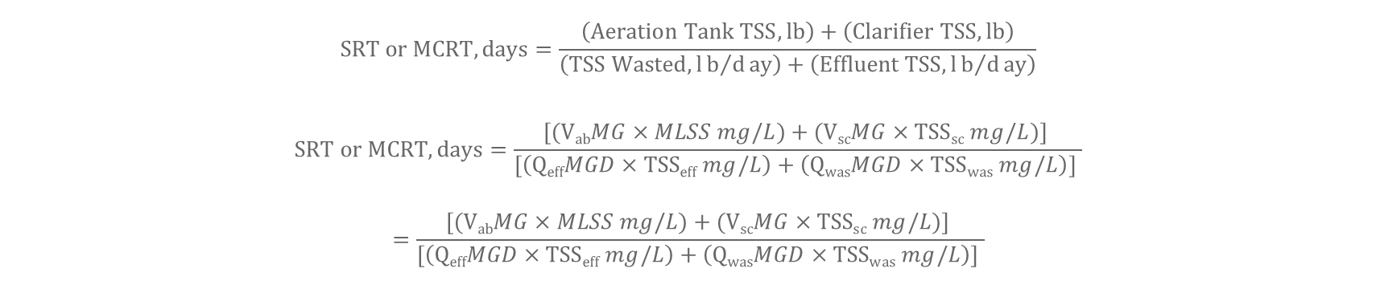
SRT Example 2
You have been asked to calculate the MCRT of a small wastewater treatment plant with an average daily flow of 1,000,000 GPD. You are given design specifications for the plant, which indicates that the volume of the aeration tank is 380,000 gallons, and the volume of the secondary clarifier is 95,000 gallons. You run some analysis to find the remaining values needed to calculate the MCRT for the plant. Using the treatment parameters provided below, calculate the MCRT for the plant and identify if this is in the desired range for a conventional activated sludge treatment plant:
$$SRT or MCRT,days=\frac{\left(Aeration Tank TSS,lb\right)+\left(Clarifier TSS,lb\right)}{\left(TSS Wasted,lb/day\right)+\left(Effluent TSS,lb/day\right)}$$
$$SRT or MCRT,days=\frac{[\text{(}\text{V}\text{ab}MG×MLSS mg/L)+\text{(}\text{V}\text{sc}MG×\text{TSS}\text{sc} mg/L)] }{[\left(\text{Q}\text{eff}MGD×\text{TSS}\text{eff} mg/L\right)+\left(\text{Q}\text{was}MGD×\text{TSS}\text{was} mg/L\right)] }$$
$$=\frac{[\text{(}\text{V}\text{ab}MG×MLSS mg/L)+\text{(}\text{V}\text{sc}MG×\text{TSS}\text{sc} mg/L)] }{[\left(\text{Q}\text{eff}MGD×\text{TSS}\text{eff} mg/L\right)+\left(\text{Q}\text{was}MGD×\text{TSS}\text{was} mg/L\right)] }$$

Slide 30
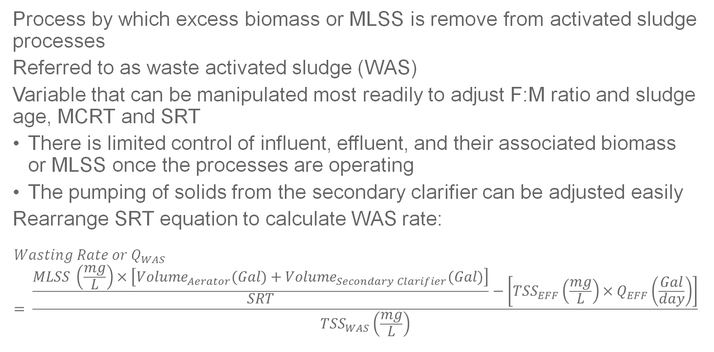
Sludge Wasting
Process by which excess biomass or MLSS is remove from activated sludge processes
Referred to as waste activated sludge (WAS)
Variable that can be manipulated most readily to adjust F:M ratio and sludge age, MCRT and SRT
There is limited control of influent, effluent, and their associated biomass or MLSS once the processes are operating
The pumping of solids from the secondary clarifier can be adjusted easily
Rearrange SRT equation to calculate WAS rate:
$$Wasting Rate or Q_{WAS}= \frac{\frac{MLSS \left(\frac{mg}{L}\right)×\left[{Volume}_{Aerator}(Gal)+{Volume}_{Secondary Clarifier}(Gal)\right]}{SRT}−\left[{TSS}_{EFF}\left(\frac{mg}{L}\right)×Q_{EFF}\left(\frac{Gal}{day}\right)\right]}{{TSS}_{WAS}\left(\frac{mg}{L}\right)}$$

Slide 31
Sludge Wasting Rate Example
Data was collected for a conventional activated sludge plant that is experiencing decreased treatment efficiency and is provided below. To decrease the sludge age of the microbial population in the the plant manager would like to decrease the SRT to 6 days to more closely resemble the design specifications. What should the target sludge wasting rate be to accomplish this?
Aeration Basin Volume | V_{ab} | 0.60 MG
Secondary Clarifier Volume | V_{sc} | 0.22 MG
Influent Flow | Q | 1.9 MGD
Waste Sludge Flow | Q_{WAS} | 29,000 gpd
Mixed Liquor Suspended Solids | MLSS | 3600 mg/L
Waste Sludge Suspended Solids | TSS_{WAS} | 6600 mg/L
Final Effluent Suspended Solids | TSS_{eff} | 14 mg/L

Slide 32
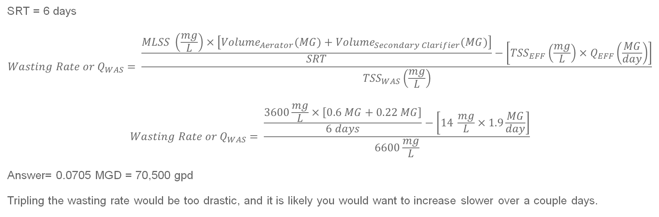
Sludge Wasting Rate Example Cont’d
Aeration Basin Volume | V_{ab} | 0.60 MG
Secondary Clarifier Volume | V_{sc} | 0.22 MG
Influent Flow | Q | 1.9 MGD
Waste Sludge Flow | Q_{WAS} | 29,000 gpd
Mixed Liquor Suspended Solids | MLSS | 3600 mg/L
Waste Sludge Suspended Solids | TSS_{WAS} | 6600 mg/L
Final Effluent Suspended Solids | TSS_{eff} | 14 mg/L
SRT = 6 days
$$Wasting Rate or Q_{WAS}= \frac{\frac{MLSS \left(\frac{mg}{L}\right)×\left[{Volume}_{Aerator}(MG)+{Volume}_{Secondary Clarifier}(MG)\right]}{SRT}−\left[{TSS}_{EFF}\left(\frac{mg}{L}\right)×Q_{EFF}\left(\frac{MG}{day}\right)\right]}{{TSS}_{WAS}\left(\frac{mg}{L}\right)}$$
$$Wasting Rate or Q_{WAS}= \frac{\frac{3600\frac{mg}{L}×\left[0.6 MG+0.22 MG\right]}{6 days}−\left[14 \frac{mg}{L}×1.9\frac{MG}{day}\right]}{6600\frac{mg}{L}}$$
Answer= 0.0705 MGD = 70,500 gpd
Tripling the wasting rate would be too drastic, and it is likely you would want to increase slower over a couple days.
Notes:
What do we use for the effluent flow if it isn’t explicitly given?
What is .60 MG in gal
What is .22 MG in gal
What is 1.9 MGD in gpd

Slide 33
Sludge Wasting Rate Practice
Data was collected for a conventional activated sludge plant that is experiencing decreased treatment efficiency and is provided below. To decrease the sludge age of the microbial population in the the plant manager would like to decrease the SRT to 7 days to more closely resemble the design specifications. What should the target sludge wasting rate be to accomplish this?
Aeration Basin Volume | V_{ab} | 0.60 MG
Secondary Clarifier Volume | V_{sc} | 0.22 MG
Influent Flow | Q | 2.0 MGD
Waste Sludge Flow | Q_{WAS} | 29,000 gpd
Mixed Liquor Suspended Solids | MLSS | 2400 mg/L
Waste Sludge Suspended Solids | TSS_{WAS} | 12000 mg/L
Final Effluent Suspended Solids | TSS_{eff} | 9 mg/L

Slide 34
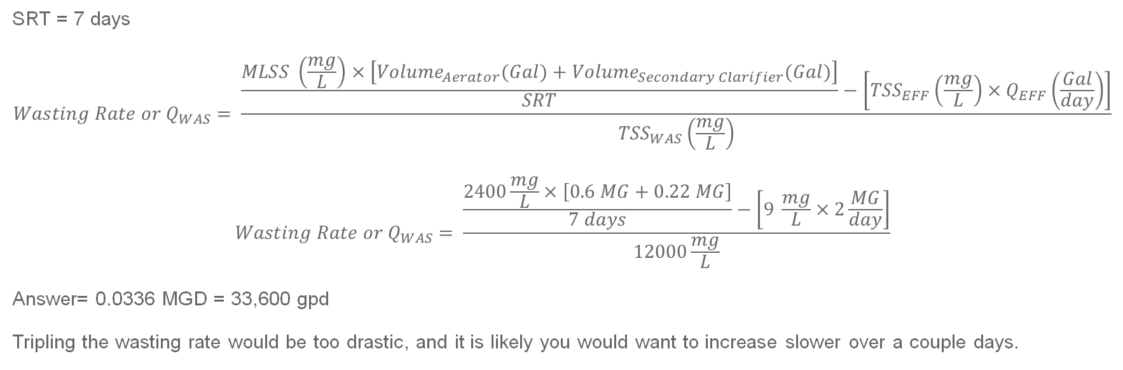
Sludge Wasting Rate Practice
Aeration Basin Volume | V_{ab} | 0.60 MG
Secondary Clarifier Volume | V_{sc} | 0.22 MG
Influent Flow | Q | 2.0 MGD
Waste Sludge Flow | Q_{WAS} | 29,000 gpd
Mixed Liquor Suspended Solids | MLSS | 2400 mg/L
Waste Sludge Suspended Solids | TSS_{WAS} | 12000 mg/L
Final Effluent Suspended Solids | TSS_{eff} | 9 mg/L
SRT = 7 days
$$Wasting Rate or Q_{WAS}= \frac{\frac{MLSS \left(\frac{mg}{L}\right)×\left[{Volume}_{Aerator}(Gal)+{Volume}_{Secondary Clarifier}(Gal)\right]}{SRT}−\left[{TSS}_{EFF}\left(\frac{mg}{L}\right)×Q_{EFF}\left(\frac{Gal}{day}\right)\right]}{{TSS}_{WAS}\left(\frac{mg}{L}\right)}$$
$$Wasting Rate or Q_{WAS}= \frac{\frac{2400\frac{mg}{L}×\left[0.6 MG+0.22 MG\right]}{7 days}−\left[9 \frac{mg}{L}×2\frac{MG}{day}\right]}{12000\frac{mg}{L}}$$
Answer= 0.0336 MGD = 33,600 gpd
Tripling the wasting rate would be too drastic, and it is likely you would want to increase slower over a couple days.
Notes:
1.9 MGD
600,000 gal
33,600 gpd
0.029 gpd

Slide 35
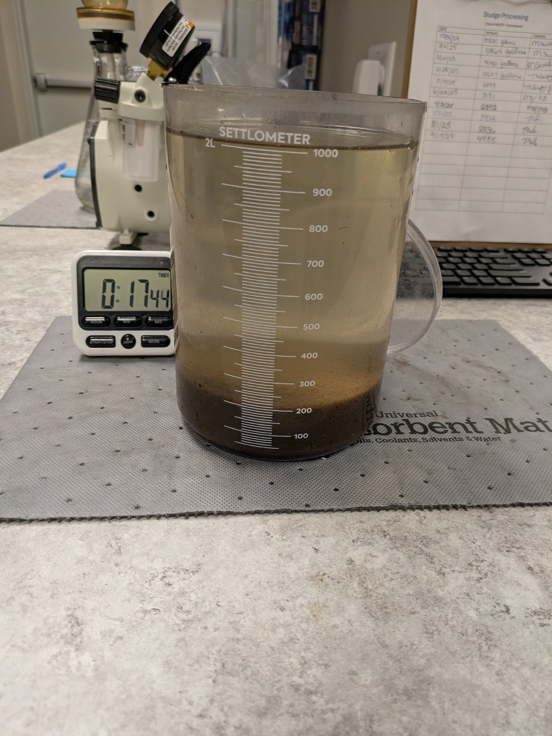
Sludge Volume Index (SVI)
SVI describes the settling of sludge
Measurement of the volume occupied by activated sludge after settling for 30 minutes
Tested in the lab using a settleability test
1-2 liters monitored in a beaker
The sample is allowed to sit for 30 minutes
Sludge volume recorded at 5 and 30 minutes
$$Sludge Volume Index,{mL}/g=\frac{\frac{V_{30}, mL}{V_{sample}, L}×1,000 mg/g}{MLSS, mg/L}$$
Notes:
SVI is a parameter used to describe the settling characteristics of sludge in the activated sludge process
Measurement of the volume occupied by activated sludge after setline in the aeration tank for 30 minutes
Tested in the lab using a settleability test
1-2 liters of activated sludge sample is place in a wide-mouthed clear cylinder beaker with clear, visible volume indicators
The sample is allowed to sit for 30 minutes
Sludge volume measurements are recorded at 5 and 30 minutes

Slide 36

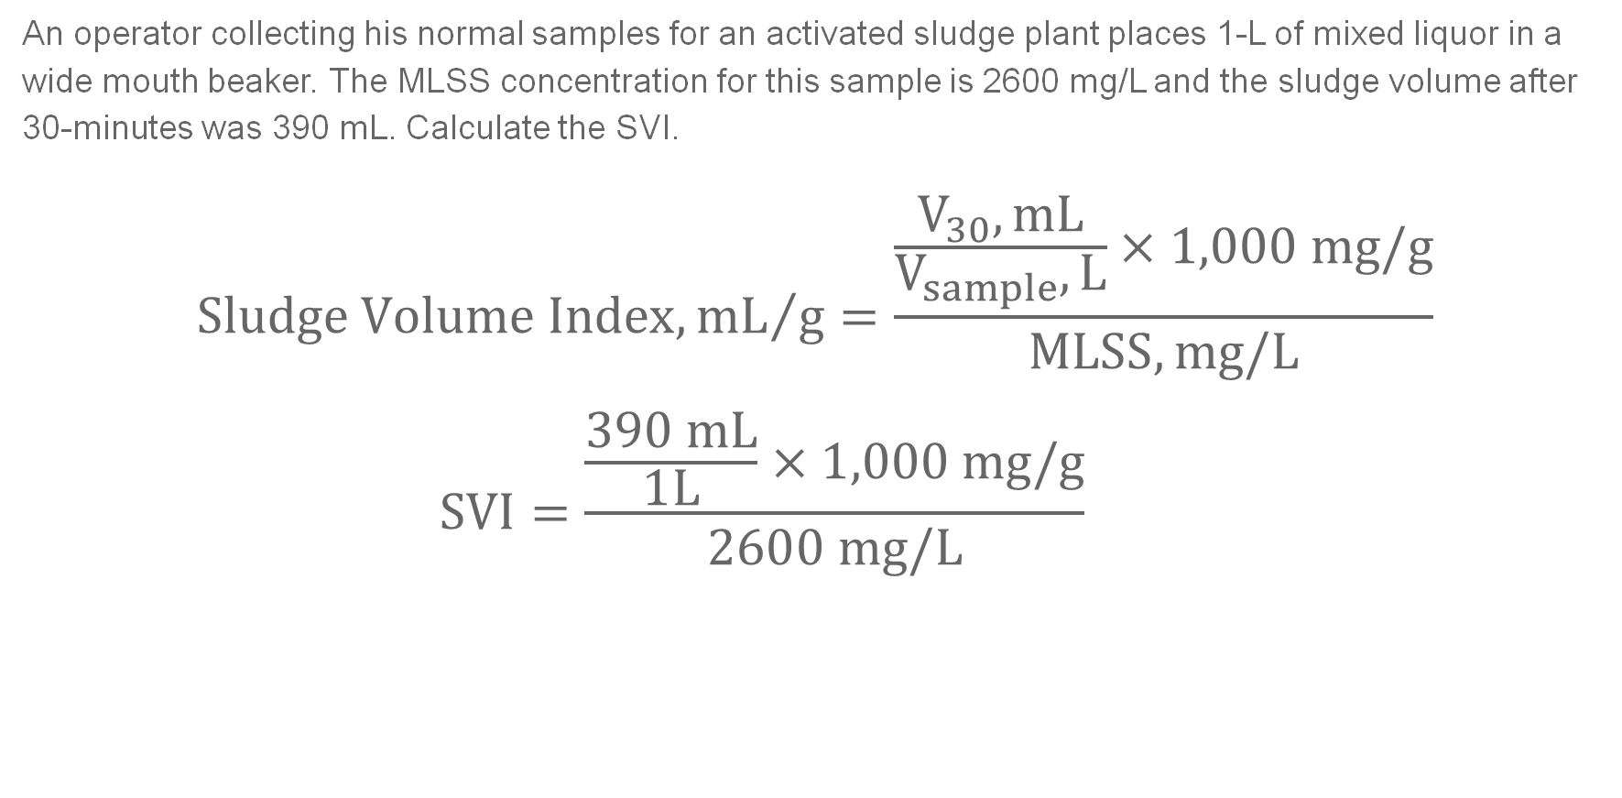
SVI Example
An operator collecting his normal samples for an activated sludge plant places 1-L of mixed liquor in a wide mouth beaker. The MLSS concentration for this sample is 2600 mg/L and the sludge volume after 30-minutes was 390 mL. Calculate the SVI.
$$Sludge Volume Index,{mL}/g=\frac{\frac{V_{30}, mL}{V_{sample}, L}×1,000 mg/g}{MLSS, mg/L}$$
$$SVI=\frac{\frac{390 mL}{1L}×1,000 mg/g}{2600 mg/L}$$
$$\text{=}\text{150 }\text{mL}\text{/}\text{g}$$

Slide 37

SVI Practice
An operator collecting his normal samples for an activated sludge plant places 2-L of mixed liquor in a wide mouth beaker. The MLSS concentration for this sample is 2900 mg/L and the sludge volume after 30-minutes was 487 mL. Calculate the SVI.
$$Sludge Volume Index,{mL}/g=\frac{\frac{V_{30}, mL}{V_{sample}, L}×1,000 mg/g}{MLSS, mg/L}$$
$$SVI=\frac{\frac{487 mL}{2L}×1,000 mg/g}{2900 mg/L}$$
$$\text{=}\text{84} \text{mL}\text{/}\text{g}$$
Notes:
2 L
84 mL/g

Slide 38
Final Thoughts
Practice!!!!!!
Become efficient with unit conversions
ALWAYS include units
Practice cancelling units

Slide 39
Questions?

Slide 40
CONTACT INFORMATION
Department of Civil Engineering MSC01 1070
1 University of New Mexico
Albuquerque, NM 87131
505-277-0644
swefc@unm.edu
http://swefc.unm.edu
A.J. Barney: ajbarney1@unm.edu

Slide 41
Basic Math Refresher
Notes:
30 Min

Slide 42
Need to know math concepts
Arithmetic (Addition, Subtraction, Multiplication, Division)
Order of operations (PEMDAS)
Basic algebra
Basic unit of measurements
Fractions, decimals, and percentages
Concentrations
Shapes
Area
Volume
Basic Statistics
Notes:
Arithmetic (Addition, Subtraction, Multiplication, Division)
Fractions, decimals, and percentages
Order of operations (PEMDAS)
Basic algebra- Inequalities and variables
Shapes
Basic unit of measurements-Understanding units of measurement are important to understand what you are looking and scaling for in the field and in the classroom

Slide 43
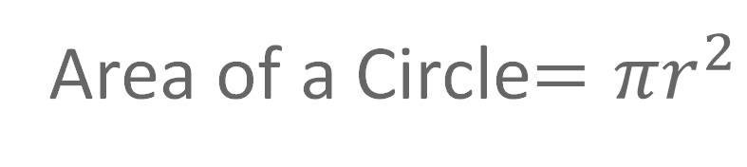
Order of Operations
P- Parentheses
E- Exponent
M- Multiplication
D- Division
A- Addition
S- Subtraction
Area of a Circle$=πr^{2}$

Slide 44
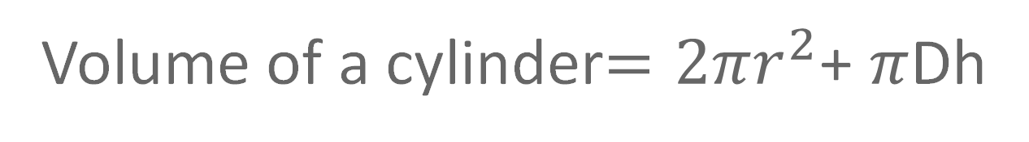
Order of Operations
P- Parentheses
E- Exponent
M- Multiplication
D- Division
A- Addition
S- Subtraction
Volume of a cylinder$=2πr^{2}$+ $π$Dh

Slide 45
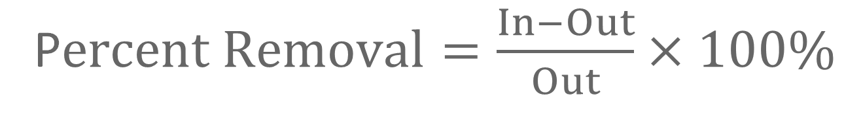
Order of Operations
P- Parentheses
E- Exponent
M- Multiplication
D- Division
A- Addition
S- Subtraction
P$ercent Removal=\frac{In−Out}{Out}×100\%$

Slide 46
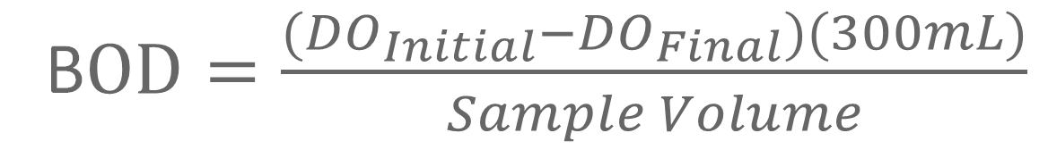
Order of Operations
P- Parentheses
E- Exponent
M- Multiplication
D- Division
A- Addition
S- Subtraction
B$OD=\frac{({DO}_{Initial}−{DO}_{Final})(300mL)}{Sample Volume}$

Slide 47
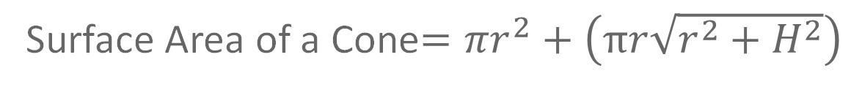
Order of Operations
P- Parentheses
E- Exponent
M- Multiplication
D- Division
A- Addition
S- Subtraction
Surface Area of a Cone$=πr^{2}+\left(πr\sqrt{r^{2}+H^{2}}\right)$

Slide 48



Basic Algebra
Understand:
Constants
Variables
How to identify the variables in a word problem
Ex. If your thermometer reads 100°C, what is the temperature in Fahrenheit?
$$℉=\left(1.8×℃\right)+32$$
$$℉=\left(1.8×100℃\right)+32$$
$$=212℉$$
Notes:
To excel in wastewater math we need to understand a few basic algebra principles.
The first is constants
Constants are fixed problems in algebra problems that serve as a reference point to calculate the correct solution. As the name suggests these stay constant whenever you use the questions. They are represented by set values.
This is highlighted here in the equation to calculate Fahrenheit.
Then there are variables, which are represented by a symbol and in the basic equation represents an unknown value. Variables take on different values depending on the information we find for the problem we are solving.
So in our same example our Fahrenheit and Celsius symbols represent our variables, and as you can see since the answer varies it is also a variable.
The other important algebra skill we need is understanding how to identify what information is a variable that we can use to solve our problem.
For example in our same problem what exactly are we trying to solve for?
And what information is given to solive it?
Solve for F
And we are given C

Slide 49
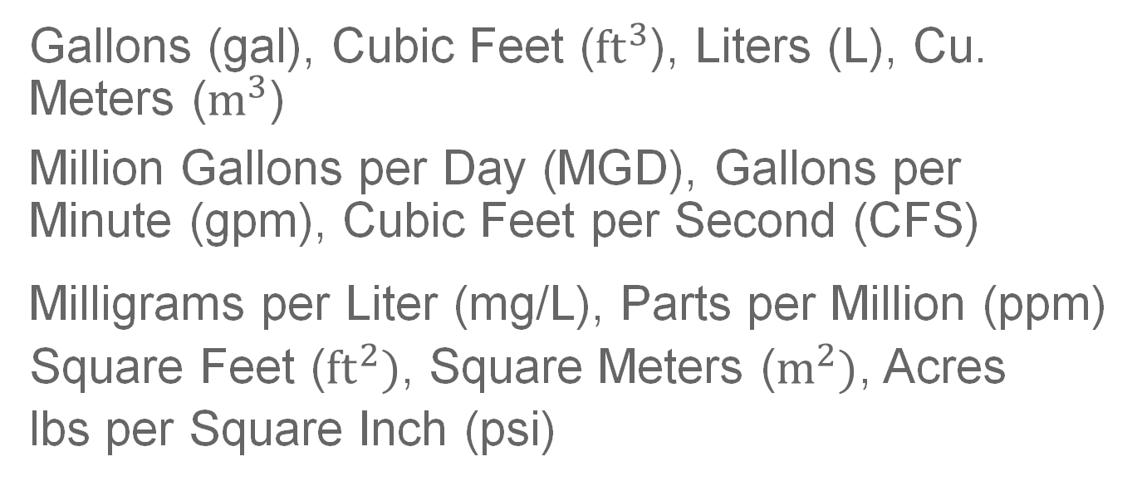
Units
Correct units ensure accuracy, consistency, correct communication, compliance, and safety in wastewater treatment
Common WW units:
Volume-
Flow-
Concentration-
Area-
Pressure-
Use units to determine if your answer makes sense!
Gallons (gal), Cubic Feet (${ft}^{3}$), Liters (L), Cu. Meters ($m^{3}$)
Million Gallons per Day (MGD), Gallons per Minute (gpm), Cubic Feet per Second (CFS)
Milligrams per Liter (mg/L), Parts per Million (ppm)
Square Feet (${ft}^{2})$, Square Meters ($m^{2})$, Acres
lbs per Square Inch (psi)
Notes:
So expanding on the concepts of units.
Units are important for a variety of other reasons
Including they^^^
Common WW units are used as measurements in wastewater math

Slide 50

Using Units to Identify Problem Solutions
Units can be used to solve word problems
Ex. If your thermometer reads 100°C, what is the temperature in Fahrenheit?
If you don’t know how to solve this problem you first try to identify a problem that includes the units we’re looking for.
$$℉=\left(1.8×℃\right)+32$$
Ex 2. An operator needs to determine the feed rate needed to provide a 10 mg/L chlorine dosage to a disinfection contact chamber. The operator knows that the average flow is 120,000 gpd and they are using a 13% strength solution of sodium chloride. What does the operator need to set the feed rate to in lbs/day?
Notes:
Units can and SHOULD be used as a strategy to help you solve WW math problems
Lets use our previous problem for example.
Lets practice this
First what are we trying to find?
Referring to our formulas sheets, does anyone see an equation we can use?
Do we have all of the inputs w
The need for the equation?

Slide 51
Using Units to Solve Wastewater Problems
Units can also be used to help identify the correct formula to use in wastewater problems
Ex. An operator needs to determine the feed rate needed to provide a 10 mg/L chlorine dosage to a disinfection contact chamber. The operator knows that the average flow is 120,000 gpd and they are using a 13% strength solution of sodium chloride. What does the operator need to set the feed rate to in lbs/day?
Notes:
If your problem

Slide 52

Fractions and Decimals
Used to represent parts of a whole
Units in the field are rarely whole numbers
Converting:
Fraction to decimals (divide the numerator by the denominator)
Ex. $\frac{1}{2}=1÷2=0.5$
Decimals to Fraction (write the decimal as a fraction, multiply the numerator and decimal by 100, simplify using the greatest common divisor.
Ex. $2.75=\frac{2.75×100}{1×100}=\frac{275÷25}{100÷25}=\frac{11}{4}$

Slide 53





Dividing by Fractions
Especially useful to understand unit conversions
When dividing by fractions the numerator and denominator trade place for the fraction we are dividing by
Then multiply by the reciprocal fraction
Ex. $21÷\frac{1}{2}=$
Ex. $Detention Time=\frac{gal}{\frac{gal}{day}}=$
**Bottom of the bottom becomes the top!!**
$$21×\frac{2}{1}=$$
$$42$$
$$gal×\frac{day}{gal}=$$
$$day$$

Slide 54

Units and Exponents
When adding units
Units don’t change
Units must be the same or compatible to add those variables together
$$Ex. 8 gal+11 gal=19 gal$$
Can add units that are different, but measure the same thing (i.e. volume)
Ex. Gallons and cubic feet (${ft}^{3}$) can be added together, but they require a unit conversion
Ex 2. Cubic feet and square feet (${ft}^{2}$) cannot be added, because they measure different things

Slide 55





Units and Exponents
When multiplying units you add the exponents together
Ex. ${ft}^{2}×ft=?$
$${ft}^{2}×ft={ft}^{2}×{ft}^{1}$$
$${ft}^{2}×ft={ft}^{2}×{ft}^{1}={ft}^{3}$$
When dividing units you subtract the exponent of the denominator from the numerator
Ex. $\frac{gal}{\frac{gal}{day}}=\frac{{gal}^{1}}{\frac{{gal}^{1}}{day}}$
$$→2+1=3$$
$$→\frac{{gal}^{1}}{\frac{{gal}^{1}}{day}}$$
$=\frac{1}{\frac{1}{day}}=day$
$$→1−1=0$$

Slide 56
Percentages
A way to express a number as a fraction of 100 using the percent symbol (%)
Intuitive way to demonstrate a ratio
In wastewater used to communicate removal efficiencies, concentrations, chemical dosages, resource recoveries, etc.

Slide 57
Converting Percentages into Decimals
65%
= 65/100
= 0.65
Remove the percentage sign
Divide the number by 100
Remove the percentage sign
Move decimal left two places
65%
= 0.65

Slide 58
Converting Decimals into Percentages
Multiply the decimal number by 100
Add the percentage sign
Move decimal right two places
Add the percent sign
0.65
= 0.65*100
= 65%
0.65
= 65%

Slide 59


Concentrations
The amount of a substance suspended or dissolved in a liquid
Used to measure the following in wastewater:
Nutrient Levels
Pollutants Levels
Effluent Quality
Chemical Dosing
Calculated by dividing the mass of the target substance by the volume of the liquid it is in
Measured in mg/L, ppm, µg/L, ppb, g/$m^{3}$, g/L
Understanding concentrations helps protect the public health and the environment
$$Solids Concentration,\frac{mg}{L}=\frac{Weight,mg}{Volume,L}$$

Slide 60

Calculating Concentration
An ammonia standard is creating by adding .5 mg of ammonia to .2 L of ultrapure water. What is the ammonia concentration of this solution?
$$Solids Concentration,\frac{mg}{L}=\frac{Weight,mg}{Volume,L}$$
$$Ammonia Concentration,\frac{mg}{L}=\frac{.5 mg}{.2 L}$$
$$=2.5\frac{mg}{L}$$
Notes:
Ammonia typically NH4Cl

Slide 61
Common Concentrations
TS
TSS
BOD
MLSS
MLVSS

Slide 62






Shapes
$$A=πr^{2}$$
Circumference = πD
Square
Rectangle
Triangle
Trapezoid
Circle
Cube
Rectangular Prism
Cylinder
Sphere
$$A=s×s$$
$$A=b×h$$
$$A=\frac{1}{2}b×h$$
$$A=b×h$$
s
h
h
h
r
r$=\frac{1}{2}D$
s
b
D$=2r$
b
b
Notes:
First we’ll start with shapes.
Wastewater processes come in all different shapes in sizes and it’s important to understand how to use them in wastewater calculations
These are the common shapes you’ll run into and they each have a different formula to calculate the area or volume.
For this slide we have a examples of the shapes you’ll see and how to calculate the areas for
Squares = side squared
Rectangle ””
Triangle “”
Circle “”
Then we will also need to the dimensions of the most common 3D shapes which are:
We’ll walk through solving some of these problems in just a little.

Slide 63
Shapes
$$A=πr^{2}$$
Circumference = πD
Square
Rectangle
Triangle
Trapezoid
Circle
Cube
Rectangular Prism
Cylinder
Sphere
r
r$=\frac{1}{2}D$
Notes:
First we’ll start with shapes.
Wastewater processes come in all different shapes in sizes and it’s important to understand how to use them in wastewater calculations
These are the common shapes you’ll run into and they each have a different formula to calculate the area or volume.
For this slide we have a examples of the shapes you’ll see and how to calculate the areas for
Squares = side squared
Rectangle ””
Triangle “”
Circle “”
Then we will also need to the dimensions of the most common 3D shapes which are:
We’ll walk through solving some of these problems in just a little.

Slide 64





Shapes
$$A=s×s$$
s
$$A=b×h$$
h
$$A=\frac{1}{2}b×h$$
h
Square
Rectangle
Triangle
Trapezoid
Circle
Cylinder
Cube
Rectangular Prism
Cylinder
Cone
s
b
b
h
$$A=πr^{2}$$
$$A=b×h$$
r
b

Slide 65

Surface Area
Area = Amount of space enclosed within a shapes boundaries
Measured in square units
Surface Area = Area of the surface of a 3D object
Surface Area of a Rectangle/ Square = L×W
Surface Area of a Circle = $πr^{2}$
$$A=b×h$$
h
b
$$A=πr^{2}$$
r
Notes:
Area measured the amount of space enclosed within the boundaries of a two dimensional shape.
Typically measured in square units

Slide 66
VOLUMES
Water and other fluid substances take on the shape of their container
Pipes
Clarifiers
Tanks
Excavations
Open reservoirs
Jars of homemade salsa

Slide 67

VOLUMES
Area of a circle = π x r²
Volume of a Cylinder = π x r² x Height
radius
Height
Height
Width
radius
radius
Length
Area of a rectangle = Length x Width
Volume of a rectangular Prism = Length x Width x Height
Notes:
Now volume measure the amount of space that an object takes up.
We explain volume by expanding on the concept of area.
For simple 3D objects that we use in wastewater calculations, we multiply our surface area by height.
It’s basically stacking up layers of the objects surface area up to the needed height.
For the volume of a rectangular prism which is the technical term for the shape of the rectangular tanks we use in wastewater operations.
As lon

Slide 68

VOLUME OF A BOX
Volume of a rectangular prism = Length x Width x Height
Example:
Height
4 ft
Volume = Length x Width x Height
Volume = 24 ft x 12 ft x 4 ft
Length
24 ft
Volume = 1152 ft³
Width
12 ft

Slide 69

Volume of a Rectangular Practice Problem
2
Find the volume of fill dirt in ft³ needed to replace an excavation that is 60 feet long, 3 feet wide, and 4 feet deep.
W = 3 ft
H = 4 ft
L = 60 ft
Vol = L x W x H
(A) 67 ft³
(B) 80 ft³
(C) 720 ft³
(D) 3460 ft³
Vol =60 ft x 3 ft x 4 ft
Vol = 720 ft³

Slide 70

VOLUME OF A CYLINDER
Volume of a cylinder = π × r² × Height
Volume of a cylinder = 0.785 × D² × Height
Diameter
20 ft
Example:
Radius
10 ft
Volume = π × r² × Height
Volume = 3.14 × (10 ft)² × 32 ft
Height
32 ft
Volume = 3.14 × 100 ft² × 32 ft
Volume = 10,048 ft³

Slide 71
Volume of a Cylinder Practice Problem
4
What is the volume in cubic feet for a clarifier that is 15 feet tall and has a diameter of 18 feet?
D = 18 ft
(A) 424 ft³
(B) 3815 ft³
(C) 38,150 ft³
(D) 179,776 ft³
Volume = π * r² * Height
R = 9 ft
Volume = 3.14 * (9 ft)² * 15 ft
H = 15 ft
Volume = 3.14 * 81 ft² * 15 ft
Volume = 3,815 ft³
Volume of a cylinder = π * r² * Height

Slide 72
Temperature
Many wastewater systems have temperature ranges they function in
Motors and pumps
Microbiological activity operates best in the Mesophilic range (20-40°C or 68-104°F)
Chemical reactions
Equipment may report temperature in different unit
$$Degrees Celsius=\frac{℉−32}{1.8}$$
$$Degrees Fahrenheit=\left(℃\right)\left(1.8\right)+32$$
Notes:
Motors and pumps must operate within a certain temperature range. Otherwise high temperatures may indicate something is wrong and can lead to issues.
Temperature changes call for operational changes in biological processes
Higher temperatures increase the reactions of most chemical reactions and certain compounds become more soluble at lower temperatures and can be settled out.
It’s important to understand what process can be manipulated with temperature changes or management.
Sometimes our equipment

Slide 73







Temperature Practice Problems
An operator measures the temperature of a solution they are mixing and find that the temperature of their mixture is 212°F. What is the temperature of their mixture in degrees Celsius.
$$Degrees Celsius=\frac{℉−32}{1.8}$$
The temperature of a digester that operates in the mesophilic range is measured to be 37°C. What is this temperature in degrees Fahrenheit?
$$Degrees Fahrenheit=\left(℃\right)\left(1.8\right)+32$$
$$=\frac{212−32}{1.8}$$
$$=\frac{180}{1.8}$$
$$=100°C$$
$$=\left(37\right)\left(1.8\right)+32$$
$$=66.6+32$$
$$=98.6°F$$
Notes:
Motors and pumps must operate within a certain temperature range. Otherwise high temperatures may indicate something is wrong and can lead to issues.
Temperature changes call for operational changes in biological processes
Higher temperatures increase the reactions of most chemical reactions and certain compounds become more soluble at lower temperatures and can be settled out.
It’s important to understand what process can be manipulated with temperature changes or management.
Sometimes our equipment

Slide 74
Significant Figures (Sig Figs)
Indicates the number of digits you should round your answer to for a calculated answer
Rule of thumb is to use the same number of digits as the variable with the least number of sig figs used in your calculation
Omit trailing 0s and initial 0s in a decimal.
Ex. $12,000,000→2 Sig Figs$ $0.00216→3 Sig Figs$
Ex. r=14 ft $A=3.14{(14 ft)}^{2}$
**Unlikely to be on your test, test answers will not be overly precise, and wrong answers will not be incorrect based on sig figs**
Sig Figs = 2

Slide 75
Unit Conversions and Davidson Pie Wheel
Notes:
30 Min 6 practice questions

Slide 76
Standard Unit Conversions
Process of changing one measurement unit to another
Min to Hours
Feet to Miles
Gallons to Liters
Requires a conversion factor
Calculated by lining up as fractions and multiplying across by the conversion factor
Unit conversions are required for standardization, simplification and to convert to the correct unit in many wastewater equations
Useful strategy for solving wastewater calculations

Slide 77
Common Water Math Conversions
Percent solution strength to decimal percent
Time
  Seconds to minutes to hours to days
Lengths
  Inches to feet
  Feet to miles
Volumes
  Cubic feet (ft³) to gallons
  Gallons to million gallons
Velocity
  ft/s to mph
Flow
  gpm to MGD

Slide 78
What is a conversion factor?
A numerical relationship used to when converting from one system of units to another
Ratio that expresses how many of one unit are equal to another
Formula Sheet

Slide 79

How do we use conversion factors?
Multiple your measurement by the conversion factor
What you’re really doing:
Turning the conversion factor into a fraction
Multiplying by one
1 gal = 3.79 Liters $\left(\frac{1gal}{3.79L}\right)$ = 1 $\left(\frac{3.79L}{1gal}\right)$ = 1
You can multiply anything by 1 and not change its quantity, only change the units.
Goal is to identify units that cancel out and result in desired units
Notes:
Unit conversions must be arranged correctly for units to

Slide 80
Example of unit conversion
Your Sodium Hypochlorite tank holds 40 gallons, but the store sells it by the liter. How many liters of Sodium Hypochlorite do you need to fill up your 40-gallon tank?
1 gal = 3.79 liters
40 gal $∗\left(\frac{3.79L}{1gal}\right)$
Units lined up to cancel out
40 gal 3.79 L
= ~ 150 L
1 1 gal
= ~ 150 L

Slide 81

Time Unit Conversion
Your well runs for 11.25 hours/day. How many minutes does it run in a day?
5 minutes
270 minutes
675 minutes
16,200 minutes
11.25 h 60 min
= $\frac{675 min}{1 day}$
1 day 1 h

Slide 82
Length Unit Conversion
You are trying to determine the volume of 1,000 feet of 8-inch pipe. The first thing you want to do is make your units match. How many feet in diameter is the 8” pipe?
0.67 feet
0.75 feet
9.6 feet
96 feet
8 in 1 foot
= 0.67 feet
1 12 in

Slide 83
Volume Unit Conversion #1
Your storage tank holds 212,000 gallons of water, how many million gallons (MG) of water is in the tank?
0.00212 MG
0.0212 MG
0.212 MG
2.12 MG
212,000 gals 1 MG
1 1,000,000 gals
= 0.212 MG

Slide 84
Volume Unit Conversion #2
To figure out the volume of your clarifier, you measure it with your tape measure and determine it holds 46 cubic feet of water. How many gallons does your clarifier hold?
6.1 gal
53 gal
344 gal
466 gal
46 ft³ 7.48 gal
= 344 gal
1 1 ft³

Slide 85
Volume Unit Conversion #3
Your storage tank is 40’ in diameter with 36’ of water in it. You calculated the total volume of water in the tank as 45,216 ft³. How many gallons of water are in the tank?
6,044 gal
60,440 gal
121,414 gal
338,216 gal
45,216 ft³ 7.48 gal
1 1 ft³
= 338,216 gal

Slide 86
Volume Unit Conversion #4
Not on Formula Sheet
You dig a trench for a new pipeline and remove 6,800 ft³ of soil. To replace the soil removed, how many cubic yards (yd3) of fill do you need to order?
1 ft x 1 ft x 1 ft = 1 ${ft}^{3}$ 1 yd x 1 yd x 1 yd = 1 ${yd}^{3}$ 1 yd = 3 ft
3 ft x 3 ft x 3ft = 27 ${ft}^{3}$= 1 ${yd}^{3}$
10 yd³
252 yd³
2,267 yd³
183,600 yd³
6,800 ft³ 1 yd³
= 252 yd³
1 27 ft³

Slide 87


Volume Unit Practice:
3
How many cubic yards is 720 cubic feet?
W = 3 ft
D = 4 ft
L = 60 ft
1 yard = 3 feet
(A) 27 yd³
(B) 240 yd³
(C) 2160 yd³
(D) 19,440 yd³
You could now convert to dump truck loads if you wanted
Do you usually buy fill dirt in cubic feet? We need to convert to cubic yards!
1 yd³ = 27 ft³
$$720ft3 1yd3$$
= 26.7 yd³
$$1 27ft3$$

Slide 88



VOLUME OF A CYLINDER
Volume of a cylinder = π × r² × Height
Example:
Volume of a cylinder = 0.785 × D² × Height
Diameter
20 ft
Volume = π × r² × Height
Volume = 3.14 × (10 ft)² × 32 ft
Radius
10 ft
Volume = 3.14 × 100 ft² × 32 ft
Volume = 10,048 ft³
Height
32 ft
Convert to gallons:
$$\text{10,048 }\text{ft}\text{3} 7.48 gal$$
= 75,159 gal
$$1 1 ft3$$
≈ 75,000 gal

Slide 89










Multiple Unit Conversion Practice Problem
A lift pump is rated to pump 245 m³/day of raw influent, how many gallons per minute can this pump manage?
$$245 \text{m}\text{3}$$
$$1000 L$$
$$gal$$
$$day$$
= 45.0 gpm
day
$$\text{m}\text{3}$$
3.785 $\text{L}$
1,440 min
$$245\frac{\text{m}\text{3}}{day}$$
$$\left(\frac{1000 L}{\text{m}\text{3}} \right)$$
$$\left(\frac{gal}{3.785 L} \right)$$
$$\left(\frac{day}{1,440 min}\right)$$
= 45.0 gpm

Slide 90


Davidson Pie Wheel
Area of a Triangle
Many wastewater and water certification tests or classes provide this visual tool to simplify complex equations
The pie wheel is divided into sections that represent the variables used for different wastewater and water equations
The variables on the bottom of the pie wheel are multiplied to calculate the value of the variable in the top half of the pie wheel
Interchangeably dividing the value at the top of the pie by any of the variable in the bottom half will result in value for the other variables or product of the variable in the bottom half
base
$$1/2$$
height
Feed Rate
(lbs./day)
Flow
(MGD)
$$8.34$$
lbs./gal
Dose
(mg/L)
Notes:
Mention that the pie wheel may have variables written out in full or just be represented by a symbol

Slide 91


Davidson Pie Wheel Example 1
Calculate the are of a triangle that was measured to have a base of 10 inches and a height of 6 inches.
Area of a Triangle
Area of a Triangle
$$Area of a Triangle$$
$$=10 in×6 in×\frac{1}{2}$$
$$=30 {in}^{2}$$
b
$$1/2$$
10 in
$$1/2$$
h
6 in
Notes:
Mention that the pie wheel may have variables written out in full or just be represented by a symbol

Slide 92



Davidson Pie Wheel Example 2
To achieve the proper detention time an activated sludge plant is required to have a rectangular sludge basin with a volume of 168 ${ft}^{3}.$ It has been determined that the space available to house the tank has a length of 7 ft and a width of 8 ft. What height is needed to provide the desired tank volume?
$$Tank Height$$
$$=\frac{\text{168 }{ft}^{3} }{7 ft ×8 ft}$$
$$=3 ft$$
Volume of a Rectangular Tank
168 ${ft}^{3}$
l
h
7 ft
h
w
8 ft

Slide 93

Davidson Pie Wheel Practice
A wastewater treatment plant (WWTP) requires a chlorine dosage of 12 mg/L to properly disinfect the wastewater before discharging. The WWTP has a daily flow of .125 MGD. Calculate the needed chlorine feed rate for the chlorinator with 100% pure chlorine to achieve the required chlorine dosage.
Feed Rate
(lbs./day)
436 lbs./day
12.51 lbs./day
2,267 gpm
18 mg/L
Flow
(MGD)
$$8.34$$
lbs./gal
Dose
(mg/L)

Slide 94


Davidson Pie Wheel Practice
A wastewater treatment plant (WWTP) requires a chlorine dosage of 12 mg/L to properly disinfect the wastewater before discharging. The WWTP has a daily flow of 0.125 MGD. Calculate the needed chlorine feed rate for the chlorinator with 100% pure chlorine to achieve the required chlorine dosage.
Feed Rate
(lbs./day)
Feed Rate
(lbs./day)
$$Feed Rate=0.125 MGD×12 mg/L×8.34 lbs./gal$$
$$=0.125\frac{Mgal}{day}×12 mg/L×8.43\frac{lbs.}{gal}$$
$=$12.51 lbs./day
Flow
(MGD)
$$8.34$$
lbs./gal
0.125 MGD
$$8.34$$
lbs./gal
Dose
(mg/L)
12
mg/L

Slide 95
Benefits of Conversion Factors and Davidson Pie Wheels
Conversion Factors
Simplifies complex equations
Reduces calculation errors by cancelling out units and verifying results have the correct units
Davidson Pie Wheels
Simplifies complex equations
Increases efficiency of calculations
Provides additional tool to ensure accuracy
Notes:
Speeds up the calculation process

Slide 96
Velocity and Flow Rates
Notes:
30 Min 6
Likely 45 min and 8-10

Slide 97
Velocity vs Flow rates
Velocity: How fast water flows through a pipe in a given time; How far something travels in a given amount of time.
- Feet per second (ft/s)
- Meters per sec (m/s)
Flow: Volume of water flowing through a pipe in a given time. AM
- Gallons per minute (gpm)
- Cubic feet per second (ft³/sec)
- Million gallons per day (MGD)
Velocity = ft/sec
Flow = ft³/sec

Slide 98


Velocity
5
You put a rubber ducky at the beginning of a pipe that is 520 feet long. It comes out the end in 142 seconds. How fast is water flowing through your pipe?
(assuming water is flowing the same speed as the ducky)
(A) 378 ft/sec
(B) 73,840 ft/sec
(C) 0.28 ft/sec
(D) 3.7 ft/sec
V = distance / time
V = $\frac{\text{520 }\text{ft}}{\text{142 }\text{sec}}$
V = 3.7 ft/sec

Slide 99
Velocity vs Flow rates
Velocity: How fast water flows through a pipe in a given time; distance travelled per unit of time
- Feet per second (ft/s)
- Meters per sec (m/s)
Flow: Volume of water flowing through a pipe in a given time
- Gallons per minute (gpm)
- Cubic feet per second (ft³/sec)
- Million gallons per day (MGD)
Velocity = ft/sec
Flow = ft³/sec

Slide 100

Flow
7
Your flow meter for your lift station pump is broken, but you want to figure out the pump's capacity. You open up the blow off and fill up 5-gallon buckets. You fill up 8 buckets in one minute. What is the capacity of your pump in GPM?
5 gallon
(A) 13 gal/min
(B) 40 gal/min
(C) 400 gal/min
(D) 130 gal/min
Flow = volume / time
$$\text{Flow}\text{ = }\frac{\text{5 }\text{gal}}{Bucket} \frac{8 Buckets}{min}$$
Flow = 40 gal / minute

Slide 101
Flow
What is the flow in gpm in an 18-inch diameter line when your rubber ducky is moving through it at a velocity of 2.5 ft/sec?
V = 2.5 ft/sec
D= 18”
Flow = Velocity x Area
Area = 3.14 * r²
Flow = 2.5 ft/sec x 1.77 ft²
Diameter = 18”
Area = 3.14 * (0.75 ft)²
Flow = 4.42 ft³/sec
Diameter = 18”/12 = 1.5 ft
Area = 3.14 * 0.56 ft²
Conversion factors:
7.48 gallons = 1 ft³
60 secs = 1 min
Radius = 1.5 ft/2 = 0.75 ft
Area = 1.77 ft²
4.42 ft³
7.48 gals
60 sec
=1984 gpm
sec
1 ft³
1 min

Slide 102
Flow
8
What is the flow in gpm in a 12-inch diameter line when your rubber ducky is moving through it at a velocity of 1.1 ft/sec?
V = 1.1 ft/sec
D= 12”
Flow = Velocity x Area
Area = 3.14 * r²
Flow = 1.1 ft/sec x 0.785 ft²
Diameter = 12”
Area = 3.14 * (0.5 ft)²
Flow = 0.864 ft³/sec
Diameter = 12”/12 = 1 ft
Area = 3.14 * 0.25 ft²
Conversion factors:
7.48 gallons = 1 ft³
60 secs = 1 min
Radius = 1 ft/2 = 0.5 ft
Area = 0.785 ft²
(A) 388 gal/min
(B) 9,293 gal/min
(C) 775 gal/min
(D) 1984 gal/min
0.864 ft³
7.48 gals
60 sec
= 388 gpm
sec
1 ft³
1 min

Slide 103
Detention Time

Slide 104

Detention Time
The time water stays in a given reservoir or treatment process.

Slide 105


Find the detention time in hours for the following WWTP:
• 4 rectangular clarifiers each 40.0 ft long, 30.0 ft wide, and with an average water depth of 21.00 ft.
• 1 oxidation ditch 295 ft long, 80.0 ft wide, and with a water depth of 11.0 ft.
• Flow is 3.50 MGD
4 Clarifiers = 40’ x 30’ x 21‘
$$Vol of One Clarifier=40 ft × 30 ft × 21 ft=25,200 ft^{3}$$
$$Vol of One Clarifier, gal=\frac{25,200 ft^{3}}{1} \frac{7.48 gal}{1 ft^{3}}$$
$$=188,496 gal$$
$$Vol of 4 Clarifiers, gal=188,496 gals × 4 Clarifiers =753,984 gal$$

Slide 106


Find the detention time in hours for the following WWTP:
• 4 rectangular clarifiers each 40.0 ft long, 30.0 ft wide, and with an average water depth of 21.00 ft.
• 1 oxidation ditch 295 ft long, 80.0 ft wide, and with a water depth of 11.0 ft.
• Flow is 3.50 MGD
1 Oxidation Ditch = 295’ x 80’ x 11‘
$$Vol of Oxidation Ditch=295 ft ×80 ft×11 ft=259,600 ft^{3}$$
$$Vol of Oxidation Ditch \left(gal\right)=\frac{259,600 ft^{3}}{1} \frac{7.48 gal}{1 ft^{3}}$$
$$=1,942,000 gal$$

Slide 107




Find the detention time in hours for the following WWTP:
• 4 rectangular clarifiers each 40.0 ft long, 30.0 ft wide, and with an average water depth of 21.00 ft.
• 1 oxidation ditch 295 ft long, 80.0 ft wide, and with a water depth of 11.0 ft.
• Flow is 3.50 MGD
Vol of Oxidation Ditch = 1,942,000 gals
Vol of Clarifiers = 753,984 gals
$$Vol of WWTP=1,942,000 gal+753,984 gal=2,695,984 gal$$
$$\frac{2,695,984 gal }{1} \frac{1 MG}{1,000,000 gal}$$
$$Vol of WWTP (MG)=$$
$$=2.695984 MG$$
$$≈2.70 MG$$

Slide 108




Find the detention time in hours for the following WWTP:
• 4 rectangular clarifiers each 40.0 ft long, 30.0 ft wide, and with an average water depth of 21.00 ft.
• 1 oxidation ditch 295 ft long, 80.0 ft wide, and with a water depth of 11.0 ft.
• Flow is 3.50 MGD
Vol of WWTP = V = 2.7 MG
Flow = Q = 3.5 MGD
$$WWTP Detention Time=\frac{V}{Q}=\frac{2.7 MG}{3.5 MGD}$$
$$=0.77 days$$
$$WWTP Detention Time=\frac{0.77 days}{1} \frac{24 hour}{day}$$
$$=18.5 hours$$
18.5 hours is the detention time for treatment in the WWTP.

Slide 109



Your secondary clarifier is 40 ft in diameter and 25 ft deep. Your max daily flow is 1.2 MGD. To determine if your clarifier meets the recommended detention time, you need to calculate the detention time of the clarifier in hours.
9
40ft
Volume = π * r² * Height
25ft
Volume = 3.14 * (20 ft)² * 25 ft
Volume = 3.14 * 400 ft² * 25 ft
(A) 1 day
(B) 4.7 hours
(C) .20 days
(D) .20 hours
Volume = 31,400 ft³
Diameter = 40 ft
Radius = 40 ft/2 = 20 ft
$\frac{31,400 ft3}{ 1 }$ $\frac{7.48 gal}{ 1 ft3}$
= 234,872 gal
$$=\frac{1}{day}$$
$\frac{234,872 gal}{1.2 MGD} \frac{MG}{1,000,000 gal}$ $\frac{24 hours}{day}$
=4.7 hours
> 2-3 recommended design DT

Slide 110


Detention Time Practice
A circular clarifier is being designed to accommodate an average flow of 76,250 gpd. To accommodate the space restrictions of the plant the diameter of the clarifier must not exceed 13 feet. What must the designed depth be to achieve a detention time of 2.5 hours?
$$DT=\frac{V}{Q}→V=DT×Q=\frac{2.5 hour}{1} \frac{day}{24 hour} \frac{76,250 gal}{day} \frac{{ft}^{3}}{7.48 gal}$$
$$V=πr^{2}h→h=\frac{V}{πr^{2}}=\frac{1062{ft}^{3}}{π{\left(6.5 ft\right)}^{2}}=\frac{1062{ft}^{3}}{132.665{ft}^{2}}=8.0 ft$$
$$=1062{ft}^{3}$$

Slide 111

Practice: Combining all the concepts
Calculate the detention time of wastewater in hours as it flows through a rectangular aeration basin measuring 47 ft x 29 ft x 21 ft and 400 ft of pipe that is 18 inches in diameter. The wastewater velocity flowing through the pipe is 1.75 ft/second.
Tip: use the velocity to calculate flow rate, then use that to calculate detention time
47 ft
29 ft
400 ft
21 ft
V = 1.75 ft/sec
D= 18 in
*Not drawn to scale

Slide 112




Practice: Combining all the concepts
Calculate the detention time of wastewater in hours as it flows through a rectangular aeration basin measuring 47 ft x 29 ft x 21 ft and 400 ft of pipe that is 18 inches in diameter. The wastewater velocity flowing through the pipe is 1.75 ft/second.
Tip: use the velocity to calculate flow rate, then use that to calculate detention time
$$r=\frac{1}{2}D=9 in=0.75 ft$$
47 ft
$$Q=A×V=\frac{π{\left(0.75 ft\right)}^{2}}{1} \frac{1.75 ft}{s}$$
29 ft
400 ft
$$=\frac{π(0.5625{ft}^{2})}{1} \frac{1.75 ft}{s}$$
$$=3.093 \frac{{ft}^{3}}{s}$$
21 ft
V = 1.75 ft/sec
D= 18 in
$$V=L×W×H=47 ft×29 ft×21 ft=28,623 {ft}^{3}$$
*Not drawn to scale
Notes:
Chanve V to 28,623

Slide 113






Practice: Combining all the concepts
Calculate the detention time of wastewater in hours as it flows through a rectangular aeration basin measuring 47 ft x 29 ft x 21 ft and 400 ft of pipe that is 18 inches in diameter. The wastewater velocity flowing through the pipe is 1.75 ft/second.
Tip: use the velocity to calculate flow rate, then use that to calculate detention time
$$Q=3.093\frac{{ ft}^{3}}{s}$$
$$V=28,623 {ft}^{3}$$
47 ft
29 ft
DT$=\frac{V}{Q}=\frac{28,623 {ft}^{3}}{1} \frac{1}{3.093\frac{{ ft}^{3}}{s}}$
400 ft
$$=\frac{28,623 {ft}^{3}}{1} \frac{s}{3.093{ ft}^{3}}$$
21 ft
$$=9,254 s$$
V = 1.75 ft/sec
D= 18 in
$$=\frac{9,254 s}{1} \frac{hr}{3600 s}=2.57hrs$$
*Not drawn to scale
Notes:
Chanve V to 28,623

Slide 114

Weir Loading Rate
Measures the amount of water leaving a settling tank per linear unit of length of weir per day
Used to ensure weirs are not hydraulically overloaded, efficient sedimentation is occurring and solids do not infiltrate clarifier effluent
Recommended 10,000-20,000 gpd/ft (124,100-248,200 Lpd/m)
Typically correlates with a correct detention time
$Weir Loading Rate or Weir Overflow Rate=\frac{Flow Rate}{Weir Length}=\frac{Q}{L}$
**Use “weir” as indicator that weir length is involved**

Slide 115





Weir Loading Rate Example
The flow for a circular clarifier is 1.2 MGD with a 26-foot diameter. What is the weir overflow rate in gallons per foot of weir length per day?
$$Weir Loading Rate=\frac{Flow Rate}{Weir Length}=\frac{Q}{L}$$
$$L=Clarifier Circumference=πD$$
$$Weir Loading Rate=\frac{Q}{L}=\frac{1,200,000 gpd}{26π ft} or \frac{1,200,000 gpd}{81.68 ft}$$
$$=π×26 ft$$
$$=81.68 ft or 26π ft$$
$$=14,691 gpd/ft$$
$$=\sim 14,700 gpd/ft$$

Slide 116


Weir Loading Rate Practice 1
A rectangular sedimentation tank with a length of 12 ft, a width of 18 ft, and a depth of 11 ft has a flow of 190,000 gpd. What is the weir overflow rate of this this sedimentation tank if influent enters on one wide side of the tank and effluent exits on the other?
$$Weir Loading Rate=\frac{Flow Rate}{Weir Length}=\frac{Q}{L}$$
$$Weir Loading Rate=\frac{Q}{L}=\frac{190,000 gpd}{18 ft}$$
18 ft
12 ft
$$=10,556gpd/ft$$

Slide 117





Weir Loading Rate Practice 2
A circular clarifier that treats an average of 4,000 $m^{3}$ per day of wastewater has a diameter of 11-meters and a depth of 4-meters. What is the weir overflow rate of the clarifier in Lpd/m?
$$Weir Loading Rate=\frac{Flow Rate}{Weir Length}=\frac{Q}{L}$$
$$Weir Loading Rate=\frac{Q}{L}=\frac{4,000 m^{3}/day}{11π m}$$
$$___pd=\frac{1}{day}$$
$$\frac{1,000 L}{m^{3}}$$
$$=\frac{4,000,000 Lpd}{11π m}or \frac{4,000,000 LPD}{34.6 m}$$
$$=115,749Lpd/m=\sim 116,000 Lpd/m$$
$$1 m^{3}=1000 L$$

Slide 118

Surface Loading Rate
Measures the amount of water passing over a unit of surface area per day
Another parameter that indicates clarifiers are not hydraulically overloaded and has a direct relationship to the settleable solids removal efficiency of sedimentation tanks
Recommended 300-1,200 gpd/${ft}^{2}$ (12,160-48,645 Lpd/$m^{2}$)
$Surface Loading Rate=\frac{Flow Rate}{Surface Area}=\frac{Q}{A}$
**Use “surface” as indicator that surface area is involved**

Slide 119




Surface Loading Rate Example
What is the surface loading rate of a circular clarifier with a depth of 8.0 ft, a diameter of 9.0 ft and an effluent flow of 42,000 gpd?
$$Surface Loading Rate=\frac{Q}{SA}$$
$$SA=Area of a Circle=πr^{2}$$
$$\frac{Q}{SA}=\frac{42,000 gpd}{20.25π{ft}^{2}}or\frac{42,000gpd}{{63.6 ft}^{2}}$$
$$=π{\left(4.5ft\right)}^{2}$$
$$=63.6 {ft}^{2} or 20.25π{ft}^{2}$$
$$=660 gpd/{ft}^{2}$$

Slide 120







Surface Loading Rate Practice 1
What is the surface loading rate of a rectangular clarifier in Lpd/$m^{2}$ with a length of 26 m, a width of 9.0 m, and a depth of 14 m. The clarifier treats on average, 10,500 cubic meters of influent per day.
$$Surface Loading Rate=\frac{Q}{SA}$$
$$SA=Area of a rectangle=L×W$$
$$\frac{Q}{SA}=\frac{10,500 m^{3}/day}{234m^{2}}$$
$$1,000 L=m^{3}$$
$$=26 m×9m$$
$$=234 m^{2}$$
$$\frac{1000 L}{m^{3}}$$
$=44,872 Lpd/$ $m^{2}$
$=\sim 45,000 Lpd/$ $m^{2}$
Notes:
234

Slide 121





Surface Loading Rate Practice 2
A known design parameters for a rectangular clarifier are listed below. What is the surface loading rate in gal/ft²*day? What is the depth required to maintain a maximum detention time of 3.0 hours?
Knowns:
Q= 2.2 MGD
L= 72 ft
W= 28 ft
$\frac{Q}{SA}=\frac{2.2 MGD}{72 ft×28 ft}=$ $\frac{2,200,000 gpd}{72 ft×28 ft}=\sim 1\text{,100 }\text{gal}\text{/}\text{ft}\text{2}\text{∗}\text{day}$
$$DT=\frac{V}{Q}=\frac{L×W×H}{Q}$$
$$→H=\frac{DT×Q}{L×W}$$
$$\frac{3.0 hrs}{72ft×28ft} \frac{2,200,000 gal}{day} \frac{{ft}^{3}}{7.48 gal} \frac{day}{24 hrs}$$
$$H=$$
$$=18 ft$$

Slide 122
Biological Treatment Calculations
Notes:
60 Min-
Likely 60 Min- 9 Questions
BOD COD TSS RBC Trickling Filters

Slide 123
Percent Removal
%

Slide 124
Percent Removal
The amount of a contaminant removed in percent form.
Helps determine if effluent meets NPDES limits
Helps inform if WWTP is doing its job.
Allows comparison of actual conditions with design specifications.

Slide 125

The iron content of a wastewater is 1.81mg/L. What is the percent removal if the effluent wastewater contains 0.11 mg/L iron?
Raw water iron (In) = 1.81 mg/L
Finished water iron = 0.11 mg/L (Out)
$$Removal \%=\frac{1.81 mg/L −0.11 mg/L}{1.81 mg/L}x 100\%=93.9\%$$
94% is the percent removal of iron in the finished water.

Slide 126

You operate a surface water treatment plant and one of the SDWA requirements as part of the DBPR is to remove a certain percentage of Total Organic Carbon. If your raw water TOC is 3.2 mg/L and your finished water TOC is 0.9 mg/L, calculate the percent removal for TOC.
Raw water TOC (In) = 3.2 mg/L
Finished water TOC = 0.9 mg/L (Out)
$$Removal \%=\frac{3.2 mg/L −0.9 mg/L}{3.2 mg/L}x 100\%=71.9\%$$
72% is the percent removal of TOC in the finished water.

Slide 127

BOD Equations
$$BOD\left(seeded\right), mg/L=\frac{\left[\left(Initial DO,{mg}/L\right)−\left(Final DO,{mg}/L\right)−\left(Seed Correction,{mg}/L\right)\right]\left[300 mL\right]}{Sample, mL}$$
$$BOD\left(unseeded\right), {mg}/L=\frac{\left[\left(Initial DO,{mg}/L\right)−\left(Final DO,{mg}/L\right)\right]\left[300 mL\right]}{Sample, mL}$$

Slide 128


BOD Problem Example
The dissolved oxygen of a sample from a WWTP’s treated effluent was measured shortly after collection and after being incubated at 20°C for 5 days and the following data was produced. Calculate the BOD₅.
Sample | Blank | Effluent
Sample Volume | N/A | 50 mL
Seed Volume | N/A | N/A
Initial DO | 9.1 mg/L | 9.1 mg/L
DO after 5 days | 8.9 mg/L | 5.5 mg/L
$$BOD \left(unseeded\right), mg/L=\frac{\left[\left({DO}_{I}, {mg}/L−{DO}_{F},{mg}/L\right)\right]\left[300 mL\right]}{Sample Volume mL}$$
$$BOD \left(unseeded\right), mg/L=\frac{\left[\left(9.1−5.5\right){mg}/L\right]\left[300 mL\right]}{50 mL}$$
$$=21.6 mg/L$$
Blank 5-day change should be <0.2 mg/L

Slide 129






BOD Problem Example 2
BOD tests were performed on a sample of WWTP influent and control laboratory control bottles. Calculate the ${BOD}_{5}$ of the plant influent based on the following data:
Sample | Blank | Influent | Seed Blank
Sample Volume | N/A | 5 mL | 0 mL
Seed Volume | N/A | 1 mL | 3 mL
Initial DO | 8.0 mg/L | 8.0 mg/L | 8.0 mg/L
DO after 5 days | 7.9 mg/L | 3.6 mg/L | 6.8 mg/L
$$BOD \left(seeded\right), mg/L=\frac{\left[\left({DO}_{I}, {mg}/L−{DO}_{F},{mg}/L\right)−\left(SCF, {mg}/L\right)\right]\left[300 mL\right]}{Sample Volume mL}$$
$$SCF=\frac{{DO}_{I}, {mg}/L−{DO}_{F},{mg}/L}{Seed Blank Volume}\left(Seed Volume in Sample\right)$$
$$=\frac{\left(8.0−6.8\right)mg/L}{3mL}\left(1mL\right)$$
$$=0.4mg/L$$
$$BOD \left(seeded\right), mg/L=\frac{\left[\left(8.0−3.6\right){mg}/L−\left(0.4mg/L\right)\right]\left[300 mL\right]}{5 mL}$$
$$=240 mg/L$$

Slide 130

BOD Practice Problem 1
The dissolved oxygen of a primary effluent sample was measured shortly after collection and after being incubated at 20°C for 5 days and the following data was produced. Calculated the BOD₅.
$$BOD \left(unseeded\right), {mg}/L=\frac{\left[\left({DO}_{I}, {mg}/L−{DO}_{F},{mg}/L\right)\right]\left[300 mL\right]}{Sample Volume mL}$$
$$BOD, {mg}/L=\frac{\left[\left(8.0−3.7\right){mg}/L\right]\left[300 mL\right]}{10 mL}=129{mg}/L$$
Sample | Effluent
Sample Volume | 10 mL
Seed Volume | N/A
Initial DO | 8.0 mg/L
DO after 5 days | 3.7 mg/L

Slide 131


BOD Practice Problem 2
BOD tests were performed on a sample of WWTP effluent and control laboratory control bottles. Calculate the ${BOD}_{5}$ of the plant influent based on the following data:
Sample | Blank | Influent | Seed Blank
Sample Volume | N/A | 150 mL | 0 mL
Seed Volume | N/A | 1 mL | 3 mL
Initial DO | 7.9 mg/L | 7.9 mg/L | 7.9 mg/L
DO after 5 days | 7.9 mg/L | 2.1 mg/L | 5.5 mg/L
$$BOD \left(seeded\right), mg/L=\frac{\left[\left({DO}_{I}, {mg}/L−{DO}_{F},{mg}/L\right)−\left(SCF, {mg}/L\right)\right]\left[300 mL\right]}{Sample Volume mL}$$
$SCF=\frac{{DO}_{I}, {mg}/L−{DO}_{F},{mg}/L}{Seed Blank Volume}\left(Seed Volume in Sample\right)$ $=\frac{\left(7.9−5.5\right)mg/L}{3mL}\left(1mL\right)$= 0.8 mg/L
$$BOD \left(seeded\right), mg/L=\frac{\left[\left(7.9−2.1\right){mg}/L−\left(0.8mg/L\right)\right]\left[300 mL\right]}{150mL}$$
$$=10 mg/L$$

Slide 132

Organic Loading Rate Example
An RBC has an influent flow of 150,000 gal/day with a BOD concentration of 180 mg/L. The total media surface area is 60,000ft². Calculate the organic load in lbs/day/1000 ft² of media surface.
The information needed isn’t provided, so we have to find it with what we know. First calculate the organic load in lb/day:
BOD (lb/day) = (BOD concentration (mg/L) * Flow (MGD) * 8.34 lb/gal)
BOD (lb/day) = (180 mg/L) * Flow (MGD) * 8.34 lb/gal)
$$\frac{150,000 gal}{day} \frac{MG}{1,000,000 gal}$$
BOD (lb/day) = (180 mg/L * 0.15 MGD * 8.34 lb/gal)
BOD (lb/day) = 225.18 lb/day
$$Organic Loading Rate−RBC,lb {{SBOD}_{5}}/day/{1,000} {ft}^{2}=\frac{Organic Load,lb {{SBOD}_{5}}/day}{Media Surface Area ,1,000 {ft}^{2}}$$
=0.15 MGD

Slide 133

Organic Loading Rate Example Cont.
Rotating Biological Contactor (RBC)
An RBC has an influent flow of 150,000 gal/day with a BOD concentration of 180 mg/L. The total media surface area is 60,000ft². Calculate the organic load in lbs/day/1000 ft² of media surface.
The information needed isn’t provided, so we have to find it with what we know.
Calculate the surface area in $1,000 {ft}^{2}$ :
Unit Conversion
$$60,000 {ft}^{2}=60(1,000 {ft}^{2})$$
Now you can fill in the equation for Organic Loading Rate:
Organic Loading Rate = 3.75 lb/day/1,000ft²
Typical organic loading of an RBC is 2.5 to 4 lbs BOD/day/1000 ft².
$$Organic Loading Rate−RBC,lb {{SBOD}_{5}}/day/{1,000} {ft}^{2}=\frac{Organic Load,lb {{SBOD}_{5}}/day}{Media Surface Area ,1,000 {ft}^{2}}$$
$$Organic Loading Rate−RBC,lb {{SBOD}_{5}}/day/{1,000} {ft}^{2}=\frac{225.18,lb {{SBOD}_{5}}/day}{60 (1,000 {ft}^{2})}$$

Slide 134


Organic Loading Rate Example 2
A flow of 1.5 MGD is applied to a trickling filter with a diameter of 48 ft and a depth of 5 ft. The incoming BOD concentration is 130 mg/L. Calculate the organic loading on the filter in lb/day/1000 ft3 of media.
$$Organic Loading Rate−Trickling Filter,lb {{SBOD}_{5}}/day/{1,000} {ft}^{3}=\frac{Organic Load,lb {{BOD}_{5}}/day}{Media Volume ,1,000 {ft}^{3}}$$
We are not provided the organic load or the media volume. How do we get those?
$$Loading Rate,lb/day=\left(Flow,MGD\right)\left(Concentration,mg/L\right)\left(8.34 lb/gal\right)$$
$$Volume of Cylinder=\frac{π}{4}\left({Diameter}^{2}\right)\left(Height\right)$$

Slide 135








Organic Loading Rate Example 2 Cont.
A flow of 1.5 MGD is applied to a trickling filter with a diameter of 48 ft and a depth of 5 ft. The incoming BOD concentration is 130 mg/L. Calculate the organic loading on the filter in lb/day/1000 ft3 of media.
$$Organic Loading Rate−Trickling Filter,lb {{SBOD}_{5}}/day/{1,000} {ft}^{3}=\frac{Organic Load,lb {{BOD}_{5}}/day}{Media Volume ,1,000 {ft}^{3}}$$
$$Loading Rate,lb/day=\left(Flow,MGD\right)\left(Concentration,mg/L\right)\left(8.34 lb/gal\right)$$
$$Loading Rate,lb/day=\left(1.5 MGD\right)\left(130{mg}/L\right)\left(8.34{lb}/{gal}\right)$$
$$Organic Loading Rate lb {{SBOD}_{5}}/day/{1,000} {ft}^{3}=\frac{1,626.3,lb {{BOD}_{5}}/day}{9.0432 ,1,000 {ft}^{3}}$$
$$Loading Rate,{lb}/{day}=1,626.3\frac{lbs}{day}$$
$$Volume of Cylinder=\frac{π}{4}\left({Diameter}^{2}\right)\left(Height\right)$$
Organic Loading Rate = 180 lb/day/1,000${ ft}^{3}$
$$Volume of Cylinder=0.785\left(48 ft×48 ft\right)\left(5 ft\right)$$
$Volume of Cylinder=$9,043.2 ft³
$$→9.0432, 1,000 \text{ft}\text{3}$$

Slide 136





Organic Loading Rate Practice Problem
An RBC receives a flow of 385,000 gpd with a BOD of 185 mg/L. What is the organic loading rate for the RBC if the surface area of the media is 225,000${ft}^{2}$?
$$Organic Loading Rate−RBC,lb {{SBOD}_{5}}/day/{1,000} {ft}^{2}=\frac{Organic Load,lb {{SBOD}_{5}}/day}{Media Surface Area ,1,000 {ft}^{2}}$$
$$Loading Rate,{lb}/{day}=\left(Flow,MGD\right)\left(Concentration,{mg}/L\right)\left(8.34{lb}/{gal}\right)$$
$$Loading Rate,{lb}/{day}=\left(385,000/1,000,000\right)\left(185,{mg}/L\right)\left(8.34{lb}/{gal}\right)$$
$$Loading Rate,{lb}/{day}=594.02{lb}/{day}$$
$$Organic Loading Rate−RBC,lb {{SBOD}_{5}}/day/{1,000} {ft}^{2}=\frac{594.02 lb∕day}{225, 1,000{ft}^{2}}$$
$Organic Loading Rate−RBC,lb {{SBOD}_{5}}/day/{1,000} {ft}^{2}=2.64$ $\frac{lb {SBOD}_{5}∕day}{1,000{ft}^{2}}$

Slide 137

Organic Loading Rate Equations Cont’d
Lagoon Ponds
$$Organic Loading Rate−Pond, lbs BOD/day/ac=\frac{Organic Loading, lbs BOD/day }{Avergage Pond Surface Area, ac}$$
$$Organic Loading Rate−Pond, gm BOD/day/m^{2}=\frac{Organic Loading, gm BOD/day}{Avergage Pond Surface Area, m^{2}}$$

Slide 138


Organic Loading Rate Example 3
A flow of 500,000 gpd enters a wastewater pond with an average length of 600 ft and an average width of 400 ft. The incoming BOD concentration is 150 mg/L. Calculate the organic loading in the pond in lb/day/acre.
$$Organic Loading Rate−Pond, lbs BOD/day/ac=\frac{Organic Loading, lbs BOD/day }{Avergage Pond Surface Area, ac}$$
We are not provided the organic load or pond’s surface area. How do we get those?
$$Loading Rate,lb/day=\left(Flow,MGD\right)\left(Concentration,mg/L\right)\left(8.34 lb/gal\right)$$
$$Volume of Cylinder=\frac{π}{4}\left({Diameter}^{2}\right)\left(Height\right)$$
$$Area of a rectangle=Base×Height$$

Slide 139







Organic Loading Rate Example 3 Cont.
A flow of 500,000 gpd enters a wastewater pond with an average length of 600 ft and an average width of 400 ft. The incoming BOD concentration is 150 mg/L. Calculate the organic loading in the pond in lb/day/acre.
$$Organic Loading Rate−Pond, lbs BOD/day/ac=\frac{Organic Loading, lbs BOD/day }{Avergage Pond Surface Area, ac}$$
$$Loading Rate,lb/day=\left(Flow,MGD\right)\left(Concentration,mg/L\right)\left(8.34 lb/gal\right)$$
$$Loading Rate,lb/day=\left(500,000/1,000,000,MGD\right)\left(150,mg/L\right)\left(8.34 lb/gal\right)$$
$Loading Rate,lb/day=$625.5
$$Area of a rectangle=Base×Height$$
$$Organic Loading Rate lb {{SBOD}_{5}}/day/{1,000} {ft}^{2}=\frac{625.5,lb {{BOD}_{5}}/day}{5.5 ac }$$
$$Area of a rectangle=400 ft×600ft$$
$$Area of a rectangle=240,000ft2$$
Organic Loading Rate = 114 lb/day/ac
$Convert Area of a rectangle=240,000ft2$ / 43,560 $ft2$/acre = 5.5 ac

Slide 140

Hydraulic Loading Rate
Measures the amount of wastewater applied to a treatment system per unit of area per day
Used as a design parameter to ensure processes can handle the expected flow and will not be overloaded
Performance monitoring indicator
Applies to: Trickling Filter
RBCs
Lagoons
Constructed Wetlands
Expressed in gpd/${ft}^{2}$ and $m^{3}$/day/ $m^{2}$

Slide 141


Hydraulic Loading Rate Equations
$$HLR,m^{3}/day{/m}^{2}=\frac{Total Flow Applied,m^{3}/day}{Area,m^{2}}$$
$$HLR,gpd/{ft}^{2}=\frac{Total Flow Applied,gpd}{Area,{ft}^{2}}$$

Slide 142

Hydraulic Loading Rate Example
A flow of 0.5 MGD is applied to a trickling filter with a diameter of 20 ft and a depth of 5 ft. The incoming BOD concentration is 130 mg/L. Calculate the hydraulic loading on the filter in gpd/ft².
Given:
Flow MGD
Diameter
Depth
Concentration
$$HLR,gpd/{ft}^{2}=\frac{Total Flow Applied,gdp}{Area,{ft}^{2}}$$
Need:
Flow gpd
Area
Need:
Flow: conversion from MGD to gpd
Area: formula to calculate it

Slide 143



Hydraulic Loading Rate Example Cont.
A flow of 0.5 MGD is applied to a trickling filter with a diameter of 20 ft and a depth of 5 ft. The incoming BOD concentration is 130 mg/L. Calculate the hydraulic loading on the filter in gpd/ft².
Convert Flow, gal/day = $\frac{0.5 MG}{day} \frac{1,000,000 gal}{MG}$ = 500,000gpd
$$HLR,gpd/{ft}^{2}=\frac{Total Flow Applied,gdp}{Area,{ft}^{2}}$$
$$Area of a Circle=\frac{π}{4}{Diameter}^{2}$$
$$HLR,gpd/{ft}^{2}=\frac{Total Flow Applied,gdp}{Area,{ft}^{2}}$$
$$Area of a Circle=0.785×20×20$$
$$HLR,gpd/{ft}^{2}=\frac{ 500,000 gdp}{314 {ft}^{2}}$$
$Area of a Circle=$314
$HLR,gpd/{ft}^{2}=$1,592

Slide 144



Hydraulic Loading Rate Practice Problem
Calculate the hydraulic loading rate on a trickling filter with an influent flow rate of 200,000 gpd and a recirculation rate of 400,000 gpd. The media surface area is 1,445 ft².
$$HLR,gpd/{ft}^{2}=\frac{Total Flow Applied,gdp}{Area,{ft}^{2}}$$
$$HLR,gpd/{ft}^{2}=\frac{200,000+400,000,gdp}{1,445,{ft}^{2}}$$
$$HLR,gpd/{ft}^{2}=\frac{600,000,gdp}{1,445,{ft}^{2}}$$
$HLR,gpd/{ft}^{2}=415$gpd/ft²

Slide 145
Multi-Question Pond Problem
Pulling it all together

Slide 146
For a wastewater pond:
Calculate
  Time to fill the pond
  Population Loading
  Organic Loading
  Hydraulic Loading
Think through
  What units will you need?
  Time to fill the pond = detention time (volume and flow rate)
  Loadings require areas
Knowns
  Average Depth = 4 ft
  Average Width = 420 ft
  Average Length = 580 ft
  Flow = 400,000 gpd
  BOD = 150 mg/L
  Population = 4,000 persons

Slide 147






Initial Calculations to Perform
Area
Volume
Loading Rate
$Area of a rectangle=$Length x Width
$Area of a rectangle=$580 ft x 420 ft
May need to convert to acres: $\frac{243,600{ft}^{2}}{1} \frac{acre}{43,560{ft}^{2}} =$5.6 acres
$Area of a rectangle=$243,600 ft²
$$Volume=Avg. Area×Depth$$
May need to convert to gallons: $\frac{974,400{ft}^{3}}{1} \frac{7.48 gal}{{ft}^{3}} =$ 7,288,512 gal
$Volume=243,600 ft2×$4 ft
$$Volume=974,400 ft3$$
$$Loading Rate,lb/day=\left(Flow,MGD\right)\left(Concentration,{mg}/L\right)\left(8.34{lb}/{gal}\right)$$
$$Loading Rate,lb/day=\left(400,000\frac{gal}{day}/1,000,000\right)\left(150,{mg}/L\right)\left(8.34{lb}/{gal}\right)$$
$$Loading Rate,{lb}/{day}=500.4$$

Slide 148
Solutions
Time to fill the pond
$Detention Time=\frac{Volume}{Flow}$ $=\frac{7,288,512 gal}{1} \frac{day}{400,000 gal}=18.22 days$
Population Loading
$Population Loading=\frac{Population}{Area}$ = 4,000 people / 5.6 acres = 714 people/ac
Organic Loading
Hydraulic Loading
$Organic Loading Rate−Pond, lbs BOD/day/ac=\frac{Organic Loading, lbs BOD/day }{Avergage Pond Surface Area, ac}$ = 500.4lb/day / 5.6ac = 89.4 lb/day/ac
$$HLR,\frac{gpd}{{ft}^{2}}=\frac{Total Flow Applied,gdp}{Area,{ft}^{2}}=\frac{400,000gpd}{243,600ft2}=1.6 gpd/ft2$$

Slide 149
Dosing Rate (Spülkraft Rate)
Used to control the film thickness in trickling filters
Incorporates hydraulic loading rate and rotating distributor speed
Increasing trickling filter dosage rates provides hydraulic sheer that removes the outer biofilm layer
$$dosing rate \left(\frac{in}{pass}\right)=\frac{HLR\left(\frac{gal}{{ft}^{2} of media×day}\right)×\frac{12 in}{ft}}{\frac{7.48 gal}{{ft}^{3}}×N×ω\left(\frac{rev}{min}\right)×\frac{1,440min}{day}}$$
$$dosing rate \left(\frac{mm}{pass}\right)=\frac{HLR\left(\frac{m^{3}}{m^{2}×day}\right)×\frac{1000 mm}{m}}{N×ω\left(\frac{rev}{min}\right)×\frac{1,440min}{day}}$$
Expressed as in/pass and mm/pass
Notes:
Biofilms that are too thick are not treating wastewater at the base, so increasing the dosing rate helps removal unnecessary biofilm. Oxygen and organic matter do not penetrate more than ~1mm into the biofilm.
You can directly manipulate the dosing rate by adjusting the HLR, which can be adjusted by increasing circulation and the dosing rate is indirectly manipulated by increasing the number of distribution arms (through design or refurbishment) or increasing the rotational speed of the distribution arm

Slide 150

Dosing Rate Example
Determine the dosing rate in inches per pass of a trickling filter with 4 arms operated at a hydraulic loading rate of 550 gallons per square foot of media per day. The rotational speed of the arms is 1 revolution per minute.
$$dosing rate \left(\frac{in}{pass}\right)=\frac{HLR\left(\frac{gal}{{ft}^{2} of media×day}\right)×\frac{12 in}{ft}}{\frac{7.48 gal}{{ft}^{3}}×N×ω\left(\frac{rev}{min}\right)×\frac{1,440min}{day}}$$
$$dosing rate \left(\frac{in}{pass}\right)=\frac{550\left(\frac{gal}{{ft}^{2} of media×day}\right)×\frac{12 in}{ft}}{\frac{7.48 gal}{{ft}^{3}}×4×1\left(\frac{rev}{min}\right)×\frac{1,440min}{day}}$$
$$dosing rate \left(\frac{in}{pass}\right)=\frac{6,600}{43,084}$$
$dosing rate \left(\frac{in}{pass}\right)=0.$15

Slide 151
Dosing Rate Practice Problem
Determine the dosing rate in inches per pass of a trickling filter with 2 arms operated at a hydraulic loading rate of 300 gallons per square foot of media per day. The rotational speed of the arms is 1.2 revolutions per minute.
$$dosing rate \left(\frac{in}{pass}\right)=\frac{HLR\left(\frac{gal}{{ft}^{2} of media×day}\right)×\frac{12 in}{ft}}{\frac{7.48 gal}{{ft}^{3}}×N×ω\left(\frac{rev}{min}\right)×\frac{1,440min}{day}}$$
$$dosing rate \left(\frac{in}{pass}\right)=\frac{300\left(\frac{gal}{{ft}^{2} of media×day}\right)×\frac{12 in}{ft}}{\frac{7.48 gal}{{ft}^{3}}×2×1.2\left(\frac{rev}{min}\right)×\frac{1,440min}{day}}$$
$$dosing rate \left(\frac{in}{pass}\right)=\frac{3,600}{25,851}$$
$dosing rate \left(\frac{in}{pass}\right)=0.$14

Slide 152
Recirculation Ratio
Process of recycling effluent back through the tricking filter
Recirculation is considered the most important parameter for trickling filter operation
Increased to dilute wastewater, increase sloughing, prevent pests, etc.
Decreased to prevent icing, etc.
Recirculation assessed by comparing rate of recirculated flow compared to influent flow
$$Recirculation ratio−Trickling Filter=\frac{Recirculation Flow}{Primary Effluent Flow}=\frac{Q_{r}}{Q_{i}}$$

Slide 153
Recirculation Ratio Example
A trickling filter receives a flow of 192,000 gpd. If the trickling filter effluent is recirculated at the rate of 225,000 gpd, what is the recirculation ratio?
$$Recirculation ratio−Trickling Filter=\frac{Recirculation Flow}{Primary Effluent Flow}=\frac{Q_{r}}{Q_{i}}$$
$$Recirculation ratio−Trickling Filter=\frac{225,00 gpd}{192,000 gpd}=\frac{Q_{r}}{Q_{i}}$$
$$Recirculation ratio−Trickling Filter=1.17$$

Slide 154
Recirculation Ratio Practice Problem
A trickling filter receives a flow of 238,000 gpd. If the trickling filter effluent is recirculated at the rate of 0.28 MGD, what is the recirculation ratio?
The units don’t match!
Convert 238,000 gpd to MGD by dividing by 1,000,000
$$Recirculation ratio−Trickling Filter=\frac{Recirculation Flow}{Primary Effluent Flow}=\frac{Q_{r}}{Q_{i}}$$
$$Recirculation ratio−Trickling Filter=\frac{0.28 MGD}{0.238 MGD}=\frac{Q_{r}}{Q_{i}}$$
$$Recirculation ratio−Trickling Filter=1.18$$

Slide 155
Hydraulic Retention Time
Measures the amount of time it takes a given amount of wastewater to pass through a treatment tank at a given flow rate
Equivalent to detention time
Expressed in hours
Operation parameter for: RBCs
Activated Sludge
$$HRT\left(hours\right)=\frac{V (gal)}{Q\left(\frac{gal}{min}\right)×\frac{60 min}{hour}}$$

Slide 156
Hydraulic Retention Time Example
A wastewater treatment tank has a volume of 200,000 gallons and a flow rate of 100gpm. What is the HRT?
$$HRT\left(hours\right)=\frac{V (gal)}{Q\left(\frac{gal}{min}\right)×\frac{60 min}{hour}}$$
$$HRT\left(hours\right)=\frac{200,000 (gal)}{100\left(\frac{gal}{min}\right)×\frac{60 min}{hour}}$$
$$HRT\left(hours\right)=\frac{200,000 (gal)}{6,000 gal/hour}$$
$$HRT\left(hours\right)=33.3 hours$$

Slide 157

Hydraulic Retention Time Practice
A wastewater treatment tank is 20 feet in diameter and 5 feet deep and has a flow rate of 10gpm. What is the HRT?
We have to calculate the volume
And convert to gallons
$$HRT\left(hours\right)=\frac{V (gal)}{Q\left(\frac{gal}{min}\right)×\frac{60 min}{hour}}$$
$$Volume of Cylinder=\frac{π}{4}\left({Diameter}^{2}\right)\left(Height\right)$$
$$HRT\left(hours\right)=\frac{11,744 (gal)}{10\left(\frac{gal}{min}\right)×\frac{60 min}{hour}}$$
$$Volume of Cylinder=0.785\left(20∗20\right)\left(5\right)$$
$Volume of Cylinder=$1,570.2 ft³
$$HRT\left(hours\right)=\frac{11,744 (gal)}{600 gal/hour}$$
$$1,570.2ft3 ∗\frac{7.48 gals}{1 ft3}=11,744 gallons$$
$$HRT\left(hours\right)=19.6 hours$$

Slide 158
Other Examples
Media substrate removal flux
Tank substrate removal flux
Etc
Maybe just use one of these equations to practice identifying equation, what we’re looking for and variables

Slide 159
Chemical Dosing
Notes:
30 Min
5 Questions

Slide 160
Chlorine Disinfection
Disinfection is used to remove all disease causing pathogens from effluent before it is discharged to receiving waters
Disinfection is accomplished with liquid (sodium hypochlorite), solid (calcium hypochlorite), and gas chlorine
Typical Chlorine Disinfection Calculation Variables:
Chlorine Dosage
Chlorine Demand
Chlorine Residual
All Concentrations
$$Chlorine Dosage=Chlorine Demand+Chlorine Residual$$
Notes:
Chlorine Dosage- Amount of Chlorine added to water. Calculated by dividing the chlorine feed by the flow or volume
Chlorine Demand- Amount of Chlorine required to act with all reactive substances in the flow
Chlorine residual- Remaining Chlorine in the water after demand has been satisfied

Slide 161
Chlorine Solution Strength
Liquid Bleach = 3-12% available chlorine
HTH = 65-70% available Chlorine
$$Solution Strength\left(\%\right)=Solution Strength \left(decimal\right)×100\%$$
$$Solution Strength\left(decimal\right)=\frac{Solution Strength \left(\%\right)}{100\%}$$

Slide 162

Solution Strength Practice Problem
Your wastewater treatment plant uses a 4% solution to disinfect treated wastewater. What is the strength of the solution expressed as a decimal?
$$Solution Strength\left(decimal\right)=\frac{Solution Strength \left(\%\right)}{100\%}$$
$$Solution Strength=\frac{4\%}{100\%}$$
$$=0.04$$

Slide 163
Chlorine Residual
1) Chlorine Dosage = Chlorine Demand + Chlorine Residual
2) Residual = Dosage – Demand
3) Demand = Dosage - Residual
Residual composed of free Chlorine and combined Chlorine
  Free Chlorine- unreacted Chlorine reacts with H2O to form hypochlorous and hydrochloric acid
  Combined Chlorine- In the presence of ammonia, hypochlorous acid forms chloramines
  Measurement of remaining chlorine after it is utilized for disinfection
Notes:
The one you would actually most likely use to calculate in the field is your chlorine demand, because the other two are measured.
The feed rate can be used to calculate dosage or if it’s in the form of a liquid the solution can be measured with a meter.
Chlorine residual is measured with a field concentration test or in a lab.

Slide 164
Chlorine Dosage Practice
Determine the chlorine demand of a treated wastewater effluent if the chlorine dosage used for disinfection is 8 mg/L and the measured chlorine residual is 1.3 mg/L.
$$Chlorine Dosage−Chlorine Residual = Chlorine Demand$$
$${Cl}_{dose}−{Cl}_{residual}={Cl}_{demand}$$
$$8\frac{mg}{L}−1.3 mg/L$$
$$=6.7 mg/L$$

Slide 165
Chlorine Dosage from Feed Rate
$${Cl}_{dosage}\left(mg/L\right)=\frac{{Cl}_{feed} (lbs/day)}{Q \left(MGD\right)×8.34lbs/gal }$$
$${Cl}_{dosage} \left(mg/L\right)=\frac{{Cl}_{feed} \left(lbs/day\right)×Cl solution strength (decimal)}{Q \left(MGD\right)×8.34 (\frac{lbs}{gal})}$$

Slide 166
Chlorine Feed Example 1
A chlorinator is set to feed 417 lbs/day of 12% chlorine bleach to treat a flow of 2 MGD. What will be the resulting chlorine dosage in mg/L?
$${Cl}_{dosage} \left(mg/L\right)=\frac{{Cl}_{feed} \left(lbs/day\right)×Cl solution strength (decimal)}{Q \left(MGD\right)×8.34 lbs/gal}$$
$$Solution Strength\left(decimal\right)=\frac{Solution Strength \left(\%\right)}{100\%}$$
$${Cl}_{dosage} \left(mg/L\right)=\frac{417 lbs/day×0.12}{2 MGD×8.34 lbs/gal}$$
$$=\frac{12\%}{100\%}$$
$=$ 0.12
$$=3ppm=3mg/L$$

Slide 167
Chlorine Fee Practice Problem
A wastewater treatment plant with a flow of 15 MGD has determined that their disinfection process has a chlorine demand of 4.3 mg/L. Their NPDES permit requires that they maintain a chlorine residual of 1.5 mg/L. What must the minimum solution strength of their chlorine solution (as a percentage) be if the maximum feed rate of their equipment is 475 lbs/day?
$$Cl solution strength =\frac{{Cl}_{dosage} \left(\frac{mg}{L}\right)×Q \left(MGD\right)×8.34\frac{lbs}{gal}}{{Cl}_{feed} \left(\frac{lbs}{day}\right)}=\frac{2.8 mg/L×15 MGD×8.34 lbs/gal}{475 lbs/day}×100\%=74\%$$

Slide 168
Chemical Feed
$$Chemical Feed Pump Setting,mL/min=\frac{\left(Flow,MGD\right)\left(Dose,mg/L\right)\left(3.785 L/gal\right)\left(1,000,000 gal/MG\right)}{\left(Feed Chemical density,mg/mL\right)\left(Active Chemical,\% expressed as a decimal\right)\left(1,440 min/day\right)}$$
$$Chemical Feed Pump Setting,mL/min=\frac{\left(Flow,{m^{3}}/day\right)\left(Dose,mg/L\right)}{\left(Feed Chemical density,mg/mL\right)\left(Active Chemical,\% expressed as a decimal\right)\left(1,440 min/day\right)}$$

Slide 169
Dechlorination
Sulfur dioxide (${SO}_{2}$) is used to dechlorinate treated wastewater
Molecular weight of ${SO}_{2}$ ≈ ${Cl}_{2}$
Can be used at a 1 to 1 ratio
$$Sulfur Feed Rate lbs/day=\left({Cl}_{residual}+SF\right) (mg/L) ×Q\left(MGD\right)×8.34(lbs/gal)$$
A safety factor of 3 mg/L is typically applied to sulfur feed calculations

Slide 170
Sulfur Feed Rate Example
A wastewater treatment plant with a 2.0 MGD flow has an average chlorine residual of 4.5 mg/L after disinfection treatment. What is the sulfur feed rate required to properly dechlorinate the wastewater, if a safety factor of 3 mg/L is desired?
$$Sulfur Feed Rate (lbs/day\text{)}=\left({Cl}_{residual}+SF\right) (mg/L) ×Q\left(MGD\right)×8.34(lbs/gal)$$
$$=\left(4.5+3\right) mg/L ×\text{2.0 }\text{MGD}×8.34 lbs/gal$$
$$Sulfur Feed Rate=125 lbs/day$$

Slide 171
Ozone ($O_{3}$) Disinfection
Ozone is a powerful oxidizing agent and destroys virus more effectively than chlorine.
Typical ozone math examples:
Calculating the ozone demand
Dosage
$$Ozone Dose \left(\frac{mg}{L}\right)=\frac{gas flowrate \left(\frac{L}{min}\right)}{liquid flowrate \left(\frac{L}{min}\right)}×(Conc. ofO_{3} in feed gas \left(\frac{mg}{L}\right)−Conc. ofO_{3} off−gas(\frac{mg}{L}))$$
Notes:
Ozone demand is done in the same way as chlorine demand. The residual is subtracted form the dosage.
Dosage is

Slide 172
Ultraviolet (UV) Disinfection
UV lamps produce UV radiation with a wavelength = 254 nm
$$UV Dosage \left(\frac{mJ}{{cm}^{2}}\right)=UV Intensity\left(\frac{mW}{{cm}^{2}}\right)×Retention Time (s)$$
$$UV Channel Volume perBank\left({ft}^{3}\right)=Width \left(ft\right)×Water Depth \left(ft\right)×Lamp Arc Length (ft)$$
$$Retention Time per Bank \left(s\right)=\frac{Channel Volume ({ft}^{3})}{Flow Rate (\frac{{ft}^{3}}{s})}$$
Notes:
Important figures and formulas to remember for UV disinfection
This wavelength penetrates microorganisms and alters their DNA so they can no longer reproduce
Lamp Arc Length is not necessarily the length of the lamps themselves and instead depend on different optical factors and would most likely be given.

Slide 173
Bacterial Density
$$\#CFU/100mL=\frac{\left[\left(\#of Colonies on Plate\right)\left(100\right)\right]}{Sample Volume, mL}$$

Slide 174
Motor and Electrical Calculations
Notes:
60 Min
Likely 45 Minutes
SVI, F:M, MCRT/SRT, Return Sludge Rate
Optional Recirc Rates etc.

Slide 175
Work and Power
Work- The Exertion of force over a specific distance
Lifting a 1-lb object one foot (1 foot-lb)
Power- The measure of how much work is done over a give amount of time
Lifting that object over a 1-minute time span
Watts, HP, etc.
1 HP = 746 Watts = 33,000 $\frac{ft−lb}{min}$

Slide 176
Work and Power
Watts is the unit of power for electrical applications
$$\text{Power}\text{ (}\text{watts}\text{)}=\text{(}\text{voltage}\text{)(}\text{amperage}\text{)}$$
$$\text{Watts}=\text{volt}\text{s}×\text{amp}\text{s}$$
$$\text{V}\text{olts}=\text{amps}×\text{resistance}$$
$$\text{V}=\text{IR}$$
$\text{1,000 }\text{watts}=\text{1−}\text{kilowatt}=\text{1 }\text{kW}$, useful for electricity costs

Slide 177
Power Example
A 220-volt motor pulls 84 amps during operation. What is the power requirement for this motor in watts? In horsepower?
$$\text{Power}\text{ (}\text{watts}\text{)}=\text{(}\text{voltage}\text{)(}\text{amperage}\text{)}$$
$$\text{Power}\text{ (}\text{watts}\text{)}=\text{220 (}\text{volt}\text{s}\text{)}×\text{84 }\text{(}\text{amps}\text{) }$$
$$\frac{\text{18,480 }\text{watts}}{\text{1}} \frac{\text{hp}}{\text{746 }\text{watts}}$$
$$=\text{18,480 }\text{watts}$$
$$=\text{24.8 }\text{hp}$$

Slide 178
Activated Sludge Analysis Scenario
Aeration Basin Volume | V_{ab} | 100,000 gal
Secondary Clarifier Volume | V_{sc} | 44,000 gal
Influent Flow | Q | 265,000 gpd
Waste Sludge Flow | Q_{WAS} | 8,000 gpd
Mixed Liquor Suspended Solids | MLSS | 2400 mg/L
Waste Sludge Suspended Solids | TSS_{WAS} | 8100 mg/L
Final Effluent Suspended Solids | TSS_{eff} | 6 mg/L
Secondary Clarifier Suspended Solids | TSS_{sc} | 500 mg/L
Influent BOD | BOD | 340 mg/L
Biomass percentage of mixed liquor |  | 85%
An operator at a wastewater treatment plant observes a couple of concerning characteristics at the activated sludge plant. The BOD and TSS concentrations in the plants effluent are approaching the plants NPDES permit limits and the operator also observes increased thick foaming at the surface of the aeration tank instead of the crisp white foam usually produced by the dissolved oxygen. The operator decides to collect some operational data and perform an SVI analysis to identify the issue. After 30 minutes the sludge volume of a 1 L sample was measured at 700 mL. Use the collected data to calculate the F:M ratio, SVI, and SRT for this system. Based on this information, what may be causing these issues at the plant and what adjustments can the operator make to address them?

Slide 179
Activated Sludge Analysis Scenario
Aeration Basin Volume | V_{ab} | 100,000 gal
Secondary Clarifier Volume | V_{sc} | 44,000 gal
Influent Flow | Q | 265,000 gpd
Waste Sludge Flow | Q_{WAS} | 8,000 gpd
Mixed Liquor Suspended Solids | MLSS | 2400 mg/L
Waste Sludge Suspended Solids | TSS_{WAS} | 8100 mg/L
Final Effluent Suspended Solids | TSS_{eff} | 6 mg/L
Secondary Clarifier Suspended Solids | TSS_{sc} | 500 mg/L
Influent BOD | BOD | 340 mg/L
Biomass percentage of mixed liquor |  | 85%
$$MLVSS=85\% ×2400\frac{mg}{L}=2040 mg/L$$
$$\frac{F}{M}= \frac{\text{265,000 }\text{gpd} ×\text{340 }\text{mg}\text{/}\text{L} }{\text{100,000 }\text{gal} ×2040 mg/L }=.44$$
Settled Sludge Volume = 700 mL
$$Sludge Volume Index,{mL}/g=\frac{\frac{700 mL}{1L}×1,000 mg/g}{2400 mg/L}=292 mg/g$$
$$SRT or MCRT,days=\frac{\left[\text{(}\text{0.1}MG×2400\frac{mg}{L}\right)+\text{(}.044MG×\text{500 }mg/L)] }{[\left(\text{.265 }MGD×\text{6 }mg/L\right)+\left(\text{0.008 }MGD×\text{8100} mg/L\right)] }=3.95 days$$
Notes:
F:M = 0.44, SVI = 292, SRT = 3.95 days

