Slide 1





US Territories Wastewater Operator Training Series
Session 17: Wastewater Math Part 3 – Flow, Detention Time and Loading
03/03/2026
www.efcnetwork.org
This program is made possible under a cooperative agreement with US EPA.
Notes:
Welcome to all of our participants from CNMI, Guam and American Samoa to session 17 in our wastewater operator training series. Today we will be focusing on calculating flow, detention time and loading.

Slide 2
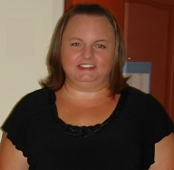

Your trainers for today:
Dawn Nall
Project Director
Valeria Cortes-Mora
Professional Intern

Slide 3



This training series is funded by the EPA

Slide 4


Slide 5

WPI/ABC Operator Certification
Notes:
This series is designed to supplement and reinforce the ABC Need to Know Criteria for the Wastewater Operator level 1 and 2 exams though there will be some higher level topics covered, and we won’t always follow the exact order listed in the NTKs
https://www.gowpi.org/services/abc-testing/standardized-exams/standardized-wastewater-treatment-operator-exams/

Slide 6
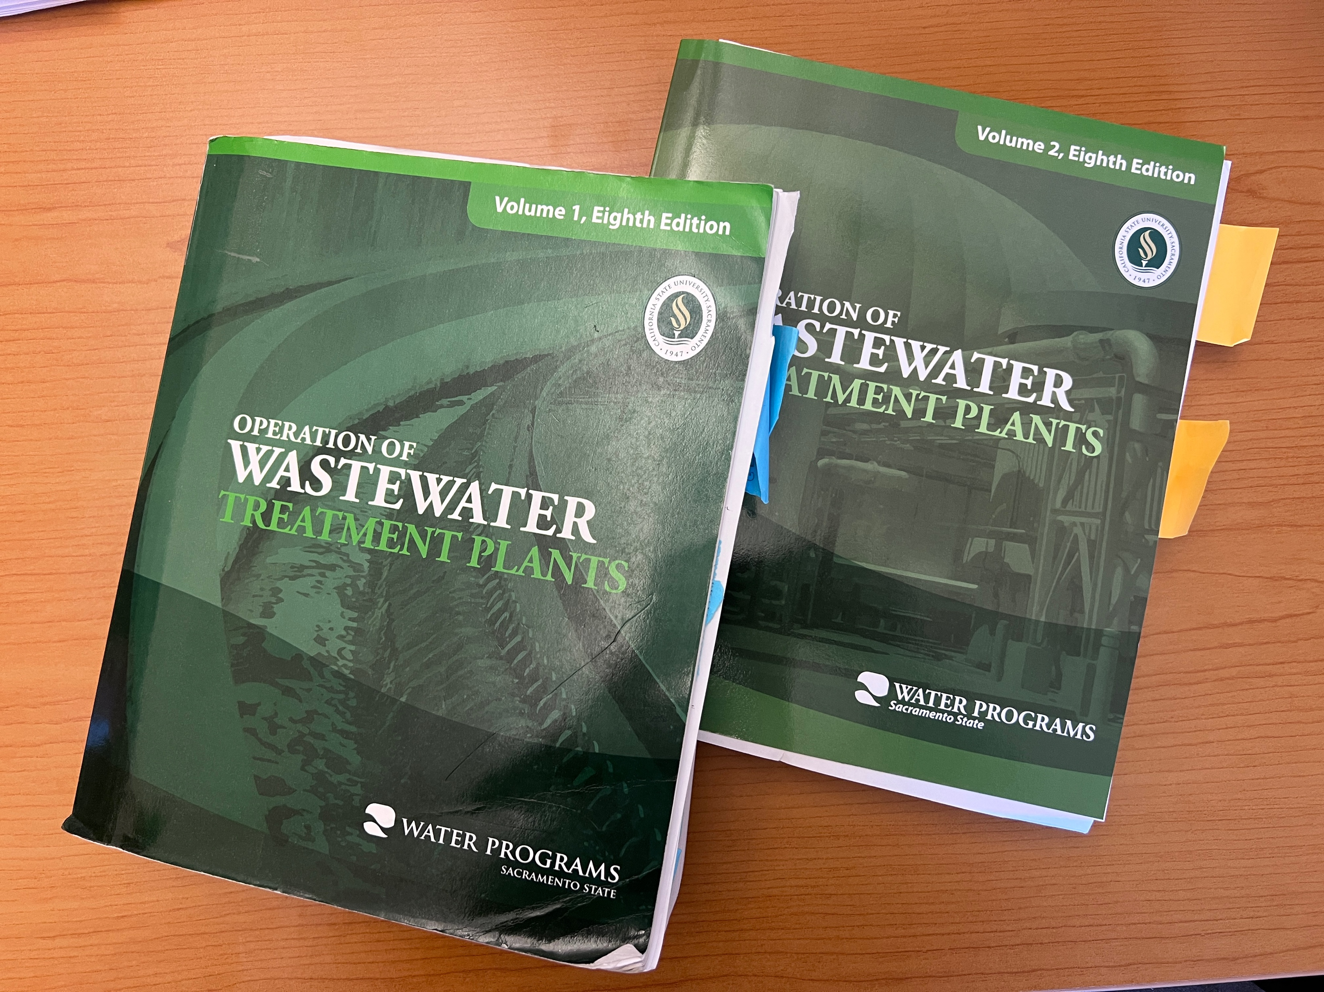
Use all your resources
Notes:
All the information we’ve covered and more is in these books – those happen to be my personal copies that I consult on the regular.

Slide 7
Schedule for 2026:
Date | Topic
1/20/26 | Concept and Math Review Session
2/3/26 | Disinfection Part 1 (chlorination/dechlorination) + related math
2/17/26 | Disinfection Part 2 - UV and other methods
3/3/26 | WW Math Part 3 (Flow, Detention Time)
3/17/26 | WW Math Part 4 (BOD Math /Advanced WW Math)
3/31/26 | Solids Handling Part 1 (Mechanical Solids Separation)
4/14/26 | Solids Handling Part 2 (Solids Handling)
4/28/26 | Sampling
5/12/26 | Regulations (NPDES Permits and Discharge Limitations)
5/26/26 | Treatment System Maintenance
6/9/26 | Lab Procedures/Analysis/Interpretation or alternate topic
6/23/26 | Using Technology in daily operations (SCADA, Computer, Tablets, CMMS, AI, etc.)
7/7/26 | Course Review Session - Short sample exam?
Notes:
26 sessions total
1 hour each
This is the schedule for the remainder of this year,
The trainers will vary depending on the topic
We’re now on session 15

Slide 8
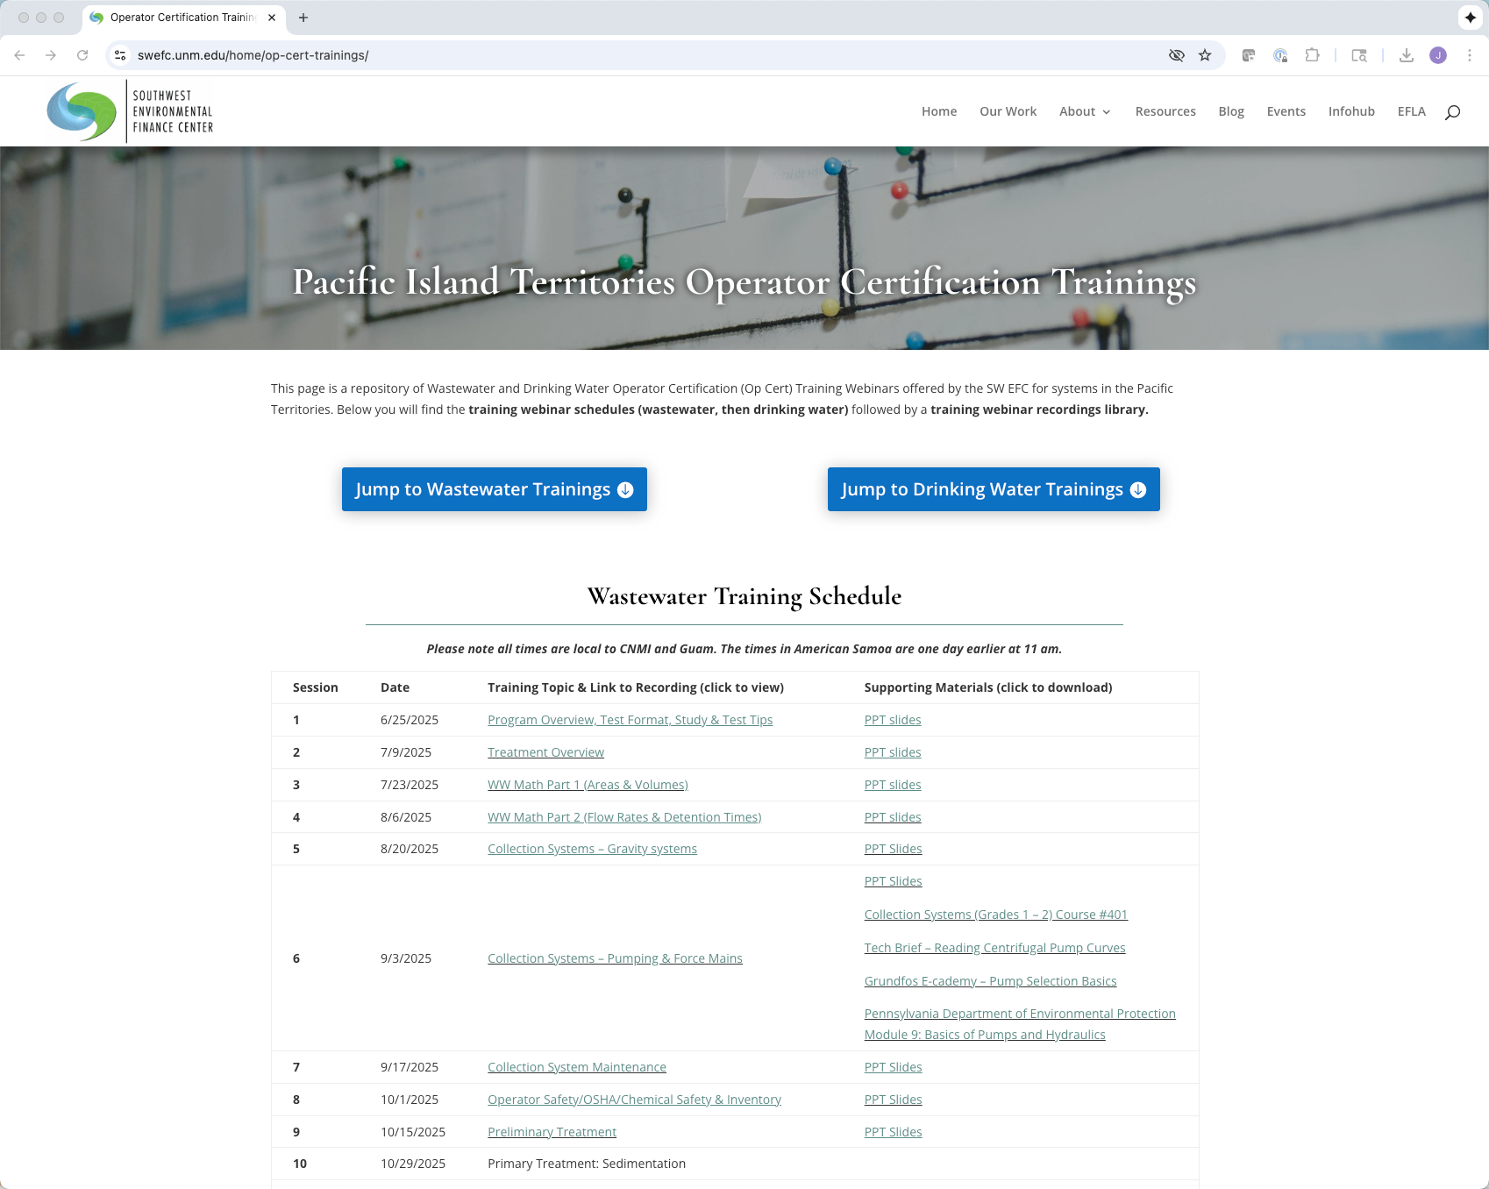
https://swefc.unm.edu/home/op-cert-trainings/
Notes:
The sessions are all being posted to our website so that you can go back and review them. I checked today and all of the sessions are posted, and this session should be posted in a day or two.

Slide 9

Sign in for every session to ensure you get credit for attending
Notes:
Be sure to sign in if you are attending in a group. The facilitator at your location will forward these to us and we will keep track of your attendance hours for credits;
With that lets get to today’s content!

Slide 10

Overview
Velocity
Flow Rates
Detention Times
Loading Rates
Practice problems
  Pencil and paper needed
  ABC Formula Sheet helpful
    https://gowpi.org/services/abc-testing/formula-conversion-tables/
Notes:
Today we are going to be discussing the formulas that you use to calculate velocity, flow rate, detention time and loading rates. I will provide time for you to practice each type of problem, so have a pencil and paper handy and if you can, pull up a copy of the ABC Formula Sheet.

Slide 11
Velocity and Flow Rates
How Fast and How Much
OR
Speed and Volume

Slide 12
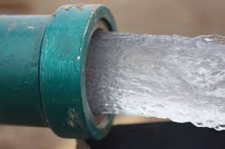
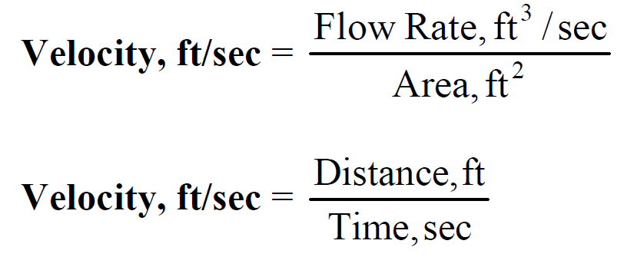
Velocity vs Flow rates
Velocity: How fast water flows through a pipe in a given time; How far something travels in a given amount of time.
Feet per second (ft/s)
Meters per sec (m/s)
Flow: Volume of water flowing through a pipe in a given time.
Gallons per minute (gpm)
Cubic feet per second (ft³/sec)
Million gallons per day (MGD)
Velocity = ft/sec
Flow = ft³/sec

Slide 13
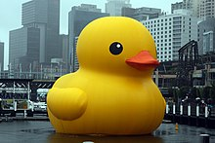
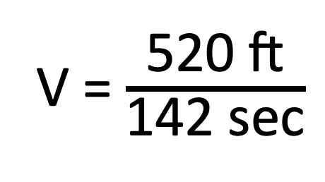
Velocity
5
You put a rubber ducky at the beginning of a pipe that is 520 feet long. It comes out the end in 142 seconds. How fast is water flowing through your pipe?
(assuming water is flowing the same speed as the ducky)
(A) 378 ft/sec
(B) 73,840 ft/sec
(C) 0.28 ft/sec
(D) 3.7 ft/sec
V = distance / time
V = $\frac{\text{520 }\text{ft}}{\text{142 }\text{sec}}$
V = 3.7 ft/sec

Slide 14
Velocity vs Flow rates
Velocity: How fast water flows through a pipe in a given time; How far something travels in a given amount of time.
Feet per second (ft/s)
Meters per sec (m/s)
Flow: Volume of water flowing through a pipe in a given time.
Gallons per minute (gpm)
Cubic feet per second (ft³/sec)
Million gallons per day (MGD)
Velocity = ft/sec
Flow = ft³/sec

Slide 15
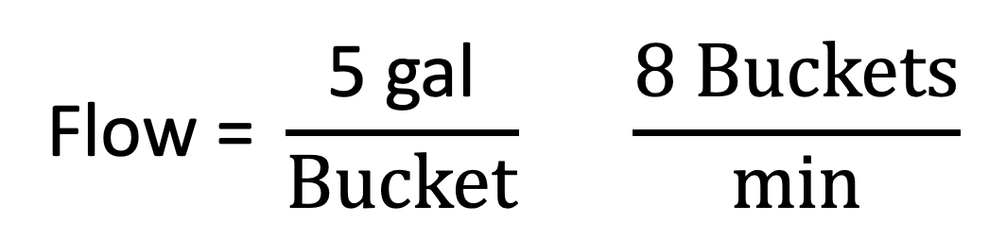
Flow
7
Your flow meter for your lift station pump is broken, but you want to figure out the pump's capacity. You open up the blow off and fill up 5-gallon buckets. You fill up 8 buckets in one minute. What is the capacity of your pump in GPM?
5 gallon
(A) 13 gal/min
(B) 40 gal/min
(C) 400 gal/min
(D) 130 gal/min
Flow = volume / time
$$\text{Flow}\text{ = }\frac{\text{5 }\text{gal}}{Bucket} \frac{8 Buckets}{min}$$
Flow = 40 gal / minute

Slide 16
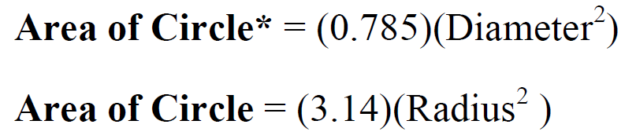
Flow
What is the flow in gpm in an 18-inch diameter line when your rubber ducky is moving through it at a velocity of 2.5 ft/sec?
V = 2.5 ft/sec
D= 18”
Flow = Velocity x Area
Area = 3.14 * r²
Flow = 2.5 ft/sec x 1.77 ft²
Diameter = 18”
Area = 3.14 * (0.75 ft)²
Flow = 4.42 ft³/sec
Diameter = 18”/12 = 1.5 ft
Area = 3.14 * 0.56 ft²
Conversion factors:
7.48 gallons = 1 ft³
60 secs = 1 min
Radius = 1.5 ft/2 = 0.75 ft
Area = 1.77 ft²
4.42 ft³
7.48 gals
60 sec
=1984 gpm
sec
1 ft³
1 min

Slide 17
Flow – you try it
8
What is the flow in gpm in a 12-inch diameter line when your rubber ducky is moving through it at a velocity of 1.1 ft/sec?
V = 1.1 ft/sec
D= 12”
Flow = Velocity x Area
Area = 3.14 * r²
Flow = 1.1 ft/sec x 0.785 ft²
Diameter = 12”
Area = 3.14 * (0.5 ft)²
Flow = 0.864 ft³/sec
Diameter = 12”/12 = 1 ft
Area = 3.14 * 0.25 ft²
Conversion factors:
7.48 gallons = 1 ft³
60 secs = 1 min
Radius = 1 ft/2 = 0.5 ft
Area = 0.785 ft²
(A) 388 gal/min
(B) 9,293 gal/min
(C) 775 gal/min
(D) 1984 gal/min
0.864 ft³
7.48 gals
60 sec
= 388 gpm
sec
1 ft³
1 min

Slide 18
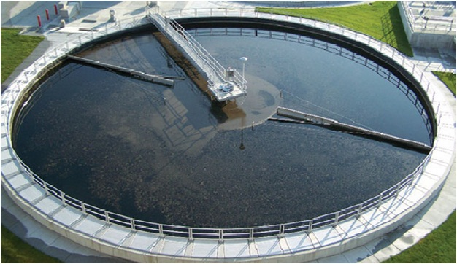
Detention Time

Slide 19
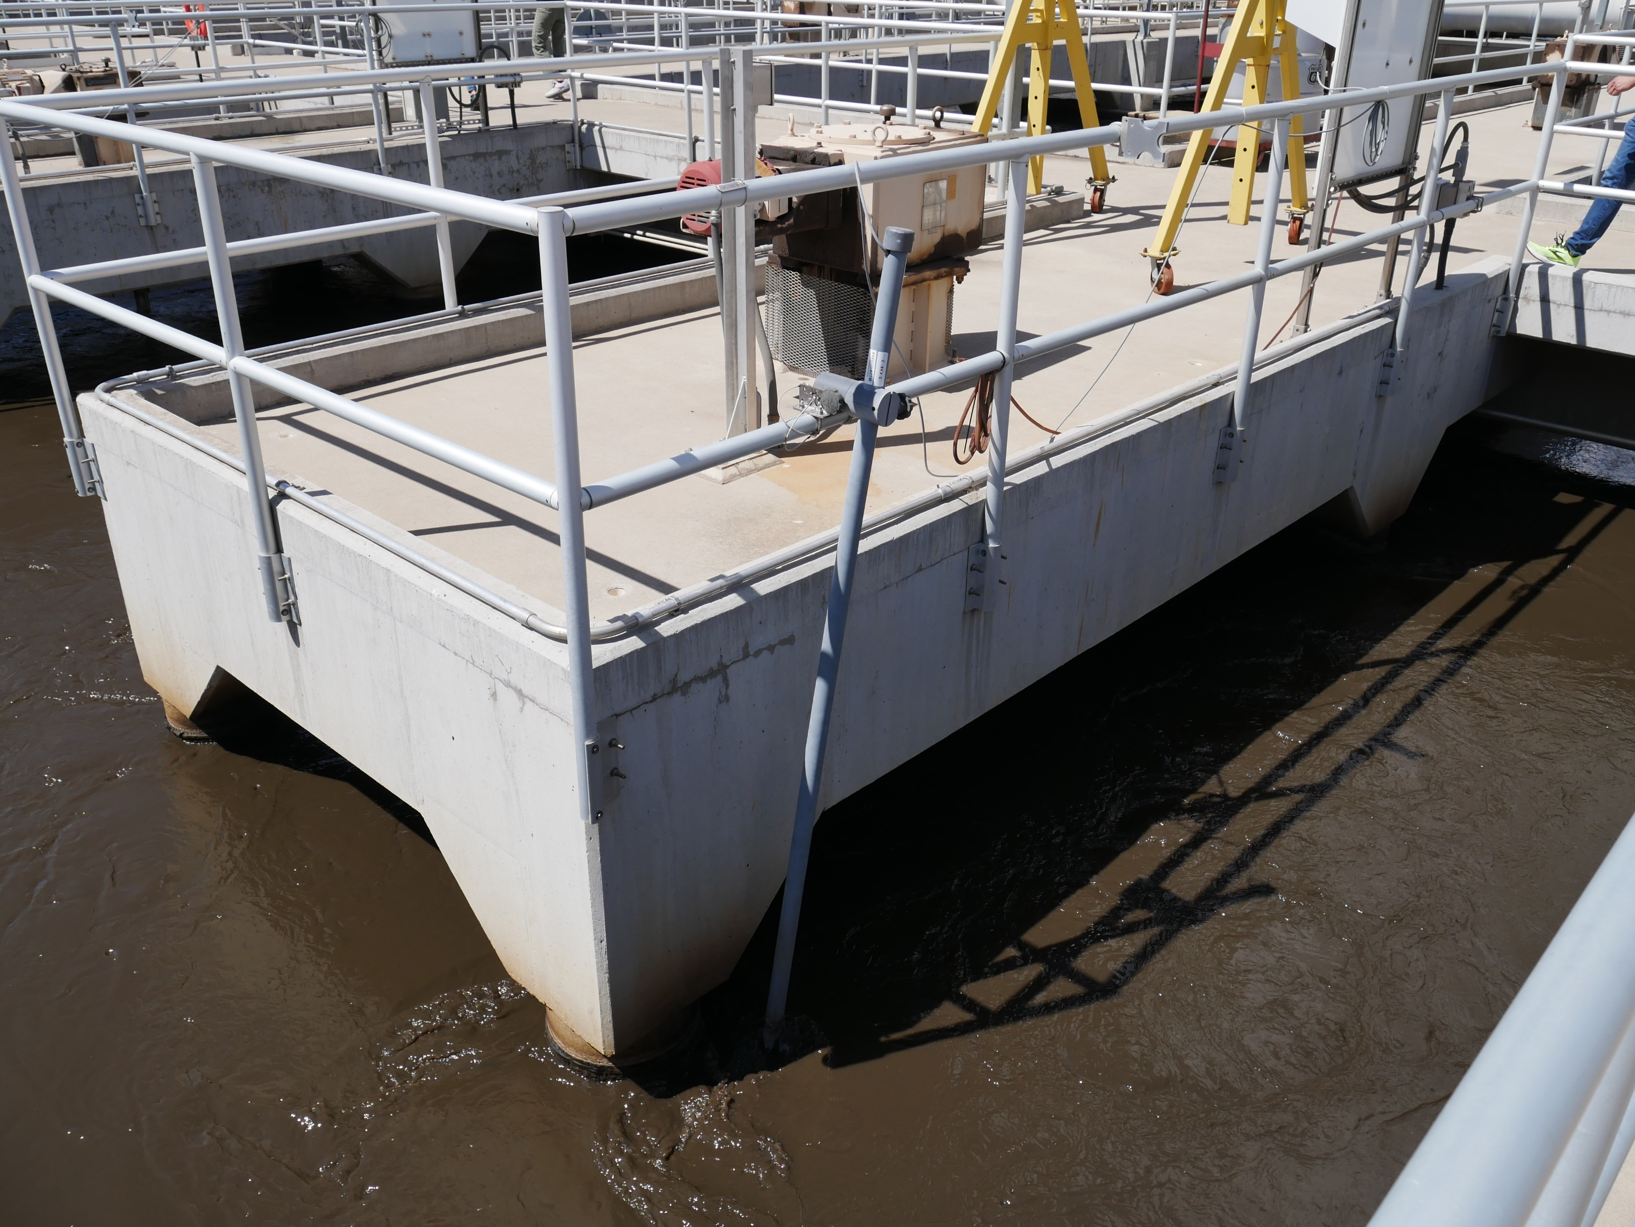
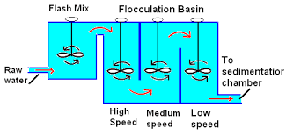
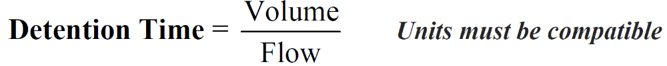
Detention Time
The time water stays in a given reservoir or treatment process.

Slide 20
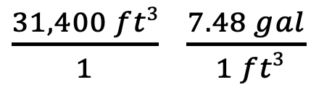

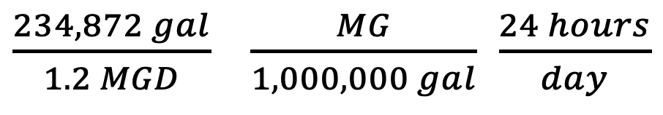
Your secondary clarifier is 40 ft in diameter and 25 ft deep. Your max daily flow is 1.2 MGD. To determine if your clarifier meets the recommended detention time, you need to calculate the detention time of the clarifier in hours.
9
40ft
Volume = π * r² * Height
25ft
Volume = 3.14 * (20 ft)² * 25 ft
Volume = 3.14 * 400 ft² * 25 ft
(A) 1 day
(B) 4.7 hours
(C) .20 days
(D) .20 hours
Volume = 31,400 ft³
Diameter = 40 ft
Radius = 40 ft/2 = 20 ft
$\frac{31,400 ft3}{ 1 }$ $\frac{7.48 gal}{ 1 ft3}$
= 234,872 gal
$$=\frac{1}{day}$$
$\frac{234,872 gal}{1.2 MGD} \frac{MG}{1,000,000 gal}$ $\frac{24 hours}{day}$
=4.7 hours
> 2-3 recommended design DT

Slide 21
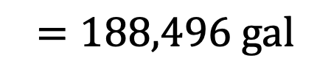
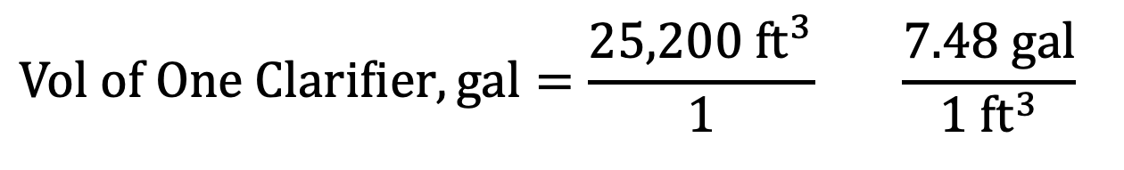
Find the detention time in hours for the following WWTP:
• 4 rectangular clarifiers each 40.0 ft long, 30.0 ft wide, and with an average water depth of 21.00 ft.
• 1 oxidation ditch 295 ft long, 80.0 ft wide, and with a water depth of 11.0 ft.
• Flow is 3.50 MGD
4 Clarifiers = 40’ x 30’ x 21‘
$$Vol of One Clarifier=40 ft × 30 ft × 21 ft=25,200 ft^{3}$$
$$Vol of One Clarifier, gal=\frac{25,200 ft^{3}}{1} \frac{7.48 gal}{1 ft^{3}}$$
$$=188,496 gal$$
$$Vol of 4 Clarifiers, gal=188,496 gals × 4 Clarifiers =753,984 gal$$

Slide 22
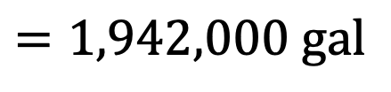
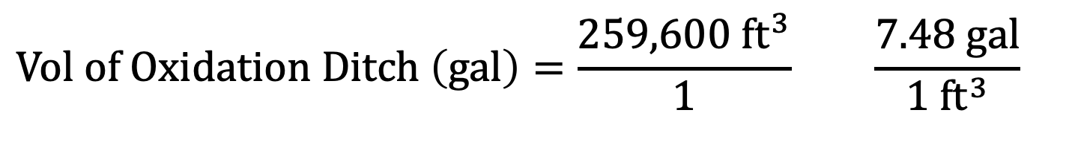
Find the detention time in hours for the following WWTP:
• 4 rectangular clarifiers each 40.0 ft long, 30.0 ft wide, and with an average water depth of 21.00 ft.
• 1 oxidation ditch 295 ft long, 80.0 ft wide, and with a water depth of 11.0 ft.
• Flow is 3.50 MGD
1 Oxidation Ditch = 295’ x 80’ x 11‘
$$Vol of Oxidation Ditch=295 ft ×80 ft×11 ft=259,600 ft^{3}$$
$$Vol of Oxidation Ditch \left(gal\right)=\frac{259,600 ft^{3}}{1} \frac{7.48 gal}{1 ft^{3}}$$
$$=1,942,000 gal$$

Slide 23
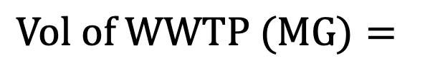


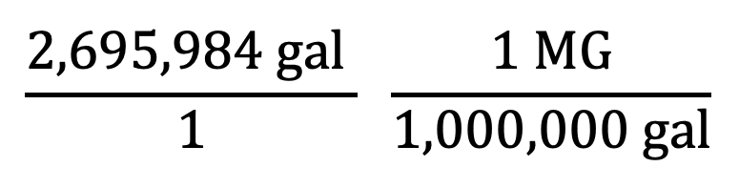
Find the detention time in hours for the following WWTP:
• 4 rectangular clarifiers each 40.0 ft long, 30.0 ft wide, and with an average water depth of 21.00 ft.
• 1 oxidation ditch 295 ft long, 80.0 ft wide, and with a water depth of 11.0 ft.
• Flow is 3.50 MGD
Vol of Oxidation Ditch = 1,942,000 gals
Vol of Clarifiers = 753,984 gals
$$Vol of WWTP=1,942,000 gal+753,984 gal=2,695,984 gal$$
$$\frac{2,695,984 gal }{1} \frac{1 MG}{1,000,000 gal}$$
$$Vol of WWTP (MG)=$$
$$=2.695984MG$$
$$≈2.70MG$$

Slide 24
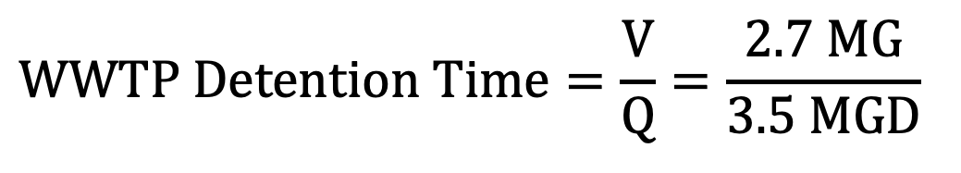
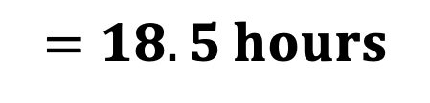
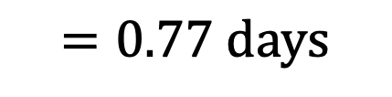
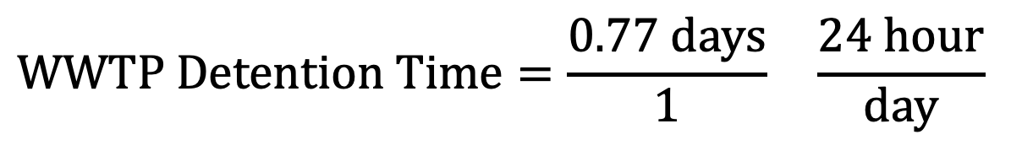
Find the detention time in hours for the following WWTP:
• 4 rectangular clarifiers each 40.0 ft long, 30.0 ft wide, and with an average water depth of 21.00 ft.
• 1 oxidation ditch 295 ft long, 80.0 ft wide, and with a water depth of 11.0 ft.
• Flow is 3.50 MGD
Vol of WWTP = V = 2.7 MG
Flow = Q = 3.5 MGD
$$WWTP Detention Time=\frac{V}{Q}=\frac{2.7 MG}{3.5 MGD}$$
$$=0.77 days$$
$$WWTP Detention Time=\frac{0.77 days}{1} \frac{24 hour}{day}$$
$$=18.5 hours$$
18.5 hours is the detention time for treatment in the WWTP.

Slide 25
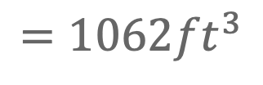
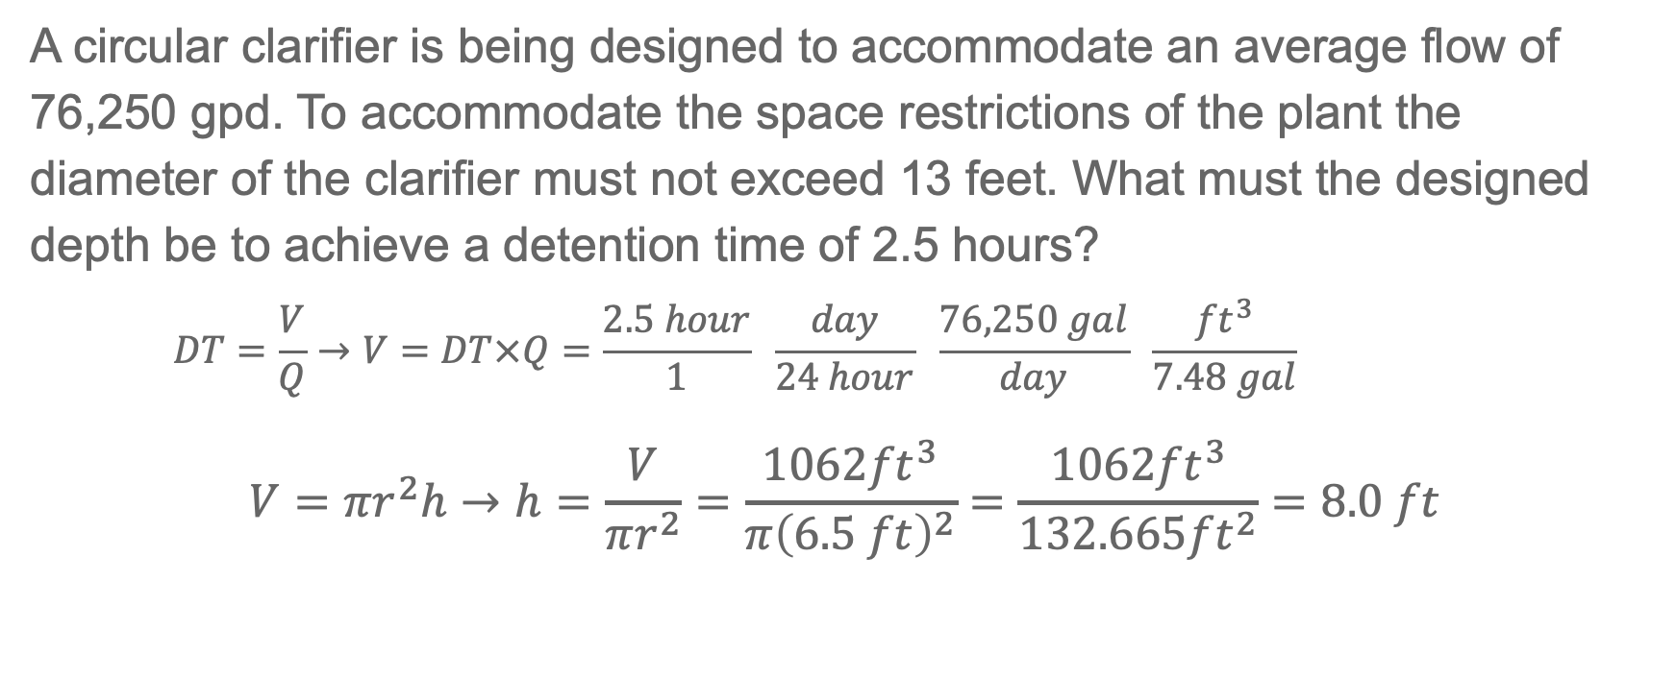
Detention Time Rearranged
A circular clarifier is being designed to accommodate an average flow of 76,250 gpd. To accommodate the space restrictions of the plant the diameter of the clarifier must not exceed 13 feet. What must the designed depth be to achieve a detention time of 2.5 hours?
$$DT=\frac{V}{Q}→V=DT×Q=\frac{2.5 hour}{1} \frac{day}{24 hour} \frac{76,250 gal}{day} \frac{{ft}^{3}}{7.48 gal}$$
$$V=πr^{2}h→h=\frac{V}{πr^{2}}=\frac{1062{ft}^{3}}{π{\left(6.5 ft\right)}^{2}}=\frac{1062{ft}^{3}}{132.665{ft}^{2}}=8.0 ft$$
$$=1062{ft}^{3}$$

Slide 26
Your Turn – Practice Detention Time
A rectangular sedimentation basin is 75 feet long, 30 feet wide, and 20 feet deep. If the treatment plant has a daily flow rate of 2.25 million gallons per day (MGD), what is the detention time in hours?
What do we know?
Dimensions: 75 (L), 30 (W), 20 (D)
Flow Rate: 2.25 MGD
Step 1: Calculate the volume of the basin
Volume = length x width x depth
Volume = 75 ft x 30 ft x 20 ft
Volume = 45,000 ft³
Step 2: Convert volume from ft³ to gallons
45,000 ft³ x 7.48 gallons = 336,600 gallons
Step 3: Calculate Detention Time
DT = Volume/Flow
DT = 336,600 gal / 2,250,000 gallons per day
DT = 0.1496 days
Step 4: Convert to hours
0.1496 days x 24 hours
3.6 hours
1 day
What are we looking for?
Detention Time in hours
What do we need?
Equations:
DT = Volume/Flow
Volume = LxWxD
Conversions:
1ft³ = 7.48 gallons
1ft³

Slide 27
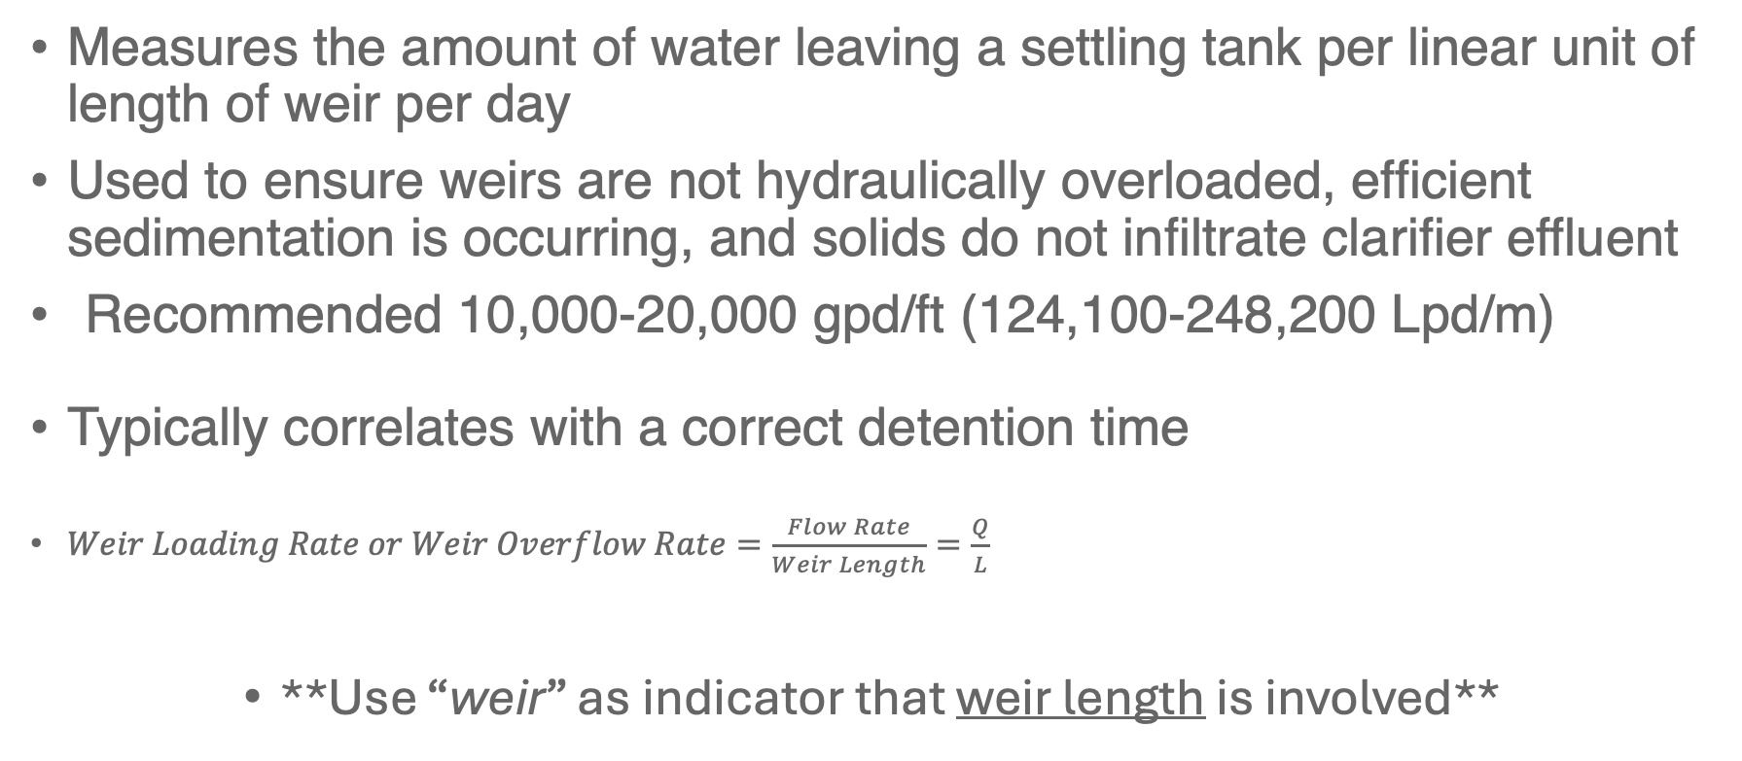
Weir Loading Rate
Measures the amount of water leaving a settling tank per linear unit of length of weir per day
Used to ensure weirs are not hydraulically overloaded, efficient sedimentation is occurring, and solids do not infiltrate clarifier effluent
Recommended 10,000-20,000 gpd/ft (124,100-248,200 Lpd/m)
Typically correlates with a correct detention time
$Weir Loading Rate or Weir Overflow Rate=\frac{Flow Rate}{Weir Length}=\frac{Q}{L}$
**Use “weir” as indicator that weir length is involved**

Slide 28

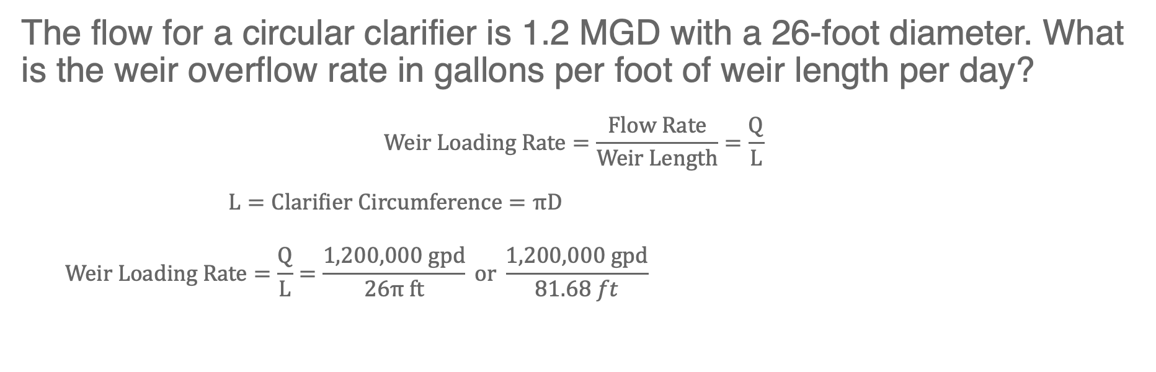



Weir Loading Rate Example
The flow for a circular clarifier is 1.2 MGD with a 26-foot diameter. What is the weir overflow rate in gallons per foot of weir length per day?
$$Weir Loading Rate=\frac{Flow Rate}{Weir Length}=\frac{Q}{L}$$
$$L=Clarifier Circumference=πD$$
$$Weir Loading Rate=\frac{Q}{L}=\frac{1,200,000 gpd}{26π ft} or \frac{1,200,000 gpd}{81.68 ft}$$
$$=π×26 ft$$
$$=81.68 ft or 26π ft$$
$$=14,691 gpd/ft$$
$$=\sim 14,700 gpd/ft$$

Slide 29
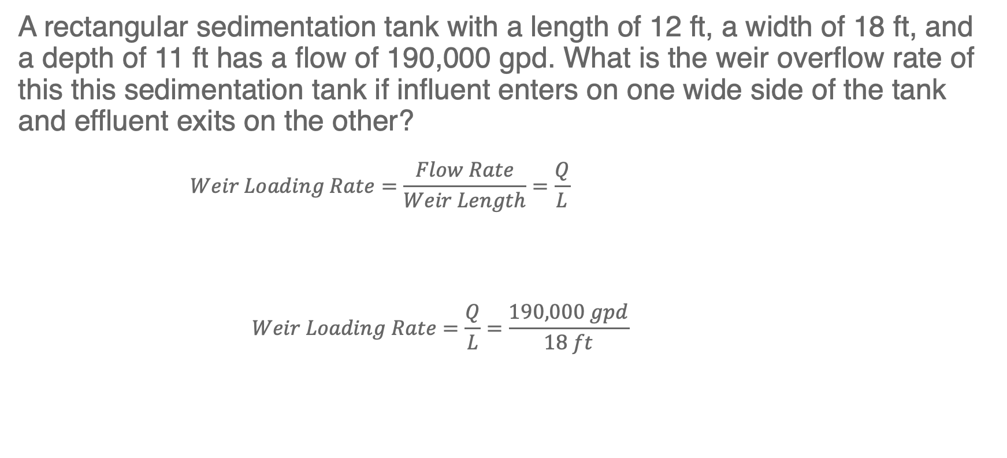

Weir Loading Rate Practice 1
A rectangular sedimentation tank with a length of 12 ft, a width of 18 ft, and a depth of 11 ft has a flow of 190,000 gpd. What is the weir overflow rate of this this sedimentation tank if influent enters on one wide side of the tank and effluent exits on the other?
$$Weir Loading Rate=\frac{Flow Rate}{Weir Length}=\frac{Q}{L}$$
$$Weir Loading Rate=\frac{Q}{L}=\frac{190,000 gpd}{18 ft}$$
18 ft
12 ft
$$=10,556gpd/ft$$

Slide 30
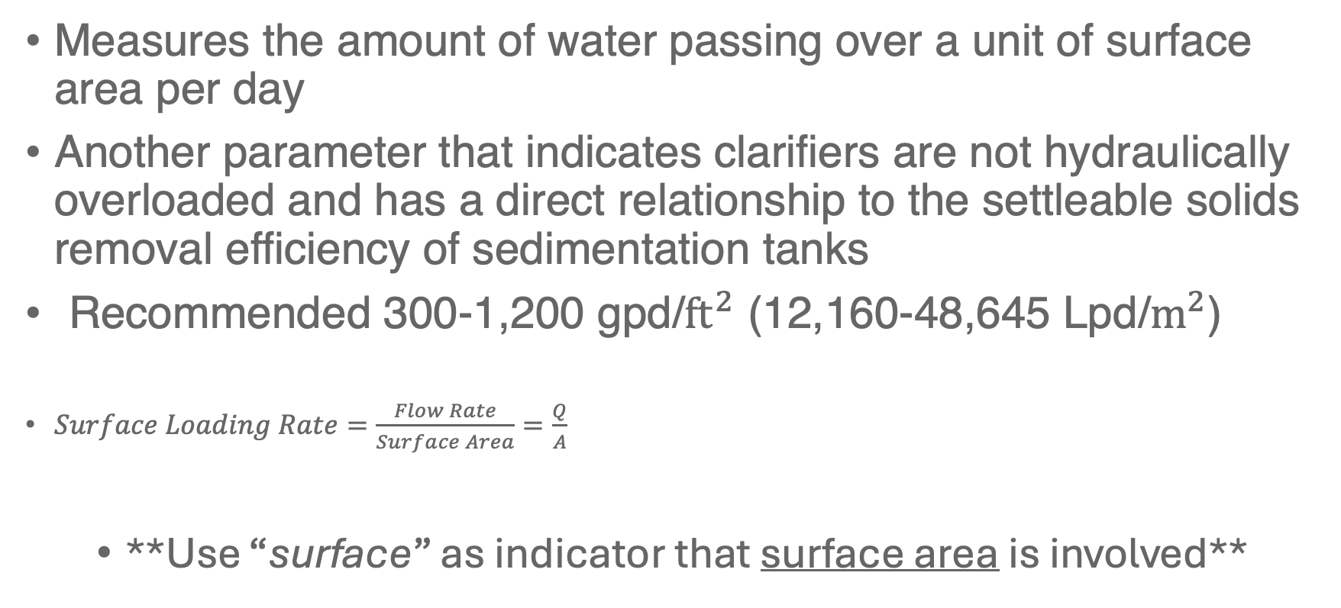
Surface Loading Rate
Measures the amount of water passing over a unit of surface area per day
Another parameter that indicates clarifiers are not hydraulically overloaded and has a direct relationship to the settleable solids removal efficiency of sedimentation tanks
Recommended 300-1,200 gpd/${ft}^{2}$ (12,160-48,645 Lpd/$m^{2}$)
$Surface Loading Rate=\frac{Flow Rate}{Surface Area}=\frac{Q}{A}$
**Use “surface” as indicator that surface area is involved**

Slide 31
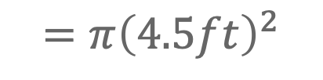
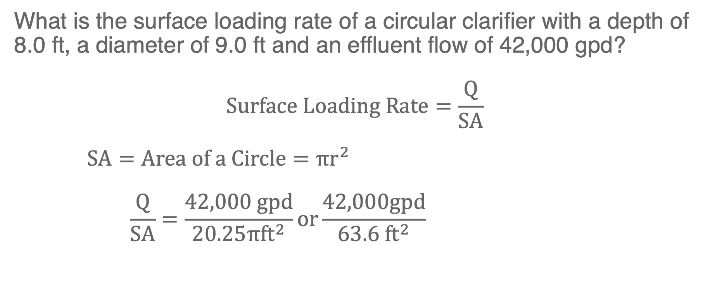
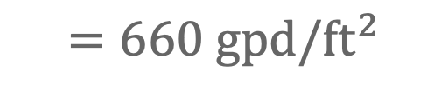
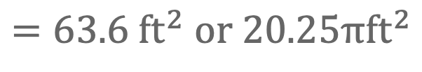
Surface Loading Rate Example
What is the surface loading rate of a circular clarifier with a depth of 8.0 ft, a diameter of 9.0 ft and an effluent flow of 42,000 gpd?
$$Surface Loading Rate=\frac{Q}{SA}$$
$$SA=Area of a Circle=πr^{2}$$
$$\frac{Q}{SA}=\frac{42,000 gpd}{20.25π{ft}^{2}}or\frac{42,000gpd}{{63.6 ft}^{2}}$$
$$=π{\left(4.5ft\right)}^{2}$$
$$=63.6 {ft}^{2} or 20.25π{ft}^{2}$$
$$=660 gpd/{ft}^{2}$$

Slide 32
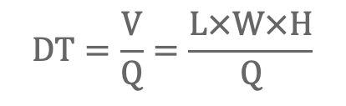

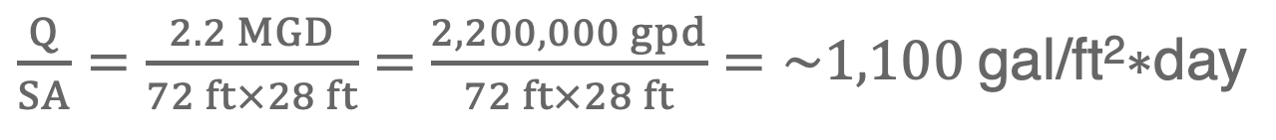

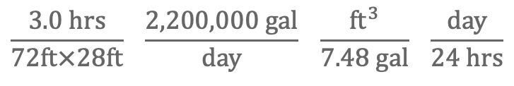
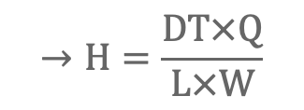
Surface Loading Rate Practice
Known design parameters for a rectangular clarifier are listed below. What is the surface loading rate in gal/ft²*day? What is the depth required to maintain a maximum detention time of 3.0 hours?
Knowns:
Q= 2.2 MGD
L= 72 ft
W= 28 ft
$\frac{Q}{SA}=\frac{2.2 MGD}{72 ft×28 ft}=$ $\frac{2,200,000 gpd}{72 ft×28 ft}=\sim 1\text{,100 }\text{gal}\text{/}\text{ft}\text{2}\text{∗}\text{day}$
$$DT=\frac{V}{Q}=\frac{L×W×H}{Q}$$
$$→H=\frac{DT×Q}{L×W}$$
$$\frac{3.0 hrs}{72ft×28ft} \frac{2,200,000 gal}{day} \frac{{ft}^{3}}{7.48 gal} \frac{day}{24 hrs}$$
$$H=$$
$$=18 ft$$

Slide 33
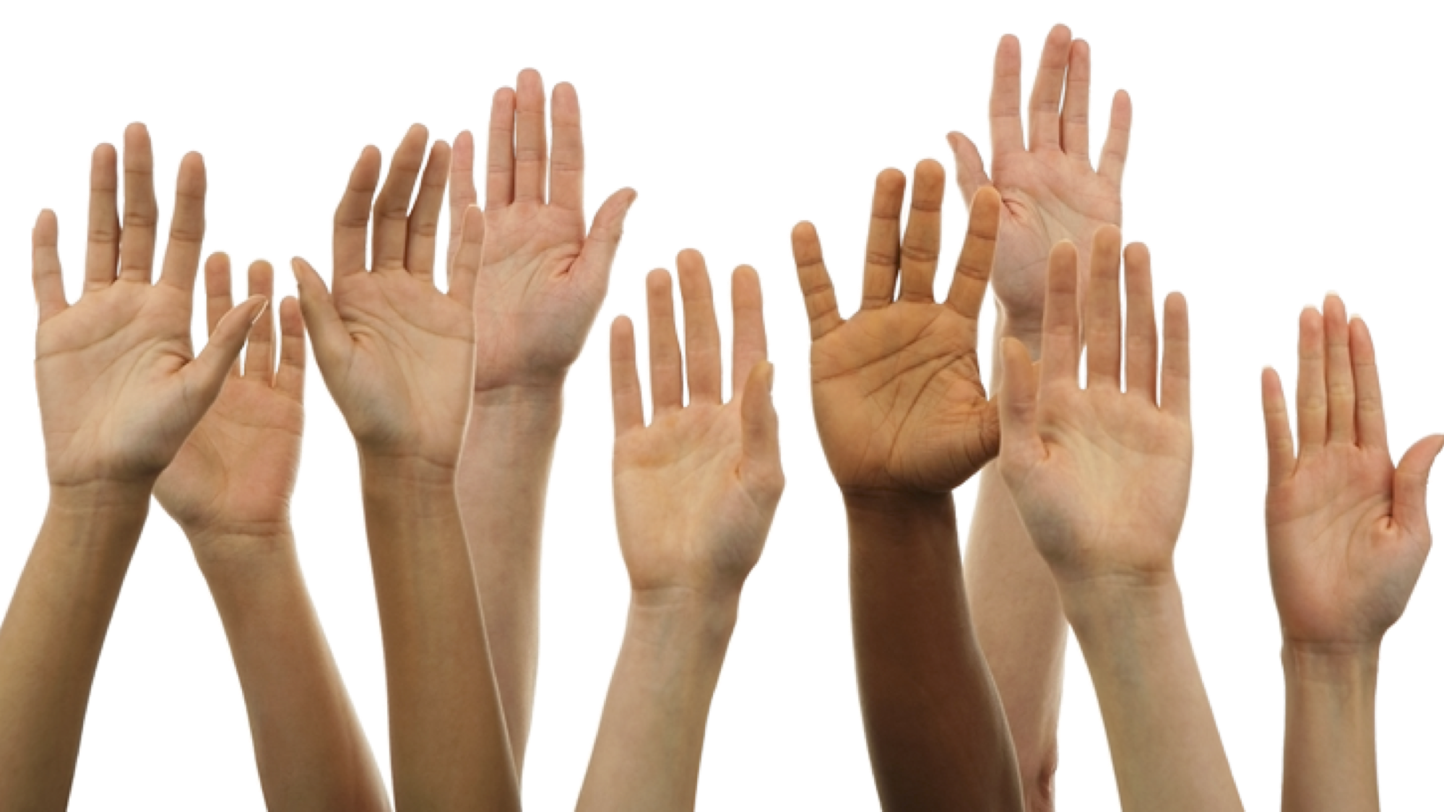
Questions?

Slide 34

CONTACT INFORMATION
Department of Civil Engineering MSC01 1070
1 University of New Mexico
Albuquerque, NM 87131
505-277-0644
swefc@unm.edu
http://swefc.unm.edu
swefc@unm.edu

