Slide 1



US Territories Water Operator Training Series
Session 16: Safety Program Basics
2/19/2026
www.efcnetwork.org
This program is made possible under a cooperative agreement with US EPA.

Slide 2


Michelle Olson
Water Utility Trainer and Specialist meolson@unm.edu

Slide 3



This training series is funded by the US EPA

Slide 4
Attendee Meeting Controls
2. Chat
3. Leave meeting
1. Mute/unmute
Mute/unmute
  Click the microphone icon to unmute yourself to speak (if you are not speaking, don’t unmute)
Chat
  Click the chat icon and then use the dropdown next to send text instant messages to:
    Everyone publicly: messages will be visible to all participants
    Host only: messages will be sent only to the meeting host – Don’t send a chat to only me; I won’t have time to see it while presenting.
    Any attendee directly: message will be sent to the selected meeting participant only
Leave meeting
  Click on the leave icon to exit the ZOOM Meeting

Slide 5
Schedule for 2026:
Date | Topic
1/22/2026 | Alternative Treatment Processes
2/5/2026 | Drinking Water Treatment Math & Concept Review
2/19/2026 | Safety Program Basics
3/5/2026 | Lead & Copper Rule and Corrosion Control
3/19/2026 | Distribution Systems 1: Hydraulics, Pipe Types, Selection, Installation, and Water Quality
4/2/2026 | Distribution Systems 2: Valves, Hydrants, Meters, and Service Connections
4/16/2026 | Distribution Systems 3: Storage and Booster Pumping
4/30/2026 | O&M: Pumps, Main, and Appurtenance Maintenance
5/14/2026 | O&M: Cross Connection Control
5/28/2026 | O&M: Distribution System Math and Concept Review
6/11/2026 | Sampling & Lab Procedures/Analysis/Interpretation
6/25/2026 | Management Overview
7/9/2026 | Drinking Water Practice Exam and Review

Slide 6

https://swefc.unm.edu/home/op-cert-trainings/

Slide 7

Sign in for every session to ensure you get credit for attending

Slide 8
Water Safety Overview
Safety is your responsibility. Be safe and make sure others are as well.

Slide 9

Don’t be the headline

Slide 10


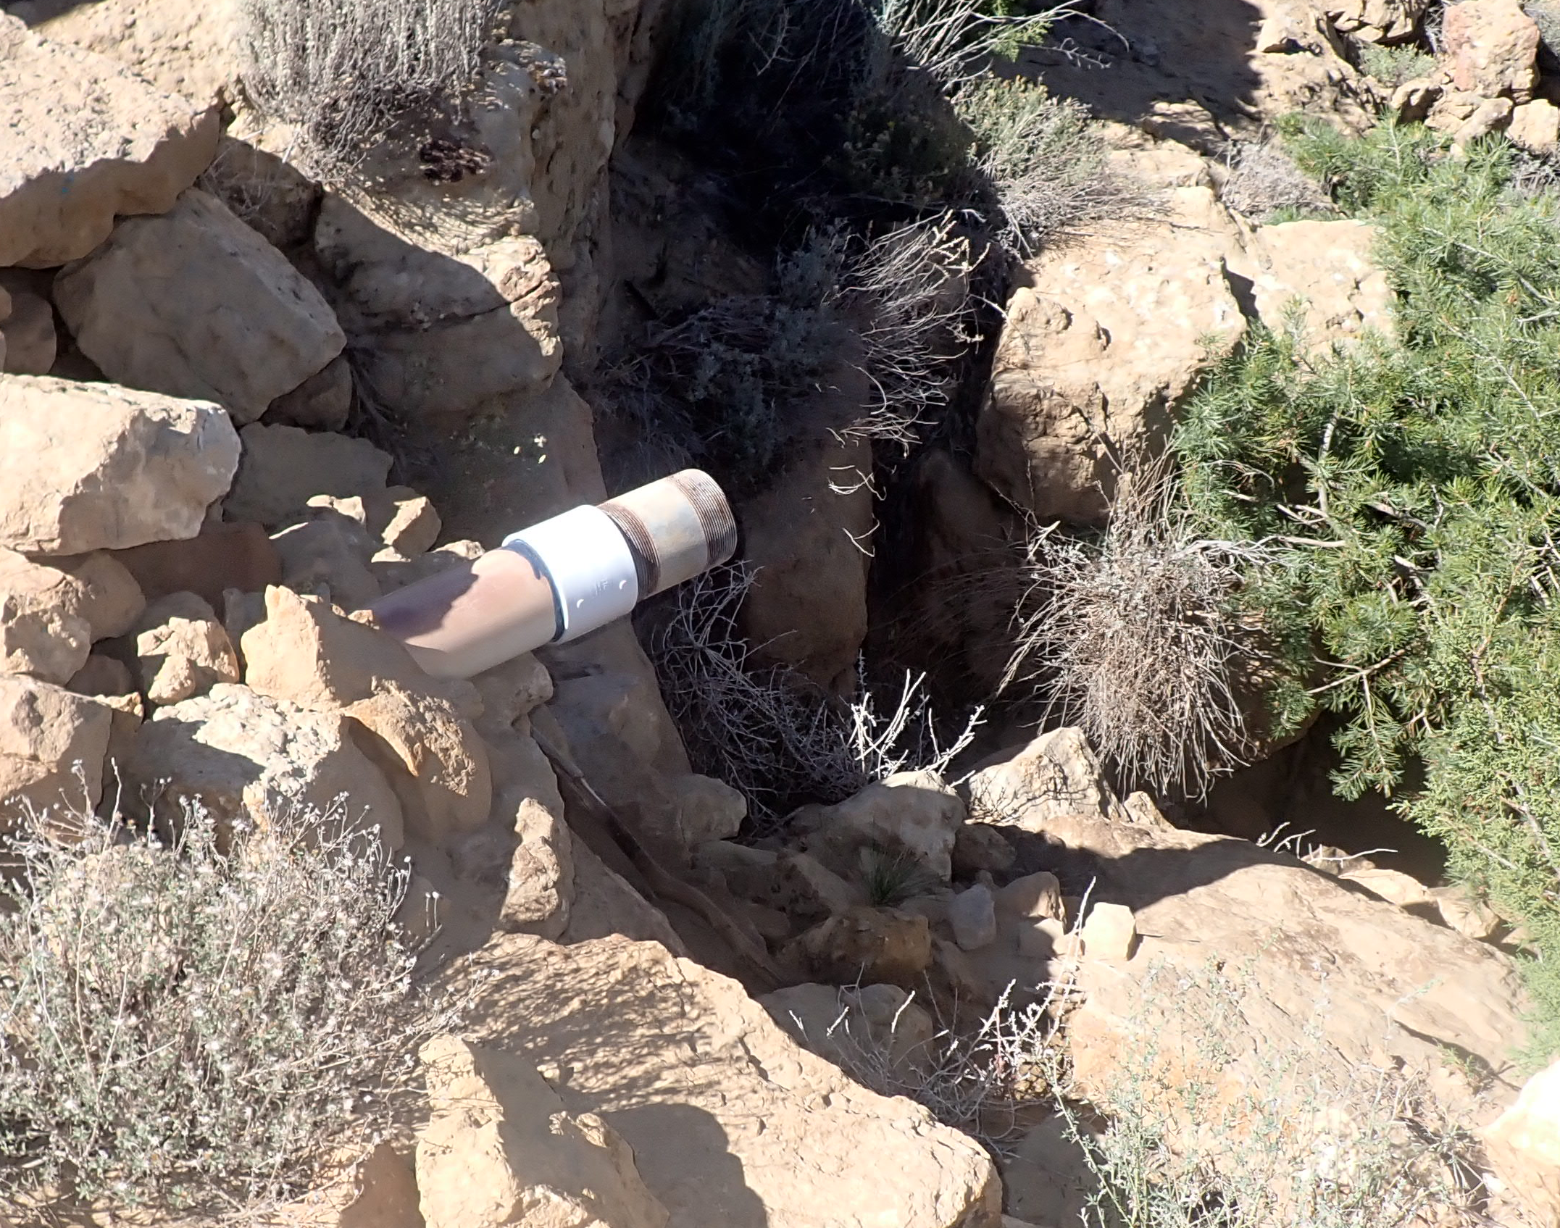
Safety Hazards
Notes:
Photo by Marcel Eberle on Unsplash
Symbols by OpenClipart-Vectors on Pixabay

Slide 11

Safety Hazards
Chemical Hazards
Toxic chemicals
Acids
Bases
Physical Hazards
Machinery
Lifting/slipping
Fire
Explosions
Falls
Noise
Biological Hazards
Pathogens
Infectious disease
Infections
Environmental Hazards
Heights
Confined spaces
Drowning
Engulfment/ entrapment
Animals
Traffic
Weather
Other Hazards
UV exposure
Electrical shock
???
Notes:
Photo by Marcel Eberle on Unsplash
Symbols by OpenClipart-Vectors on Pixabay

Slide 12
Safety Roles
Management’s responsibility is to provide each employee with a safe place of employment
The operator has primary responsibility for their own safety

Slide 13

Most utility injuries are caused by the injured employee

Slide 14

Safety is your responsibility
Working safely is a condition
of employment
Notes:
Photo by Mufid Majnun on Unsplash

Slide 15

Question
Operators can experience physical injuries caused by:
A) Moving machinery
B) Improper lifting
C) Slippery surfaces
D) All of the above
Notes:
Operators can experience physical injuries caused by:
1) Moving machinery
2) Improper lifting
3) Slippery surfaces
4) All of the above
Time check: 13:00

Slide 16
Question
Operators can experience physical injuries caused by:
1) Moving machinery
2) Improper lifting
3) Slippery surfaces
4) All of the above
Notes:
Operators can experience physical injuries caused by:
1) Moving machinery
2) Improper lifting
3) Slippery surfaces
4) All of the above
Time check: 13:00

Slide 17

Occupational Safety and Health Regulations
Notes:
Note that although we’re showing the OSHA logo, this is not an OSHA sponsored or supported webinar.

Slide 18
OSHA’s Mission
“to assure safe and healthy working conditions for working men and women by setting and enforcing standards and by providing training, outreach, education, and assistance."

Slide 19






















22 States & Puerto Rico have OSHA approved programs

Slide 20






5 States and the US Virgin Islands have OSHA approved programs that cover public sector employees

Slide 21

Be Aware of Your Local Occupational Safety and Health Regulations
Notes:
Image Source: https://commons.wikimedia.org/wiki/File:Flag_Map_of_the_United_States%28subdivisions%29.png
https://www.flickr.com/photos/107442568@N08/14014130835/
Alefar
This file is licensed under the Creative Commons Attribution 2.0 Generic license.

Slide 22
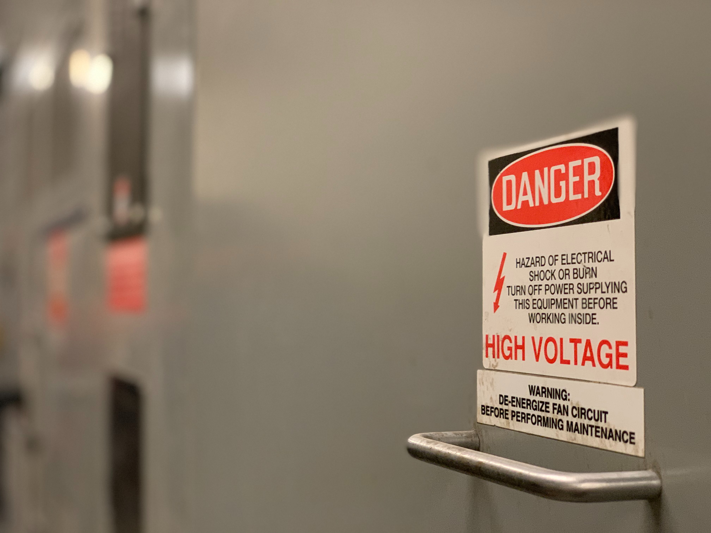
Safety Programs
Safety is everyone’s
concern
Notes:
Photo by Troy Bridges on Unsplash

Slide 23
Safety Programs
Identify the causes of accidents, illness, and injuries
Provide safety training
Implement an accident reporting system
Hold supervisors responsible for implementing the safety program

Slide 24
Operator Safety Duties
Ask about your employer’s safety program, and participate in it
Follow safety protocols and standards when doing your job
Use your safety equipment, like SCBA, hardhats, goggles, gloves, and other PPE
Report safety hazards and injuries

Slide 25
Management Safety Duties
Develop a written safety statement & establish a safety program
Assign responsibilities for injury prevention
Appoint a safety officer or coordinator
Establish realistic safety goals & revise them to encourage continual improvement
Evaluate safety program results

Slide 26
Three safety program training components
Safety education of all employees
Reinforced education in safety
Safety education in the use of tools and equipment

Slide 27
Three safety program training components
Safety education of all employees
Reinforced education in safety
Safety education in the use of tools and equipment

Slide 28

Tailgates aren’t just for parties
Short: 10-20 minutes, held approximately weekly or before new work
Notes:
Image: Rich Anderson
https://flickr.com/photos/memestate/36001975/

Slide 29
Question
Who has the most to gain from a safety program?
A) Management
B) Office Staff
C) Operators
D) Supervisors
Notes:
Who has the most to gain from a safety program
Management
Office Staff
Operators
Supervisors

Slide 30
Question
Who has the most to gain from a safety program?
A) Management
B) Office Staff
C) Operators
D) Supervisors
Notes:
Who has the most to gain from a safety program
Management
Office Staff
Operators
Supervisors
Operators – you’re the most likely to be injured. Everyone benefits from a safety program, but the front-line employees benefit the most.
Time check 20:30

Slide 31
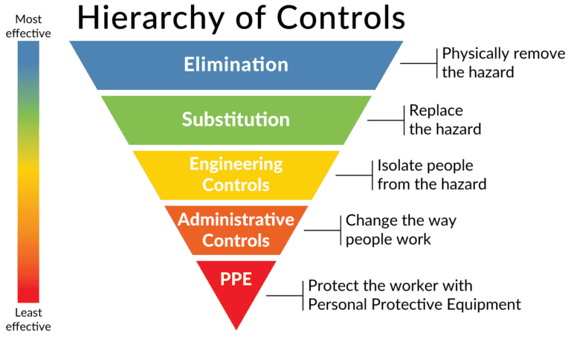
Actions to Control Workplace Hazards

Slide 32
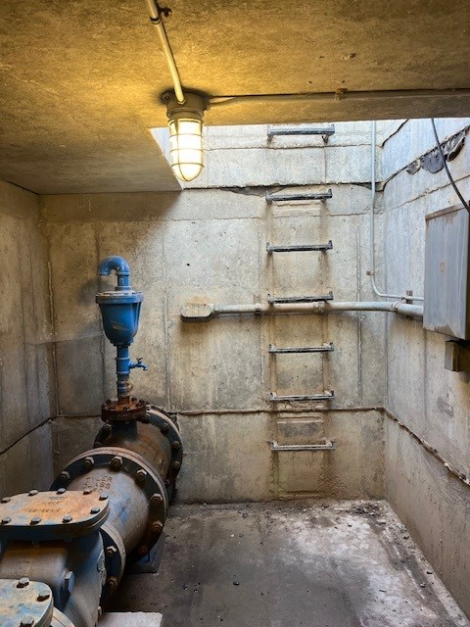
Well Vaults:
  Confined spaces
  Electrical hazards
  Slippery surfaces
  ?…

Slide 33
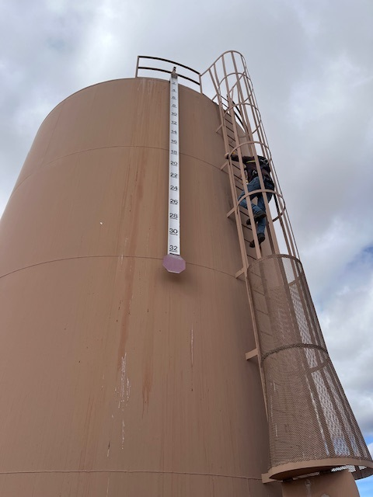
Water Tanks:
Falling hazards
Drowning
?…

Slide 34

Water Safety
Keep handrails and ladders in good repair
Replace damaged rails and ladders
Use extra caution in wet and icy weather

Slide 35
Water Safety
Reduce slip hazards
Station approved emergency gear near filters and basins:
  Safety vests
  Buoys
  Life poles
Learn how to swim
Use personal floatation devices

Slide 36
Question
Which control method is most effective in the Hierarchy of Controls for eliminating workplace hazards?
A) Personal protective equipment
B) Elimination
C) Substitution
D) Administrative controls
Notes:
Which control method is most effective in the Hierarchy of Controls for eliminating workplace hazards?
Personal protective equipment
Elimination
Substitution
Administrative controls

Slide 37
Question
Which control method is most effective in the Hierarchy of Controls for eliminating workplace hazards?
A) Personal protective equipment
B) Elimination
C) Substitution
D) Administrative controls
Notes:
Which control method is most effective in the Hierarchy of Controls for eliminating workplace hazards?
Personal protective equipment
Elimination
Substitution
Administrative controls
Elimination – the best way to protect yourself from a hazard is to remove the hazard.
Time check 24:30 min.

Slide 38
Electrical Hazards
Notes:
Photo by Thomas Kelley on Unsplash

Slide 39

Transformers
Starters
Motors
Instrumentation
Control Panels

Slide 40
Question
Can 120 volts kill you?
Yes
No
Notes:
Can 120 volts kill you?
Yes
No
Just for reference most outlets in homes in the US are around 120 volts.

Slide 41
Question
Can 120 volts kill you?
Yes
No
Notes:
Can 120 volts kill you?
Yes
No
Just for reference most outlets in homes in the US are around 120 volts.

Slide 42
120 volts can kill you.
12 volts can injure you

Slide 43


Current and Voltage
Ohms Law:
$$Current= \frac{Voltage}{Resistance}$$
Or:
$$Amps= \frac{Voltage}{Ohms}$$

Slide 44
Resistance in the Body
    Ear-to-Ear ~ 100 Ohms
    Hand-to-Foot ~ 500 Ohms
    Dry Skin ~ 300,000 Ohms
    Wet Skin ~ 1000 Ohms

Slide 45
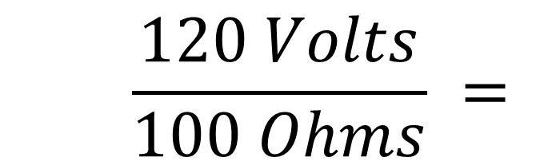


Resistance in the Body
    Ear-to-Ear ~ 100 Ohms
$$Ohms Law: \frac{Voltage}{Ohms}=Amps$$
    $$\frac{120 Volts}{100 Ohms} =$$
    $1.2 Amps$
Outcome: instant death

Slide 46
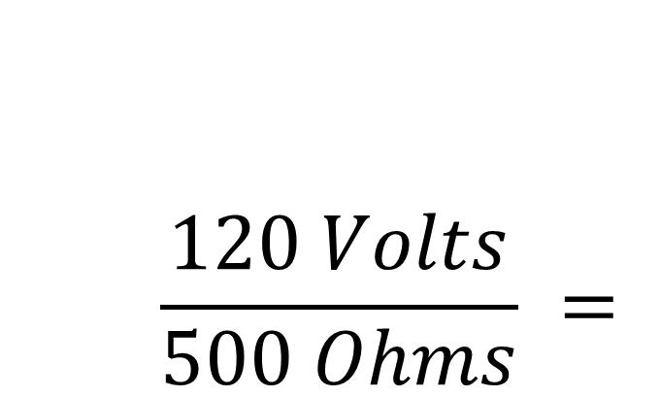
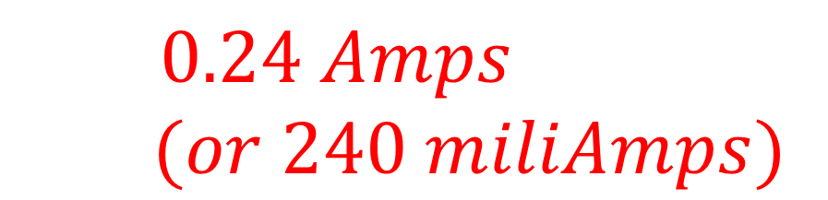
Resistance in the Body
    $$\frac{120 Volts}{500 Ohms} =$$
    Hand-to-Foot ~ 500 Ohms
    $$0.24 Amps$$
    $$(or 240 miliAmps)$$
Outcome: Severe burns, possible death

Slide 47
Basic Electrical Safe Practices
Do proactive maintenance to identify performance and safety issues
Use non-conductive tools when working around electricity
Don’t use electrical equipment with worn or frayed cords
Permanent wiring should be installed with conduit or armored cable by an electrician

Slide 48
Basic Electrical Safe Practices
Replace connections with worn or thinning insulation
Ground equipment with three-pronged plugs
Be alert for overheating equipment or “tingling”
Electrical units operated in areas exposed to flammable vapors should be explosion proof
Work in pairs to service, repair or troubleshoot electrical equipment

Slide 49
Lockout and
Tagout Programs
Notes:
https://www.pxfuel.com/en/free-photo-jgxqs
Listed as CC in Google Image Search 5/1/23
https://creativecommons.org/licenses/publicdomain/

Slide 50
Lockout and Tagout Basics
Notify affected employees that the lockout/tagout procedure will be used and why
Shut down equipment using normal shut down procedures
Isolate the equipment from energy sources and ensure stored energy is dissipated
Lockout and tagout the energy isolating device with the assigned individual lock and tag

Slide 51
Lockout and Tagout Basics
Confirm the circuit is dead. Ensure energy source is disconnected after ensuring no personnel are exposed.
NOW, work can begin
After work is complete, tools are removed and everything is returned to working order, ensure all employees are clear then remove lockout and tagout devices
Then notify affected employees that lockout and tagout have been removed and restore power to the equipment.
Notes:
https://www.pxfuel.com/en/free-photo-jgxqs
Listed as CC in Google Image Search 5/1/23
https://creativecommons.org/licenses/publicdomain/

Slide 52
Question
Who should remove locks and tags from electrical equipment?
A) The operator who needs to use the equipment next
B) The operator who locked and tagged out the equipment
C) Any operator that is qualified as an electrician
D) Any operator on the next shift
Notes:
Who should remove locks and tags from electrical equipment?
The operator who needs to use the equipment next
The operator who locked and tagged out the equipment
Any operator that is qualified as an electrician
Any operator on the next shift

Slide 53
Question
Who should remove locks and tags from electrical equipment?
A) The operator who needs to use the equipment next
B) The operator who locked and tagged out the equipment
C) Any operator that is qualified as an electrician
D) Any operator on the next shift
Notes:
Who should remove locks and tags from electrical equipment?
The operator who needs to use the equipment next
The operator who locked and tagged out the equipment
Any operator that is qualified as an electrician
Any operator on the next shift
Time check: 32:00

Slide 54
Never remove lockout and tagout equipment that someone else installed!

Slide 55
Chemical Hazards

Slide 56

Chemical Hazards
Burns
Respiratory Damage
Eye Damage
Rashes
Skin Damage
Headaches
Death

Slide 57
Acute vs Chronic Effects
Acute: Short-term effects occur with contact and usually resolve when no longer in contact or with medical treatment.
Chronic: Long-term effects that may not appear immediately or after a single exposure. May or may not be reversible.

Slide 58
Acids and Bases
Corrosive
Hazards:
  Chemical burns
  Toxic
  Fire
Harmful to tissue and mucus membranes

Slide 59
Hazard Communication
“Fire Diamond” or “Safety Square”
NFPA 704: Standard System for Identification of Hazards of Materials for Emergency Response

Slide 60
Hazard Communication

Slide 61
Safety Data Sheets

Slide 62
Safety Data Sheets

Slide 63
Safety Data Sheets

Slide 64
Safety Data Sheets

Slide 65
Let’s Talk About Chlorine

Slide 66
You DON’T want chlorine here
Notes:
Photo by Victor Freitas on Unsplash

Slide 67
Or here…
Notes:
Photo by Robina Weermeijer on Unsplash

Slide 68
Mishandling chlorine can kill you
Notes:
Photo by Waldemar on Unsplash

Slide 69
Chlorine Exposure Effects
ppm in Air by Volume | Health Effect
1 | Slight Symptoms after several hours’ exposure
0.3 to 3.5 | Detectable Odor
5 | Noxiousness
15 | Throat Irritation
30 | Coughing
40 | Dangerous after 30 minutes
1000 | Death after a few deep breaths

Slide 70
Know your safety equipment
Where it is, how and when to use it, and how to maintain it

Slide 71
Respirator with cartridges:
For escape purposes only
Notes:
Image: https://www.grainger.com/product/HONEYWELL-NORTH-Full-Face-Respirator-Silicone-5AC56?gucid=N%3AN%3APS%3APaid%3AGGL%3ACSM-2295%3A4P7A1P%3A20501231&gclid=CjwKCAjw9J2iBhBPEiwAErwpeayfzlJwrFixlb22YTsrYPKOnJV-w4g_-QaoQbV119H3FjZTmXikVhoCGC4QAvD_BwE&gclsrc=aw.ds
Noted as creative commons licensed in Google Image Search

Slide 72
If O₂ level drops below 12%, there’s not enough oxygen to sustain you.
Notes:
Image: https://www.grainger.com/product/HONEYWELL-NORTH-Full-Face-Respirator-Silicone-5AC56?gucid=N%3AN%3APS%3APaid%3AGGL%3ACSM-2295%3A4P7A1P%3A20501231&gclid=CjwKCAjw9J2iBhBPEiwAErwpeayfzlJwrFixlb22YTsrYPKOnJV-w4g_-QaoQbV119H3FjZTmXikVhoCGC4QAvD_BwE&gclsrc=aw.ds
Noted as creative commons licensed in Google Image Search

Slide 73
SCBA System: b
Self Contained Breathing Apparatus
Notes:
Image: https://www.grainger.com/product/3M-SCOTT-Industrial-SCBA-792HX2?gucid=N%3AN%3APS%3APaid%3AGGL%3ACSM-2295%3A4P7A1P%3A20501231&gclid=CjwKCAjw9J2iBhBPEiwAErwpeRD_6VJi_4GN32ZDClsI6y0pf36H8SDx8mlBB6bytbJwxzbNsM_OcRoCyhIQAvD_BwE&gclsrc=aw.ds
Noted as creative commons licensed in Google Image Search

Slide 74
SCBA System: b
Requires training to use properly
Notes:
Image: https://www.grainger.com/product/3M-SCOTT-Industrial-SCBA-792HX2?gucid=N%3AN%3APS%3APaid%3AGGL%3ACSM-2295%3A4P7A1P%3A20501231&gclid=CjwKCAjw9J2iBhBPEiwAErwpeRD_6VJi_4GN32ZDClsI6y0pf36H8SDx8mlBB6bytbJwxzbNsM_OcRoCyhIQAvD_BwE&gclsrc=aw.ds
Noted as creative commons licensed in Google Image Search

Slide 75
Question
Respirators can be used without fit testing as long as they are the right size?
True
False
Notes:
Respirators can be used without fit testing as long as they are the right size?
True
False

Slide 76
Question
Respirators can be used without fit testing as long as they are the right size?
True
False
Notes:
Respirators can be used without fit testing as long as they are the right size?
True
False
False – Simply wearing a respirator that is the right size isn’t enough to ensure it works properly. A fit test is needed to check that the mask seals tightly to your face, so no harmful air leaks in. A common mistake is believing that size alone guarantees protection. Even a well-sized respirator can have small gaps if the shape doesn’t match your face exactly, allowing dangerous particles to bypass the filter. The fit test helps catch these gaps that size alone can’t reveal.
Time check 49:00

Slide 77
Confined Spaces

Slide 78
Confined Spaces
Large enough and configured so that an employee can bodily enter and perform work
Has limited or restricted means for entry and exit
Is not designed for continuous occupancy
Every entry into a confined space requires a confined space entry permit

Slide 79
Confined Space Hazards
Air contamination:
  Flammable
  Explosive
  Toxic
Explosive chemical dust
Oxygen enriched atmosphere (increases explosion risk)
Oxygen deficient atmosphere

Slide 80
Oxygen Facts
20.9% oxygen: normal conditions
<19.5% oxygen: potentially dangerous conditions
17% oxygen: shortness of breath
10% to 6% oxygen: rapid loss of consciousness
<6% oxygen: death occurs in minutes

Slide 81
Oxygen Deficiency Causes
Bacterial action using up available oxygen
Displacement of oxygen by other gases
Oxidation of metals or other materials depletes oxygen
Absorption of oxygen into surfaces
Combustion

Slide 82
Pits and Vaults
Deadly gases can accumulate, or oxygen can be displaced.
Atmospheric testing
Adequate ventilation
Corrosive gasses eat away at steps

Slide 83
Maintenance, Repairs, etc.
Notes:
Image: Valerie Edwards: https://www.flickr.com/photos/valeriebb/2719873655/
https://creativecommons.org/licenses/by-sa/2.0/

Slide 84
Permits and Monitors

Slide 85
Question
What is the minimum acceptable oxygen concentration for safe entry into a confined space?
A) 20.9%
B) 19.5%
C) 10%
D) 5%
Notes:
What is the minimum acceptable oxygen concentration for safe entry into a confined space?
A) 20.9%
B) 19.5%
C) 10%
D) 5%

Slide 86
Question
What is the minimum acceptable oxygen concentration for safe entry into a confined space?
A) 20.9%
B) 19.5%
C) 10%
D) 5%
Notes:
What is the minimum acceptable oxygen concentration for safe entry into a confined space?
A) 20.9%
B) 19.5%
C) 10%
D) 5%
20.9% oxygen: normal conditions
<19.5% oxygen: potentially dangerous conditions
17% oxygen: shortness of breath
10% to 6% oxygen: rapid loss of consciousness
<6% oxygen: death occurs in minutes
Time check: 55 min

Slide 87
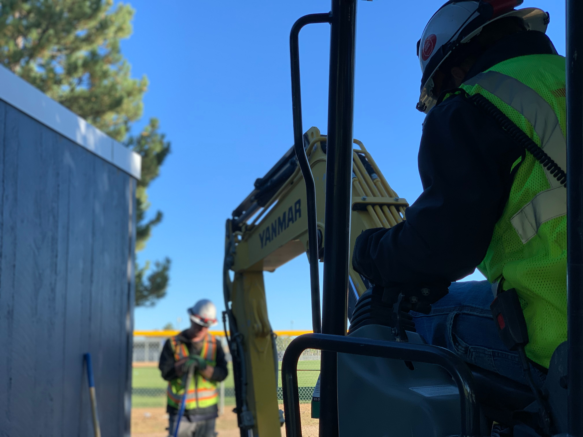
Excavation Hazards
Notes:
Photo by Troy Bridges on Unsplash

Slide 88
When trenches without adequate cave in protection collapse there is usually no warning and no time to escape.

Slide 89
OSHA requires protection if an excavation is
5 feet or more in depth.

Slide 90
NMED recommends protection if an excavation is
4 feet or more in depth.

Slide 91
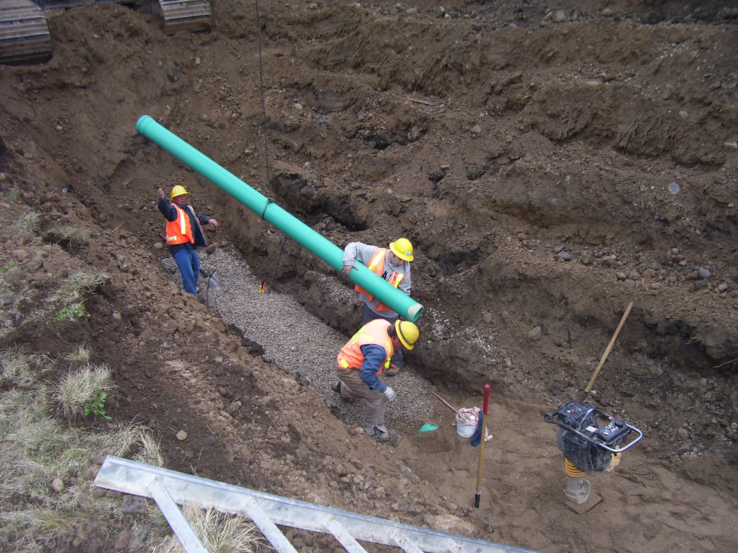
Protection:
Shoring, Shielding, and Sloping
Notes:
By en:User:Imprezzive1 - English Wikipedia, original description is/was here., Public Domain, https://commons.wikimedia.org/w/index.php?curid=2385305

Slide 92
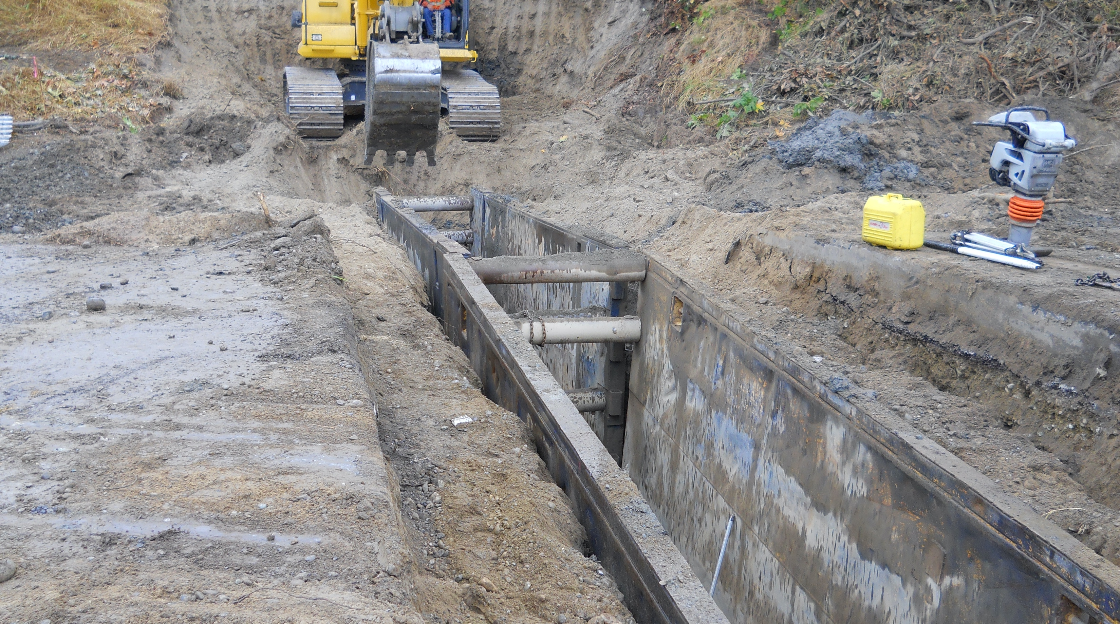
Shoring
Notes:
Washington State Dept of Transportation
https://flickr.com/photos/wsdot/8033733048
https://creativecommons.org/licenses/by-nc-nd/2.0/

Slide 93
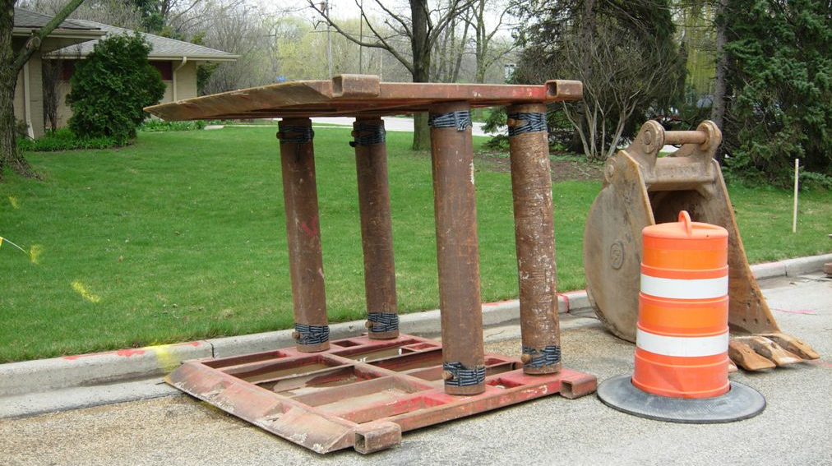
Shielding (Trench Boxes)
Notes:
https://flickr.com/photos/87297882@N03/15496057702
https://creativecommons.org/licenses/by-nc-nd/2.0/

Slide 94
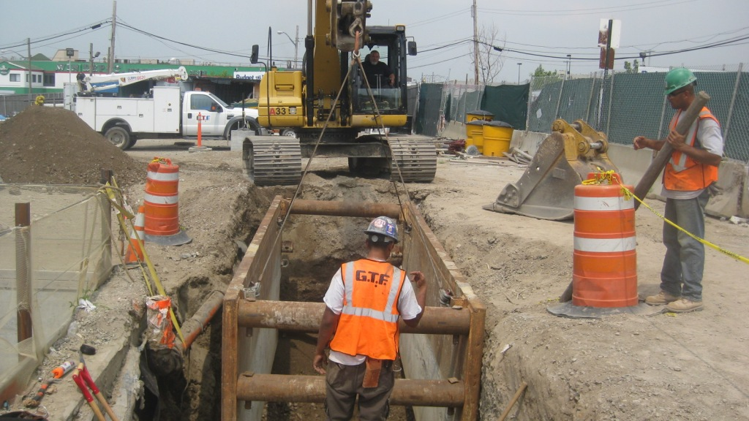
Shielding (Trench Boxes)
Notes:
https://flickr.com/photos/mtacc-esa/7747844774
https://creativecommons.org/licenses/by-nc-nd/2.0/

Slide 95
Sloping
Notes:
By en:User:Imprezzive1 - English Wikipedia, original description is/was here., Public Domain, https://commons.wikimedia.org/w/index.php?curid=2385305

Slide 96
The acceptable slope angle:
34 degrees or
slope of 1.5 : 1 (run over rise)
1.5 ft of horizontal excavation for every 1 ft vertical, on both sides of the trench.
Notes:
Read the slide

Slide 97
34º or 1.5 : 1 Slope (on both sides)
7.5 Feet
7.5 Feet
5 Ft Deep Trench
34 degrees

Slide 98
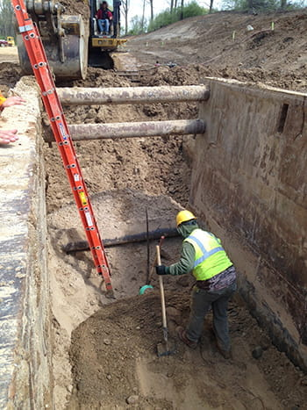
Ladders
Are required every 25 lateral feet
Must extend at least 3 feet above the excavation wall
Must be placed on firm ground within the trench
Image: https://www.michigan.gov/leo/bureaus-agencies/miosha/topics/excavation-and-trenching
Notes:
Read slide

Slide 99
Question
What does the “1.5 to 1 rule” in excavation mean?
A) Excavations should not be more than 1.5 feet deep
B) The width of an excavation should be 1.5 times its depth
C) For every 1 foot depth, the excavation should be 1.5 feet wide
D) Shoring is not required up to a depth of 1.5 feet
Notes:
What does the “1.5 to 1 rule” in excavation mean?
a) Excavations should not be more than 1.5 feet deep
b) The width of an excavation should be 1.5 times its depth
c) For every 1 foot depth, the excavation should be 1.5 feet wide
d) Shoring is not required up to a depth of 1.5 feet

Slide 100
Question
What does the “1.5 to 1 rule” in excavation mean?
A) Excavations should not be more than 1.5 feet deep
B) The width of an excavation should be 1.5 times its depth
C) For every 1 foot depth, the excavation should be 1.5 feet wide
D) Shoring is not required up to a depth of 1.5 feet
Notes:
What does the “1.5 to 1 rule” in excavation mean?
a) Excavations should not be more than 1.5 feet deep
b) The width of an excavation should be 1.5 times its depth
c) For every 1 foot depth, the excavation should be 1.5 feet wide
d) Shoring is not required up to a depth of 1.5 feet
Time check 58:00

Slide 101
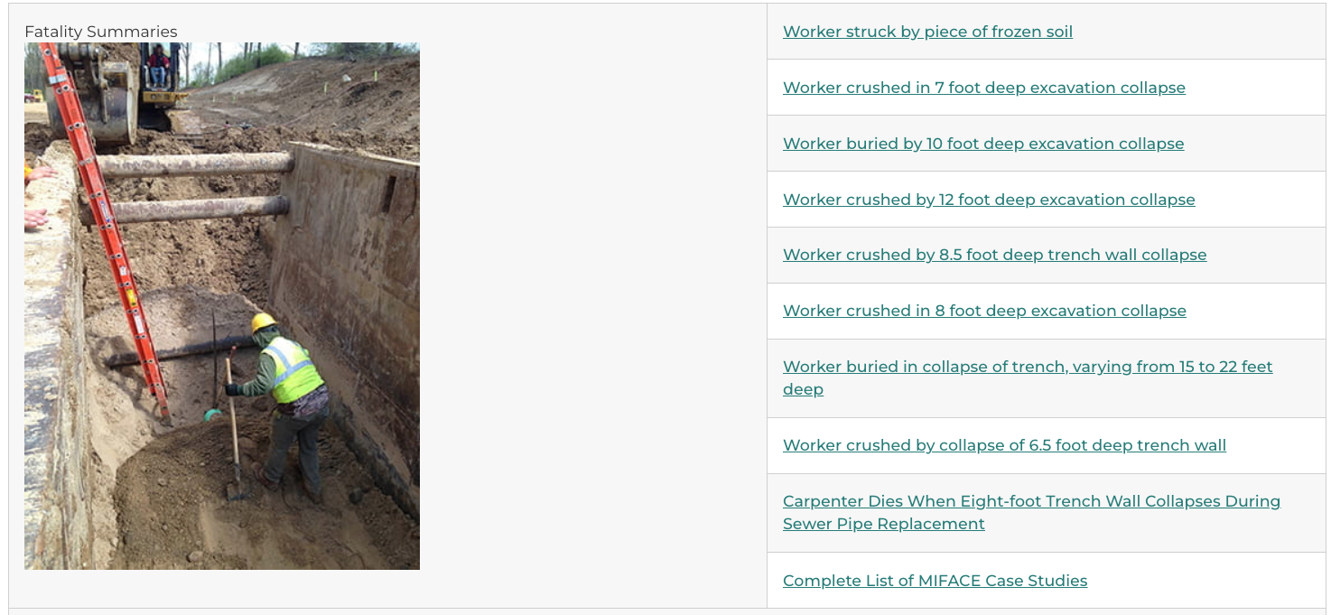
Don’t be the headline.

Slide 102
There are other hazards that we did not cover today.
Study available materials.
Follow your safety program.
Use your head.

Slide 103
CONTACT INFORMATION
Department of Civil Engineering MSC01 1070
1 University of New Mexico
Albuquerque, NM 87131
swefctribal@unm.edu
http://swefc.unm.edu
Michelle Olson: meolson@unm.edu

