Slide 1





US Territories Water Operator Training Series
Session 15: Drinking Water Treatment Math
2/5/2026
www.efcnetwork.org
This program is made possible under a cooperative agreement with US EPA.

Slide 2


Matt Ziegler
Program Director
Your trainer for today

Slide 3



This training series is funded by the US EPA

Slide 4


Slide 5
Schedule for 2026:
Date | Topic
1/22/26 | Alternative Treatment Processes (e.g. flouridation, ion exhange, RO…)
2/5/26 | Drinking Water Treatment Math & Concept Review
2/19/26 | Safety Program Basics (including personal safety, equipment safety, facility safety)
3/5/26 | Lead & Copper Rule, Corrosion Control
3/19/26 | Distribution Systems 1: Hydraulics, Pipe Types, Selection, Installation, and Water Quality
4/2/26 | Distribution Systems 2: Valves, Hydrants, Meters, and Service Connections
4/16/26 | Distribution Systems 3: Storage and Booster Pumping
4/30/26 | O&M: Pumps, Main, and Appurtenance Maintenance (including pressure monitoring, valve exercising, and flushing)
5/14/26 | O&M: Cross Connection Control
5/28/26 | O&M: Distribution System Math and Concept Review
6/11/26 | Sampling & Lab Procedures/Analysis/Interpretation
6/25/26 | Management Overview (including organization, communication, PR & record keeping)
7/9/26 | Drinking Water Practice Exam and Review
Links to recordings and material are available on our website at https://swefc.unm.edu/home/op-cert-trainings/

Slide 6

https://swefc.unm.edu/home/op-cert-trainings/

Slide 7

Sign in for every session to ensure you get credit for attending

Slide 8
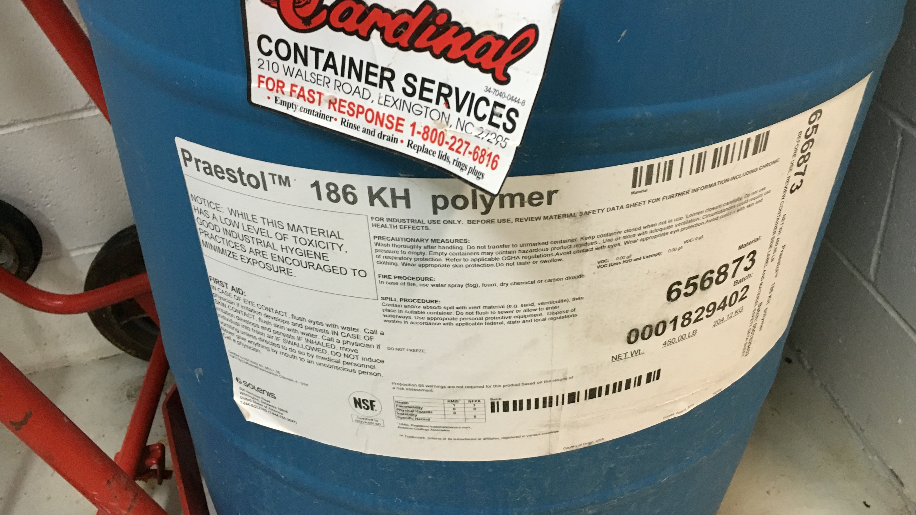
Feed Rate
Chemicals That Are Not Chlorine

Slide 9
How many pounds per day of alum, is needed to treat 8.2 MGD to a dosage of 12 mg/L? The purity of the alum is 49%.
Example
Flow rate = 8.2 MGD
Dosage = 12 mg/L
Purity = 49% = 0.49
Feed Rate, lb/day = $\frac{\left(12 mg/L\right)\left(8.2 MGD\right)\left(8.34 lb/gal\right)}{0.49}=1,675 lb/day$
1,675 pounds/day of 49% alum are required to treat 8.2 MGD to a dosage of 12 mg/L.

Slide 10

If 16.34 lbs/day of zinc orthophosphate has been fed into a 1 MGD water system, determine the average dose in mg/L.
1
Practice
Feed rate = 16.34 lb/day
Flow rate = 1.0 MGD
Purity = 100% = 1
$$Dosage,mg/L=\frac{\left(Feed Rate, lb/day\right)\left(Purity\right)}{\left(8.34 lb/gal\right)(Flow, MGD)}$$
$$Dosage, mg/L=\frac{\left(16.34 lb/day\right)\left(1\right)}{\left(8.34 lb/gal\right)\left(1.0 MGD\right)}=1.96 mg/L$$
2.0 mg/L is the average dose of zinc orthophosphate when 1 MGD of water is treated with 16.34 lbs/day.

Slide 11
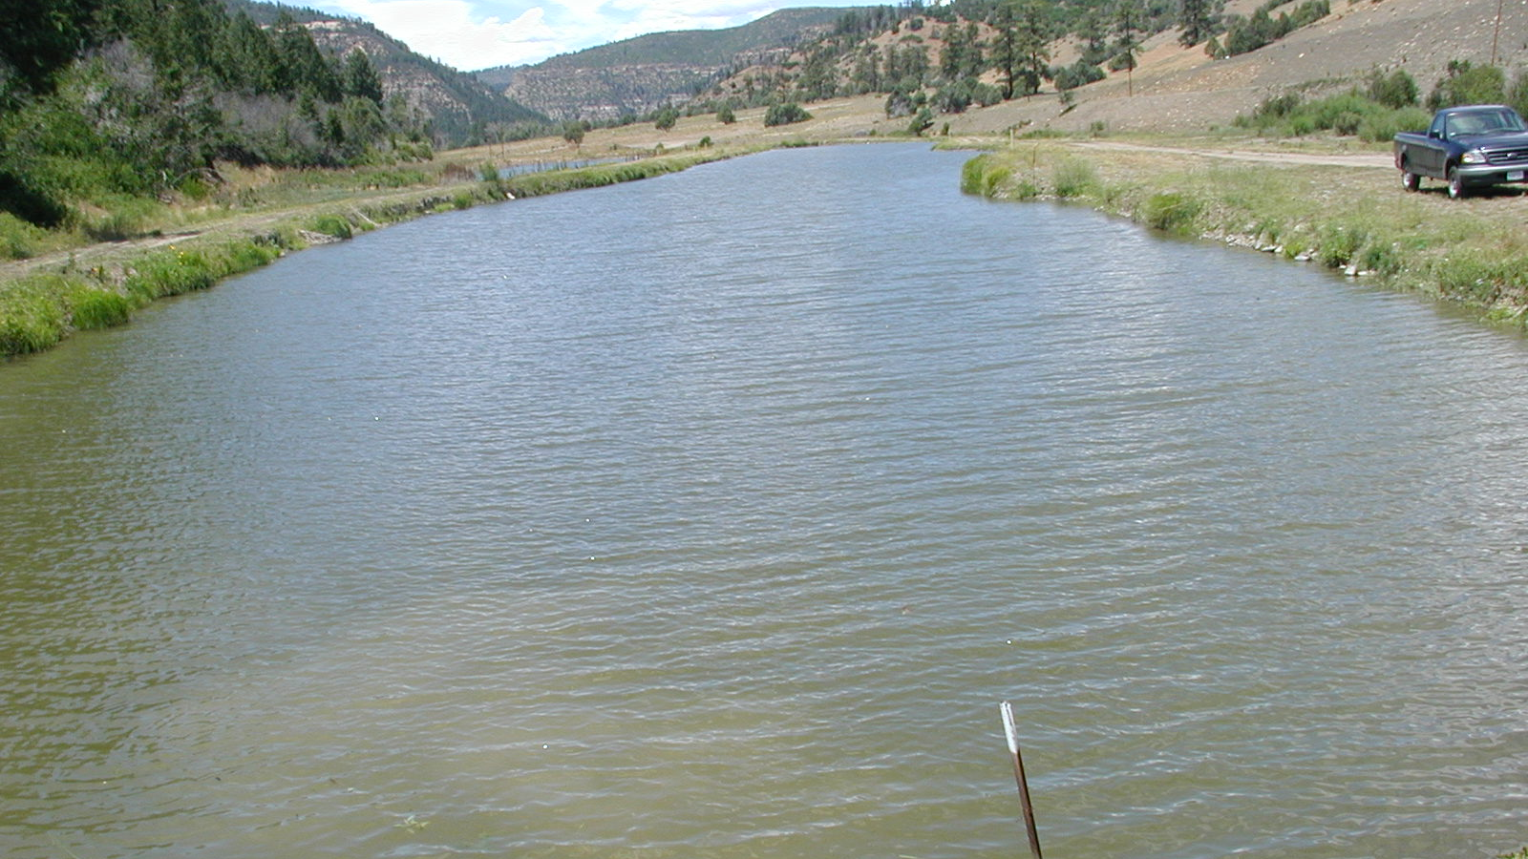
Surface Area Application of Chemicals

Slide 12

Copper sulfate is used for algae control. Your reservoir is 1,200 ft long and 600 ft wide. At an application rate of 5.5 lb per surface acre, how much copper sulfate is required?
Example
No Equation on Formula Sheet
Reservoir length = 1,200’
Reservoir width = 600’
Application rate = 5.5 lb/acre
$$Reservoir area, ft^{2}=1,200 ft x 600 ft=720,000 ft^{2}$$
$$Reservoir area, acres=720,000 ft^{2}x\frac{1 acre}{43,560 ft^{2}}=16.5 acres$$
$$Copper Sulfate, lb=16.5 acres x\frac{5.5 lb}{acre}=91 lb$$
91 lbs of copper sulfate are needed to treat a 1,200’ x 600’ reservoir at an application rate of 5.5 lb per surface acre.

Slide 13
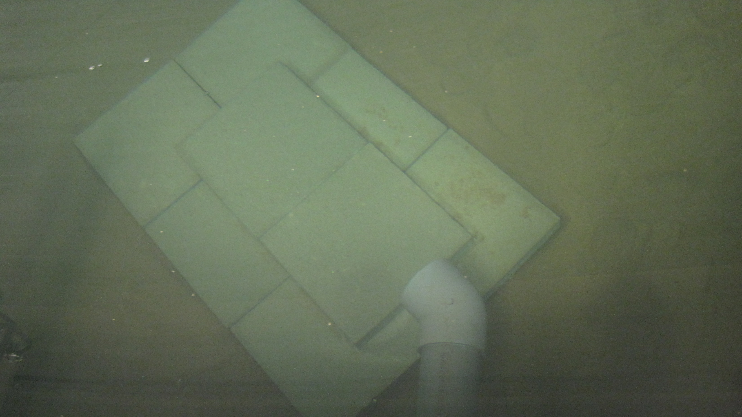
Filter Loading Rate

Slide 14
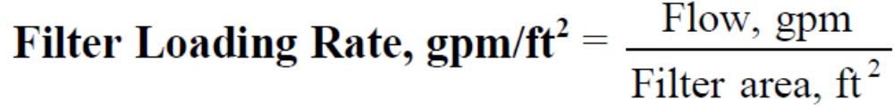
Filter Loading Rate
Also known as the Filtration Rate.
Measured in gpm/ft².
Allows comparison of actual conditions with design specifications.

Slide 15
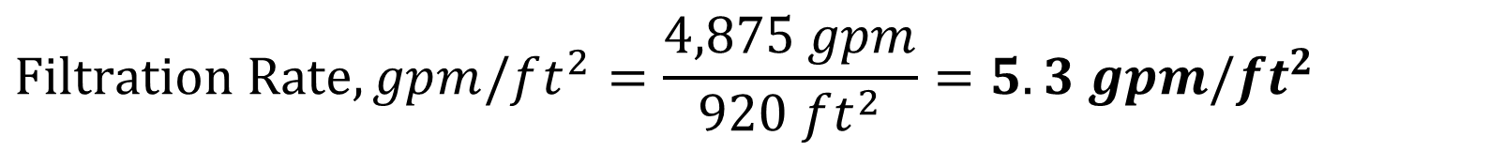
A filter has a surface area of 920 sq ft. What is the filtration rate in gallons per minute per square foot, if it receives a flow of 4,875 gpm?
Example
Filter surface area = 920 ft²
Flow = 4,875 gpm
$$Filtration Rate,gpm/ft^{2}=\frac{4,875 gpm}{920 ft^{2}}=5.3 gpm/ft^{2}$$
5.3 gpm/ft² is the filtration rate for this filter at a flow rate of 4,875 gpm.

Slide 16
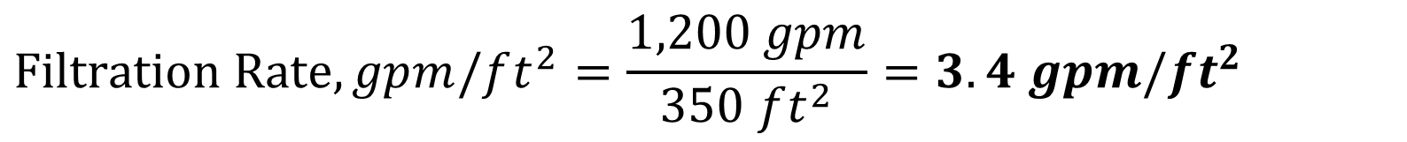
A filter has a surface area of 350 sq ft. What is the filtration rate in gallons per minute per square foot, if it receives a flow of 1,200 gpm?
Practice
2
Filter surface area = 350 ft²
Flow = 1,200 gpm
$$Filtration Rate,gpm/ft^{2}=\frac{1,200 gpm}{350 ft^{2}}=3.4 gpm/ft^{2}$$
3.4 gpm/ft² is the filtration rate for this filter at a flow rate of 1,200 gpm.

Slide 17
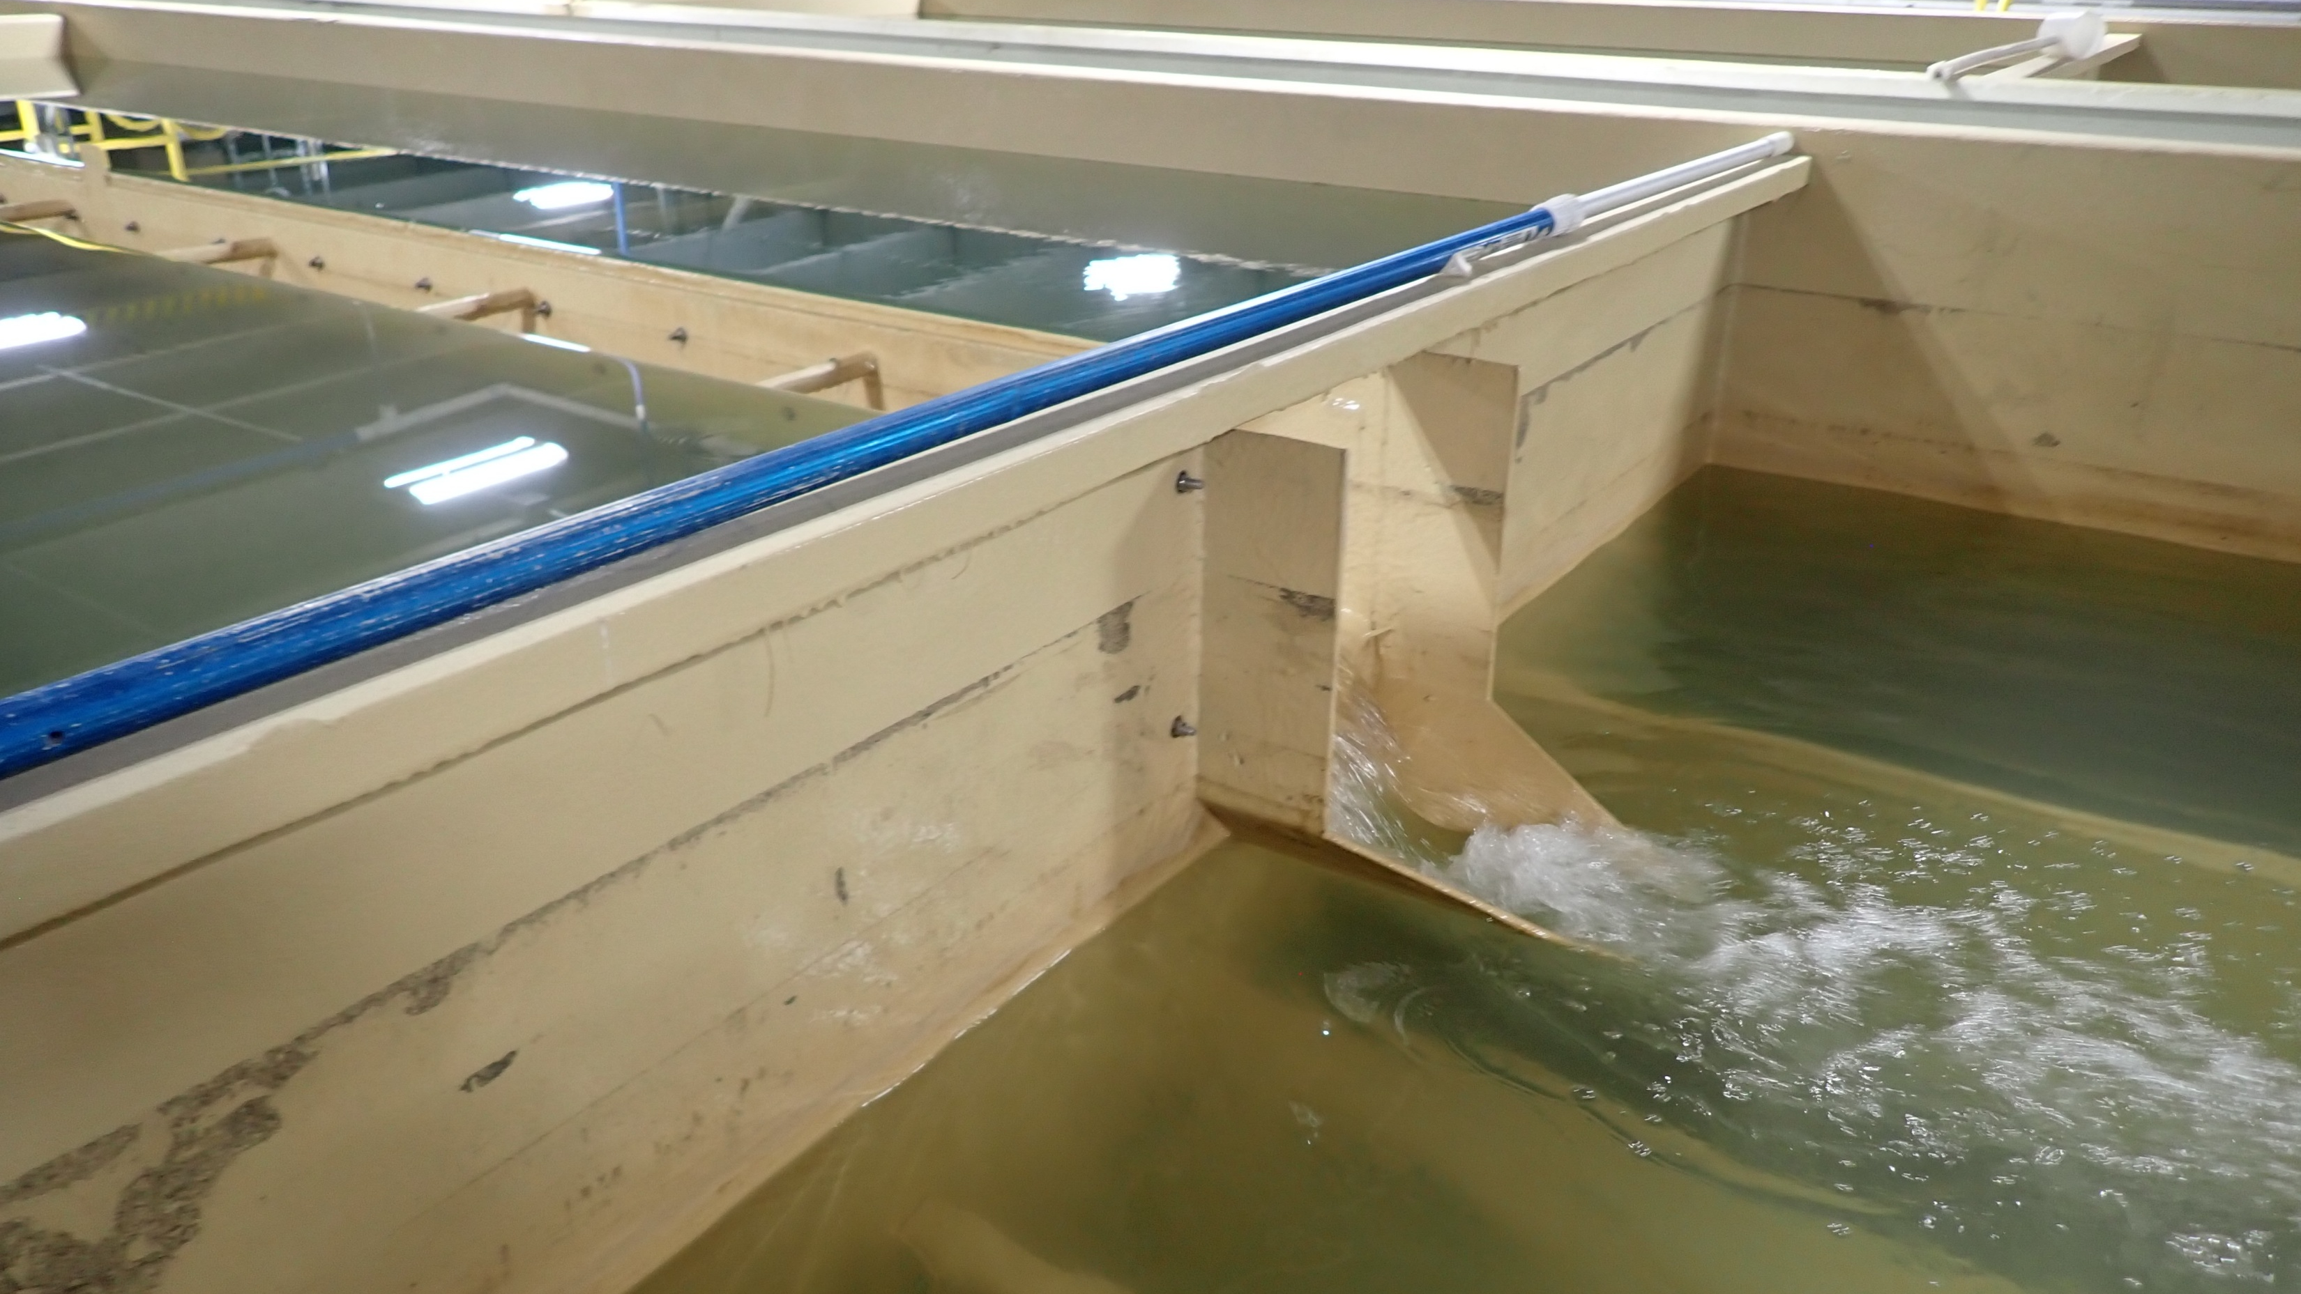
Surface Loading Rate

Slide 18
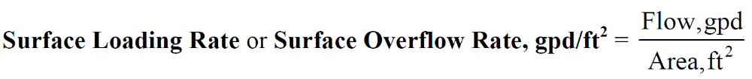
Surface Loading Rate
The amount of water per day (gpd) passing over 1 square foot (ft²) of a treatment process.
Allows comparison of actual conditions with design specifications.
AKA – Surface Settling Rate or Surface Overflow Rate

Slide 19
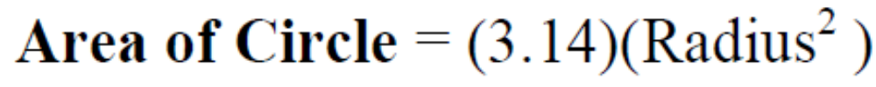
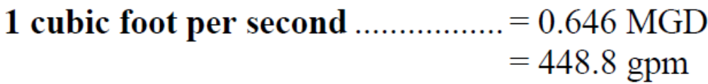
What is the surface loading rate for a circular clarifier that is 90 feet in diameter, if it is treating an instantaneous flow rate of 5 cfs?
Example
Clarifier = 90 ft diameter
Flow rate = 5 cfs
Need flow in gpd &
Need area in ft²

Slide 20
What is the surface loading rate for a circular clarifier that is 90 feet in diameter, if it is treating an instantaneous flow rate of 5 cfs?
Example
Flow rate = 5 cfs (convert to gpd)
$$Flow Rate, gpd=5 cfs x\frac{0.646 MGD}{1 cfs}=3.23 MGD=3,230,000 gpd$$
Clarifier = 90 ft diameter (calculate area)
$$Clarifier Area, ft^{2}=0.785 x{\left(90 ft\right)}^{2}=6,359 ft^{2}$$

Slide 21
What is the surface loading rate for a circular clarifier that is 90 feet in diameter, if it is treating an instantaneous flow rate of 5 cfs?
Example
Flow rate = 3,230,000 gpd
Clarifier area = 6,359 ft²
$$Surface Loading Rate,gpd/ft^{2}=\frac{3,230,000 gpd}{6,359 ft^{2}}=508 gpd/ft^{2}$$
508 gpd/ft² is the surface loading rate for this circular clarifier at a flow rate of 5 cfs.

Slide 22
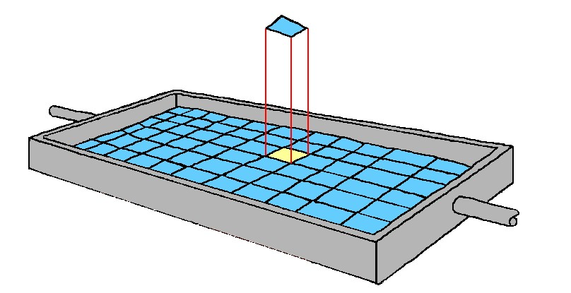
A rectangular sedimentation basin measures 375 ft by 50 ft, what is the surface loading rate if it is treating an instantaneous flow rate of 17 cfs?
Practice
Sedimentation basin = 375 ft x 50 ft
Flow rate = 17 cfs
Need flow in gpd &
Need area in ft²
375 ft
50 ft

Slide 23
A rectangular sedimentation basin measures 375 ft by 50 ft, what is the surface loading rate if it is treating an instantaneous flow rate of 17 cfs?
Practice
Flow rate = 17 cfs (convert to gpd)
3
$$Flow Rate, gpd=17 cfs x\frac{0.646 MGD}{1 cfs}=10.982 MGD=10,982,000 gpd$$
Sedimentation basin = 375 ft x 50 ft (calculate area)
4
$$Sedimentation Basin Area, ft^{2}=375 ft x 50 ft=18,750 ft^{2}$$

Slide 24
A rectangular sedimentation basin measures 375 ft by 50 ft, what is the surface loading rate if it is treating an instantaneous flow rate of 17 cfs?
5
Practice
Flow rate = 10,982,000 gpd
Sedimentation basin area = 18,750 ft²
$$Surface Loading Rate,gpd/ft^{2}=\frac{10,982,000 gpd}{18,750 ft^{2}}=586 gpd/ft^{2}$$
586 gpd/ft² is the surface loading rate for this sedimentation basin at a flow rate of 17 cfs.

Slide 25
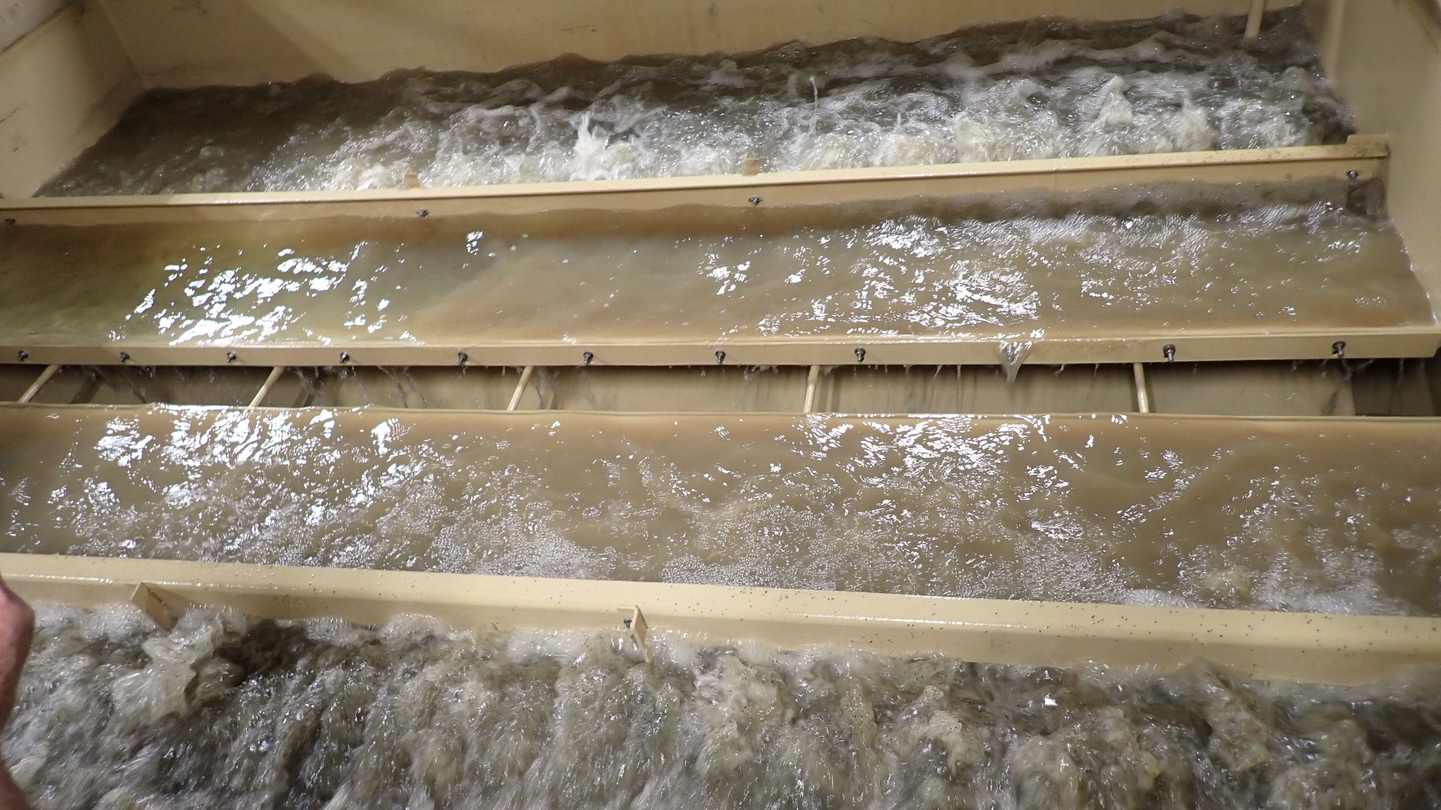
Backwash Rate & Backwash Rise Rate

Slide 26
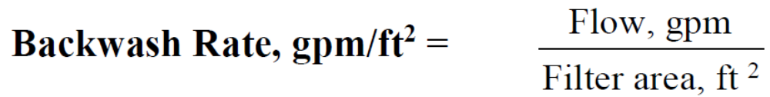
Backwash Rate
Backwash rate is the movement of water in the opposite direction of filtration to clean and remove filtered solids.
Measured in gpm/ft².
Allows comparison of actual conditions with design specifications.
No direct formula on the ABC formula sheet.
Can Adapt Formula

Slide 27
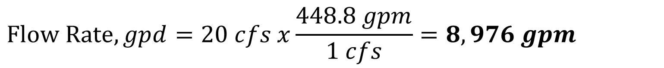
A filter has an area of 840 sq ft with a backwash pumping rate of 20 cfs. What is the backwash rate in gallons per minute per square foot?
Example
Filter area = 840 ft²
Flow rate = 20 cfs
Need flow in gpm
$$Flow Rate, gpd=20 cfs x\frac{448.8 gpm}{1 cfs}=8,976 gpm$$

Slide 28
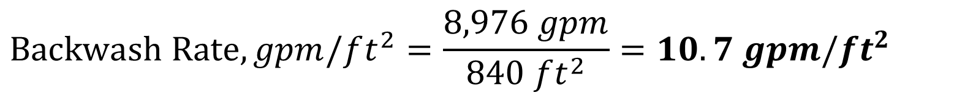
A filter has an area of 840 sq ft with a backwash pumping rate of 20 cfs. What is the backwash rate in gallons per minute per square foot?
Example
Filter area = 840 ft²
Flow rate = 8,976 gpm
$$Backwash Rate, gpm/ft^{2}=\frac{8,976 gpm}{840 ft^{2}}=10.7 gpm/ft^{2}$$
10.7 gpm/ft² is the backwash rate for this filter at a flow of 20 cfs.

Slide 29
Based on your calculation of the filter backwash rate in Question Ex3, what is the filter backwash rise rate for this filter in inches/minute?
Example
Filter backwash rate = 10.7 gpm/ft²
$$Filter Backwash Rise Rate,in/min=\frac{(10.7gpm/ft^{2})12in/ft}{7.48gal/ft^{3}}=17.2 in/min$$
17.2 in/min is the filter backwash rise rate for this filter if it is backwashed at a rate of 10.7 gpm/ft².

Slide 30
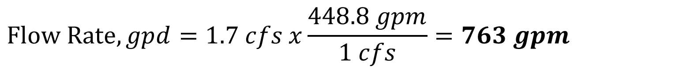
A filter has an area of 50 sq ft with a backwash pumping rate of 1.7 cfs. What is the backwash rate in gallons per minute per square foot?
Practice
Filter area = 50 ft²
Flow rate = 1.7 cfs
Need flow in gpm
6
$$Flow Rate, gpd=1.7 cfs x\frac{448.8 gpm}{1 cfs}=763 gpm$$

Slide 31

A filter has an area of 50 sq ft with a backwash pumping rate of 1.7 cfs. What is the backwash rate in gallons per minute per square foot?
Practice
7
Filter area = 50 ft²
Flow rate = 763 gpm
$$Backwash Rate,\frac{gpm}{ft^{2}}=\frac{763 gpm}{50 ft^{2}}=15.3 gpm/ft^{2}$$
15.3 gpm/ft² is the backwash rate for this filter at a flow of 1.7 cfs.

Slide 32
Based on your calculation of the filter backwash rate in Question 7, what is the filter backwash rise rate for this filter in inches/minute?
8
Practice
Filter backwash rate = 15.3 gpm/ft²
$$Filter Backwash Rise Rate,in/min=\frac{(15.3 gpm/ft^{2})12in/ft}{7.48gal/ft^{3}}=24.5 in/min$$
24.5 in/min is the filter backwash rise rate for this filter if it is backwashed at a rate of 15.3 gpm/ft².

Slide 33
Percent Removal
%

Slide 34
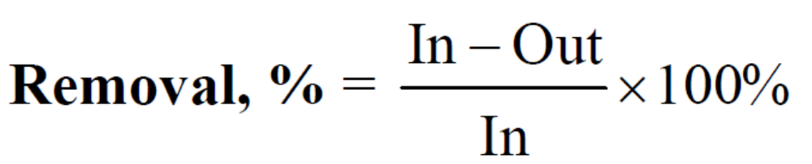
Percent Removal
The amount of a contaminant removed in percent form.
Helps determine if meet some SDWA regulatory requirements.
Helps inform if treatment plant is doing its job.
Allows comparison of actual conditions with design specifications.

Slide 35
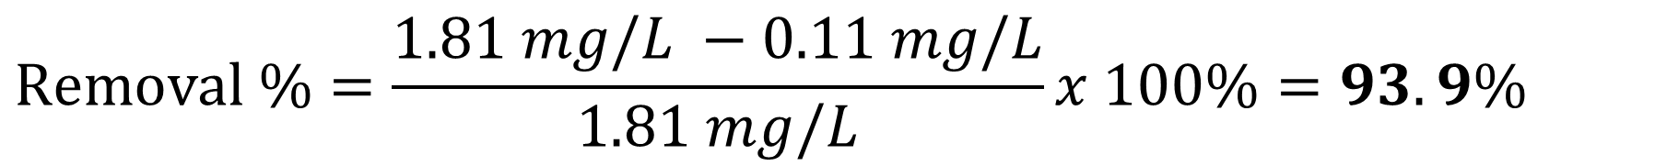
The iron content of a raw water is 1.81mg/L. What is the percent removal if the finished water contains 0.11 mg/L iron?
Example
Raw water iron (In) = 1.81 mg/L
Finished water iron (Out) = 0.11 mg/L
$$Removal \%=\frac{1.81 mg/L −0.11 mg/L}{1.81 mg/L}x 100\%=93.9\%$$
94% is the percent removal of iron in the finished water.

Slide 36
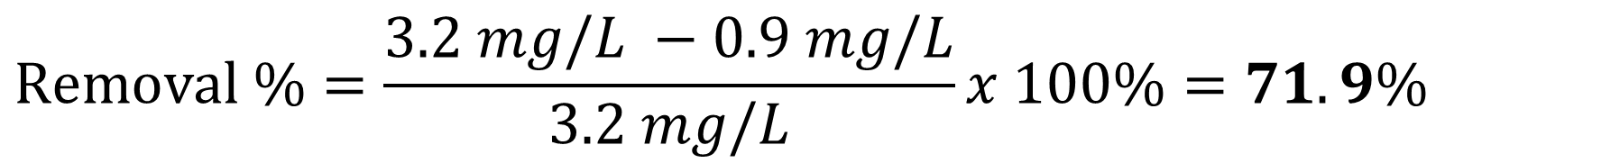
You operate a surface water treatment plant and one of the SDWA requirements as part of the DBPR is to remove a certain percentage of Total Organic Carbon. If your raw water TOC is 3.2 mg/L and your finished water TOC is 0.9 mg/L, calculate the percent removal for TOC.
9
Practice
Raw water TOC (In) = 3.2 mg/L
Finished water TOC (Out) = 0.9 mg/L
$$Removal \%=\frac{3.2 mg/L −0.9 mg/L}{3.2 mg/L}x 100\%=71.9\%$$
72% is the percent removal of TOC in the finished water.

Slide 37
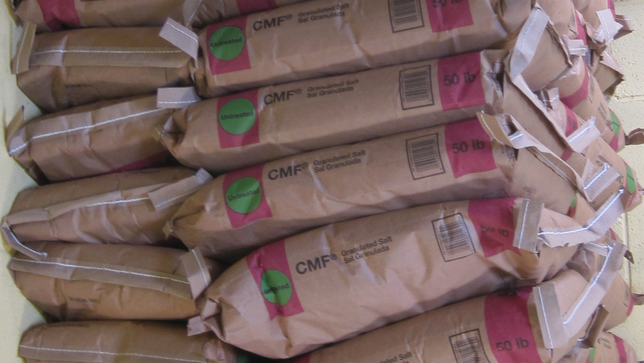
Ordering Treatment Material

Slide 38
It is time to submit an order so that you can do a maintenance on your filter to keep it operating and removing contaminants. You must add 8 inches of coal to one of the 12 ft by 8 ft filters in your treatment plant. If each bag holds 3.5 ft³, how many bags do you need to order?
Example
Height of coal = 8 inches
Filter Size = 12 ft x 8 ft
Bag size = 3.5 ft³
Need to determine volume of coal adding to filter in ft³
$$Volume of Coal, ft^{3}=\left(8 in x \frac{1 ft}{12 in}\right)x 12 ft x 8 ft=64 ft^{3}$$
$$\# of Bags=64 ft^{3}x \left(\frac{1 bag}{3.5 ft^{3}}\right)=18.3 bags$$
19 bags of coal should be ordered to add 8 inches to the filter.

Slide 39
Next time:
Date | Topic
1/22/26 | Alternative Treatment Processes (e.g. flouridation, ion exhange, RO…)
2/5/26 | Drinking Water Treatment Math & Concept Review
2/19/26 | Safety Program Basics (including personal safety, equipment safety, facility safety)
3/5/26 | Lead & Copper Rule, Corrosion Control
3/19/26 | Distribution Systems 1: Hydraulics, Pipe Types, Selection, Installation, and Water Quality
4/2/26 | Distribution Systems 2: Valves, Hydrants, Meters, and Service Connections
4/16/26 | Distribution Systems 3: Storage and Booster Pumping
4/30/26 | O&M: Pumps, Main, and Appurtenance Maintenance (including pressure monitoring, valve exercising, and flushing)
5/14/26 | O&M: Cross Connection Control
5/28/26 | O&M: Distribution System Math and Concept Review
6/11/26 | Sampling & Lab Procedures/Analysis/Interpretation
6/25/26 | Management Overview (including organization, communication, PR & record keeping)
7/9/26 | Drinking Water Practice Exam and Review
Links to recordings and material are available on our website at https://swefc.unm.edu/home/op-cert-trainings/

Slide 40
CONTACT INFORMATION
SW EFC email: swefc@unm.edu
Department of Civil Engineering MSC01 1070
1 University of New Mexico
Albuquerque, NM 87131
505-277-0644
swefc@unm.edu
http://swefc.unm.edu

