Slide 1





US Territories Wastewater Operator Training Series
Session 16: Disinfection Part 2 – Chlorination Chemistry, and Alternative Disinfection Methods
2/17/2026
www.efcnetwork.org
This program is made possible under a cooperative agreement with US EPA.
Notes:
Welcome to all of our participants from CNMI, Guam and American Samoa to session 16 in our wastewater operator training series. Today is part 2 of disinfection where we will be focusing on effluent disinfection. Today…

Slide 2


Your trainers for today:
A.J. Barney
Research Engineer
Valeria Cortes-Mora
Professional Intern

Slide 3



This training series is funded by the EPA

Slide 4


Slide 5

WPI/ABC Operator Certification
Notes:
This series is designed to supplement and reinforce the ABC Need to Know Criteria for the Wastewater Operator level 1 and 2 exams though there will be some higher level topics covered, and we won’t always follow the exact order listed in the NTKs
https://www.gowpi.org/services/abc-testing/standardized-exams/standardized-wastewater-treatment-operator-exams/

Slide 6
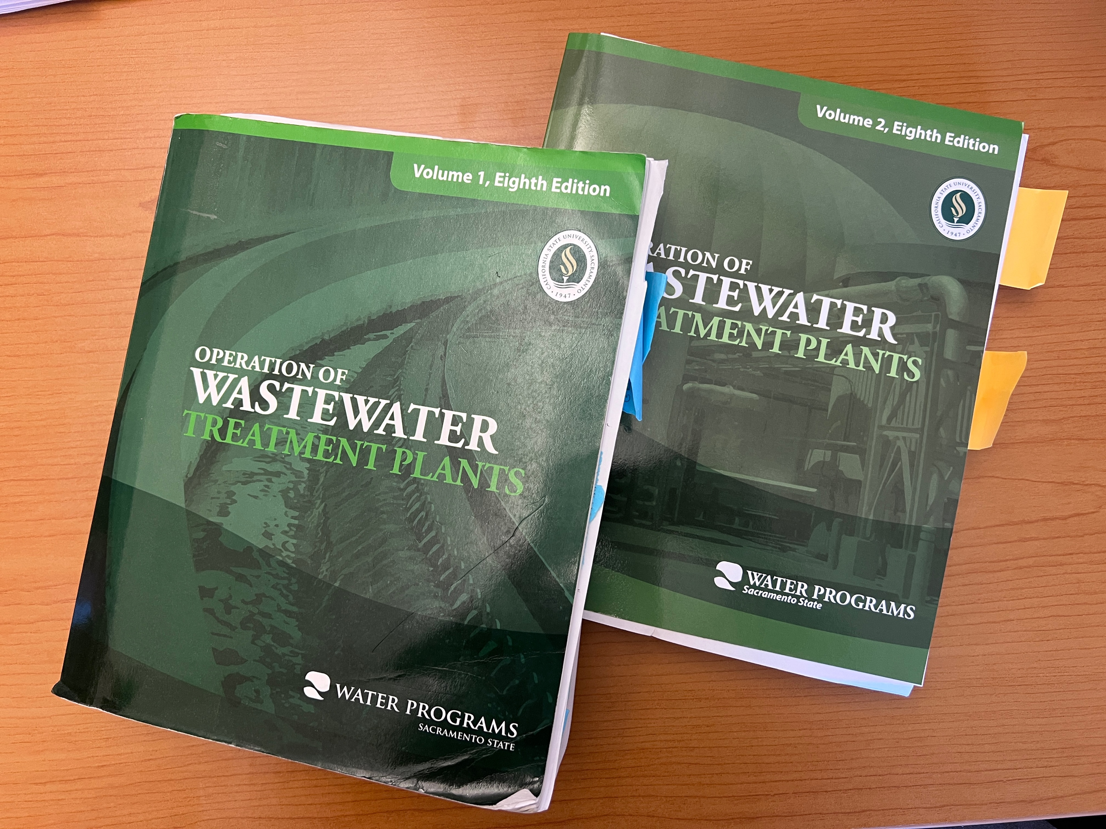
Use all your resources
Notes:
All the information we’ve covered and more is in these books – those happen to be my personal copies that I consult on the regular.

Slide 7
Schedule for 2025:
Date | Topic
1/20/26 | Concept and Math Review Session
2/3/26 | Disinfection Part 1 (chlorination/dechlorination) + related math
2/17/26 | Disinfection Part 2 - UV and other methods
3/3/26 | WW Math Part 3 (Flow, Detention Time)
3/17/26 | WW Math Part 4 (BOD Math /Advanced WW Math)
3/31/26 | Solids Handling Part 1 (Mechanical Solids Separation)
4/14/26 | Solids Handling Part 2 (Solids Handling)
4/28/26 | Sampling
5/12/26 | Regulations (NPDES Permits and Discharge Limitations)
5/26/26 | Treatment System Maintenance
6/9/26 | Lab Procedures/Analysis/Interpretation or alternate topic
6/23/26 | Using Technology in daily operations (SCADA, Computer, Tablets, CMMS, AI, etc.)
7/7/26 | Course Review Session - Short sample exam?
Notes:
26 sessions total
1 hour each
This is the schedule for the remainder of this year,
The trainers will vary depending on the topic
We’re now on session 15

Slide 8
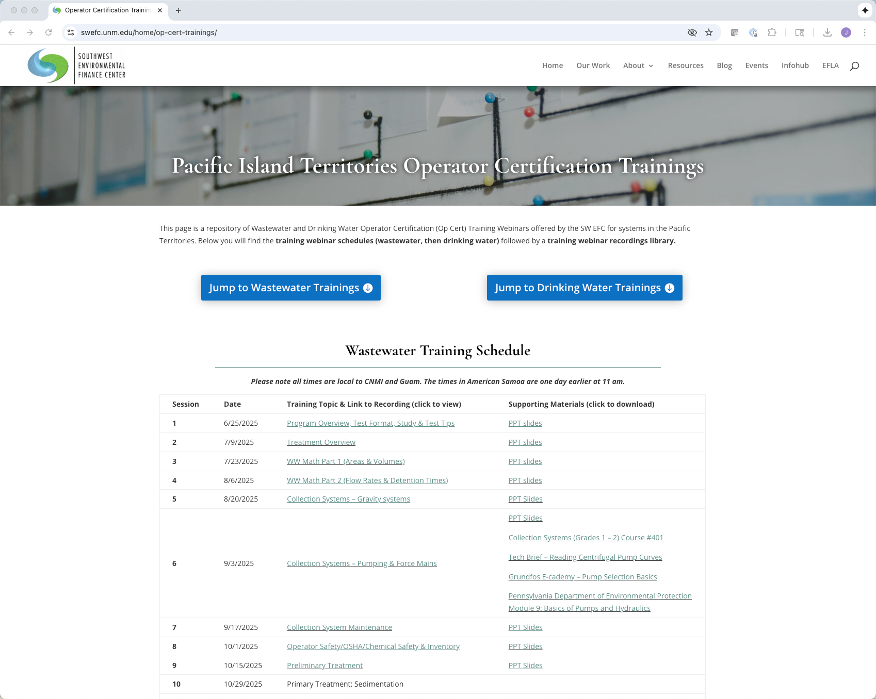
https://swefc.unm.edu/home/op-cert-trainings/
Notes:
The sessions are all being posted to our website so that you can go back and review them. I checked yesterday and all of the sessions 1-9 are posted, and this session should be posted in a day or two.

Slide 9

Sign in for every session to ensure you get credit for attending
Notes:
Be sure to sign in if you are attending in a group. The facilitator at your location will forward these to us and we will keep track of your attendance hours for credits;
With that lets get to today’s content!

Slide 10

Overview
Advanced Chlorine Chemistry
Chlorine Calculations
Alternative Methods of Disinfection
Alternative Methods Safety
Notes:
Last week we talked about chlorination and introduced a lot of important concepts that explain the chemistry involved in chlorination and today we’ll expand on that to help prepare you even more for wastewater certification with concepts like breakpoint chlorination and chloramines
Then we’ll briefly go over the types of calculations you should understand for chlorine disinfection
Then we’ll talk about alternative methods of disinection and the safety considerations that come with them.

Slide 11
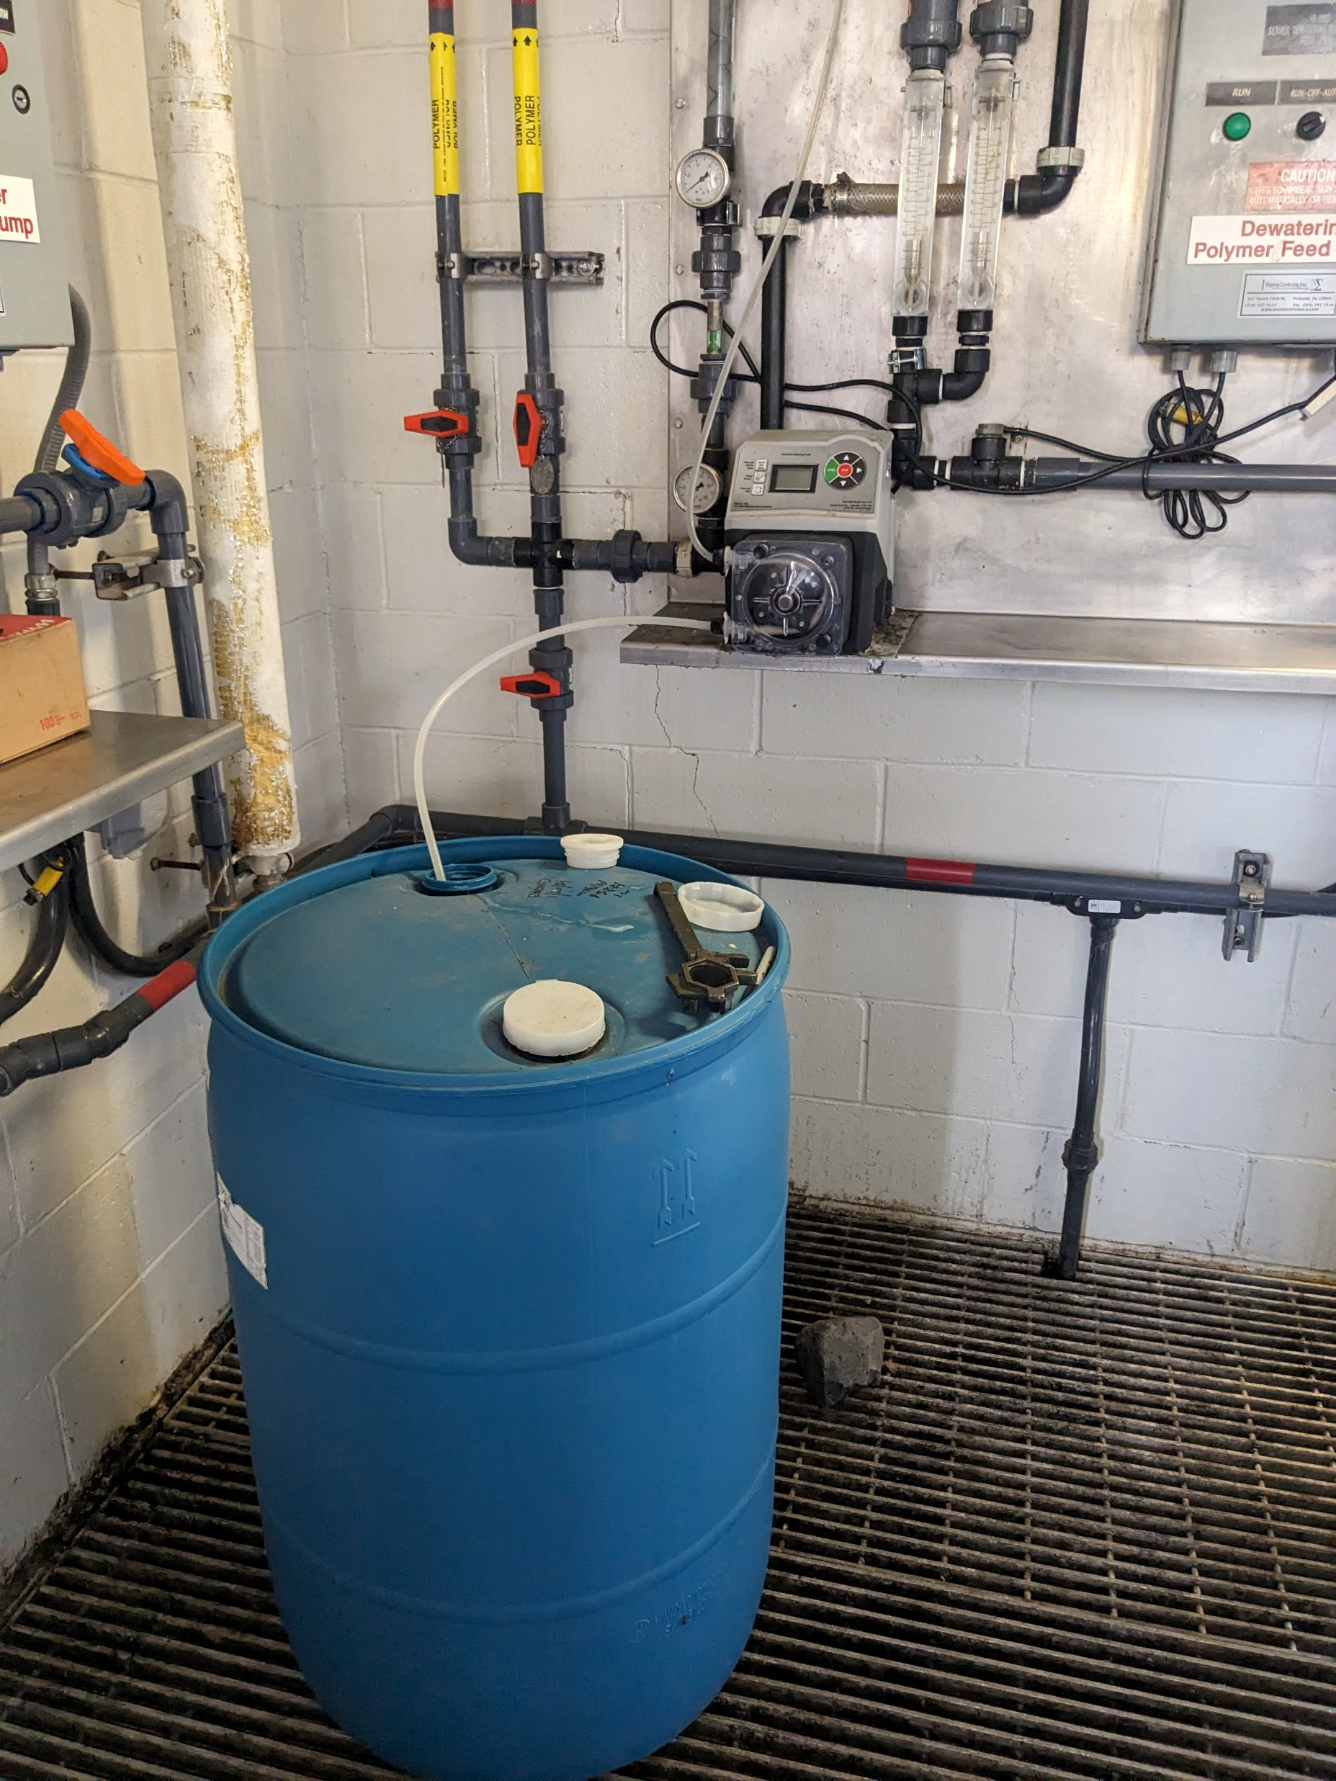
Chlorine Chemistry
Benefits of understanding chlorination chemistry
Process Control
Disinfection Efficiency
Permit Compliance
Safety
Cost
Common Certification Topic
Notes:
Process Control- Understanding the chemistry of chloring helps you understand the demand for disinfection of your system, what other parameters may be affecting chlorine disinfection, and can help with unwanted consequences of incorrect chlorine disinfection such as odors.
That process control then determines disinfection efficiency
And also effects permit compliance in both ensuring that there is enough chlorine to disinfect, but also excessive chlorine is not discharged
Excessive chlorine can also be a safety hazard so understanding it’s chemistry helps mitigate that
Then by using chlorine efficiently it helps manage costs and help your system not waste money
The final reason is that it is a common certification topic, so understanding the chemistry will help you pass your operator exams

Slide 12
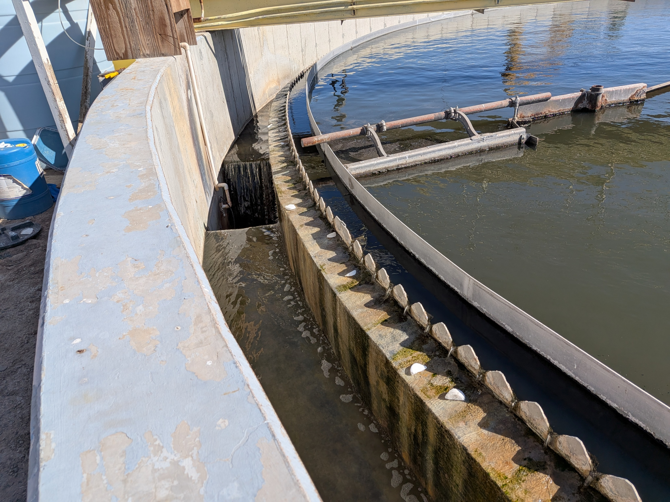
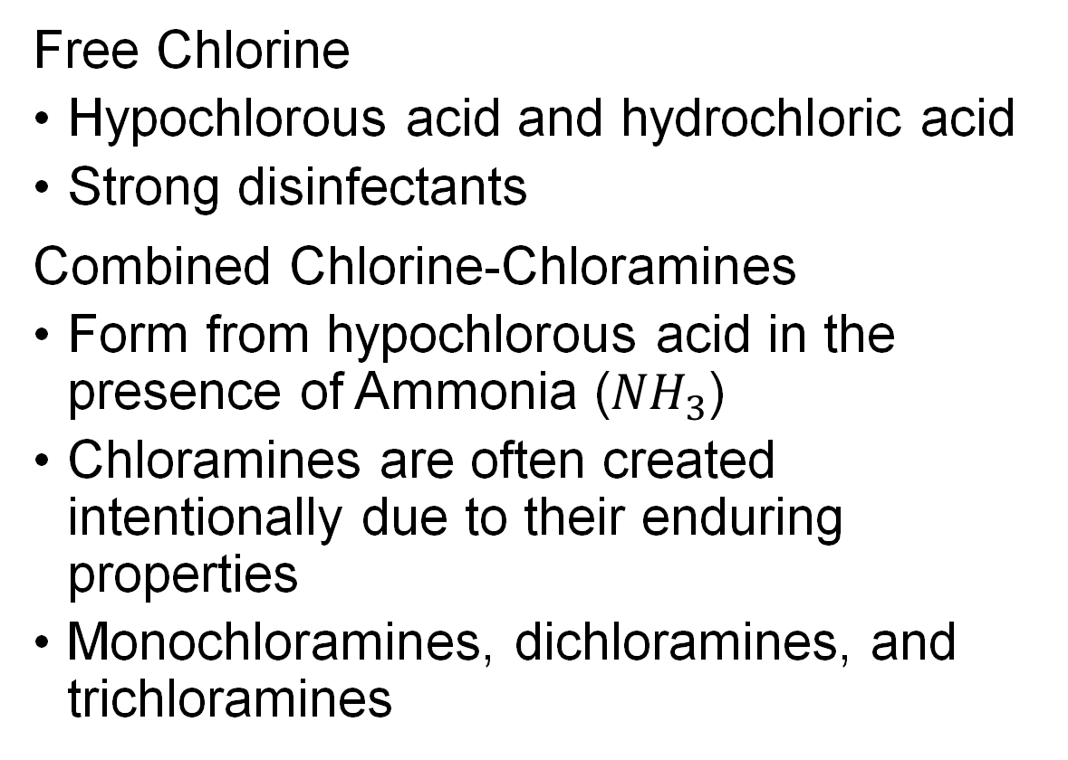
Chlorine Variations
Free Chlorine
Hypochlorous acid and hydrochloric acid
Strong disinfectants
Combined Chlorine-Chloramines
Form from hypochlorous acid in the presence of Ammonia (${NH}_{3}$)
Chloramines are often created intentionally due to their enduring properties
Monochloramines, dichloramines, and trichloramines
Notes:
First I want to quickly review the types of chlorine that were discussed in our previous presentation for this series
If you’ll remember from last week or if you weren’t able to make it last week there are two types of chlorine that are important in wastewater
The first is free chlorine which is made up of Hypochlorous acid and hydrochloric acid which are stronger disinfectants
Then there is combined chlorine in the form of Chloramines, which are longer lasting
These compounds are created when chlorine interacts with ammonia
Ammonia is an important wastewater parameter that we frequently remove during treatment so that is another reason we want other processes proceeding disinfection to operate correctly.
Reuse flow treated with chlorine is also dosed with Ammonium Sulfate [${\text{(}{NH}_{4}\text{)}}_{s}{SO}_{4}$] to create chloramines that will increase the contact time of the flow with the disinfectant
There are three types of chloramines which are monochloramines, dichloramines, and trichloramines

Slide 13
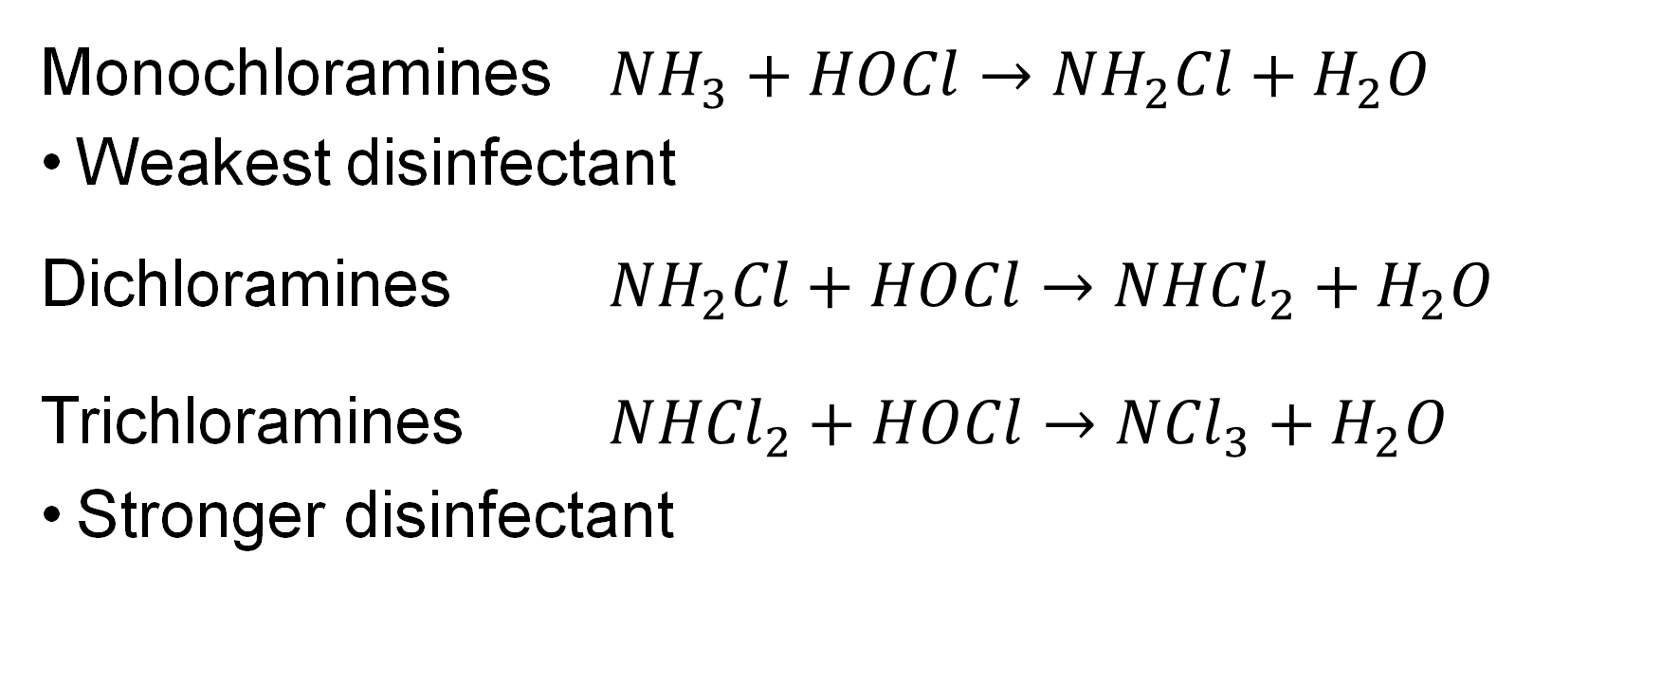
Chloramine
Monochloramines ${NH}_{3}+HOCl→{NH}_{2}Cl+H_{2}O$
Weakest disinfectant
Dichloramines ${NH}_{2}Cl+HOCl→{NHCl}_{2}+H_{2}O$
Trichloramines ${NHCl}_{2}+HOCl→{NCl}_{3}+H_{2}O$
Stronger disinfectant
Notes:
As you can see they all form under similar chemical reactions, but the chemical species is determined by pH.

Slide 14
Chloramines and pH
pH determines the concentration of the different types
Below pH = 4.0 trichloramines exist by themselves
At pH= 4.0-5.5 dichloramine is the dominant form
Both monochloramines and dichloramines exist at thel pH of 6.5-7.5 of typical wastewater flows
Notes:
So as you can see this breakdown how pH influences which type of chloramine is present in our treated wastewater.
At a pH of ….
And at around a pH of 10 or greater it is almost exclusively monochloramines present
Certification examples may state that your wastewater is

Slide 15
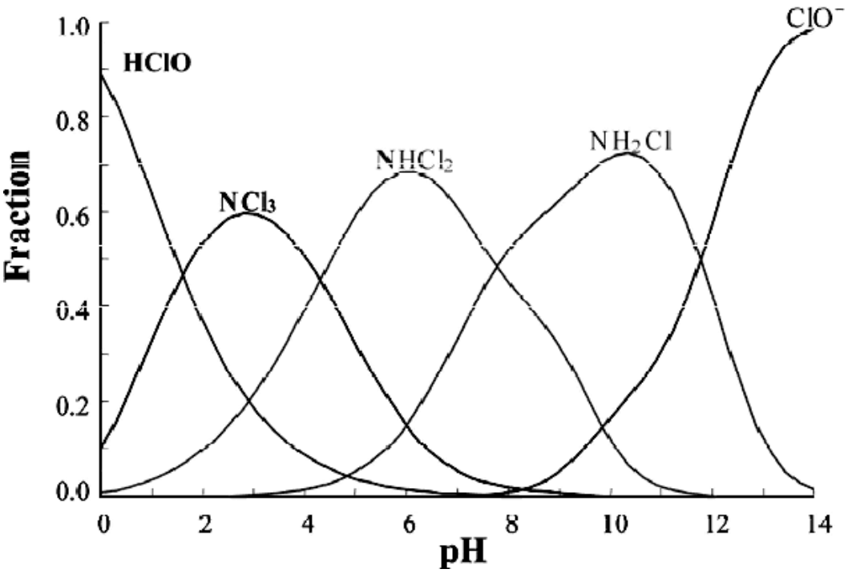
Chloramines as a function of pH
Notes:
This is how chloramine speciation typically looks when graphed. For exam purposes sometimes they include this and they may state the pH of treated water and ask you what is the likely dominant chloramine type present.
Ibanez, Jorge & Hernandez-Esparza, Margarita & Doria-Serrano, Carmen & Fregoso-Infante, Arturo & Singh, Mono. (2008). Production and Analysis of Chloramines. 10.1007/978-0-387-49493-7_18.

Slide 16
Chlorine Residual Sampling
Sampling and Analysis used to determine chlorine components
Indicates effectiveness of disinfection and compliance
Conducted as compliance and process sampling
Compliance samping determined by discharge permit
Process samples typically taken post-chlorination or after dechlorination
Sampling should be consistent and standardized
Notes:
That brings us to the practical ways we can determine the chlorine contents in our system and therefore the effectiveness of our disinfection efforts and our compliance status, which consists of sampling and analysis for chlorine residuals
This is typically performed as compliance or process sampling
Compliance sampling is performed at the sampling location indicated in your discharge permit which is often the effluent discharge point right before receiving waters or ground water discharge point
Process samples will be taken after the chlorination process to verify chlorine residual or after dichlorination to verify chlorine is being removed during dichlorination process.
The last thing is you want to make sure your sampling procedure is standardized and documents somewhere to ensure consistent results that provide a true representation of the chlorine content in your flow especially if multiple people take these samples in your system.

Slide 17
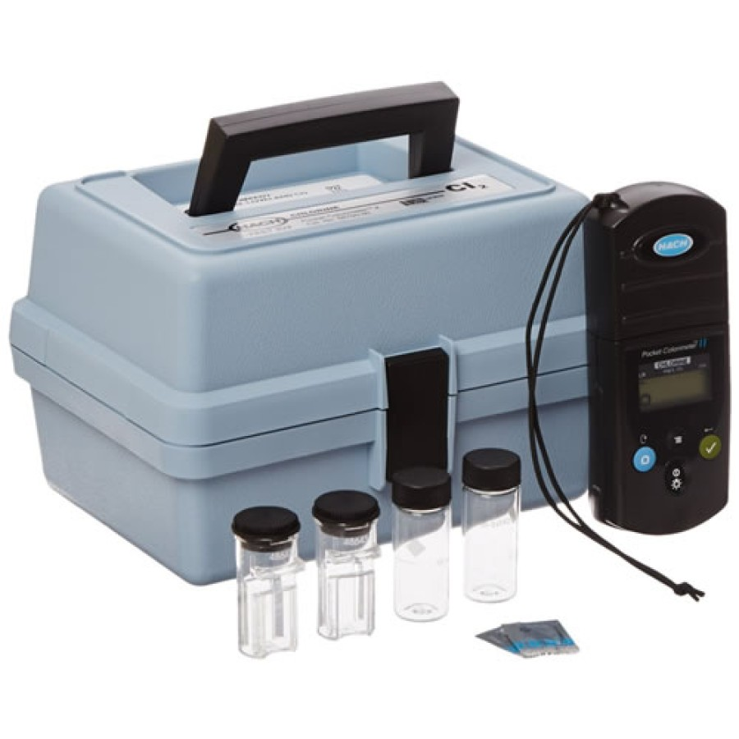
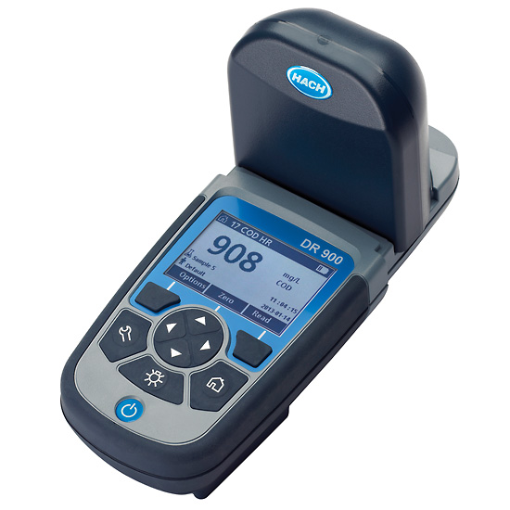
Chlorine Analysis
Chlorine Residuals often detected with a DPD test
Must be tested within 15 minutes of sampling
Reagent is added and compared to the blank with a colorimeter or a color
Can test for free or total chlorine
$$Combined Chlorine=Total Chlorine−Free Chlorine$$
Notes:
Most common field test for Chlorine residual is DPD test
DPD stands for the chemical which is N,N-diethyl-p-phenylenediamene that reacts with chlorine and turns pink for those of you familiar with the process.
Must be tested within 15 minutes of sampling
Reagent is added and compared to the blank with a color wheel or a spectrometer
Can test for free or total chlorine
Testing for free and total chlorine can be used to calculate how much combined chlorine is in your system
Indicating how much organics are interfering with disinfection and how much extra dechlorination resources are possibly wasted on longer lasting chloramines.

Slide 18
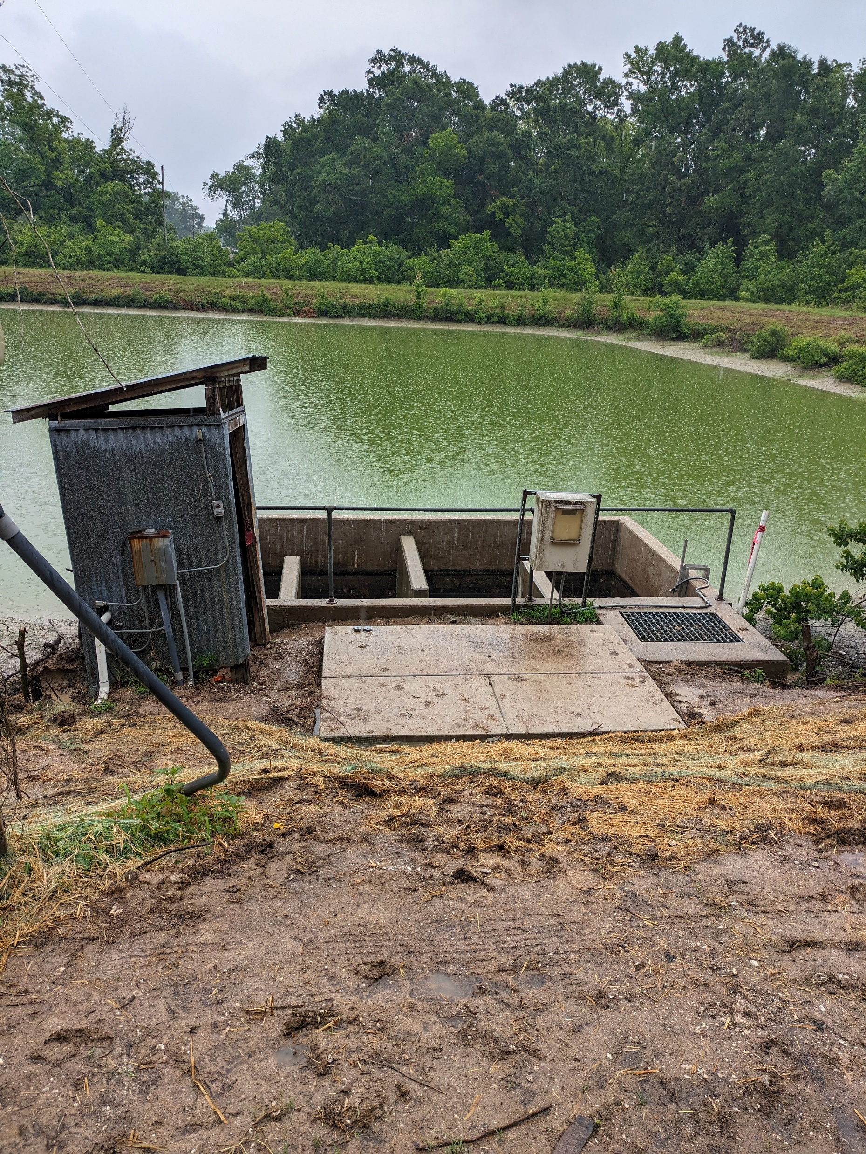
Chlorine Sampling Sample Point
Sample point should provide representative sample
Samples should be taken mid-stream, mid-depth
Well-mixed flow
Upstream of turbulent areas
At the end of contact/mixing channels
Safety must be considered
Utilize handrails, sample ports, and effluent taps when available
Avoid leaning over ledges, confined spaces and slippery surfaces
Notes:
Determining the sample point is an important aspect of sampling to ensure samples are representative of the overall flow
Taking samples from flow should be mid stream and mid-depth, so basically right in the middle where it is less likely to scrape channel walls and the surface to avoid surface debris, scum and foam
The sample point should also avoid stagnant areas that provides flow that has been mixed, but areas after turbulent sections are not ideal as turbulence and aeration dechlorinate flow
It is also ideal for sample points to be at the end of contact chambers where they are separated from injection points which can compromise samples
Safety point safety is another necessary consideration
Samplin points should be in safe accessible areas.
It is especially useful when there are safety measurements in place such as hand rails or when specific sample ports or effluent taps are in place.
If you’re luck enough to have an effluent tap you want to make sure to allow effluent to flow for an extended amount of time so that you’re not sampling stagnant water
You also want to avoid leaning over ledges or surfaces that could result in you falling into the water, confined spaces, or areas that are prone to slippery conditions.
If your sample point is unsafe its reasonable to request corrections to those conditions.

Slide 19
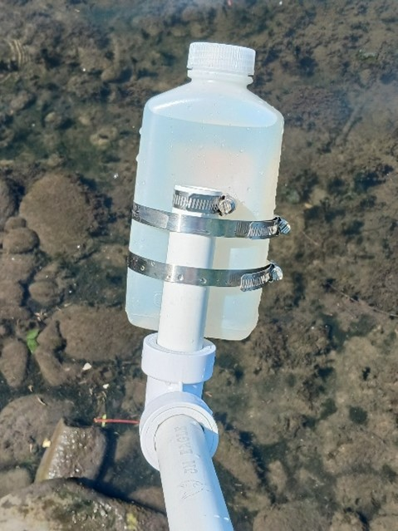
Chlorine Sampling Procedures
Standard operating procedures should outline sample collection, analysis, documentation and reporting
Utilize personal protective equipment
Sample procedure basics
Utilize clean sample bottles
Rinse sample bottle with three times
Transfer collected sample to sample vial
Add free or total chlorine reagent within expiration date
Fill lab analzed samples completely and cap
Follow blank procedure
Document date and time, sample location, instrumentent ID, unusual conditions etc.
Notes:
(2m)
Now when taking samples exact procedures can vary, but here are a couple basic practices that are frequently recommended
These should be incorporated into your standard operating procedure we mentioned earlier that contains details for sample collection, analysis, documentation, and reporting
When sampling just like other process work you want to make sure you are utilizing adequate personal protective equipment or PPE.
This should include safety glasses, gloves, and non-slip footwear to protect you from all the hazards we mentioned in the last presentation of this series.
A basic sample procedure would start with using a clean sample bottle that is initially rinsed with sample or effluent three times to condition the bottle.
This entails filling up the bottle possible swishing it around and emptying it back into the flow or a sample drain.
You would then collect the sample mid-depth/mid-stream like we mentioned earlier and transfer the collected sample to the sample vial for the colorimeter if you are performing analysis in the field and add the free or total chlorine reagent making sure to follow the procedures outlined in the anlaysis kit if you’re using one.
You also want to make sure the reagent is not expired and is within the expiration date listed on the pillow packet.
If you analyze your sample in the lab you want to fill the bottle completely to minimize headspace, because air degrades chlorine and cap the bottle immediately.
Make sure you’re familiar with the blank procedure which is usually adding sample to a clean vial and pressing zero so the analyzer has a point of reference for sample without the reagent reaction
And then lastly you follow standard documentation procedures/ fill out log book, and label bottles if necessary.
At a minimum this information would include date and time, sample type, sample location, instrument ID or required lab analysis, and any unusual conditions

Slide 20
Poll Question 1
Notes:
What type of chloramine would primarily be present in an acidic environment of a pH= to 3?
Trichloramines
Monochloramines
Free Chlorine
Sodium Hypochlorite

Slide 21
Poll Question 2
Notes:
What types of chlorine are typically detected by a DPD test?
Free and Combined Chlorine
Monochloramine, dichloramine, trichloramine
Free and Total Chlorine
Total Chlorine and Ammonia

Slide 22
Chlorine Dosage
Chlorine applied to wastewater for treatment
A concentration represented as a mass/volume
Expressed as mg/L or ppm
Most operators record pounds or gallons per day. This is the FEED RATE, not the dosage.
  Dosage calculated from feed rate
DOSAGE = RESIDUAL + DEMAND
Notes:
After we sample and analyze for chlorine in our system we can then use that data along with our other disinfection settings to calculate the dosage demand and residual.
The relationship between dosage demand and residual is pretty simple. Basically the chlorine demand of our wastewater + the chlorine residual is equal to the dosage we apply for treatment.
All three of these are represented as concentrations of mass over volume.
This would be expressed as mg/L or ppm, which are equal to each other.
Typically during your every day operations you would record the pounds of chlorine or gallons per day used to treat your flow, but those values are used to calculate feed rate so it is still valuable data

Slide 23
Chlorine Residual
The amount of chlorine remaining after the chlorine demand is satisfied (expressed as mg/L)
Total residual chlorine used as residual
This chlorine IS available for further disinfection
RESIDUAL = DOSAGE – DEMAND
Notes:
Next we have the chlorine residual which we’ve talked about as the amount of chlorine present in our treated wastewater after treatment.
Now I know we used the work residual to talk about both the remaining total or free chlorine during sample analysis, but in terms of these components residual is represented by the total residual chlorine we analyze for, usually not the free chlorine

Slide 24
Chlorine Residual
Three types of residuals
  Free
  Combined
  Total
TOTAL = COMBINED + FREE

Slide 25
Chlorine Demand
The difference between the amount of chlorine applied and the residual chlorine remaining
The amount of chlorine consumed or bound up by material in the water (expressed as mg/L)
This chlorine is NOT available as residual (free or total)
DEMAND = DOSAGE – RESIDUAL
Notes:
Chlorine reacts with iron, manganese, organic matter, turbidity & microorganisms. This is the demand

Slide 26
DOSAGE = DEMAND + RESIDUAL
DEMAND = DOSAGE – RESIDUAL
RESIDUAL = DOSAGE – DEMAND

Slide 27
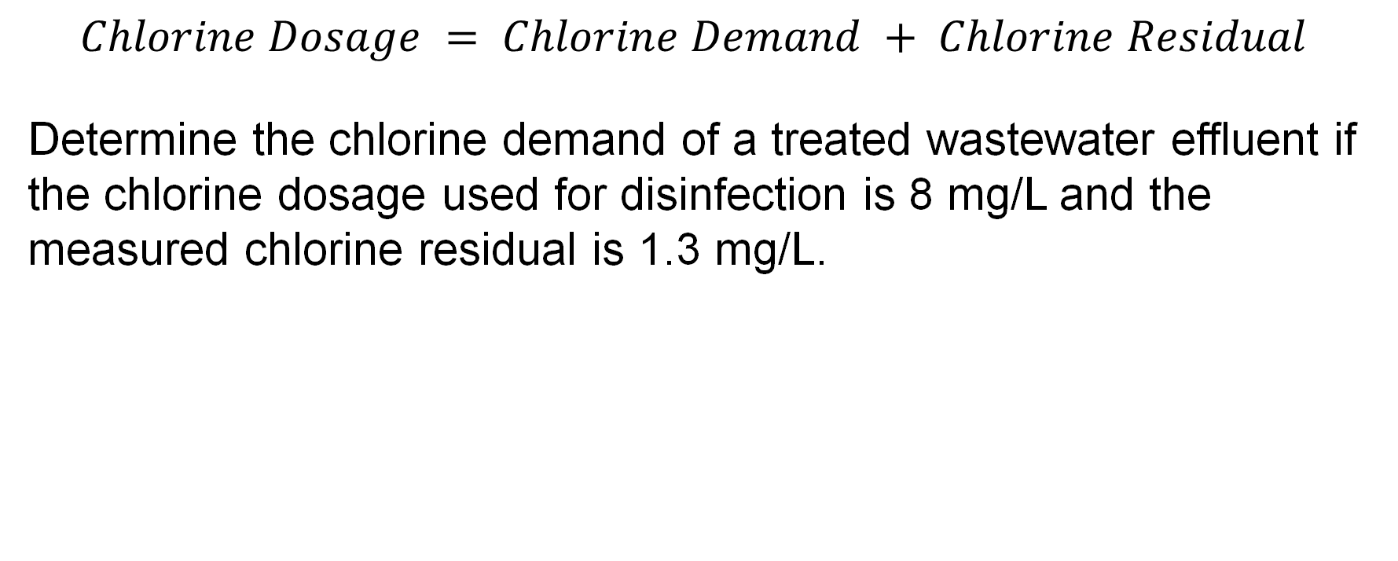
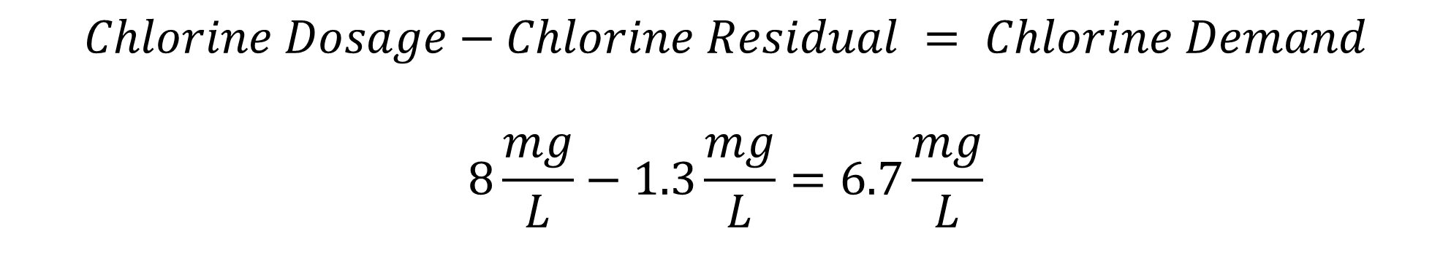
Dosage Practice Problem
$$Chlorine Dosage = Chlorine Demand + Chlorine Residual$$
Determine the chlorine demand of a treated wastewater effluent if the chlorine dosage used for disinfection is 8 mg/L and the measured chlorine residual is 1.3 mg/L.
67 mg/L
9.3 lbs/day
6.7 mg/L
D. 9.3 mg/L
$$Chlorine Dosage−Chlorine Residual = Chlorine Demand$$
$$8\frac{mg}{L}−1.3\frac{mg}{L}=6.7\frac{mg}{L}$$

Slide 28
Breakpoint Chlorination
Chloramines are being “destroyed”
Chloramines formed (combined chlorine residual)
3
Total Chlorine residual (ppm)
2
Free chlorine residual increasing
Free residual
1
Total residual
Combined residual
0
1
2
3
4
Chlorine added (ppm)
Breakpoint – Chlorine demand of wastewater satisified
Notes:
Now that we've gone more in-depth on chlorine demand, chlorine residual and combined chlorine we should review the topic of breakpoint chlorination
So as you might remember from last week this is a breakpoint chlorination curve
At the beginning of the curve chlorine is reacting with inorganic and organic impurities in wastewater such as Fe or Manganese and many others because wastewater contains lots of these types of components and chlorine reacts with a very large variety of these impurities, then as you see the chlorine concentration increasing this is where it is reacting with ammonia in the water to form chloramines until all the free ammonia is consumed. At this point which is the first peak those chloramines and organic chlorine compounds begin to degrade and are converted to nitrogen gas which means they exit the wastewater.
They degrade until the lower point after the peak which if you recall this is known as breakpoint chlorination. Break point chlorination refers to the point at which the chlorine demand of the treated water has been reached and as the curve begins to increase again the chlorine being added to increase the concentration is free available chlorine.
If there is no free chlorine you haven’t reached breakpoint chlorination and you may need to make adjustments to your contact time or dosage.
SWEFC created figure

Slide 29
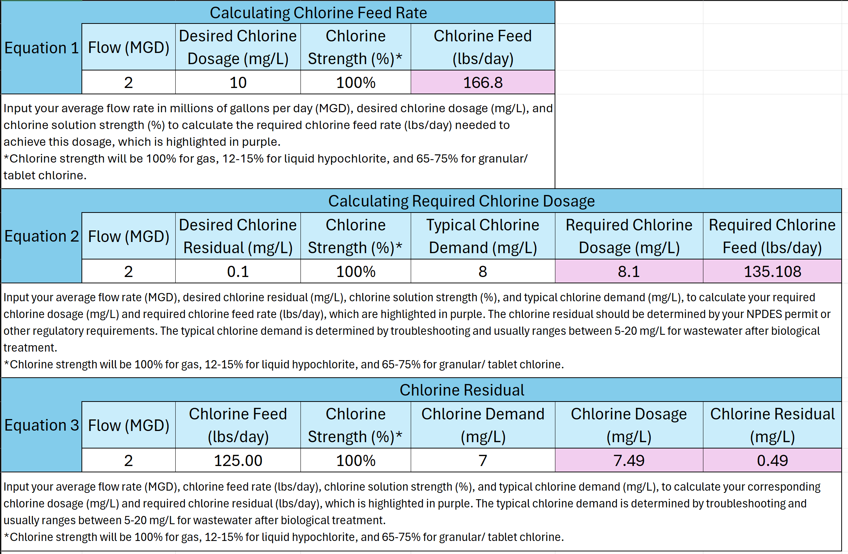
Dosing Calculator
Notes:
Chat:
https://efcnetwork.org/tools-publications/calculating-chlorine-dosage-feed-rate-and-residual-chlorination-estimator/

Slide 30
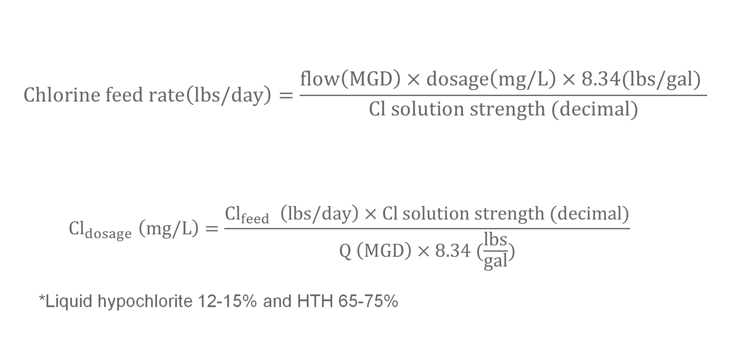
Chlorine Feed Rate Calculations
$$Chlorine feed rate\left(lbs/day\right)=\frac{flow\left(MGD\right)×dosage\left(mg/L\right)×8.34(lbs/gal) }{Cl solution strength (decimal)}$$
  $${Cl}_{dosage} \left(mg/L\right)=\frac{{Cl}_{feed} \left(lbs/day\right)×Cl solution strength (decimal)}{Q \left(MGD\right)×8.34 (\frac{lbs}{gal})}$$
  *Liquid hypochlorite 12-15% and HTH 65-75%
Notes:
You can also perform these calculations yourself and it is good to know how to apply these equations for your certifications
Flox x dosage x conversion factor divide the whole product by the solution strength
If chlorine gas your solution strength is 100% or which is equal to 1 in decimal form so you don’t have to input a value for solution strength if it’s liquid bleach/ hypochlorite or solid chlorine commonly referred to as hth.
L is 12-15 s is 65-75
One thing I’d like to point out is the units on these equations chlorine feed rate is measure in lbs per day like we mentioned but that isn’t intuitive if you’re looking at this for the first time, but millions…

Slide 31
Poll Question 3
Notes:
Chlorine breakpoint refers to point at which:
Free chlorine is equal to dichloramines
Chlorine demand has been met
Chloramines begin to degrade
Chloramines begin to form

Slide 32
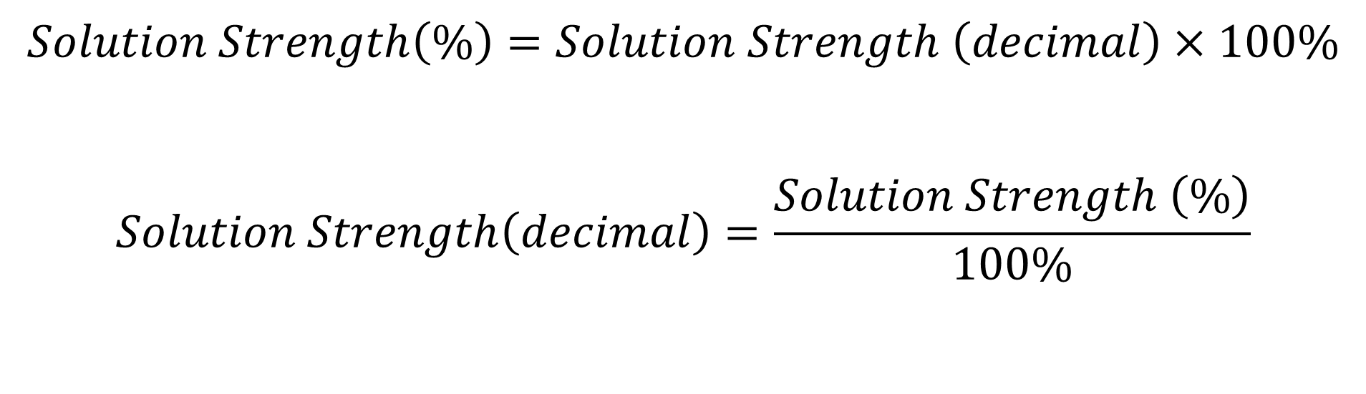
Solution Strength
$$Solution Strength\left(\%\right)=Solution Strength \left(decimal\right)×100\%$$
$$Solution Strength\left(decimal\right)=\frac{Solution Strength \left(\%\right)}{100\%}$$

Slide 33
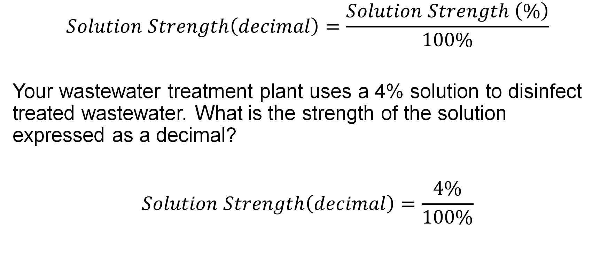

Solution Strength Practice Problem
$$Solution Strength\left(decimal\right)=\frac{Solution Strength \left(\%\right)}{100\%}$$
Your wastewater treatment plant uses a 4% solution to disinfect treated wastewater. What is the strength of the solution expressed as a decimal?
$$Solution Strength\left(decimal\right)=\frac{4\%}{100\%}$$
$$=.04$$

Slide 34
Alternative Disinfection Methods
UV, Ozone, Filtration, Wetlands

Slide 35
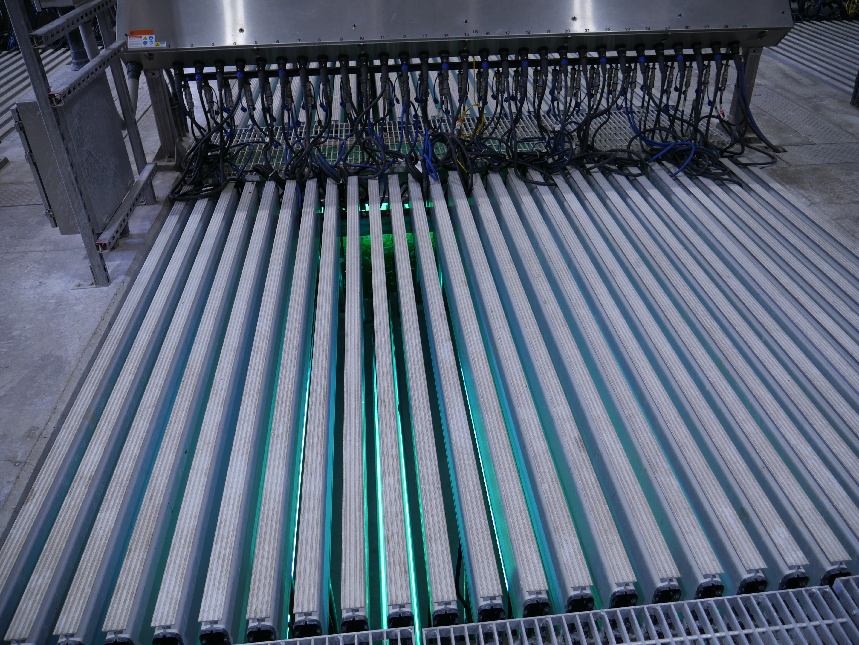
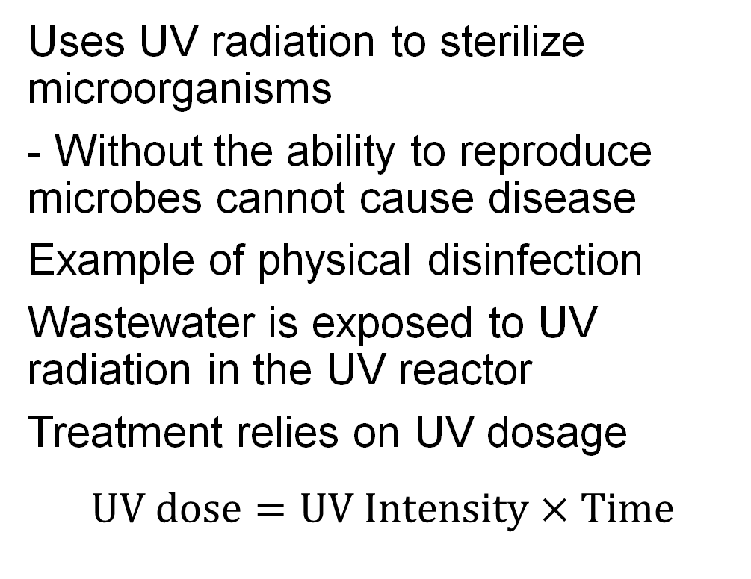
UV Disinfection
Uses UV radiation to sterilize microorganisms
- Without the ability to reproduce microbes cannot cause disease
Example of physical disinfection
Wastewater is exposed to UV radiation in the UV reactor
Treatment relies on UV dosage
$$UV dose=UV Intensity×Time$$
Notes:
Uses UV radiation to sterilize microorganisms, this is the same invisible type of radiation that causes sun burns and leads to skin cancer
- Now sterilizing microorganisms means taking away their ability to reproduce and without the ability to reproduce microbes cannot cause disease
This this type of disinfection is known as physical disinfection as opposed to chemical disinfection that chlorine causes and ozone as well
The process itself does work similar to chlorine disinfection in that you pass the wastewater through a contact chamber where the wastewater is exposed to UV radiation
These types of contactors are frequently referred to as UV reactors
This type of treatment relies on UV dosage
$$UV dose=UV Intensity×Contact Time$$
SWEFC Photos

Slide 36


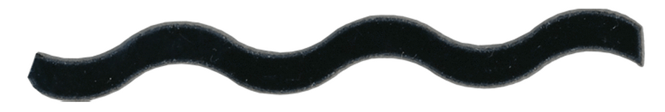
UV Radiation
Wastewater is exposed to UV radiation by banks of long tubular UV lamps filled with mercury vapor
- Water flows in line with UV lamps
Ultraviolet (UV) lightbulbs emit a specific range of wavelengths of light that damage microbe DNA to prevent replication
200-300 nm is the germicidal range
- 264 nm specifically kills microbes most effectively
UV
Notes:
This wavelength is the most effective because this wavelength is where microbes experience peak absoprtion
SWEFC Photos

Slide 37
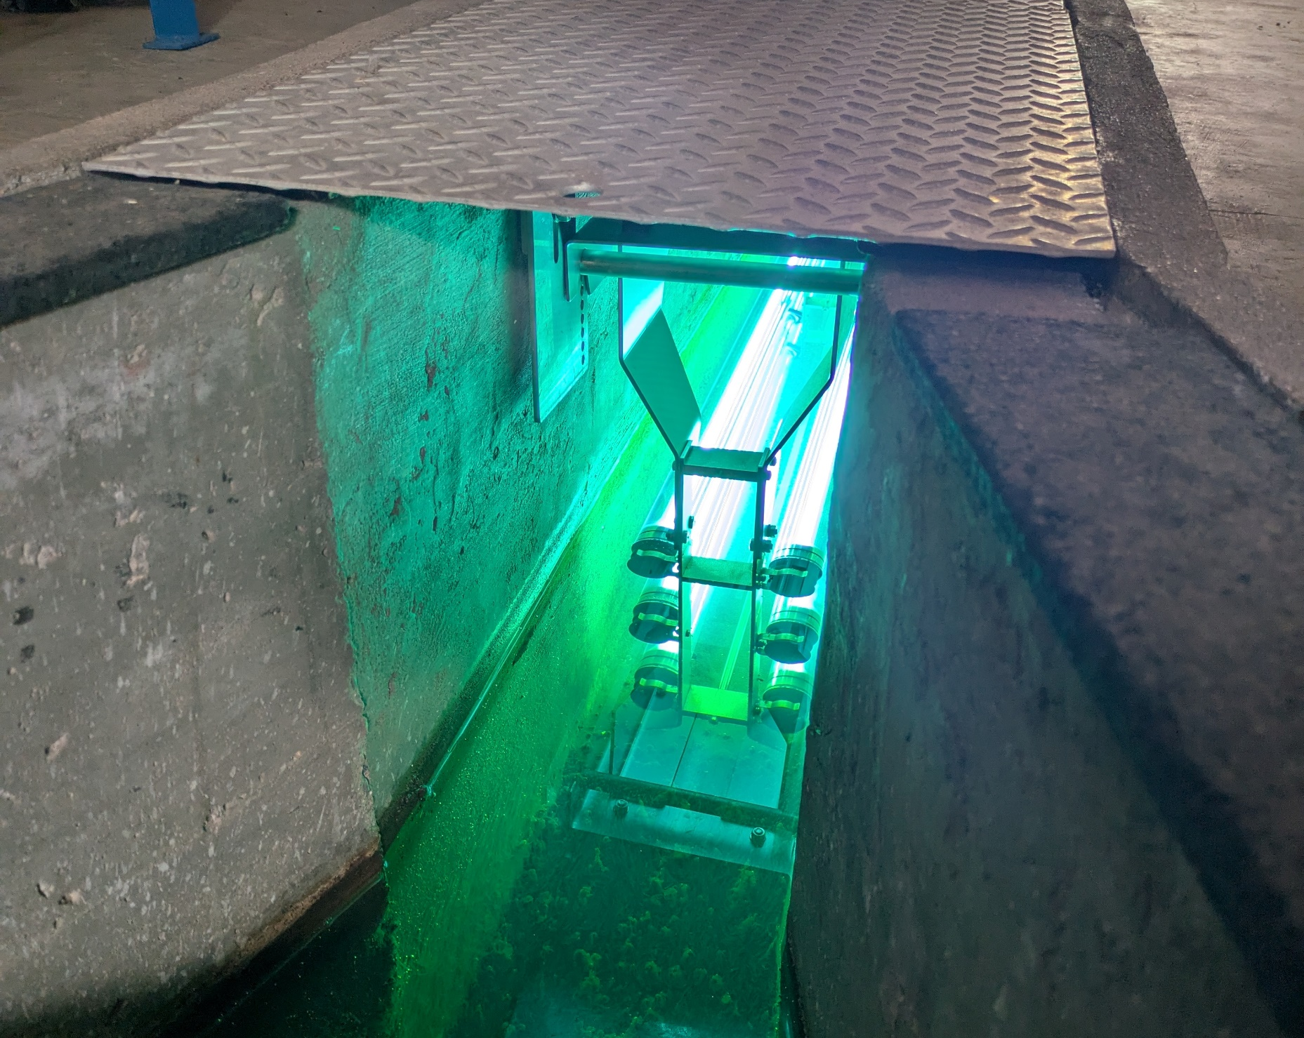
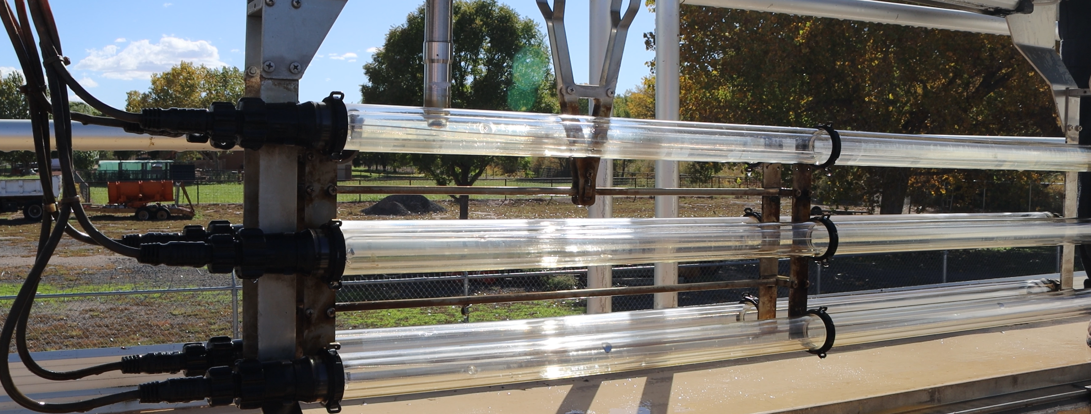
UV Disinfection Components
Modules of watertight tubular bulbs mounted into banks
UV bulbs installed parallel to the flow
Lamp enclosed by quartzite sleeve filled with air
Lamps are fitted mechanical wipers
Contact chamber with banks installed to precisely fill the channel
Sensors- Flowmeter, UV intensity, UV transmittance analyzer, turbidity meter
Prescreens to prevent algae and other growth
Flow
Notes:
Modules of watertight tubular bulbs mounted into banks
UV bulbs installed parallel to the flow
For cleaning purposes lamps are fitted mechanical wipers as the long tubular lights are prone to fouling especially with algae or small worms.
Sometimes UV systems are installed with prescreens to mitigate fouling as well.
Screening also helps mitigate the most common cause of inefficient UV disinfection which is typically caused by debris or turbidity shielding microorganisms from the UV radiation
Contact chamber with banks installed to precisely fill the channel so that waster is not to far for UV exposure but does not experience excessive overlap either
Prescreens to prevent algae and other growth
SWEFC Photos

Slide 38
UV Disinfection Process Control
Operation of UV Disinfection includes the following
Monitoring and managing the UV dose
Cleaning UV tubes
Monitoring equipment performance and performing maintenance
Cleaning pre-screens
UV systems are designed to treat a specific volume of water
Treatment is measured by the designed UV intensity or determined UV dosage
Adjustments to UV intensity, the number of modules used for treatment, or to the flow are used to adjust UV operation
Flow level should always be right above the top UV bulb
Notes:
Operation of UV Disinfection includes the following
Monitoring and managing the UV dose, flow, and turbidity
Cleaning UV tubes
Monitoring equipment performance and performing maintenance
Cleaning pre-screens
UV systems are designed to treat a specific volume of water and undergo validation during design and usually during installation to measure microbial activity before and after UV exposure to verify that disinfection is adequate.
Treatment is measured by the designed UV intensity or determined UV dosage
Adjustments to UV intensity, the number of modules used for treatment, or to the flow are used to adjust UV operation and these are usually adjusted automatically by the system
Flow level should always be right above the top UV bulb

Slide 39
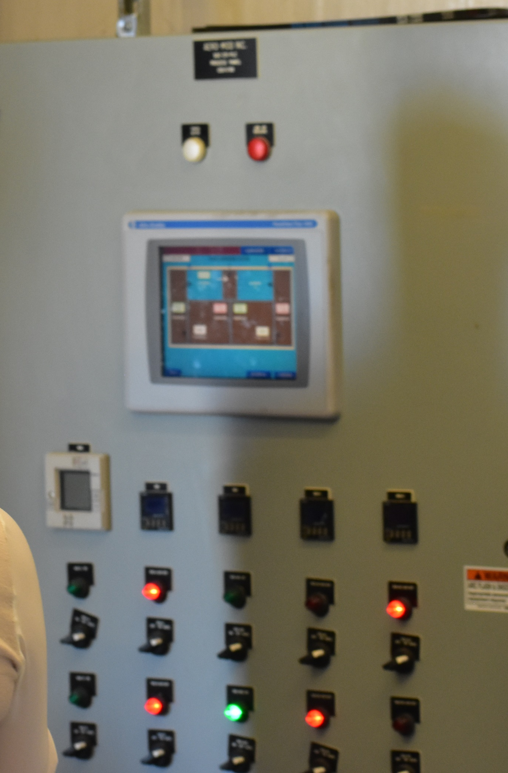
UV Disinfection Operation Check List
Visually inspect reactor
Confirm controls are in auto and check for alarms
Check sensors, flow meters, and data records
Use data logs to verify
Periodically initiate manual wiper sequence
Check UV light run times
Calibrate sensors periodically
Notes:
Visually inspect reactor- make sure bulbs are actually working, flow level is correct and no other observable issues
Confirm controls are in auto and check for alarms
Check that sensors and flowmeters are online, data is being recorded normally
Use data logs to verify that data is being collected correctly
An example of this is verifying dosage, intensity and flow data are in similar ranges as previous days and overall flow totalizer readings are consistent
Periodically initiate manual wiper sequence
It’s recommended this is done at least once a week
Check UV light run times, if they exceed design life it may be time to change them out
You’ll also want to periodically calibrate the UV sensors and flow meters
Some of this maintenance can be done without specialized knowledge such as cleaning and replacing UV bulbs, but calibrating sensors adjusting the automatic systems may require specialized knowledge that would require using a contractor or contacting the manufacturer for assistance.
Also cleaning or replacing bulbs should involve more than one person for safety

Slide 40
Ultraviolet (UV) Light Disinfection
Advantages of UV Disinfection | Disadvantages of UV Disinfection
No need to handle chemicals | Tubes can foul
No residual | High interference from turbidity
User friendly for operator | Higher cost than chlorine
Low contact time needed | Organisms can sometimes repair the damage from UV radiation
Low space requirement
Notes:
Can’t overdose like you can with chlorine, which is convenient as UV dose is hard to predict when it comes into contact with microorganisms for disinfection due to UV being absorbed by dissolved material in the water and it is also scattered by turbidity.
Due to this system setting are usually defaulted with some saturation.
When lower pressure bulbs are used, organisms can repair DNA when they are exposed to sunlight.

Slide 41
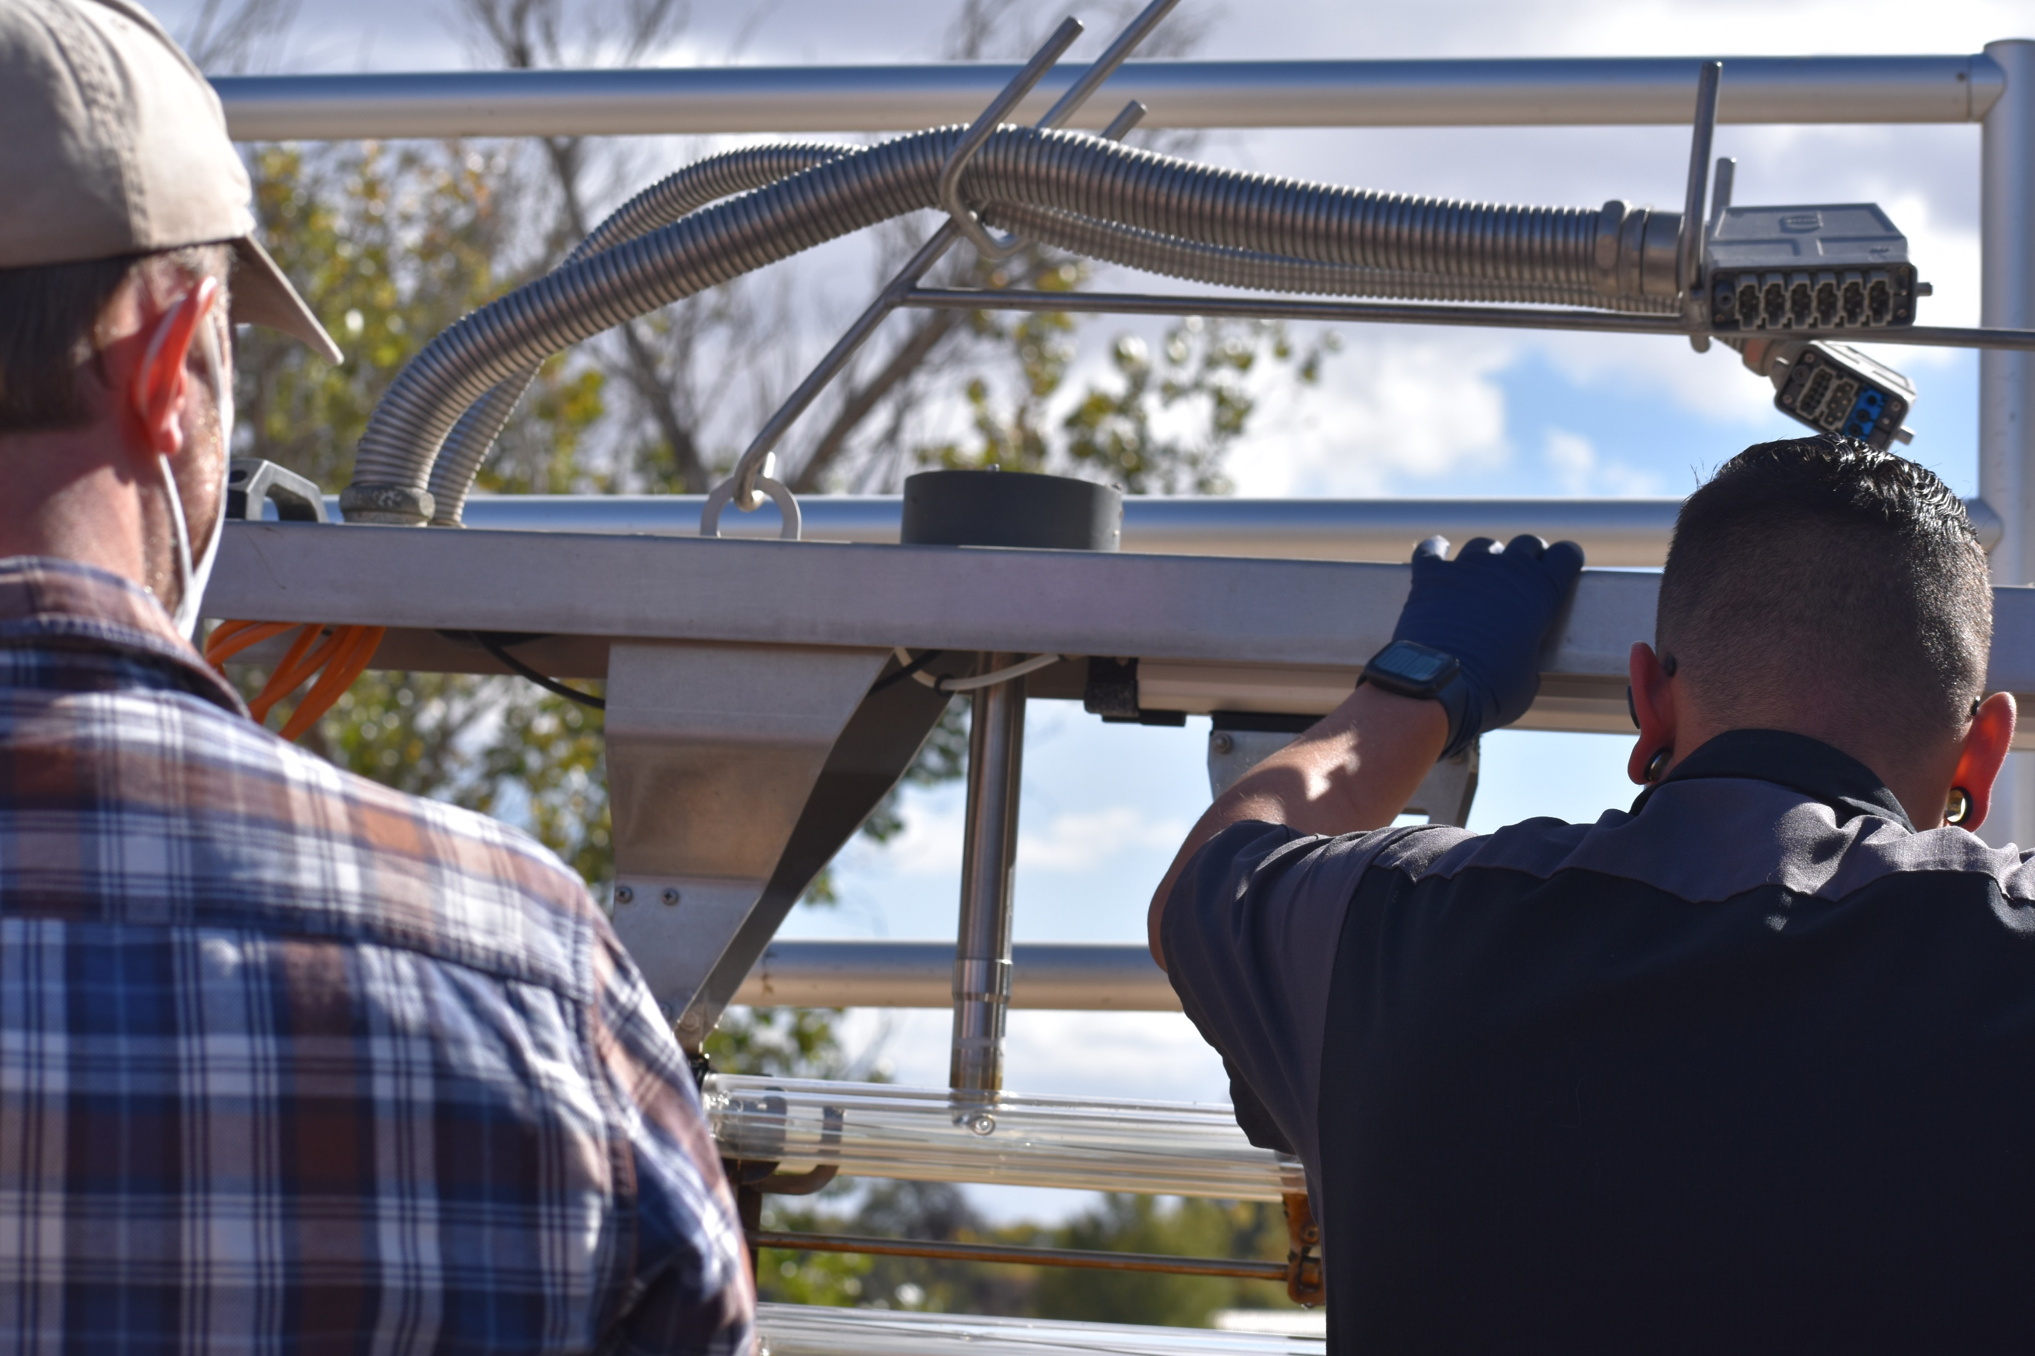
UV Safety
UV Hazards
UV radiation is intense and much stronger than visible light
  Avoid looking directly at UV lightbulbs
  Do not expose your skin to UV light
Ensure hazard signs are present in the UV areas
Power off lights when handling UV lights
UV lamps contain mercury vapor
Notes:
UV Hazards
UV radiation is intense and much stronger than visible light
Avoid looking directly at UV lightbulbs
Do not expose your skin to UV light
Ensure hazard signs are present in the UV areas
Power off lights when cleaning, repairing or replacing UV lights, because the heat from UV lights can cause burns and they present an electrocution hazard
Finally UV lamps contain mercury vapor, which can be toxic if contacted by workers after a UV light break
In the event of a break along with typical glass handling precautions operators should utilize hazardous waste disposal practices and follow state and federal regulations for disposal
A mercury disposal kit is always useful in aiding those efforts

Slide 42
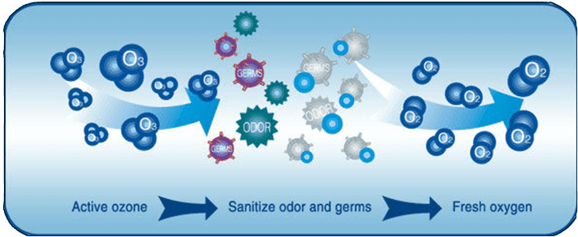
Ozone
Notes:
Ozone (O3)is creating by adding energy to atmospheric oxygen (O2) in an ozonator.
Ozone is a strong oxidant, which makes it an effective disinfectant and virus killer.
Ozone must be generated on site with high voltage electricity due to its unstable nature.
Water is exposed directly to ozone in a plug-flow type contactor.
Due to ozones unstable nature all of the produced ozone reacts and there are no harmful residuals, but direct exposure can have serious health effects
https://sensorex.com/2021/07/19/ozone-disinfection-treatment/

Slide 43
Ozone Process and Safety
Ozone generated and injected into the contact chamber where it mixes with the treated wastewater
Plug-flow type reactor
Contact time typically 10-20 min
Process is automated
Ozone monitors should be installed near ozone generators, ozone reactors, and distribution lines
Be aware of ozone sickness symptoms
Notes:
In the ozone process ozone generated and injected into the contact chamber where it mixes with the treated wastewater
These types of reactors are called plug-flow type reactors, which entails a cylinder shaped reactor where the introduced chemical is introduced at the front of the cylinder.
This is done to make sure water is exposed to ozone uniformly since ozone is consumed very quickly
These reactors are designed to allow for a contact time of approximately 10-20 min
Process is automated to maintain contact time, temperature, etc.
In terms of safety ozone is toxic if inhaled so ozone monitors should be installed near ozone generators, ozone reactors, and distribution lines.
Ozone leaks can otherwise be difficult to detect.
In areas using ozone, if operators begin to show signs of ozone sickness such as respiratory issues or irritation precautions should be taken including restricting access to those areas and measures to detect ozone leaks should begin

Slide 44



Ozone
Oxidation – the oxidant steals electrons from the virus or cell’s enzymes so the it can no longer perform metabolic functions

Slide 45
Ozone
Advantages
More effective than chlorine in destroying bacteria and viruses
Short contact time
No harmful residuals
No shipping hazards due to onsite production
Bacteria will not grow back unless shielded by molecules
Disadvatages
Low doses may not be effective enough
Technology is very complex and can be dangerous
Notes:
The lack of harmful residuals has increased the interest in ozone around the world and helps with more reuse water applications

Slide 46
Alternative Methods of Disinfection
Filtration
Microfiltration (0.1-10 µm): Bacteria and protozoa
Ultrafiltration (0.01-0.1 µm): Bacteria, protozoa, and some viruses
Nanofiltration (0.001-0.01 µm): Bacteria, protozoa, and most viruses
Reverse Osmosis (<0.001 µm): Virtually all pathogens
Sand Filtration: Some pathogens
Constructed Wetlands
- Natural microbial ecology results in the removal of pathogens

Slide 47
Poll Question 4
Notes:
What UV radiaiton wavelength is considered germicidal?
Sanitation
200-300 nm
Visible
400-700 nm

Slide 48
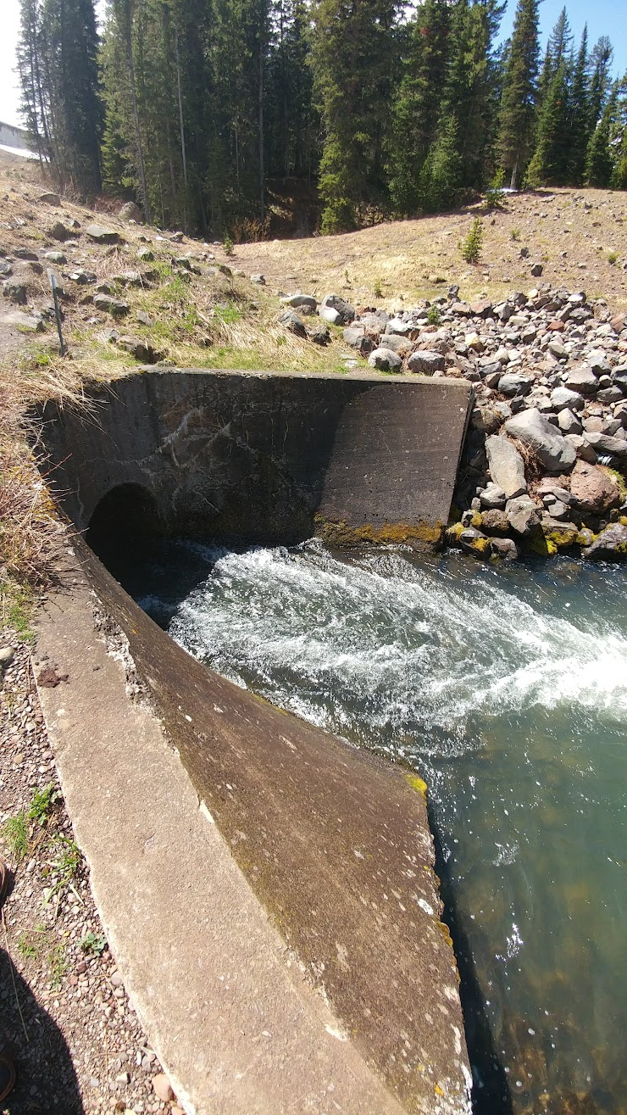
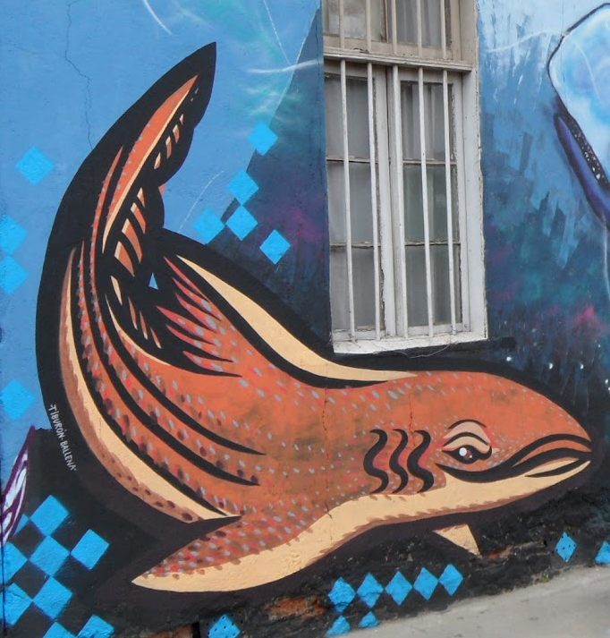
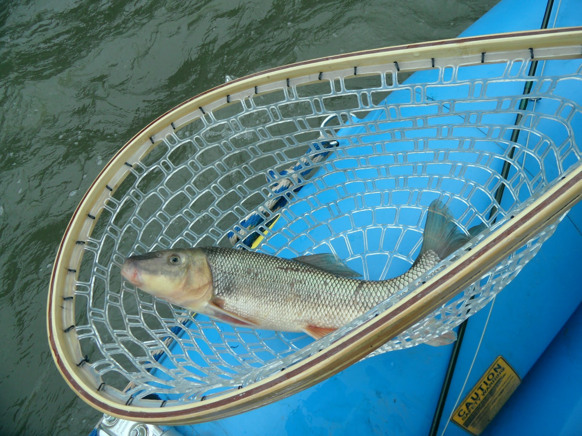
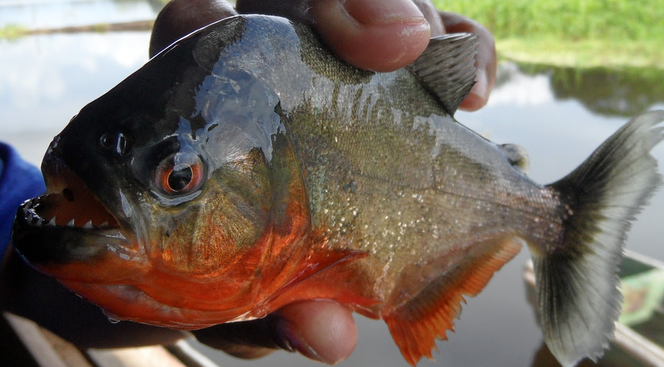
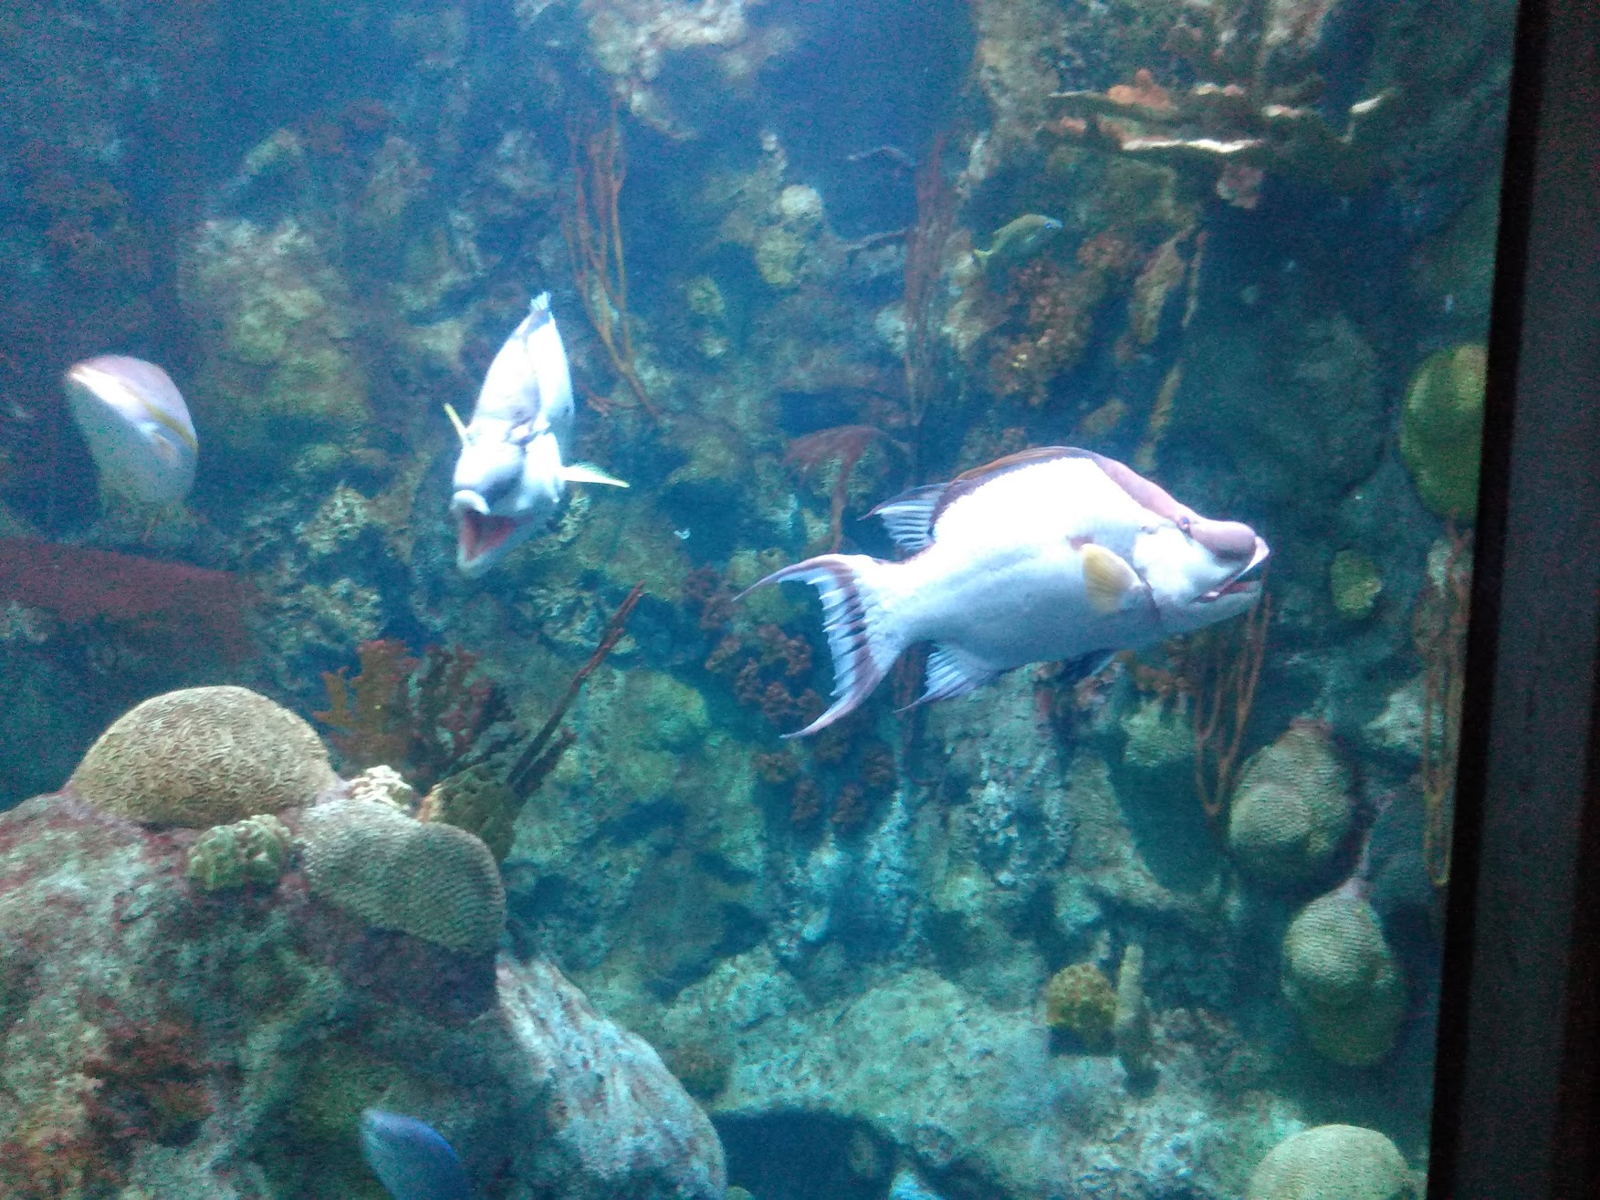
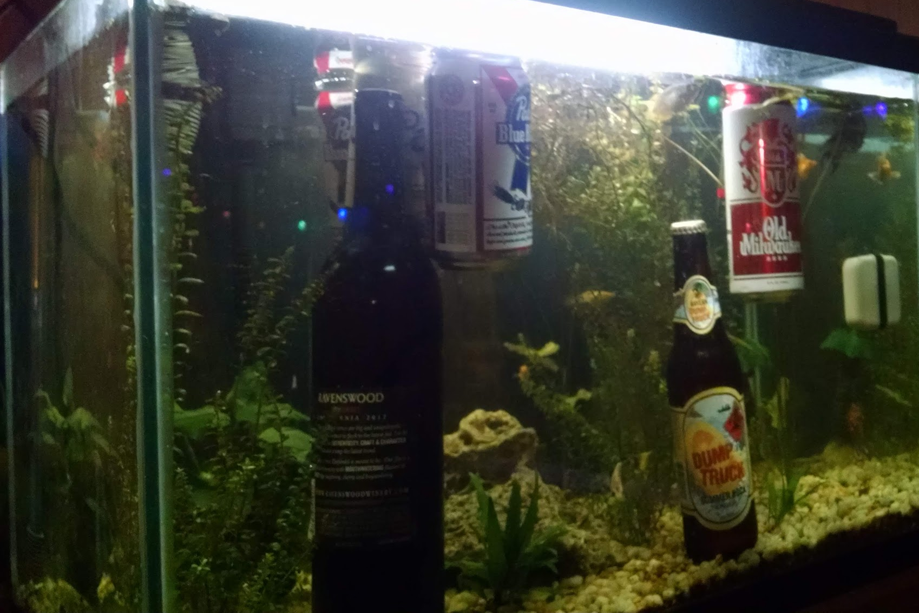
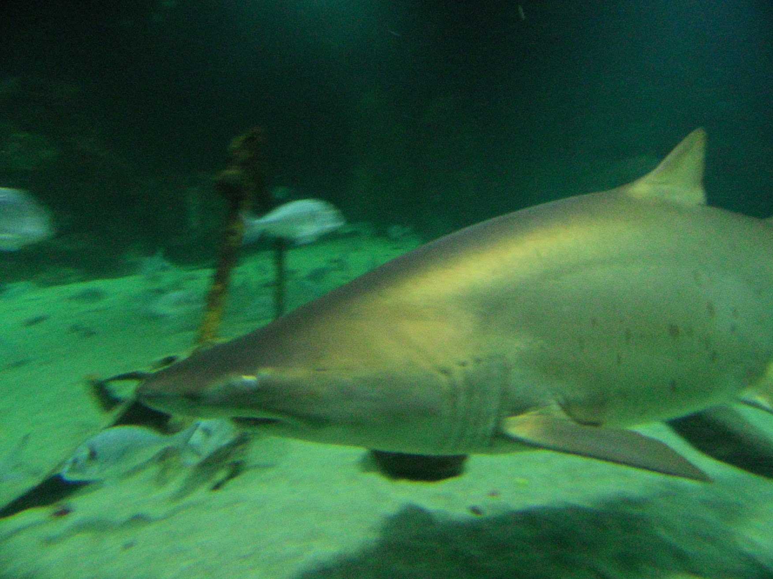

Thank you for attending and for protecting aquatic life and water for downstream consumption!

Slide 49

Questions?

Slide 50

CONTACT INFORMATION
Department of Civil Engineering MSC01 1070
1 University of New Mexico
Albuquerque, NM 87131
505-277-0644
swefc@unm.edu
http://swefc.unm.edu
swefc@unm.edu

