Slide 1

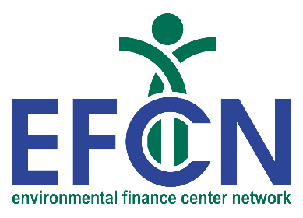



US Territories Water Operator Training Series
Session 14: Alternative Treatment Processes
01/22/2026
www.efcnetwork.org
This program is made possible under a cooperative agreement with US EPA.

Slide 2


Tucker Colvin
Research Scientist tcovin@unm.edu

Slide 3



This training series is funded by the US EPA

Slide 4


Slide 5
Schedule for 2026:
Date | Topic
1/22/2026 | Alternative Treatment Processes (e.g. fluoridation, ion exchange, RO…)
2/5/2026 | Drinking Water Treatment Math & Concept Review
2/19/2026 | Safety Program Basics (including personal safety, equipment safety, facility safety)
3/5/2026 | Lead & Copper Rule, Corrosion Control
3/19/2026 | Distribution Systems 1: Hydraulics, Pipe Types, Selection, Installation, and Water Quality
4/2/2026 | Distribution Systems 2: Valves, Hydrants, Meters, and Service Connections
4/16/2026 | Distribution Systems 3: Storage and Booster Pumping
4/30/2026 | O&M: Pumps, Main, and Appurtenance Maintenance (including pressure monitoring, valve exercising, and flushing)
5/14/2026 | O&M: Cross Connection Control
5/28/2026 | O&M: Distribution System Math and Concept Review
6/11/2026 | Sampling & Lab Procedures/Analysis/Interpretation
6/25/2026 | Management Overview (including organization, communication, PR & record keeping)
7/9/2026 | Drinking Water Practice Exam and Review
Links to recordings and material are available on our website at https://swefc.unm.edu/home/op-cert-trainings/

Slide 6

https://swefc.unm.edu/home/op-cert-trainings/

Slide 7

Sign in for every session to ensure you get credit for attending

Slide 8

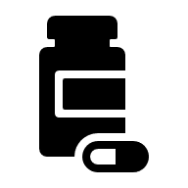
Other types of treatment
Aeration
Precipitation and filtration
Green sand filtration
Phosphate sequestration
Fluoridation
Corrosion control
Adsorption
Ion exchange
Lime softening
Reverse osmosis
Notes:
Other than coagulation, flocculation, filtration, disinfection, which we have already talked about.
For dissolved contaminants

Slide 9
Poll: What treatment techniques do you use?
Aeration
Precipitation and filtration
Green sand filtration
Phosphate sequestration
Fluoridation
Corrosion control
Adsorption
Ion exchange
Lime softening
Reverse osmosis
Notes:
Other than coagulation, flocculation, filtration, disinfection, which we have already talked about.
For dissolved contaminants

Slide 10
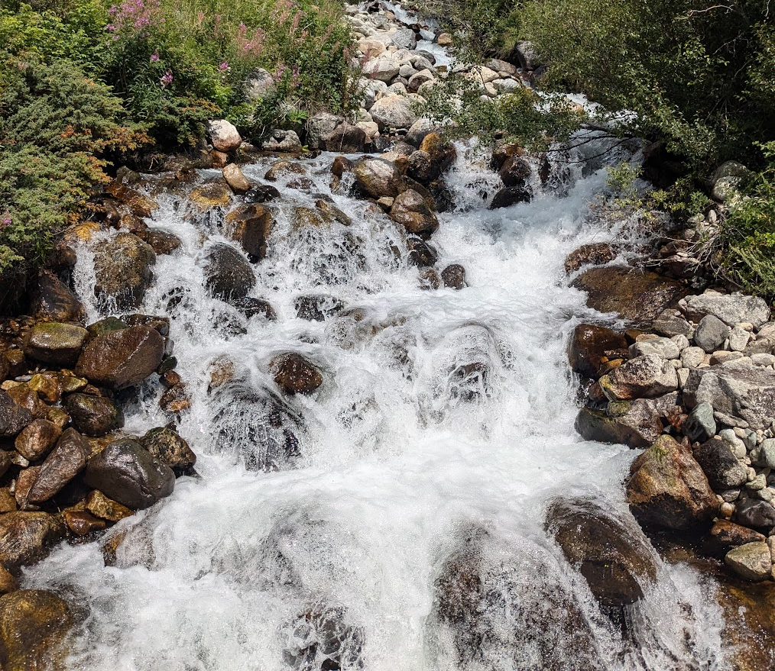
Aeration / air stripping
Addition of air into water to remove dissolved gasses or contaminants
  Useful for removal of:
  Carbon dioxide
  Hydrogen sulfide
  Methane
  Volatile organic chemicals
  Radon
  Iron and manganese (oxidation facilitates their removal)
  Tastes and odors
Works by creating contact between water and air allowing trapped gases to leave water and enter air
Two types of aerators:
  Water into air
  Air into water
Notes:
Photo: Tucker Colvin

Slide 11
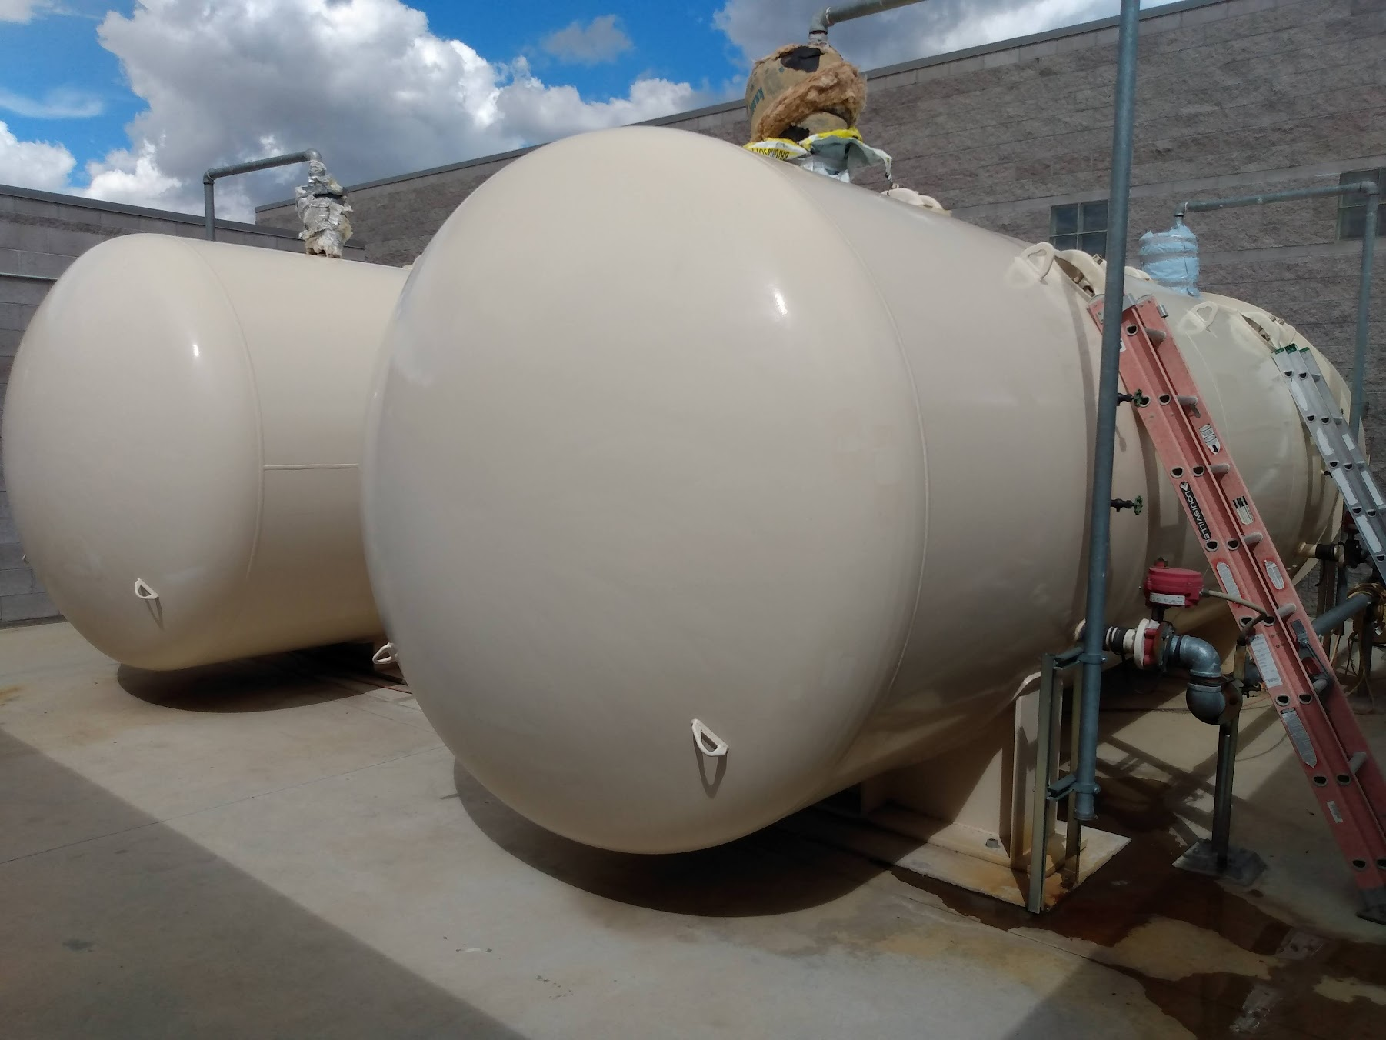
Precipitation and filtration
Oxidation of dissolved solids (arsenic, iron, manganese, etc.)
Reduction-oxidation reaction (Redox)
  Transfer of electrons from one substance to another
  Oxidizers include: chlorine, potassium permanganate, ferric chloride, ozone, aeration, etc.
OIL RIG
  Oxidation Is Loss (of electrons)
  Reduction Is Gain (of electrons)
Dissolved solids precipitated into a solid
Filtered out or settled out
Notes:
Arsenic removement at Sandia

Slide 12
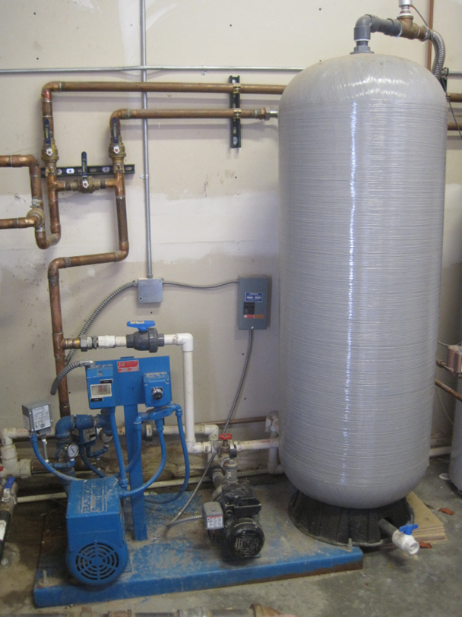
Adsorption
Removal of organic substances
  Taste and smell issues
  Combine with chlorine to form Disinfection Byproducts (DBPs)
Volatile Organic Carbon (VOCs)
Synthetic Organic Chemicals (SOCs)
Chlorine
Metals

Slide 13
Adsorption process
Adhesion of contaminant to media with extremely high surface area
Activated Carbon most common media
  Granular Activated Carbon (GAC)
  Powder Activated Carbon (PAC)
Activated refers to oxidizing carbon by steam
Wood, nutshells, coconut husks, coal, peat, petroleum residues
Can be fed into water stream (PAC) or used as filter media (GAC)
Pb
Cu
Activated
Carbon
C
Activated
Carbon
Hg
Cl
C
Activated
Carbon
Cl
Cl
Cr
C
C
As
Cl
Fe
C
Cl
C
Cl
Cl
13
Notes:
Adsorption meaning attaching to the surface, not absorption meaning going within.
Activated carbon has extremely high surface area for chlorine and other compounds to attach to.

Slide 14
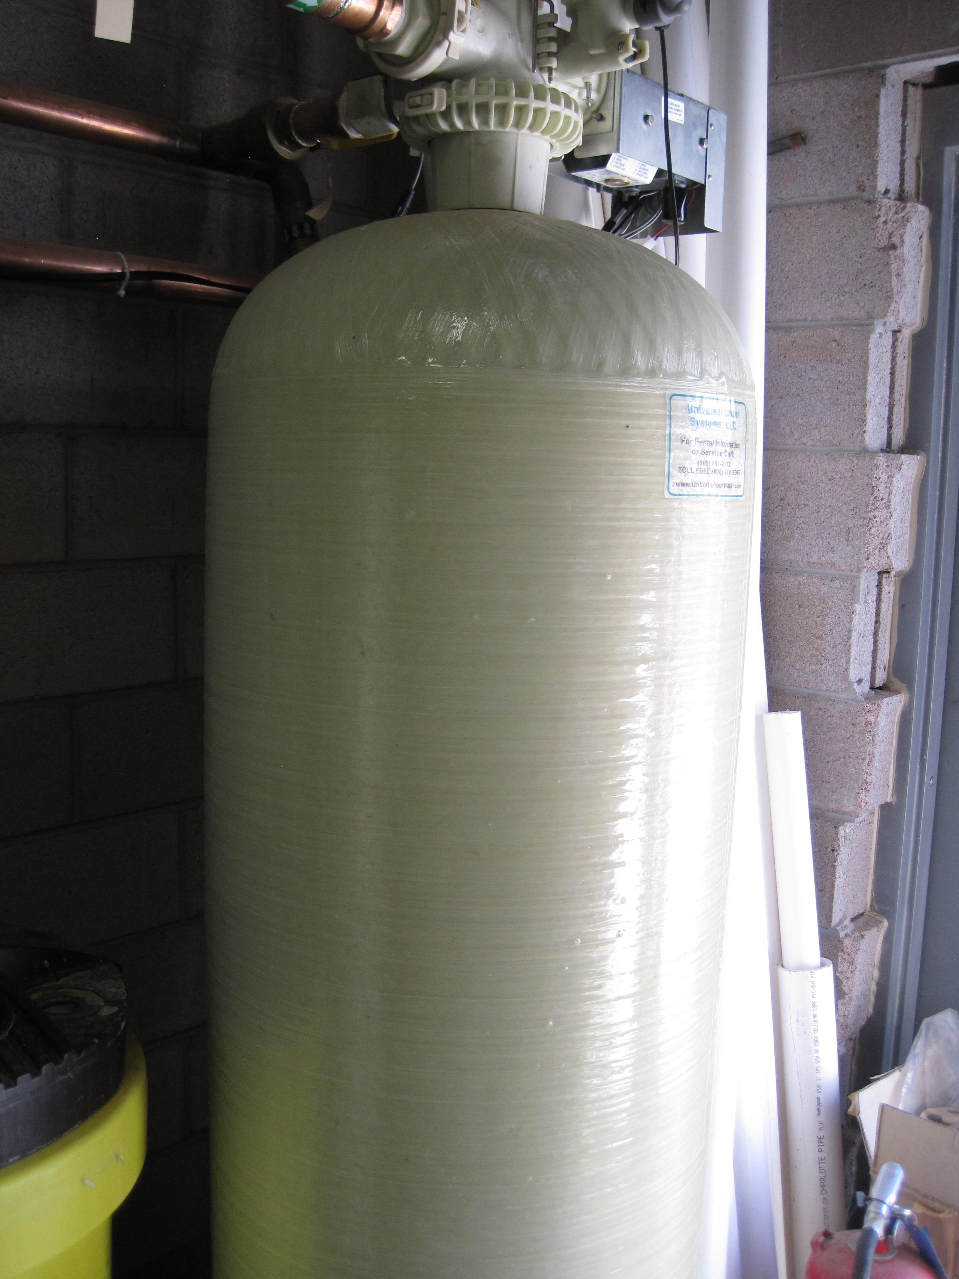
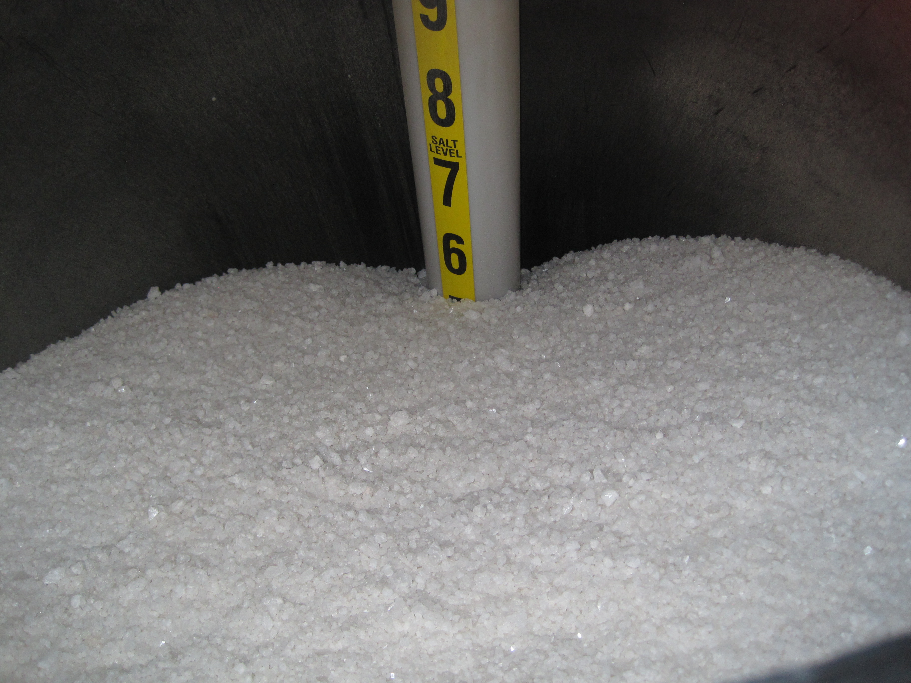
Ion Exchange
Removes many inorganic contaminants (not containing carbon)
Beads made of zeolite (silica) or synthetic resins
Replaces contaminant with sodium
Contaminant removed by regeneration or media replacement
Removes hardness (replaces calcium and manganese with sodium)
Can remove arsenic, barium, radium, nitrate, sulfate, iron, manganese, total organic carbon, etc.
Beads dependent on what is being removed (cation exchangers, anion exchangers)
Notes:
https://extension.psu.edu/iron-and-manganese-in-private-water-systems

Slide 15
Where does water hardness come from?
Rocks
Air pollution
Water treatment facilities
Bacteria

Slide 16
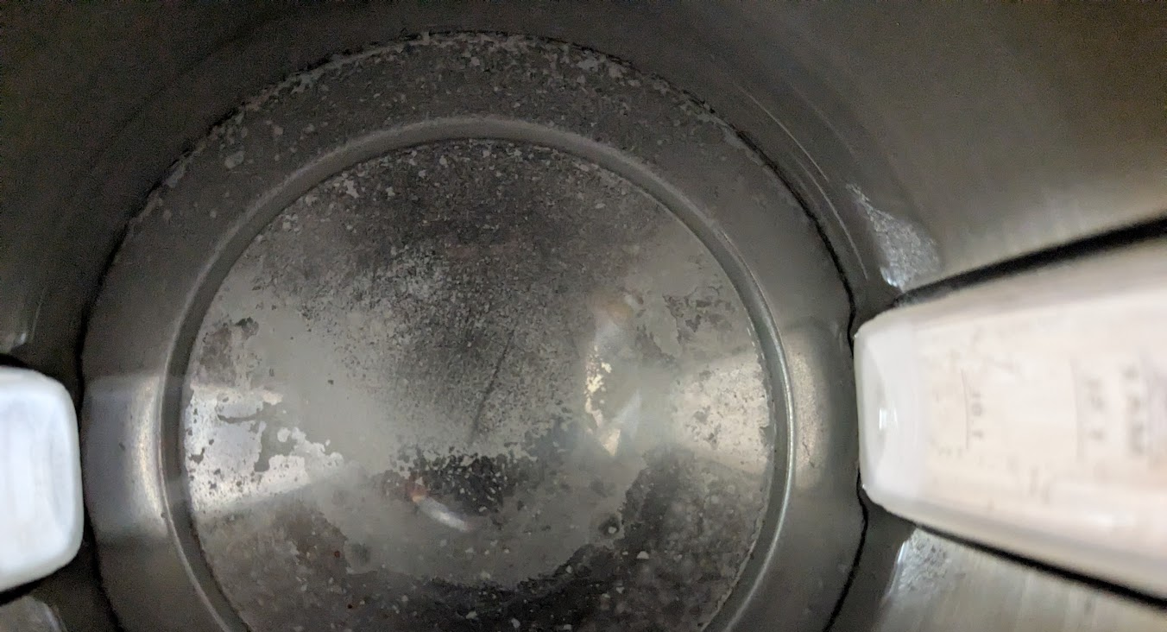
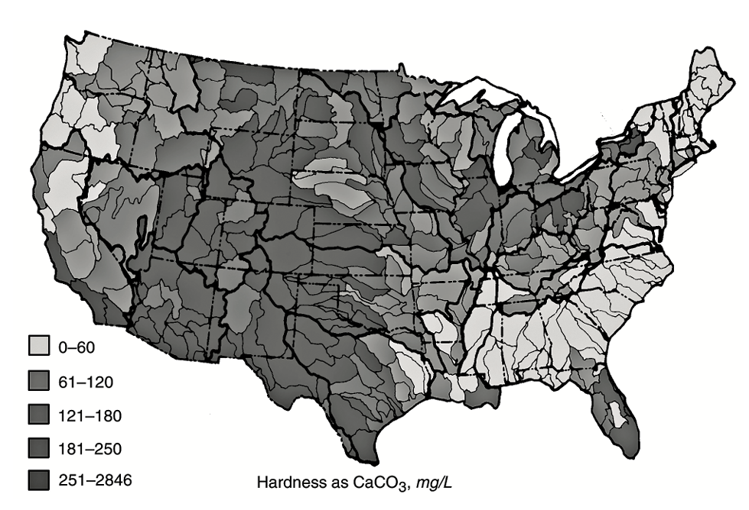
Water Hardness
Rain becomes acidic as it has contact with air
Carbon dioxide makes carbonic acid
Acidic rain dissolves rocks on the land and creates hard water
Groundwater typically harder than surface water
Notes:
Photo: Tucker Colvin’s water kettle

Slide 17
Water Hardness
Temporary Hardness
  Bicarbonates of calcium (Ca(HCO₃)₂) and magnesium (Mg(HCO₃)₂)
  Can be removed by boiling and lime softening
Permanent Hardness
  Calcium and magnesium sulfates (CaSO₄, MgSO₄) or chlorides (CaCl₂, MgCl₂)
  Cannot be removed by boiling and lime softening
Hardness - calcium and magnesium cations in combination with bicarbonate, carbonate, sulfate, nitrate, or chloride anions
Minerals can precipitate out of solution
Increased use of soap in households
Notes:
Photo: Tucker Colvin’s water kettle

Slide 18
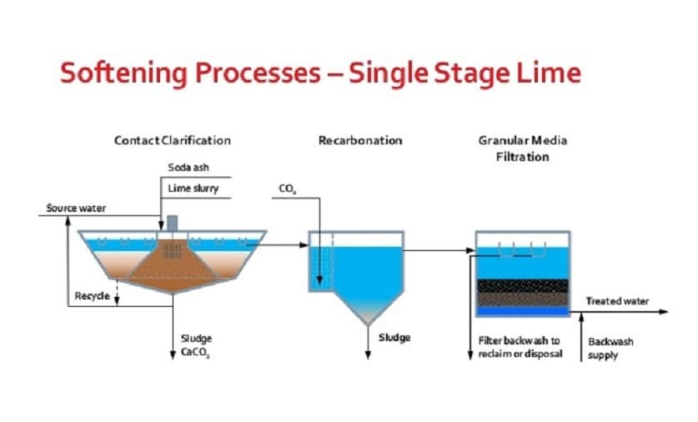
Lime Softening
Addition of limewater (calcium hydroxide, Ca(OH)₂)
Increases pH of water
Calcium carbonate and magnesium carbonate precipitates out
Settle out in sedimentation basin
Removes hardness (reduces TDS) whereas ion exchange replaces hardness
Lime softening cheaper softening than ion exchange
Only practical for medium and large systems
Notes:
Image source: https://waterfiltersadvisor.com/softened-water-guide/

Slide 19
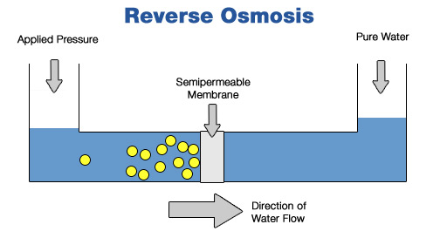
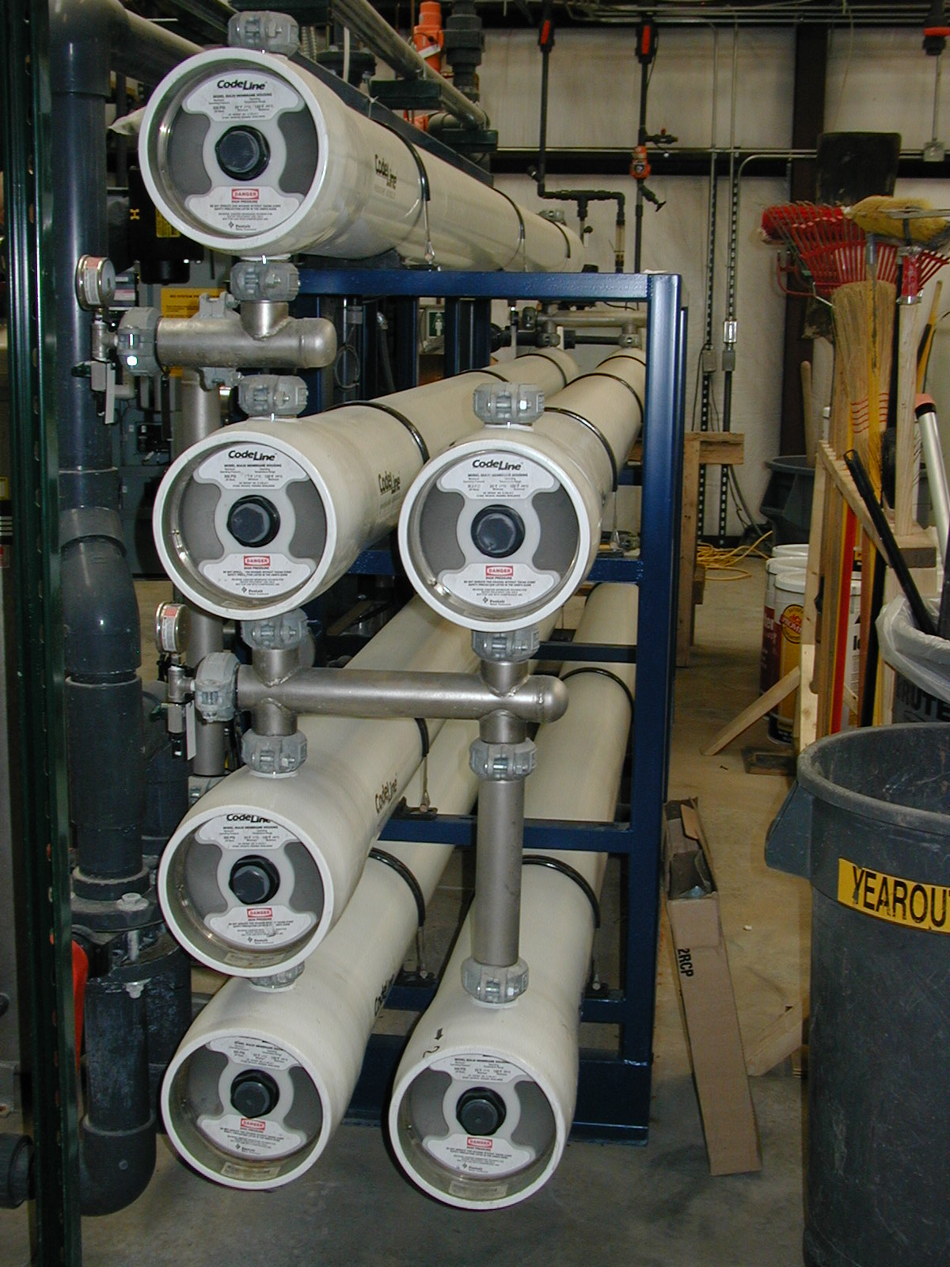
Reverse Osmosis (RO)
Water forced through a semipermeable membrane
Called reverse osmosis because it works by pushing water the opposite direction it would naturally flow through a semipermeable membrane
High pressure, 300 – 600 psi
High energy use
Water passing through membrane called permeate
Salty water rejected by membrane called reject
Takes out all minerals and creates aggressive water
Permeate often mixed with pre-RO water to add back some minerals
Reject water must be disposed of

Slide 20
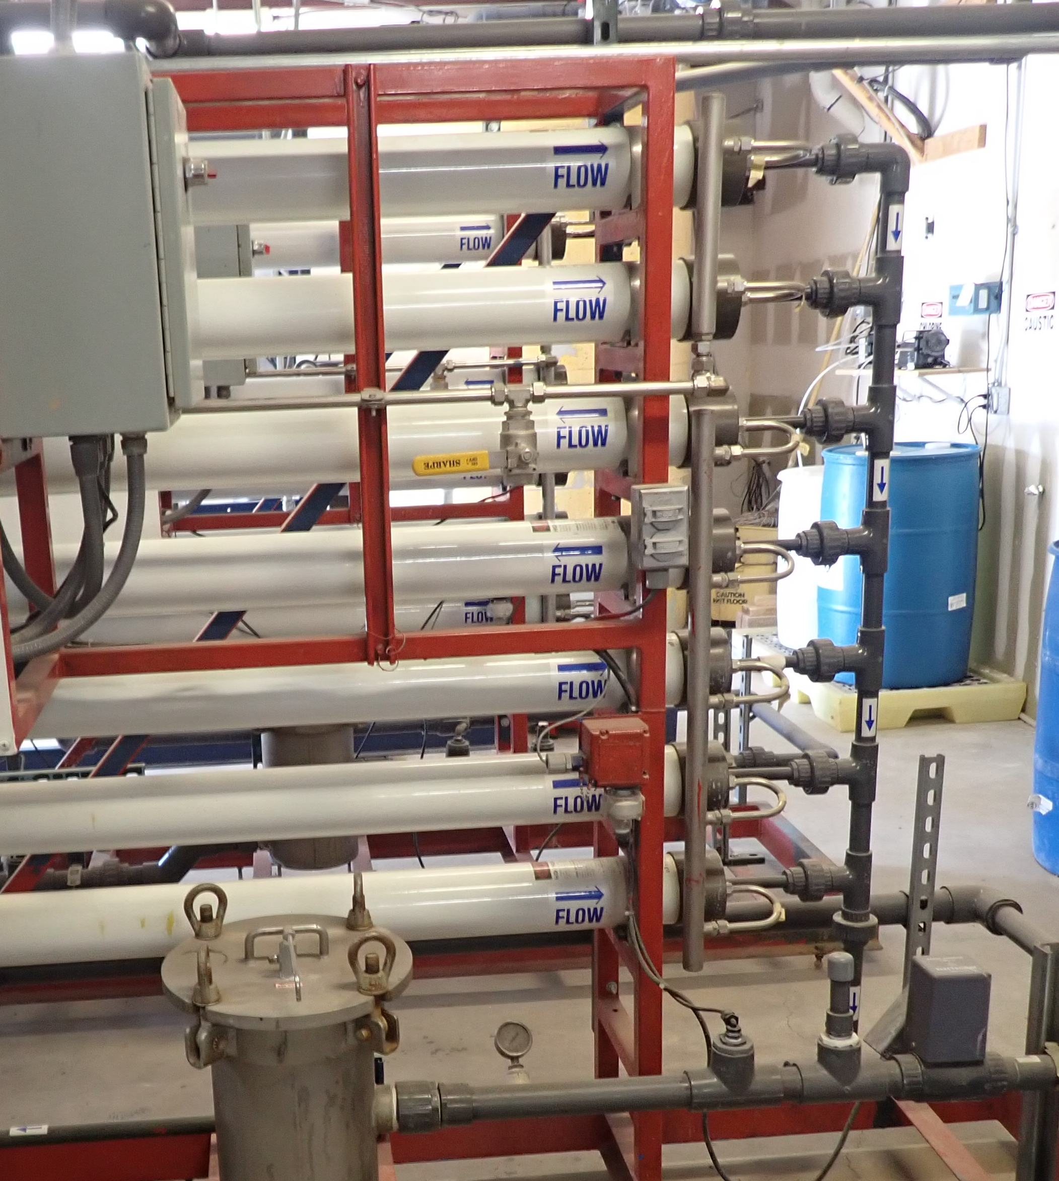
RO membrane fouling
Indicators that RO membranes need cleaning:
Decreased production (flux)
Increased feed pressure
Increased salt passthrough
Membranes cleaned chemically, generally using Clean In Place (CIP) procedure and chemicals approved by manufacturer
Backwash not used for RO to prevent membrane damage

Slide 21
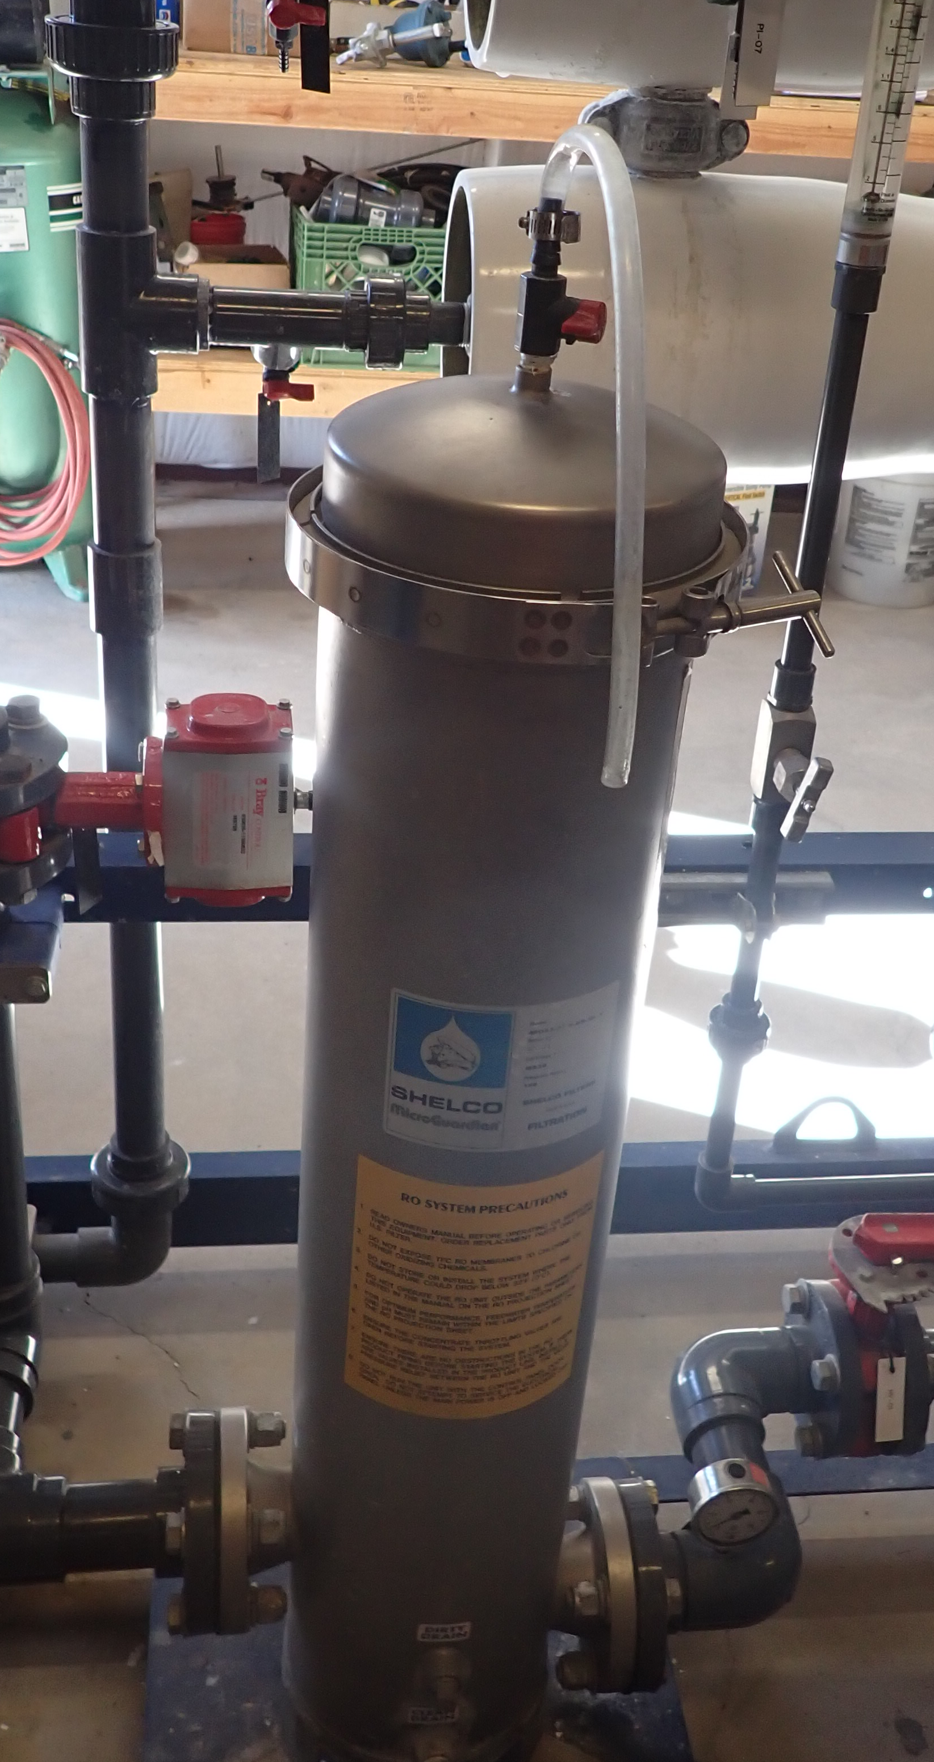
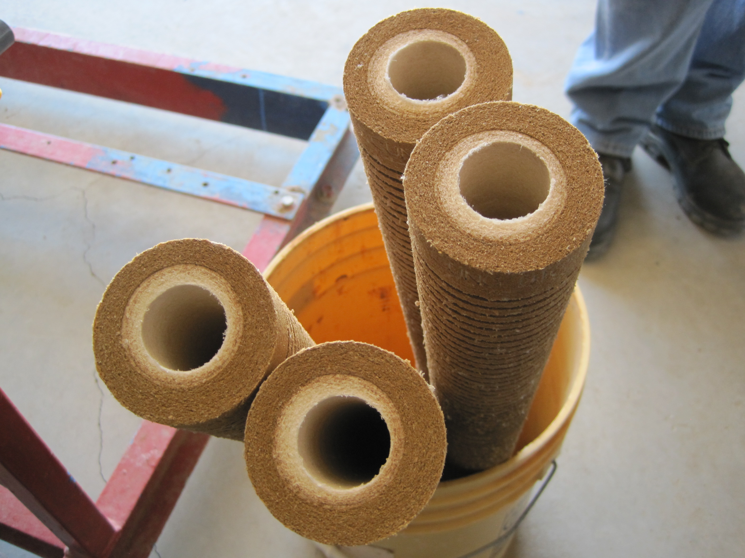
Cartridge / bag filter
Proceeds RO units
Protects membrane from large fouling or damaging material
Pore size of 5-10 µm
Cartridge filters can be used outside of RO units
Can get log removal credit for cartridge filters
May include activated carbon

Slide 22
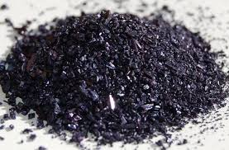
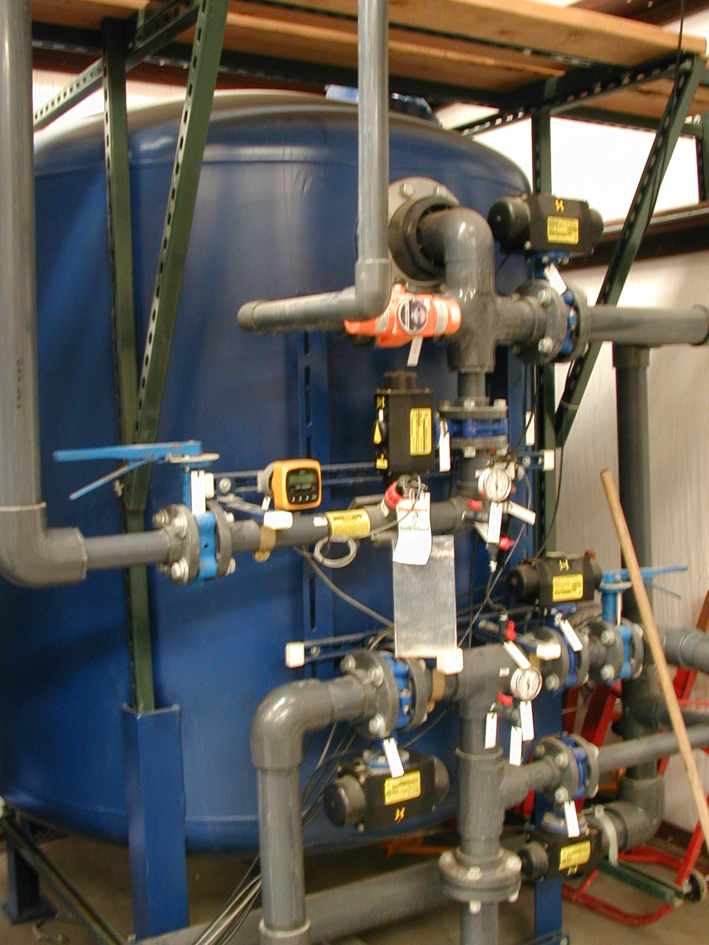
Green Sand Filtration
Removes iron and manganese
Combines oxidation and filtration into one step
Uses potassium permanganate to oxidize iron and manganese from soluble form to insoluble form and filters out
Requires regular backwashing and regeneration of medium with potassium permanganate solution
If there is a pink color in finished water, then reduce the potassium permanganate dosage
Notes:
https://extension.psu.edu/iron-and-manganese-in-private-water-systems

Slide 23
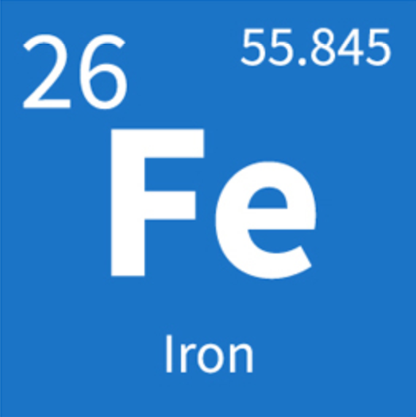
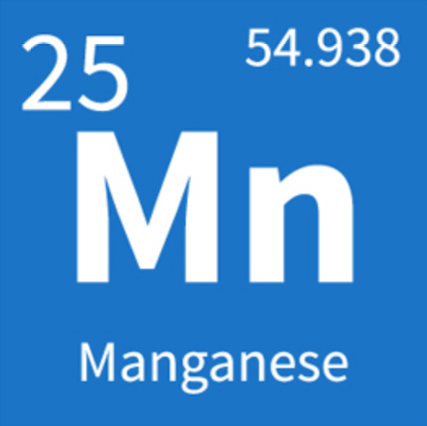
Phosphate Sequestration for iron & manganese
Binds to iron/manganese and puts it into solution if it is in an oxidized state and precipitated out of solution
Only works for low concentrations
Does not remove iron/manganese from the water
Takes care of aesthetic issues, such as staining, but not health concerns
Can create a metallic taste and if dosing is off can give water slippery feel and cause diarrhea.
Notes:
https://extension.psu.edu/iron-and-manganese-in-private-water-systems

Slide 24
Where does lead and copper ins water most often come from?
Decomposition of rocks
Pipes and plumbing fixtures
Industrial contamination
Biological metabolic functions

Slide 25
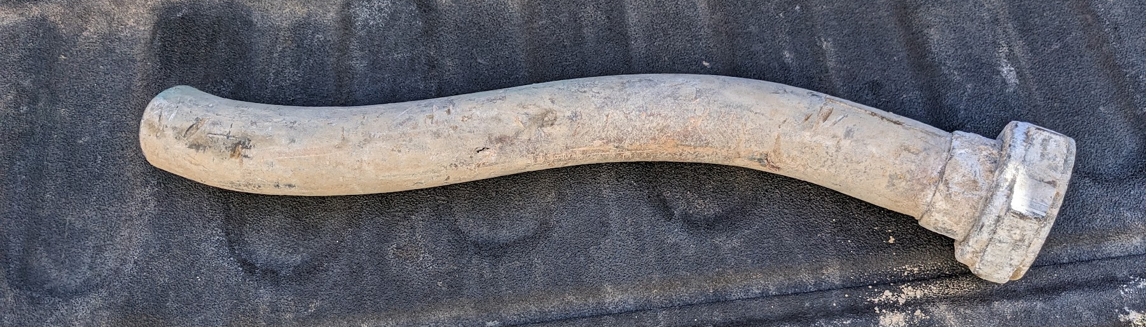
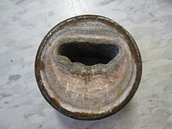
Corrosion Control and Scale
Corrosive / aggressive water
  Dissolves material into water
  Health concerns – lead and copper
  Deterioration of pipe and appurtenances
Scale forming water
  Deposition of dissolved minerals onto pipe / appurtenances
  Decreased lifespan and flow
Notes:
Photo 1: Tucker Colvin, lead service line goose neck removed in Albuquerque
Photo 2: Wikipedia

Slide 26
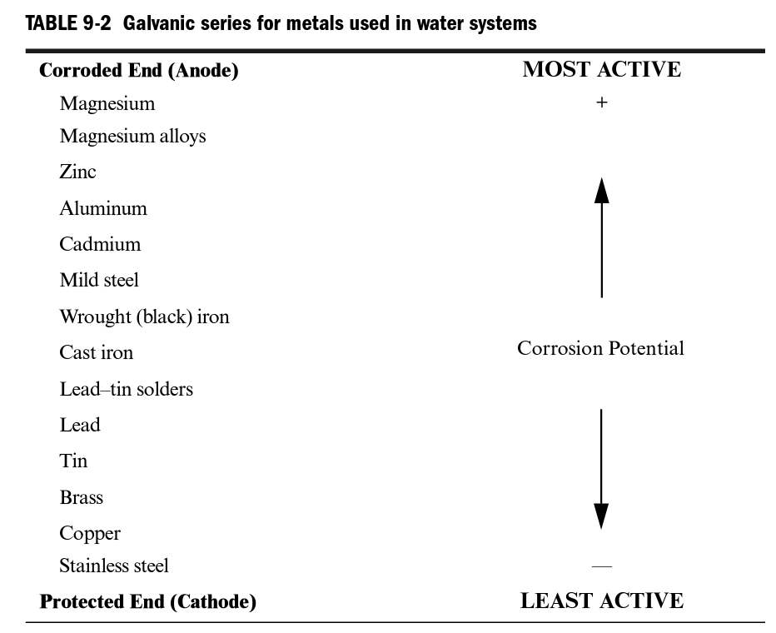
Corrosivity and Water Stabilization
Complicated chemical interactions
Models used to predict corrosivity (Langelier Saturation Index, Ryznar Stability Index)
Factors that affect corrosivity
  Dissolved oxygen
  Total dissolved solids
  Alkalinity and pH
  Temperature
  Flow velocity
  Type of metal
  Electrical current
  Bacteria
Remedied through altering of pH or alkalinity, sequestering agents, formation of protective coating
Notes:
Table source: AWWA Water Treatment

Slide 27
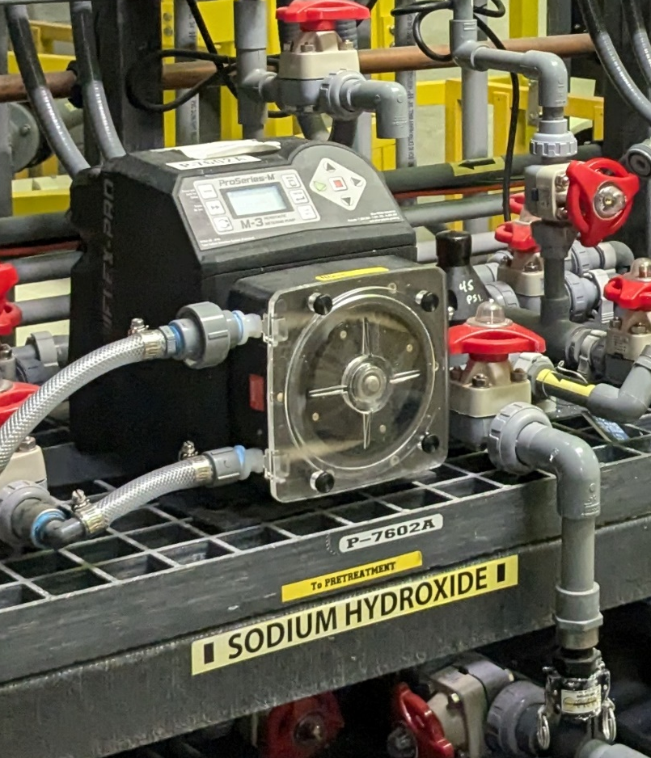
pH/Alkalinity Adjustment
Sodium Hydroxide – increase pH
Carbon Dioxide – decrease pH
Muriatic Acid (HCl) – decrease pH
Calcium Carbonate (increase alkalinity)
Notes:
Photo: Tucker Colvin, Bozeman WTP

Slide 28
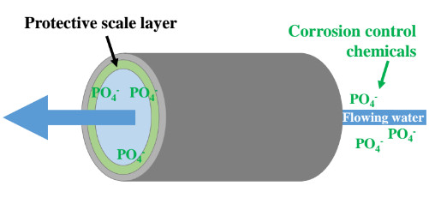
Corrosion Control
Reduce corrosivity of water by forming a protective film on pipes due to corrosive water
Addition of orthophosphate or polyphosphate
Galvanic corrosion – caused by use of dissimilar metals
Notes:
Table source: AWWA Water Treatment

Slide 29
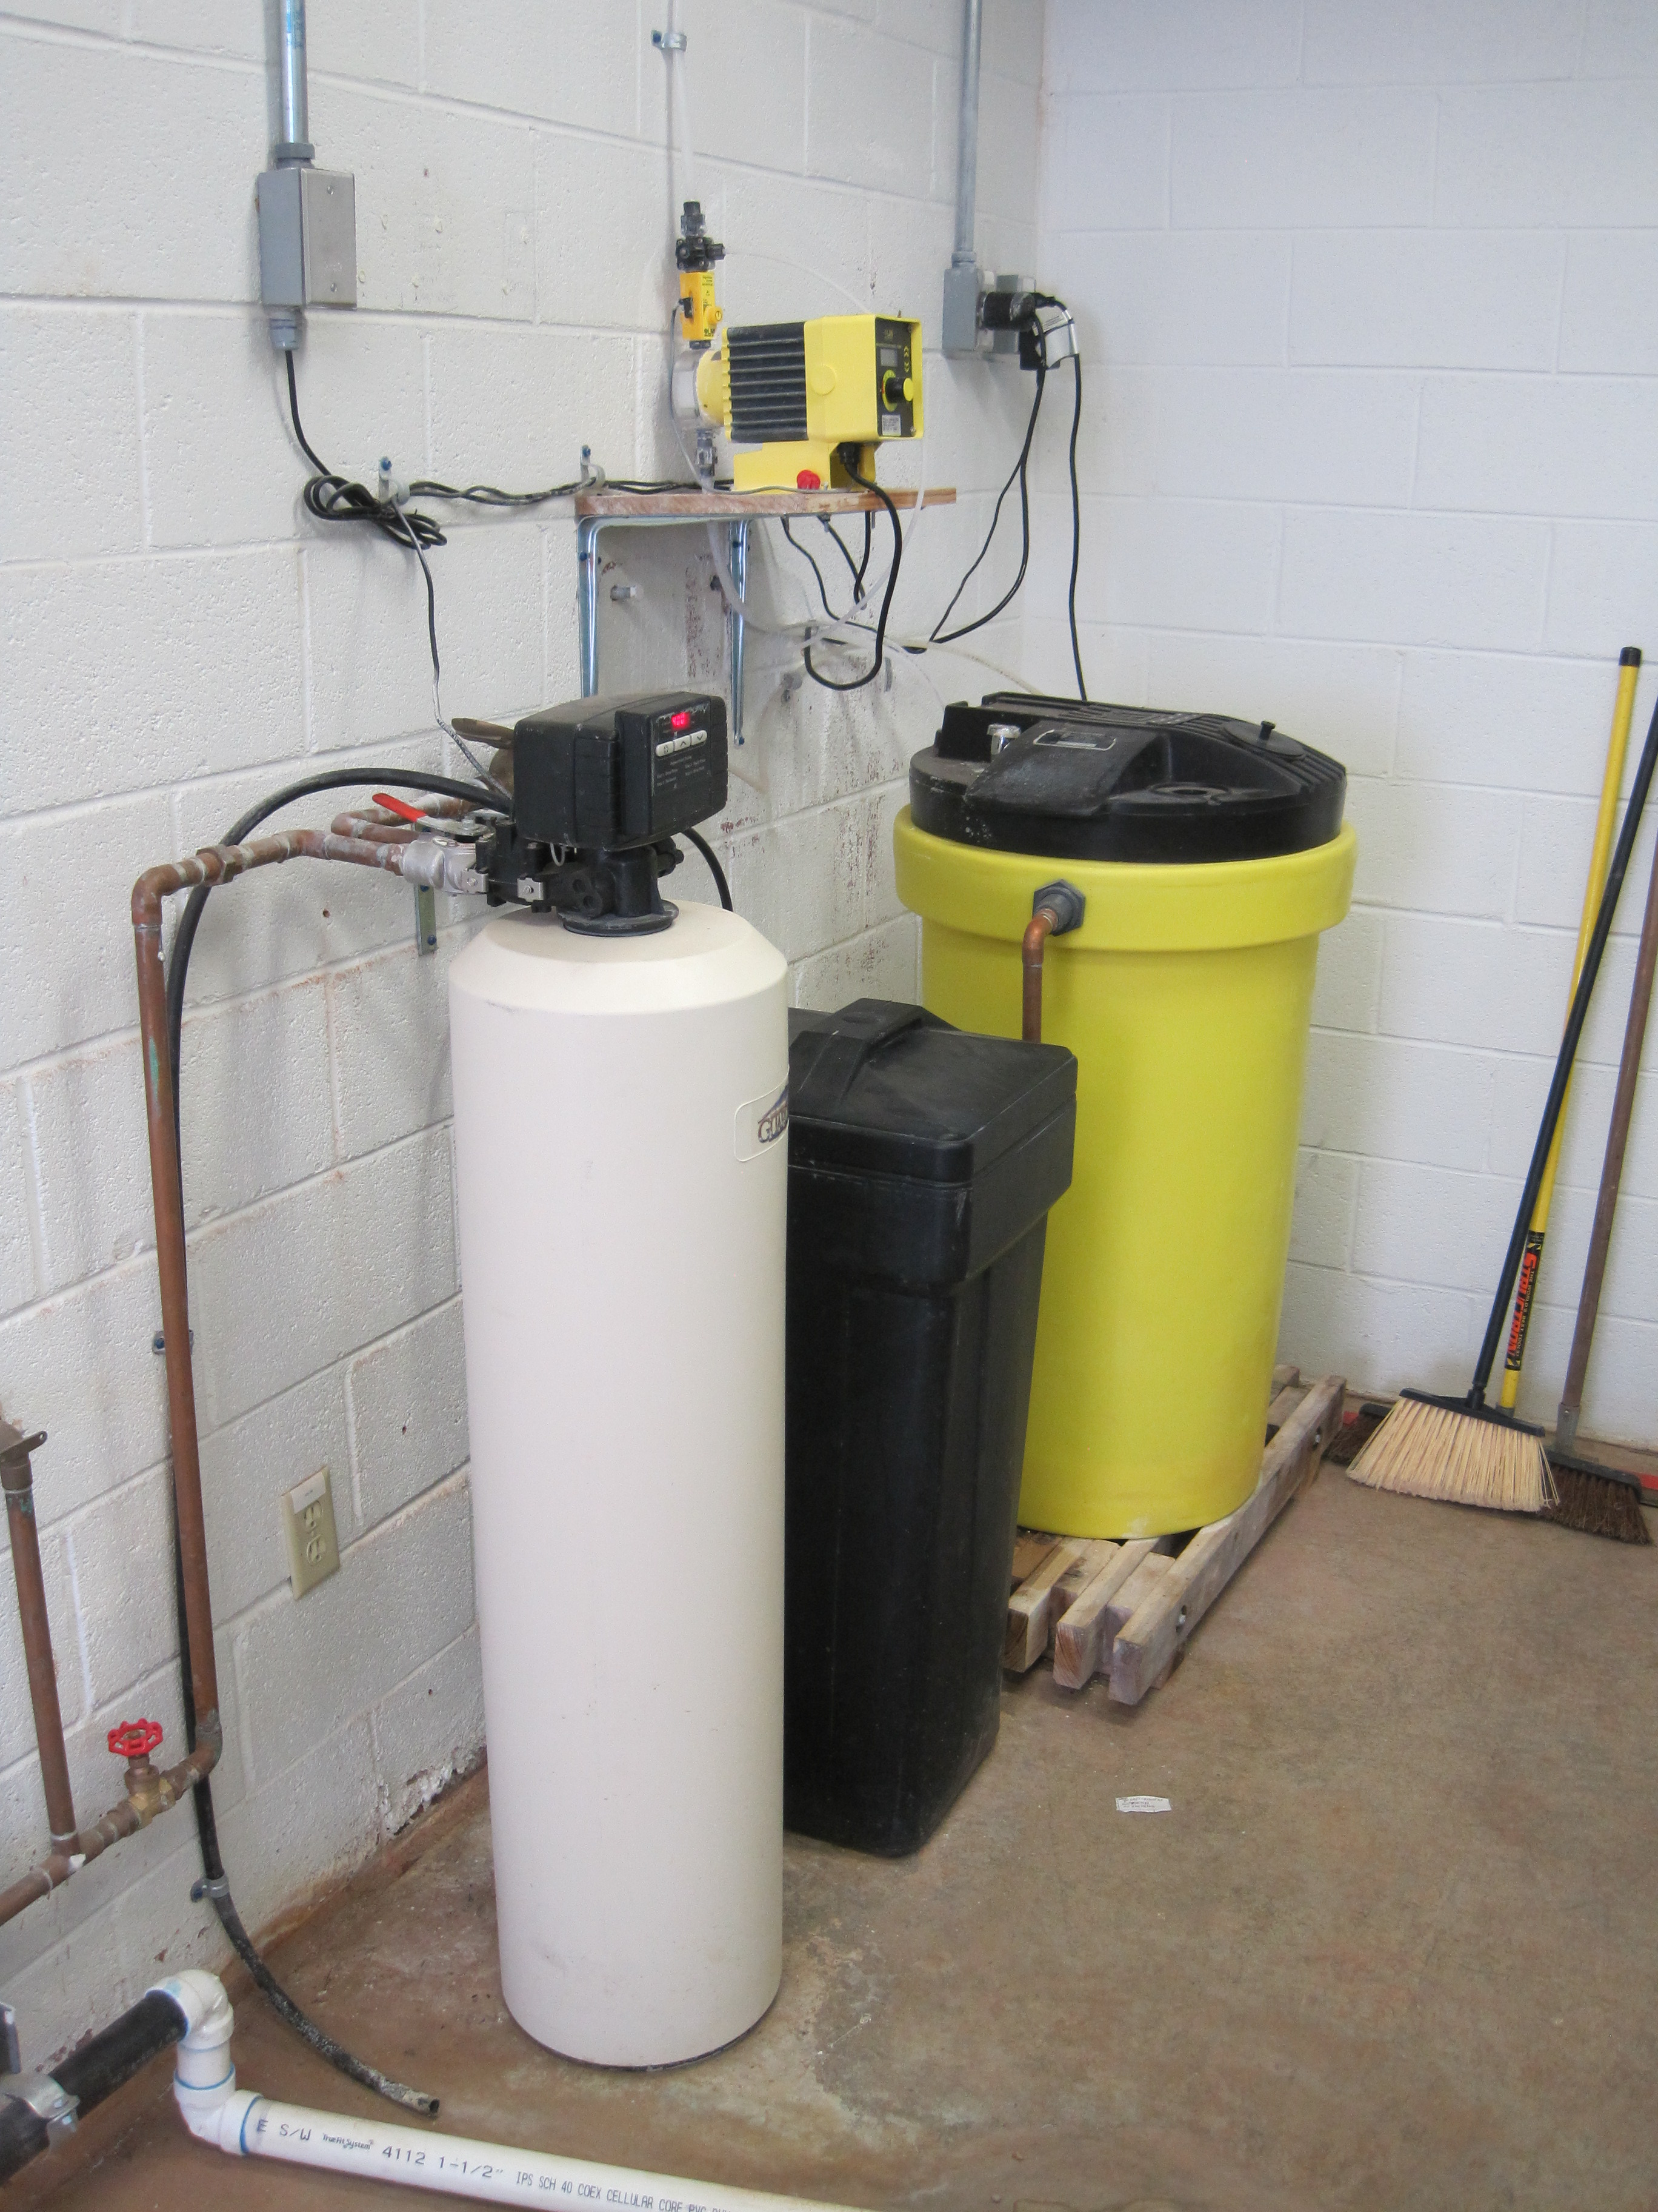
Fluoridation
Fluoride already present in most water sources
Fluoride as an additive to prevent cavities and protect dental health
Recommend concentration of 0.7 mg/L by US CDC
Process control sampling for fluoride should be done in the plant on the finished water every day
A spectrophotometer is used to determine fluoride levels in the lab

Slide 30
Questions?

Slide 31
Schedule for 2026:
Date | Topic
1/22/2026 | Alternative Treatment Processes (e.g. fluoridation, ion exchange, RO…)
2/5/2026 | Drinking Water Treatment Math & Concept Review
2/19/2026 | Safety Program Basics (including personal safety, equipment safety, facility safety)
3/5/2026 | Lead & Copper Rule, Corrosion Control
3/19/2026 | Distribution Systems 1: Hydraulics, Pipe Types, Selection, Installation, and Water Quality
4/2/2026 | Distribution Systems 2: Valves, Hydrants, Meters, and Service Connections
4/16/2026 | Distribution Systems 3: Storage and Booster Pumping
4/30/2026 | O&M: Pumps, Main, and Appurtenance Maintenance (including pressure monitoring, valve exercising, and flushing)
5/14/2026 | O&M: Cross Connection Control
5/28/2026 | O&M: Distribution System Math and Concept Review
6/11/2026 | Sampling & Lab Procedures/Analysis/Interpretation
6/25/2026 | Management Overview (including organization, communication, PR & record keeping)
7/9/2026 | Drinking Water Practice Exam and Review
Links to recordings and material are available on our website at https://swefc.unm.edu/home/op-cert-trainings/

Slide 32
CONTACT INFORMATION
SW EFC email: swefc@unm.edu
Department of Civil Engineering MSC01 1070
1 University of New Mexico
Albuquerque, NM 87131
505-277-0644
swefc@unm.edu
http://swefc.unm.edu

