Slide 1





US Territories Water Operator Training Series
Session 12: Surface Water Treatment 1: Coagulation, Flocculation, Sedimentation
12/4/25
www.efcnetwork.org
This program is made possible under a cooperative agreement with US EPA.

Slide 2


Tucker Colvin
Research Scientist tcovin@unm.edu

Slide 3



This training series is funded by the US EPA

Slide 4


Slide 5
Schedule for 2025:
Date | Topic
6/26/25 | Program Overview, Test Format, Study & Test Tips
7/10/25 | Drinking Water System Overview - (Source, Treatment, & Distribution)
7/24/25 | Basic Operator Math (+, -, /, x, Exponents and basic algebra)
8/7/25 | Applied Operator Math (e.g. Areas, Volume, Flow Rates, Detention Time, Pressure/Hydraulic Head)
8/21/25 | Drinking Water Regulations
9/4/25 | Source Water Characteristics
9/18/25 | Surface Water Intake Components, Well Components, and O&M
10/2/25 | Disinfection 1: Chloramines, UV, Chlorine Dioxide, Chlorine
10/16/25 | Disinfection 2: Chlorine Disinfection Application for Sodium Hypochlorite and Gas Chlorine (including storage and safety)
10/30/25 | Disinfection 3: Distribution System Application, Residual Measurement, Evaluation & Adjustment,
11/13/25 | Disinfection 4: Chlorine Disinfection Math
12/4/25 | Surface Water Treatment 1: Coagulation, Flocculation, Sedimentation (including chemistry, process controls, operations)
12/18/25 | Surface Water Treatment 2: Filtration
Links to recordings and material are available on our website at https://swefc.unm.edu/home/op-cert-trainings/

Slide 6
Schedule for 2026:
Date | Topic
1/21/2026 | Alternative Treatment Processes (e.g. flouridation, ion exhange, RO…)
2/4/2026 | Drinking Water Treatment Math & Concept Review
2/18/2026 | Safety Program Basics (including personal safety, equipment safety, facility safety)
3/4/2026 | Lead & Copper Rule, Corrosion Control
3/18/2026 | Distribution Systems 1: Hydraulics, Pipe Types, Selection, Installation, and Water Quality
4/1/2026 | Distribution Systems 2: Valves, Hydrants, Meters, and Service Connections
4/15/2026 | Distribution Systems 3: Storage and Booster Pumping
4/29/2026 | O&M: Pumps, Main, and Appurtenance Maintenance (including pressure monitoring, valve exercising, and flushing)
5/13/2026 | O&M: Cross Connection Control
5/27/2026 | O&M: Distribution System Math and Concept Review
6/10/2026 | Sampling & Lab Procedures/Analysis/Interpretation
6/24/2026 | Management Overview (including organization, communication, PR & record keeping)
7/8/2026 | Drinking Water Practice Exam and Review
Links to recordings and material are available on our website at https://swefc.unm.edu/home/op-cert-trainings/

Slide 7

https://swefc.unm.edu/home/op-cert-trainings/

Slide 8

Sign in for every session to ensure you get credit for attending

Slide 9
Today’s Agenda
CT
Distribution System Application
Residual Measurement
Residual Evaluation
Dosage Adjustment
Repairing Mains

Slide 10
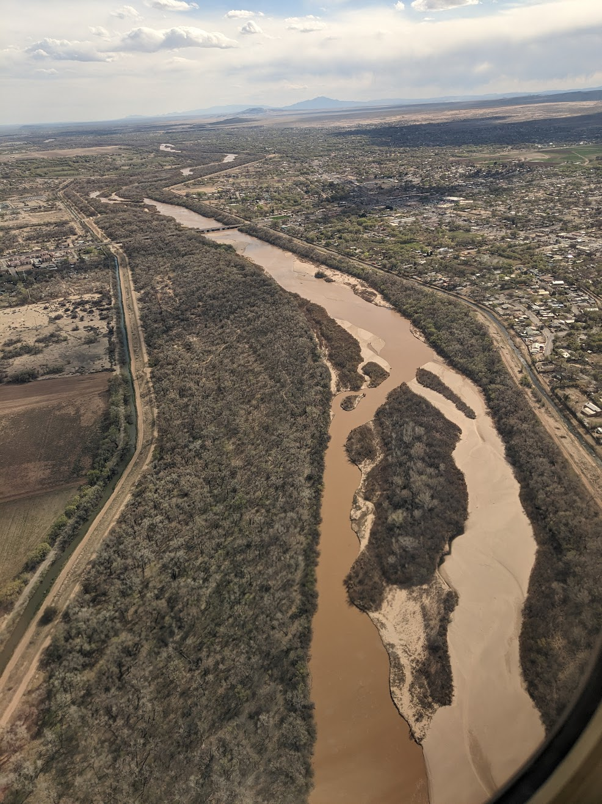
Surface Water Treatment 1: Coagulation, Flocculation, Sedimentation
Purpose of treatment
Turbidity reduction
Removal of suspended solids (TSS)
Removal of dissolved solids (TDS)
Removal or inactivation of organisms and viruses
Alter water chemistry

Slide 11
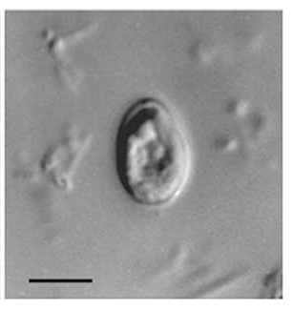
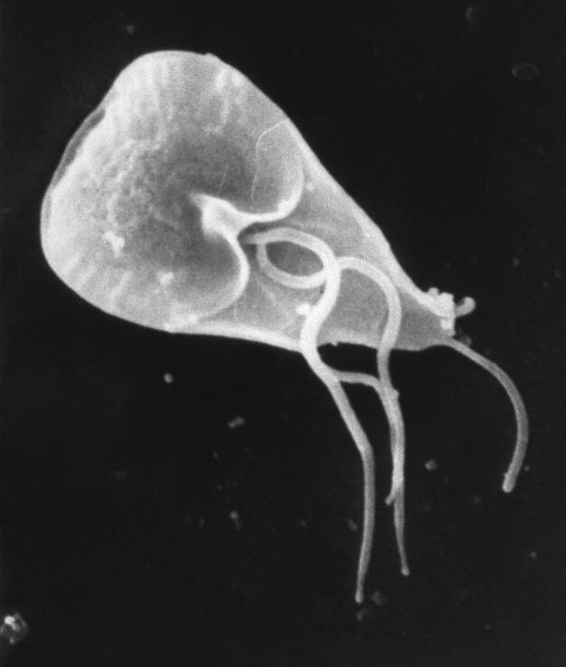
Log removal
Cryptosporidium
Giardia
Bacteria
Viruses
1 log removal = 90%
2 log removal = 99%
3 log removal = 99.9%
4 log removal = 99.99%
Etc.
Credits for treatment methods

Slide 12
Surface water treatment steps
Intake / bar screening
Chemical addition
Rapid mix
Coagulation
Flocculation
Sedimentation
Filtration
pH adjustment / corrosion control
Disinfection
Fluoridation
Storage / distribution
Grit removal

Slide 13
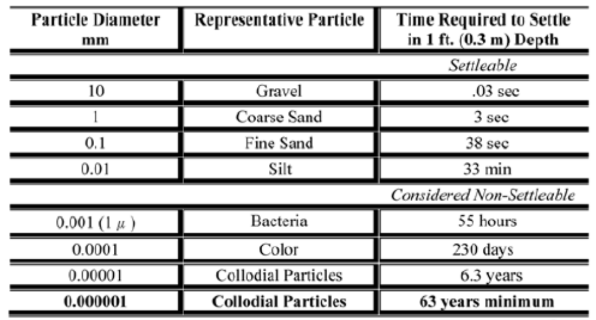
Pretreatment - chemical and physical process
Physical process – particle settling
Chemical process – creating particles to settle

Slide 14
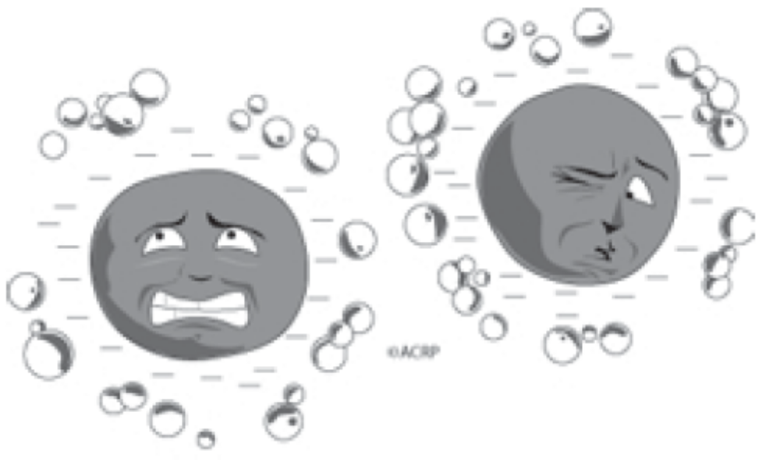
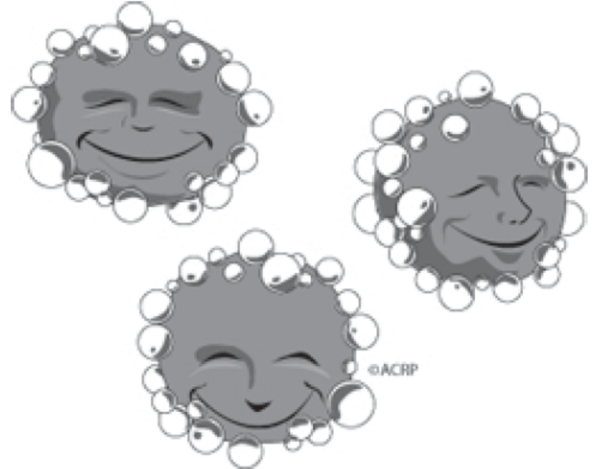
Colloids
- Do not settle quickly due to small size
- Charge overcomes force of gravity
Hydrophobic (water fearing)
Hydrophilic (water loving)

Slide 15
Surface water treatment steps
Intake / bar screening
Chemical addition
Rapid mix
Coagulation
Flocculation
Sedimentation
Filtration
pH adjustment / corrosion control
Disinfection
Fluoridation
Storage / distribution
Grit removal

Slide 16
Surface water treatment steps
Intake / bar screening
Chemical addition
Rapid mix
Coagulation
Flocculation
Sedimentation
Grit removal
Filtration
pH adjustment
Disinfection
Fluorination

Slide 17
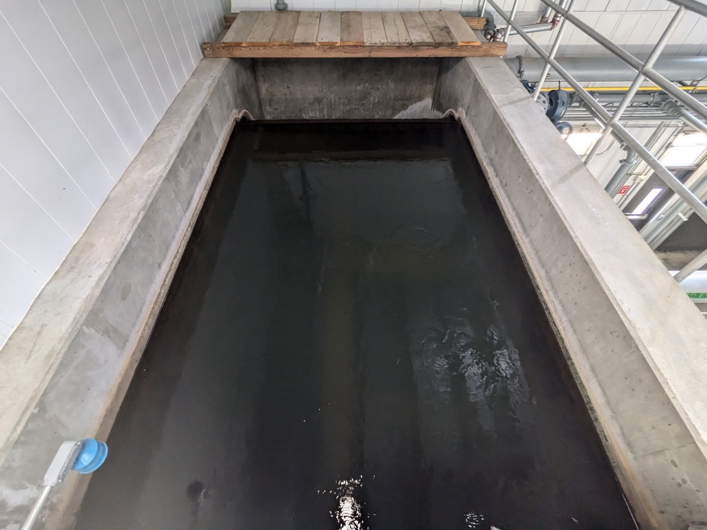
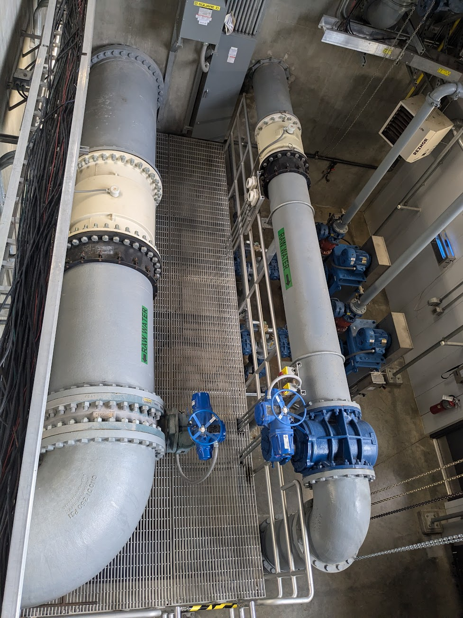
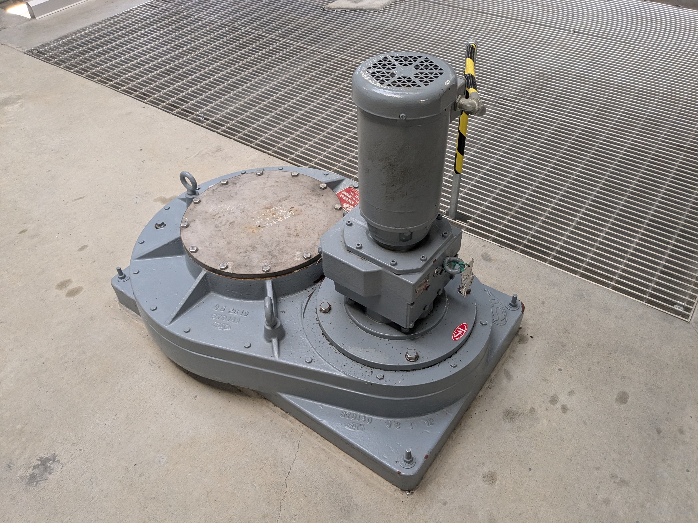
Influent / grit removal

Slide 18
Grit Removal Devices: Vortex Separator
Click on link to watch Video (Grit King) https://www.youtube.com/watch?v=v9Shzp4S1NU
Notes:
Viortex
May have a grit pump or other mechanism at the bottom to extract the grit that accumulates at the bottom
These ware typically used where there is a lot of fine grit, and can remove up to about 73% or grit down to 0.004 inches in diameter (about a 10th of a millimeter)
These also have consistent m removal efficiencies over wide flow ranges and don’t have any moving parts. They have low head loss and usually have a small footprint – much smaller than a settling basin
Some of the downsides of vortex units is that they can have clogs in the grit sumps (down at the bottom), they’re typically proprietary
Ideally you would have two so you have redundancy for repairs or unexpected higher flows but a small plant probably won’t be able to afford it.

Slide 19
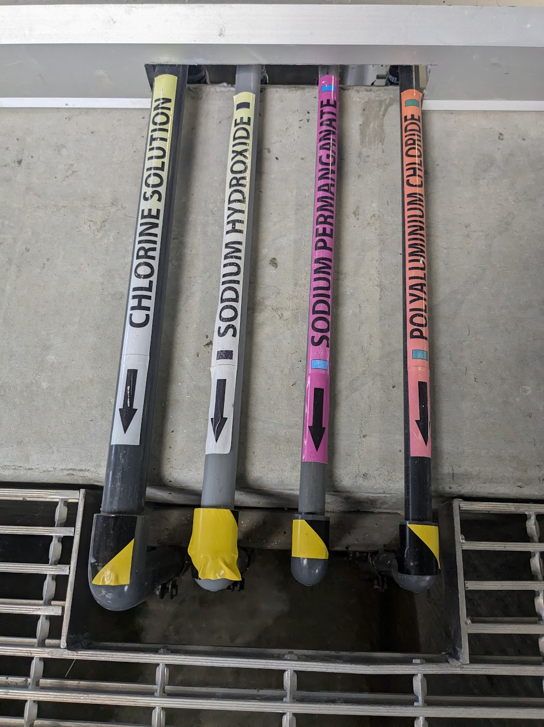
Water Pre-treatment Chemicals
  Oxidants
  pH adjustment
  Coagulants
  Adsorption

Slide 20
Water Pre-treatment Chemicals
  Oxidizing agents include
  Chlorine
  Ozone
  Aeration
  Hydrogen peroxide
  Sodium permanganate

Slide 21
Water Pre-treatment Chemicals
  Oxidizing agents
  Precipitate out contaminants such as iron and manganese
  Decreased volatile organic compounds (VOCs), disinfection byproducts, hydrogen sulfide, carbon dioxide
  Can help with coagulation
  Neutralizes negative particle charges

Slide 22
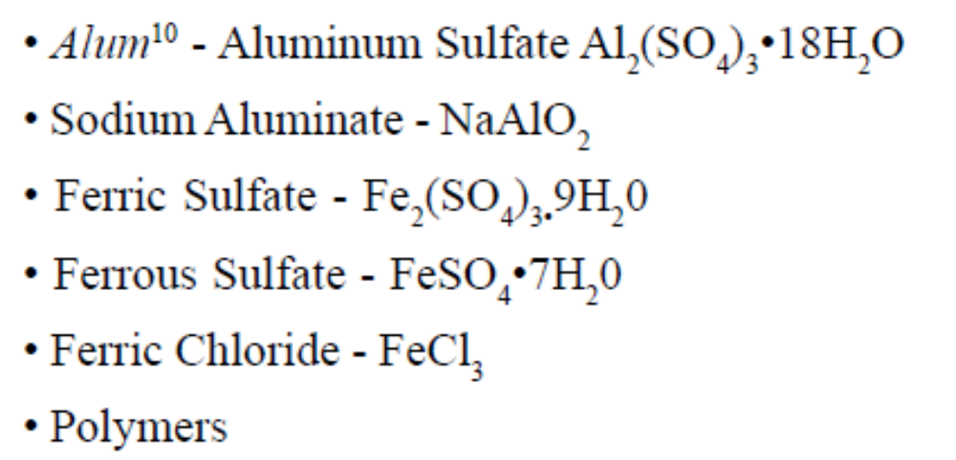
Water Pre-treatment Chemicals
  Coagulants

Slide 23
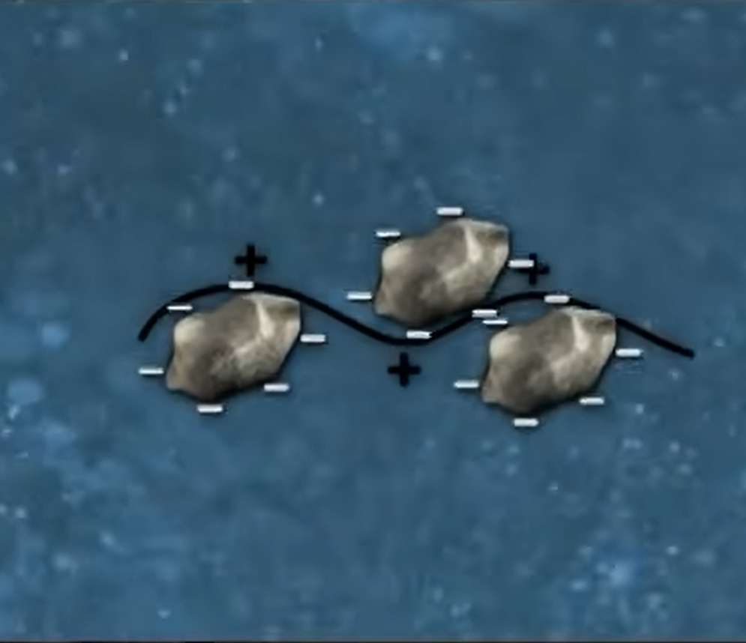
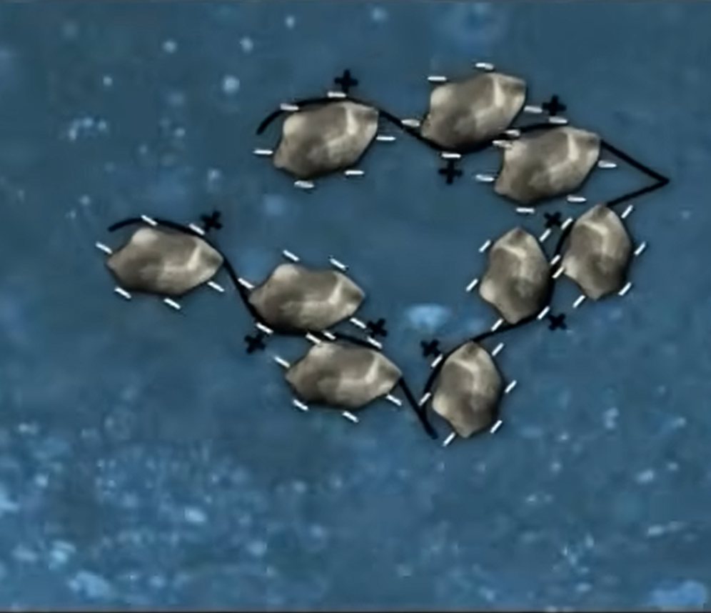
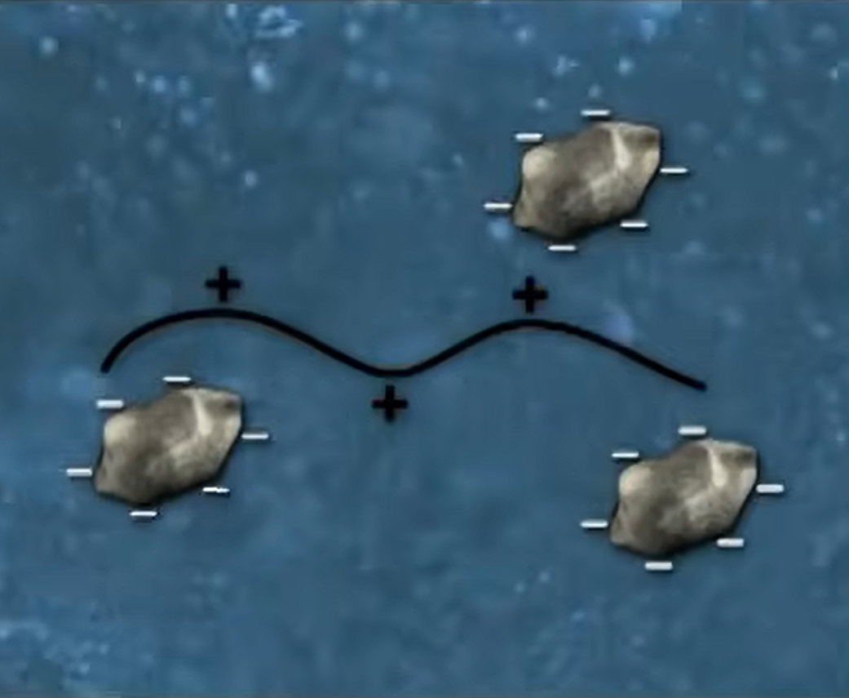
Coagulation
Chemical process
Sediment particles are mostly negatively charged and push away from each other
Coagulant is positively charged and bonds to sediment to neutralize charge
Microflocs are formed
Notes:
Photo credit: AWWA, https://www.youtube.com/watch?v=GVCWwWCLY7w

Slide 24
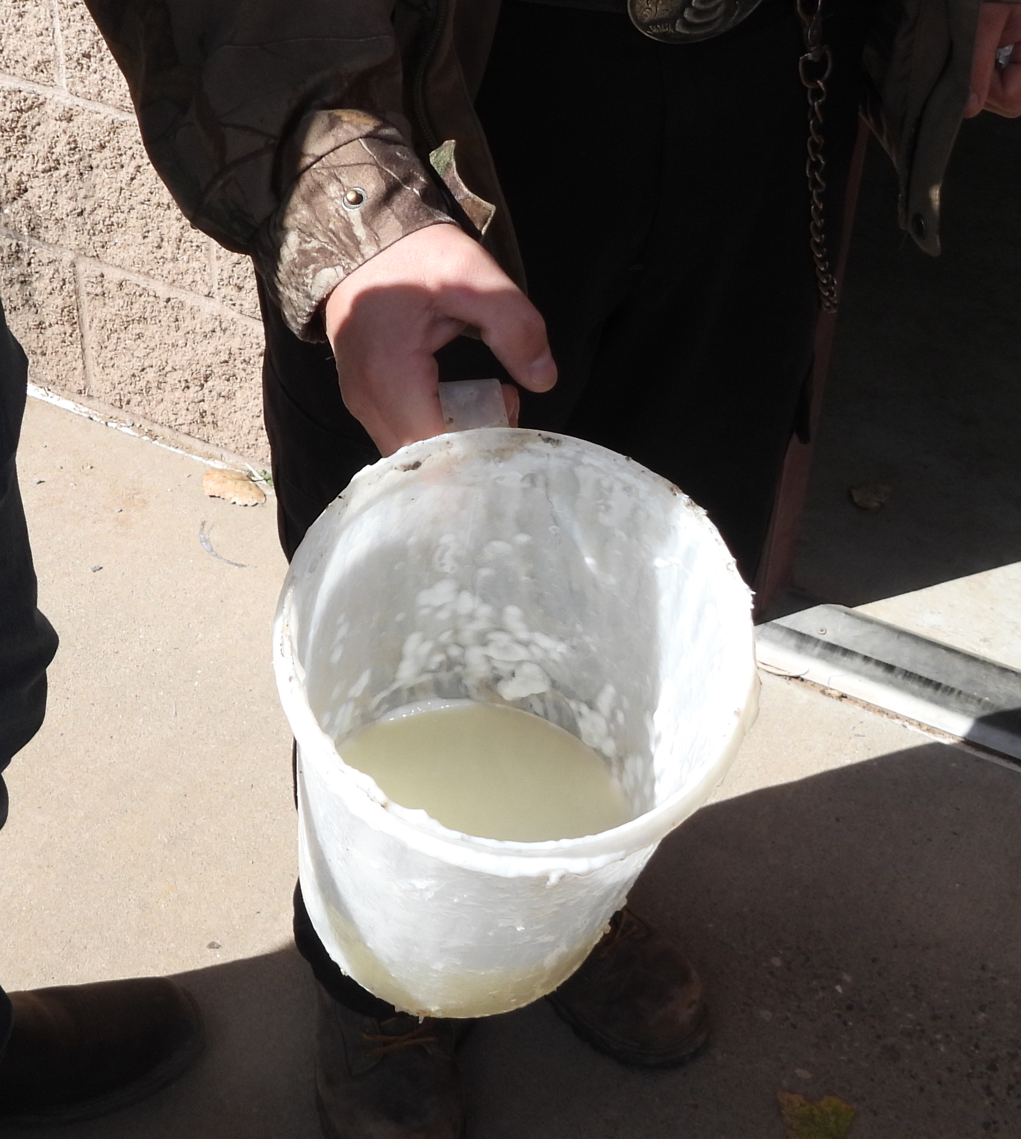
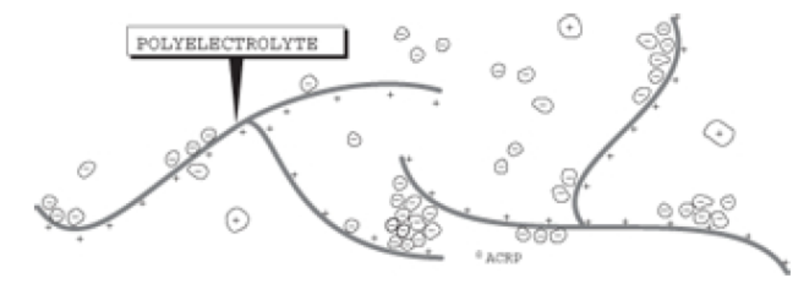
Coagulation and Polymers/Polyelectrolytes
String-like chain molecules with charges along the string
Aid in coagulation (sometimes as primary coagulant)
Three types (type use depends on colloidal material)
  Cationic polymers – positive charged
  Anionic polymers – negative charged
  Nonionic polymers – not charged

Slide 25




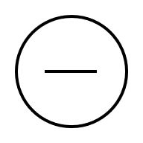
Factors that Affect Coagulation
pH
Alkalinity
Turbidity
Temperature
Polymer type
-

Slide 26
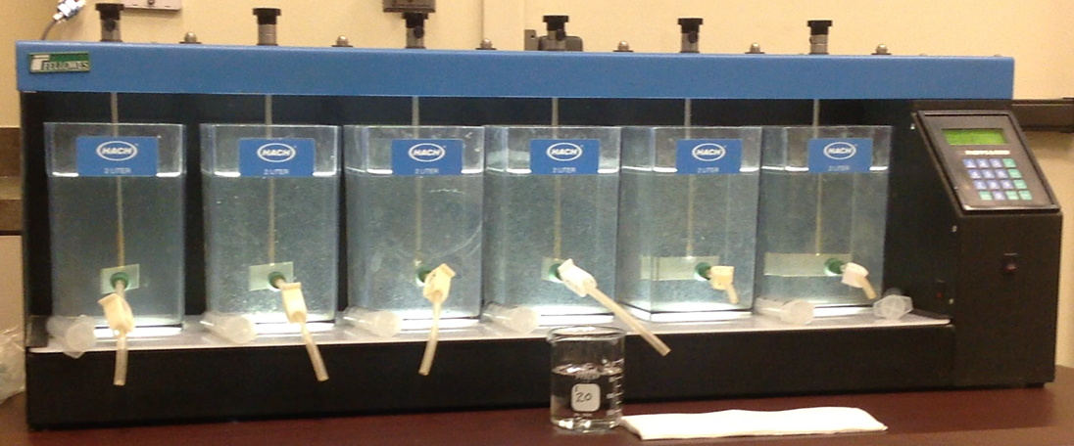
Determining Chemical Dosage (jar test)
Notes:
Source unknown

Slide 27
Feed Rate
The amount of chemical in pounds or gallons that you feed into a volume of water over a period of time.
pounds or gallons/day

Slide 28
Feed Rate Equation Parts
Dosage, (mg/L) = The total amount of chemical solution fed into a volume of water.
Flow (MGD) = The volume of water in Million Gallons per Day that you are feeding the chemical into.
8.34 lb/gal = The weight of water.
Purity, % expressed as a decimal = Purity of the chemical that you are feeding into the water expressed as a decimal.

Slide 29

1) After doing a jar test, a 500K gpd water plant determined they want a dosage of 1.3 mg/L of their alum liquid solution with a 48% concentration. What is their lbs per day of alum solution usage?
Feed Rate, lb/day = $\frac{\left(1.3 mg/L\right)\left(0.5 MGD\right)\left(8.34 lb/gal\right)}{0.48}=$
A) 5.42 lb/day
B) 11.3 lb/day
C) 86.9 lb/day
D)112.9 lb/day
Feed Rate, lb/day = $\frac{\left(1.3 mg/L\right)\left(0.5 MG/D\right)\left(8.34 lb/gal\right)}{0.48}=$
Feed Rate, lb/day = $\frac{\left(5.42 lb/day\right)}{0.48}=$
$$11.3 lb/day$$

Slide 30
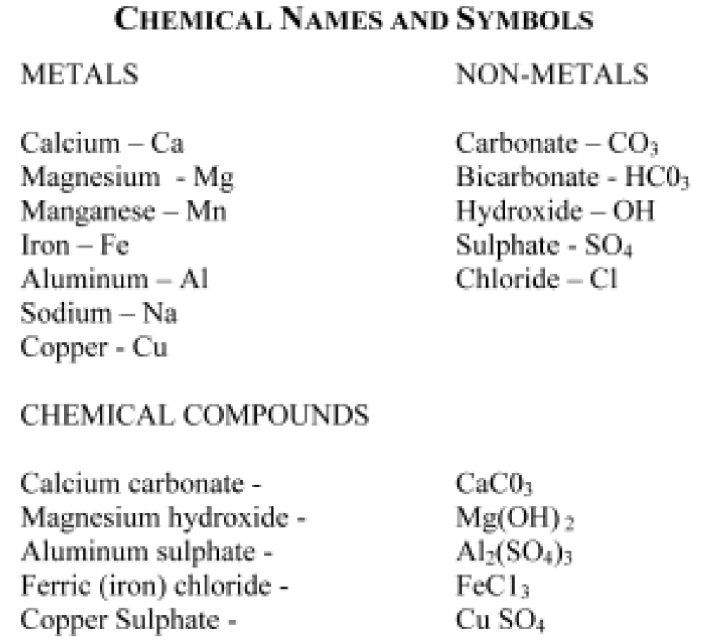
Solubility of Salts and Water Treatment
Salt = metal + other mineral
Some salts soluble in water and some are not
Most undesirable minerals in water are soluble salts
Add chemicals and adjust pH to make soluble undesirables insoluble so can be removed

Slide 31
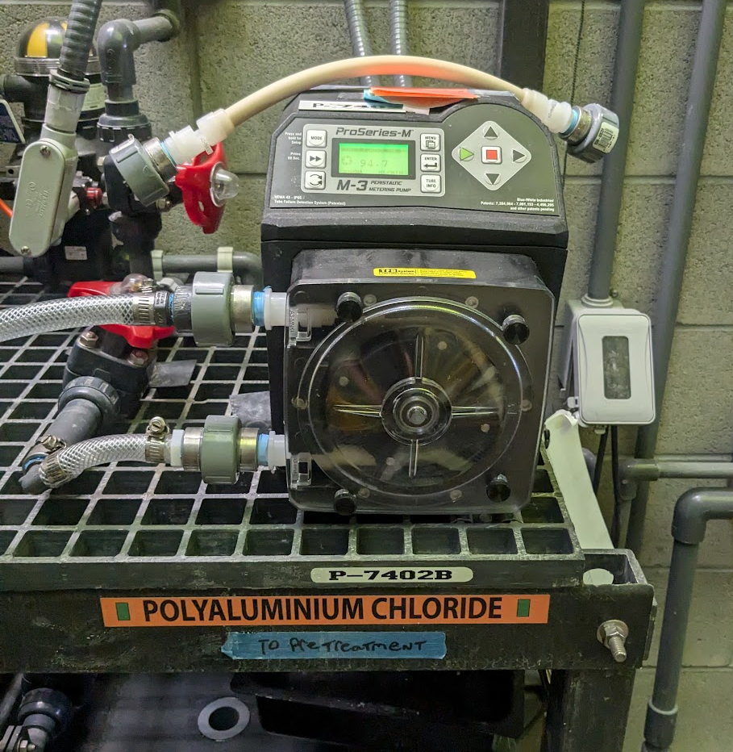
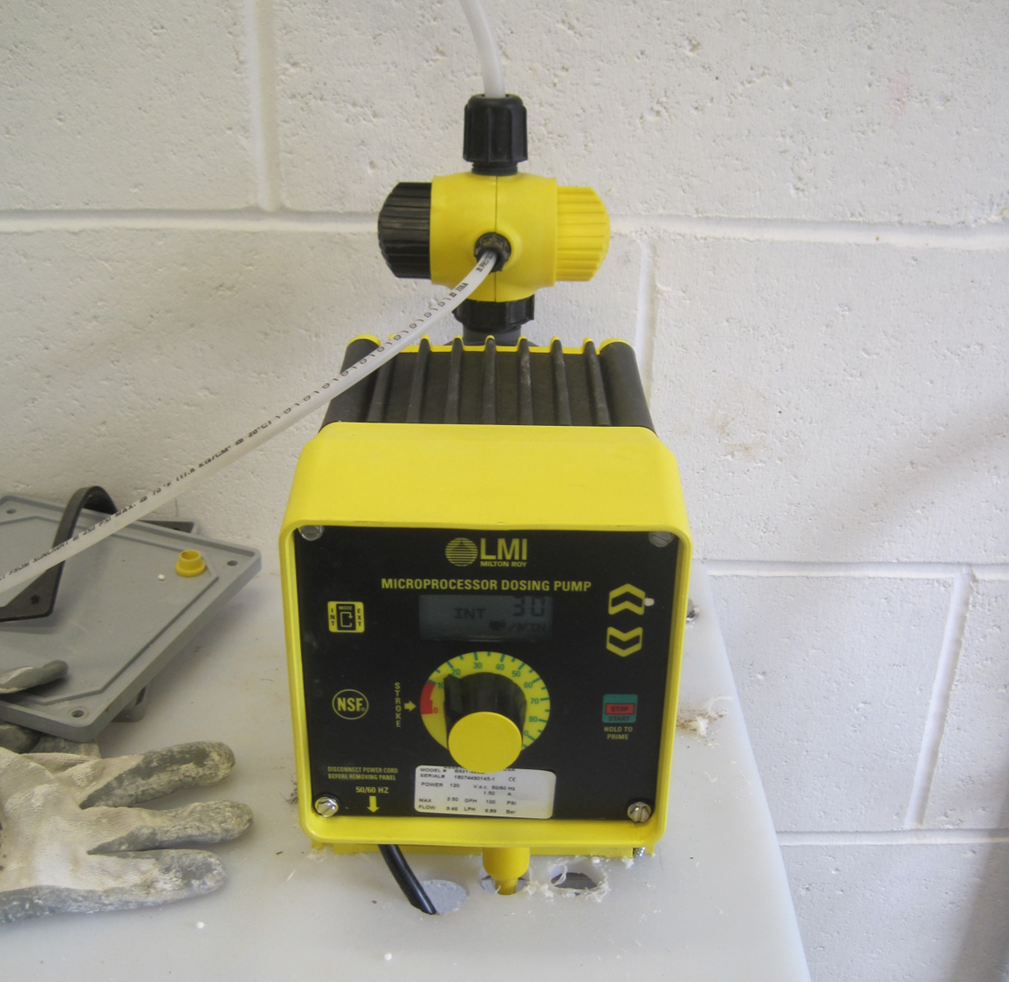
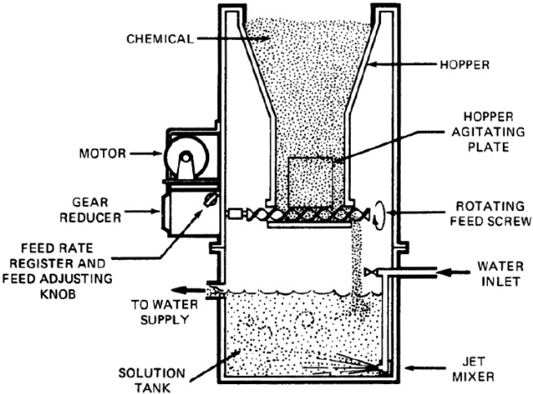
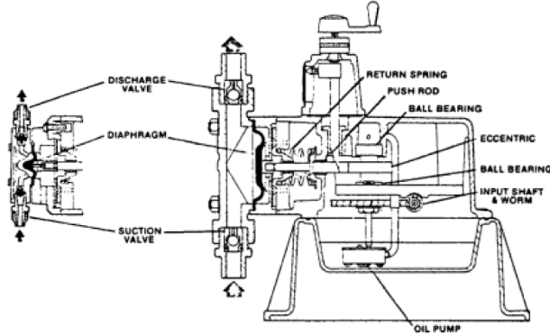
Pretreatment Equipment - Chemical Feeders
Volumetric (most common)
  Auger feeders
  Positive displacement metering pumps
Notes:
Peristaltic pump
Solenoid piston pump

Slide 32
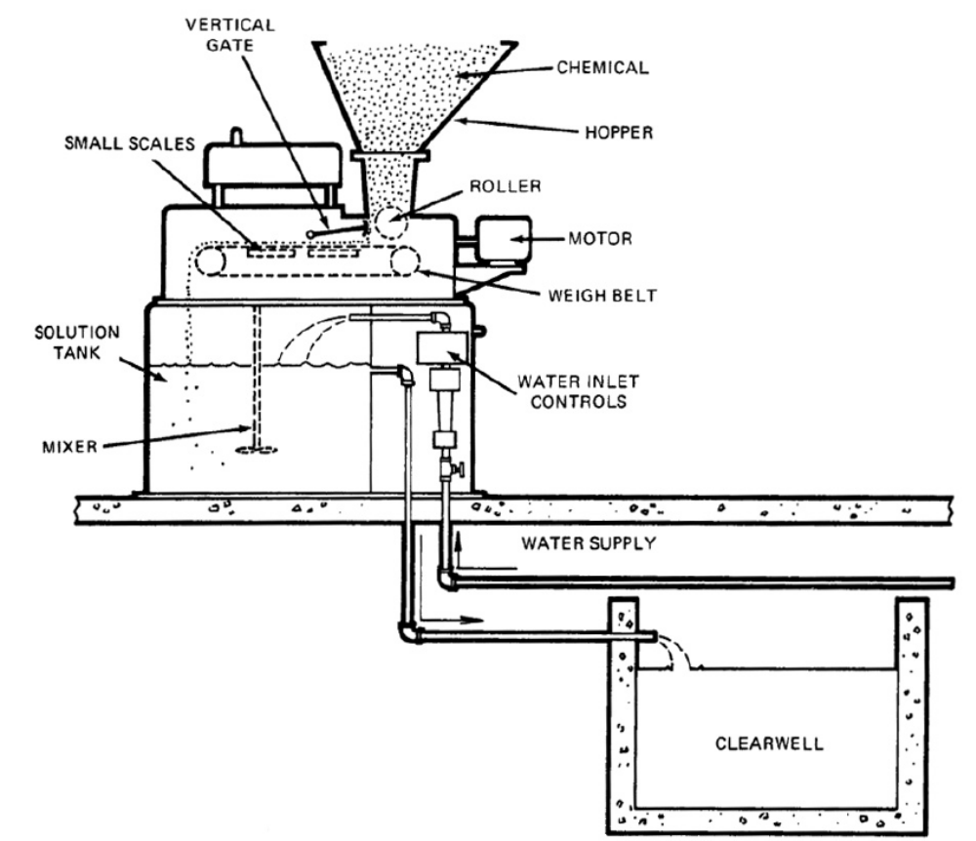
Pretreatment Equipment - Chemical Feeders
Gravimetric
  Conveyor with set of scales to maintain constant weight of materials on belt
  Not used much in water treatment because most chemicals are corrosive and will damage the scale mechanism

Slide 33
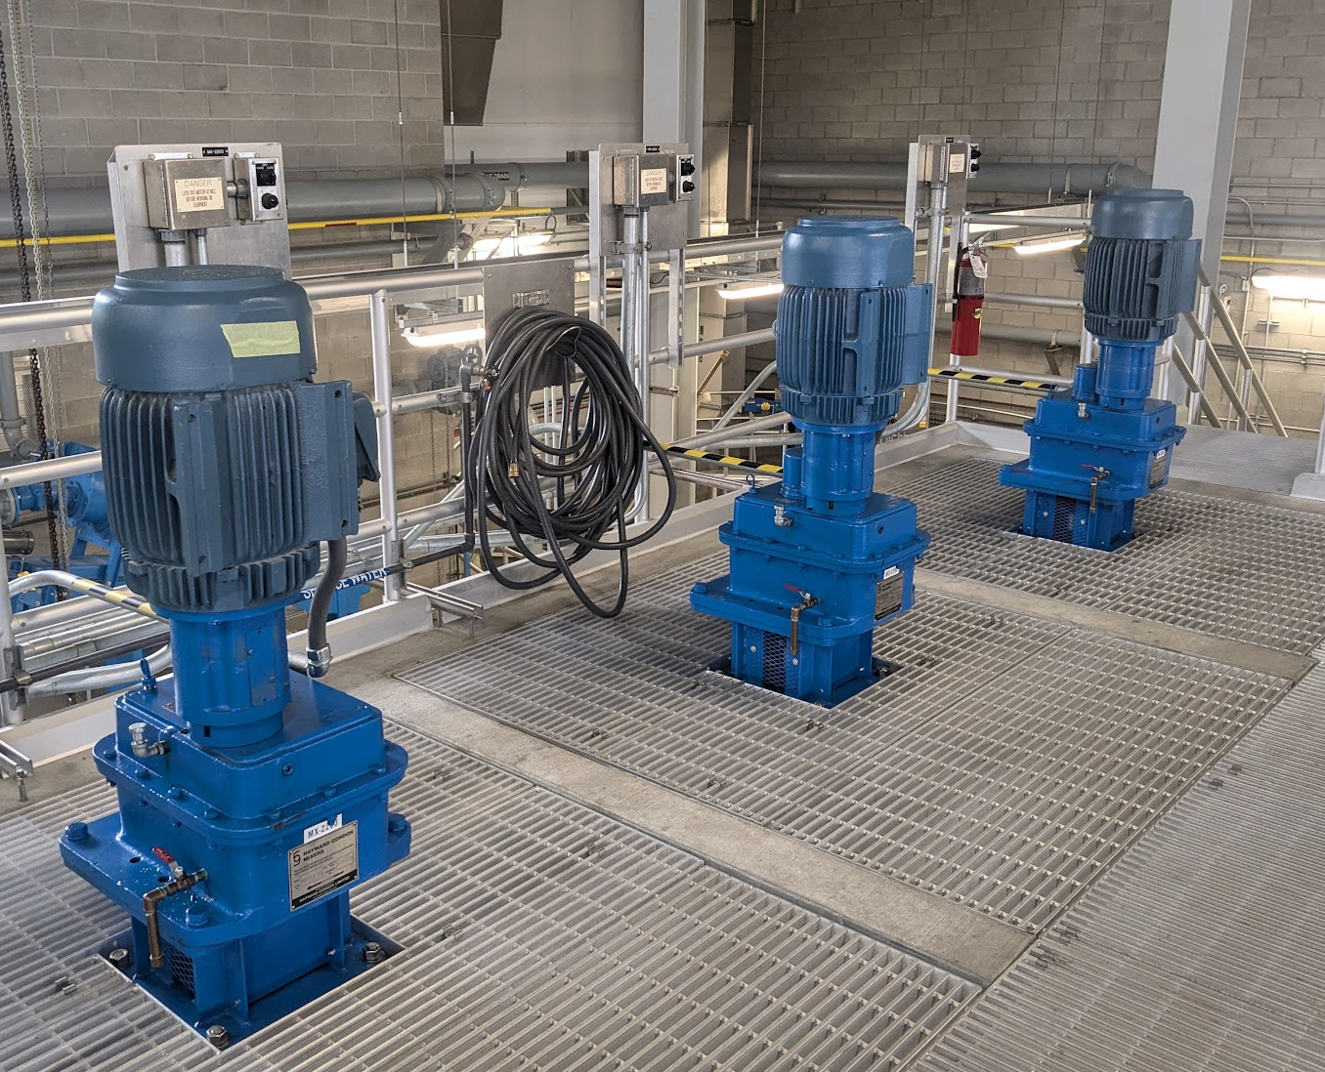
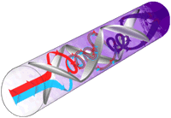
Rapid Mix
Rapid mixers
In-line mixers
Static mixers
Aeration
Source: Ozone Solutions

Slide 34
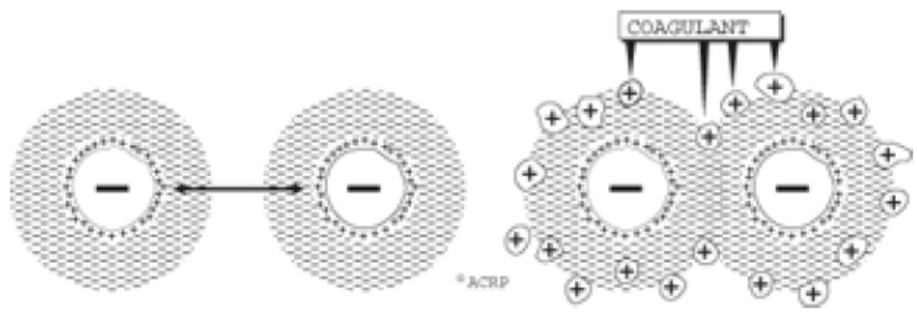
Coagulation (flash/rapid mix)
The process of decreasing the stability of the colloids in water using salts
Makes particles sticky
Mechanical mixers
Detention time of 1-3 minutes
Mixing velocities = 5-7 ft/sec

Slide 35
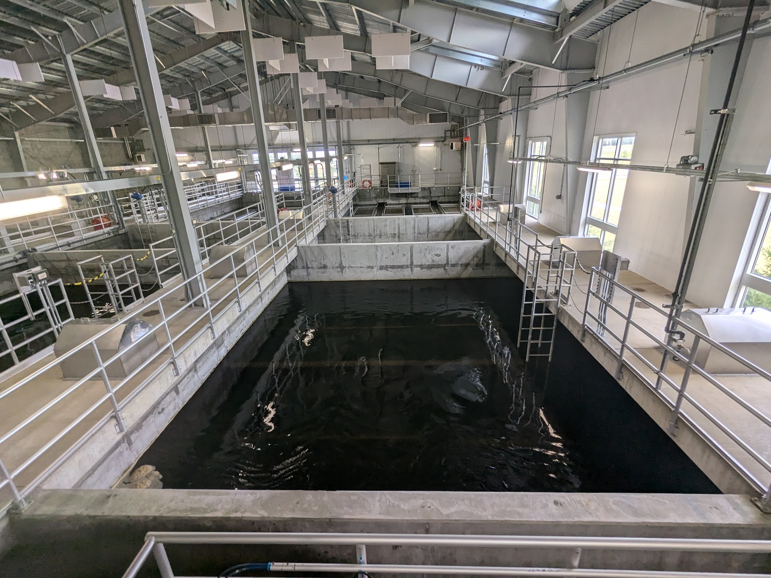
Flocculation
Occurs in large basin
Physical process
Microflocs bump together to create larger flocs

Slide 36
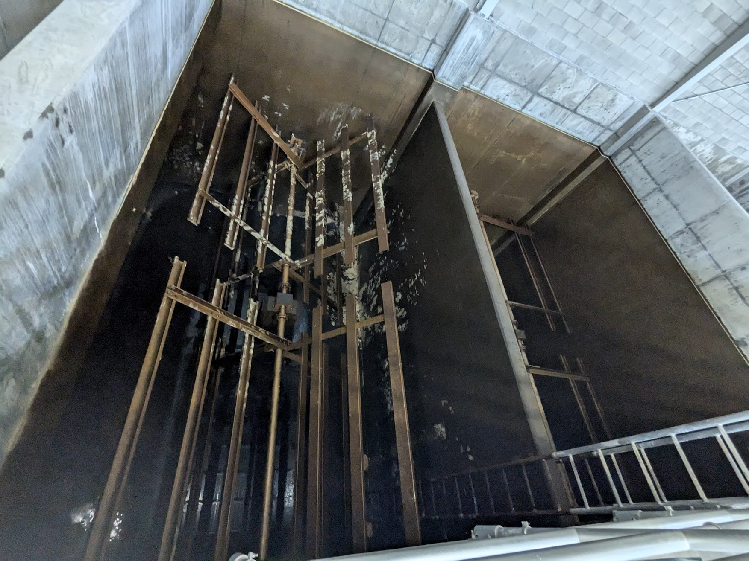
Flocculation
Mixing to increase flocs impacts, but not to break apart flocs
Too slow of mixing can result in settling in floc basin

Slide 37
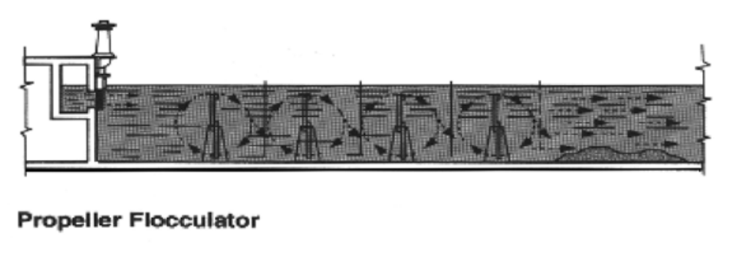
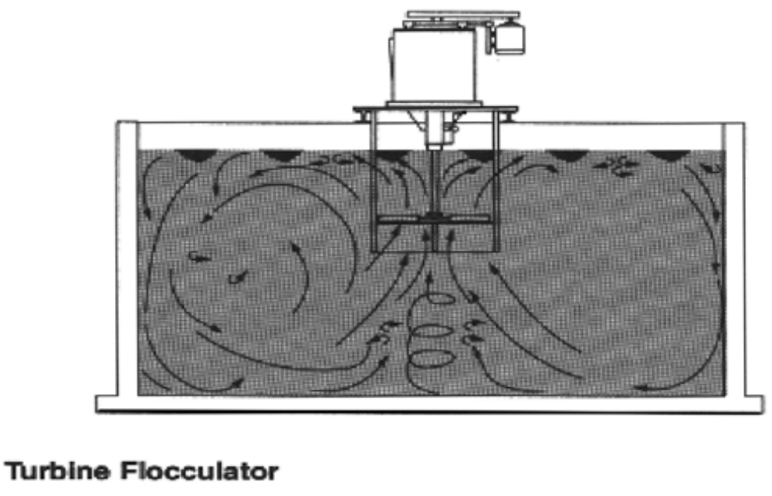
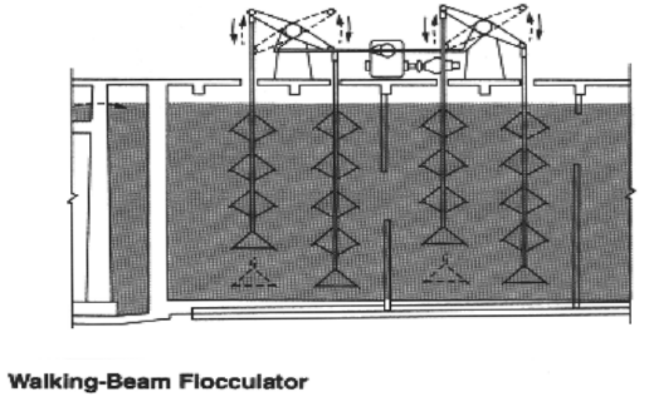
Flocculation Equipment

Slide 38
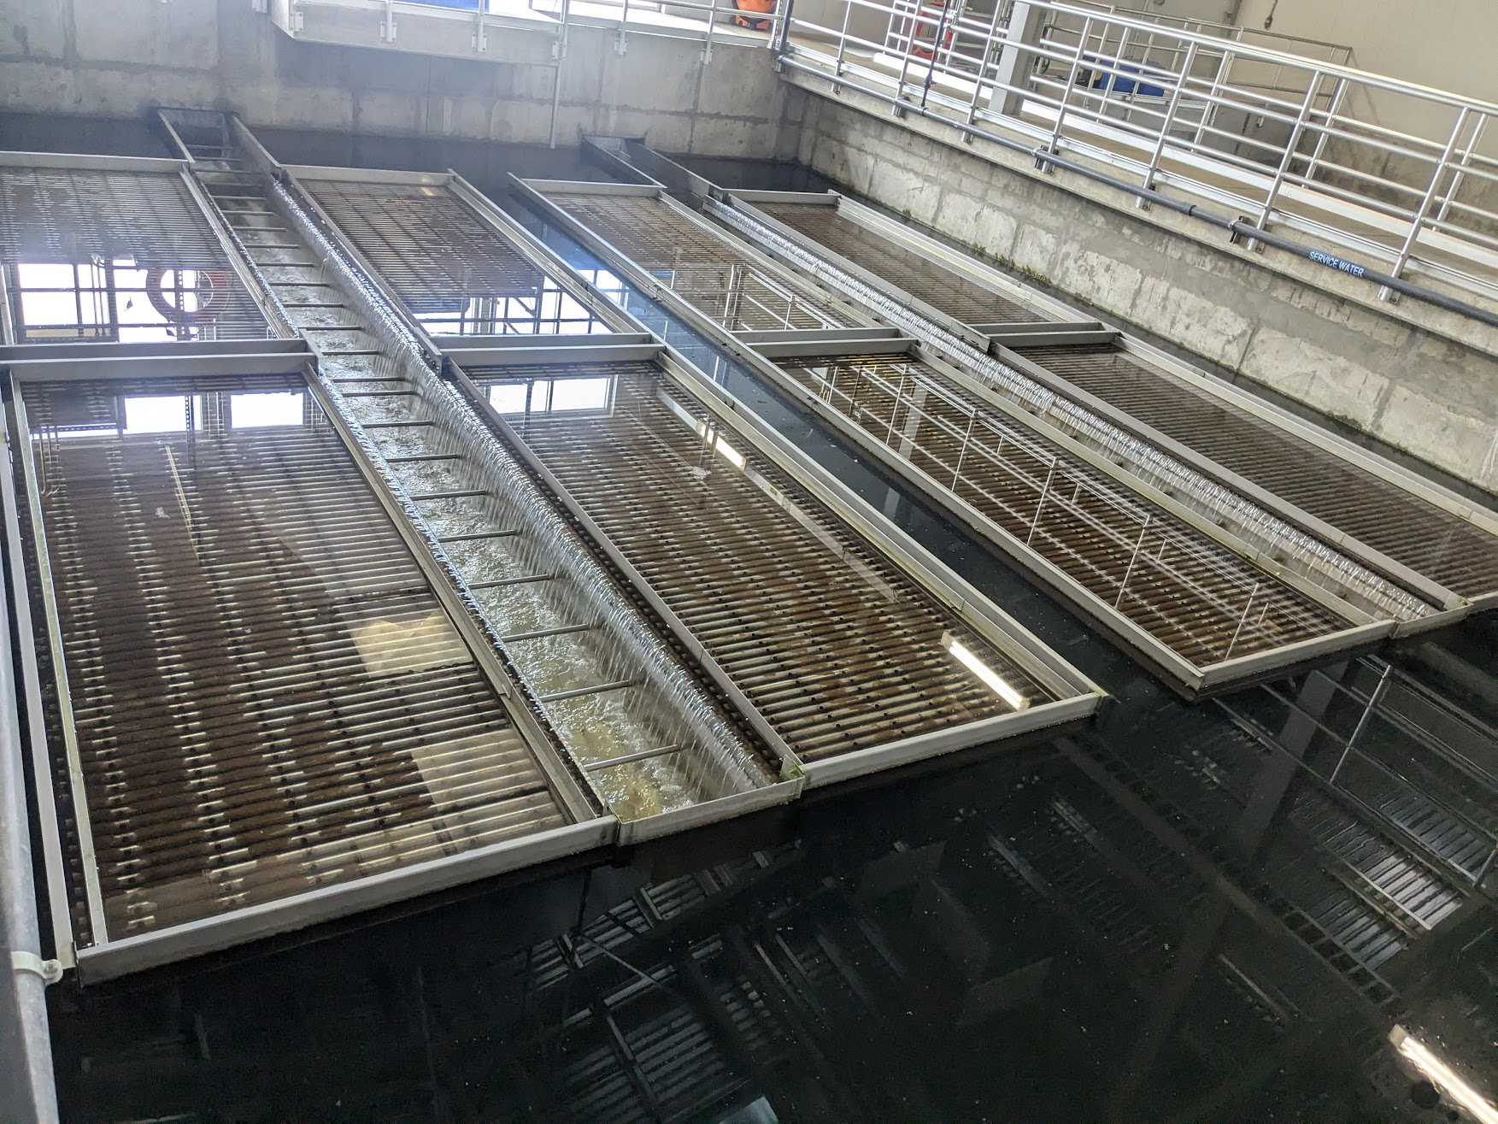
Sedimentation
Large basin with long detention time
Sedimentation can be assisted by plate or tube settlers
Mechanism at bottom to remove sludge

Slide 39
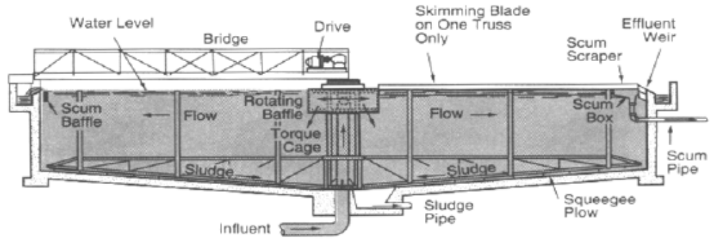
Circular Sedimentation Basin

Slide 40
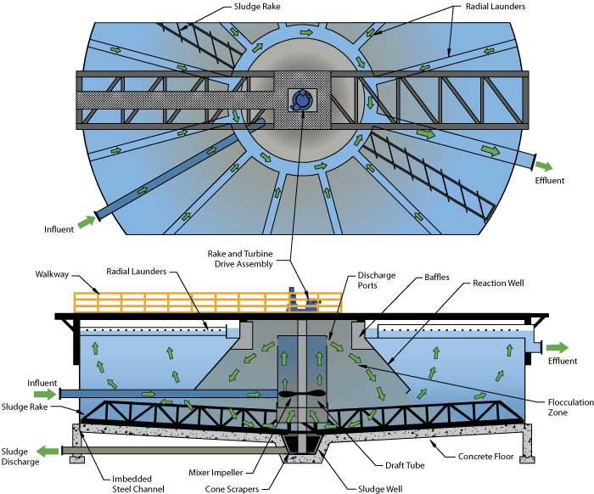
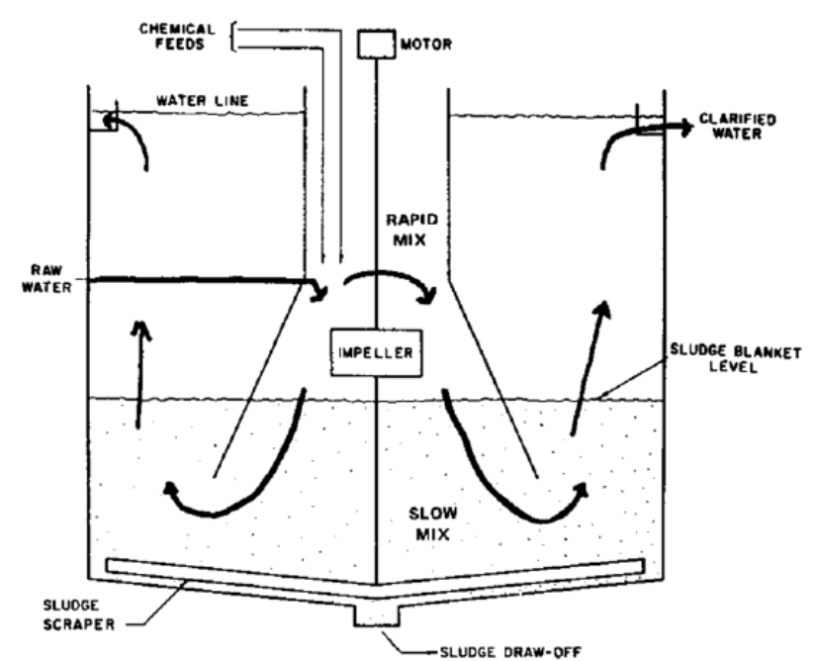
Up-Flow Clarifiers/Solids Contact Basin
Combine coagulation, flocculation, and sedimentation into one unit

Slide 41
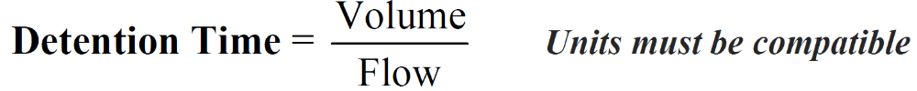
2) Find the detention time in hours for a sedimentation basin that is 295 ft long, 80.0 ft wide, and with a water depth of 11.0 ft. Flow is 1.50 MGD
A) 1.29 hours
B) 4.15 hours
C) 31.0 hours
D) 69.8 hours
$$Vol of Sed Basin=295 ft x 80 ft x 11 ft=259,600 ft^{3}$$
$$Vol of Sed Basin, gal=259,600 ft^{3}x\frac{7.48 gal}{1 ft^{3}}=1,942,000 gals$$
$$Vol of Sed Basin,MG=1,942,000 gal x\frac{1 MG}{1,000,000 gal}=1.94 MG$$
$$Detention Time=\frac{1.94 MG}{1.5 MG/D}=1.29 days$$
$$Treatment Plant Detention Time=1.29 days x\frac{24 hour}{day}=31.0 hrs$$

Slide 42
Next time:
Date | Topic
6/26/25 | Program Overview, Test Format, Study & Test Tips
7/10/25 | Drinking Water System Overview - (Source, Treatment, & Distribution)
7/24/25 | Basic Operator Math (+, -, /, x, Exponents and basic algebra)
8/7/25 | Applied Operator Math (e.g. Areas, Volume, Flow Rates, Detention Time, Pressure/Hydraulic Head)
8/21/25 | Drinking Water Regulations
9/4/25 | Source Water Characteristics
9/18/25 | Surface Water Intake Components, Well Components, and O&M
10/2/25 | Disinfection 1: Chloramines, UV, Chlorine Dioxide, Chlorine
10/16/25 | Disinfection 2: Chlorine Disinfection Application for Sodium Hypochlorite and Gas Chlorine (including storage and safety)
10/30/25 | Disinfection 3: Distribution System Application, Residual Measurement, Evaluation & Adjustment,
11/13/25 | Disinfection 4: Chlorine Disinfection Math
12/4/25 | Surface Water Treatment 1: Coagulation, Flocculation, Sedimentation (including chemistry, process controls, operations)
12/18/25 | Surface Water Treatment 2: Filtration
Links to recordings and material are available on our website at https://swefc.unm.edu/home/op-cert-trainings/

Slide 43
CONTACT INFORMATION
SW EFC email: swefc@unm.edu
Department of Civil Engineering MSC01 1070
1 University of New Mexico
Albuquerque, NM 87131
505-277-0644
swefc@unm.edu
http://swefc.unm.edu

