Slide 1





US Territories Water Operator Training Series
Session 11: Disinfection 4 Chlorine Disinfection Math
11/13/25
www.efcnetwork.org
This program is made possible under a cooperative agreement with US EPA.

Slide 2


Michelle Olson
Water Utility Trainer and Specialist meolson@unm.edu

Slide 3



This training series is funded by the US EPA

Slide 4
Attendee Meeting Controls
2. Chat
3. Leave meeting
1. Mute/unmute
Mute/unmute
  Click the microphone icon to unmute yourself to speak (if you are not speaking, don’t unmute)
Chat
  Click the chat icon and then use the dropdown next to send text instant messages to:
    Everyone publicly: messages will be visible to all participants
    Host only: messages will be sent only to the meeting host – Don’t send a chat to only me; I won’t have time to see it while presenting.
    Any attendee directly: message will be sent to the selected meeting participant only
Leave meeting
  Click on the leave icon to exit the ZOOM Meeting

Slide 5
Schedule for 2025:
Date | Topic
6/26/25 | Program Overview, Test Format, Study & Test Tips
7/10/25 | Drinking Water System Overview - (Source, Treatment, & Distribution)
7/24/25 | Basic Operator Math (+, -, /, x, Exponents and basic algebra)
8/7/25 | Applied Operator Math (Areas, Volume, Pressure)
8/21/25 | Drinking Water Regulations
9/4/25 | Source Water Characteristics
9/18/25 | Surface Water Intake Components, Well Components, and O&M
10/2/25 | Disinfection 1: Chloramines, UV, Chlorine Dioxide, Chlorine
10/16/25 | Disinfection 2: Chlorine Disinfection Application for Sodium Hypochlorite and Gas Chlorine (including storage and safety)
10/30/25 | Disinfection 3: Distribution System Application, Residual Measurement, Evaluation & Adjustment,
11/13/25 | Disinfection 4: Chlorine Disinfection Math
12/4/25 | Surface Water Treatment 1: Coagulation, Flocculation, Sedimentation (including chemistry, process controls, operations)
12/18/25 | Surface Water Treatment 2: Filtration
Links to recordings and material are available on our website at https://swefc.unm.edu/home/op-cert-trainings/

Slide 6
Disinfection 4:
Chlorine Disinfection Math
Solid Concentrations and Chemical Solutions
Specific Gravity
Feed Rate

Slide 7
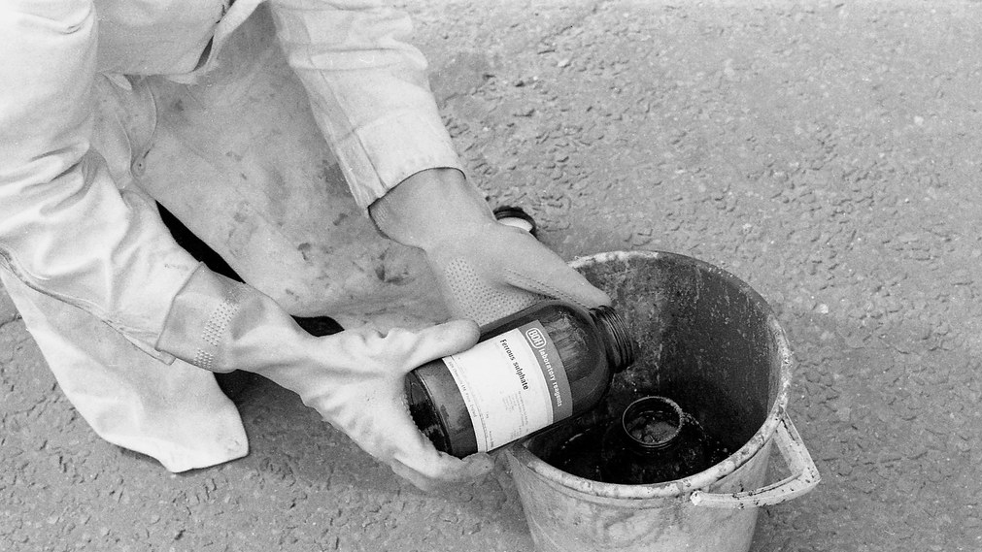
Solids Concentration & Chemical Solutions
Notes:
"bucket chemistry - mixing ferrous sulphate with cyanide residues" by Leo Reynolds is licensed under CC BY-NC-SA 2.0

Slide 8
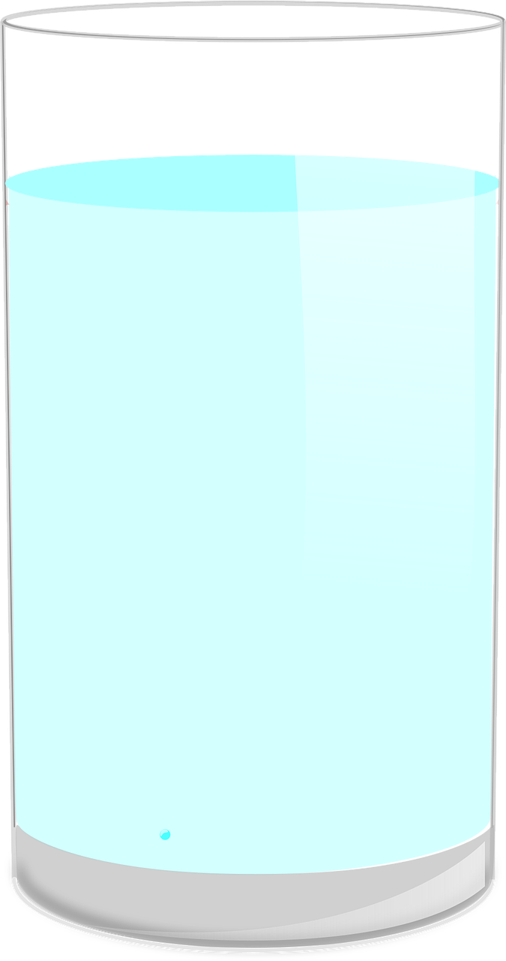
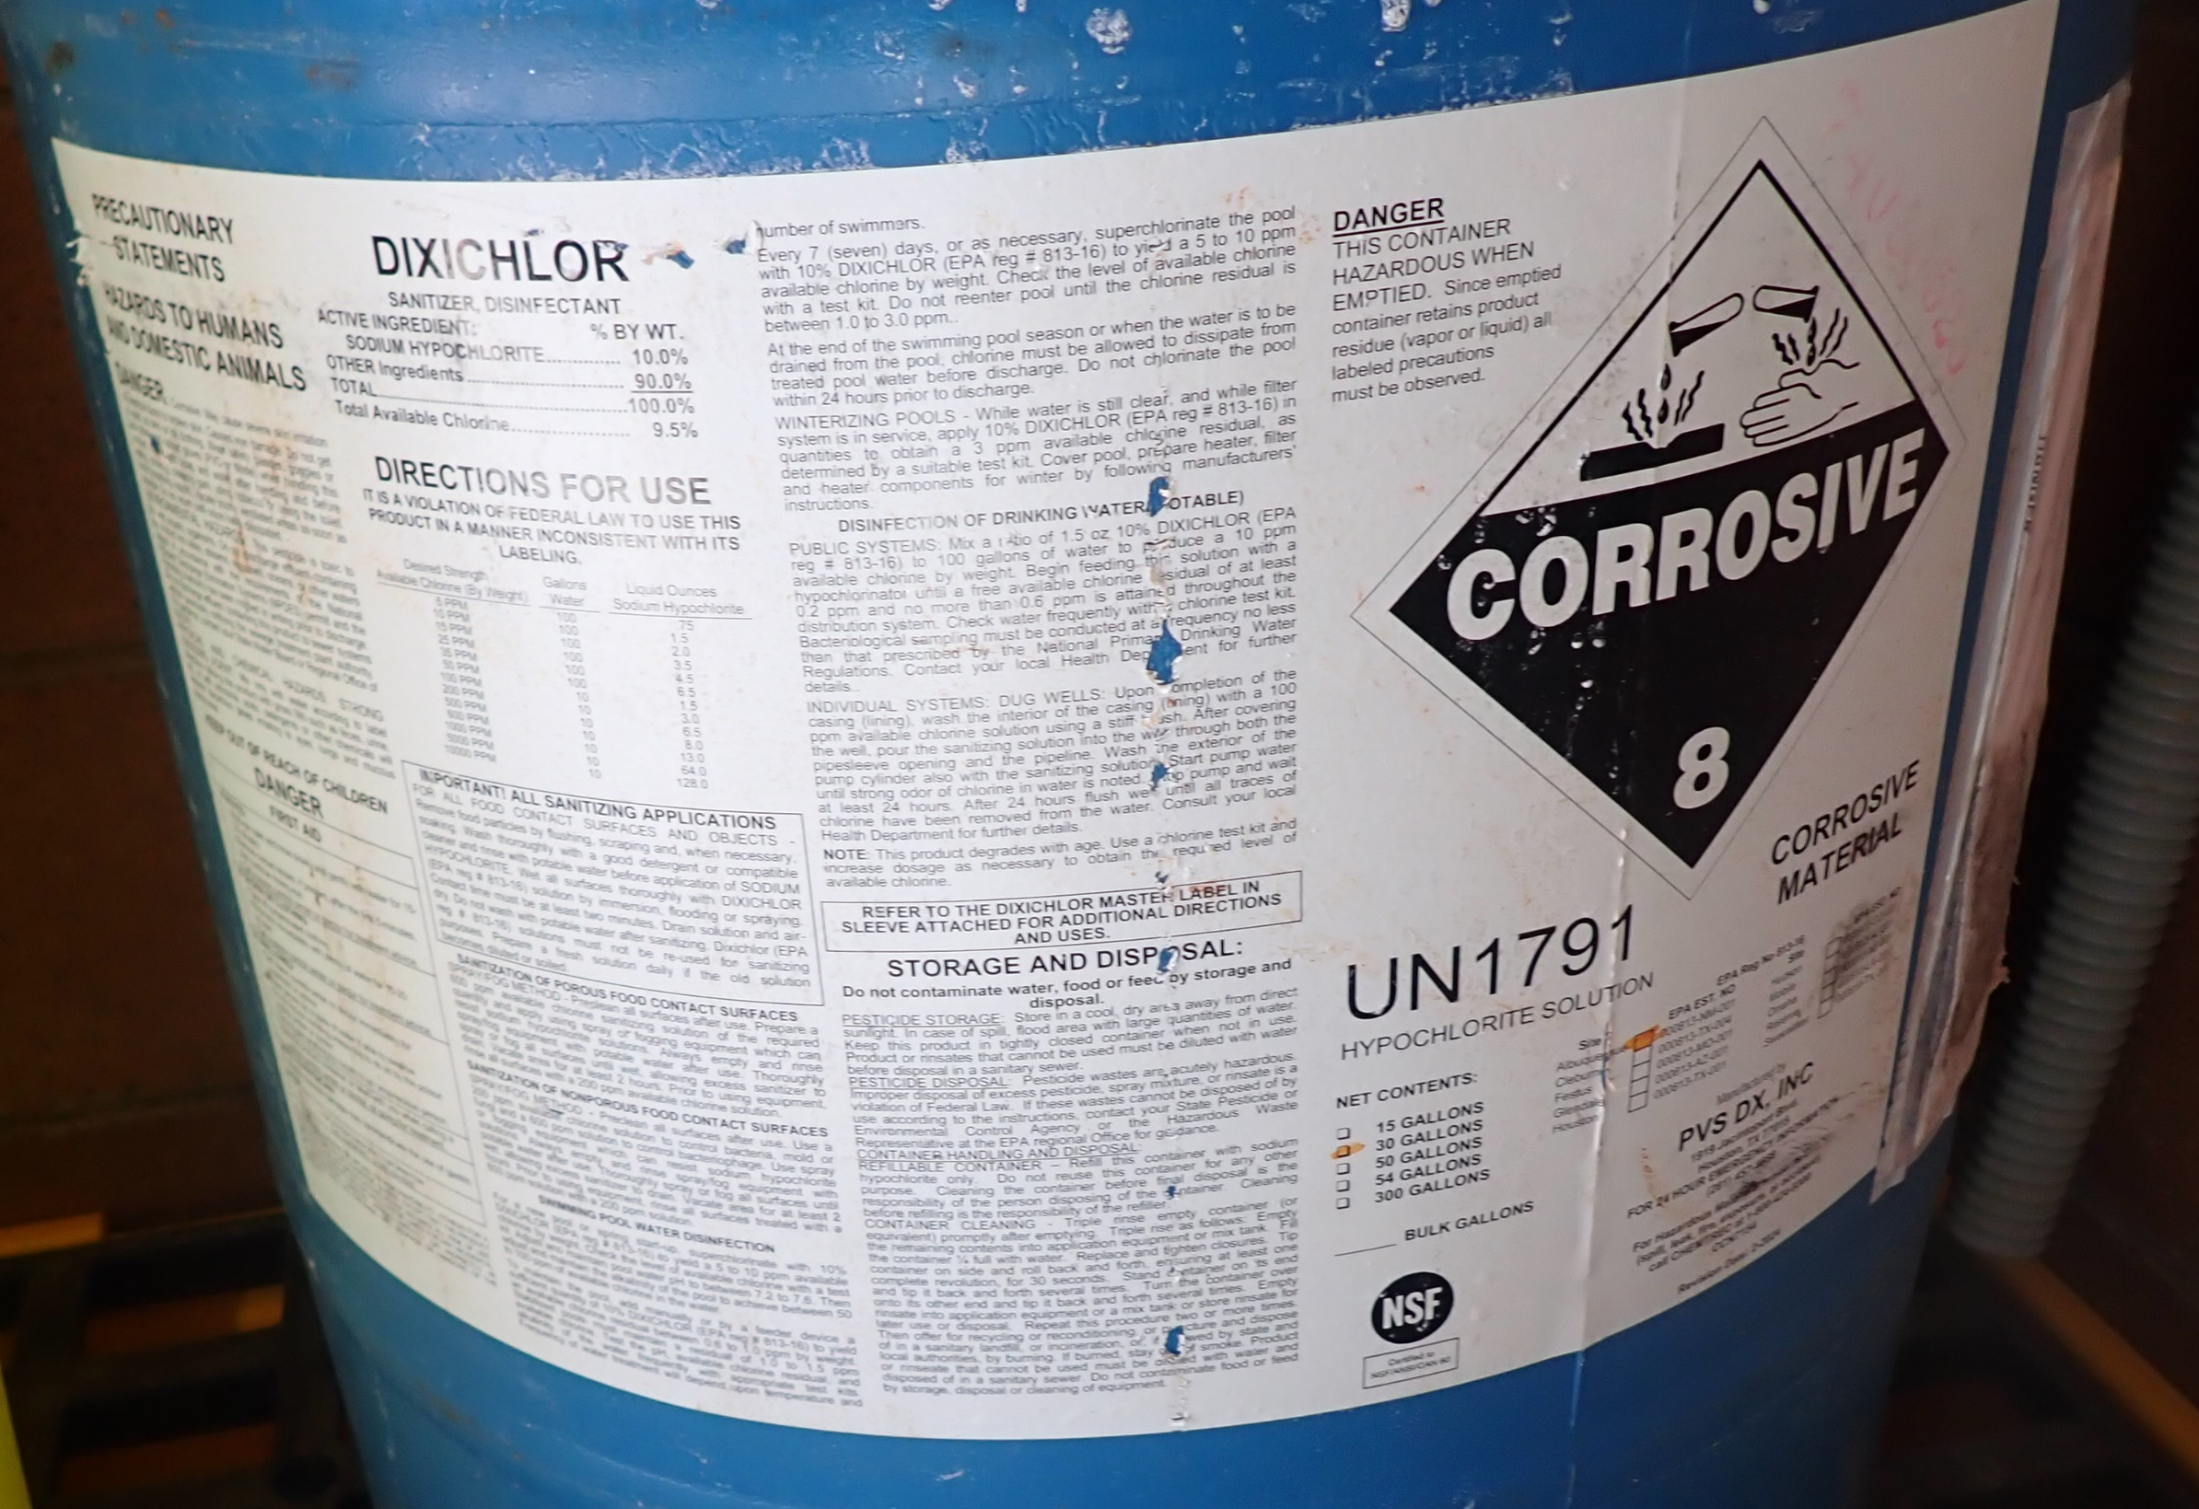
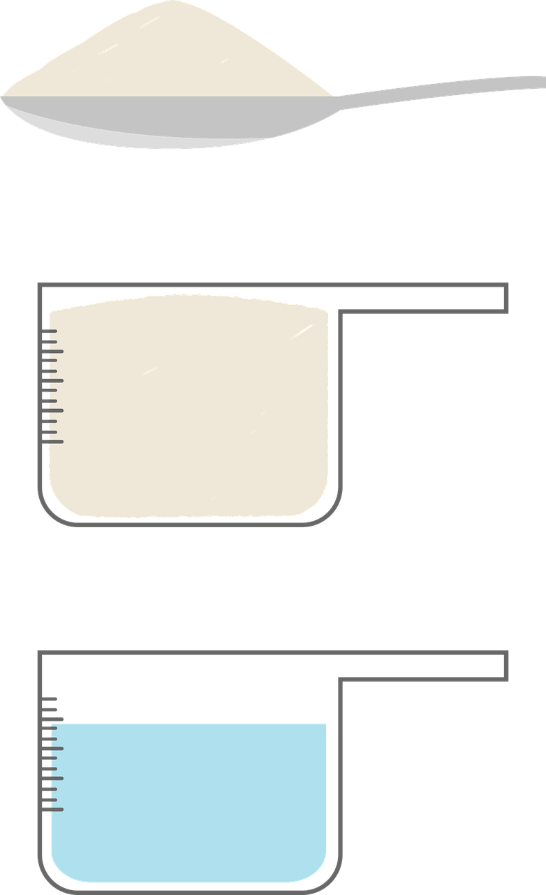
Chemical Solutions: A homogenous mixture of at least two substances.
Chemical Solution
(Hypochlorite Solution)
Solute
(Hypochlorite Salt)
Solvent
(Water)
Notes:
“food-46573_1280” and “water-305656_1280” by Clker-Free-Vector-Images, Pixabay

Slide 9
Chemical Solutions
Add hypochlorite salt to the water.
Notes:
“powder-4617732_1280” by one94 and “water-305656_1280” by Clker-Free-Vector-Images, Pixabay

Slide 10
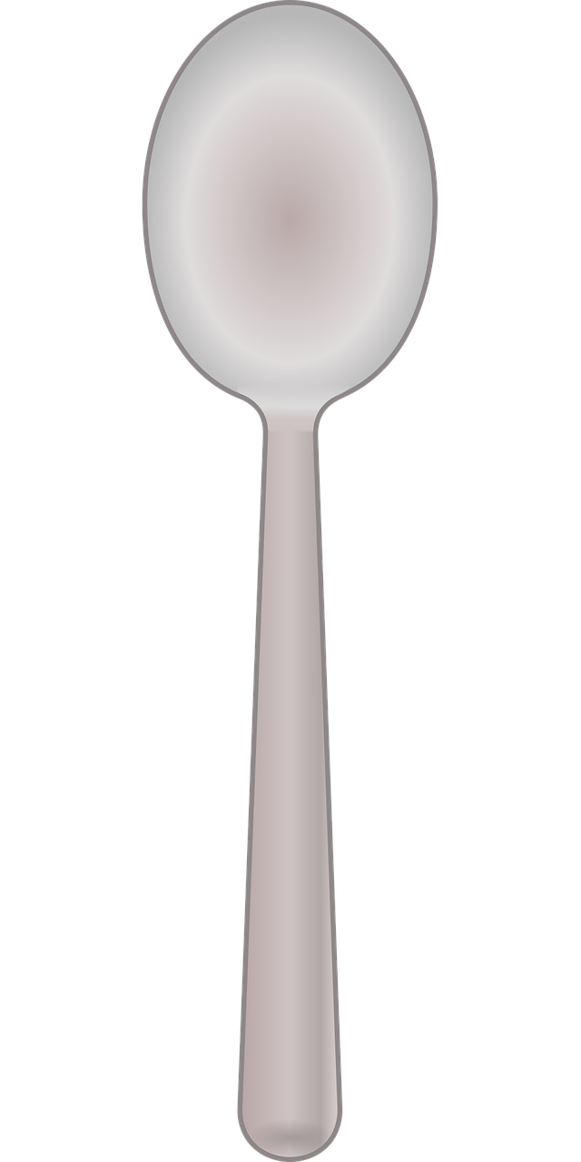
Chemical Solutions
Chemical Solution
Mix until solute is completely dissolved.
Now we have our hypochlorite solution.
Notes:
“spoon-41028_1280” and “water-305656_1280” by Clker-Free-Vector-Images, Pixabay

Slide 11
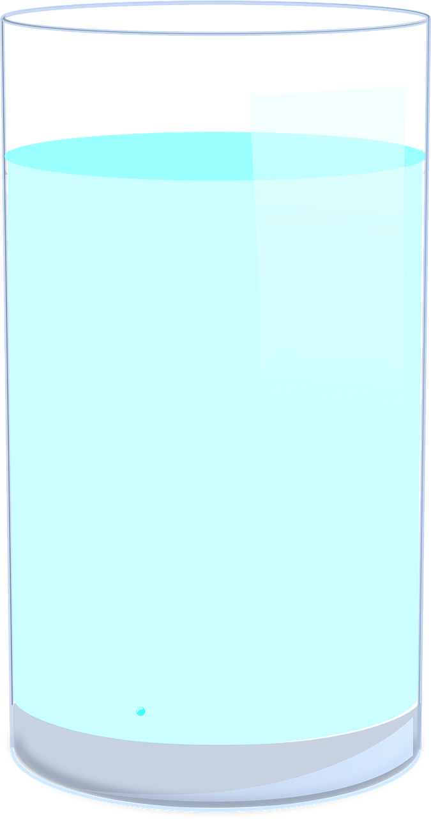
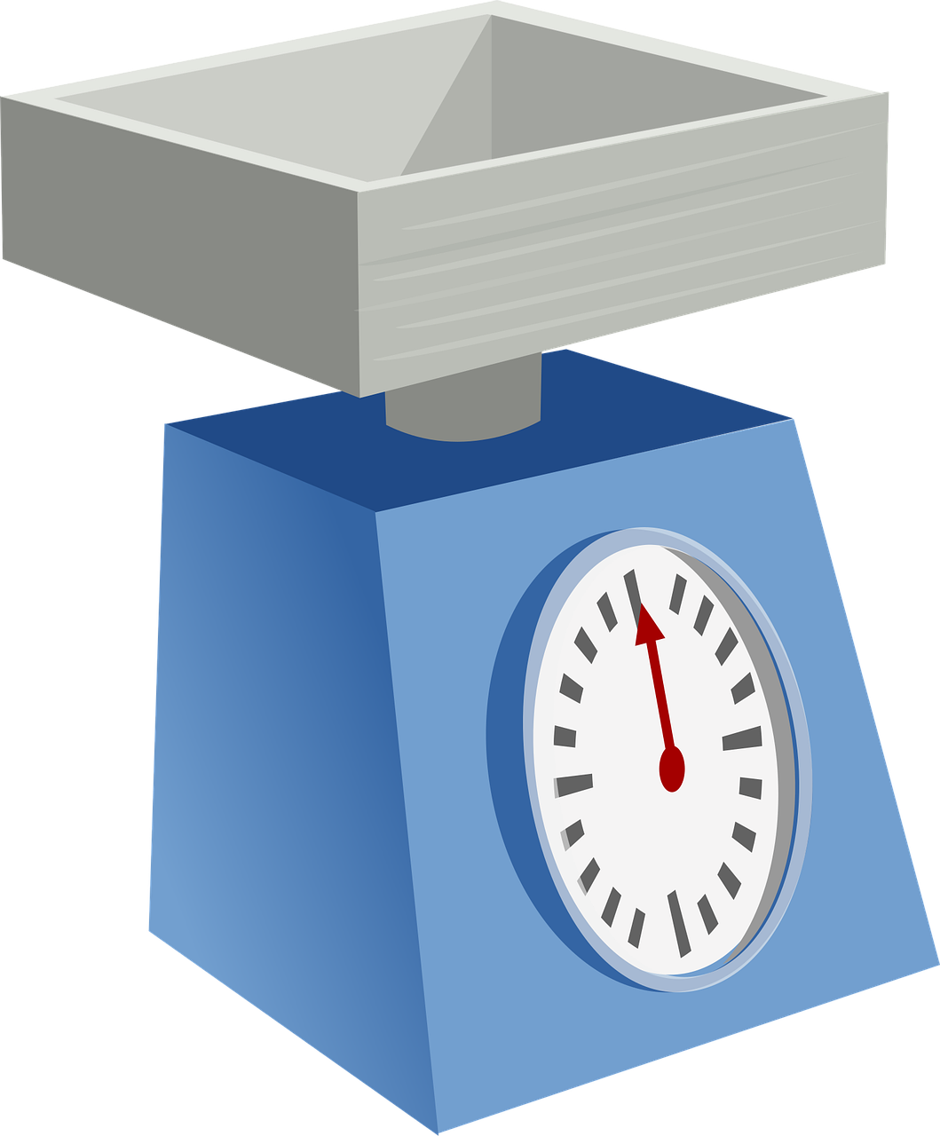
Solids Concentration & Chemical Solutions
Solids concentration is the amount of dry chemical by weight (milligrams) mixed with an amount of water by volume (Liters) to make a chemical solution.

Slide 12
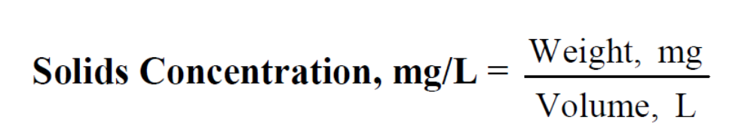
Solids Concentration & Chemical Solutions
Solids concentration is the amount of dry chemical by weight (milligrams) mixed with an amount of water by volume (Liters) to make a chemical solution.

Slide 13
Solids Concentration & Chemical Solutions
What ways are concentration expressed?
mg/L
  Weight of Solids (mg)/Volume of Liquid (L)
Parts per million (ppm)
  ppm = mg/L
  10 ppm = 10 mg/L
Purity (%)
  (Mass_{chemical})/(Mass_{sample}) x 100%
  1% = 10,000 mg/L = 10,000 ppm
  10% NaClO solution = 100,000 mg/L = 100,000 ppm

Slide 14
Chlorine Dosage
Residual
A concentration represented as a weight/volume
Expressed as mg/L or ppm
Most operators record pounds/day or gallons/day. This is the FEED RATE, not the dosage.
Demand
Dosage
DOSAGE = DEMAND + RESIDUAL

Slide 15
Chlorine Demand
The amount of chlorine consumed or bound up by material in the water (expressed as mg/L)
This chlorine is NOT available as residual (free or total)
DOSAGE = DEMAND + RESIDUAL

Slide 16
Chlorine Residual
The amount of chlorine remaining after the chlorine demand is satisfied (expressed as mg/L)
This chlorine IS available for further disinfection
DOSAGE = DEMAND + RESIDUAL

Slide 17
Chlorine Residual
Free
Three types of residuals
  Free
  Combined
  Total
Combined
Total
TOTAL = COMBINED + FREE

Slide 18
DOSAGE = DEMAND + RESIDUAL
DEMAND = DOSAGE – RESIDUAL
RESIDUAL = DOSAGE – DEMAND

Slide 19

Calculate chlorine dosage if the demand is 0.35 mg/L and the residual is 0.82 mg/L.
1
(A) -0.47 mg/L
(B) 0.47 mg/L
(C) 1.17 mg/L
(D) 2.34 mg/L

Slide 20
Calculate chlorine dosage if the demand is 0.35 mg/L and the residual is 0.82 mg/L.
1
✓
✓
Demand = 0.35 mg/L
Residual = 0.82 mg/L
✓
✓
✓
✓
(A) -0.47 mg/L
(B) 0.47 mg/L
(C) 1.17 mg/L
(D) 2.34 mg/L
Step 1: Set up the equation to solve for the unknown, Dosage.
Step 2: Make sure units match.
Step 3: Plug in the known values for Demand and Residual.
Dosage = 0.35 mg/L + 0.82 mg/L
Step 4: Solve.
Dosage = 0.35 mg/L + 0.82 mg/L = 1.17 mg/L

Slide 21
Calculate chlorine dosage if the demand is 0.35 mg/L and the residual is 0.82 mg/L.
1
(A) -0.47 mg/L
(B) 0.47 mg/L
(C) 1.17 mg/L
(D) 2.34 mg/L
Step 1: Set up the equation to solve for the unknown, Dosage.
Step 2: Make sure units match.
Step 3: Plug in the known values for demand and residual.
Dosage = 0.35 mg/L + 0.82 mg/L
Step 4: Solve.
= 1.17 mg/L
Dosage = 0.35 mg/L + 0.82 mg/L
Chlorine Dosage = 1.17 mg/L

Slide 22
Calculate Chlorine Residual
2
Calculate the residual chlorine if the demand is 2.0 mg/L and the dosage is 2.8 mg/L.
Demand = 2.0 mg/L
Dosage = 2.8 mg/L

Slide 23
Calculate Chlorine Residual
2
Calculate the residual chlorine if the demand is 2.0 mg/L and the dosage is 2.8 mg/L.
✓
✓
Demand = 2.0 mg/L
Dosage = 2.8 mg/L
✓
✓
Step 1: Set up the equation to solve for the unknown, Residual.
Dosage = Demand + Residual
-Demand
-Demand
Residual = Dosage - Demand
Step 2: Make sure units match.

Slide 24
Calculate Chlorine Residual
2
Calculate the residual chlorine if the demand is 2.0 mg/L and the dosage is 2.8 mg/L.
Demand = 2.0 mg/L
Dosage = 2.8 mg/L
Step 3: Plug in values for Dosage and Demand.
Residual = 2.8 mg/L - 2.0 mg/L
Step 4: Solve.
Residual = 2.8 mg/L - 2.0 mg/L = 0.8 mg/L

Slide 25
Calculate Chlorine Residual
1
Calculate the residual chlorine if the demand is 2.0 mg/L and the dosage is 2.8 mg/L.
Step 3: Plug in values for Dosage and Demand.
Residual = 2.8 mg/L - 2.0 mg/L
Step 4: Solve.
Residual = 2.8 mg/L - 2.0 mg/L = 0.8 mg/L
Residual chlorine = 0.8 mg/L

Slide 26
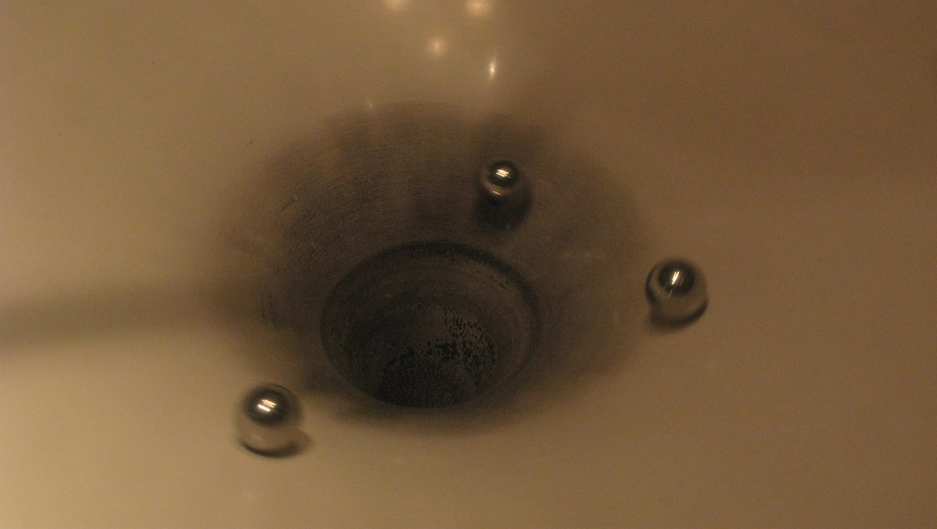
Specific Gravity

Slide 27
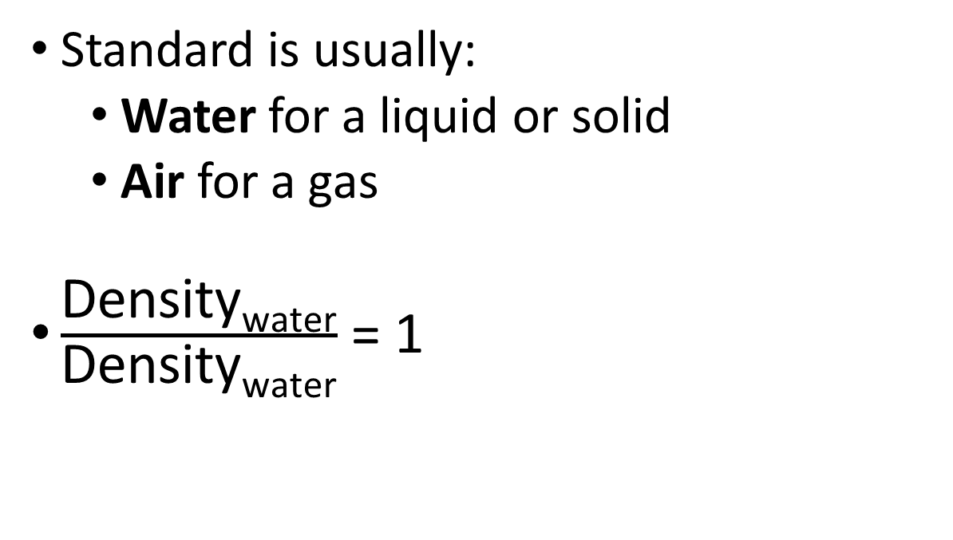

Specific Gravity
$\text{Ratio}: \frac{\text{Density}\text{substance}}{\text{Density}\text{standard}}$
= Unitless Number
Standard is usually:
  Water for a liquid or solid
  Air for a gas
$\frac{\text{Density}\text{water}}{\text{Density}\text{water}}$ = 1

Slide 28
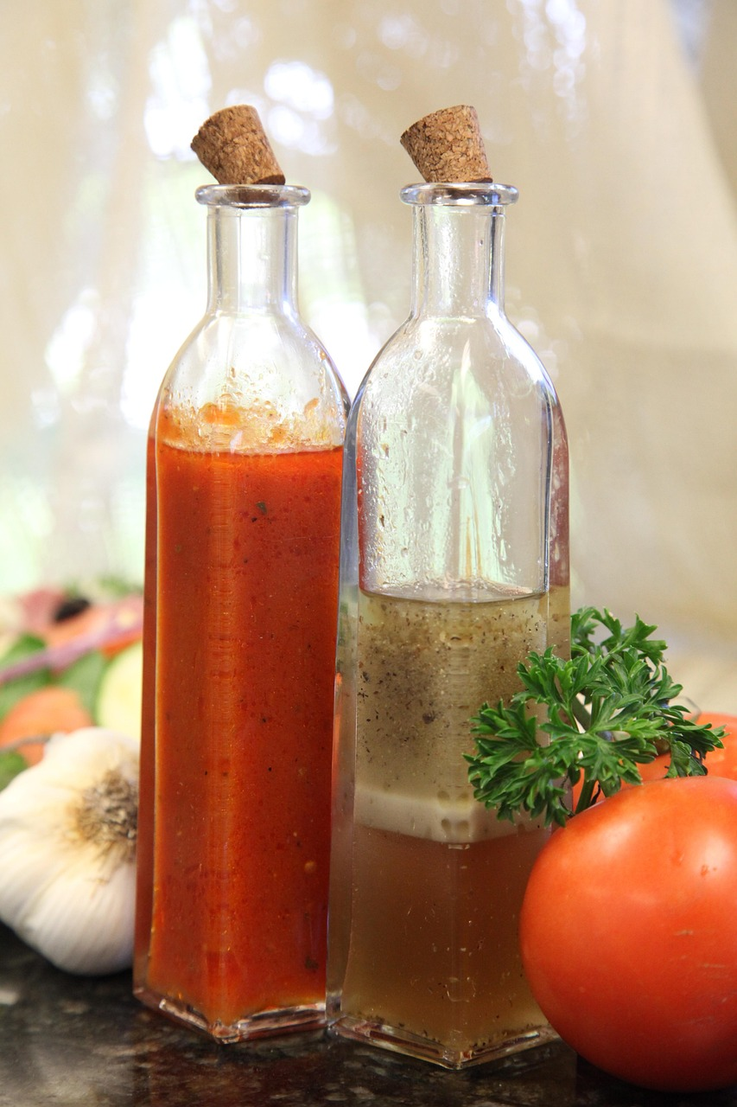
Specific Gravity
Some liquids are:
  Lighter than water
  Heavier than water
Chlorine solutions are heavier than water

Slide 29
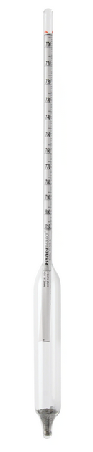
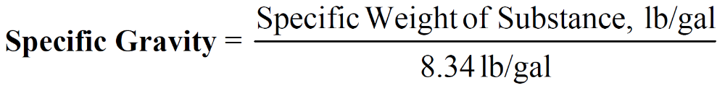
Specific Gravity
Specific gravity can be measured with a hydrometer
Specific gravity can also be calculated

Slide 30


Specific Weight

Slide 31
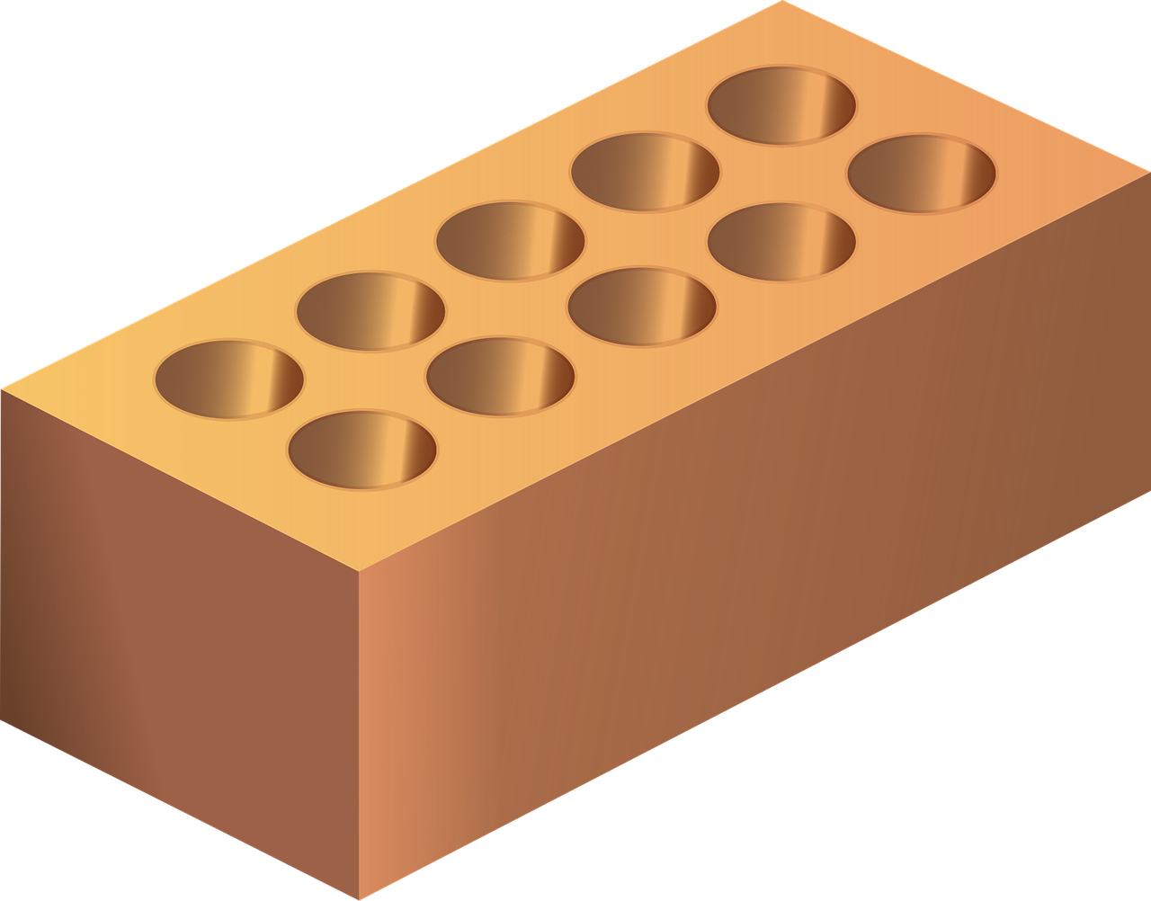
Specific Weight

Slide 32

Specific Weight

Slide 33
Specific Weight

Slide 34
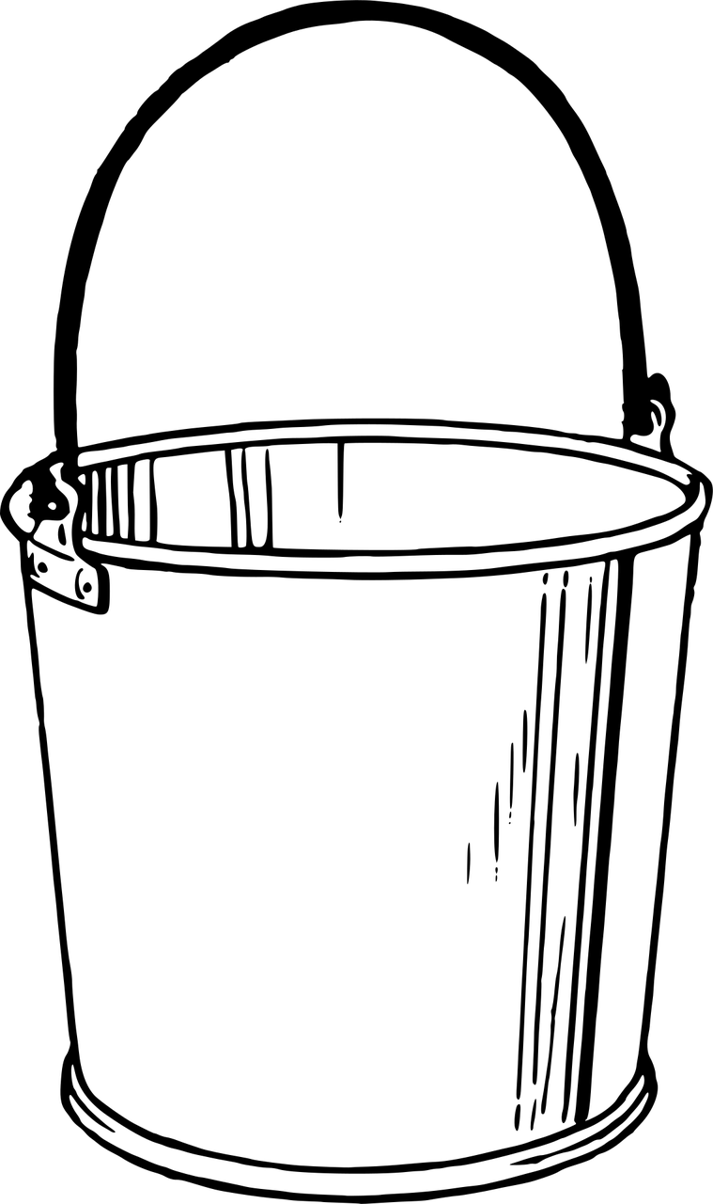

Specific Weight

Slide 35
Specific Gravity
Specific gravity can be measured with a hydrometer
Specific gravity can also be calculated

Slide 36

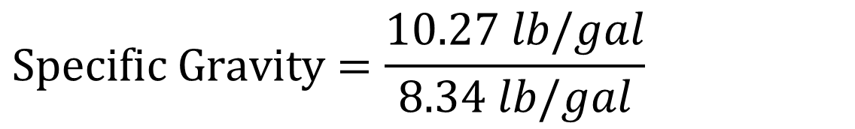
What is the specific gravity for a solution that weighs 10.27 lb/gal?
3
✓
Specific Weight = 10.27 lb/gal
✓
✓
✓
(A) 0.81
(B) 1.23
(C) 1.93
(D) 18.61
Step 1: Set up the equation to solve for the unknown, Specific Gravity.
Step 2: Make sure units match.
Step 3: Plug in the value for Specific Weight and solve.
$$Specific Gravity=\frac{10.27 lb/gal}{8.34 lb/gal}$$
$$=1.23$$

Slide 37
What is the specific gravity for a solution that weighs 10.27 lb/gal?
3
(A) 0.81
(B) 1.23
(C) 1.93
(D) 18.61
Step 1: Set up the equation to solve for the unknown, Specific Gravity.
Step 2: Make sure units match.
Step 3: Plug in the value for Specific Weight of a Substance and solve.
$$Specific Gravity=\frac{10.27 lb/gal}{8.34 lb/gal}$$
$$=1.23$$
1.23 is the specific gravity of a solution that weighs 10.27 lb/gal.

Slide 38
A 12.5% chlorine solution has a specific gravity of 1.20. How many pounds would 55 gallons of this solution weigh?
4

Slide 39

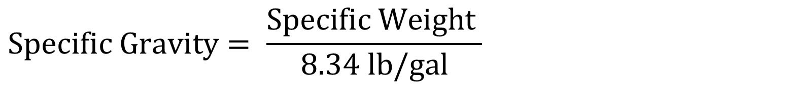

A 12.5% chlorine solution has a specific gravity of 1.20. How many pounds would 55 gallons of this solution weigh?
4
Specific Gravity = 1.20
Volume = 55 gal
Step 1: Set up the equation to solve for the unknown, Specific Weight. Multiply both sides by 8.34 lb/gal.
$$Specific Gravity= \frac{Specific Weight }{8.34 lb/gal}$$
$×$ $8.34 lb/gal$
$×$ $8.34 lb/gal$
$$Specific Weight=Specific Gravity x 8.34 lb/gal$$

Slide 40

A 12.5% chlorine solution has a specific gravity of 1.20. How many pounds would 55 gallons of this solution weigh?
4
How many pounds
✓
Specific Gravity = 1.20
Volume = 55 gal
✓
Step 2: Make sure units match.
$$Specific Weight=Specific Gravity x 8.34 lb/gal$$
Step 3: Plug in the value for Specific Gravity and solve.
$$=10.0 lb/gal$$
$$Specific Weight=1.20 x 8.34 lb/gal$$

Slide 41

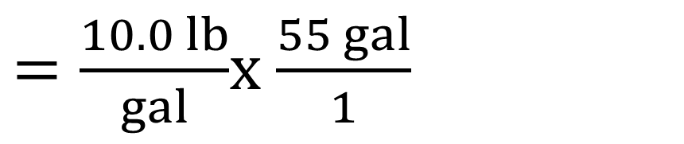


A 12.5% chlorine solution has a specific gravity of 1.20. How many pounds would 55 gallons of this solution weigh?
4
✓
Specific Gravity = 1.20
Volume = 55 gal
Step 4: Calculate the weight of 55 gals of the solution by multiplying the specific weight of the solution by the volume of the solution.
$$Specific Weight=1.20 x 8.34 lb/gal$$
$$=10.0 lb/gal$$
$=\frac{10.0 lb}{gal}$x $\frac{55 gal}{1}$
✓
$$Weight of 55 gal$$
$$\text{= 550 }\text{lb}$$

Slide 42

A 12.5% chlorine solution has a specific gravity of 1.20. How many pounds would 55 gallons of this solution weigh?
45
Step 4: Calculate the weight of 55 gals of the solution by multiplying the specific weight of the solution by the volume of the solution.
$$Specific Weight=1.20 x 8.34 lb/gal$$
$$=10.0 lb/gal$$
$=\frac{10.0 lb}{gal}$x $\frac{55 gal}{1}$
$$Weight of 55 gal$$
$$\text{= 550 }\text{lb}$$
550 lb is the weight of 55 gallons of 12.5% chlorine solution.

Slide 43

The 50% sodium hydroxide solution you use to increase pH has a specific gravity of 1.50 at 20°C. How many pounds would 20 gallons of this solution weigh?
5
✓
Specific Gravity = 1.50
Volume = 20 gal
✓
Step 1: Set up the equation to solve for the unknown, Specific Weight. Multiply both sides by 8.34 lb/gal.
(A) 3.6 lbs
(B) 197 lbs
(C) 250 lbs
(D) 550 lbs
$$Specific Weight,lb/gal=Specific Gravity x 8.34 lb/gal$$
Step 2: Make sure units match.
Step 3: Plug in the value for Specific Gravity and solve for Specific Weight.
$$Specific Weight,lb/gal=1.50 x 8.34 lb/gal$$
$$=12.5 lb/gal$$

Slide 44
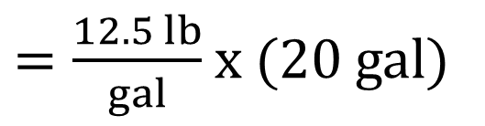

The 50% sodium hydroxide solution you use to increase pH has a specific gravity of 1.50 at 20°C. How many pounds would 20 gallons of this solution weigh?
5
Specific Gravity = 1.50
Volume = 20 gal
Step 4: Calculate the weight of 20 gals of the solution by multiplying the specific weight of the solution by the volume of the solution.
(A) 3.6 lbs
(B) 197 lbs
(C) 250 lbs
(D) 550 lbs
$$Specific Weight,lb/gal=1.50 x 8.34 lb/gal$$
$$=12.5 lb/gal$$
$=\frac{12.5 lb}{gal}$ x (20 gal)
$$Weight of 20 gal NaOH$$
= 250 lb

Slide 45
The 50% sodium hydroxide solution you use to increase pH has a specific gravity of 1.50 at 20°C. How many pounds would 20 gallons of this solution weigh?
5
Step 4: Calculate the weight of 20 gals of the solution by multiplying the specific weight of the solution by the volume of the solution.
(A) 3.6 lbs
(B) 197 lbs
(C) 250 lbs
(D) 550 lbs
$$Specific Weight,lb/gal=1.50 x 8.34 lb/gal$$
$$=12.5 lb/gal$$
$=\frac{12.5 lb}{gal}$ x (20 gal)
$$Weight of 20 gal NaOH$$
= 250 lb
250 lb is the weight of 20 gallons of 50% sodium hydroxide solution.

Slide 46

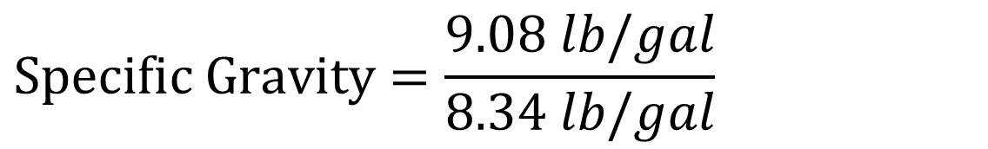
The NaOCl in your day tank is getting a bit old and you want to determine its percent concentration. You weigh a gallon of it and your scale reads 9.08 lbs. What is your percent concentration?
% Concentration | Specific Gravity
1.0 | 1.020
2.0 | 1.034
3.0 | 1.048
4.0 | 1.062
5.0 | 1.076
6.0 | 1.089
7.0 | 1.103
8.0 | 1.116
9.0 | 1.129
10.0 | 1.142
11.0 | 1.155
12.0 | 1.168
13.0 | 1.181
14.0 | 1.193
15.0 | 1.206
6
✓
Specific Weight = 9.08 lb/gal
✓
✓
Step 1: Set up the equation to solve for the unknown, Specific Gravity.
✓
Step 2: Make sure units match.
Step 3: Plug in the value for Specific Weight and solve.
$$Specific Gravity=\frac{9.08 lb/gal}{8.34 lb/gal}$$
$$=1.09$$
Source: USA Bluebook Operator’s Companion
*values vary with temperature

Slide 47

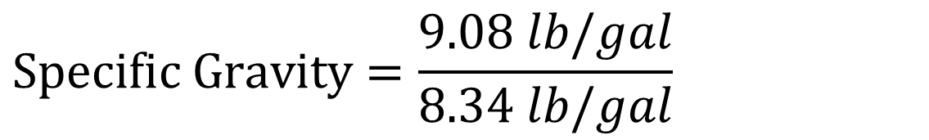
The NaOCl in your day tank is getting a bit old and you want to determine its percent concentration. You weigh a gallon of it and your scale reads 9.08 lbs. What is your percent concentration?
% Concentration | Specific Gravity
1.0 | 1.020
2.0 | 1.034
3.0 | 1.048
4.0 | 1.062
5.0 | 1.076
6.0 | 1.089
7.0 | 1.103
8.0 | 1.116
9.0 | 1.129
10.0 | 1.142
11.0 | 1.155
12.0 | 1.168
13.0 | 1.181
14.0 | 1.193
15.0 | 1.206
6
Specific Weight = 9.08 lb/gal
Step 4: Read the chart to get the Percent Concentration value.
$$Specific Gravity=\frac{9.08 lb/gal}{8.34 lb/gal}$$
$$=1.09$$
Source: USA Bluebook Operator’s Companion
*values vary with temperature

Slide 48
The NaOCl in your day tank is getting a bit old and you want to determine its percent concentration. You weigh a gallon of it and your scale reads 9.08 lbs. What is your percent concentration?
% Concentration | Specific Gravity
1.0 | 1.020
2.0 | 1.034
3.0 | 1.048
4.0 | 1.062
5.0 | 1.076
6.0 | 1.089
7.0 | 1.103
8.0 | 1.116
9.0 | 1.129
10.0 | 1.142
11.0 | 1.155
12.0 | 1.168
13.0 | 1.181
14.0 | 1.193
15.0 | 1.206
6
Step 4: Read the chart to get the Percent Concentration value.
$$Specific Gravity=\frac{9.08 lb/gal}{8.34 lb/gal}$$
$$=1.09$$
Percent concentration of NaOCl ≈ 6.0%
fishersci.com
Source: USA Bluebook Operator’s Companion
*values vary with temperature

Slide 49
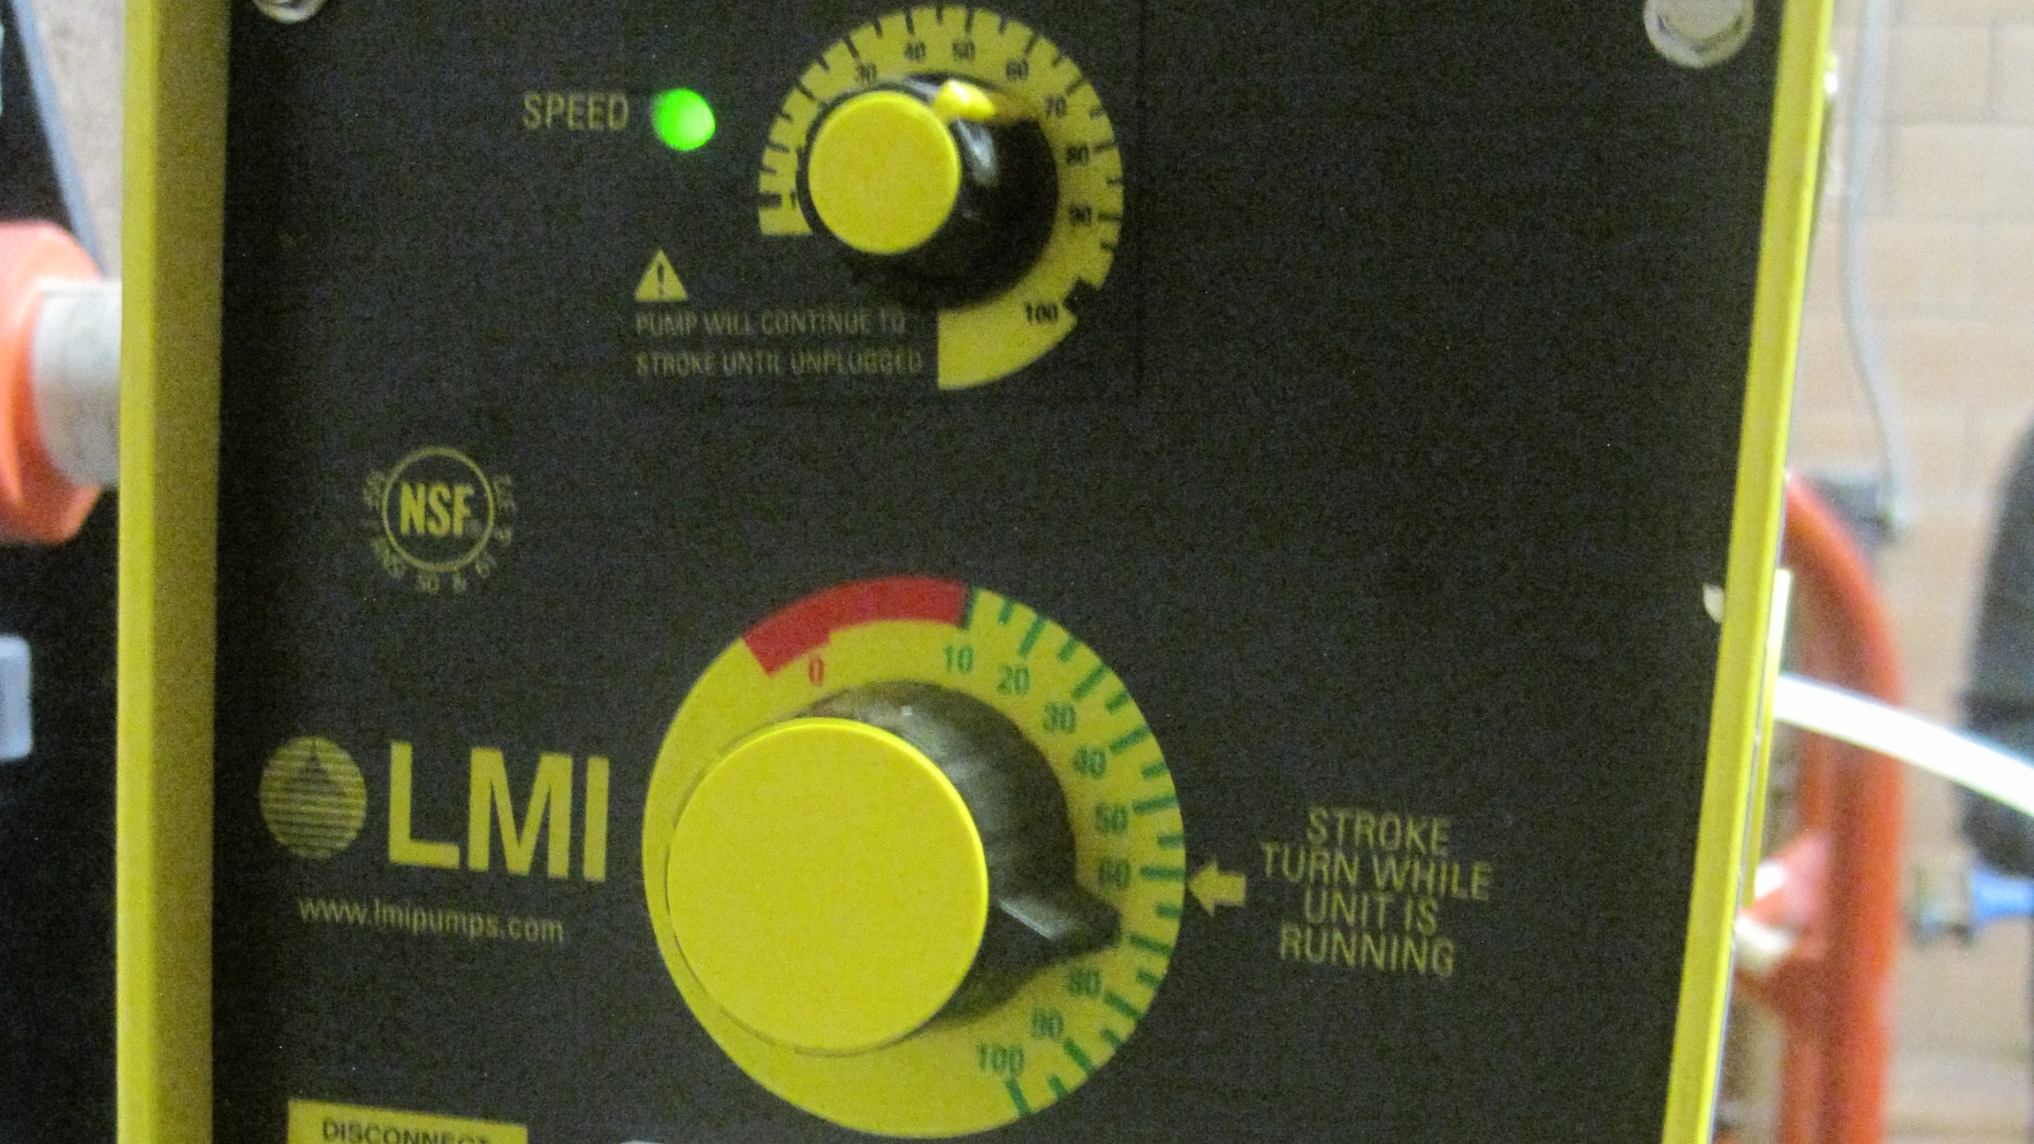
Feed Rate
Chlorine

Slide 50
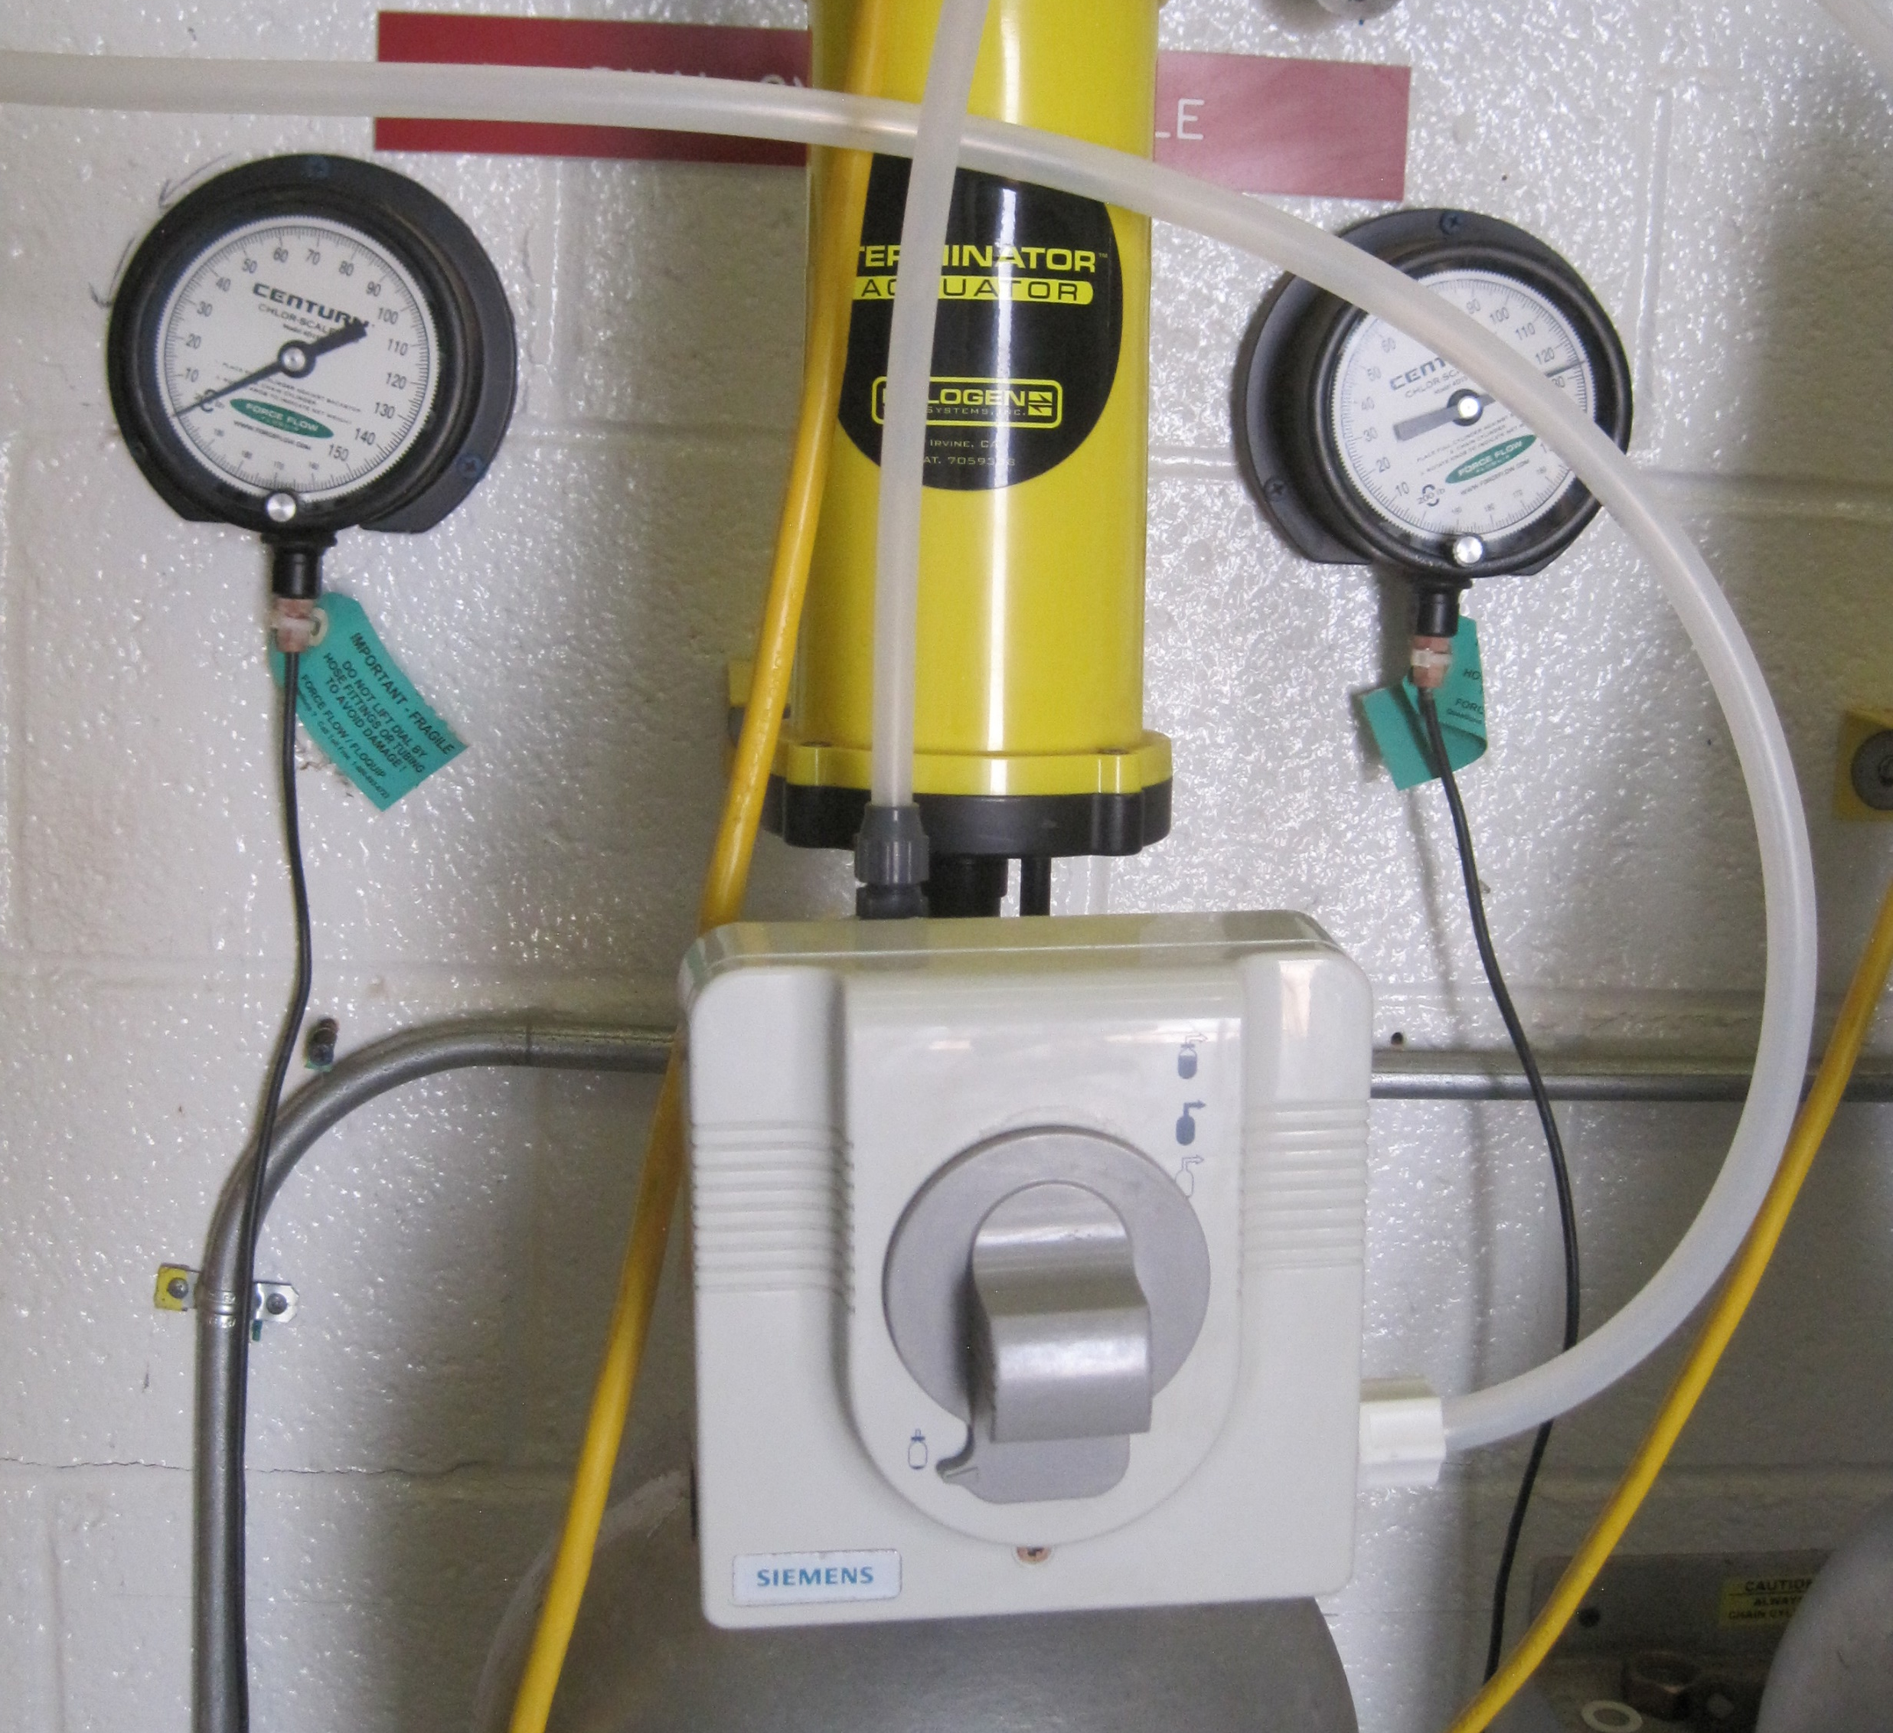
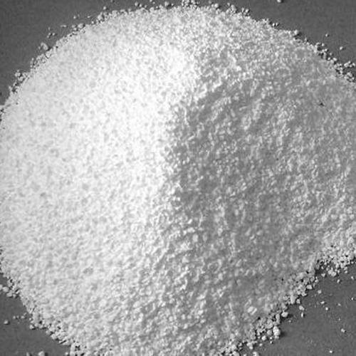
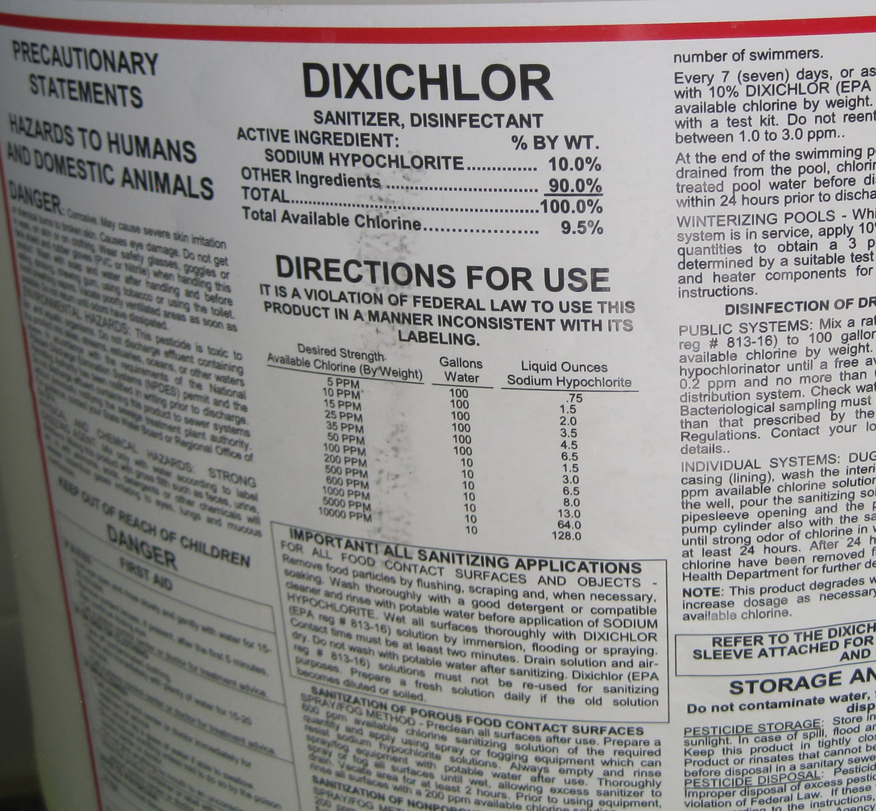
Chlorine/Chemical Purity
Gas Chlorine
100% Purity
Solid Chlorine
Calcium Hypochlorite
60-65% Purity
Liquid Chlorine
Sodium Hypochlorite
10-12% Purity
1% = 10,000 mg/L = 10,000 ppm

Slide 51
In what situations at a water system does the feed rate formula come in handy for using chlorine?
Disinfecting Drinking Water
Shocking Wells
Batch Chlorinating Stored Water
Shocking Distribution Repairs/New Construction

Slide 52
Feed Rate
The amount of chemical in pounds or gallons that you feed into a volume of water over a period of time.
Pounds/Day or Gallons/Day

Slide 53
Feed Rate Equation Parts
Dosage, (mg/L) = The total amount of chemical solution fed into a volume of water.
Flow (MGD) = The volume of water in Million Gallons per Day that you are feeding the chemical into.
8.34 lb/gal = The weight of water. This is what converts gallons to pounds.
Purity, % expressed as a decimal = Purity of the chemical that you are feeding into the water expressed as a decimal.

Slide 54

Feed Rate in Gallons per Day
gallons
$$Feed Rate, lb/day=\frac{(Dosage, mg/L)(Flow, MGD)(8.34 lb/gal) }{Purity, \% expressed as a decimal}$$
$$Feed Rate, gallons/day=\frac{(Dosage, mg/L)(Flow, MGD)}{Purity, \% expressed as a decimal}$$

Slide 55
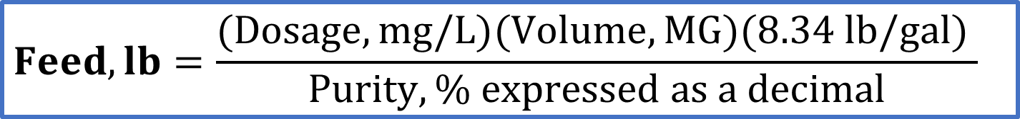
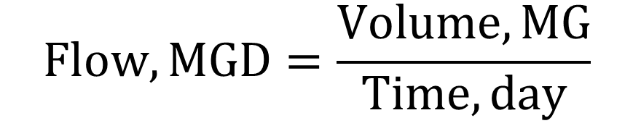
Feed (Not Feed Rate) in Pounds
Volume, MG
$$Feed Rate, lb/day=\frac{(Dosage, mg/L)(Flow, MGD)(8.34 lb/gal) }{Purity, \% expressed as a decimal}$$
$$Flow, MGD=\frac{Volume, MG}{Time, day}$$
$$Feed, lb=\frac{(Dosage, mg/L)(Volume, MG)(8.34 lb/gal) }{Purity, \% expressed as a decimal}$$

Slide 56

Feed (Not Feed Rate) in Gallons
Volume, MG
gallons
$$Feed Rate, lb/day=\frac{(Dosage, mg/L)(Flow, MGD)(8.34 lb/gal) }{Purity, \% expressed as a decimal}$$
$$Feed, gallons=\frac{(Dosage, mg/L)(Volume, MG)}{Purity, \% expressed as a decimal}$$

Slide 57
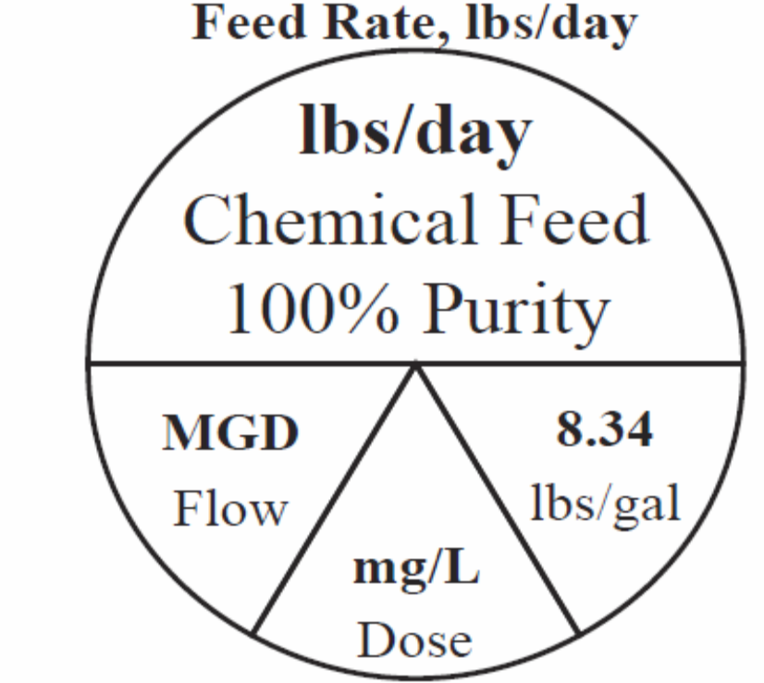
Pie Wheel Formulas
Top half: One side of the equation
**Your units must match the units in the pie wheel!!**
Balance the top of the wheel, to the bottom of the wheel
Bottom half: Opposite side of the equation

Slide 58

How many pounds of 60% calcium hypochlorite is needed to add to a system each day that has a flow rate of 1.5 MGD to achieve a dosage of 1.1 mg/L?
7
✓
✓
✓
✓
✓
✓
✓
Purity = 60%
Flow Rate = 1.5 MGD
Dosage = 1.1 mg/L
= 0.60
100%
✓
Step 1: Set up the equation to isolate the unknown, Feed Rate.
Step 2: Make sure units match.
Step 3: Plug in values for Dosage, Flow, and Purity and solve for Feed Rate.
$$Feed Rate,lb/day=\frac{\left(1.1 mg/L\right)\left(1.5 MGD\right)\left(8.34 lb/gal\right)}{0.60}$$
$$=22.9 lb/day$$

Slide 59

How many pounds of 60% calcium hypochlorite is needed to add to a system each day that has a flow rate of 1.5 MGD to achieve a dosage of 1.1 mg/L?
7
Step 1: Set up the equation to isolate the unknown, Feed Rate.
Step 2: Make sure units match.
Step 3: Plug in values for dosage, flow, and purity and solve for feed rate.
$$Feed Rate,lb/day=\frac{\left(1.1 mg/L\right)\left(1.5 MGD\right)\left(8.34 lb/gal\right)}{0.60}$$
$$=22.9 lb/day$$
22.9 lb of calcium hypochlorite must be added to the system each day to achieve a dosage of 1.1 mg/L.

Slide 60



$$Feed Rate,lb/day=\frac{\left(1.1 mg/L\right)\left(1.5 MGD\right)\left(8.34 lb/gal\right)}{0.60}$$
$$=22.9 lb/day$$
$$Feed Rate,\text{lb}\text{/}\text{day}=\frac{1.1 mg}{L}×\frac{1.5 MG}{day}×\frac{8.34 lb}{gal}×\frac{1}{0.60}$$
mg/L = parts per million
$$million$$
$$Feed Rate,\text{lb}\text{/}\text{day}=\frac{1.1 }{million}×\frac{1.5 million gal}{day}×\frac{8.34 lb}{gal}×\frac{1}{0.60}=22.9 lb/day$$
or
$$Feed Rate,\text{lb}\text{/}\text{day}=\frac{1.1}{1,000,000}×\frac{1.5×1,000,000 gal}{day}×\frac{8.34 lb}{gal}×\frac{1}{0.60}=22.9 lb/day$$

Slide 61
A 500,000 gpd system has switched from gas disinfection to disinfection with a 10% sodium hypochlorite solution. How many gallons per day of 10% sodium hypochlorite are required to treat the water to a dosage of 2.8 mg/L?
8
Flow = 500,000 gpd
Purity = 10%
Dosage = 2.8 mg/L

Slide 62

A 500,000 gpd system has switched from gas disinfection to disinfection with a 10% sodium hypochlorite solution. How many gallons per day of 10% sodium hypochlorite are required to treat the water to a dosage of 2.8 mg/L?
8
gallons
Flow = 500,000 gpd
= 0.10
Purity = 10%
Dosage = 2.8 mg/L
✓
Step 1: Rewrite the equation to solve for Feed in gallons/day.
✓
$$Feed Rate, gallons/day=\frac{(Dosage, mg/L)(Flow, MGD)}{Purity, \% expressed as a decimal}$$

Slide 63

A 500,000 gpd system has switched from gas disinfection to disinfection with a 10% sodium hypochlorite solution. How many gallons per day of 10% sodium hypochlorite are required to treat the water to a dosage of 2.8 mg/L?
8
✓
✓
$$Feed Rate, gallons/day=\frac{(Dosage, mg/L)(Flow, MGD)}{Purity, \% expressed as a decimal}$$
✓
✓
✓
✓
= 0.5 MGD
= 0.10
Flow = 500,000 gpd
Purity = 10%
Dosage = 2.8 mg/L
1,000,000
100%
Step 2: Make sure units match.

Slide 64

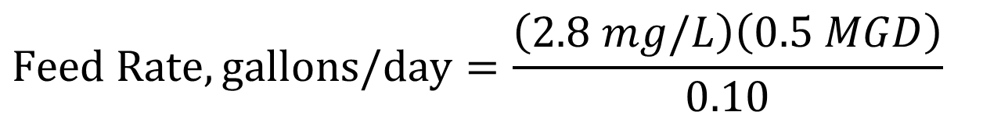
A 500,000 gpd system has switched from gas disinfection to disinfection with a 10% sodium hypochlorite solution. How many gallons per day of 10% sodium hypochlorite are required to treat the water to a dosage of 2.8 mg/L?
8
$$Feed Rate, gallons/day=\frac{(Dosage, mg/L)(Flow, MGD)}{Purity, \% expressed as a decimal}$$
= 0.5 MGD
Flow = 500,000 gpd
= 0.10
Dosage = 2.8 mg/L
Purity = 10%
Step 1: Set up the equation to isolate the unknown, Feed Rate.
Step 2: Make sure units match.
Step 3: Plug in values for Dosage, Flow, and Purity and solve for Feed Rate.
$$Feed Rate,gallons/day=\frac{\left(2.8 mg/L\right)\left(0.5 MGD\right)}{0.10}$$
= 14.00 gal/day

Slide 65
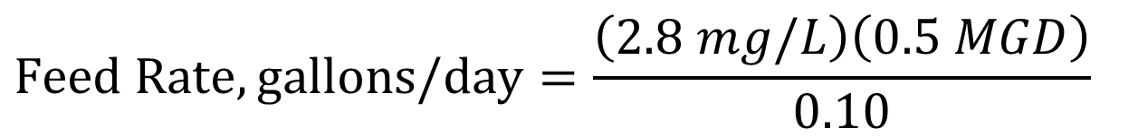
A 500,000 gpd system has switched from gas disinfection to disinfection with a 10% sodium hypochlorite solution. How many gallons per day of 10% sodium hypochlorite are required to treat the water to a dosage of 2.8 mg/L?
8
$$Feed Rate,gallons/day=\frac{\left(2.8 mg/L\right)\left(0.5 MGD\right)}{0.10}$$
= 14.00 gal/day
14.00 gal/day of 10% sodium hypochlorite are required to treat 500,000 gallons of water per day to a chlorine dosage of 2.8 mg/L

Slide 66
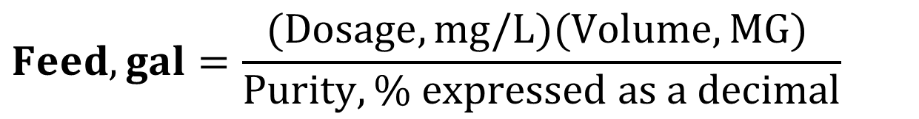
How many gallons of 10% sodium hypochlorite are required to disinfect the water in a 20 ft diameter tank with 30 ft of water to a dosage of 5.0 mg/L?
9
Volume
gallons
Step 1: Rewrite the equation to solve for Feed in gallons.
$$Feed, gal=\frac{(Dosage, mg/L)(Volume, MG) }{Purity, \% expressed as a decimal}$$

Slide 67

How many gallons of 10% sodium hypochlorite are required to disinfect the water in a 20 ft diameter tank with 30 ft of water to a dosage of 5.0 mg/L?
9
$$Feed, gal=\frac{(Dosage, mg/L)(Volume, MG) }{Purity, \% expressed as a decimal}$$
Purity = 10%
Dosage = 5.0 mg/L
Volume of Water =
?
Tank Diameter = 20’
Water Height = 30’
Step 2: Find the volume of our water in MG.
Volume of a Cylinder

Slide 68
How many gallons of 10% sodium hypochlorite are required to disinfect the water in a 20 ft diameter tank with 30 ft of water to a dosage of 5.0 mg/L?
9
Step 2: Find the volume of our water in MG.
Volume of a Cylinder = πr² x Height
Volume of a Cylinder = (0.785)(Diameter)²(Height)

Slide 69
How many gallons of 10% sodium hypochlorite are required to disinfect the water in a 20 ft diameter tank with 30 ft of water to a dosage of 5.0 mg/L?
9
✓
Step 2: Find the volume of our water in MG.
Volume of a Cylinder = πr² x Height
units must be compatible
Tank Diameter = 20’
✓
2
Step 3: Set up the equation to solve for the unknown, Volume of a Cylinder.
Tank Radius = 10’
✓
✓
Water Height = 30’
Step 4: Make sure units match.

Slide 70


How many gallons of 10% sodium hypochlorite are required to disinfect the water in a 20 ft diameter tank with 30 ft of water to a dosage of 5.0 mg/L?
9
Step 2: Find the volume of our water in MG.
Volume of a Cylinder = πr² x Height
units must be compatible
Step 5: Plug in values for Radius and Height and solve for Volume of Water.
Tank Radius = 10’
Water Height = 30’
= 9,425 ft³
$Vol of Water=π(10 ft)\text{2}×30 ft$
Step 6: Convert ft³ to gallons.
$$Vol of Water, gal=9,425 ft^{3}×\frac{7.48 gal}{1 ft^{3}}$$
$$=70,500 gals$$
Step 7: Convert gallons to MG.
$$Vol of Well,MG=\frac{70,500 gals}{1 }×\frac{1 MG}{1,000,000 gals}$$
$$=0.075 MG$$

Slide 71
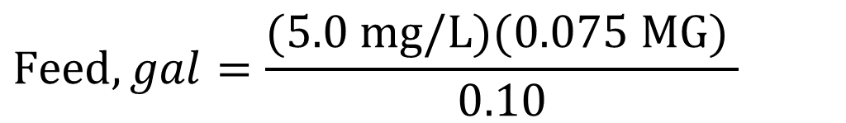
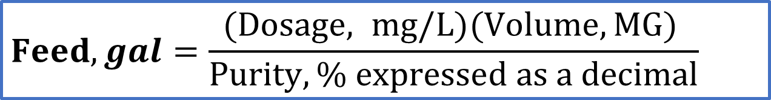
How many gallons of 10% sodium hypochlorite are required to disinfect the water in a 20 ft diameter tank with 30 ft of water to a dosage of 5.0 mg/L?
9
✓
✓
$$Feed, gal=\frac{(Dosage, mg/L)(Volume, MG) }{Purity, \% expressed as a decimal}$$
✓
✓
✓
✓
Purity = 10%
= 0.10
Dosage = 5.0 mg/L
Volume of Water = 0.075 MG
Step 8: Make sure units match.
Step 9: Plug values for Dosage, Volume, and Purity into the equation and solve for Feed in gallons.
$$Feed, gal=\frac{(5.0 mg/L)(0.075 MG) }{0.10}$$
= 3.75 gallons

Slide 72
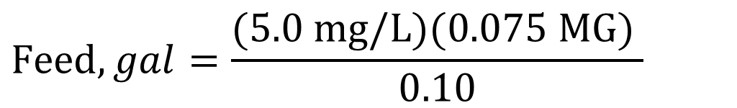
How many gallons of 10% sodium hypochlorite are required to disinfect the water in a 20 ft diameter tank with 30 ft of water to a dosage of 5.0 mg/L?
9
$$Feed, gal=\frac{(Dosage, mg/L)(Volume, MG) }{Purity, \% expressed as a decimal}$$
Step 8: Make sure units match.
Step 9: Plug values for Dosage, Volume, and Purity into the equation and solve for Feed in gallons.
$$Feed, gal=\frac{(5.0 mg/L)(0.075 MG) }{0.10}$$
= 3.75 gallons
3.75 gallons of 10% sodium hypochlorite are required to disinfect the tank to a chlorine dosage of 5.0 mg/L

Slide 73
CONTACT INFORMATION
Michelle Olson: meolson@unm.edu
Department of Civil Engineering MSC01 1070
1 University of New Mexico
Albuquerque, NM 87131
swefctribal@unm.edu
http://swefc.unm.edu

