Slide 1





US Territories Water Operator Training Series
Session 10: Disinfection 3: Distribution System Application, Residual Measurement, Evaluation & Adjustment (part 3 of 4)
10/30/25
www.efcnetwork.org
This program is made possible under a cooperative agreement with US EPA.

Slide 2
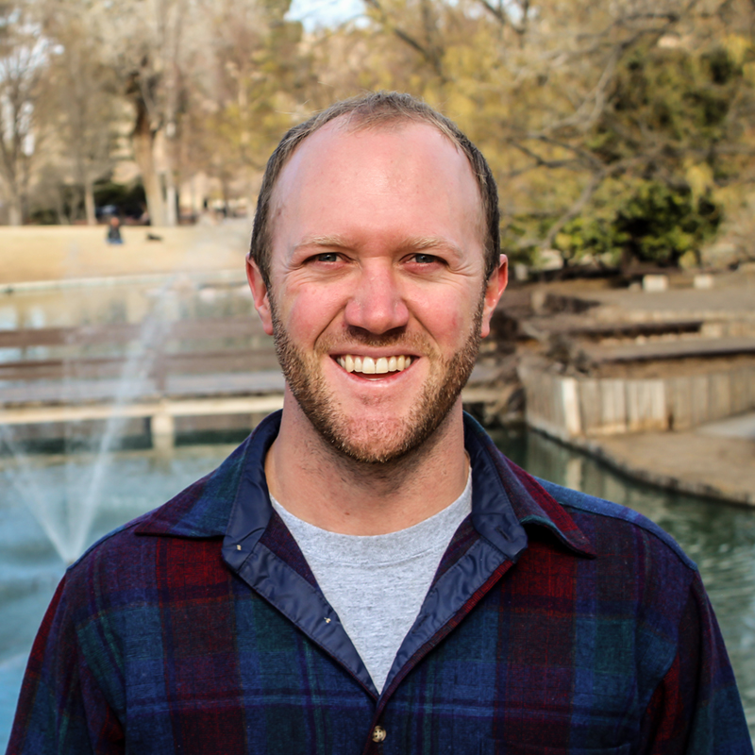

Tucker Colvin
Research Scientist tcovin@unm.edu

Slide 3



This training series is funded by the US EPA

Slide 4


Slide 5
Schedule for 2025:
Date | Topic
6/26/25 | Program Overview, Test Format, Study & Test Tips
7/10/25 | Drinking Water System Overview - (Source, Treatment, & Distribution)
7/24/25 | Basic Operator Math (+, -, /, x, Exponents and basic algebra)
8/7/25 | Applied Operator Math (e.g. Areas, Volume, Flow Rates, Detention Time, Pressure/Hydraulic Head)
8/21/25 | Drinking Water Regulations
9/4/25 | Source Water Characteristics
9/18/25 | Surface Water Intake Components, Well Components, and O&M
10/2/25 | Disinfection 1: Chloramines, UV, Chlorine Dioxide, Chlorine
10/16/25 | Disinfection 2: Chlorine Disinfection Application for Sodium Hypochlorite and Gas Chlorine (including storage and safety)
10/30/25 | Disinfection 3: Distribution System Application, Residual Measurement, Evaluation & Adjustment,
11/13/25 | Disinfection 4: Chlorine Disinfection Math
12/4/25 | Surface Water Treatment 1: Coagulation, Flocculation, Sedimentation (including chemistry, process controls, operations)
12/18/25 | Surface Water Treatment 2: Filtration
Links to recordings and material are available on our website at https://swefc.unm.edu/home/op-cert-trainings/

Slide 6

https://swefc.unm.edu/home/op-cert-trainings/

Slide 7

Sign in for every session to ensure you get credit for attending

Slide 8
Today’s Agenda
CT
Distribution System Application
Residual Measurement
Residual Evaluation
Dosage Adjustment
Repairing Mains

Slide 9
Total amount of chlorine fed into a volume of water (mg/L)
Chlorine remaining after demand is satisfied (mg/L)
IS available for disinfection
DOSAGE = DEMAND + RESIDUAL
Chlorine consumed by material in the water (mg/L)
NOT available for disinfection
NO residual chlorine

Slide 10
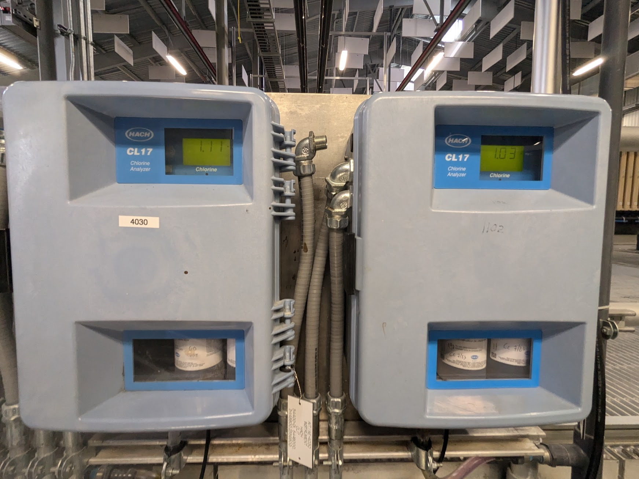

Slide 11

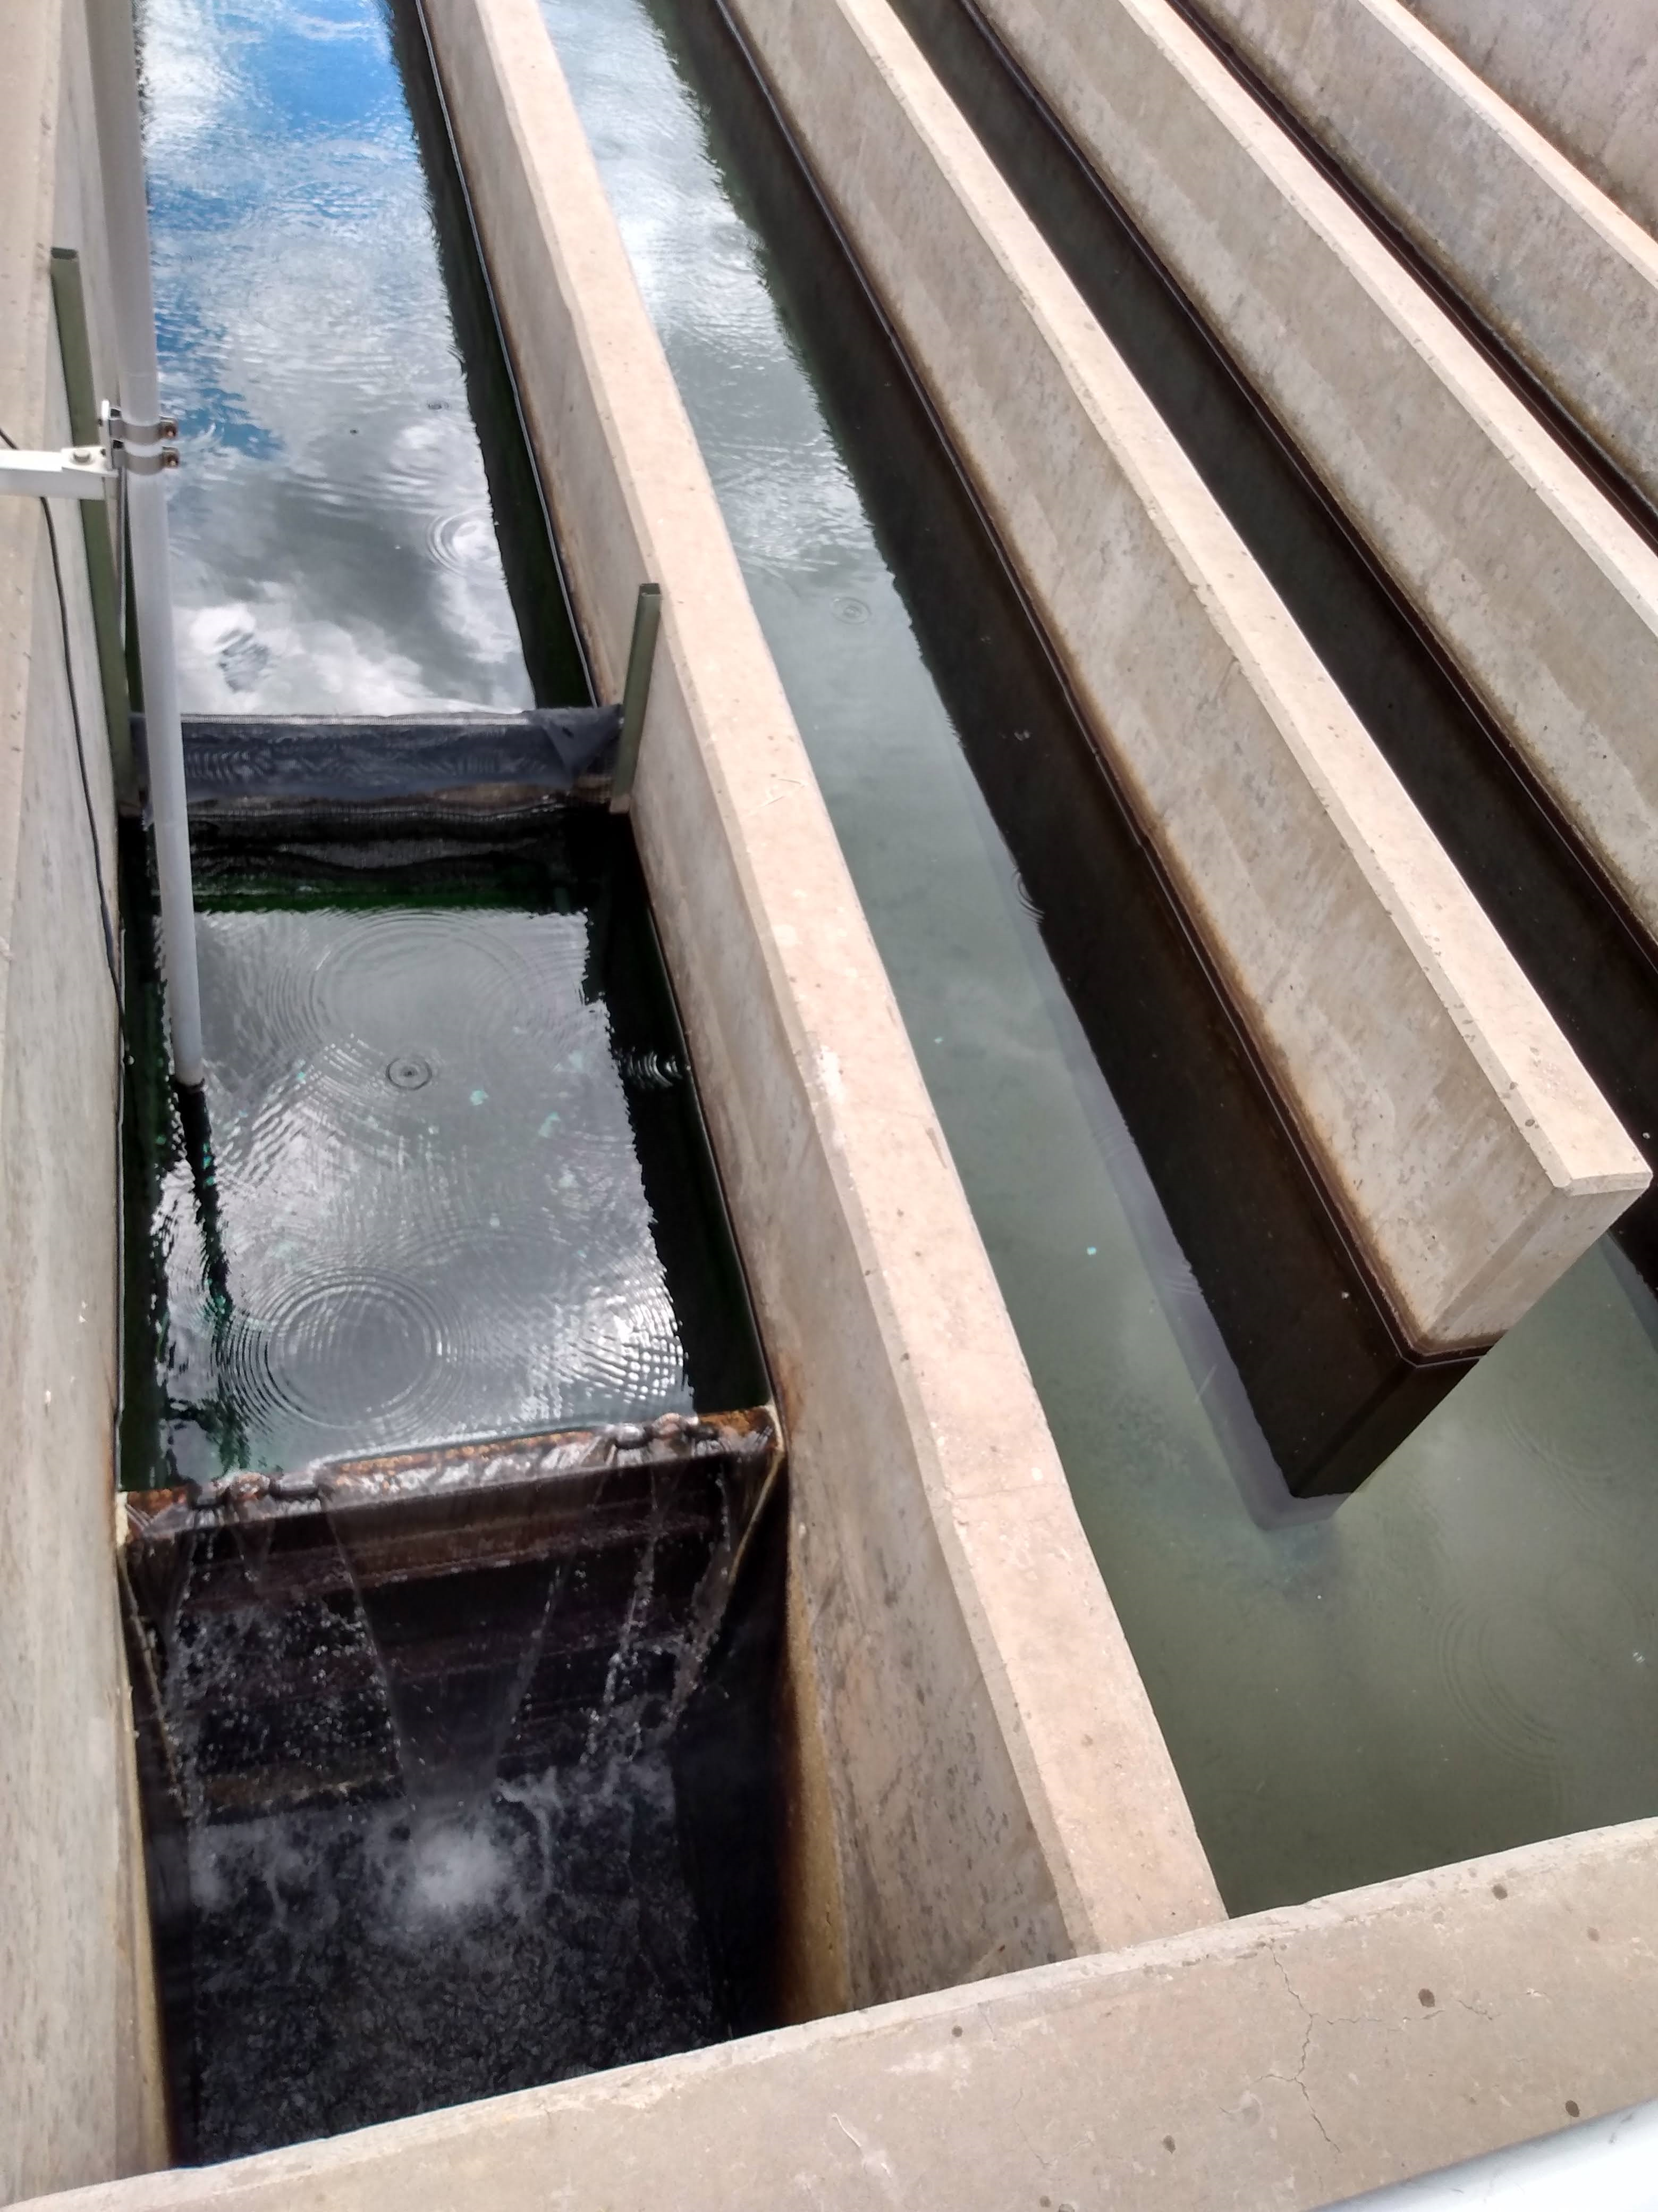
CT
= Concentration x Time
Chlorine takes time to interact with and inactivate organisms. CT must be met to ensure affective inactivation.
The higher the concentration the less time needed.
The more time available the lower the required concentration.
Notes:
A certain CT must me met before water is released back into the environment. This ensures that the chlorine has had sufficient time to react with all the pathogens. The chlorine concentration and time are inversely related, meaning that if you have a higher concentration of chlorine in the water, you don’t need as long of a time for it to react. Alternatively, if your water is in contact with your chlorine for a long period of time, you don’t need as high of a concentration of chlorine.
SWEFC Photo

Slide 12
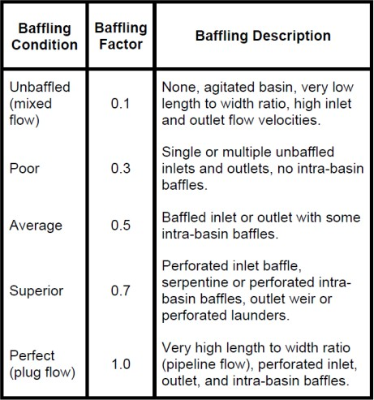
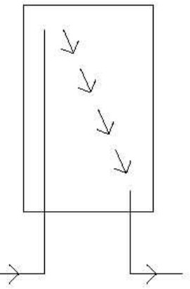
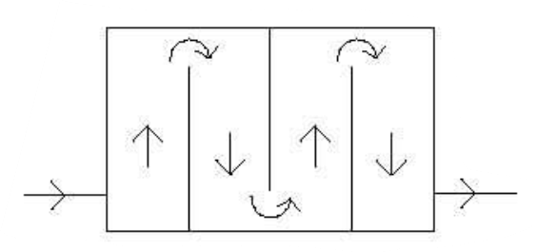
Baffling factor indicates the degree of short circuiting.

Slide 13
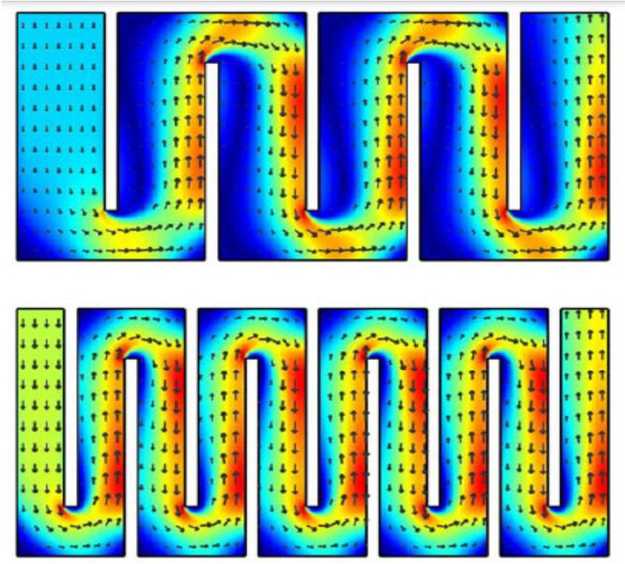
Average baffling
Superior baffling

Slide 14
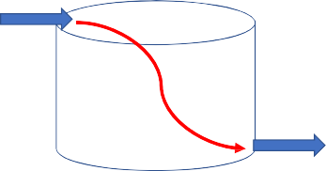

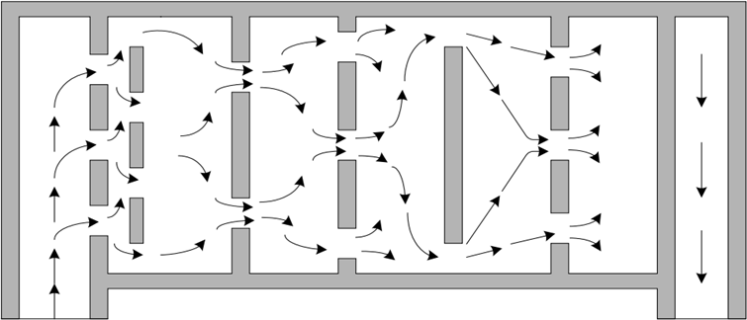
Unbaffled tank B.F = 0.1 to 0.3
Pipeline flow: B.F. = 1.0
Plug flow
2. Tank with baffles B.F. = 0.5 to 0.7

Slide 15
What is the CT of a system with the following information?
Chlorine concentration at EP of 0.5 mg/L
28 minutes in clearwell between chlorination and EP
Clearwell baffling factor of 0.3
CT = Concentration x (time x baffling factor)
CT = 0.5 mg/L x (28 minutes x 0.3)
CT = 0.5 mg/L x 8.4 minutes
CT = 4.2 mg-min/L
Is this CT sufficient?

Slide 16
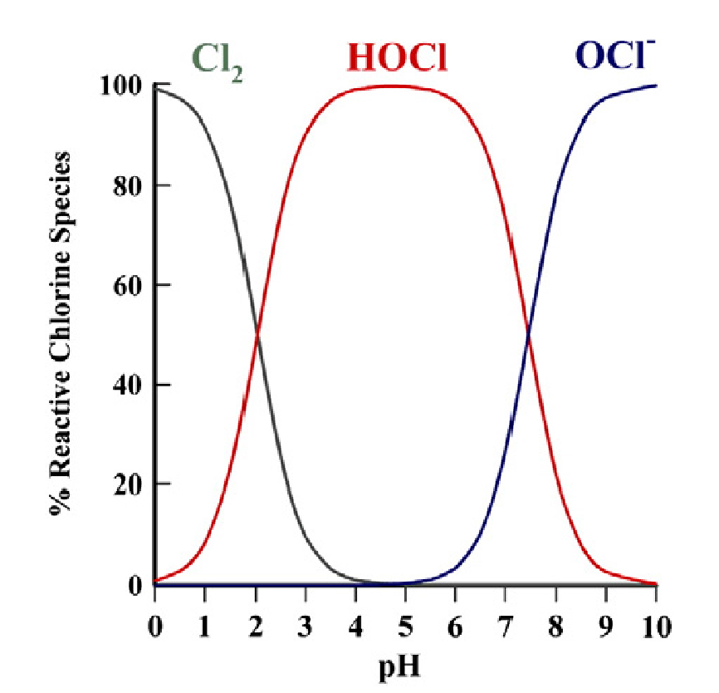
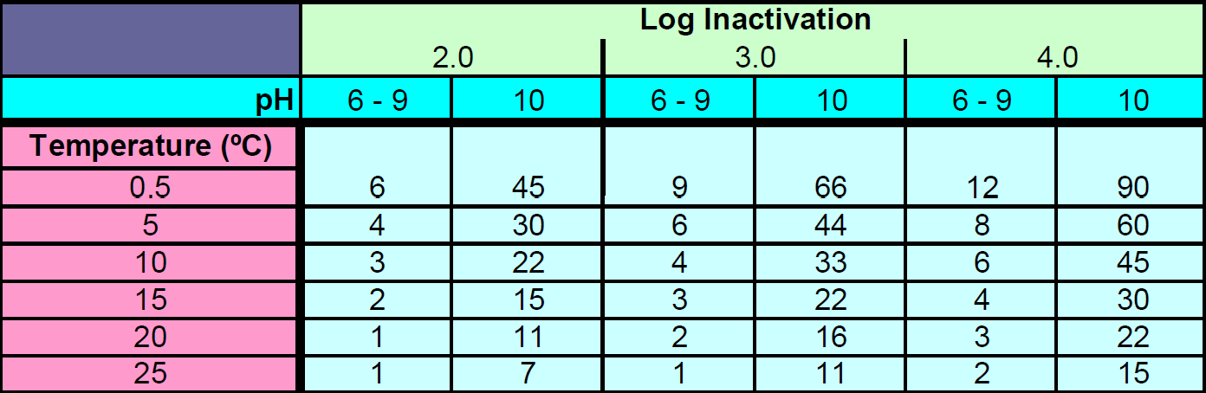
CT table - Virus inactivation with chlorine
In our example:
CT = 4.2 mg-min/L
Temperature = 15°C
pH = 8.4
4 log removal of viruses was achieved

Slide 17
Understanding Log Treatment Levels
3 log treatment means 99.9% removal or inactivation.
4 log treatment means 99.99% removal or inactivation
The term log refers to an exponent of 10
Illustrative Example
A quantity of raw water contains 1,000,000 microbes and receives 4-log treatment to remove 99.99%.
1,000,000 microbes – [1,000,000 x 0.9999] = 100 microbes remaining
Take aways:
  The quantity of 10⁶ microbes was reduced to 10².
  The reduction factor is 10,000 [10,000 x 100 = 1,000,000]
  This reduction factor can be expressed as 10⁴, or 4-log

Slide 18
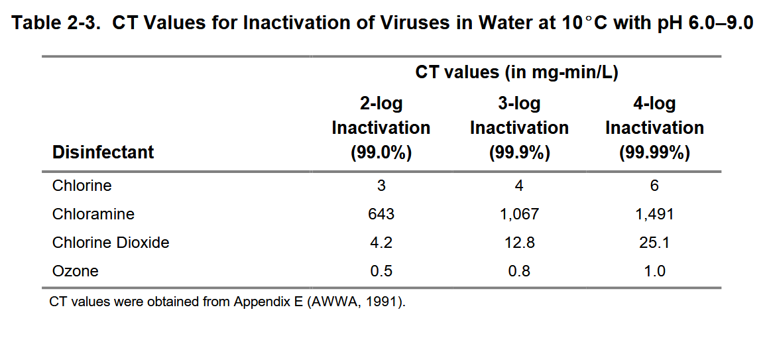
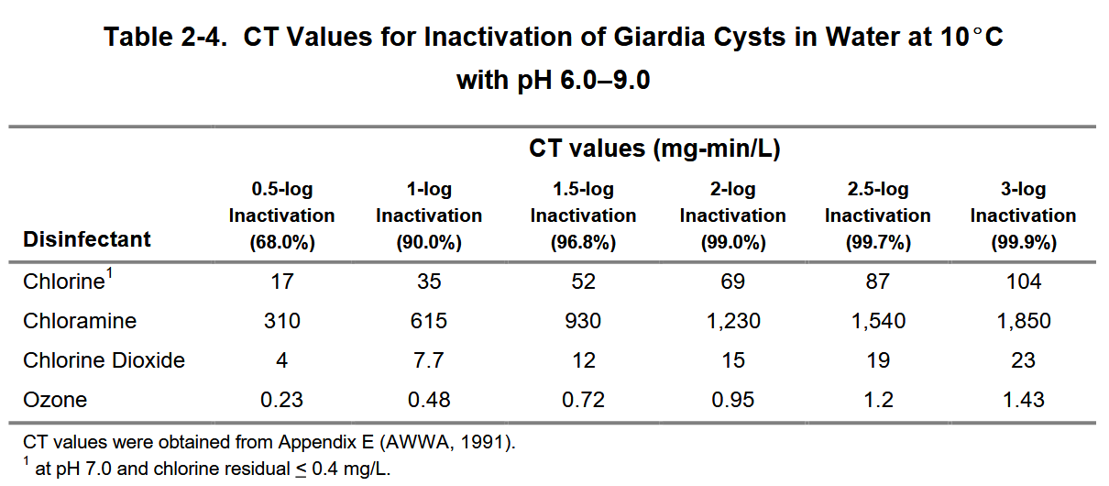
Notes:
https://nepis.epa.gov/Exe/ZyPDF.cgi?Dockey=200022IP.txt

Slide 19
Poll: What types of disinfectant do you use at your plant?
Chlorination
Chloramination
Chlorine dioxide
Ozone
UV

Slide 20
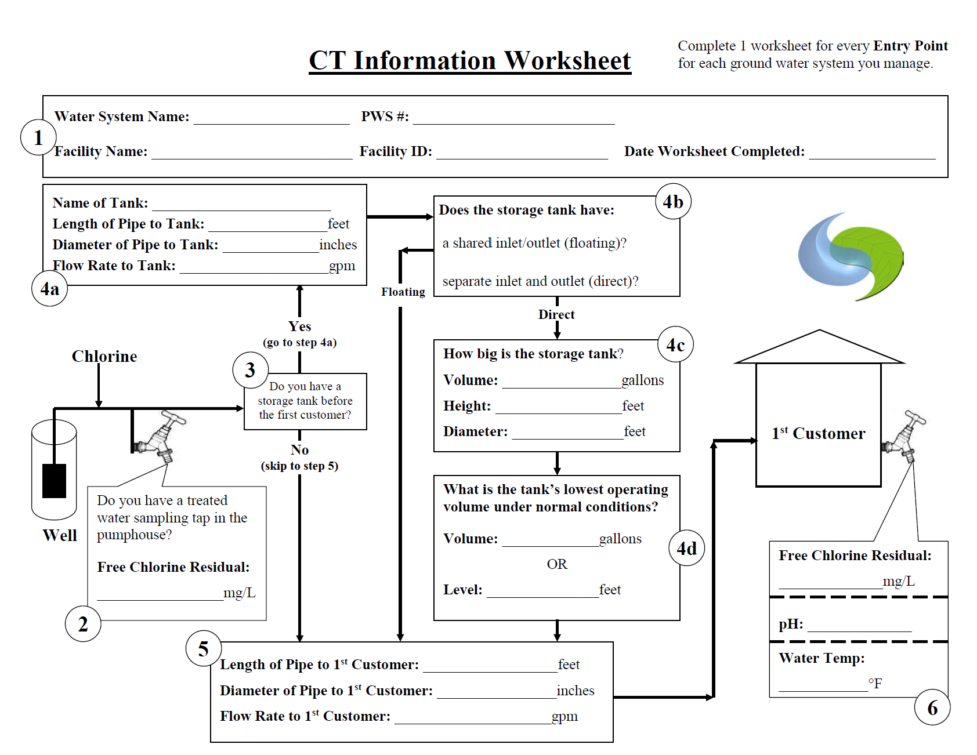

Slide 21
Parameter | Value
Diameter of pipe to First Customer (inches) | 6
Length of pipe to First Customer (feet) | 900
Volume of pipe to First Customer (gallons) | 1321.16
Peak flow to First Customer (gpm) | 150
Total contact time to First Customer (minutes) | 8.8
Temperature at First Customer (°F) | 77
Temperature at First Customer (°C) | 25
pH at First Customer | 7.9
CT from table - based on water temperature & pH (mg-min/L) | 2
Minimum Free Chlorine Residual Concentration Required at First Customer (mg/L) | 0.23

Slide 22
Poll: Are you a ground water or surface water system?
Groundwater
Surface water
Poll: Have you ever calculated your CT?
Yes
No

Slide 23
What is the log removal of a system with the following information?
Chlorine concentration at first customer of 0.41 mg/L
At peak flow, 40 minutes in clearwell with baffling factor of 0.2
At peak flow, 12 minutes in pipe going to first customer (baffling factor of 1.0)
Minimum temperature of 5°C
Maximum pH of 7.9
1 log removal
2 log removal
3 log removal
4 log removal

Slide 24
What is the log removal of a system with the following information?
Chlorine concentration at first customer of 0.41 mg/L
At peak flow, 20 minutes in clearwell with baffling factor of 0.2
At peak flow, 4 minutes in pipe going to first customer (baffling factor of 1.0)
Minimum temperature of 11°C
Maximum pH of 7.9
Time = time in clearwell x baffling factor + time in pipe x baffling factor
Time = 20 minutes x 0.2 + 4 minutes x 1
Time = 4 minutes + 4 minutes
Time = 8 minutes
CT = Concentration x Time
CT = 0.41 mg/L x 8 min
CT = 3.28 mg-min/L
B. 2 log removal achieved

Slide 25

Disinfection byproducts
Disinfectant reacts with naturally present substances in the water
  Fulvic and humic acids
  Amino acids
  Organic matter
  Iodide
  Bromide
DBPS include:
  Trihalomethanes (THMs)
  Haloacetic acids (HAAs)
  Bromate
  Chlorite
  Other non-regulated DBPs
Microbials
Byproducts

Slide 26
Testing for chlorine residuals

Slide 27
Testing For Chlorine Residuals

Slide 28
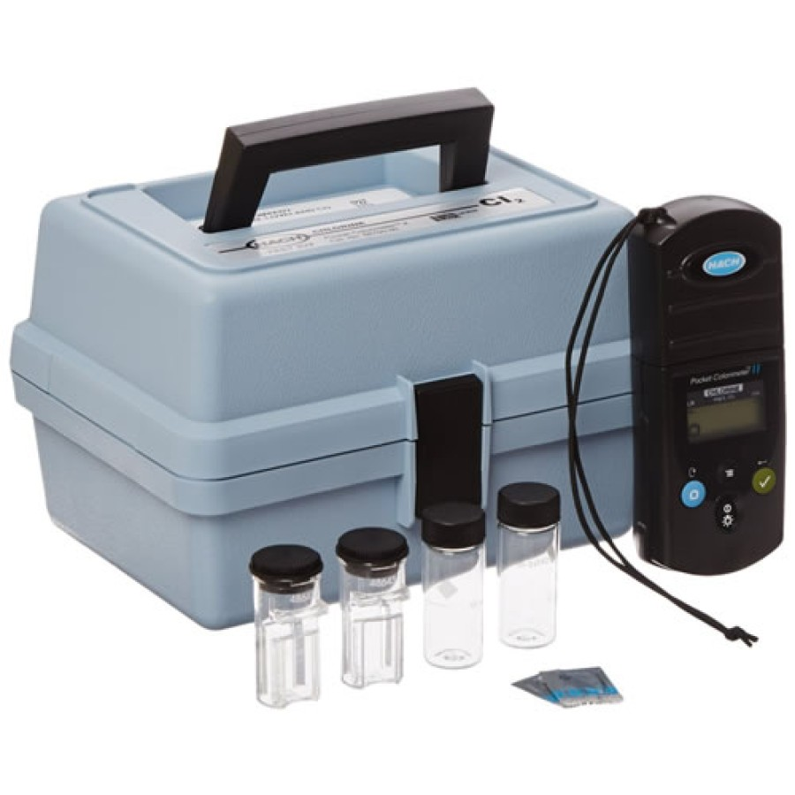
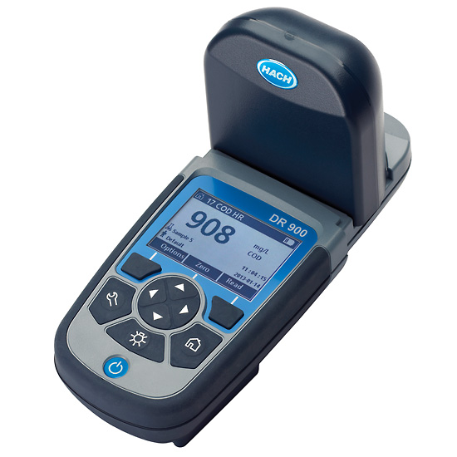
Testing For Chlorine Residuals
DPD test
Must be tested within 15 minutes of sampling
Reagent is added and compared to the blank with a color wheel or a spectrometer/colorimiter
Reagent for free and total residual

Slide 29
Distribution system
Cl
Hospital
Casino
$$$$$$
Senior Center
Legend
School
Well
Tank
Store
House
29
Building

Slide 30
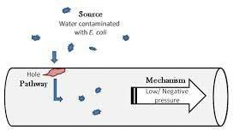
Distribution protection
Important distribution control measures
Physical integrity of the distribution system
Continuous positive water pressure (between 20 and 100 psi)
Maintain a chlorine residual (at least 0.20 mg/L)
  Contamination events require a source (contaminated groundwater), a pathway (pipe crack), and a mechanism (low pressure event).
  After initial disinfection, maintaining a free chlorine residual in the distribution system is a final barrier to protect against contamination, but once the residual is used up, there is no more disinfecting power.
  Multiple studies correlate water borne disease occurrences with main breaks, main repairs, and low pressure events.

Slide 31
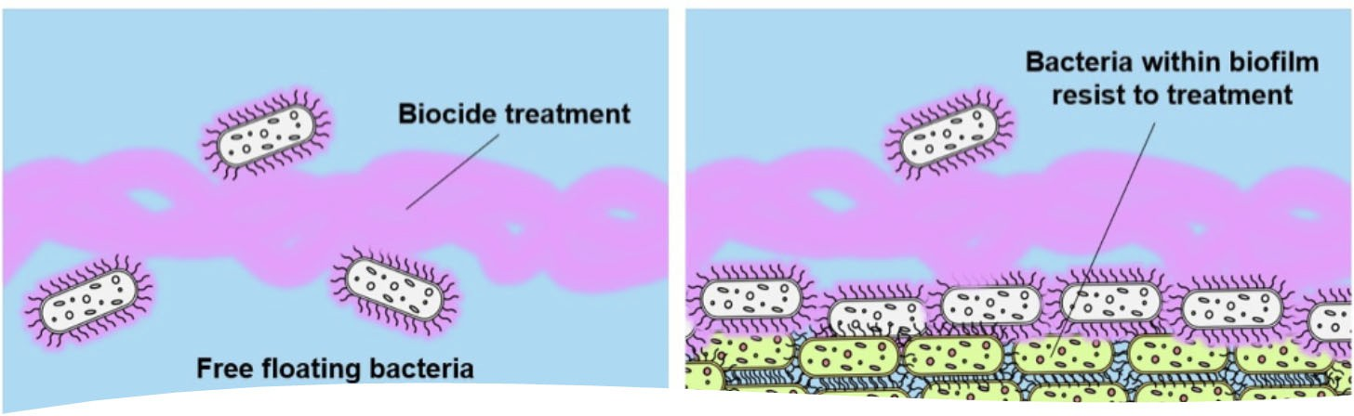
Biofilms protect pathogenic microbes from harsh environmental factors, including chlorine, shear stress, heat, inhibitors, and detergents, allowing them to survive (Hemdan et al., 2021).
EPS – Extracellular polymeric substances – gel like substances secreted by bacteria

Slide 32
Waterville Residual Measurement
Cl
Hospital
Casino
$$$$$$
Senior Center
Legend
School
Well
Tank
Store
House
Building

Slide 33
Which customers do we need to consider?
First customer (CxT)
Dead ends
Far ends of the distribution system
Susceptible populations
  Hospitals, dialysis clinics, schools

Slide 34
Waterville Residual Measurement
Cl
1st customer
First Customer – C x T
Hospital
Casino
$$$$$$
Senior Center
Legend
School
Well
Tank
Store
House
Building

Slide 35
Waterville Residual Measurement
Cl
Hospital
Dead Ends
Casino
$$$$$$
Senior Center
Legend
School
Well
Tank
Store
House
Building

Slide 36
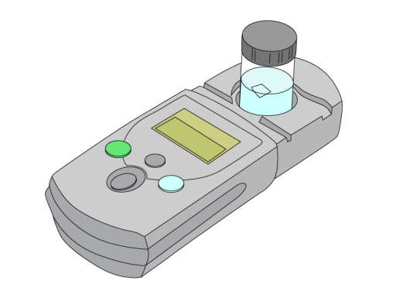
Dead Ends
Chlorine concentrations will be variable compared to the rest of distribution
Flush dead ends to ensure good chlorine levels - amount and timing depends on system
Increased biofilm growth
Increased disinfection byproduct formation (DBPs)
LeChevallier et al. (1996) found that distribution systems that have dead-ends with free chlorine residuals less than 0.2 mg/L or chloramine levels less than 0.5 mg/L had substantially more coliform occurrences (system-wide) than systems maintaining higher residuals.

Slide 37
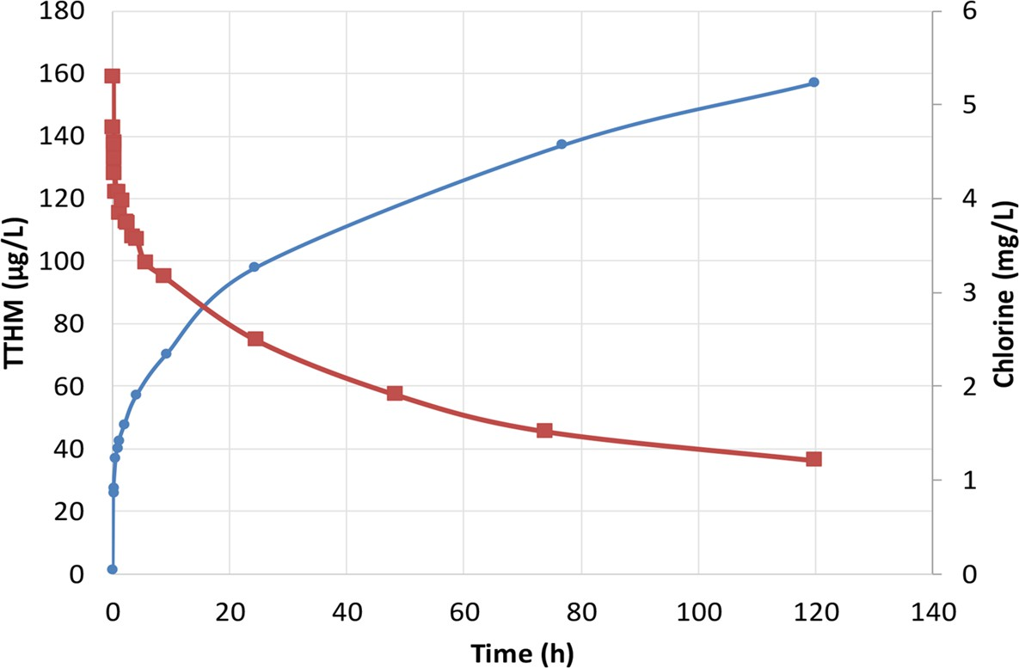
Total Trihalomethanes increase
Chlorine residual decreases

Slide 38
Waterville Residual Measurement
Cl
Far Ends of Distribution
Hospital
Casino
$$$$$$
Senior Center
Legend
School
Well
Tank
Store
House
Building

Slide 39
Far Ends of Distribution
Maintain 0.2 mg/L minimum
May need to increase chlorine at EP to make sure good residual at ends

Slide 40
Measuring Residual
Where and When?
Distribution
RTCR Sites – Monthly
DBP Sites –according to compliance schedule
First Customer – Daily
Dead Ends – Daily
Long Runs – Daily
Far Ends of Distribution – Daily
Susceptible Populations – Daily
After treatment (EP)
Process Control – Daily
SDWA Compliance Samples – according to compliance schedule

Slide 41
Chlorine Residual Goals
Chlorine Disinfection & Daily Operations

Slide 42



Written Goals Change How You Operate

Slide 43




Goals Are Not Set in Stone
GOALS CAN BE ADDED OR REMOVED
GOALS CAN BE CHANGED
OR ADJUSTED OVER TIME

Slide 44

SMART Goals

Slide 45

How much free residual do we need to protect the customers?

Slide 46
What is your goal for free residual chlorine at the EP?

Slide 47
What is your goal for free residual chlorine at the first customer?

Slide 48
What is your goal for free residual chlorine at dead ends?

Slide 49
Under what conditions would you turn up your chlorine feed rate?

Slide 50
Under what conditions would you turn down your chlorine feed rate?

Slide 51
Disinfecting Water Mains

Slide 52
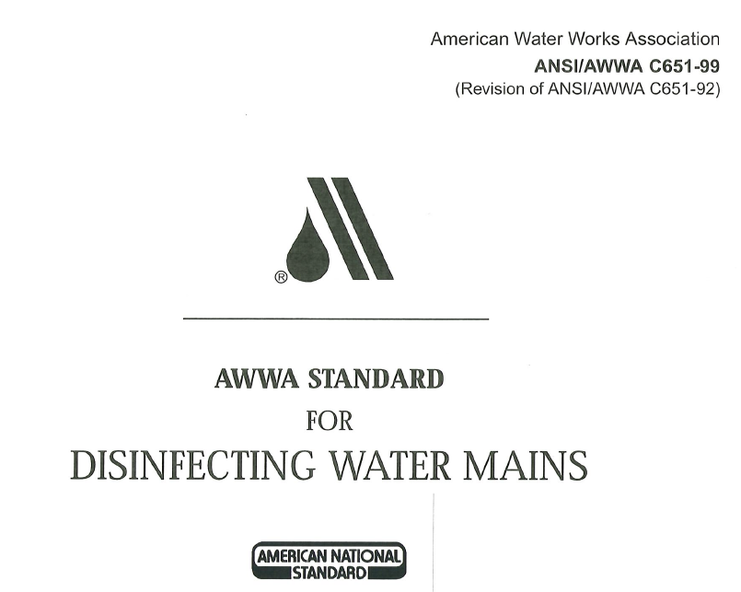

Slide 53
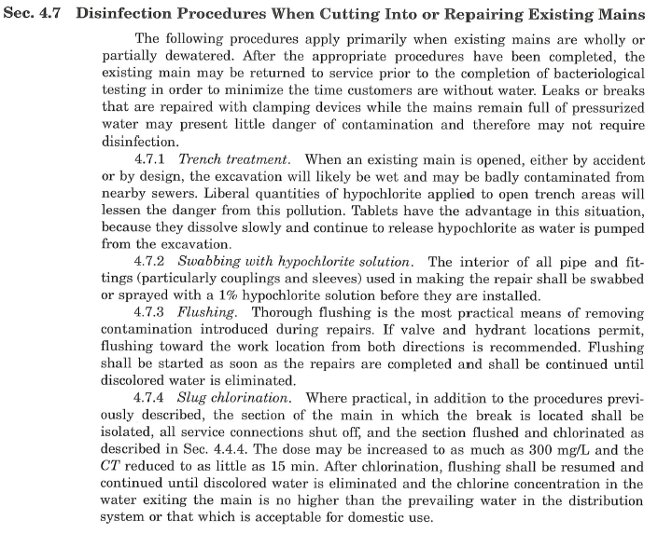
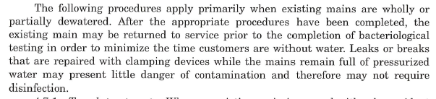

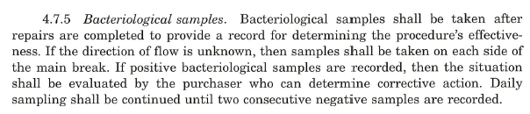

Slide 54
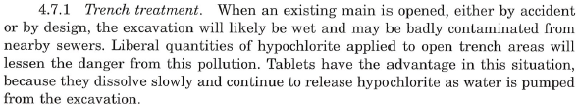

Slide 56


Slide 57
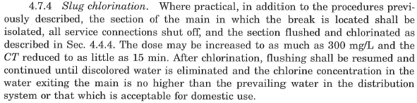

Slide 58
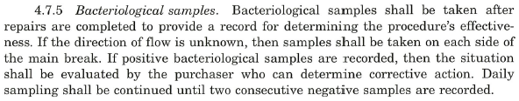

Slide 59
Next time:
Date | Topic
6/26/25 | Program Overview, Test Format, Study & Test Tips
7/10/25 | Drinking Water System Overview - (Source, Treatment, & Distribution)
7/24/25 | Basic Operator Math (+, -, /, x, Exponents and basic algebra)
8/7/25 | Applied Operator Math (e.g. Areas, Volume, Flow Rates, Detention Time, Pressure/Hydraulic Head)
8/21/25 | Drinking Water Regulations
9/4/25 | Source Water Characteristics
9/18/25 | Surface Water Intake Components, Well Components, and O&M
10/2/25 | Disinfection 1: Chloramines, UV, Chlorine Dioxide, Chlorine
10/16/25 | Disinfection 2: Chlorine Disinfection Application for Sodium Hypochlorite and Gas Chlorine (including storage and safety)
10/30/25 | Disinfection 3: Distribution System Application, Residual Measurement, Evaluation & Adjustment,
11/13/25 | Disinfection 4: Chlorine Disinfection Math
12/4/25 | Surface Water Treatment 1: Coagulation, Flocculation, Sedimentation (including chemistry, process controls, operations)
12/18/25 | Surface Water Treatment 2: Filtration
Links to recordings and material are available on our website at https://swefc.unm.edu/home/op-cert-trainings/

Slide 60
CONTACT INFORMATION
SW EFC email: swefc@unm.edu
Department of Civil Engineering MSC01 1070
1 University of New Mexico
Albuquerque, NM 87131
505-277-0644
swefc@unm.edu
http://swefc.unm.edu

