Slide 1





US Territories Wastewater Operator Training Series
Session 10: Sedimentation (plus Flocculation & Floatation)
10/28/25
www.efcnetwork.org
This program is made possible under a cooperative agreement with US EPA.
Notes:
Welcome to all of our participants from CNMI,Guam and American Samoa

Slide 2


Your trainers for today:
James Markham
Research Engineer
Valeria Cortes-Mora
Professional Intern

Slide 3



This training series is funded by the EPA

Slide 4


Slide 5

WPI/ABC Operator Certification
Notes:
This series is designed to supplement and reinforce the ABC Need to Know Criteria for the Wastewater Operator level 1 and 2 exams though there will be some higher level topics covered, and we won’t always follow the exact order listed in the NTKs
https://www.gowpi.org/services/abc-testing/standardized-exams/standardized-wastewater-treatment-operator-exams/

Slide 6
Schedule for 2025:
Date | Topic
6/24/25 | Program Overview, Test Format, Study & Test Tips
7/8/25 | Treatment Overview - Reg history, overview
7/22/25 | WW Math Part 1 (Areas & Volumes)
8/5/25 | WW Math Part 2 (Flow Rates & Detention Times)
8/19/25 | Collection Systems - Gravity systems
9/2/25 | Collection Systems - Pumping & force mains
9/16/25 | Collection System Maintenance
9/30/25 | Operator Safety/OSHA/Chemical Safety & Inventory
10/14/25 | Preliminary Treatment
10/28/25 | Primary Treatment: Sedimentation
11/11/25 | Fixed-Film Media
12/2/25 | Activated Sludge Part 1
12/16/25 | Activated Sludge Part 2
Notes:
26 sessions total
1 hour each
This is the schedule for the remainder of this year,
The trainers will vary depending on the topic
We’re now on session 10

Slide 7
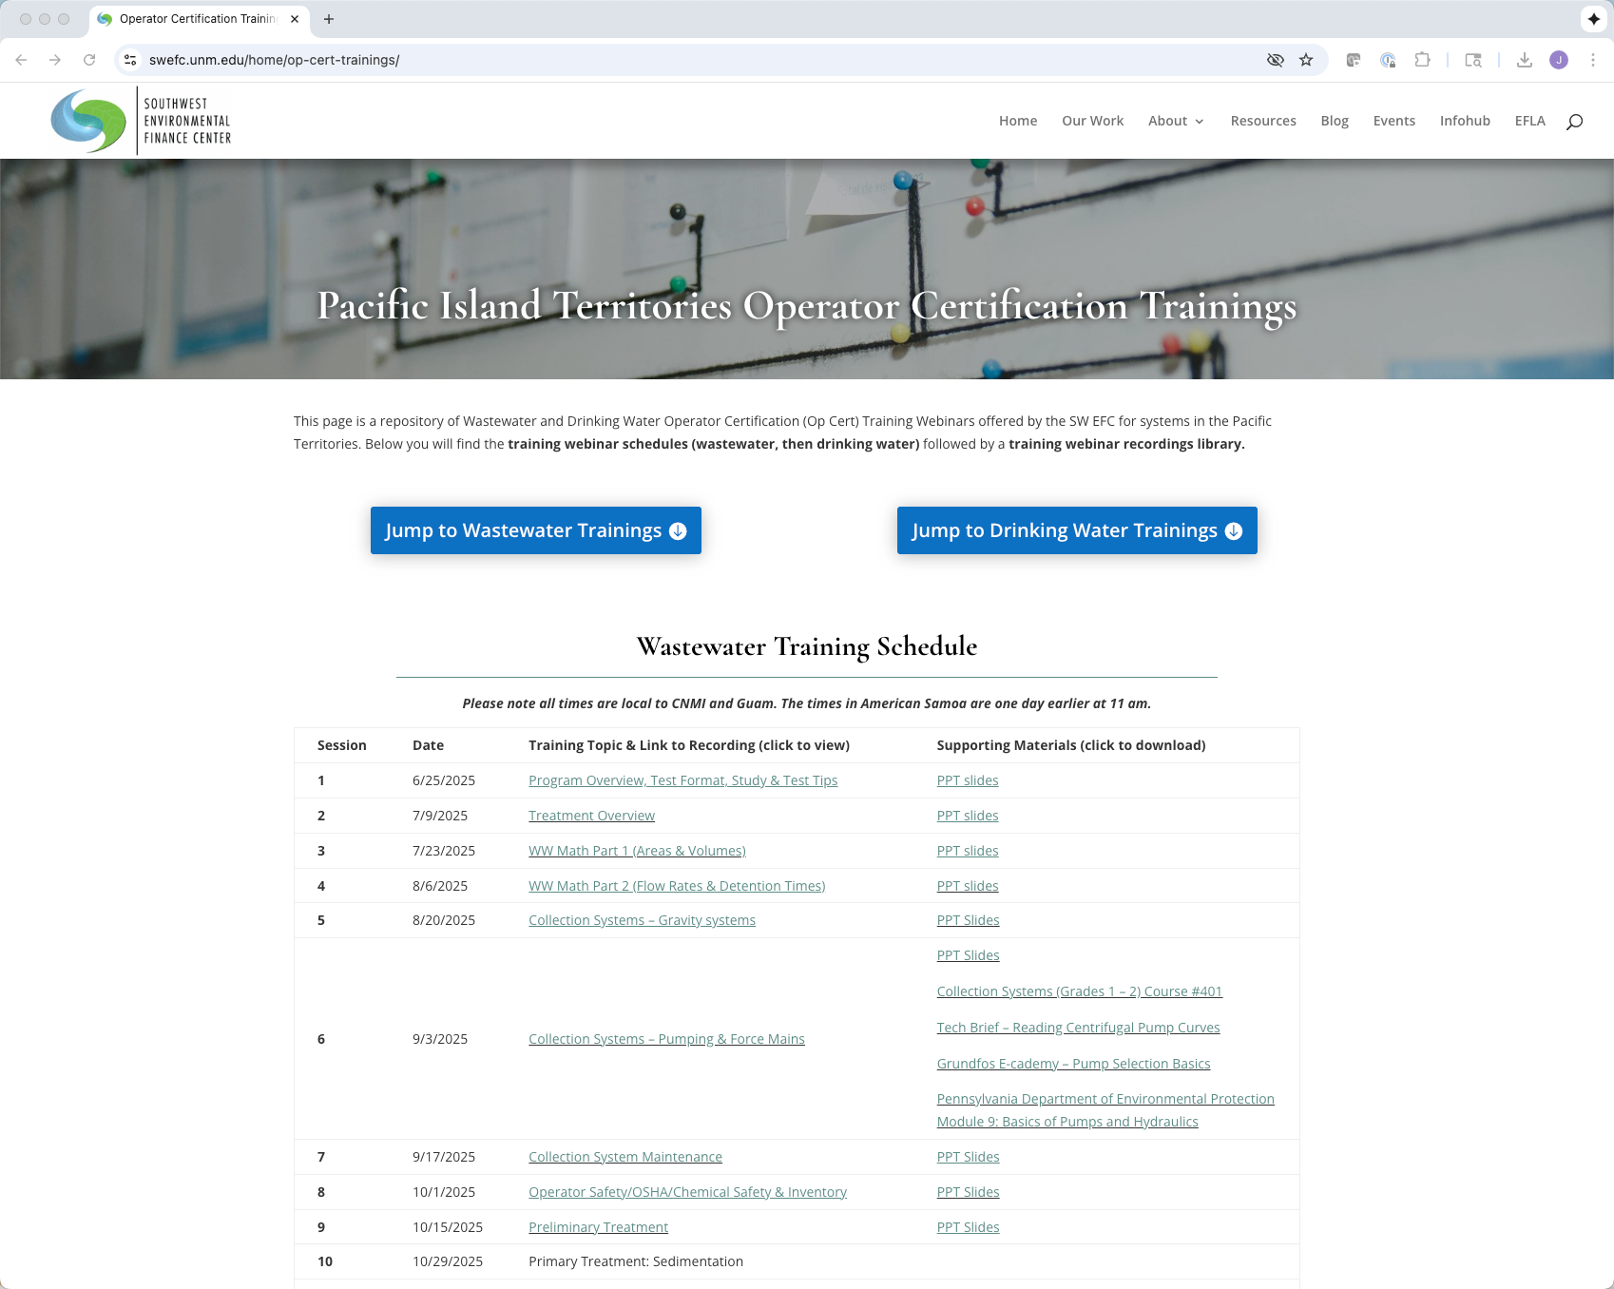
https://swefc.unm.edu/home/op-cert-trainings/
Notes:
The sessions are all being posted to our website so that you can go back and review them. I checked yesterday and all of the sessions 1-9 are posted, and this session should be posted in a day or two.

Slide 8

Sign in for every session to ensure you get credit for attending
Notes:
Be sure to sign in if you are attending in a group. The facilitator at your location will forward these to us and we will keep track of your attendance hours for credits;
With that lets get to today’s content!

Slide 9
Introduction
Our topics for today
Notes:
And with that, lets get on with the show.
This particular webinar will cover some concepts and theory and examples and some useful math related to our main topic which is
(CLICK)

Slide 10
“Sedimentation”
The settling of heavier particles in the wastewater
Notes:
Sedimentation.
Sedimentation in its most basic form is just the settling of heavier particles in the wastewater stream out of the stream
The idea is to put the effluent in a basin and slow the wastewater to the point where it can’t transport the suspended material that you are focusing on for a particular process so that gravity can pull it to the bottom of the channel or tank that its in for removal.
The reason this works is that solids in wastewater typically have a specific gravity higher than 1.
Remember specific gravity is the weight of particles to an equal volume of water. The SG water is 1 and that's what everything else is compared to. If the SG is higher than 1 a particle will sink given enough time and a slow enough flow velocity, (though particle shape size and water temperature can impact the rate at which it sinks)
And we'll get into some more specifics about those concepts and things you can do to speed the process up a bit later.
(CLICK)

Slide 11
“Flocculation”
Gathering fine particles together after coagulation to form larger particles by a process of mixing
Notes:
We’ll also cover the concept of flocculation which involves using mixing techniques and sometimes additives to promote the “clumping together” of smaller particles so that they’ll fall out of suspension quicker.
Flocculants in relatively dilute solutions don’t behave like discrete particles and instead they clump together – or coallece - during sedimentation they gain mas and settle faster
The extent to which flocculation occurs depends on opportunity for contact, which in turn will depend on overflow rates, depth of the basin, velocity gradients in the system, particle concentration, and the range of particle sizes. The effects of these variables can typically only be determined by sedimentation tests (which are beyond the scope of today’s talk)
We’re talking about using physics and some clever engineering to facilitate or speed the sedimentation process and to segment it so that we separate out particular particulates where we want to
Although we typically think of flocculation in terms of it’s impact on sedimentation processes, it can also be used in processes that separate solids from water using skimming, draining or filtering.
The main take away with flocculation is that we’re getting small particles to clump together to form big particles that have different physical properties that can be exploited for their removal
For example, there are quite a few microbes used in wastewater treatment (for example in the activated sludge process) that have a natural tendency to flocculate and settle easily, and we can exploit that tendency in the removal process.
and of course we fight that tendency in the activated sludge tanks by using aggitation and aeration to keep everyting in suspension

Slide 12
“Floatation”
Floating lighter materials like grease to the top for removal
Notes:
Floatation is, of course, the opposite of sedimentation,. Here we’re raising lighter materials to the top of the wastewater for removal – fats, oils, hair and other lightweight material like plastics
This can be done with aeration, the evolution of gas in the water, chemicals, electrolysis, heat or bacterial decomposition.
Some materials will float to the top by themselves given time – like fats, oils and grease – which is why there are skimmers on clarifiers
What these floating substances have in common is that they have specific gravity less than 1 – in other words they’re less dense than water, so they float to the top
Again, we’ll discuss floatation a bit as it applies to the various processes as we go forward, but our primary focus is on sedimentation and some of the formulas related to evaluating sedimentation processes that you might see on an op cert test and that you can use to evaluate whether your plant is operating within typical parameters

Slide 13
The Sedimentation Principle is used throughout the treatment train.
Notes:
The sedimentation principle is used throughout the treatment train, and in most cases the primary purpose is to produce a clarified effluent and in some cases to produce sludge with a solids concentration that can be easily handled and treated easily
It's really the same process that happens in a basic sewage lagoon as well. Given slow enough flow most solids in wastewater will sink to the bottom of the tank they're in. what we do is design the processes so that the given suspended solids we are focusing on fall out of the effluent where we want them to in the treatment train.
Time Check 8 Min

Slide 14
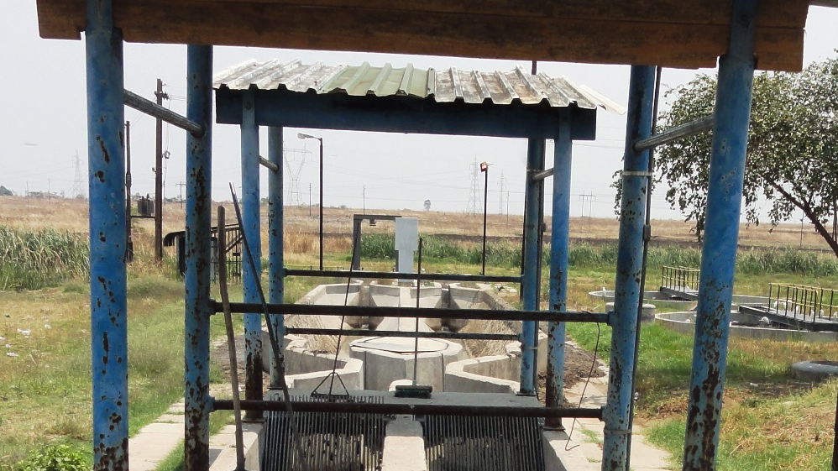
In Preliminary Treatment
Notes:
You got a preview of sedimentation (without the math we’ll be doing today) when AJ discussed the grit removal process in preliminary treatment and some of the velocity based methods that are used. In the last session
For those of you who weren’t with us
(CLICK)
That is an empty grit removal channel where the sedimentation principle is used to let grit drop out of the influent stream before it hits primary treatment
The main difference between what we covered last session and this session is that in primary and secondary treatment we’re dealing with the organic particles suspended in the wastewater stream which are much lighter and finer than the predominantly inorganic grit AJ covered in the last session (rocks, sand, glass, seeds etc)
(so smaller and with a lower specific gravity )
Grit has a specific gravity of around 2.5-2.6
particles in Primary treatment stages are much finer and have a specific gravity that is much closer that that of water than grit.
Specific gravity can be in the 1.03 range (so just a bit higher than water) and the size can actaually be in the micron range
so the time it will take solids to settle out in primary and secondary treatment is typically longer.
IN a preliminary treatment sedimentation process like grit removal our detention time is typically counted in minutes. In later primary and secondary treatment stages the detention time may be hours
Another difference between grit settling and settling in later stages is that with grit settling we're talkinga bout discrete particles that really don't interact much with each other and settle out simplu with gravity
So, the physics and therefore math is a little bit different and a little more complicated in primary and secondary sedimentation processes
Skip this
Though the time influent spends in rapid mixing stage to promote flocculation (which some, but not all, treatment plants use and which we'll cover in a bit) is an exception to that - but of course because we're mixing - we're actually preventing sedimentation AT THAT STAGE, though we're promoting that settling in the following stage.

Slide 15
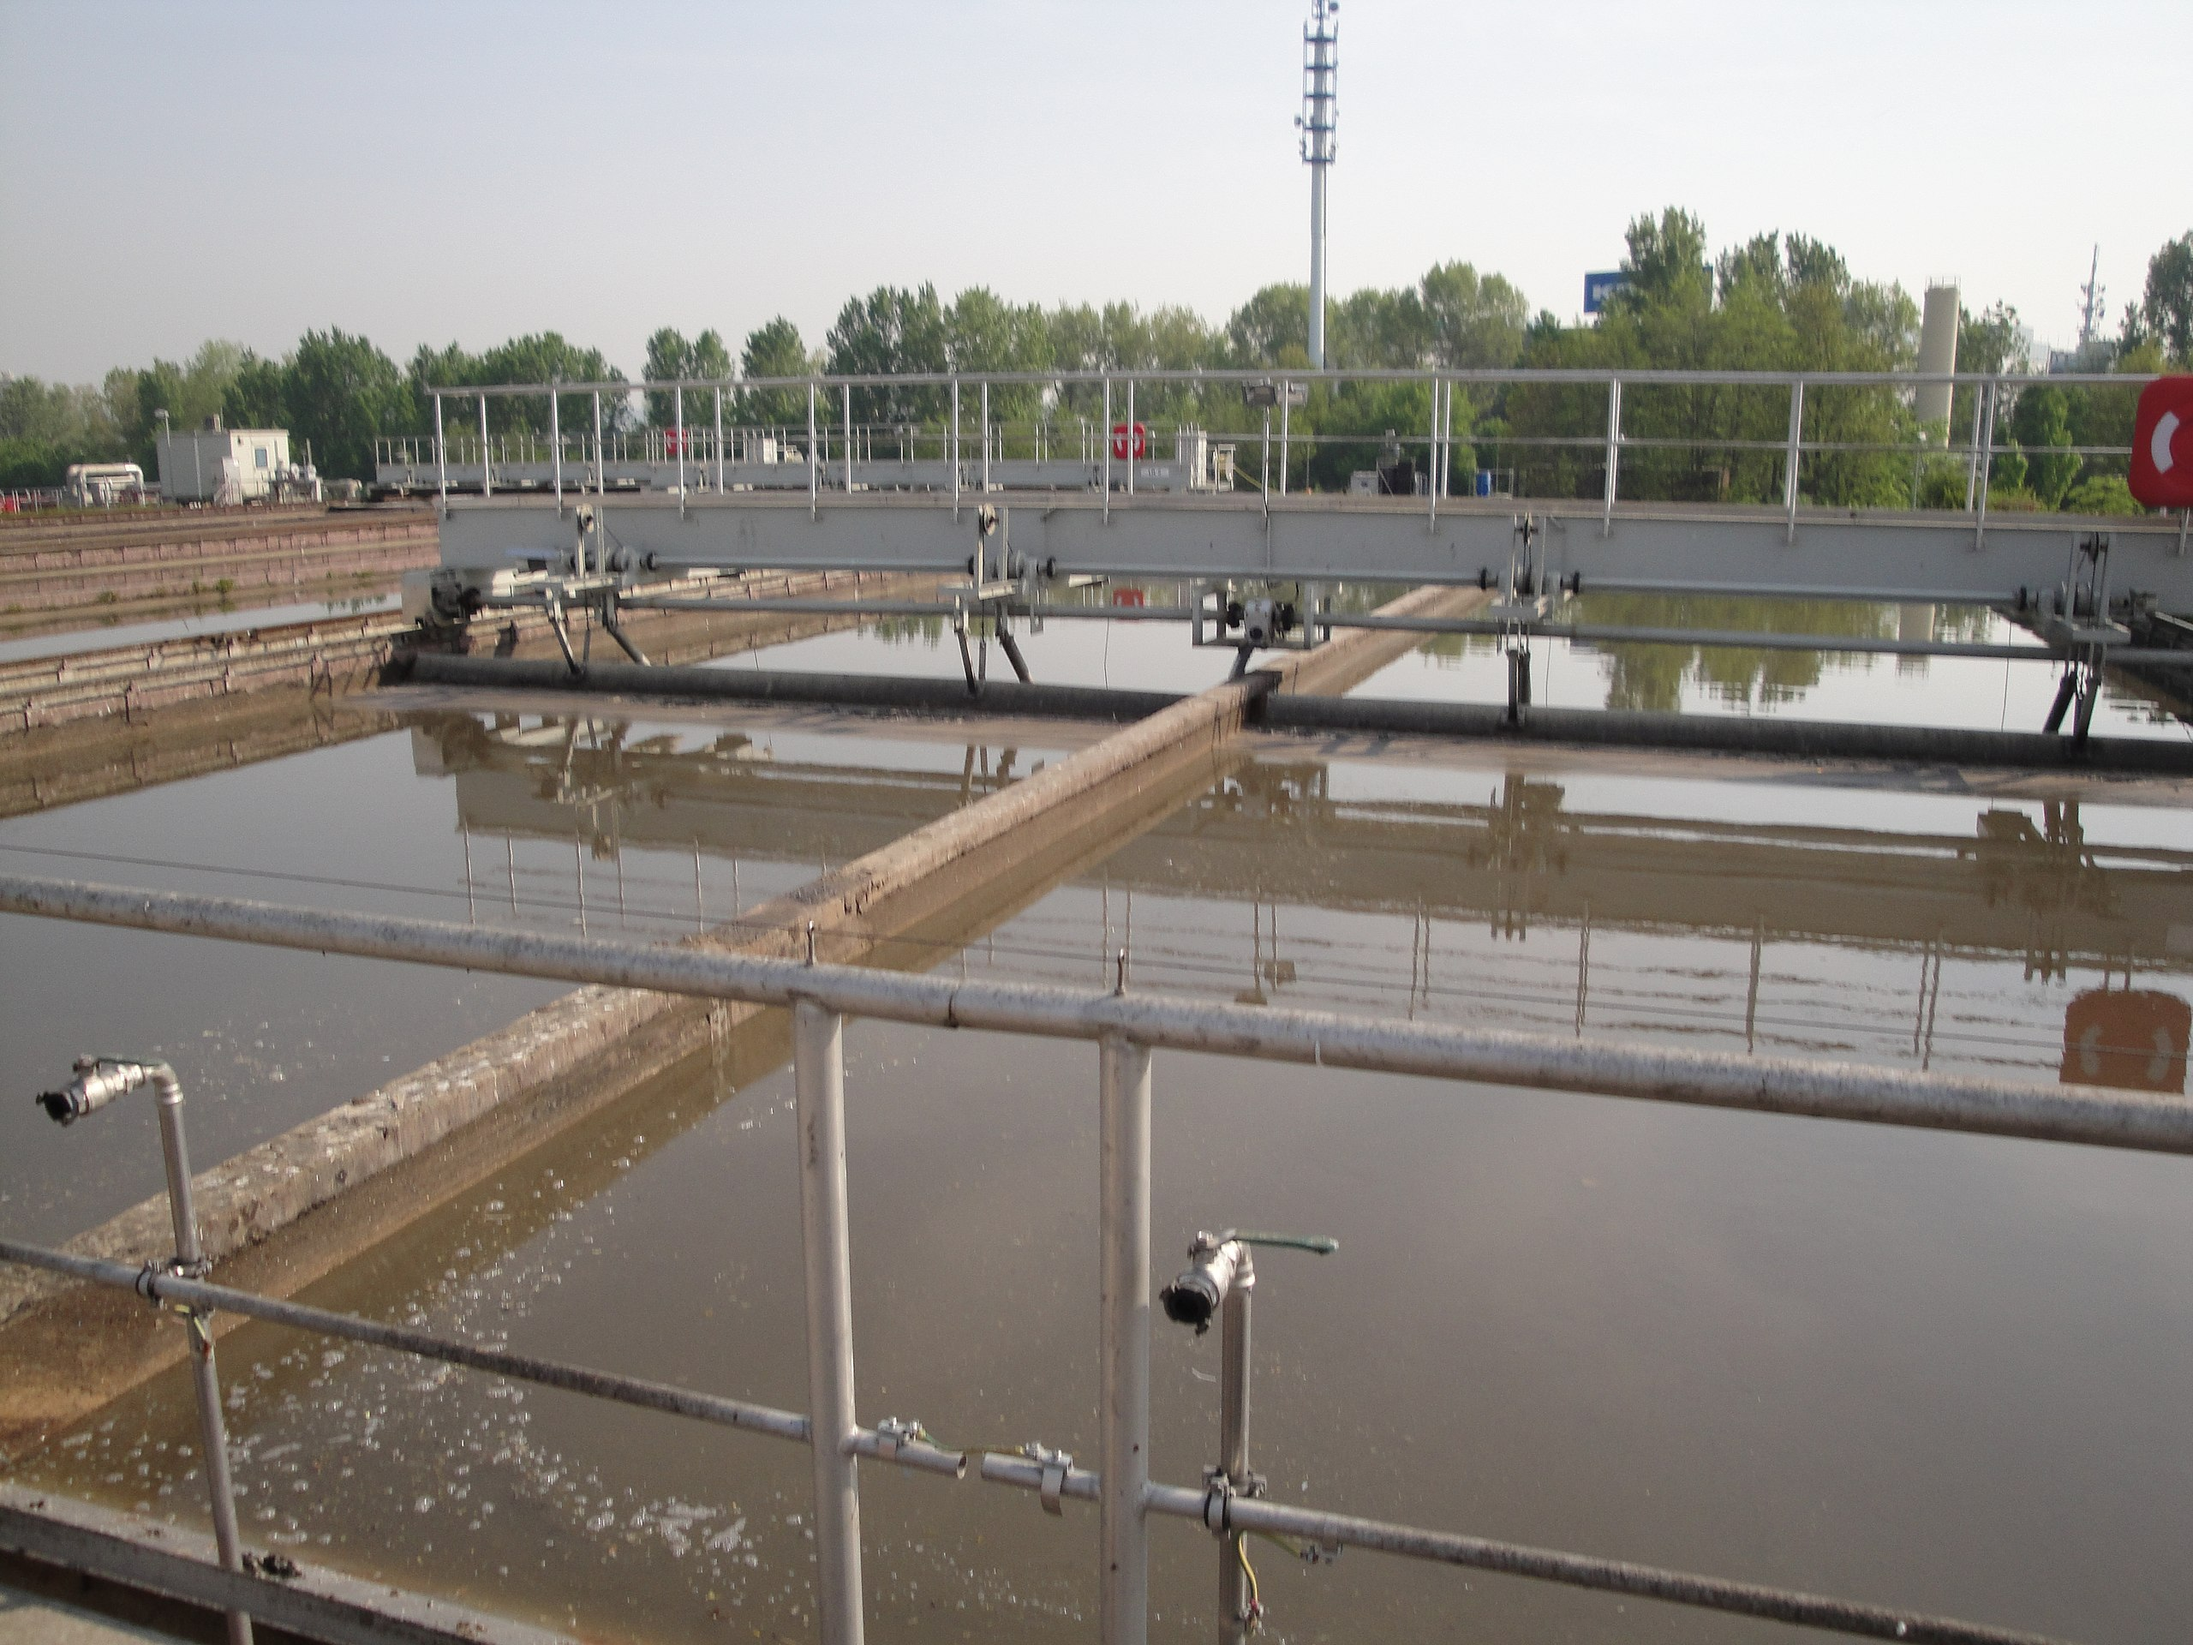
In Primary Treatment
Notes:
It’s used in Primary Treatment in primary settling tanks for TSS removal
Tank shapes vary, but the principle is the same – we’re engineering and operating structures that allow particulates that we want to fall out of the influent at a particular stage to do that. and we do that by regulating the velocity of the influent through the tank

Slide 16
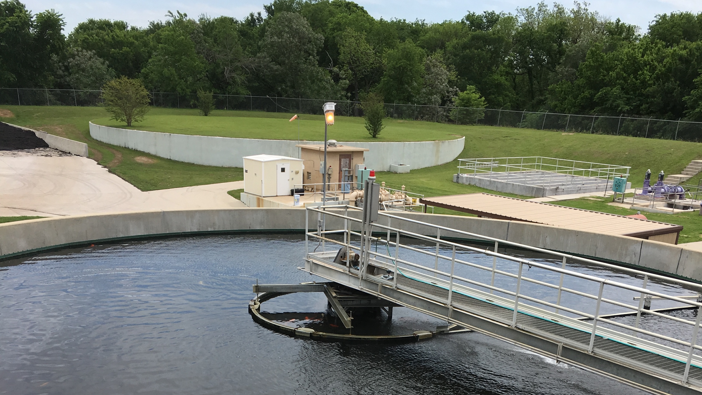
In Secondary Treatment
Notes:
It’s used in secondary treatment as well Biological floc removal in activated sludge settling basins and chemical floc removal when the chemical coagulation processa re used.
– in secondary clarifiers, after activated sludge processes to remove solids remaining in the wastewater stream prior to disinfection, dechlorination and discharge

Slide 17
Gravity Separation Theory
Type | Description | Application
Discrete Particle Settling | Low solids concentration, particles settle by gravity, particles settle individually w/out significant interaction with other particles | Grit & sand removal from wastewater
Flocculant Settling | Dilute suspensions of particles that coalesce (flocculate) during the settling process, increase in mass and settle at a faster rate | TSS removal in primary settling facilities & upper portions of secondary settling facilities; also removes chemical floc in settling tanks
Ballasted Flocculant Settling | Addition of inert ballasting agent and polymer to partially flocculated suspension to promote rapid settling and improved solids reduction (some ballasting agent recycled typically) | TSS removal in primary settling facilities; combined system influent; industrial wastewater (also reduces BOD and phosphorus)
Hindered Settling (aka “Zone Settling”) | Intermediate concentration suspensions where interparticle forces hinder settling, and the mass settles as a unit with a solids-liquid interface at the top | In secondary settling facilities used in conjunction with biological treatment facilities
Compression Settling | Where particles are so concentrated that further settling results from compression due to weight of solids being added by sedimentation | Occurs in lower levels of a deep solids or biosolids mass, such as deep secondary facilities or biosolids thickening facility
Accelerated Gravity Settling | Removal of particles in suspension by gravity settling in acceleration field | Removal of grit and particles
Floatation | Removal of particles in suspension that are lighter than water by air or gas floatation | Removal of greases and oils, light material that floats, thickening of solids suspensions
Notes:
there are actually several kinds of settling that happen in various processes within the treatment plant and although gravity is central to all of them with smaller particles we have to consider the interactions between the particles as well as gravity
The primary purpose is to produce a clarified effluent and a sludge that has a solids concentration that can be handled and treated easily
Gravitational settling can be condensed Into 4 basic categories: discrete particle settling, flocculant, hindered settling and compression settling
Go through table.
Were going to start by focusing on discrete particle settling to start with and then talk about the formulas we use to calculate operational parameters in the later primary and secondary stages to determine whether we're operating within typical parameters, because, quite frankly the math for calculating particle settling velocities of non-spehercial particles and terminal particle velocities
is a bit too complicated to cover in the time we have – so we’ll discuss what’s physically going on in those processes some typical operating parameters for those processes
and then go over some of the formulas you can use to determine whether the sedimentation processes used in primary and secondary treatment are within typical operating parameters
Metcalf page 345
Table 5-14
T
ime Check : 14 min

Slide 18
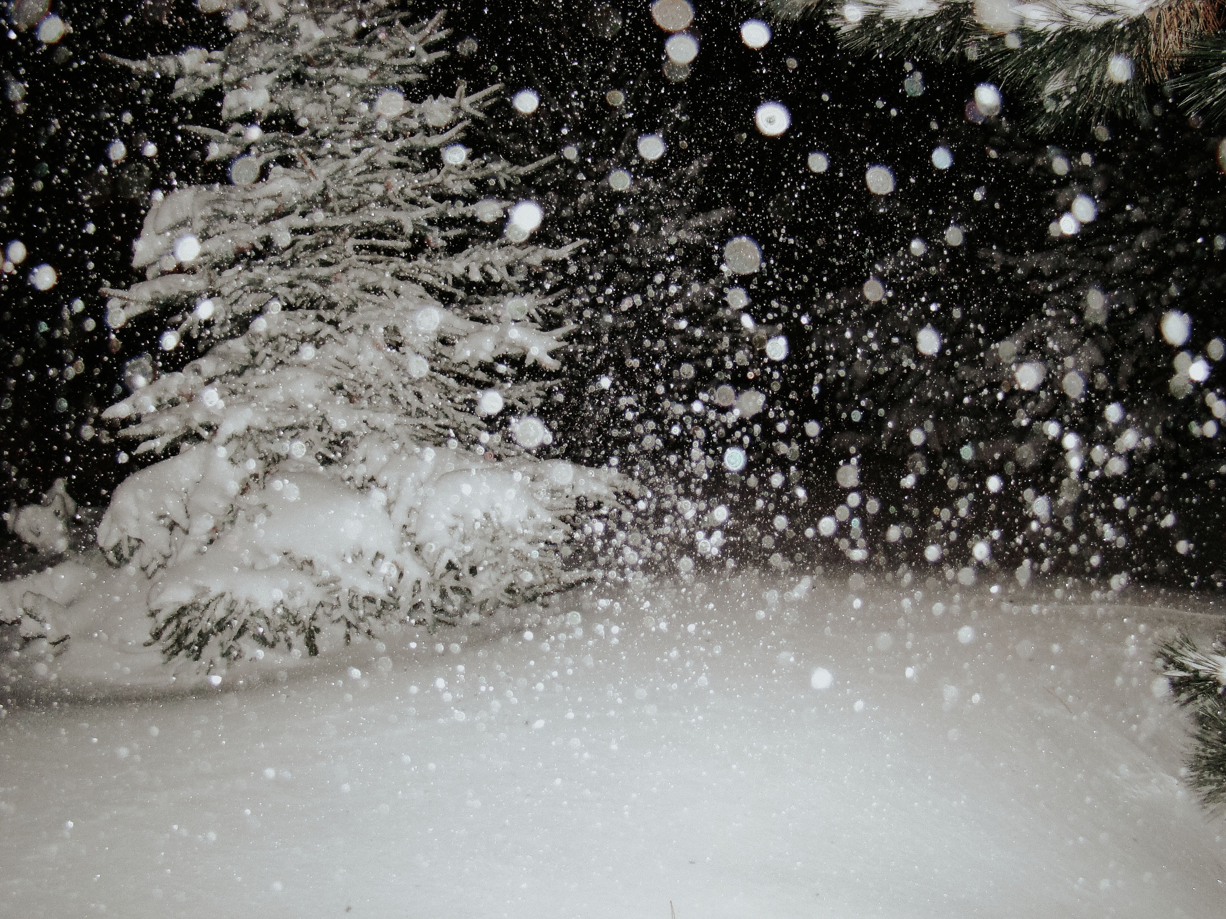
Analogous to snowfall
Notes:
Discrete particle settling is kind of like hail it just comes straight down
You can kind of thing of flocculation settling hindered settling and compression settling as analogous to what happens during a snow event
As the snow falls from the sky, the discrete flakes form together and form bigger snow flakes that fall faster
Those in turn land on the ground and as they pile the snow at the surface starts to act as a unit because the flakes are packed together
Eventually as more snow builds up the lower layers get compressed or packed together
Photo by Jasmin Schuler on Unsplash

Slide 19

Look at a snowglobe
Notes:
You can really visualize this by shaking up and looking at a snowglobe (assuming you have one out in summer) which is literally a clear crystal full of flocs.
time 15 min
Photo by Shaylyn on Unsplash

Slide 20
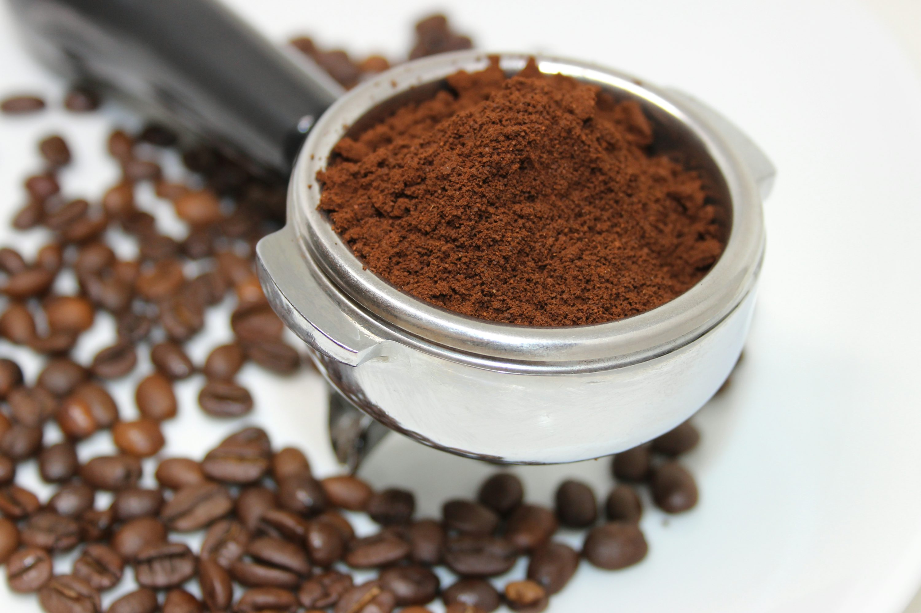
You can experiment at home with coffee grounds …

Slide 21

Poll Question
Notes:
Questions 00
Where is sedimentation used in wastewater treatment (Check all that apply)
In the collection system (last thing we want is particles settling out in the collection system because that will cause blockage that need to be cleaned)
In preliminary treatment ****
In in primary treatment ****
In in secondary treatment ****

Slide 22
Poll Question
Notes:
Question 01
Flocculation is: (select one answer)
The breakup of large particles into small particles
Gathering fine particles together to form larger particles ****
Discrete particle settling

Slide 23
Grit removal works via sedimentation
What’s grit? Heavy particulate matter like sand, eggshells, coffee grounds, bone fragments, seeds, etc.
How is it removed? Water velocity is reduced so that the heavier grit particles can settle to the bottom of the basin for mechanical removal, while lighter organic particles move to the next treatment unit
What’s the ideal water velocity for grit removal? 1 ft/sec is the ideal velocity though a range of 0.7 to 1.4 ft/sec is typically acceptable.
Notes:
start with grit removal - remember this is discrete particle settling because it's the easiest to model
Different books provide slightly different ranges – you might also see 0.8 to 1.3 in some references.

Slide 24
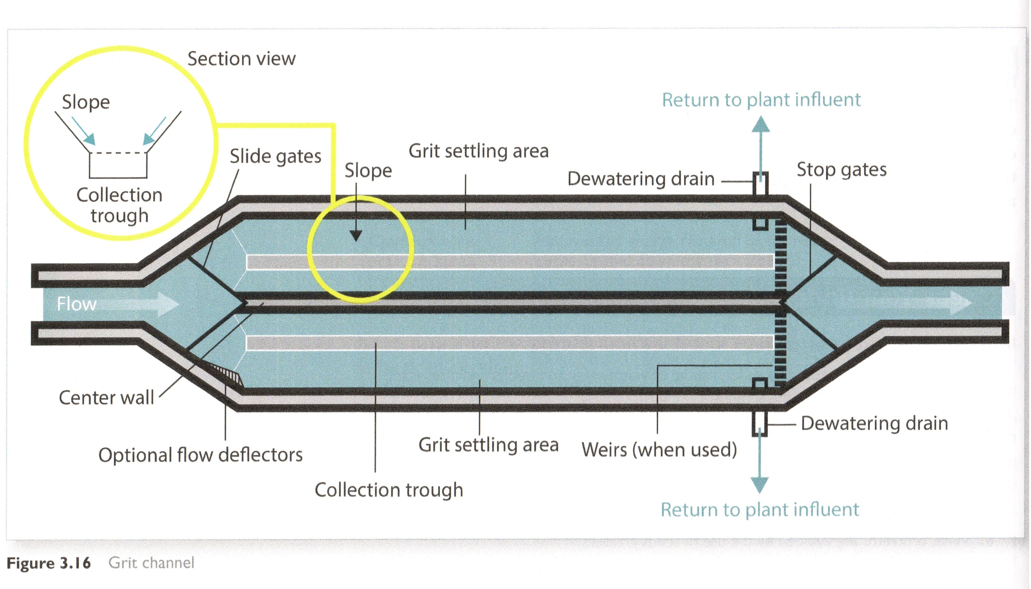
A little review: Grit Channels
Source: Operation of Wastewater Treatment Plants, Vol 1, 8th Edition, Sacramento State, 2019
Notes:
At 1 ft/sec velocity (or close to it) the grit, which consists of heavier solids, can drop out of the flow stream and settle on the bottom of the channel in the collection trough
BUT, and this is VERY important, the organic suspended materials in the influent will not settle out
At that demosntrates\ the fact that not everything settles at the same rate. different particles are going to settle at different rates, we can facilitate that by dialing in flow velocities,
and we can exploit that to target the heaviest grit first while letting the organics get by and we'll get into that a little bit deeper in a second
If the design of a grit channel is right and it's operated within the correct parameters (not too fast, and not to slow) you'll trap the inorganic grit, but let through the organics so they can be treated effectively in the primary and secondary treatment stages.
Taht's important, becuase if the organics settle out in the grit they can create odors and attract vermin when the grit is removed, and if the grit isn't captured in the channel it will plug up your primary and possibly secondary tanks and processes
Now that we've got the concept and theory down – let’s look at a litte basic math
this is a typlical grit channel set up and let's assume that for whatever reason we're just using one of these channels and the flow is 4 feet deep

Slide 25
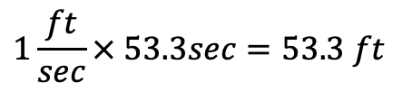


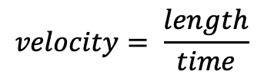


Grit removal via sedimentation
Designed to remove 0.2mm sized sand and heavier particles
They typically settle downward at about 0.075ft/sec
Imagine a 5 ft deep basin with 4 ft of water in it
s$ettling time= \frac{depth}{settling rate}$
Flow Velocity
s$ettling time= \frac{4 ft}{0.075 ft/sec}$
s$ettling time=53.3 seconds$
Settling rate: 0.075 ft/sec
Particle Path
$$velocity= \frac{length}{time}$$
$$velocity × time=length$$
$$1\frac{ft}{sec}× 53.3sec=53.3 ft$$
Notes:
We didn’t really go into the math last time as it was more of a process overview but we’ll cover a bit more of that today since the concepts are the same and it’s a good introduction to sedimentation in general and discrete particle settling ins specific,
Let’s say our grit typically settles at a rate of about 0.075 ft/second. CLICK. (for the sake of this example, take it as written that 0.075ft/second is the rate our grit settles out at)
Settling time is how long it takes to drop from the top to the bottom of the 4 foot channel. It's important to remember we’re talking about the water depth here, which will be less than the actual channel depth
We can calulate the settleing time by dividing the depth of the water (4 ft) by the settling rate ( 0.075ft/sec) whcih gives us 53.3 secionds
This calculation tells you that you’ll need 53.3 seconds for the grit entering suspended at the top of the flow to settle to the bottom
But the water is flowing through the basin at some velocity. CLICK
That means the basin has to be long enough for those particles settle out before they leave the basin in the effluent stream
-
and since the particle is moving, it will follow a diagonal path. (CLICK)
So hopefully your tank islong enough so that the flow velocity of about 1ft per second doesn’t take the particles out of the basin before they’ve sunk to the collection trough –
Lets do the math on how long the basin would have to be at that ideal 1 ft/s we talked about
Click through formula
Veloicity = length / time (as in ft/sec). time units cancel leaving us with distance
SO (theoretically at least) WOITH THESE VALUES THE CHANNEL WOULD HAVE TO BE 53.3 FT LONG IF OPERATING AT A 1 FT/SEC FLOW RATE.
It’s worth pointing out, that your settling rate might be a bit different,
BUT OF COURSE YOU CANT RANDOMLY CHANGE THE LENGTH OF THE BASIN
So let's take this a step further and see how we would set the influent velocity in a tank of a specific length to make sure it's doing what we need it to.
CLICK
Time Check: 21 min.

Slide 26
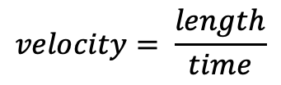

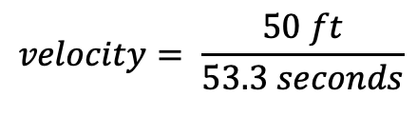

Grit removal via sedimentation
The flow has to be slow enough to let those particles settle to the bottom of the channel before it ends.
Of course, you’re stuck with the channel length you have.
Let’s say it’s 50 feet long. What’s the maximum velocity for removal?
s$ettling time=53.3 seconds$
Flow Velocity
$$velocity= \frac{length}{time}$$
Settling rate: 0.075 ft/sec
Particle Path
$$velocity= \frac{50 ft}{53.3 seconds}$$
$$velocity=0.94 ft/sec$$
The maximum velocity of your flow in the channel is 0.94 ft/sec
Notes:
For example, perhaps the reason we started digging into this is that we know our 50 foot. basin is running at 1 ft per second but we also know that too much grit is getting into the primary tank
and you’re trying to figure out why
As we’ve established in the prior slide 1 ft/second x 53.3 seconds is 53.3 ft. Based on a 1ft/sec velocity the 50 ft basin might be too short.
So how could we dial in the grit removal process to be more effective. Well, we could determine what the max flow velocity is for that 50 ft,channel
So what I'm saying here is if the particle is going to take 53.3 seconds to fall to the bottom (and I can't change that because the settling rate is what it is) what I can do to ensure that the particle settles out in the 50 ft channel, is to slow the flow velocity down so the particle stays in the channel for 53.3 seconds.
And i can figure out that velocity by dividing the length of the channel by the settling time I established in the prior calculation
What’s the maximum velocity for GRIT removal in this particular channel?
We have established the settling time 53.3
Velocity is length divided by time
We know the length of the basin 50 ft
Velocity is .94 ft/sec, so a bit slower
So the next question becomes, is that within the appropriate velocity range that's determined to be effective for grit removal?

Slide 27
Grit removal via sedimentation
The next question is: Will that velocity of 0.94 ft/sec be effective?
Item | Range Metric | Typical Metric
Detention Time | 45 - 90 seconds | 60 seconds
Horizontal Velocity | 0.7 – 1.4 ft/s | 1 ft/s
Settling Velocity (50 mesh) | 9.2 – 10.2 ft/min | 9.6 ft/min
Settling Velocity (100 mesh) | 2 - 3 ft/min | 2.5 ft/min
Headloss (% of channel depth) | 30 – 40% | 36%
It’s in the right range
Source: Operation of Wastewater Treatment Plants, Vol 1, 8th Edition, Sacramento State, 2019
Notes:
So the next question becomes, is that within the appropriate velocity range that's determined to be effective for grit removal? Because remember we want to get the grit out and leave the organics in.
Fortunately we can look these metric ranges up
The practical velocity range for grit removal is between 0.8 and 1.3 ft/second –
And the practical detention time (which we calculated as 53 seconds) is also ok
so we’re probably ok
But as with all things, there is theory and there is practice. Something might not have been designed quite right, or maybe it’s not operating as intended so you may still have to make process adjustments based on your observations.
But with these relatively simple formulas and metric ranges you can do some math and make some modifications based on logic.
Maybe you realize that you need to run both channels at high flows and one at low flow.s. maybe you should open both channels and run with only 2 foot deep flow

Slide 28
Grit removal via sedimentation
What other options are there for us to get to the ideal 1 ft/sec if that were determined to be necessary?
Adjust the inflow?
Lower the water depth in the channel by opening the other one?
Alter flow equalization practices
Other options?
What could work?
What would be practical?
Notes:
Maybe the key for your particular operation
Is to adjust the inflow rate
is to open that second channel so that the flow is distributed between the two, thereby leaving the water at a lower depth, becuase you,re distributing the flow over two 50 foot channels instead of one.
Maybe you could make changes in your flow equalization processes if you have them
It's also worth pointing out that not every particle is going o be at the top of the water column - some grit particles will take almost no time to sink to the bottom maybe you adust the wiers at the end
or maybe you slow down the flow knowing you're going to trap some unwanted organics, but add a grit washing stage or replace the channles with a cyclone
A drastic change like that might be necessary if for example your system was designed for a smaller population than you currently serve
My point here is not to give you the difinitive answer to solve the problem of excess grit showing up in your primary sedimentation tank
The point here is to show that you can use some basic math and observations and understanding of the sedimentation process to determine whether your system is operating within typical parameters, or the the specific design parameters of your system, and whether prospective changes might be feasible ND HAVE THE RESULTS THAT YOU INTEND
Time Check 26 min

Slide 29

Aerated Grit Chamber
Influent enters perpendicular to axis of basin
Aerating disburses air into the wastewater to lower velocity
The air water mixture has a lower specific gravity than water alone – this causes the grit to settle out better
The rolling action of water in the tank also moves grit toward to bottom
Aerated grit chambers have low detention times – in the 3-to-5- minute range
Water Surface
Notes:
If you were designing a new grit removal system you might not go with a conventional design.
I mentioned earlier that we can use engineering to facilitate sedimentation – of course we’re typically talking about design phase considerations here
A differently designed grit chamber may allow you to alter the parameters you are working with. The grit channels in our prior example rely entirely on gravity and velocity for sedimentation
The aeration in an Anaerated grit chamber, among other things effectively lowers the specific gravity of the influent – an air water mix has a slightly lower specific gravity than water alone which makes the grit settle out better. (Call back to our regs and safety webinar – this is the same reason that you’re likely to sink in a aerated activated sluge tank if you fall in – the aerated water is less has a lower SG than water alone which means youy are relatively less buoyant in it and sink ealseir.
In an aerated grit chamber you ma recall that the wastewater enters at a tangent
The air bubbles make the water less dense and the spiral pattern the water is flowing in actually helps grit settle out at the bottom
But the same principles are at work here as in the plain channel – just being aided by some fancier engineering.
That also gives you additional parameters to play with, now you have velocity and detention time, but ther's also the mechanical action of the flow pattern moving grit to the bottomw and the change in influent specific gravity to help0 it stay there.
I want to point out that I am not suggesting that you can retrofit a simple grit removal channel to be an aerated one. Just pointing out that there are addtional parameters at work.
So that's the math behind discrete particle settling Lert's move on to some of the more complicated sedimentation processes that happen in primary treatment
Time Check: 28 minutes

Slide 30

Quick and dirty flow velocity estimation
Use a stick: Measure the time it takes to travel from one end of the basin to the other. v = d/t
Notes:
Photo by Rob Fuller on Unsplash
Use a stick: Measure the time it takes to travel from one end of the channel to the other (assuming of course that . v = d/t
The average velocity will probably be just a bit slower than what you calculate

Slide 31
In Primary Treatment
Notes:
Lets talk about sedimentation in the context of primary clarifiers – this is going to take up the bulk of the discussion
Primary clarifiers are designed to physically remove solids that will settle easily to the bottom or float to the top, but sedimentation is usually the principal basis of design for clarifiers
Ane what wer'e focussing on here ins TSS
One of the main reasons we focus on settling out TSS or organic solids in the primary treatement phase is because they will have a high BOD – biochemical oxygen demand on the receiving waters and subsequent biological treatment units
If a clarifier is sized correctly most particles with an SG of 1.05 (meaning SG is 5% higher than that of water) will settle to the bottom if the flow is slow enough (in the 1 to 2 ft/min range) and the tank is large enough – and most organic solids are within that 5% range. But because the SG is so close to water that means settling rates are VERY slow
Let slook at the basic math related to this type of settling
Water SG is 1 at 39 F or 4.0 C and decreases slightly as water gets warmer – its about 0.998 at 70 degrees
Side note – water is weird because when it freezes the specific gravity goes down – ice at 0 degrees has an SG of about 0.82 while water at 0 degreees has an SG o 0.99 which is why ice floats.

Slide 32


Primary sedimentation
Targeting particles with Specific Gravity between 1.01 and 1.05
Assume settling rate of 0.167 ft/min or 0.0028 ft/sec
Assume horizontal flow velocity of 2 ft/min or 0.033 ft/sec
Basin is 200 ft long with 10 ft of water in it
s$ettling time= \frac{depth}{settling rate}$
Flow Velocity
s$ettling time= \frac{10 ft}{0.167 ft/min}$
s$ettling time=60 min$
Settling rate: 0.167 ft/min
Particle Path
Notes:
We're targeting those low SG particles - so we're going to use the same formulas but very different time frames.
Le'ts assume a settling rate of 0.167 ft/min accounting for the fact that these particles have much lower SG and may be interacting with each other.
This Recall that in the grit removal example we were taking about settling rates of 0.075 ft per second which is over 4.5 ft per minute, we're order of magnitued slower settling her
Lets a ssume a flow velocity of 2ft/ min (.033 ft/sec) – recogfnize that this is MUCH slower than grit removal velocity – there were were talking about 1 ft per SECONS as the ideal flow velocituy
Thypically the ragne is 1 to 2 feet per min but lets assume 2 for our example CLICk
And since we know ththe particle is moving horizontally , it will follow a diagonal path to the bottom.
Notice also that in this cAse Im using minutes as the time, not seconds like I did in the grit example because the downwatrd settling is so slow we’d end u with really big numbers using seconds,.
CLICK to show formula
Settling time is how long it takes to drop from the top to the bottom of the 10 foot channel. Again we’re talking about the water depth here,not the basin depth
We can calculate the settling time by dividing the depth of the water (10 ft) by the settling rate ( 0.167ft/min) which gives 60 minutes (or 1 hour) – much longer than our grit which was lcoser to 60 seconds.
So the question is where in our 200 ft long tank will the sediments land
If the tank is 200 ft long and the water is flowing at 2 ft per min it’ll take 100 min (1 hour 40 minutes for water to floe flow from one end to the other

Slide 33


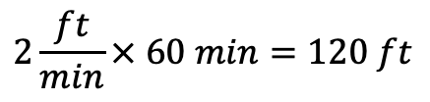

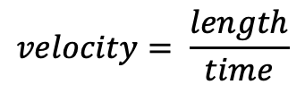
Primary sedimentation
Targeting particles with Specific Gravity between 1.01 and 1.05
Assume settling rate of 0.167 ft/min or 0.0028 ft/sec
Assume horizontal flow velocity of 2 ft/min or 0.033 ft/sec
Basin is 200 ft long with 10 ft of water in it
$$settling time=60 min$$
What’s the horizontal distance traveled?
Flow Velocity
$$horizontal velocity=2 ft/min$$
$$velocity= \frac{length}{time}$$
Settling rate: 0.167 ft/min
Particle Path
$$velocity × time=length$$
$$2\frac{ft}{min}× 60 min=120 ft$$
Notes:
Click
We've established our settling tim is 60 minutes (CLICL)
what's the horizontal distance traveled by our particles? (CLICK)
We know the velocity is 2 ft /min (CLICK)
and we know velocity is length or distance divided by time (click)
we cna re-arrange that formula to give us a lenght or distance traveled by mulitplying horizontal velocity by the settleing time (CKLICK)
that gives us
2 ft/min x 60 min or 120 ft
CLICK (check the units, were good)
CLICK
Time Check: 30 min.

Slide 34
Primary sedimentation
So, what does that mean?
Particles settling at this rate will settle within first 120 ft of 200 foot tank (first 60% from inlet) and water exiting will be clearer
Flow Velocity
10 ft
Particle Path
60 min
120 ft
100 min
200 ft
Notes:
So that means that in our 200 ft long tank it takes 100 minute for water entering at the left side to leave the right side, but the particles suspended in that water should be settleing on the bottom of the tank within an hour, or the first 120 feet
Which means most of my particles should end up in here (click) though of course that’s not gonna catch everything and ther weill be solids out near the edge here (point)
but the wastewater going on to the next stage will have significantly lower solids concentrations than it had when it entered the basin, and because we're typically removing water through a weir in the upper portion of the tank most of what's in the tank will have settled. Even much of the ligther material
I mentioned not everyting is going to get trapped in the the settling tank and one way you can verify removal efficiency is with lab testing
But you can also calculated an expected removal efficiency empirically
CLICK
time - 36 min

Slide 35
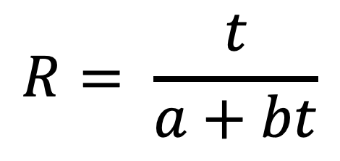
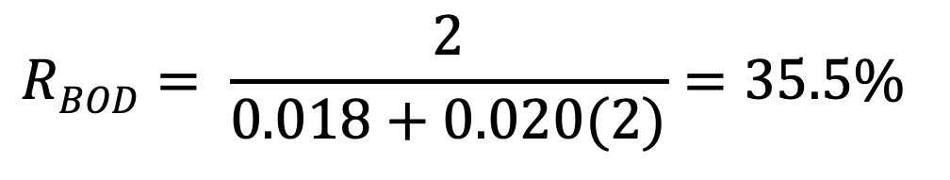
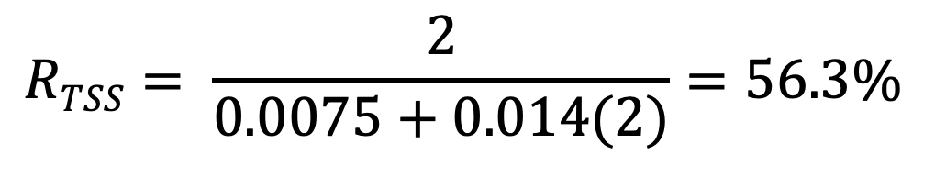
Sedimentation Tanks Expected Removal Efficiency – 2 hr DT
$$R= \frac{t}{a+bt}$$
R = expected removal efficiency
t = nominal detention time (hrs)
a, b = empirical constants
BOD and TSS removal:
50 to 70% of TSS
25-40% of BOD
Item | a | b
BOD | 0.018 | 0.020
TSS | 0.0075 | 0.014
$$RBOD= \frac{2}{0.018+0.020(2)}=35.5\%$$
$$RTSS= \frac{2}{0.0075+0.014(2)}=56.3\%$$
Notes:
So what kind of removal rate can you exptect?
DTS are typically in the 1.5 to 2.5 ranges
might use shorter times 0.5 – 1 hr removing less solids sometimes use for preliminary treatment ahead of biological units
CLICK
BOD and TSS removal effiency is tyopically in the 50 -60 range for tss and 25 to 40 range for BOD
You can use this formula
CLICK
to estimate TSS and BOD removal rates using the nominal detention time in hours and
CLCIK
the empoirical constants for BOD and TSS
So for a 2 hour detenbtion time this is how I would expec thing sto wash out though actuyal performace will vary. But a formaula like this can give yuou an idea o
wat you should be sseing and you can compare that to test results and also evaluate the impact of deteintion time changes
Our prio example had a DT oif 1hr 40 min so 1.66 hrs, that would ofcourse result in a lower expected removal efviciendy

Slide 36
Poll Question
Notes:
Question 03
The specific gravity of water is 1. If a particle in the wastewater effluent has a specific gravity of 2.5, what is it likely to be?
Grit (like sand, or glass)
Organic suspended solids
Fat or grease

Slide 37
Detention Time
Settling tanks are typically designed for 2 to 3-hour detention times (though designs may vary)
Operator experience comes into play when actually running the plant because flows can increase or decrease suddenly, and organic loads can vary as well
Can calculate theoretical detention time using tank volume and flow rate
Can verify using dyes, tracers or floats
Actual detention times are often shorter than the calculated theoretical time
Notes:
So I mentioned earlier that detention time is much longer in primary sedimentation tanks that grit remvoal and now whe know why (
when we’re talking about detention times for clarifiers they are typically in the 2 to 3 hour range (CLICK)
Operator experience .... (CLICK)
Detention times can be calucluated using tank volume and flow rate (we covered that in a prior session) (CLICK)
You can verify your calculations with dyes tracers or floats (CLICK)
Of course actual detention times can be shorter becuase flow is going to vary

Slide 38
Detention Time
If you have a detention time of less than 2 hours and lab tests are showing poor solids removal, you may need to add tanks, or restrict flow to solve the detention time/solids removal problem
Detention times are going to vary considerably between day and night
This is one reason some systems use flow equalization techniques in preliminary treatment
Notes:
If you have a detention time of less than 2 hours and lab tests are showing poor solids removal, you may need to add tanks, or restrict flow to solve the detention time/solids removal problem.
click
Recognize that detention times are going to vary considerably between day and night –
cilick
again this is one reason systems use flow equalization techniques to even out flow and make processes more predictable
I’m not going to cover calculating detention times today because we already covered that in a prior webinar on wastewater math that you can review on line. But I will talk about other parameters that are used to determinine whether clarifiers are hydraulically overloaded (and therefor won’t have the expected or designed sedimentation efficiency
Thje forst of thse is the weir loading rate

Slide 39
Horizontal Flow Design Criteria for Sedimentation
Item | Typical Horizontal Grit Channel | Typical Primary Settling Tank
Detention Time | 1 to 3 min | 2 to 3 hours
Horizontal Flow Velocity | 0.7 to 1.4 ft/s | 1 to 2 ft/min
Specific Gravity of Particles | ~ 2.5 to 2.6 | <1 to 1.25
Notes:
So just to hammer home the differet issues (can skip)
Typical detention time in a primary clarifier is 2 to 3 hours – though as I often say, this is a “your millage may vary” kind of situation because that time may vary due to conditions like increased flows and changes in organic loads.
Note that flows are going to change quite a bit during peak vs low flows so detention time can vary, and any detention time you calculate at a given flow is for that specific flow,
This is one of the reasons some plants have flow equialization (which we touched on briefly during the discussion of preliminary treatment a few weeks ago) so that flows can be evened out – a byproduct of even flow is more even and predictable detention times.

Slide 40
Primary sedimentation
Particles settling at this rate will settle within first 120 ft of 200 foot tank (first 60% from inlet) and water exiting will be clearer
Flow Velocity
10 ft
Particle Path
Weirs
60 min
120 ft
100 min
200 ft
Notes:
What I left out of the picture erlier was the weir that water flows out of the tank over. which in a horizontal tank mifth be here (where these orange bars are, and there may be more than one in a rectangular tanl
typiclly the water is going to be flowing over a wier near the end becuase the top layer of water is going to be the clearest layer
Scouring (which we talked about in the context of grit removal in the preliminary treatment webinar) can be an issue here as well, we don't want the water leaving so fast that it pulls particles up from the bottom
As we establishec before MOST, but NOT all of the particles will fall out in the fitsty 60% in our esample, but there are going to be lighter particles and could be weird currents or short circuiting because of temperature gradients going on that are carying particles further toward the end of the tank than our calculation would indicate - one way we mitigate (and prevent scouring of the bottom of the tank) is to h
Antoher reason we want the particles to settle sooner is that the weir often isn’t at the edge of a rectanglular clariflier or the perimeter of a round one. It may be inset.
ave thew water flow over a weir near the end or edge of the tank,

Slide 41
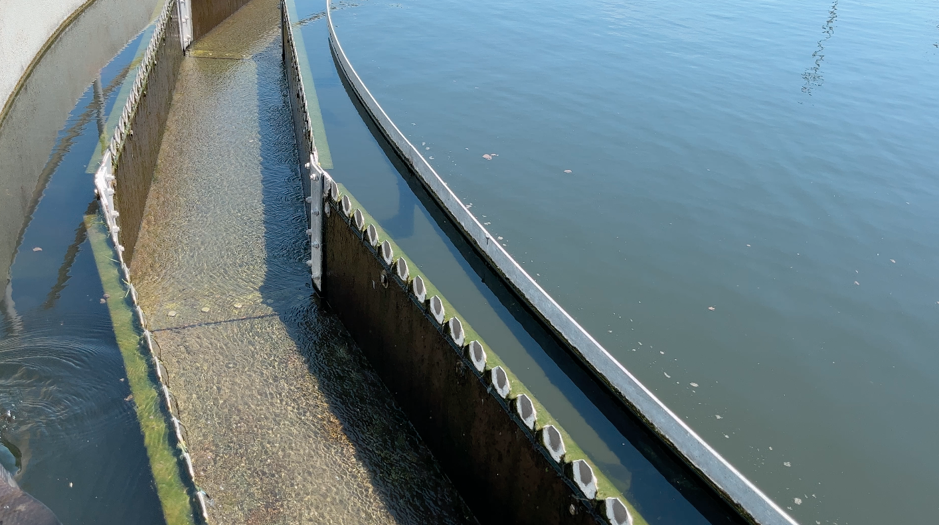
Wier Loading Rates
TROUGH
BASIN
WEIR
Notes:
This is a pretty good view of what you’ would see on tje edge of a round clarifier (the water here is moving right to left
there will be a trough with a weir that lets water from right near the surface pass on to the next treatment stage
You can see the white ring is a baffle that catches anything floating on the surface so that the skimmer arm can grab it
A rectangular basin would typically have one or more straight weirs neareTHE End of the a rectangular basin or
Notice the difference beween the water in the basin (click) (NOTE THAT THIS IS AN IMAGE OF A SECONDARY CLARIFIER BUT THE CONCEPT IS THE SAME)
VERSUS
the water in the collection trough (CLICK)
The basin water is cloudy, the trough is almost crystal clear.
Now someof that has to do with the depth of the water in the basin,but most of the difference is due to the fact that there are still particles settling out in the lower levels of the basin (which you can see) where as, but the time it gets to the weir and goes over there’s almost nothing in that layer of water.
becuase we have a long weir with nottches in it the velocity going over the weir is low and we're not scouring.
so the the loading rate is a design parameter used to ensure that we're not dragging excess particulates out of the tank
so that such that it’s clarified (though in the primary stage, not necessarily clear) water going over on the weir to the next treatment stages.
The parameter we use to determine whether the right amount of water is going over the weir is the weir loaiding rate
The linear feet of weir relative to the flow is really important tp prevent short circuits and high velocities near the weir which might actually pull settling solids over and out

Slide 42
Wier Loading Rates
Number of lineal feet of weir on the clarifier in relation to flow
Weir Loading Rate is what volume flows over 1 linear foot of weir per day
Typical design parameters are 10,000 to 20,000 GPD per foot of weir
Might be higher for fast settling solids or intermediate treatment
Secondary clarifiers and higher quality water will require lower WLRs that what’s acceptable for primary clarifier
Notes:
The linear feet of weir relative to the flow is really important tp prevent short circuits and high velocities near the weir which might actually pull settling solids over and out

Slide 43
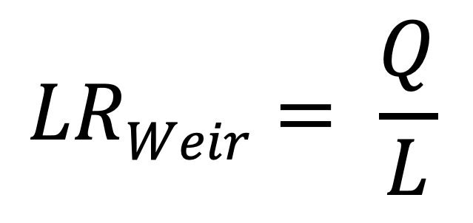
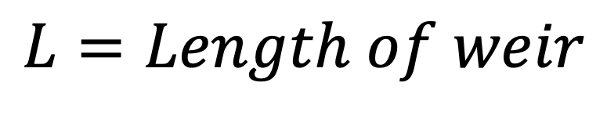
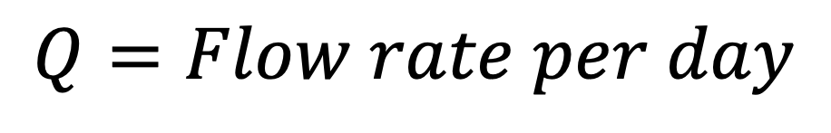
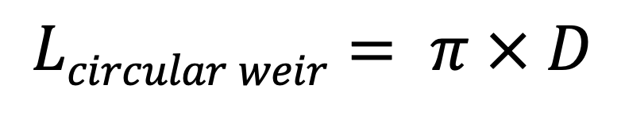
Wier Loading Rates
So how do we calculate it?
$$LRWeir= \frac{Q}{L}$$
$$Q=Flow rate per day$$
$$L=Length of weir$$
Note that for a circular basin:
$$Lcircular weir= π × D$$
Notes:
Lo the WLR is simplhy the flow per day (Q) divided by the linear length of the weir the water is flowing over
which normalizes this to a volume per foot of weir

Slide 44
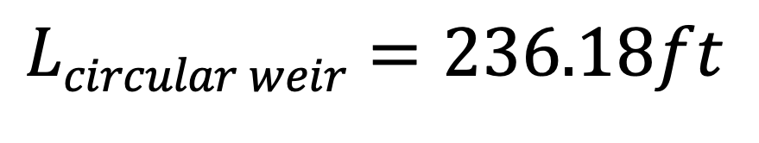
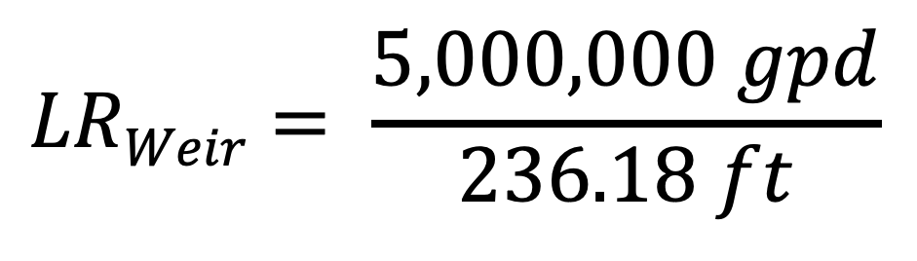
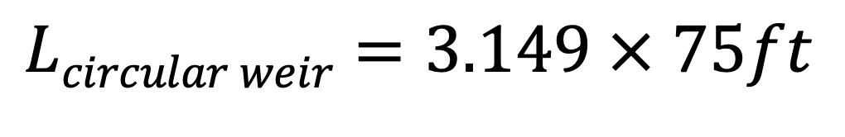
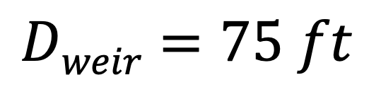
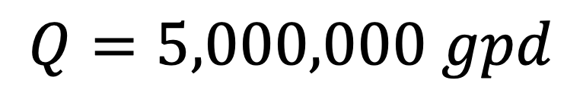
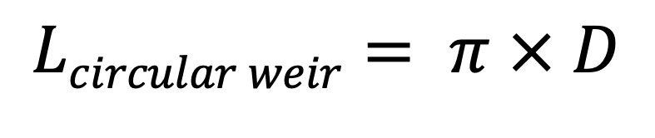
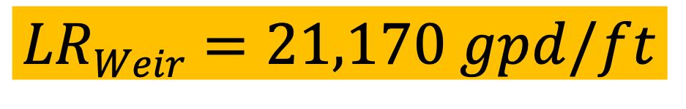
Wier Loading Rates Example
$$Dweir=75 ft$$
$$Q=5,000,000 gpd$$
$$Lcircular weir= π × D$$
$$LRWeir= \frac{5,000,000 gpd}{236.18 ft}$$
$$Lcircular weir=3.149 × 75ft$$
$$Lcircular weir=236.18ft$$
$$LRWeir=21,170 gpd/ft$$
Typical design parameters are 10,000 to 20,000 gpd/ft
This might be a problem.
Notes:
TLets do an example
Lets say I have a round clarifier
Remember – we’re talking about the wier diameter, not the tank diameter – tank is going to be larger
Might – I say might because we’re only about 6% outside the typical range
Depending on the situation the loading rate might be acceptable, but it might also indicate that flow rates are higher than what the plant was designed for and that you may have to do some compensating for that change.

Slide 45
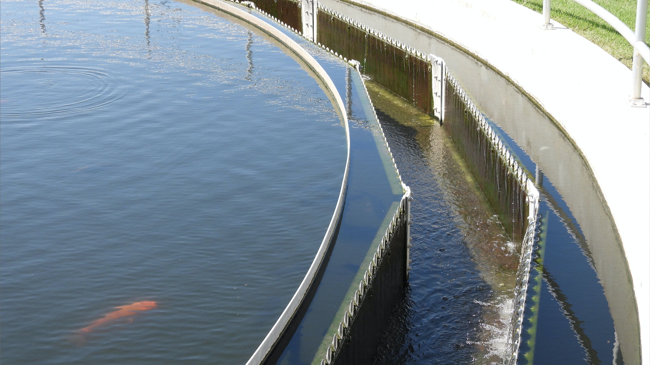
Notes:
So would that calculation work on this particular clarifier?
NO – first off the weir isn’t round, though it’s probably close enough to round so that you could go with that,
But the big issue is that this clarifler has Wiers on BOTH SIDES OF THE COLLECTION TROUGH. There’s water goong over both sides of the trough, SO IT’S NOT just a single weIr with the ouSide edge of the tank forming the outer trough barrier, THAT WE HAVE TO ACCOUNT FOR, BUT TWO WIERS both the inner and outer (which are connected below)
which means if you only accounted for one wier in your calculation your off by half

Slide 46
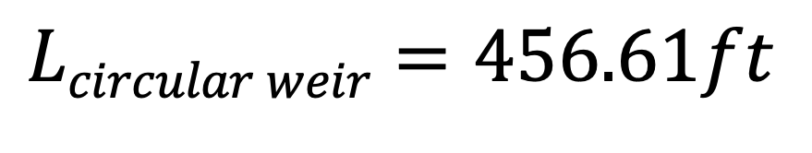
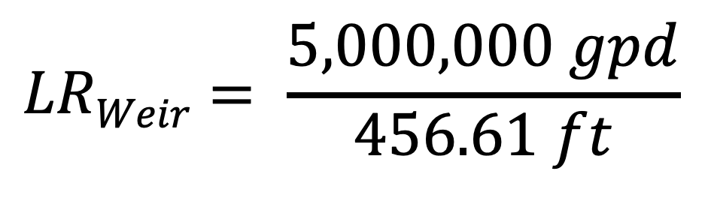
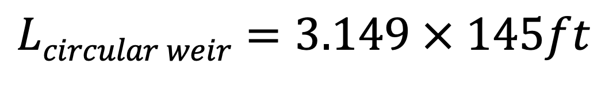
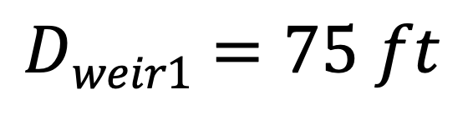
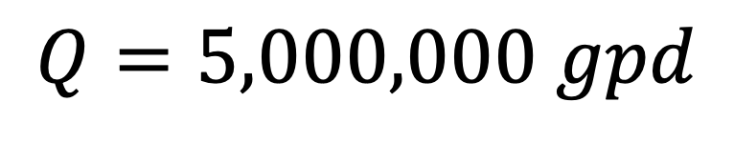
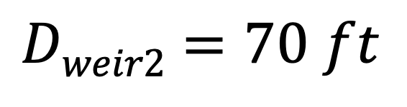
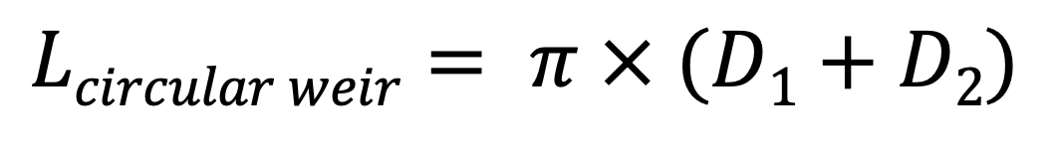
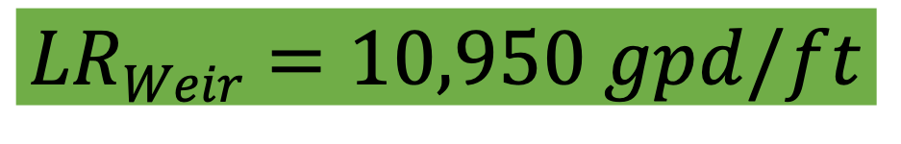
Wier Loading Rates Example
$$Dweir1=75 ft$$
$$Dweir2=70 ft$$
$$Q=5,000,000 gpd$$
$$Lcircular weir= π × (D1+D2)$$
$$LRWeir= \frac{5,000,000 gpd}{456.61 ft}$$
$$Lcircular weir=3.149 × 145ft$$
$$Lcircular weir=456.61ft$$
$$LRWeir=10,950 gpd/ft$$
Typical design parameters are 10,000 to 20,000 gpd/ft
We’re are within typical design parameters.
Notes:
This is right in the typical parameters. Again, you aren’t just going to look at weir loading rate, you'd look at detention time, surface loading rate etc, but they're all related and can be used to evaluate performance and determine whether your system is working within typical design parameters or the specific parameters of your system

Slide 47
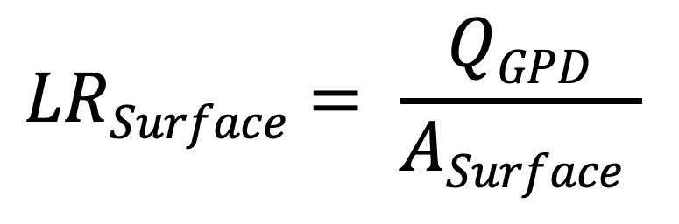

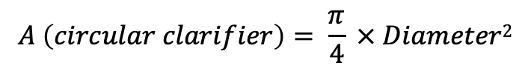

Surface Loading Rates aka “Overflow Rates”
GPD per ft² of clarifier surface area
Typical range is 300 to 1200 GPD/ft² depending on solids and treatment requirements
In cold regions low surface loading rates are common for small plants but in warm regions low SLRs can cause excessive detention time result in septicity
$$A \left(circular clarifier\right)= π × Radius2$$
Or
$$LRSurface= \frac{QGPD}{ASurface }$$
$$A \left(circular clarifier\right)= \frac{π}{4} × Diameter2$$
$$A \left(rectanguar clarifier\right)= L × W$$
Notes:
Surface loading rate is anther parameter that you can measure to determine wheither you are operating within typical norms
It’s simluy the ratio o fyour daily flow volume to the surface area of the clarifier
And its antoher mathematical model yuou can use to check the peformacne of existing facilities against design values
Combined with process control tests and lab analysis for compliance these mathematical guidelines can help you verify that operational goals for the clarification processes are being met

Slide 48
Poll Question
Notes:
Typical Weir Loading Rates range between: (select one answer)
5,000 to 10,000 gpd/ft
10,000 to 20,000 gpd/ft *****
20,000 to 30,000 gpd/ft
30,000 to 40,000 gpd/ft
This is one of those questions where flashcards come in handy

Slide 49
Things that impact sedimentation
A few examples
Notes:
48 minutes

Slide 50


Temperature
You might see seasonal changes in settling rates that are primarily temperature driven
Notes:
You may see seasonal changes to sedimentation processes, particularly if your area has large seasonal temperature swings, or if you move from a plant in a hot area vs a plant in a colder area
This is going to be less of an issue in areas where temperature doesn’t change much over the year, but it’s something that might come up on a test, or be more applicable if you go work in a different part of the world.
Summer: Photo by Alex Perez on Unsplash
Winter: Photo by Donnie Rosie on Unsplash

Slide 51
Temperature
Particles tend to settle easier in warmer water – because it becomes less viscous
= Water Molecule
= Particles
Warm water 100 Degrees F
Cold water 40 Degrees F
Notes:
You may see seasonal changes to sedimentation processes, particularly if your area has large seasonal temperature swings, or if you move from a plant in a hot area vs a plant in a colder area
This is obviously a gross exaggeration for the visual, but what it demonstrates is that in warm weather, water is less visoucs which means its easier for the settling particles to push the water out of the way as they make their way to the bottom
In cold weather (assuming it’s not frozen entirely) the water is MORE viscous which means they provide more resistance to the particles moving down through the water resulting in slower settling times.
Summer: Photo by Alex Perez on Unsplash
Winter: Photo by Donnie Rosie on Unsplash

Slide 52
Short Circuiting
When water isn’t evenly disbursed across the tank area and velocity is much faster in some parts than others
In the high velocity area detention time is reduced and particles escape before settling; in the low velocity area septic conditions and odor can arise.
High Velocity Area
Low Velocity Area
FLOW
FLOW
Notes:
short circuiting, which defeats our sedimentation goals happens when water isn’t evenly disbursed across the tank area and velocity is much faster in some parts than others
we're looking top down on tank and flow is from left to right coming in a channel and going through baffles or weir plates or port openings across the tank and out the baffles on the other side
If this isn’t operated correctly ( or if the baffles, or weir plates or port openings are poorly designed)
CLICK
In the high velocity area detention time is reduced and particles escape before settling
In the low velocity area detention time is increased and the influent may become septic and develop odors.
Good design and operation is key to avoiding short circuiting
This is why we use weirs, baffles and port openings in clarifiers and pay special attention to the inlet design – to make sure that operations meet design parameters

Slide 53
Short Circuiting: Temperature
Temperature stratification can cause short circuiting too.
Cold water is denser, warmer water tends to float on top.
If the basin is cold and the influent is very warm, it may flow along the top and cause septic conditions at the bottom
(High Velocity Area)
(Low Velocity Area)
Notes:
You can also get vertical short circuiting due to temperature stratification in the tanks
looking at a side view here
CLICK
If the basin is cold and the influent is very warm, the incoming influent may flow along the top and cause septic conditions at the bottom
In the high velocity area detention time is reduced and particles escape before settling
In the low velocity area detention time is increased and the influent may become septic and develop odors.

Slide 54
Short Circuiting: Temperature
Temperature stratification can cause short circuiting too.
Cold water is denser, warmer water tends to float on top.
If the basin is warm and the influent is very cold, it may flow along the bottom, and cause septic conditions at the top
(Low Velocity Area)
(High Velocity Area)
Notes:
A similar thing can happen when conditions are reversed
This is the reverse situation where the basin is warm and the influent is very cold
In this case the influent, it may flow along the bottom, and cause septic conditions at the top
In the high velocity area detention time is reduced and particles escape before settling
In the low velocity area detention time is increased and the influent may become septic and develop odors.

Slide 55
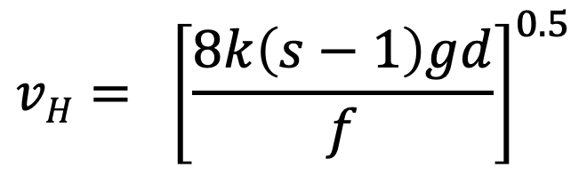

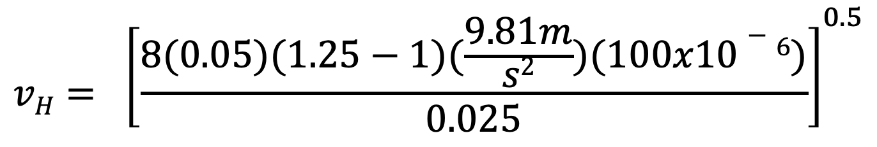
Scour Velocity (it’s complicated)
 | Value
Particle cohesion constant (k) | 0.05
Darcy-Weibach friction factor (f) | 0.025
Specific Gravity (s) | 1.25
Gravity | 9.81 m/s²
Particle diameter | 100 x 10^{-6m}
$$vH= {\left[\frac{8k\left(s−1\right)gd}{f}\right]}^{0.5}$$
$$vH= {\left[\frac{8(0.05)(1.25−1)(\frac{9.81m}{s2})(100x10−6)}{0.025}\right]}^{0.5}$$
$$vH= 0.063\frac{m}{s} =0.21\frac{ft}{s} =12.4 ft/min$$
Notes:
Skip this
Lerts say I have 2 primary sedimentiation tank that are 42 meters long, 6 meters wide and assume water will be 4 meters deep
So for this particular setup the scour velocity (horizontal velocity) iw 12.4 which is almost 6 times the normal range so scouring shouldn’t be a concern here
This shoudlnt really be a concern for you unless your plant was REALLY badly designed, or you are operating WAY out of normal parameters – the point here is to show that a well designed and correctly operated sedimentation tank shouldn’t run into scouring issues

Slide 56
In Secondary Treatment
Notes:
After the activated sludge process sedondary clarifiers take out the remaining solids leaving (hopefully) clarified effluent that can be disinfected and discharged
There are a lot of different designs – rectangular, center feeed and rim feed, and a variety of sludge collection methods used

Slide 57
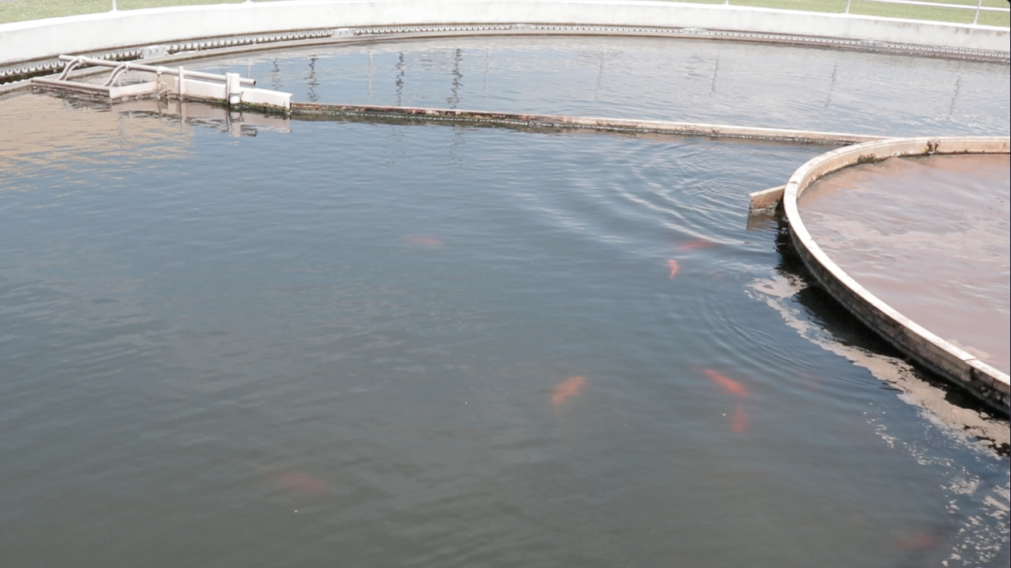
Secondary Clarification
Notes:
There’s no real food in the secondary clarifier so the goal is to get the microbes back out of here and back into the activated sludge tanks where’ there’s food.
We use the secondary clarifier to accomplish that process
In here the mixed liquor isn’t agitated or aerated anymore so the microbes flocculate together, entrap even smaller particles and sink to the bottom of the clariflier where they form a sludge blanket
The clarifier has a collection and removal system at the bottom similar to a primary clarifier
The clarifier is set up and operated to maintain a minimum sludge blanket depth, but not to let it get too deep because we don’t want solids being scoured out of the clarifier or causing other issues

Slide 58
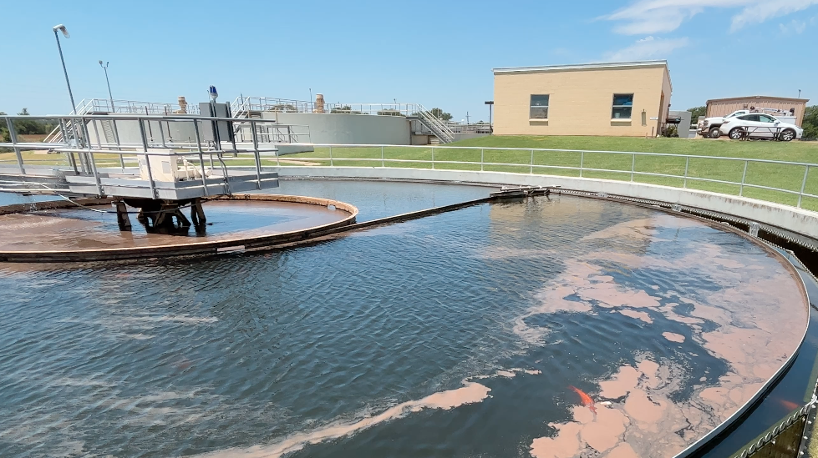
Flocculation Well
CENTER WELL
WEIR
Notes:
This is a center feed clarifier that center well will tupically have a smaller influent port and diffusion well inside with baffles that dissipate the energy of the influent mixed liquor
and the center well typicall has a minimum size of 25% of the tank diameter and can extend half way to the bottom of the tank – it may be as large as 30 to 35% of the clarifier diameter
this is to promote flocculation of the remaining solids – they get confined in there and bump into each other and flocculate on their way down and, because
Can have scrapers or suction orifices spread out along the bottom
There are square tanks as well, though they aren’t as effective in retaining separated solids as circular or rectangular tanks
Here you can see the SCUM BAFFLE (CLICK) THAT RING JUST INSIDE THE WEIR trapping any floating solids and preventing them from going over the weir while the SKIMMER ARM
(CLICK)
goes around and collects them
That baffle is one of the mechanisms in place to prevent short circuiting

Slide 59
Floatation
SCUM BAFFLE
SKIMMER ARM
SCUM
Notes:
This is a center feed clarifier
Can have scrapers or suction orifices spread out along the bottom
Here you can see the SCUM BAFFLE (CLICK) THAT RING JUST INSIDE THE WEIR trapping any floating solids and preventing them from going over the weir while the SKIMMER ARM
(CLICK)
goes around and collects them
That baffle is one of the mechanisms in place to prevent short circuiting

Slide 60
Checking Facility Performance
You can use SLR, WLR, Removal Efficiency and detention time formulas to compare facilities to common design values
Used in combination with lab tests, process control tests they can help to verify operational goals are being achieved
If lab tests showing poor performance these math tests can help identify operational problems
Notes:
So that was a lot of info in a short time but the main point was to demonstrate what is physically going on in sedimentation processes and show you some of the formulas you can use, like
Surface Loading Rates, Wier Loading rate and detention time to compare facilities to common design values
Used in combination with lab tests, amd process control tests these formulas can help to verify operational goals are being achieved
If lab tests showing poor performance these math tests can help identify operational problems

Slide 61

Questions?

Slide 62

CONTACT INFORMATION
Department of Civil Engineering MSC01 1070
1 University of New Mexico
Albuquerque, NM 87131
505-277-0644
swefc@unm.edu
http://swefc.unm.edu
swefc@unm.edu

