Slide 1





US Territories Wastewater Operator Training Series
Session 8: Operator Safety/OSHA/Chemical Safety
9/30/25
www.efcnetwork.org
This program is made possible under a cooperative agreement with US EPA.

Slide 2


Michelle Olson
Water Utility Trainer and Specialist meolson@unm.edu

Slide 3



This training series is funded by the US EPA

Slide 4
Attendee Meeting Controls
2. Chat
3. Leave meeting
1. Mute/unmute
Mute/unmute
  Click the microphone icon to unmute yourself to speak (if you are not speaking, don’t unmute)
Chat
  Click the chat icon and then use the dropdown next to send text instant messages to:
    Everyone publicly: messages will be visible to all participants
    Host only: messages will be sent only to the meeting host – Don’t send a chat to only me; I won’t have time to see it while presenting.
    Any attendee directly: message will be sent to the selected meeting participant only
Leave meeting
  Click on the leave icon to exit the ZOOM Meeting

Slide 5
Schedule for 2025:
Date | Topic
6/24/25 | Program Overview, Test Format, Study & Test Tips
7/8/25 | Treatment Overview - Reg history, overview
7/22/25 | WW Math Part 1 (Basic Math)
8/5/25 | WW Math Part 2 (Areas & Volumes)
8/19/25 | Collection Systems - Gravity systems
9/2/25 | Collection Systems - Pumping & force mains
9/16/25 | Collection System Maintenance
9/30/25 | Operator Safety/OSHA/Chemical Safety
10/14/25 | Preliminary Treatment
10/28/25 | Primary Treatment: Sedimentation
11/11/25 | Fixed-Film Media
12/2/25 | Activated Sludge Part 1
12/16/25 | Activated Sludge Part 2
Links to recordings and material are available on our website at https://swefc.unm.edu/home/op-cert-trainings/

Slide 6
Wastewater Safety Overview
Safety is your responsibility. Be safe and make sure others are as well.

Slide 7


Safety Hazards
Chemical Hazards
Toxic chemicals
Acids
Bases
Physical Hazards
Machinery
Lifting/slipping
Fire
Explosions
Falls
Noise
Biological Hazards
Pathogens
Infectious disease
Infections
Environmental Hazards
Confined spaces
Drowning
Engulfment/ entrapment
Traffic
Weather
Other Hazards
UV exposure
Radiological waste
Electrical shock
???
Notes:
Photo by Marcel Eberle on Unsplash
Symbols by OpenClipart-Vectors on Pixabay

Slide 8
Safety Roles
Management’s responsibility is to provide each employee with a safe place of employment
The operator has primary responsibility for their own safety

Slide 9

Don’t be the headline

Slide 10

Safety is your responsibility
Working safely is a condition
of employment
Notes:
Photo by Mufid Majnun on Unsplash

Slide 11

Most utility injuries are caused by the injured employee

Slide 12

Question
Notes:
Operators can experience physical injuries caused by:
Moving machinery
Improper lifting
Slippery surfaces
All of the above

Slide 13

Occupational Safety and Health Regulations
Notes:
Note that although we’re showing the OSHA logo, this is not an OSHA sponsored or supported webinar.

Slide 14
OSHA’s Mission
“to assure safe and healthy working conditions for working men and women by setting and enforcing standards and by providing training, outreach, education, and assistance."

Slide 15






















22 states & Puerto Rico have OSHA approved programs

Slide 16






5 states and the US Virgin Islands have OSHA approved programs that cover public sector employees

Slide 17

Be Aware of Your Local Occupational Safety and Health Regulations
Notes:
Image Source: https://commons.wikimedia.org/wiki/File:Flag_Map_of_the_United_States%28subdivisions%29.png
https://www.flickr.com/photos/107442568@N08/14014130835/
Alefar
This file is licensed under the Creative Commons Attribution 2.0 Generic license.

Slide 18
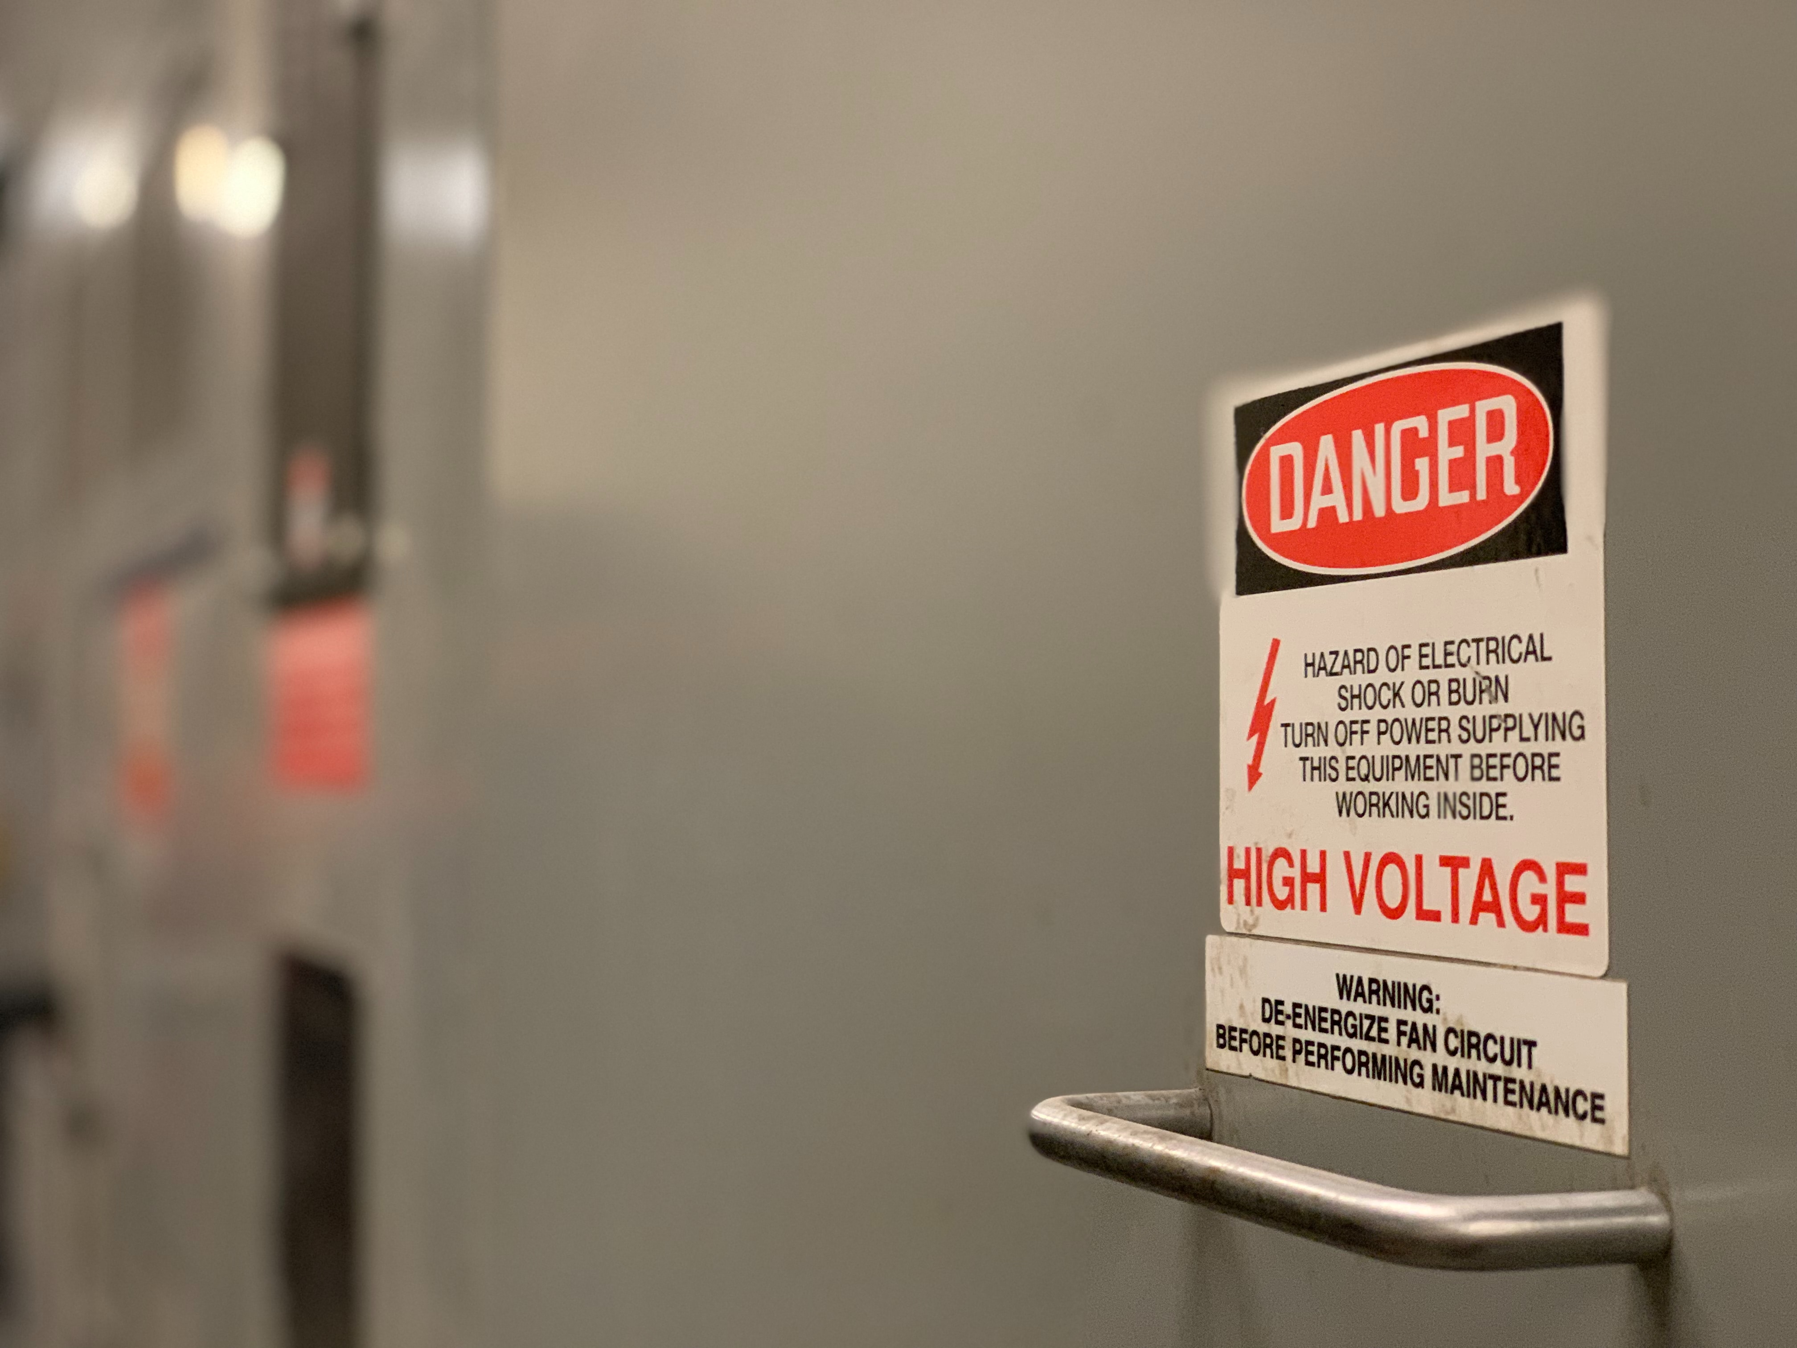
Safety Programs
Safety is everyone’s
concern
Notes:
Photo by Troy Bridges on Unsplash

Slide 19
Safety Programs
Identify the causes of accidents, illness, and injuries
Provide safety training
Implement an accident reporting system
Hold supervisors responsible for implementing the safety program

Slide 20
Operator Safety Duties
Ask about your employer’s safety program, and participate in it
Follow safety protocols and standards when doing your job
Use your safety equipment, like SCBA, hardhats, goggles, gloves, and other PPE
Report safety hazards and injuries

Slide 21
Management Safety Duties
Develop a written safety statement & establish a safety program
Assign responsibilities for injury prevention
Appoint a safety officer or coordinator
Establish realistic safety goals & revise them to encourage continual improvement
Evaluate safety program results

Slide 22
Three safety program training components
Safety education of all employees
Reinforced education in safety
Safety education in the use of tools and equipment

Slide 23
Three safety program training components
Safety education of all employees
Reinforced education in safety
Safety education in the use of tools and equipment

Slide 24

Tailgates aren’t just for parties
Short: 10-20 minutes, held approximately weekly or before new work
Notes:
Image: Rich Anderson
https://flickr.com/photos/memestate/36001975/

Slide 25
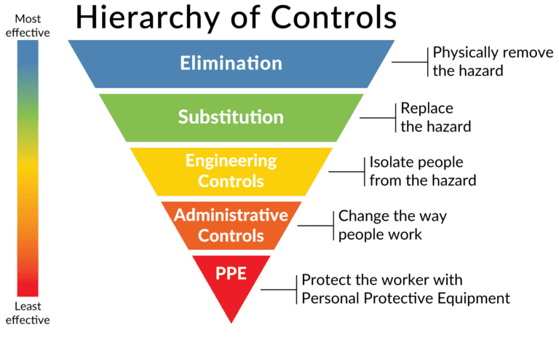
Actions to Control Workplace Hazards

Slide 26
Question
Notes:
Who has the most to gain from a safety program
Management
Office Staff
Operators
Supervisors
Operators – you’re the most likely to be injured. Everyone benefits from a safety program, but the front-line employees benefit the most.

Slide 27

Infectious Materials
Many microorganisms can cause illness including:
  Bacteria
  Protozoa
  Helminths (parasitic worms)
  Viruses
Talk to your safety officer about inoculation for:
  Typhoid
  Paratyphoid
  Polio
  Hepatitis A & B
  Tetanus

Slide 28
Infectious Materials
Use PPE like gloves when:
handling hazardous samples
you may come into contact with wastewater
you may come into contact with sludge

Slide 29
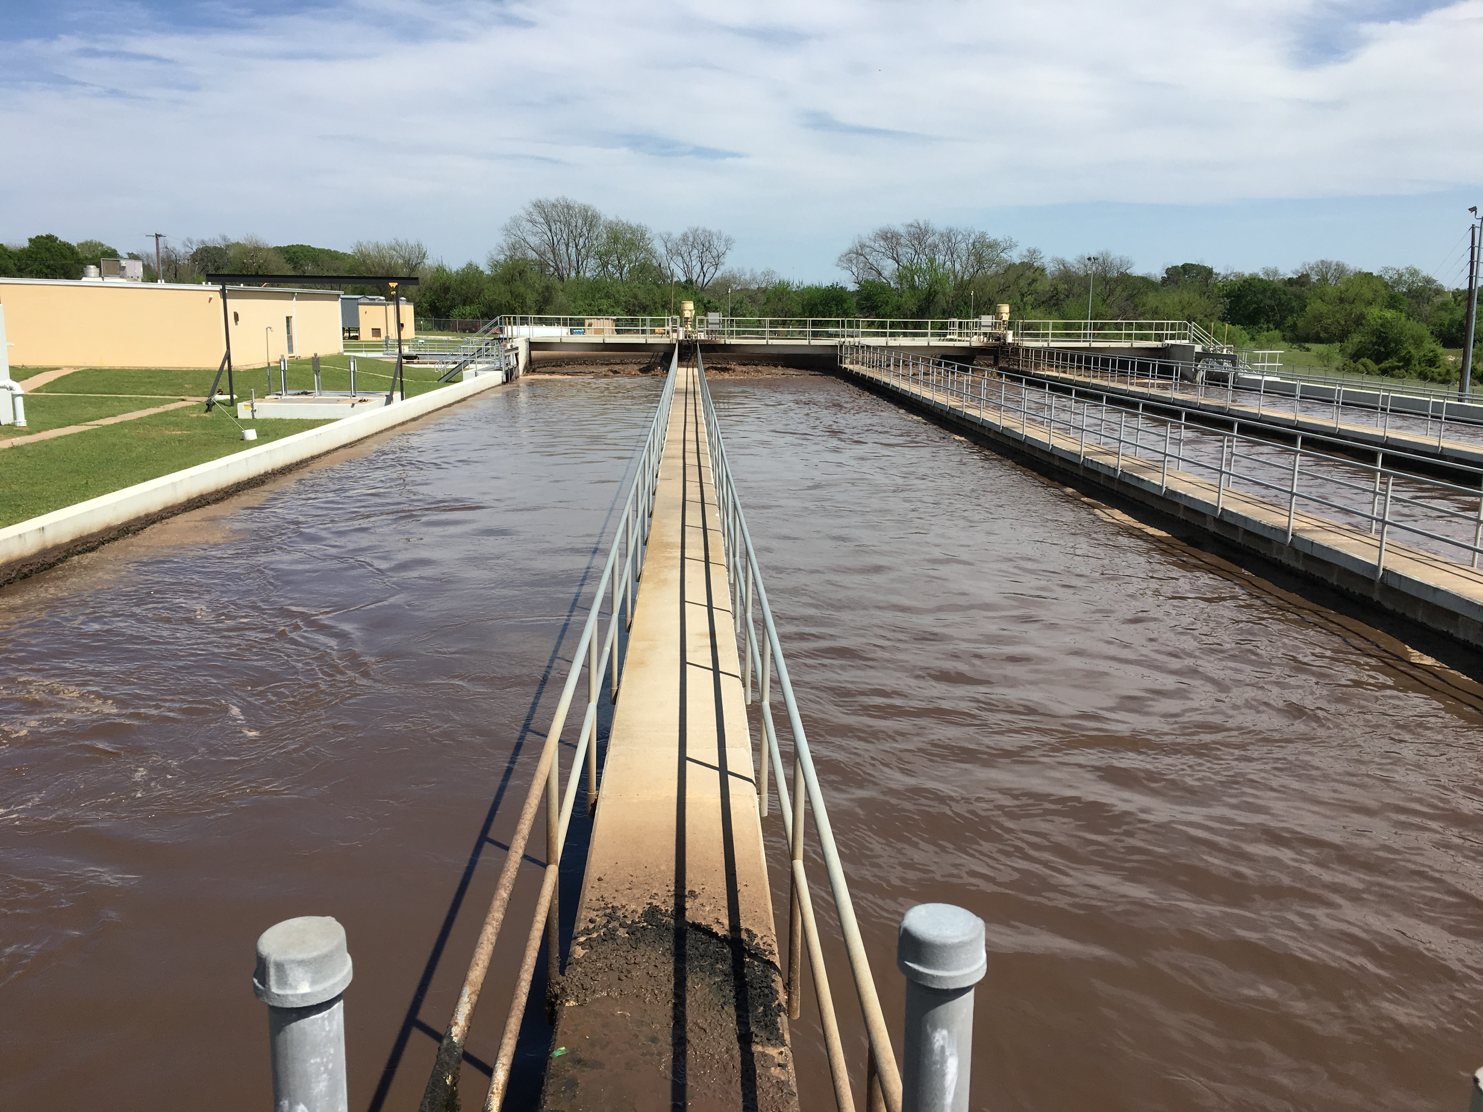
Water Safety
Reduce slip hazards on catwalks around clarifiers and basins
Use extra caution in wet and icy weather
Keep handrails in good repair, replace damaged rails
Mark and guard unsafe areas with guardrails, rope, chains, or cable
Station emergency gear near filters, tanks, basins, and clarifiers, such as approved safety vests, buoys, and life poles
Learn how to swim (but use personal floatation devices where appropriate even if you can swim)

Slide 30
Question
Notes:
If you fall into an active aeration basin will you always be able to swim out?
Yes
No
NO – aeration tanks involve more danger due to aeration mixing equipment and currents in the tank. In addition, aeration reduces buoyancy and makes it difficult to stay afloat.
If the blowers are going full blast and you aren’t wearing a PFD (personal floatation device) there’s a good chance you’ll sink like a rock.

Slide 31

Electrical Hazards
Notes:
Photo by Thomas Kelley on Unsplash

Slide 32


Transformers
Starters
Motors
Instrumentation
Control Panels

Slide 33
Question
Notes:
Can 120 volts kill you?
Yes
No
(Just for reference most outlets in homes in the US are around 120 volts.)

Slide 34
120 volts can kill you.
12 volts can injure you

Slide 35
Current & Voltage
Ohms Law:
$$Current= \frac{Voltage}{Resistance}$$
Or:
$$Amps= \frac{Voltage}{Ohms}$$

Slide 36
Resistance in the body
    Ear-to-Ear ~ 100 Ohms
    Hand-to-Foot ~ 500 Ohms
    Dry Skin ~ 300,000 Ohms
    Wet Skin ~ 1000 Ohms

Slide 37

Resistance in the body
    Ear-to-Ear ~ 100 Ohms
$$Ohms Law: \frac{Voltage}{Ohms}=Amps$$
    $$\frac{120 Volts}{100 Ohms} =$$
    $1.2 Amps$
Outcome: instant death

Slide 38
Resistance in the body
    Hand-to-Foot ~ 500 Ohms
    $$\frac{120 Volts}{500 Ohms} =$$
    $$0.24 Amps$$
    $$(or 240 miliAmps)$$
Outcome: Severe burns, possible death

Slide 39
Basic Electrical Safe Practices
Do proactive maintenance to identify performance and safety issues
Use non-conductive tools when working around electricity
Don’t use electrical equipment with worn or frayed cords
Permanent wiring should be installed with conduit or armored cable by an electrician

Slide 40
Basic Electrical Safe Practices
Replace connections with worn or thinning insulation
Ground equipment with three pronged plugs
Be alert for overheating equipment or “tingling”
Electrical units operated in areas exposed to flammable vapors should be explosion proof
Work in pairs to service, repair or troubleshoot electrical equipment

Slide 41
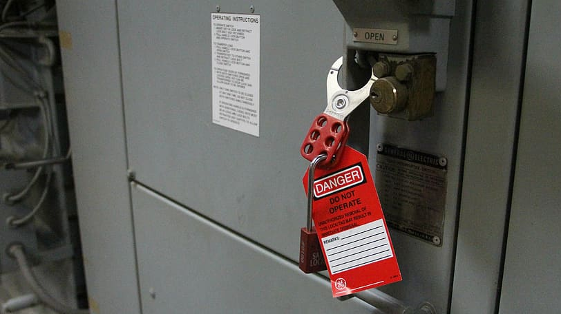
Lockout and Tagout Programs
Notes:
https://www.pxfuel.com/en/free-photo-jgxqs
Listed as CC in Google Image Search 5/1/23
https://creativecommons.org/licenses/publicdomain/

Slide 42
Lockout and Tagout Basics
Notify affected employees that the lockout/tagout procedure will be used and why
Shut down equipment using normal shut down procedures
Isolate the equipment from energy sources and ensure stored energy is dissipated
Lockout and tagout the energy isolating device with the assigned individual lock and tag

Slide 43
Lockout and Tagout Basics
Confirm the circuit is dead. Ensure energy source is disconnected after ensuring no personnel are exposed.
NOW, work can begin
After work is complete, tools are removed and everything is returned to working order, ensure all employees are clear then remove lockout and tagout devices
Then notify affected employees that lockout and tagout have been removed and restore power to the equipment.

Slide 44
Question
Notes:
Who should remove locks and tags from electrical equipment?
The operator who needs to use the equipment next
The operator who locked and tagged out the equipment
Any operator that is qualified as an electrician
Any operator on the next shift

Slide 45
Never remove lockout and tagout equipment that someone else installed unless your employer has specific procedures and training for removal by others.

Slide 46
Chemical Hazards

Slide 47

Chemical Hazards
Burns
Respiratory Damage
Eye Damage
Rashes
Skin Damage
Headaches
Death

Slide 48
Acute vs Chronic Effects
Acute: Short term effects occur with contact and usually resolve when no longer in contact or with medical treatment.
Chronic: Long term effects that may not appear immediately or after a single exposure. May or may not be reversible.

Slide 49
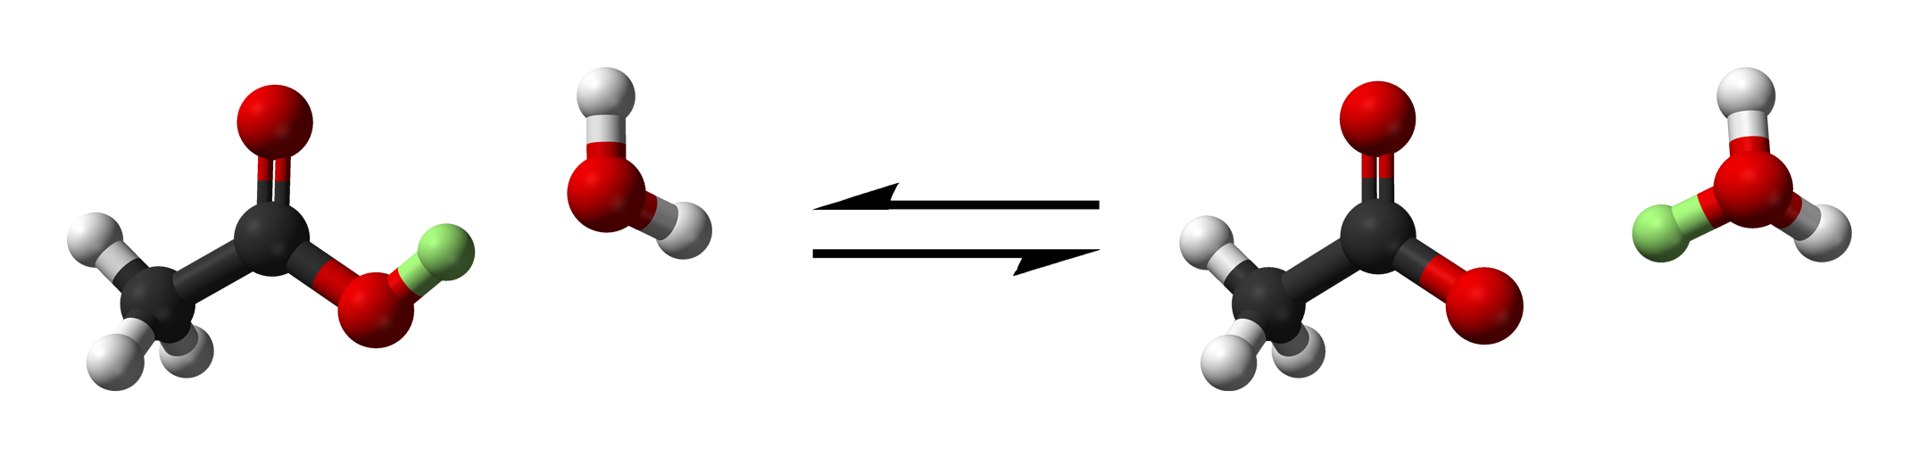
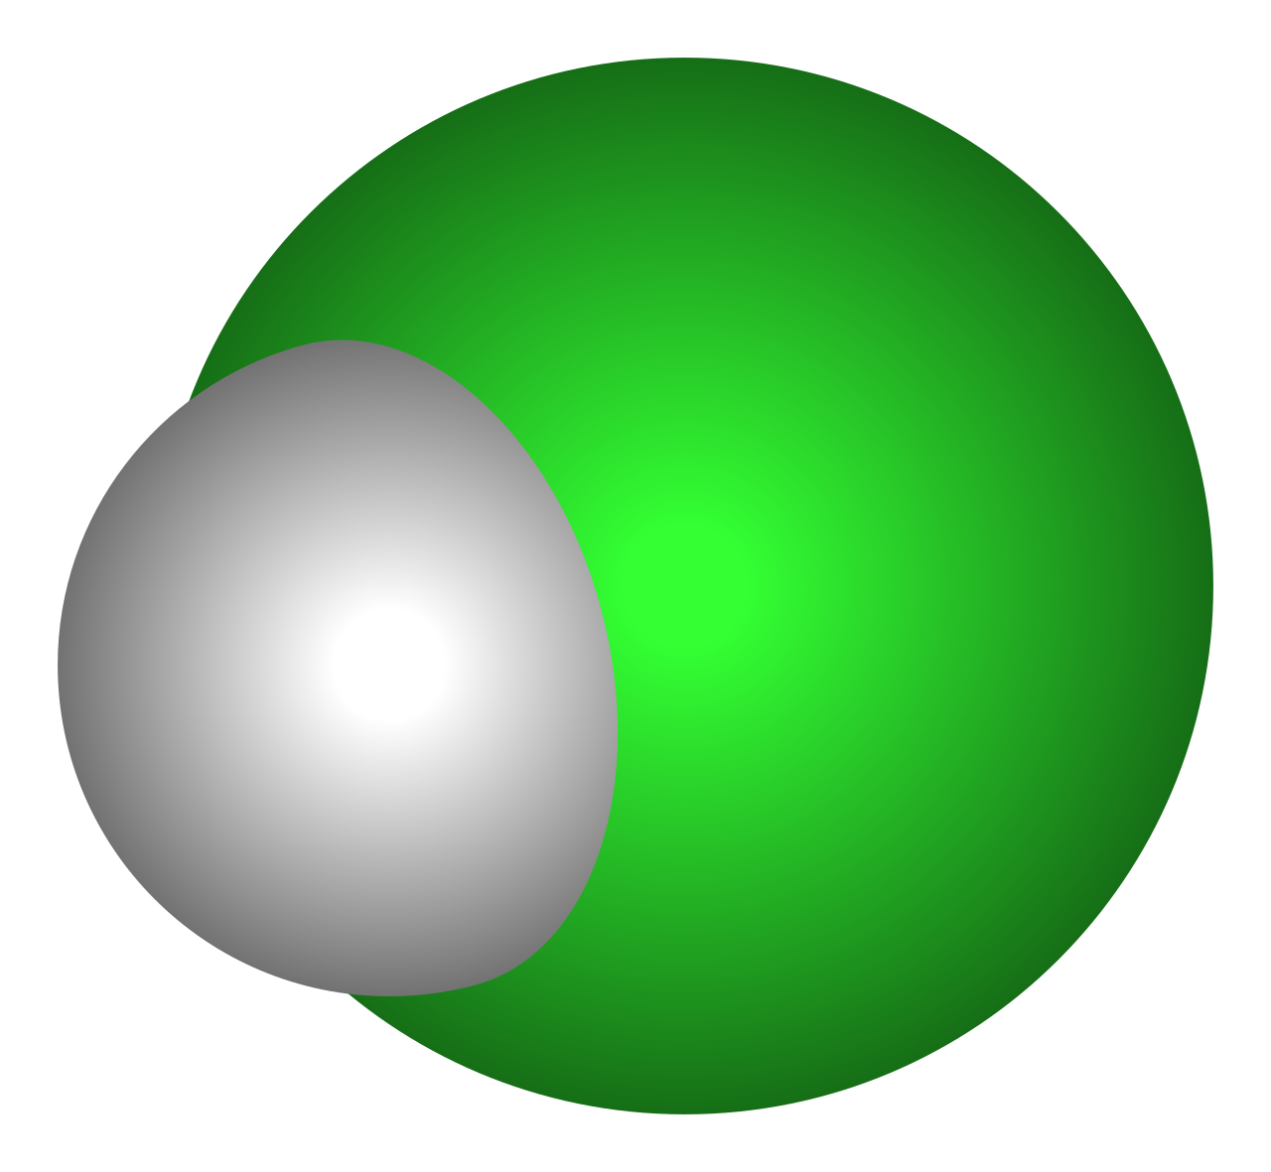
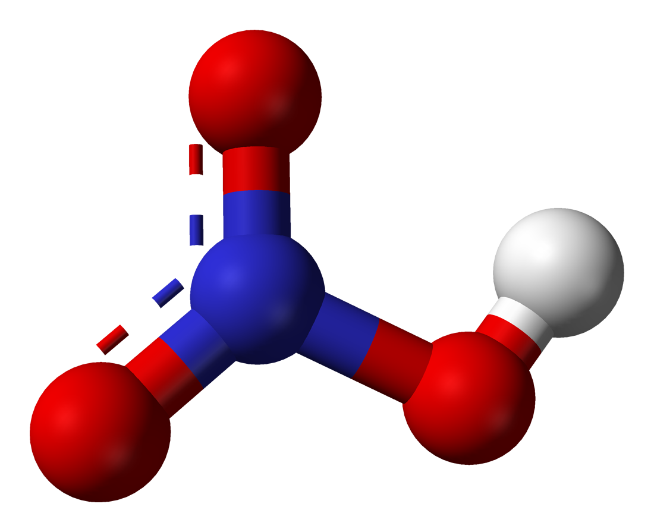
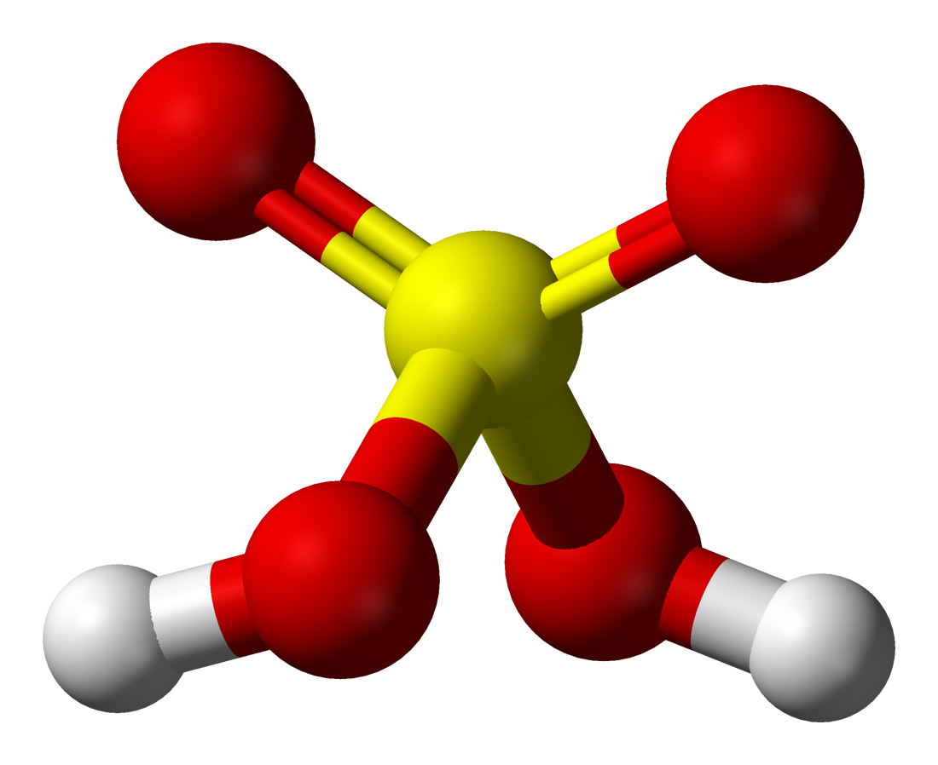
Acids Used in WW Treatment
Acetic Acid (CH₃COOH)
Hydrochloric Acid (HCl)
Nitric Acid (HNO₃)
Sulfuric Acid (H₂SO₄)

Slide 50
Bases Used in WW Treatment
Hydrated Lime or Calcium Hydroxide (Ca (OH)₂)
Quicklime or Calcium Oxide (CaOH)
Sodium Hydroxide or Caustic Soda (NaOH)
Hypochlorite (OCl⁻)
Sodium Carbonate or Soda Ash (Na₂CO₃)

Slide 51
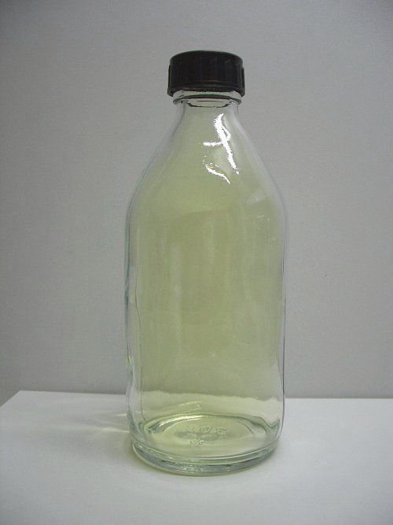
Other Chemicals you may encounter
Chlorine
Methane
Hydrogen Sulfide
Other gases
Alum
Activated Carbon
Chlorine Gas
Notes:
https://en.wikipedia.org/wiki/Chlorine#/media/File:Chlorine_in_bottle.jpg

Slide 52
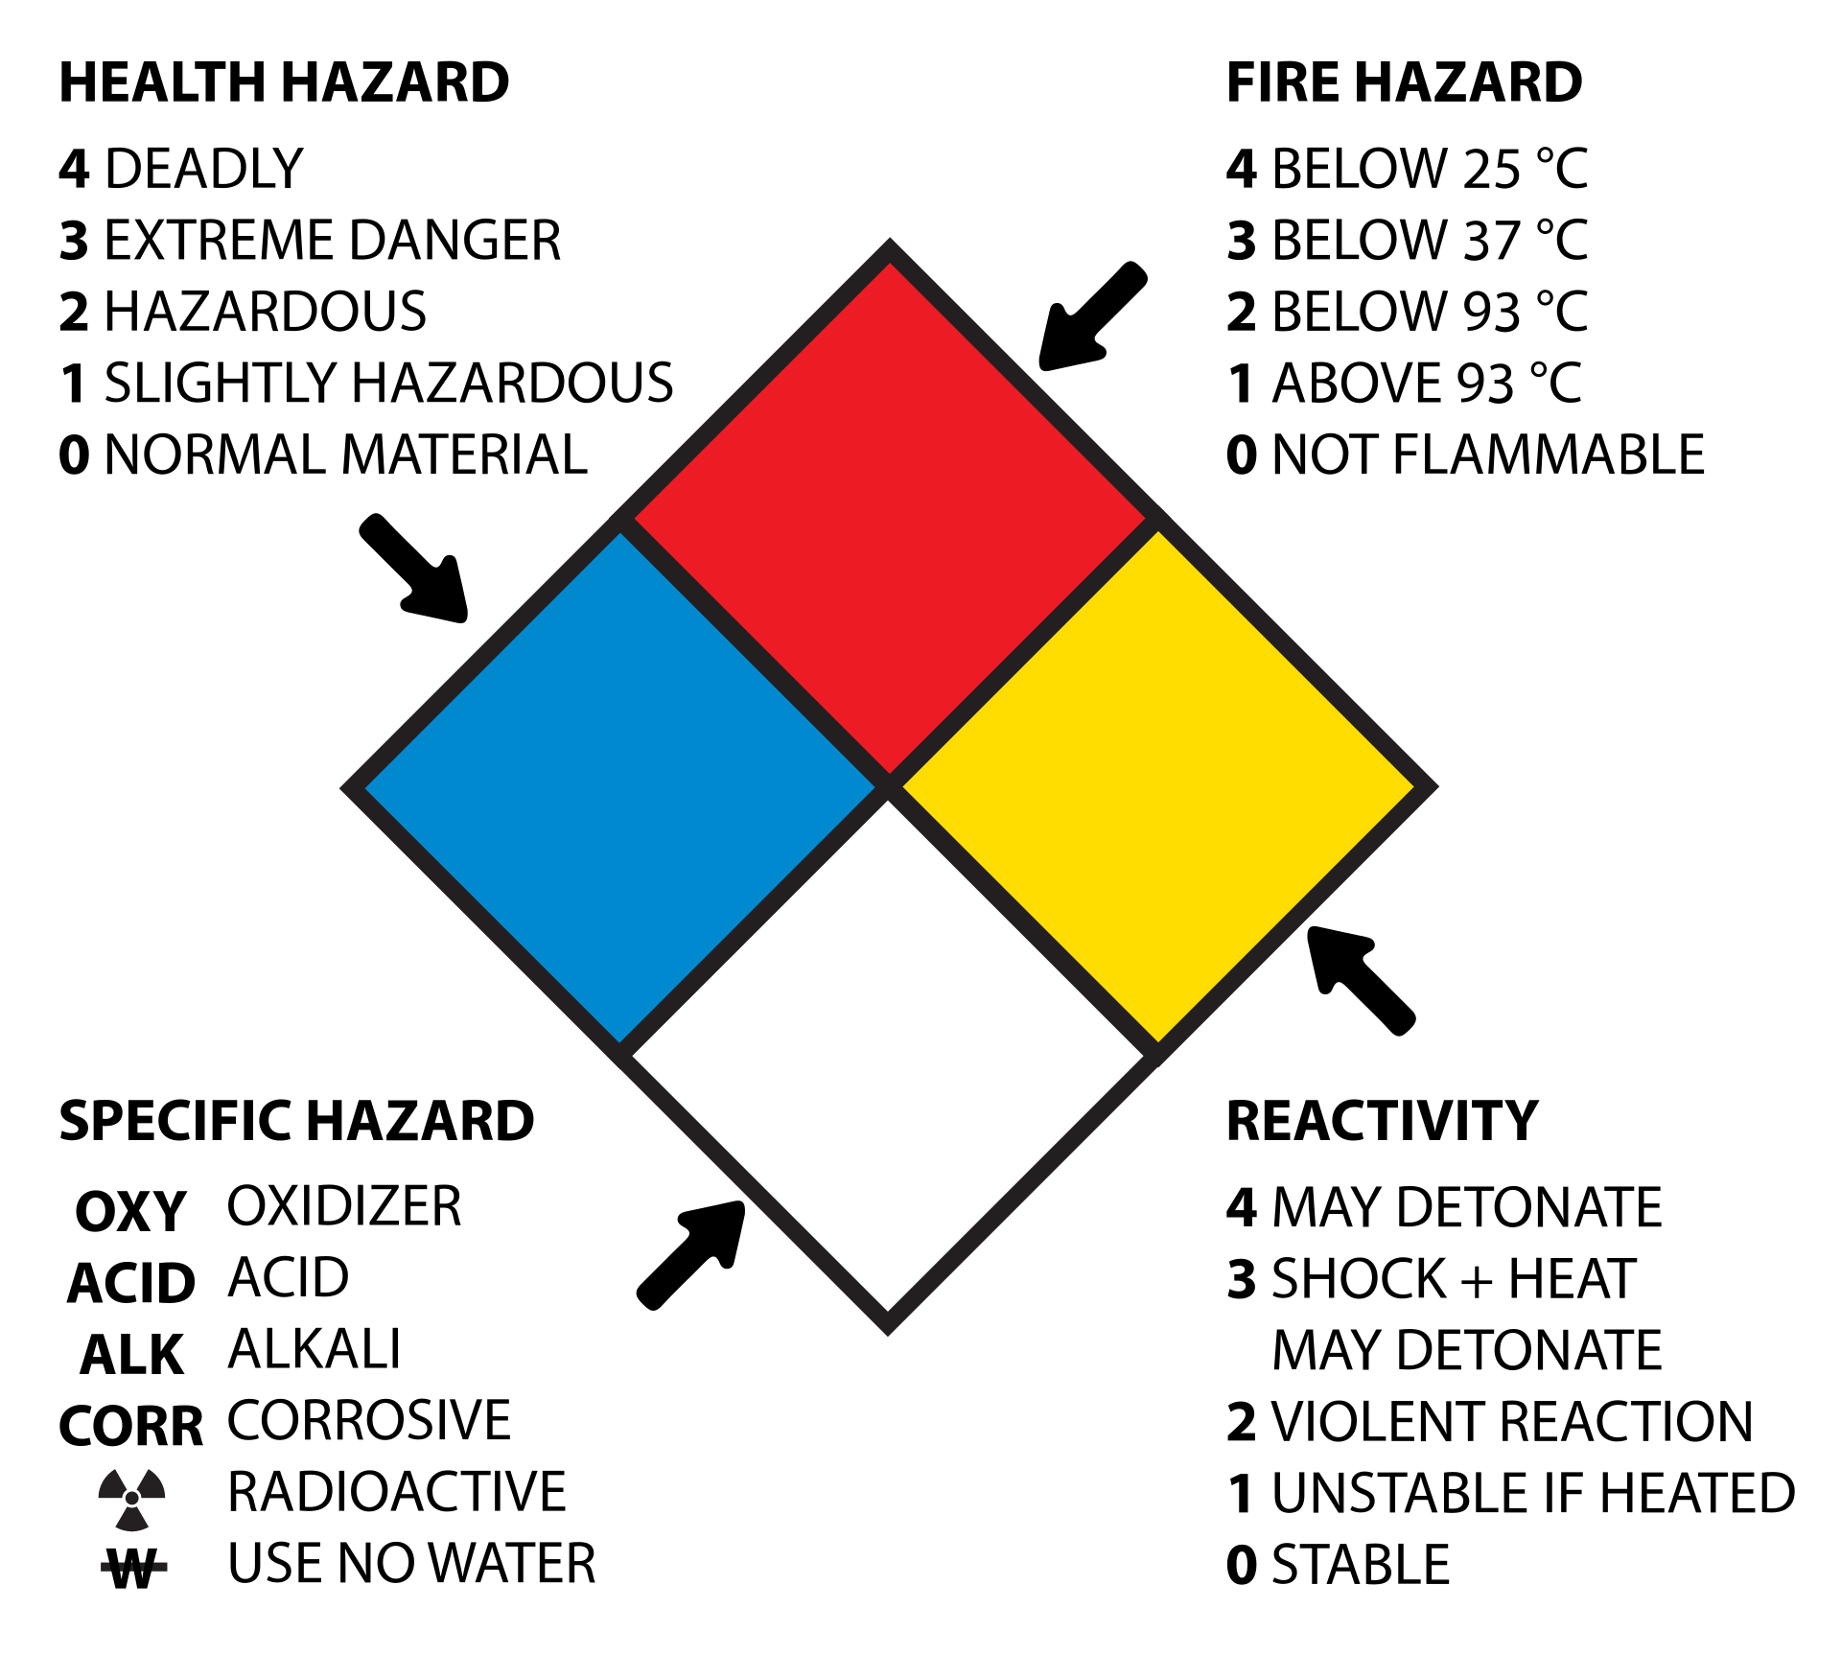
Hazard Communication
“Fire Diamond” or “Safety Square”
NFPA 704: Standard System for Identification of Hazards of Materials for Emergency Response

Slide 53

Hazard Communication

Slide 54
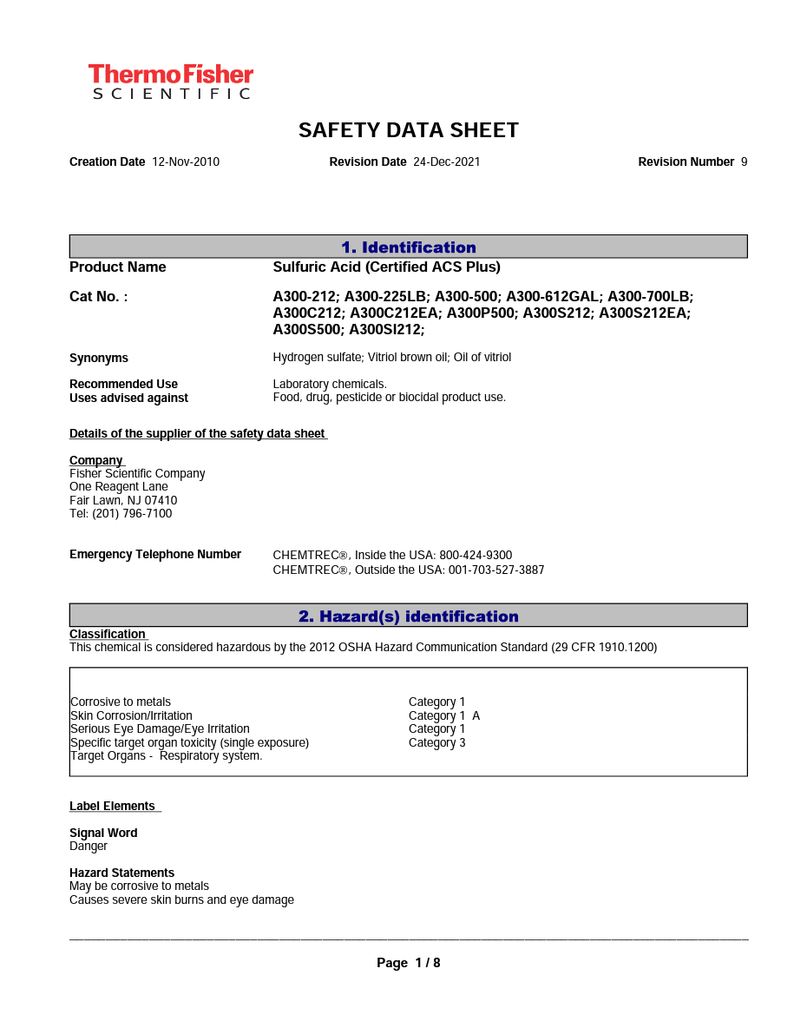
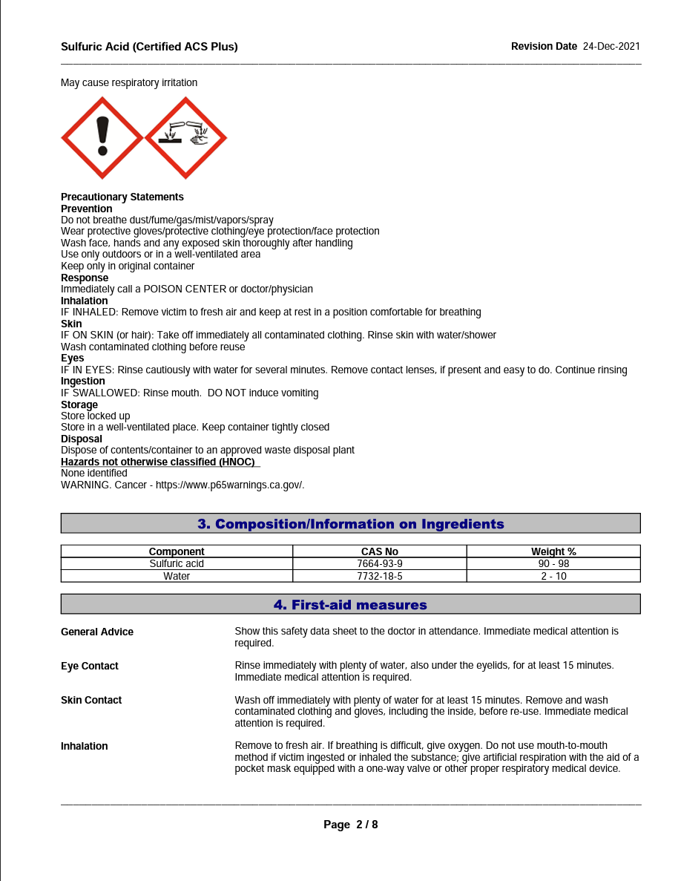
Safety Data Sheets

Slide 55
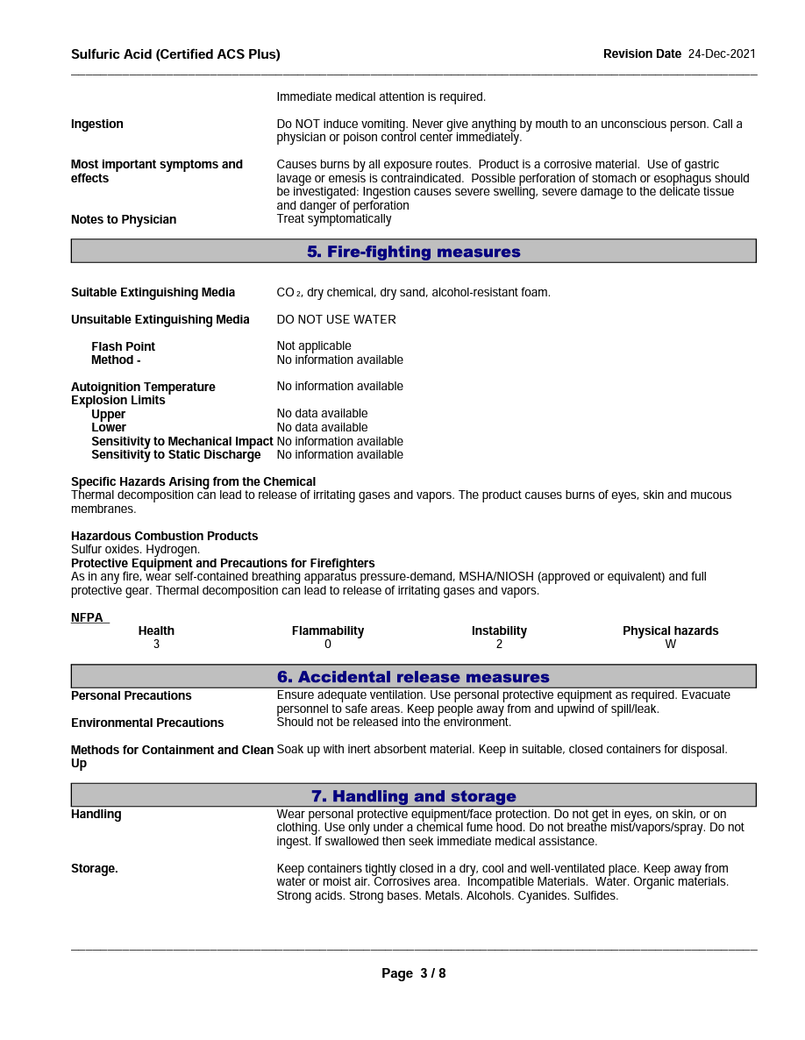
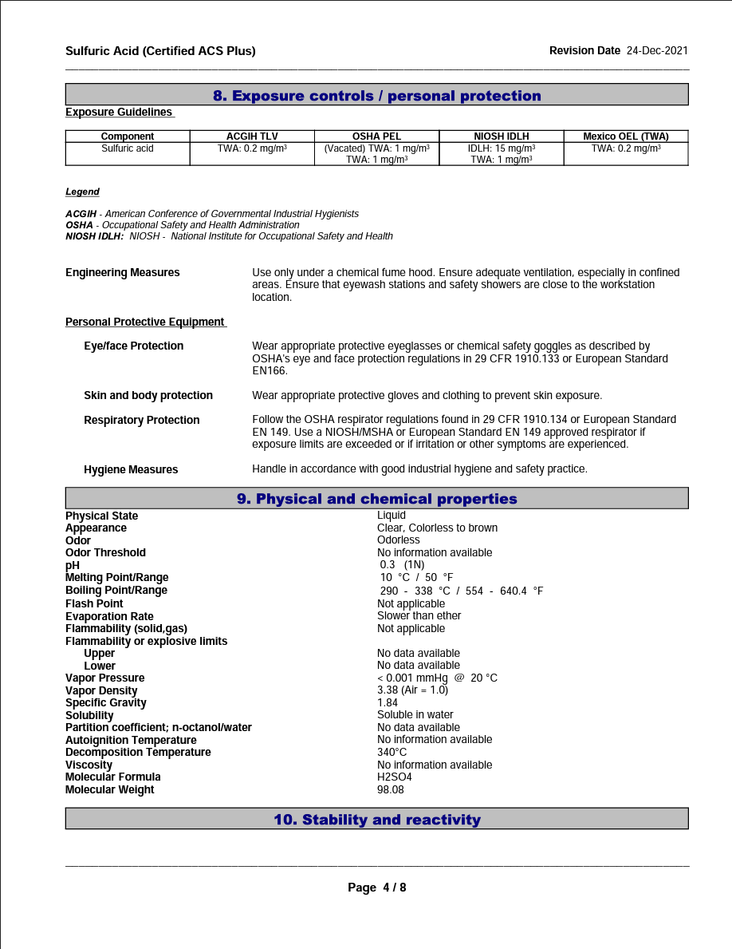
Safety Data Sheets

Slide 56
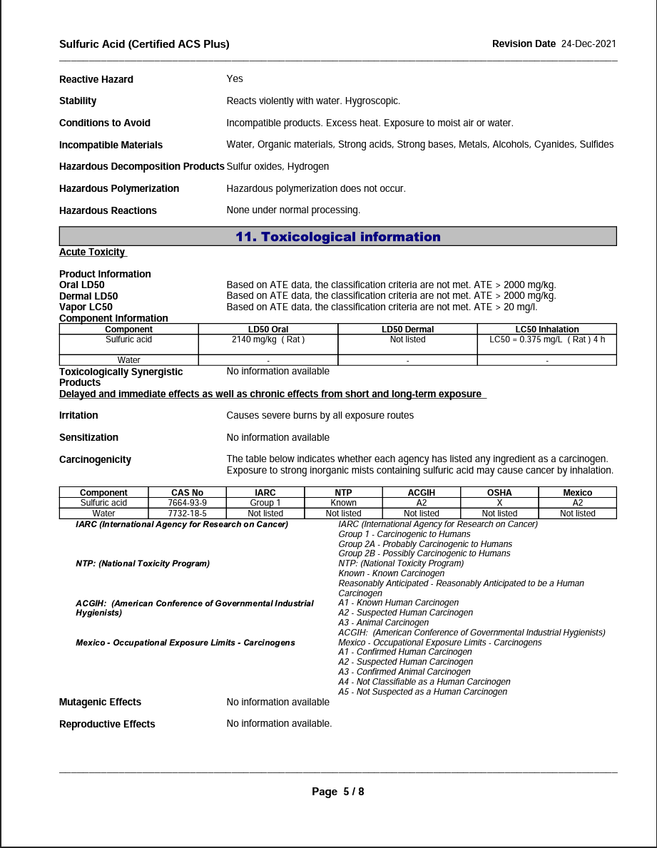
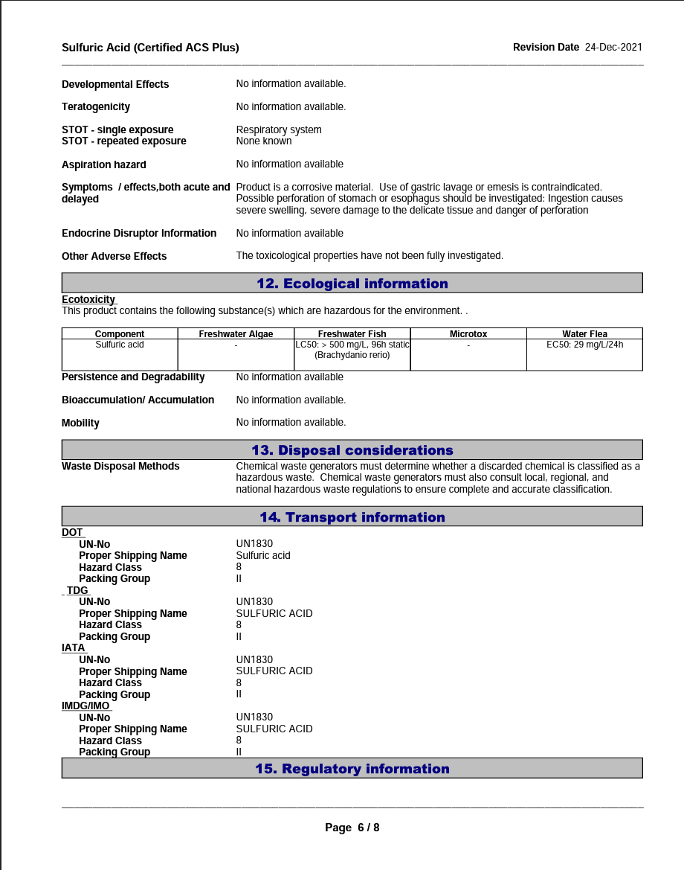
Safety Data Sheets

Slide 57
Safety Data Sheets

Slide 58
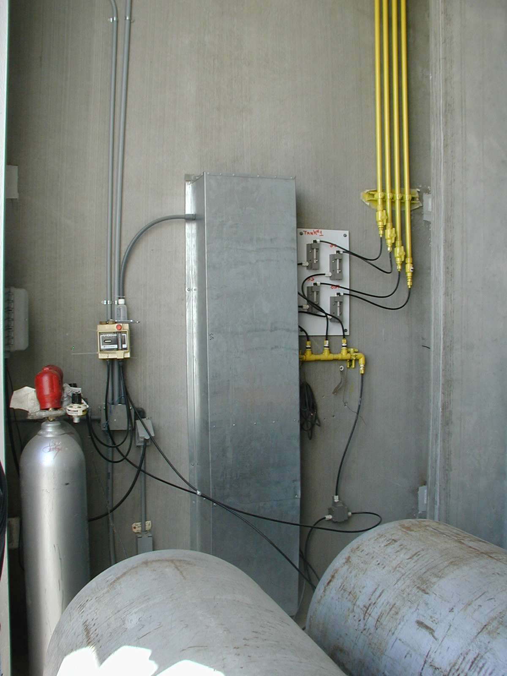
Let’s talk about Chlorine

Slide 59

You DON’T want chlorine here
Notes:
Photo by Victor Freitas on Unsplash

Slide 60
Or here…
Notes:
Photo by Robina Weermeijer on Unsplash

Slide 61
Mishandled chlorine can kill you.
Notes:
Photo by Waldemar on Unsplash

Slide 62
Chlorine Exposure Effects
ppm in Air by Volume | Health Effect
1 | Slight Symptoms after several hours’ exposure
0.3 to 3.5 | Detectable Oder
5 | Noxiousness
15 | Throat Irritation
30 | Coughing
40 | Dangerous from 30 min to 1 hour
1000 | Death after a few deep breaths

Slide 63
Know your safety equipment
Where it is, how and when to use it, and how to maintain it

Slide 64
Respirator with cartridges:
for escape purposes only.
Notes:
Image: https://www.grainger.com/product/HONEYWELL-NORTH-Full-Face-Respirator-Silicone-5AC56?gucid=N%3AN%3APS%3APaid%3AGGL%3ACSM-2295%3A4P7A1P%3A20501231&gclid=CjwKCAjw9J2iBhBPEiwAErwpeayfzlJwrFixlb22YTsrYPKOnJV-w4g_-QaoQbV119H3FjZTmXikVhoCGC4QAvD_BwE&gclsrc=aw.ds
Noted as creative commons licensed in Google Image Search

Slide 65
If O₂ level drops below 12% you could die – there’s not enough oxygen to sustain you.
Notes:
Image: https://www.grainger.com/product/HONEYWELL-NORTH-Full-Face-Respirator-Silicone-5AC56?gucid=N%3AN%3APS%3APaid%3AGGL%3ACSM-2295%3A4P7A1P%3A20501231&gclid=CjwKCAjw9J2iBhBPEiwAErwpeayfzlJwrFixlb22YTsrYPKOnJV-w4g_-QaoQbV119H3FjZTmXikVhoCGC4QAvD_BwE&gclsrc=aw.ds
Noted as creative commons licensed in Google Image Search

Slide 66
SCBA System:
Self Contained Breathing Apparatus
Notes:
Image: https://www.grainger.com/product/3M-SCOTT-Industrial-SCBA-792HX2?gucid=N%3AN%3APS%3APaid%3AGGL%3ACSM-2295%3A4P7A1P%3A20501231&gclid=CjwKCAjw9J2iBhBPEiwAErwpeRD_6VJi_4GN32ZDClsI6y0pf36H8SDx8mlBB6bytbJwxzbNsM_OcRoCyhIQAvD_BwE&gclsrc=aw.ds
Noted as creative commons licensed in Google Image Search

Slide 67
SCBA System:
Requires training to use properly
Notes:
Image: https://www.grainger.com/product/3M-SCOTT-Industrial-SCBA-792HX2?gucid=N%3AN%3APS%3APaid%3AGGL%3ACSM-2295%3A4P7A1P%3A20501231&gclid=CjwKCAjw9J2iBhBPEiwAErwpeRD_6VJi_4GN32ZDClsI6y0pf36H8SDx8mlBB6bytbJwxzbNsM_OcRoCyhIQAvD_BwE&gclsrc=aw.ds
Noted as creative commons licensed in Google Image Search

Slide 68
Confined Spaces
Notes:
https://flickr.com/photos/joeshlabotnik/2411692991/in/photolist-4F7yiD-7rstvj-2m2JC7u-nMDpEB-nrAv1e-dienJa-KkwwDs-8Htmhs-5pgxKM-28pmQb1-88s6NF-8EPkCc-2nzPABF-6tqefy-qucNUM-2heZPsZ-97uELd-eQWnn5-91dcet-4XctSL-87j3Td-4SXuXM-5DsF1W-2jwXCug-Gn9Pyg-7SGXkv-meuHrY-bwktDr-iskVG-dbkVh1-PCiWZz-bmbsWx-aH3hT8-aH3nqn-6GeHCb-aH3f4i-6GaBV4-aH3gvt-aH3jKZ-aH3diF-dhVLef-nrtUDa-7AvJNe-7Azwqb-7Azvt7-7AviW4-7AvMmZ-7Avecr-96VLFp-7Azvzs

Slide 69
Confined Spaces
Large enough and configured so that an employee can bodily enter and perform work
Has limited or restricted means for entry and exit
Is not designed for continuous occupancy
Every entry into a confined space requires a confined space entry permit

Slide 70
Confined Space Hazards
Air contamination:
  Flammable
  Explosive
  Toxic
Explosive chemical dust
Oxygen enriched atmosphere (increases explosion risk)
Oxygen deficient atmosphere

Slide 71
Oxygen facts
Normal air is 20.9% Oxygen
Below 19.5% Oxygen a potentially dangerous condition exists
At 17% Oxygen, you will experience shortness of breath
At 10% to 6% Oxygen, rapid loss of consciousness occurs
Below 6% Oxygen, death occurs in minutes

Slide 72
Oxygen Deficiency Causes
Bacterial action using up available oxygen
Displacement of Oxygen by other gases
Oxidation of metals or other materials depletes Oxygen
Absorption of Oxygen into surfaces
Combustion

Slide 73
Manholes are Confined Spaces
Deadly gases can accumulate, or oxygen can be displaced.
Manholes require atmospheric testing
Manholes require adequate ventilation
Corrosive gasses eat away at steps

Slide 74
Sewer Cleaning, Repairs, etc.
Notes:
Image: Valerie Edwards: https://www.flickr.com/photos/valeriebb/2719873655/
https://creativecommons.org/licenses/by-sa/2.0/

Slide 75

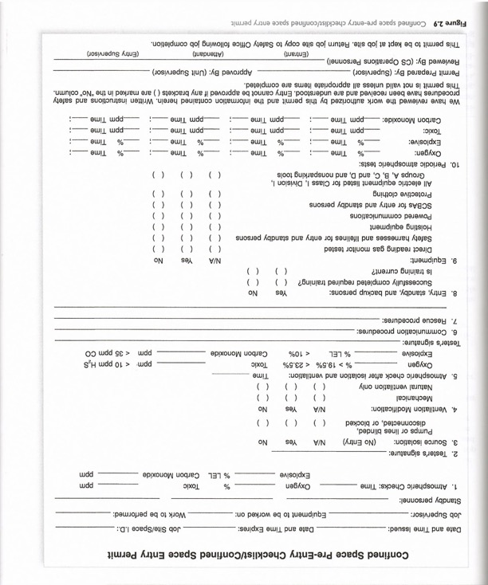
Permits and Monitors

Slide 76
Excavation Hazards
Notes:
Photo by Troy Bridges on Unsplash

Slide 77
When trenches without adequate cave in protection collapse there is usually no warning and no time to escape.

Slide 78
OSHA requires protection if an excavation is 5 feet or more in depth.

Slide 79
NMED recommends protection if an excavation is 4 feet or more in depth.

Slide 80
Protection:
Shoring, Shielding, and Sloping
Notes:
By en:User:Imprezzive1 - English Wikipedia, original description is/was here., Public Domain, https://commons.wikimedia.org/w/index.php?curid=2385305

Slide 81
Shoring
Notes:
Washington State Dept of Transportation
https://flickr.com/photos/wsdot/8033733048
https://creativecommons.org/licenses/by-nc-nd/2.0/

Slide 82
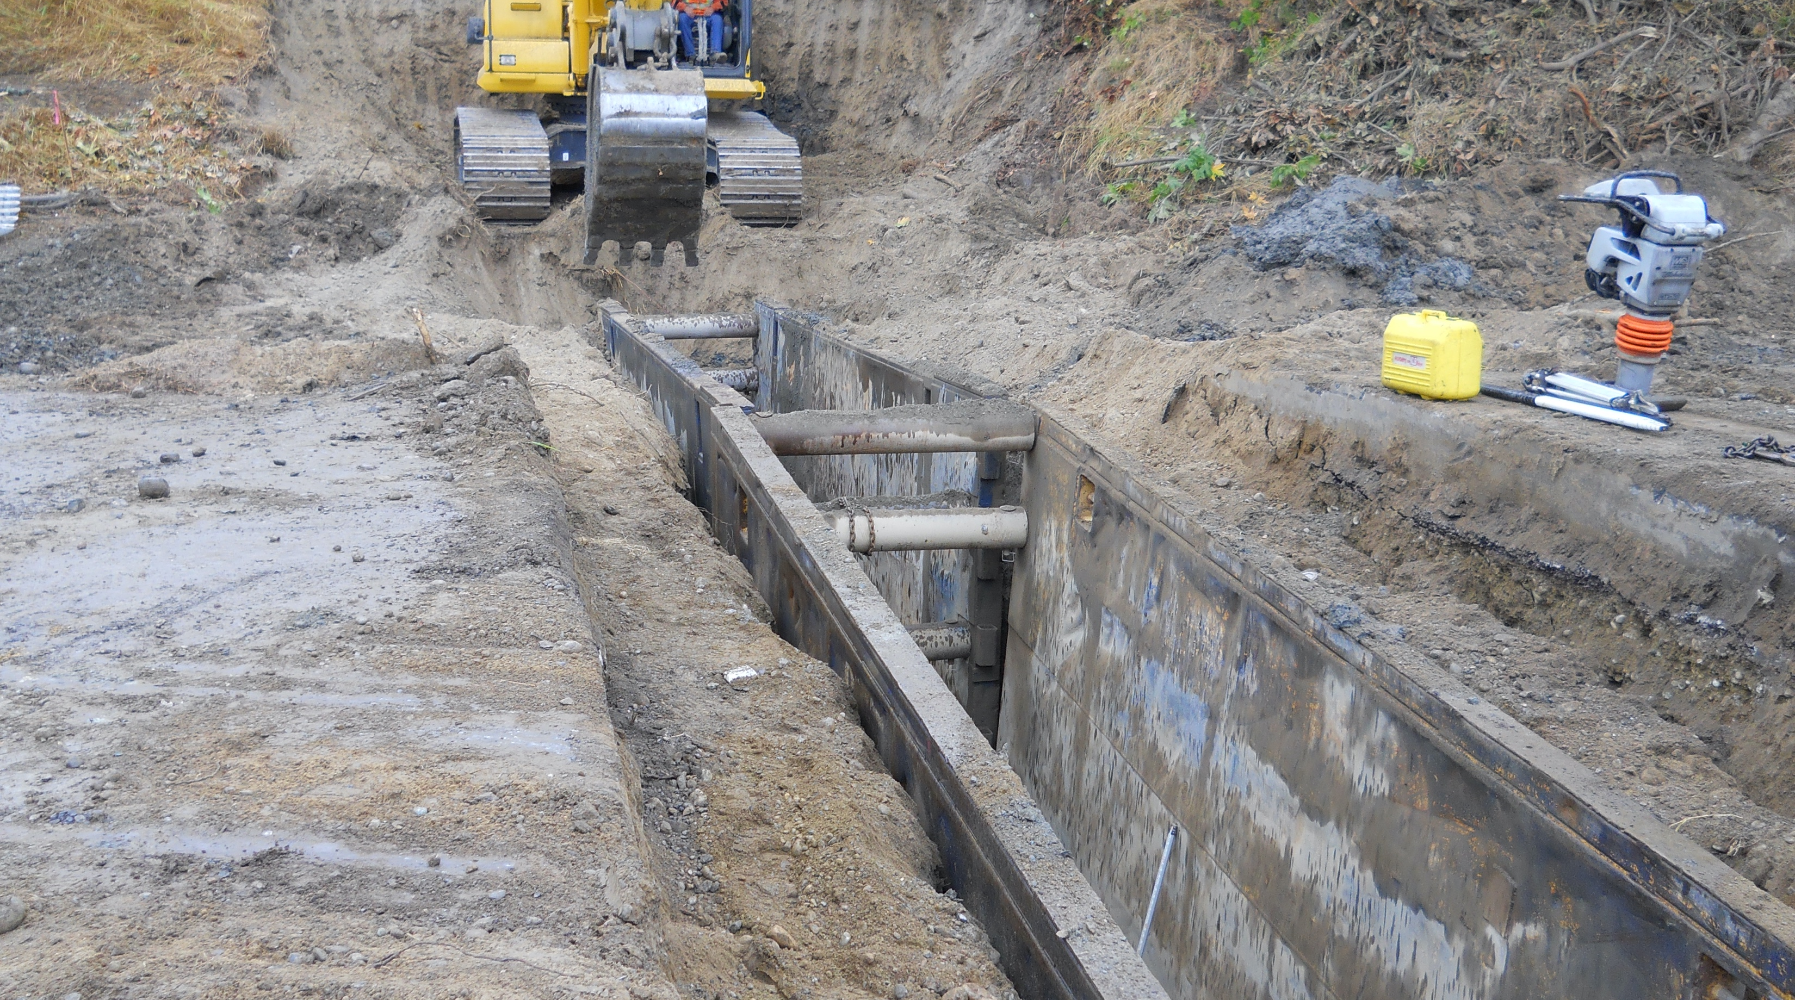
Shoring
Notes:
Washington State Dept of Transportation
https://flickr.com/photos/wsdot/8033733048
https://creativecommons.org/licenses/by-nc-nd/2.0/

Slide 83
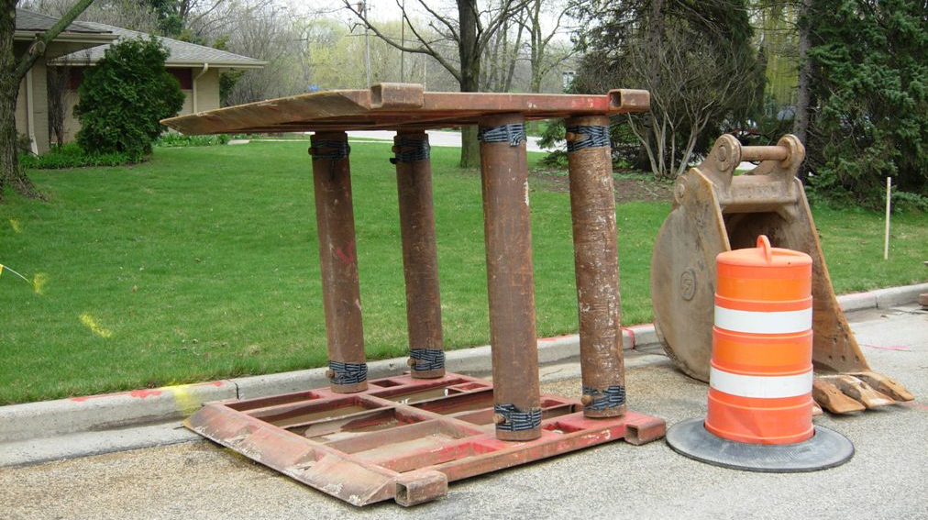
Shielding (Trench Boxes)
Notes:
https://flickr.com/photos/87297882@N03/15496057702
https://creativecommons.org/licenses/by-nc-nd/2.0/

Slide 84
Shielding (Trench Boxes)
Notes:
https://flickr.com/photos/mtacc-esa/7747844774
https://creativecommons.org/licenses/by-nc-nd/2.0/

Slide 85
Sloping
Notes:
By en:User:Imprezzive1 - English Wikipedia, original description is/was here., Public Domain, https://commons.wikimedia.org/w/index.php?curid=2385305

Slide 86
The acceptable slope angle is 34 degrees or
a slope of 1.5 : 1 (run over rise)
1.5 ft of horizontal excavation for every 1 ft vertical, on both sides of the trench.

Slide 87
34º or 1.5 : 1 Slope (on both sides)
7.5 Feet
7.5 Feet
5 Ft Deep Trench
34 degrees

Slide 88
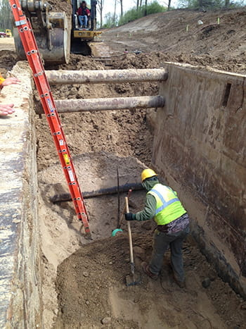
Ladders
Are required every 25 lateral feet
Must extend at least 3 feet above the excavation wall
Must be placed on firm ground within the trench
Image: https://www.michigan.gov/leo/bureaus-agencies/miosha/topics/excavation-and-trenching

Slide 89
Don’t be the headline.
Notes:
https://www.michigan.gov/leo/bureaus-agencies/miosha/topics/excavation-and-trenching

Slide 90
There are other hazards that we did not cover today.
Study available materials.
Follow your safety program.
Use your head.

Slide 91
CONTACT INFORMATION
Department of Civil Engineering MSC01 1070
1 University of New Mexico
Albuquerque, NM 87131
swefctribal@unm.edu
http://swefc.unm.edu
Michelle Olson: meolson@unm.edu
Matt Ziegler: mattz@unm.edu

