Slide 1





US Territories Water Operator Training Series
Session 8: An Introduction to Disinfection (part 1 of 4)
10/2/25
www.efcnetwork.org
This program is made possible under a cooperative agreement with US EPA.

Slide 2


Matt Ziegler
Program Director
Your trainer for today

Slide 3



This training series is funded by the US EPA

Slide 4


Slide 5
Schedule for 2025:
Date | Topic
6/26/25 | Program Overview, Test Format, Study & Test Tips
7/10/25 | Drinking Water System Overview - (Source, Treatment, & Distribution)
7/24/25 | Basic Operator Math (+, -, /, x, Exponents and basic algebra)
8/7/25 | Applied Operator Math (e.g. Areas, Volume, Flow Rates, Detention Time, Pressure/Hydraulic Head)
8/21/25 | Drinking Water Regulations
9/4/25 | Source Water Characteristics
9/18/25 | Surface Water Intake Components, Well Components, and O&M
10/2/25 | Disinfection 1: Chloramines, UV, Chlorine Dioxide, Chlorine
10/16/25 | Disinfection 2: Chlorine Disinfection Application for Sodium Hypochlorite and Gas Chlorine (including storage and safety)
10/30/25 | Disinfection 3: Distribution System Application, Residual Measurement, Evaluation & Adjustment,
11/13/25 | Disinfection 4: Chlorine Disinfection Math
12/4/25 | Surface Water Treatment 1: Coagulation, Flocculation, Sedimentation (including chemistry, process controls, operations)
12/18/25 | Surface Water Treatment 2: Filtration
Links to recordings and material are available on our website at https://swefc.unm.edu/home/op-cert-trainings/

Slide 6

https://swefc.unm.edu/home/op-cert-trainings/

Slide 7

Sign in for every session to ensure you get credit for attending

Slide 8
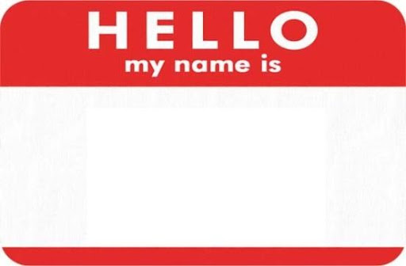
An Introduction to Disinfection
Disinfection

Slide 9
What is Disinfection?
Disinfection is the inactivation of pathogenic microorganisms
Sterilization is the destruction of all living organisms and is NOT disinfection

Slide 10
Disease Causing Viruses
Acute Health Effects
Hepatitis A
Rotavirus
Norovirus
Fatigue, Nausea, Abdominal Pain,
Loss of Appetite, Low-grade Fever
Gastroenteritis
Gastroenteritis
Notes:
Hepatitis A Virus from https://www.fda.gov/food/foodborne-pathogens/hepatitis-virus-hav
Rotovirus from Wikipedia By Dr Graham Beards, CC BY 3.0, https://commons.wikimedia.org/w/index.php?curid=5535228
Norovirus from CDC.gov

Slide 11
Disease Causing Bacteria
Escherichia coli
Shigella dysenteriae
Salmonella typhi
Vibrio cholerae
Mycobacterium tuberculosis
Gastroenteritis
Bacillary Dysentery
Typhoid Fever
Acute Health Effects
Cholera
Tuberculosis
Notes:
Ecoli image on Wikipedia by By Credit: Rocky Mountain Laboratories, NIAID, NIH - NIAID: These high-resolution (300 dpi) images may be downloaded directly from this site. All the images, except specified ones from the World Health Organization (WHO), are in the public domain. For the public domain images, there is no copyright, no permission required, and no charge for their use., Public Domain, https://commons.wikimedia.org/w/index.php?curid=104228
Shigella Image on Wikipedia by By Armed Forces Institute of Pathology, AFIP - https://phil.cdc.gov/Details.aspx?pid=22229, Public Domain, https://commons.wikimedia.org/w/index.php?curid=77323598
"Salmonella" by National Institutes of Health (NIH) is licensed under CC BY-NC 2.0
"Vibrio bacteria" by National Institutes of Health (NIH) is licensed under CC BY-NC 2.0
"Mycobacterium tuberculosis Bacteria" by NIAID is licensed under CC BY 2.0

Slide 12
Disease Causing Protozoa
Acute Health Effects
Giardia lamblia
Cryptosporidium
Giardiasis
Cryptosporidiosis
Notes:
Giardia image from Wikipedia By Dr. Stan Erlandsen (1988) - Public Health Image Library (PHIL) -- image #11632, Public Domain, https://commons.wikimedia.org/w/index.php?curid=9779989
Crypto cyst on Wikimedia Av Centers for Disease Control and Prevention - https://www.cdc.gov/parasites/crypto/, CC BY-SA 4.0, https://commons.wikimedia.org/w/index.php?curid=68364333

Slide 13
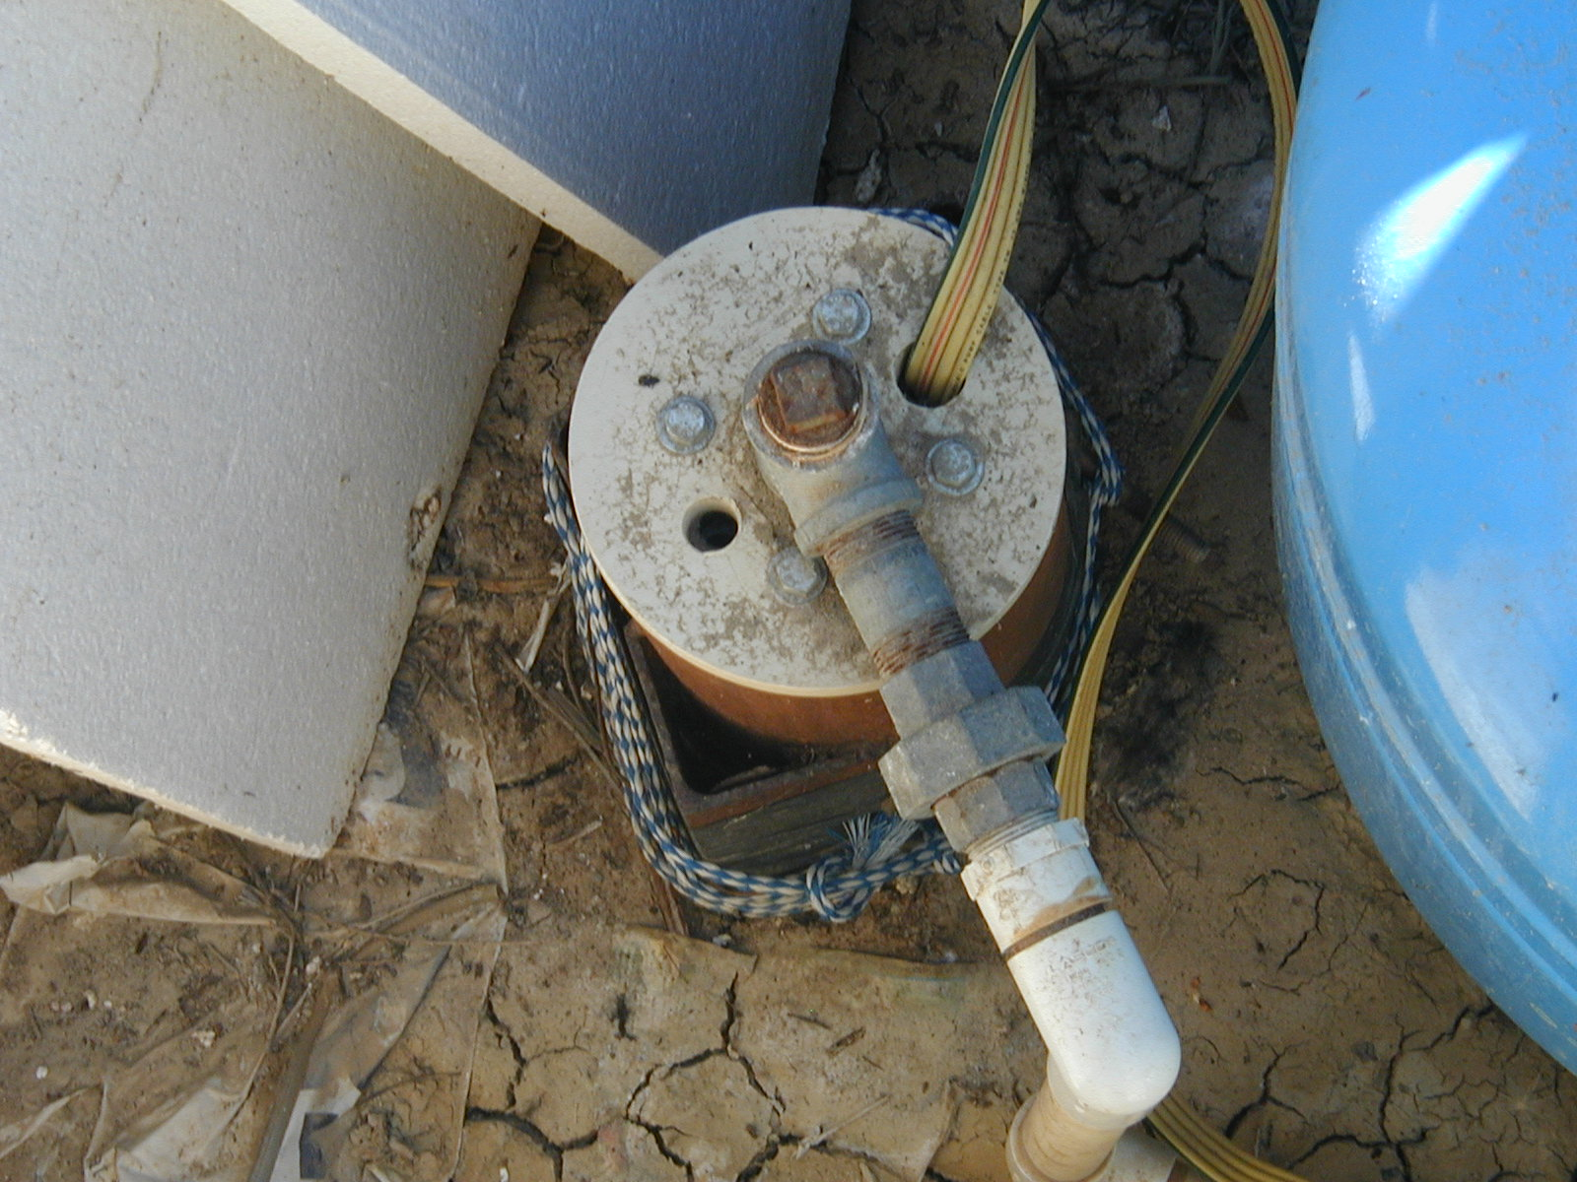
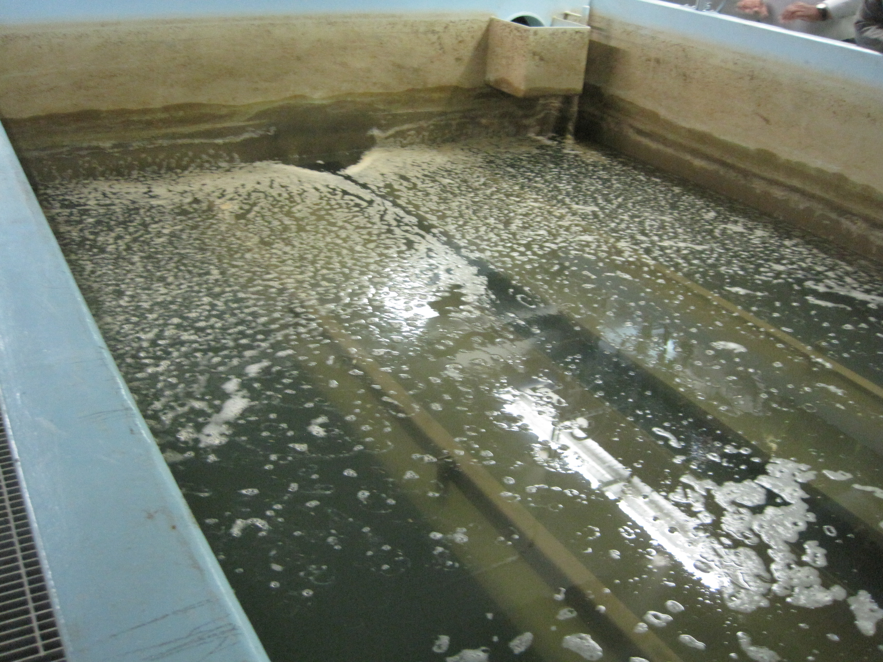
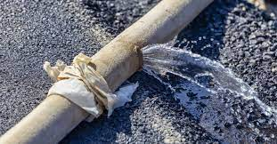
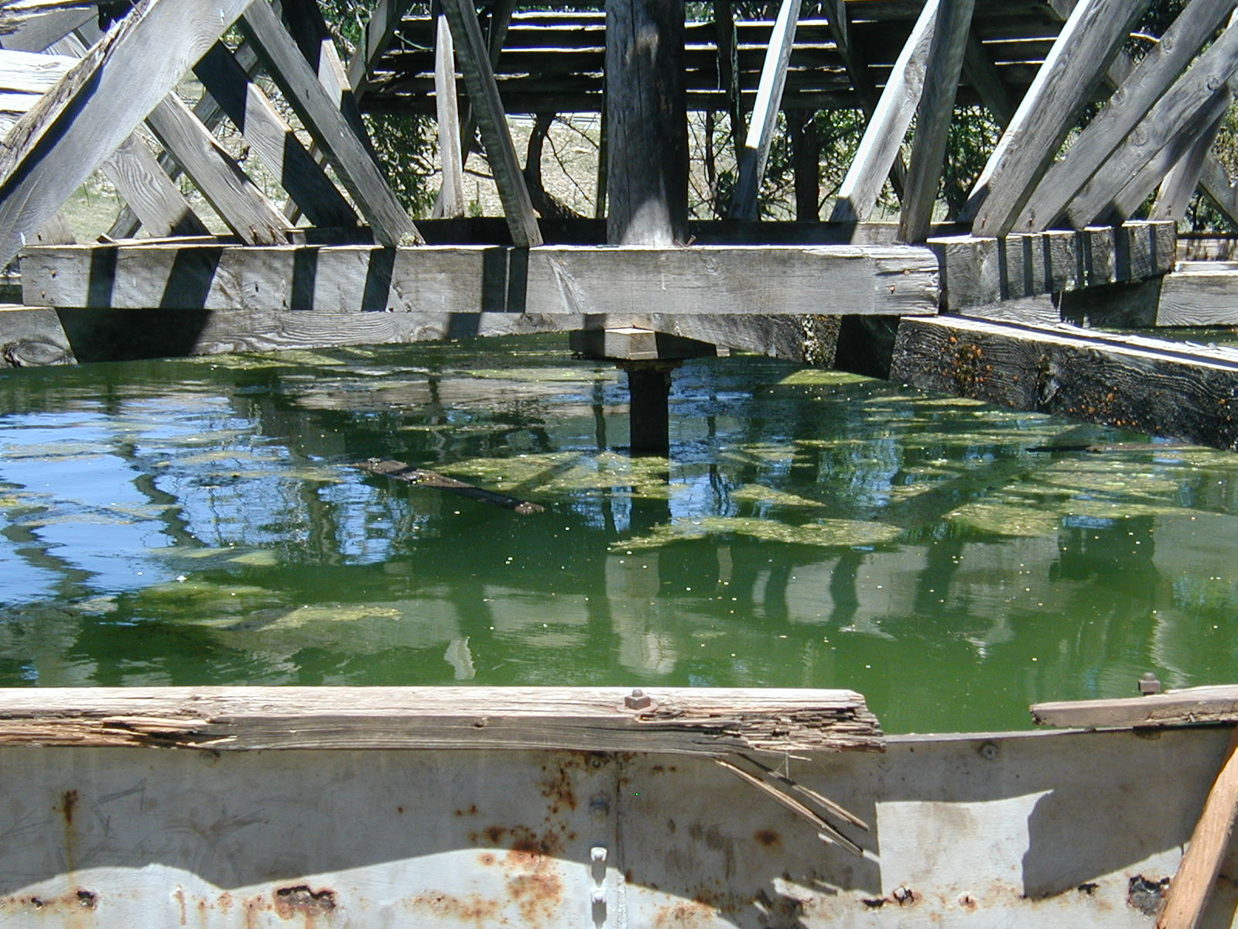
How can pathogens enter our drinking water systems?
DISINFECTION
Source Contamination
Treatment Contamination
Distribution Contamination
Storage Contamination

Slide 14
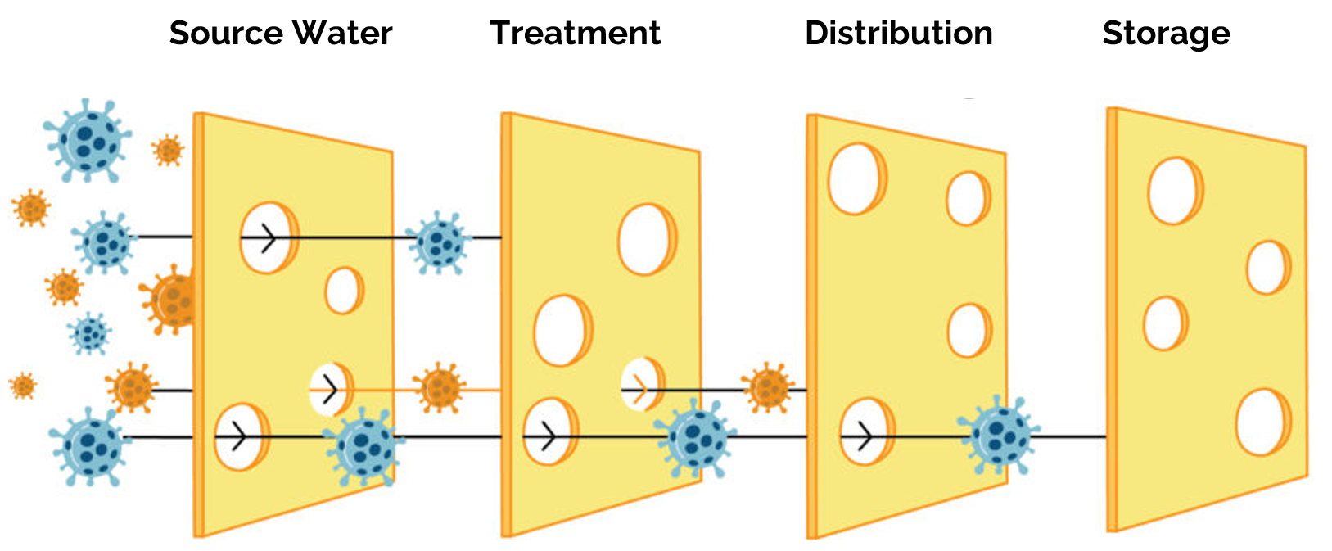
WATER TREATMENT
The second barrier to preventing waterborne disease using the Multiple Barrier Approach

Slide 15
Types of Disinfectants
Chloramines
Ozone
Chlorine
Chlorine Dioxide
Ultraviolet Light (UV)
Physical
Chemical
Notes:
Chlorine Dioxide Public Domain, https://commons.wikimedia.org/w/index.php?curid=832546
Chloramine molecule from wikipedia by By Benjah-bmm27 - Own work, Public Domain, https://commons.wikimedia.org/w/index.php?curid=1264855

Slide 16
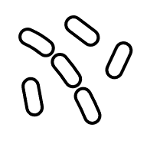


Chemical Disinfection Process
Oxidation – the oxidant steals electrons from the virus or cell’s enzymes so they can no longer perform metabolic functions

Slide 17
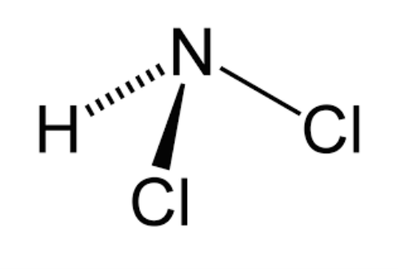


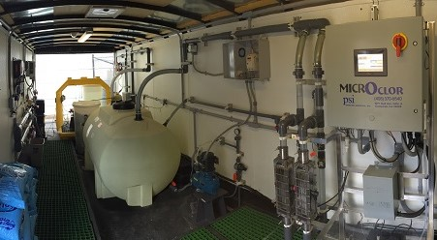
Chloramine Disinfection
Chemical
I’m #2!!!
Used as a drinking water disinfectant for >90 years
Used by >1 in 5 larger systems in the U.S.
Generated on-site when ammonia is added to water containing chlorine

Slide 18
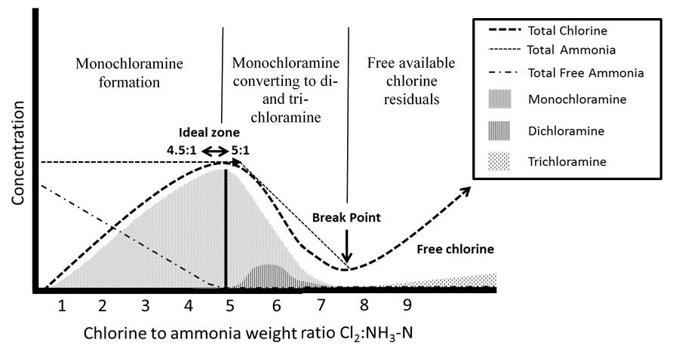
Measure TOTAL Chlorine
Chloramine Disinfection Objectives
Maximize monochloramines
Minimize free ammonia
Prevent excess dichloramines
Prevent breakpoint
From Guidelines for Canadian Drinking Water Quality
Technical Document Chloramines
Notes:
https://www.canada.ca/content/dam/hc-sc/images/services/publications/healthy-living/guidelines-canadian-drinking-water-quality-guideline-technical-document-chloramines/fig1-eng.jpg

Slide 19
Chloramine Disinfection
Advantages
Used as a secondary disinfectant with a long-lived combined chlorine residual that produces fewer halogenated disinfection byproducts
Disadvantages
Less effective as a primary disinfectant than chlorine
Can change water chemistry and impact lead & copper pipes – follow EPA guidance
Taste & odor issues

Slide 20
Chloramine Disinfection SDWA Regulations
Maximum Residual Disinfectant Level (MRDL) = 4.0 mg/L
Subject to the Stage 1 & 2 Disinfectant and Disinfection By Products Rules (D/DBPR)
  Monitor for Total Trihalomethanes (MCL = 80 ug/L)
  Monitor for Haloacetic Acids (MCL = 60 ug/L)
Notes:
https://www.canada.ca/content/dam/hc-sc/images/services/publications/healthy-living/guidelines-canadian-drinking-water-quality-guideline-technical-document-chloramines/fig1-eng.jpg

Slide 21
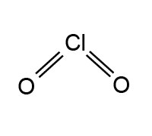
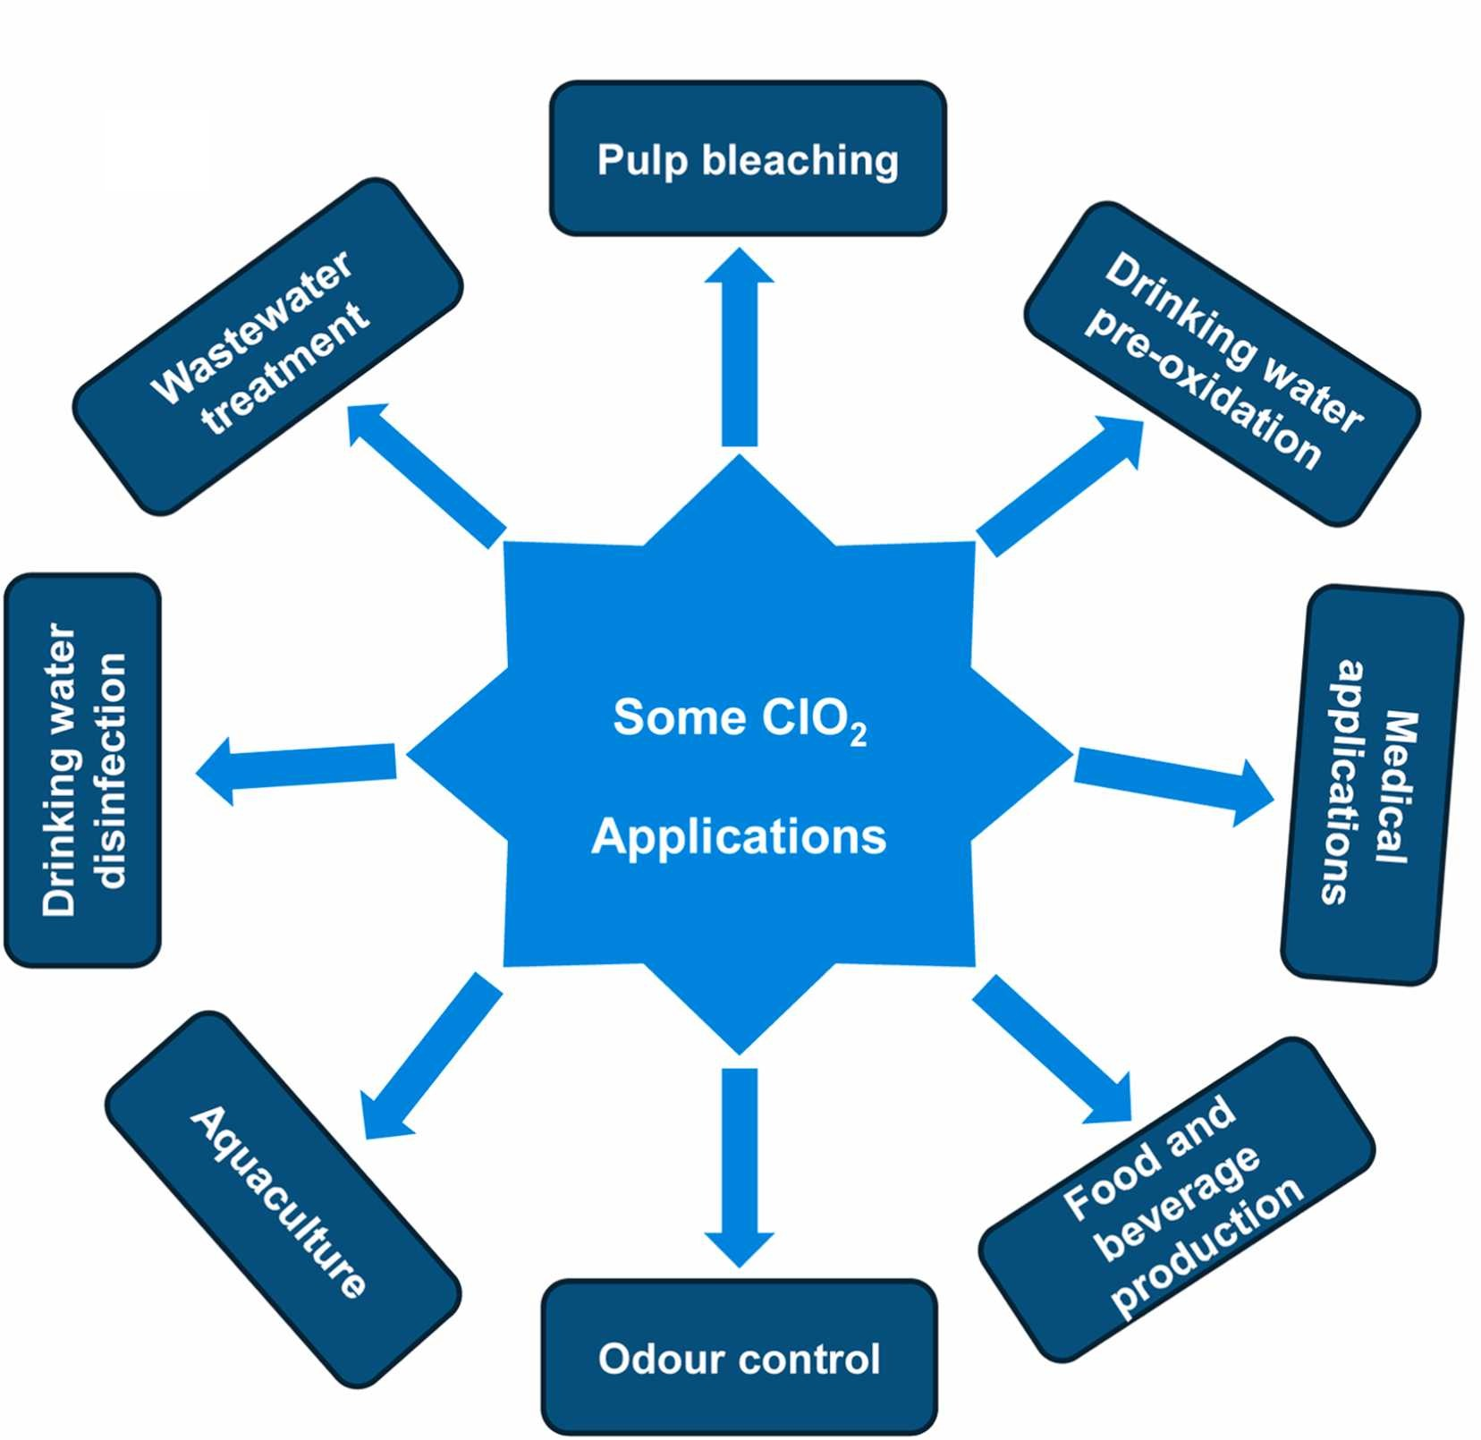
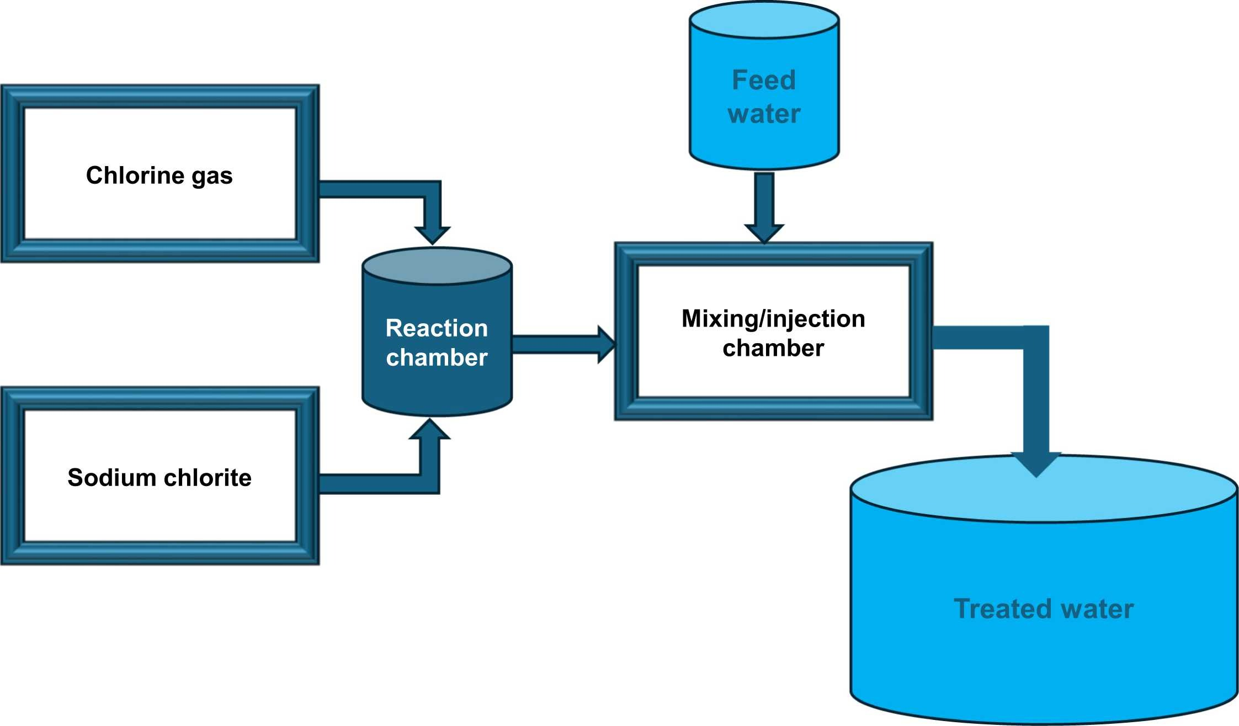
Chlorine Dioxide
Chemical
Yellow to reddish-yellow gas
On-site generation
Used by ~5% of large water systems in the U.S.
Notes:
Graphic from: https://www.sciencedirect.com/science/article/pii/S194439862500356X
Chlorine dioxide drinking water pre-oxidation and disinfection: A review of its effectiveness, mechanisms, and disinfection by-products
Author: M. Mzinyathi,V. Muthuraj,E.O. Ajala,B. Kakavandi,S. Janse van Rensburg,T.T.I. Nkambule,G. Mamba
Publication: Desalination and Water Treatment
Publisher: Elsevier
Date: July 2025

Slide 22
Chlorine Dioxide Disinfection
Advantages
Very effective disinfectant against viruses, bacteria, and cysts
Disadvantages
Storage and handling hazards of chemical precursors
Improves taste, odor, & color caused by chlorophenols and algae
Removes Fe & Mn
Less likely to form DBPs
pH neutral
More volatile than liquid chlorine
Chlorite byproduct (daily monitoring)
Higher initial costs

Slide 23
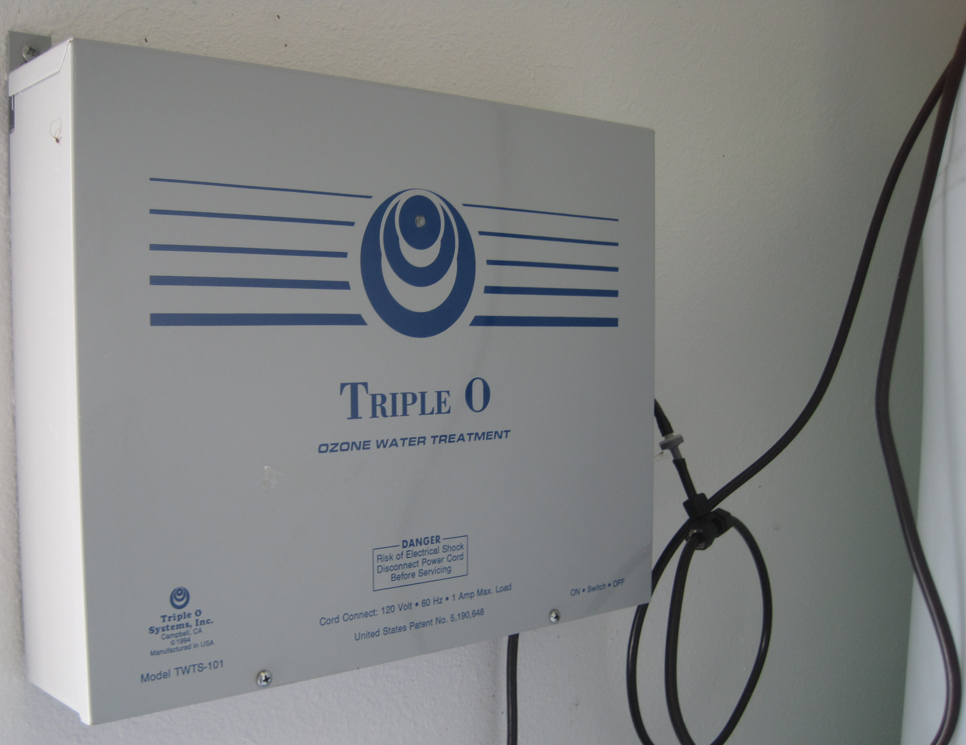
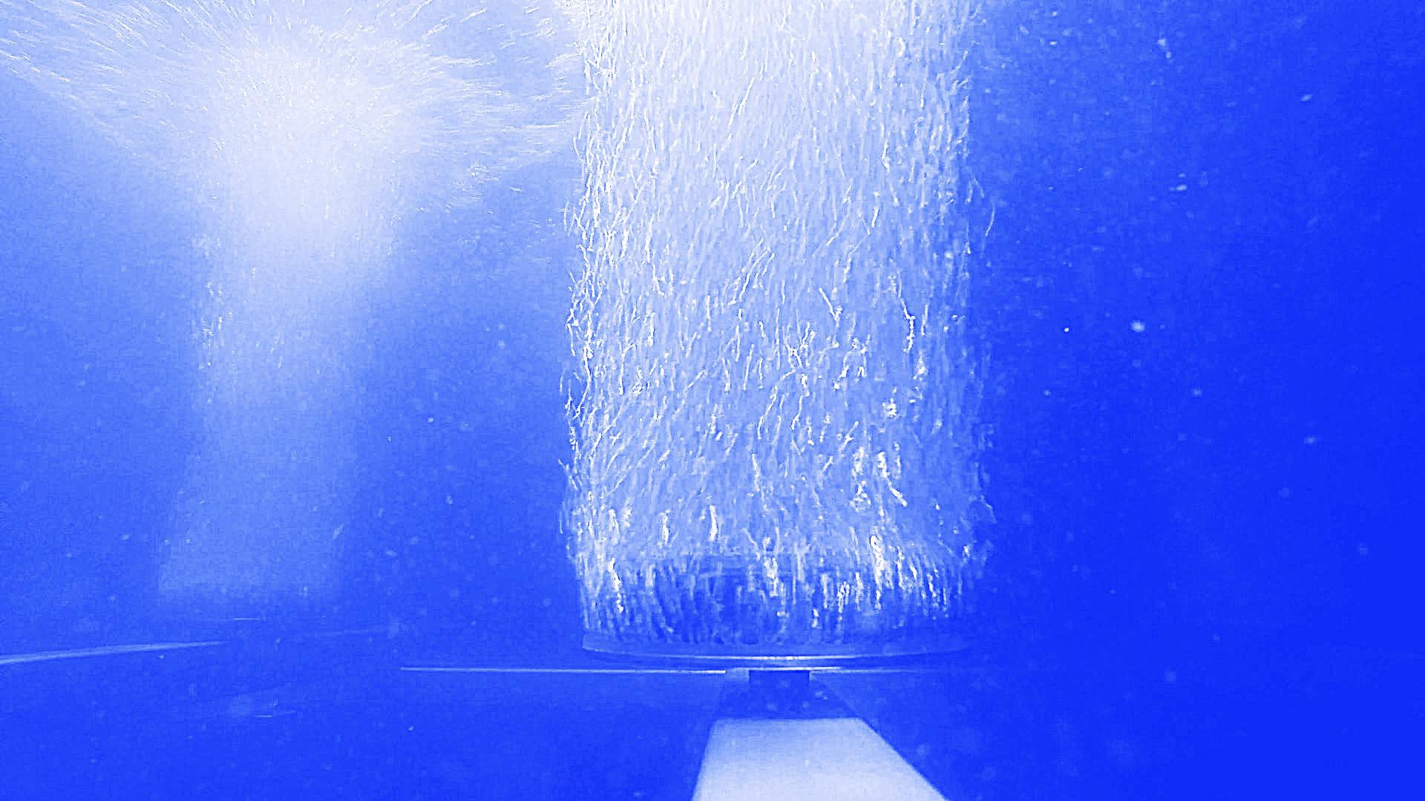
Ozonation
Chemical
Effective disinfectant for relatively clean source waters
Onsite generation with UV and compressed air
Can damage lungs due to oxidizing effect on tissue
  PPE = canister (carbon) respirator at low concentrations (0.3-10 ppm)
Submerged Bubbler

Slide 24
Ozone Disinfection
Advantages
Rapid and effective against Crypto oocysts, E.coli and other pathogens
Disadvantages
Quick decomposition
Removes precursors of organic DBPs
No residual
Bromate byproduct (monthly monitoring)

Slide 25
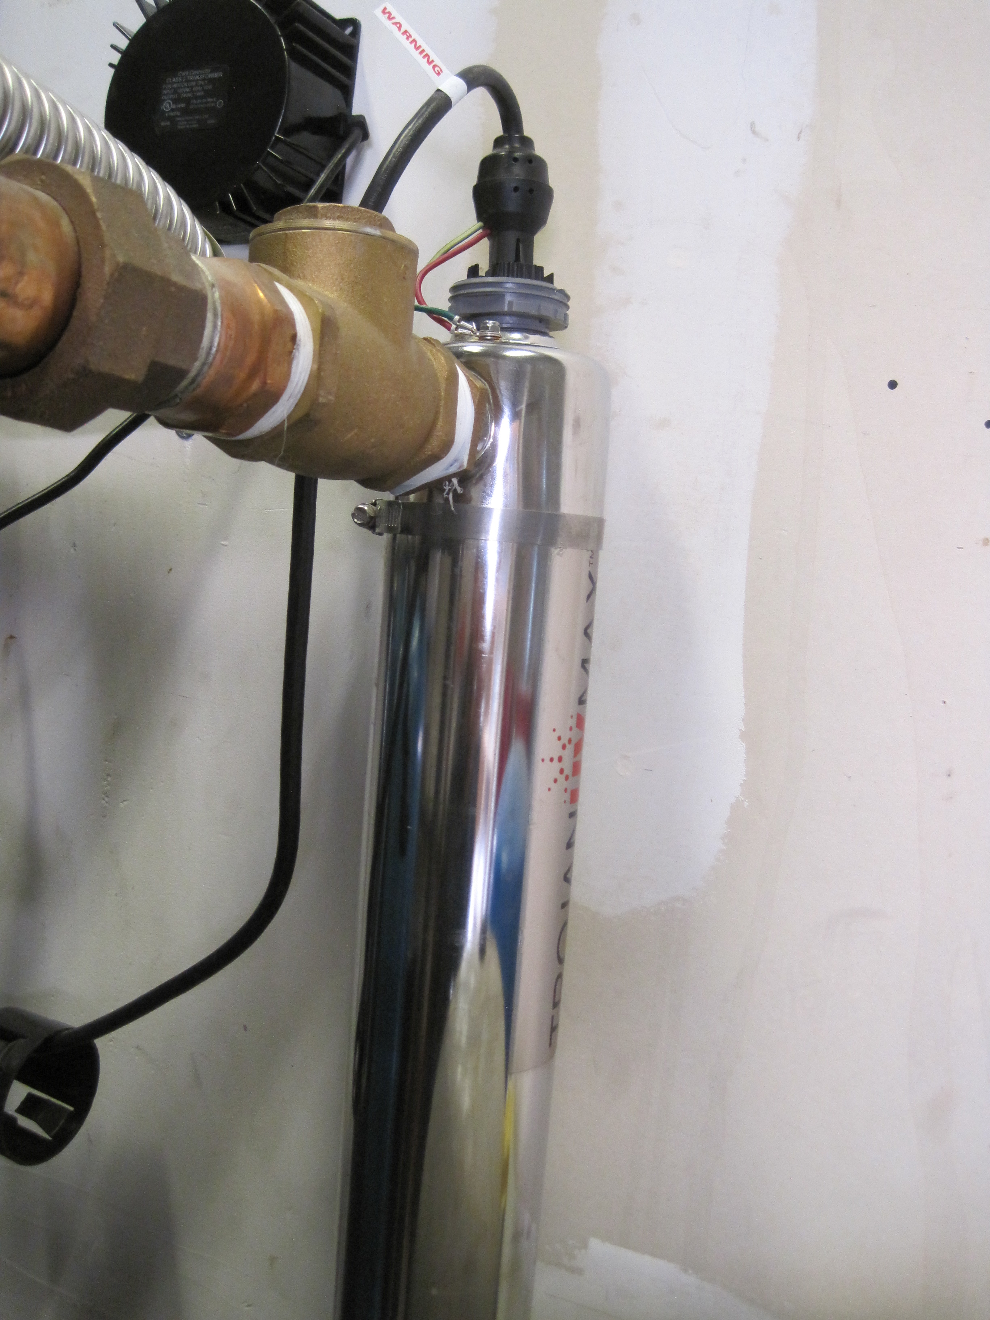



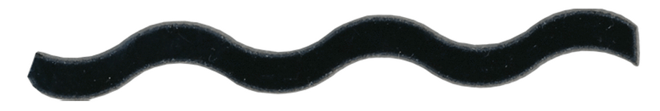
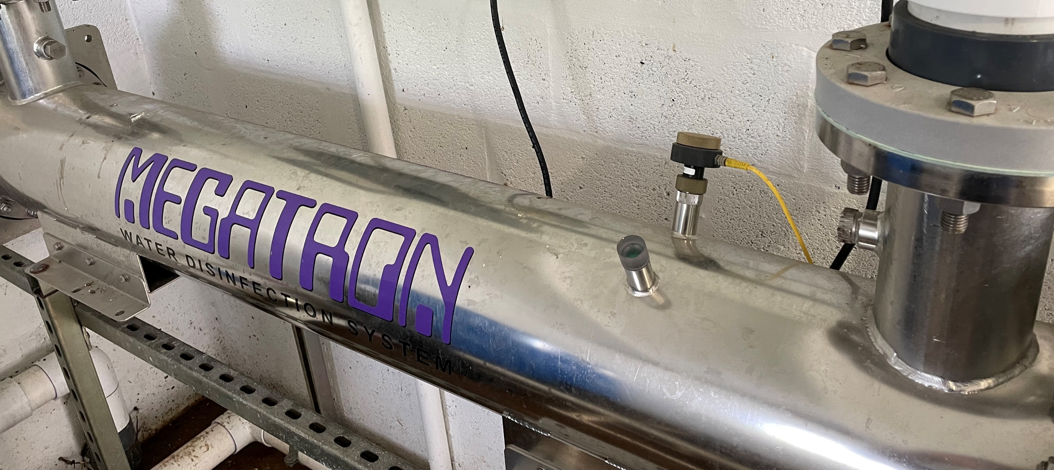
Ultraviolet Light
Physical
250 nm wavelength
Notes:
Bulbs are generally placed in-line with the flow of water, which is at a shallow depth, so all the water flows a close distance to the bulbs for a period of time.
SWEFC Photos

Slide 26
UV Disinfection
Advantages
Effective against Crypto and Giardia
Disadvantages
Source water needs to be clean
Short contact time
No chemical handling
No halogenated DBP formation
User friendly with minimal maintenance
Ineffective against some bacteria (adenovirus) and bacterial spores
Organisms may undergo self-repair
No residual in distribution

Slide 27
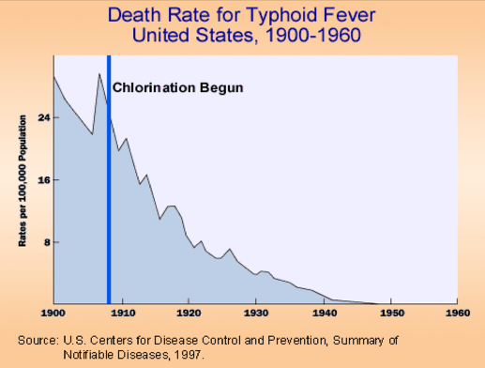
Chlorine Disinfection
Most Common Disinfectant in the U.S.
Chemical

Slide 28
Types of Chlorine
  1% = 10,000 mg/L Cl₂
Chlorine (Cl₂)
Gas
Calcium Hypochlorite
(CaOCl)
Liquid
10-12.5% (30-50 gallon drums)
Compresses to a liquid
Bleach = 4.75-8.25%
~1 month shelf life
Sodium Hypochlorite
(NaOCl)
Solid
1-3% mixed by operator
~1-year shelf life
Handling hazards
100% chlorine
Notes:
Cl2 gas photo https://hu.wikipedia.org/wiki/Szerkeszt%C5%91vita:Boro/Arch%C3%ADv03

Slide 29
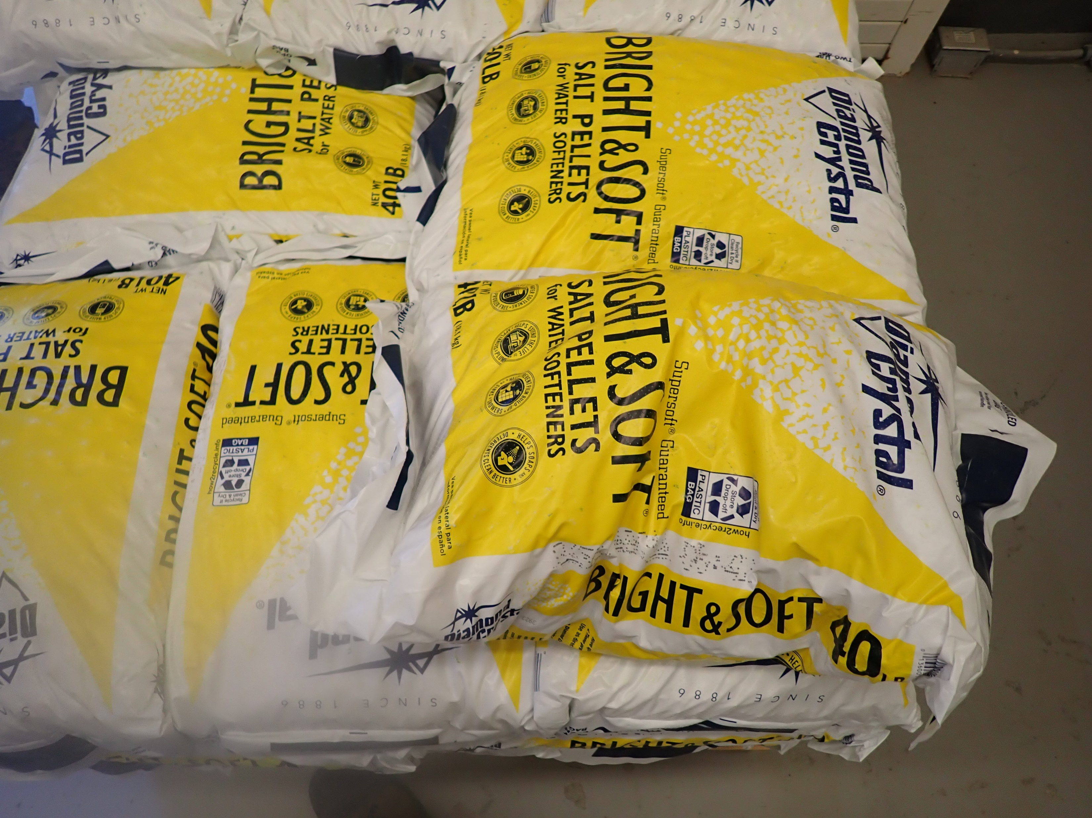
On-site Generation of Sodium Hypochlorite
NaCl + H₂O + energy = NaOCl + H₂
Creates low concentration NaOCl (0.4-0.8 ppm)

Slide 30
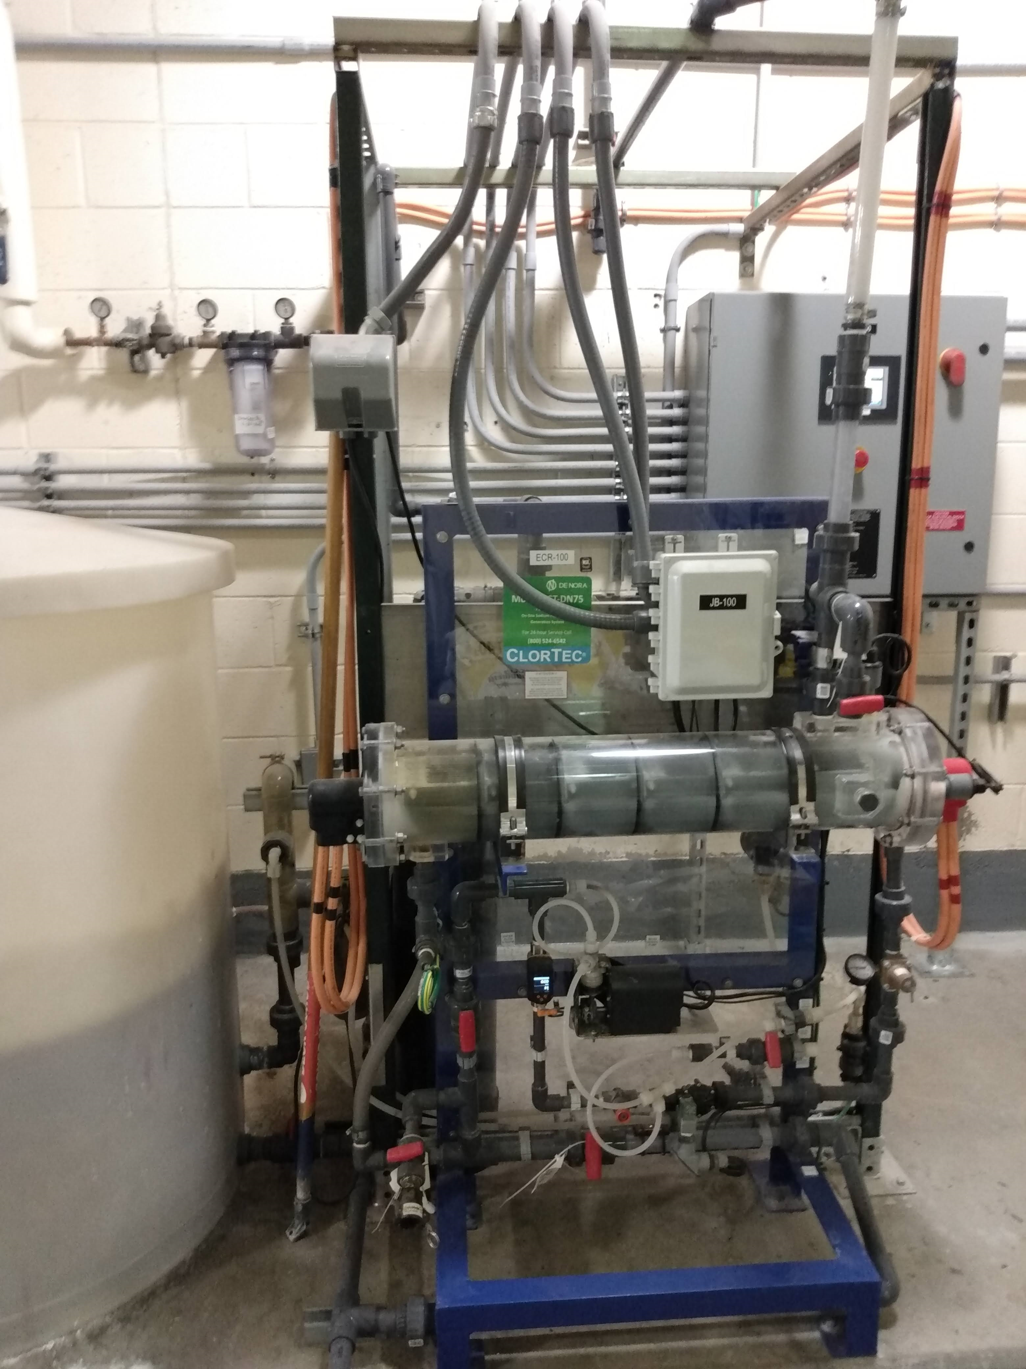
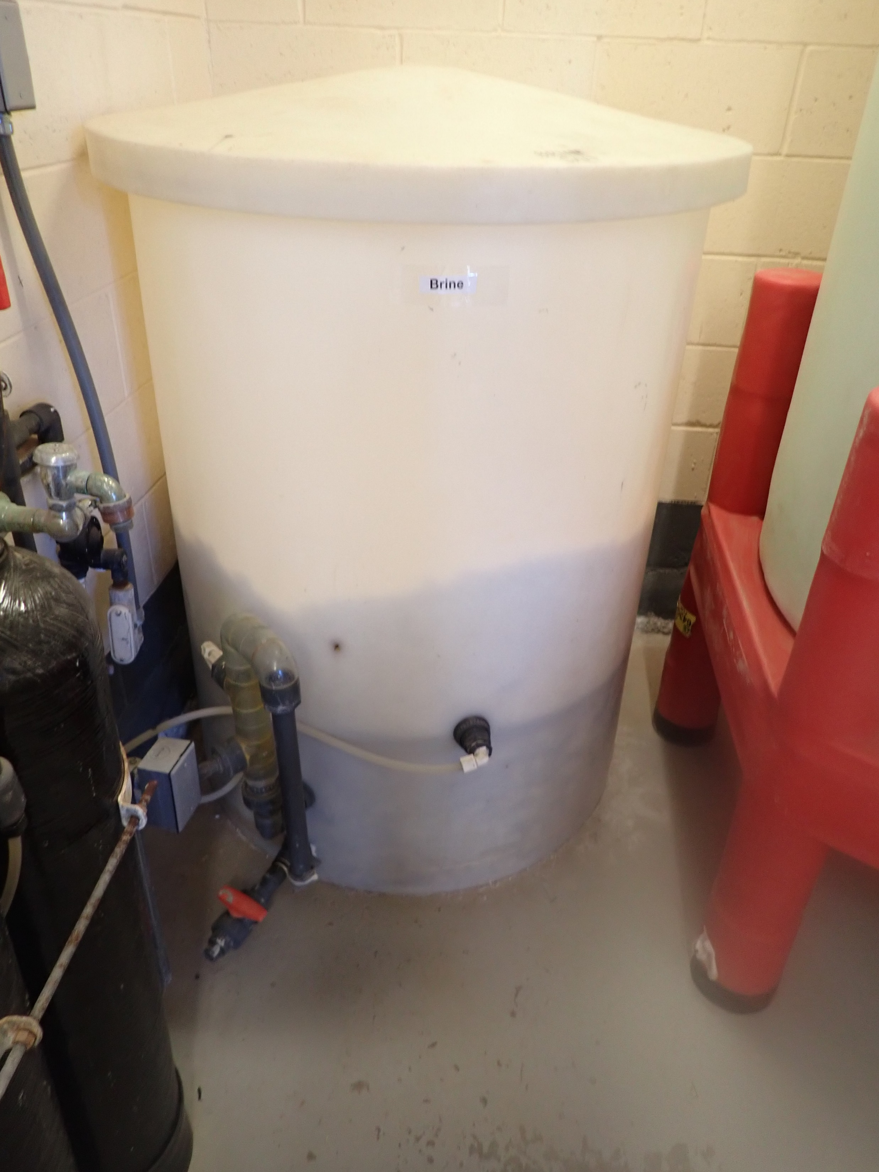
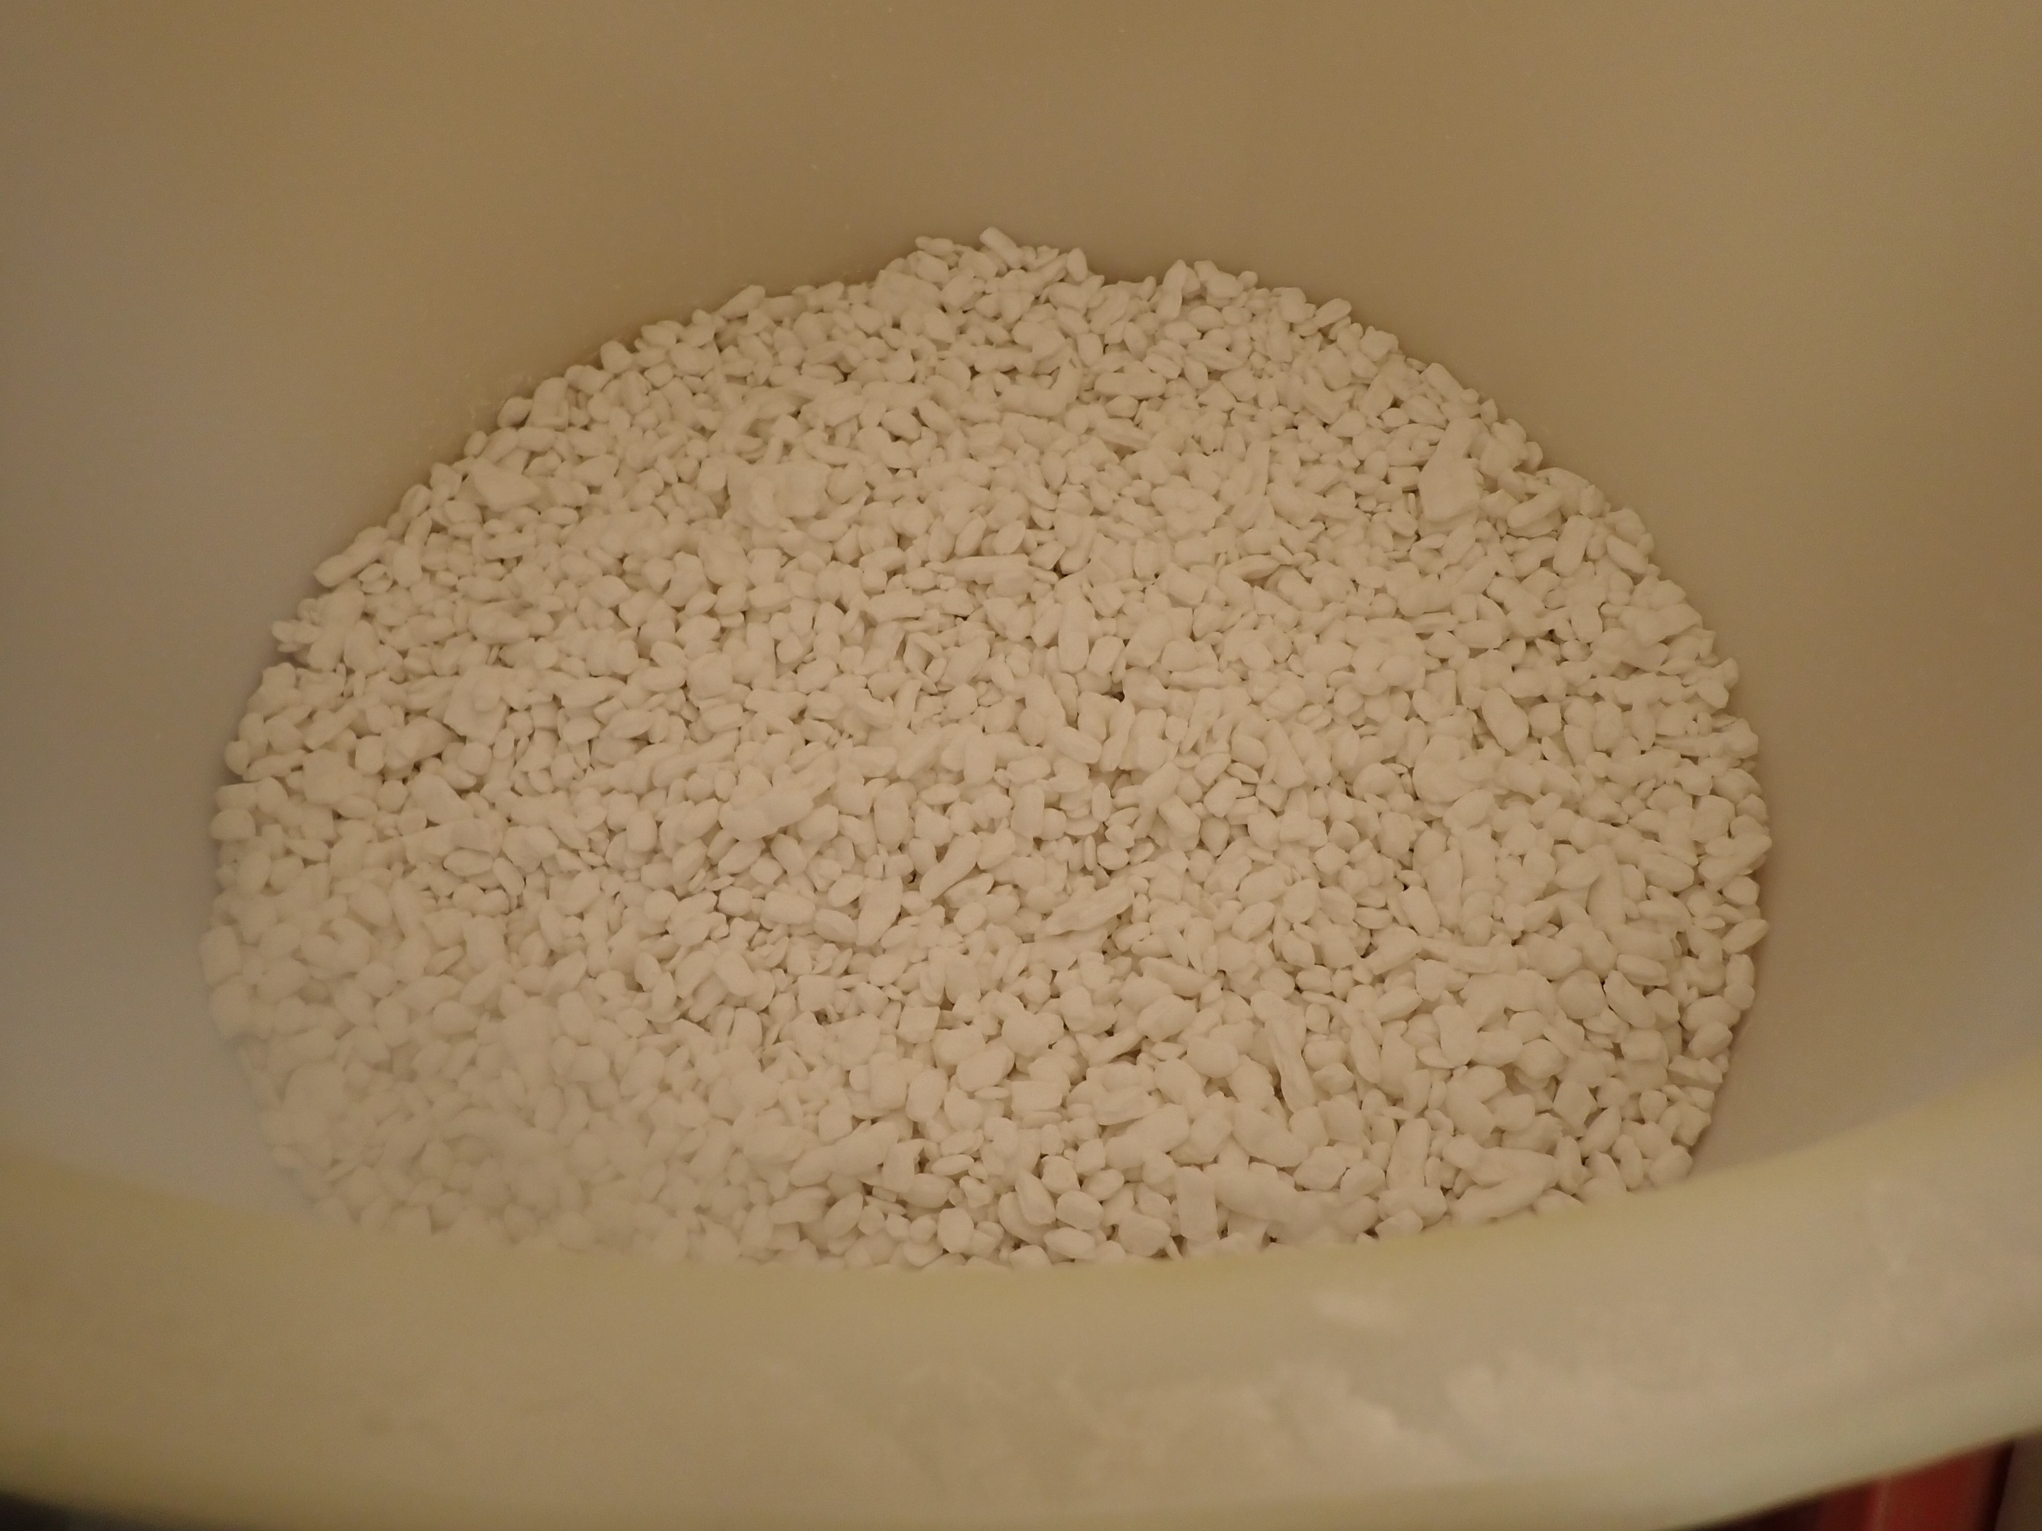
On-site Generation of Sodium Hypochlorite

Slide 31
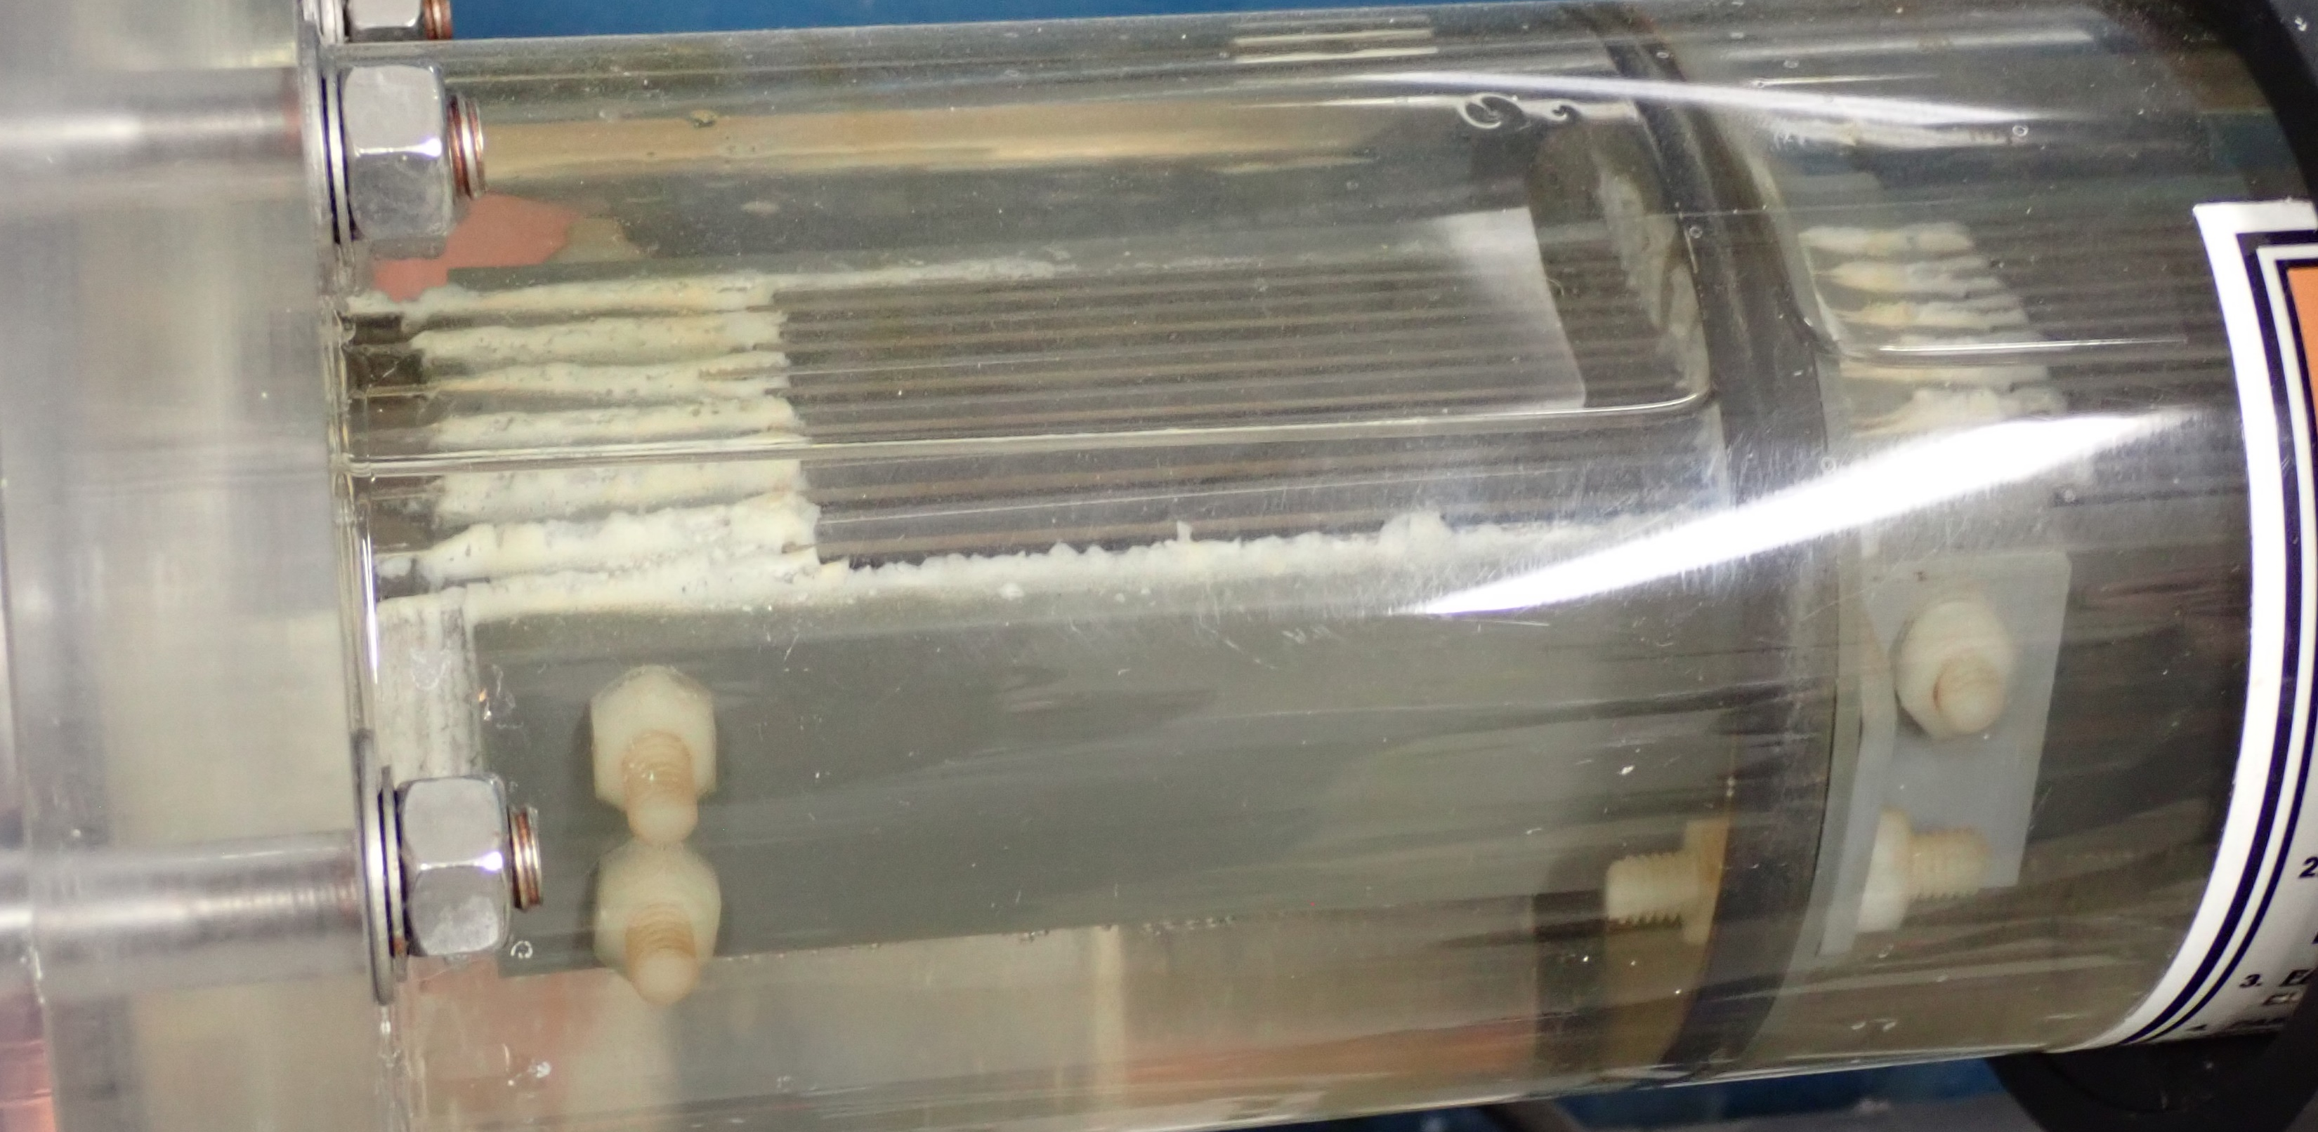
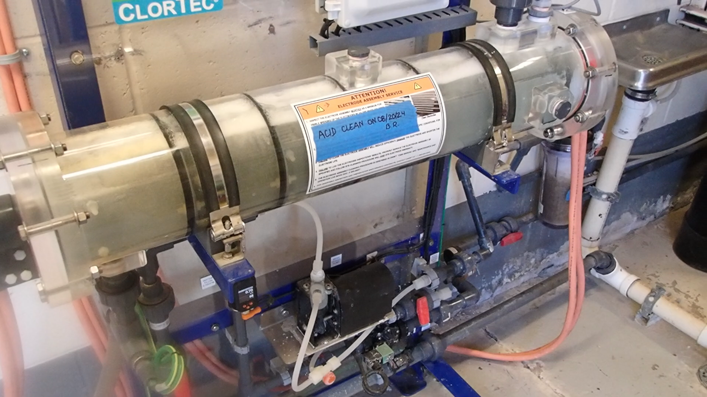
On-site Generation of Sodium Hypochlorite

Slide 32
Chlorine Disinfection
Advantages
High germicidal power
Disadvantages
Used up quickly
Highly soluble in water
Cost less than other methods & readily available
Measure residual to evaluate effectiveness
Strong residual protection in distribution
Formation of disinfection byproducts (DBPs)
Increases corrosiveness
Risk of accidental release

Slide 33
Chlorine Disinfection
SDWA Regulations
Same As Chloramines
Maximum Residual Disinfectant Level (MRDL) = 4.0 mg/L
Subject to the Stage 1 & 2 Disinfectant and Disinfection By Products Rules (D/DBPR)
  Monitor for Total Trihalomethanes (MCL = 80 ug/L)
  Monitor for Haloacetic Acids (MCL = 60 ug/L)
Notes:
https://www.canada.ca/content/dam/hc-sc/images/services/publications/healthy-living/guidelines-canadian-drinking-water-quality-guideline-technical-document-chloramines/fig1-eng.jpg

Slide 34
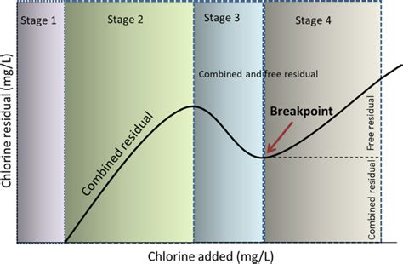
Measure FREE Chlorine
Chlorine Disinfection Objectives
Reach breakpoint
Minimize chloramines and combined chlorine
Demand
From Nature.com
Notes:
https://www.canada.ca/content/dam/hc-sc/images/services/publications/healthy-living/guidelines-canadian-drinking-water-quality-guideline-technical-document-chloramines/fig1-eng.jpg

Slide 35
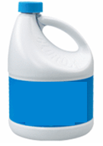
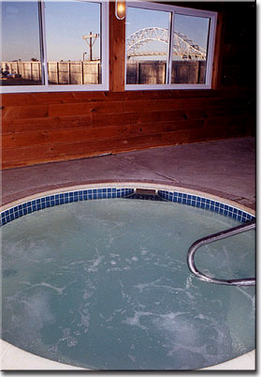
Oooh… That Smell!
Chloramine odor (Often confused w/ strong “chlorine” odor)
Slight chlorine odor
Clean, fresh smell
Pungent to acrid smell
It’s the difference that causes burning eyes and skin rashes after using a pool or hot tub

Slide 36

How Chlorine Disinfection Works

Slide 37
Chlorine & Water
First Reaction
Cl₂ + H₂O = HOCl + HCl
Cl₂ = Chlorine
H₂O = Water
HOCl = Hypochlorous Acid
HCl = Hydrochloric Acid

Slide 38
Chlorine & Water
Second Reaction
HOCl = H⁺ + OCl⁻
HOCl = Hypochlorous Acid
H⁺ = hydrogen ion
OCl⁻ = hypochlorite ion
HOCl is more effective as a disinfectant than OCl- (100-300 times greater)

Slide 39

Factors that Affect Chlorine Disinfection

Slide 40
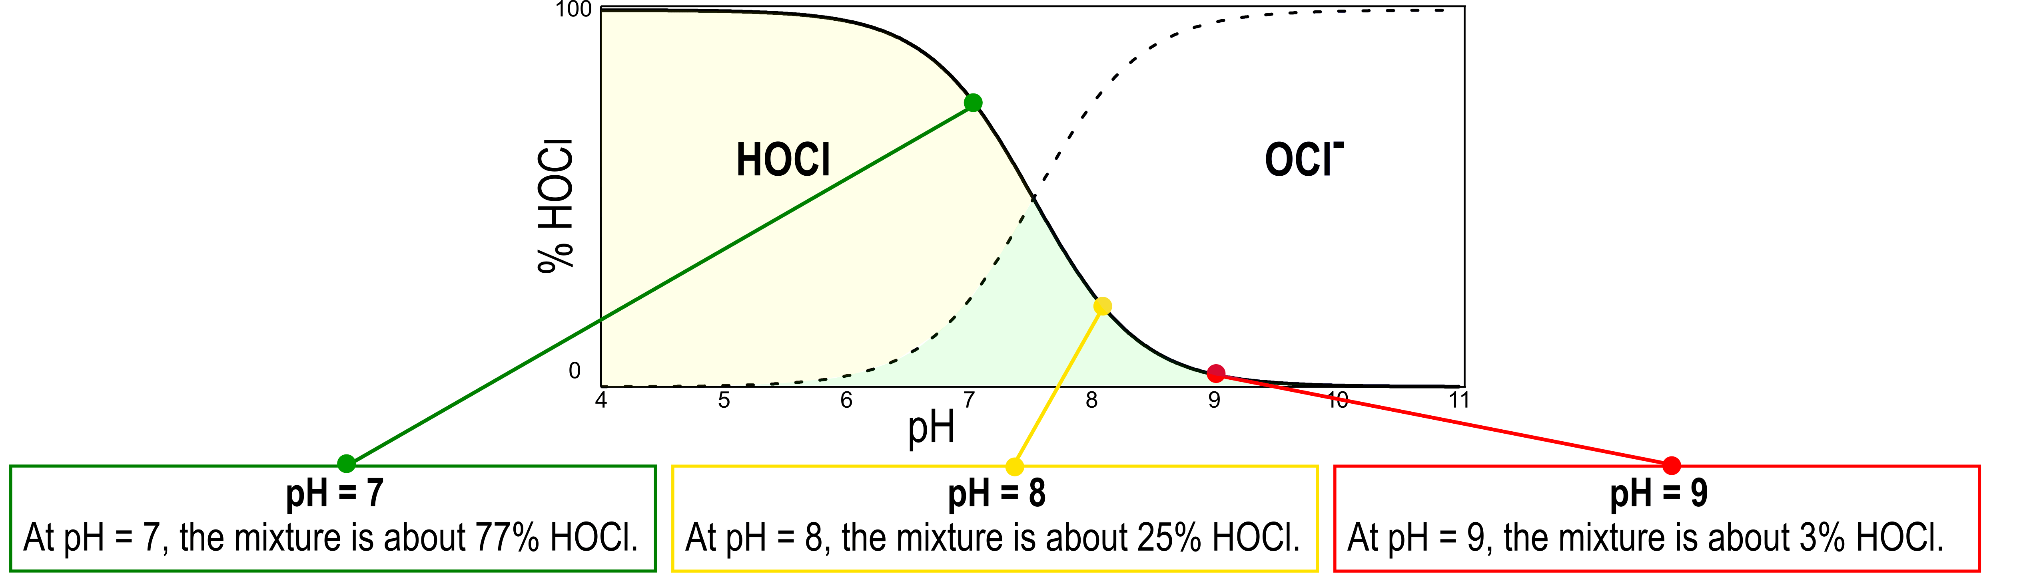
Factors That Affect Chlorine Disinfection
pH
  Better disinfection occurs at lower pHs

Slide 41
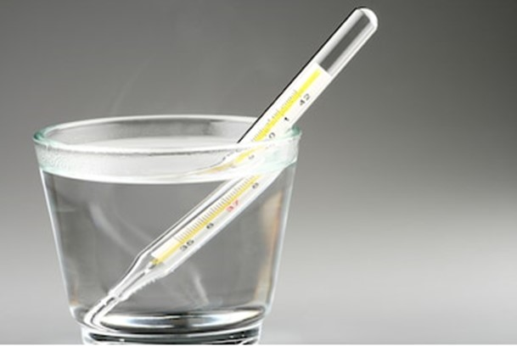
Factors That Affect Chlorine Disinfection
Water Temperature
The colder the water, the longer the contact time
The warmer the water, the shorter the contact time
The warmer the water and the surrounding environment, the more chlorine dissipates into the atmosphere

Slide 42
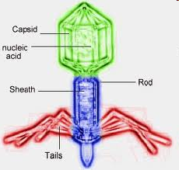
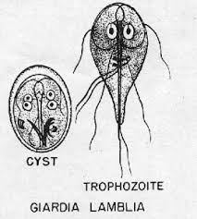
Factors That Affect Chlorine Disinfection
Type of Organism
Viruses are much harder to kill than bacteria and require higher chlorine dosages
Some protozoans are extremely resistant to chlorine and may not be affected at all
  Cryptosporidium
  Giardia
*That’s why surface water systems and GWUDI systems must also provide filtration in addition to disinfection*
Notes:
42

Slide 43
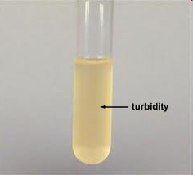

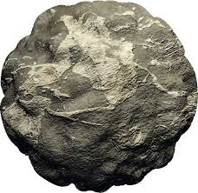

Factors That Affect Chlorine Disinfection
Interfering Agents
Organic Materials
Minerals
Turbidity
Interfering agents increase the chlorine demand in the distribution system
Notes:
43

Slide 44
Factors That Affect Chlorine Disinfection
Type of Residual
Nitrogen compounds present in the water combine with HOCl and form chloramines
  Inorganic ammonia
  Organic proteins and amino acids
Chloramines are Combined Residual Chlorine
Combined chlorine is available for disinfection

Slide 45
Factors That Affect Chlorine Disinfection
Type of Residual
The amount of hypochlorous acid (HOCl) or hypochlorite ion (OCl⁻) that has not combined with nitrogen compounds and is still available is measured as:
Free Residual Chlorine
Free chlorine is available for disinfection

Slide 46
Factors That Affect Chlorine Disinfection
Type of Residual
Required minimum of 0.2 mg/L everywhere in the distribution system if surface water
Recommend 0.2 mg/L everywhere if ground water
Higher at the EP
This level will vary with different systems
FREE RESIDUAL CHLORINE
IS THE BEST DISINFECTANT

Slide 47
Chlorine Disinfection
Terminology Review

Slide 48
Chlorine Dosage
The total amount of chlorine fed into a volume of water (expressed as mg/L)
Most operators record pounds or gallons per day. This is the FEED RATE, not the dosage.
DOSAGE = DEMAND + RESIDUAL

Slide 49
Chlorine Demand
The difference between the amount of chlorine fed (dosage) and the residual chlorine remaining
The amount of chlorine consumed or bound up by material in the water (expressed as mg/L)
This chlorine is NOT available for residual (free or total)
DEMAND = DOSAGE - RESIDUAL
Notes:
Chlorine reacts with iron, manganese, organic matter, turbidity & microorganisms. This is the demand

Slide 50
Chlorine Residual
The amount of chlorine remaining after the chlorine demand is satisfied (expressed as mg/L)
This chlorine IS available for further disinfection
RESIDUAL = DOSAGE - DEMAND

Slide 51
Three Types of Chlorine Residual
Total
Combined
Free
TOTAL = COMBINED + FREE

Slide 52
Calculate Chlorine Residual
Calculate the residual chlorine if the demand is 2.0mg/L and the dosage is 2.8 mg/L
Residual Cl₂ = Dosage – Demand
Residual Cl₂= 2.8 mg/l – 2.0 mg/L
What do we know?
Residual Cl₂ = Dosage – Demand
Demand = 2.0 mg/L
Dosage = 2.8 mg/L
Residual Cl₂= 0.8 mg/L
This equation can be re-arranged to solve for any of the given parameters by isolating the unknown
Residual = Dosage – Demand
Dosage = Residual + Demand

Slide 53
Next time:
Date | Topic
6/26/25 | Program Overview, Test Format, Study & Test Tips
7/10/25 | Drinking Water System Overview - (Source, Treatment, & Distribution)
7/24/25 | Basic Operator Math (+, -, /, x, Exponents and basic algebra)
8/7/25 | Applied Operator Math (e.g. Areas, Volume, Flow Rates, Detention Time, Pressure/Hydraulic Head)
8/21/25 | Drinking Water Regulations
9/4/25 | Source Water Characteristics
9/18/25 | Surface Water Intake Components, Well Components, and O&M
10/2/25 | Disinfection 1: Chloramines, UV, Chlorine Dioxide, Chlorine
10/16/25 | Disinfection 2: Chlorine Disinfection Application for Sodium Hypochlorite and Gas Chlorine (including storage and safety)
10/30/25 | Disinfection 3: Distribution System Application, Residual Measurement, Evaluation & Adjustment,
11/13/25 | Disinfection 4: Chlorine Disinfection Math
12/4/25 | Surface Water Treatment 1: Coagulation, Flocculation, Sedimentation (including chemistry, process controls, operations)
12/18/25 | Surface Water Treatment 2: Filtration
Links to recordings and material are available on our website at https://swefc.unm.edu/home/op-cert-trainings/

Slide 54
CONTACT INFORMATION
SW EFC email: swefc@unm.edu
Department of Civil Engineering MSC01 1070
1 University of New Mexico
Albuquerque, NM 87131
505-277-0644
swefc@unm.edu
http://swefc.unm.edu

