Slide 1





US Territories Wastewater Operator Training Series
Session 6: Collection Systems - Pumping & Force Mains
09/03/2025
www.efcnetwork.org
This program is made possible under a cooperative agreement with US EPA.
Notes:
Welcome to all of our participants from CNMI, Guam and American Samoa. Today is the second of three Collection Systems focused webinars. Today we’ll be focusing on Pumping and Force mains . Then in our next session we’ll cover Collections system maintenance.

Slide 2


Your trainers for today:
Dawn Nall
Research Engineer
Valeria Cortes-Mora
Professional Intern

Slide 3



Notes:
Heather introduction

Slide 4


Slide 5

WPI/ABC Operator Certification
Notes:
This series is designed to supplement and reinforce the ABC Need to Know Criteria for the Wastewater Operator level 1 and 2 exams though there will be some higher level topics covered, and we won’t always follow the exact order listed in the NTKs
https://www.gowpi.org/services/abc-testing/standardized-exams/standardized-wastewater-treatment-operator-exams/

Slide 6
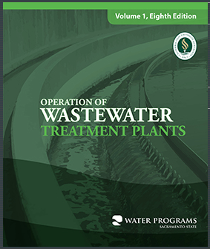
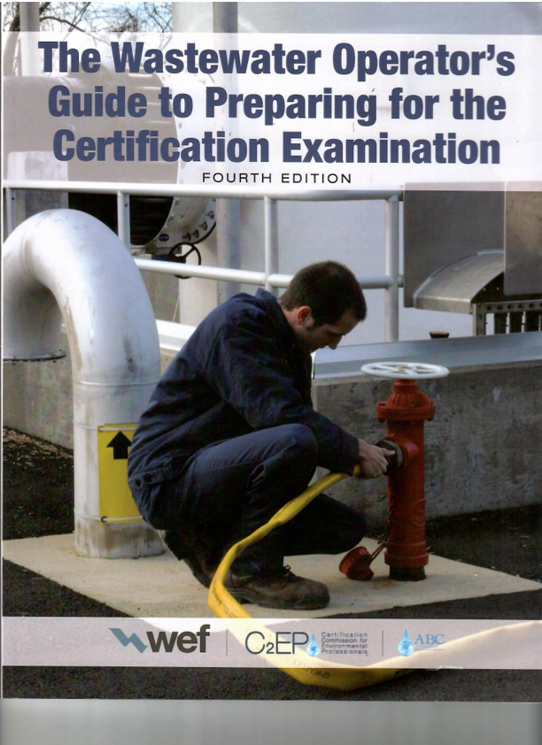
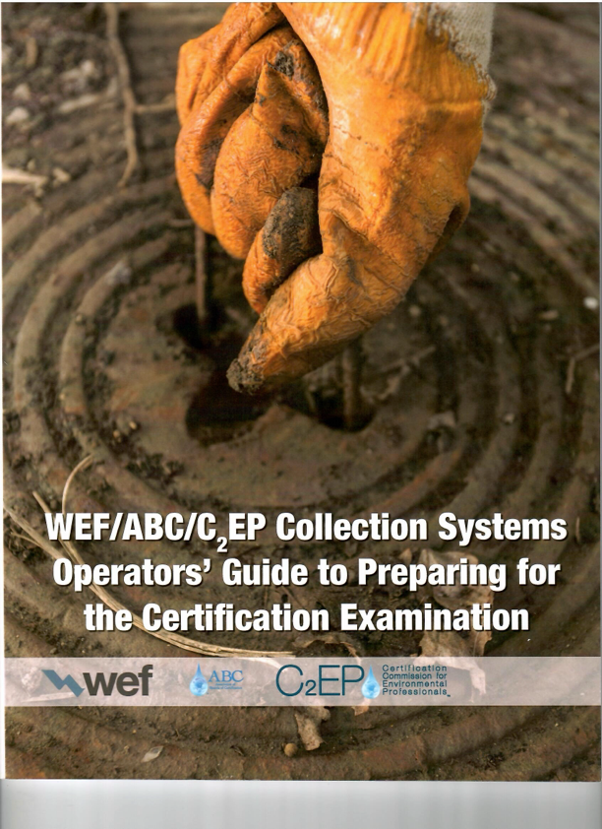
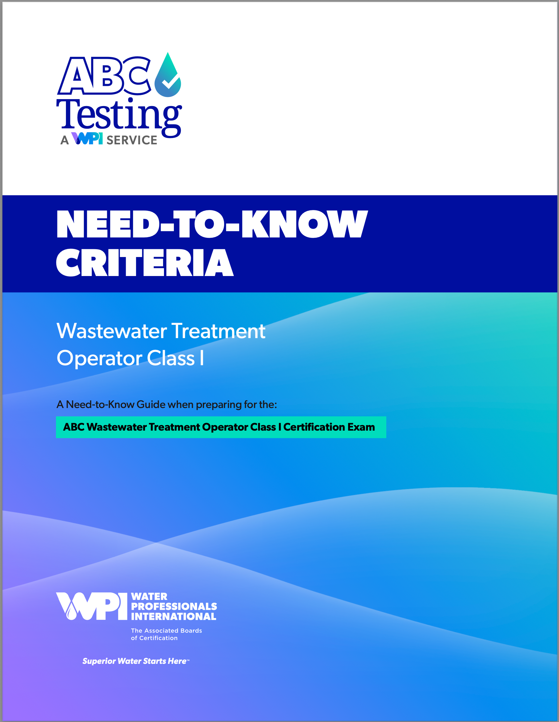
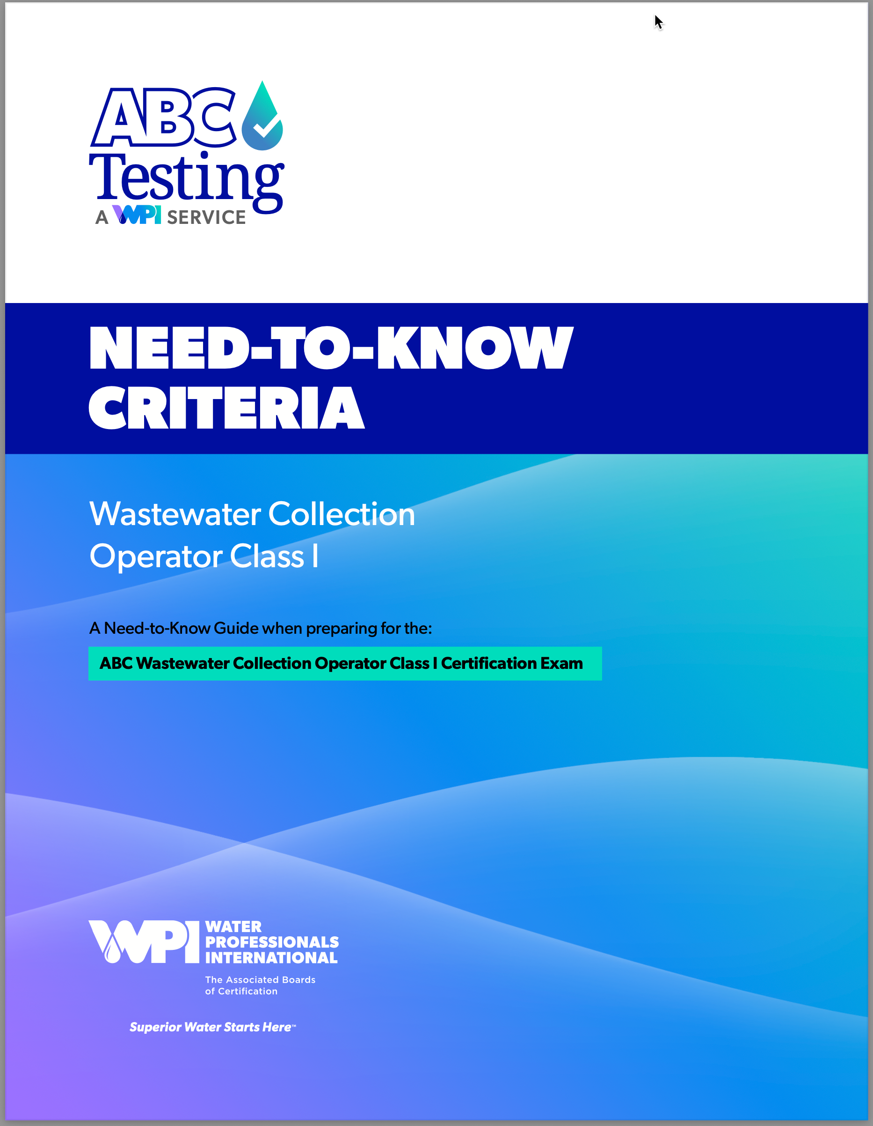
Notes:
I want to point out that WPI really has 3 wastewater Operator certification tracks – Wastewater Collection operator, Wastewater treatment operator, and biological industrial waste Treatment operator. For the purposes of this training series, and these collection systems sessions we’ll be focusing on the first two, and as we’ve said many times before, familiarizing yourself with the need to knows for the test you plan on taking is a critical step to passing the exam
I also want to point out that although a lot of what we’re covering over the next few sessions is Collection Operator focused, ether is quite a bit of overlap, and even if there weren’t it is critical for treatment operators to understand how collection systems work, are operated and maintained, and for collection system operators to understand the treatment processes because they are two parts of a complete systems or process, and as we’ll see over the next few session actions taken (or not taken) in the collection system can have a significant impact on the treatment facility.
Finally, there are several resources available that you can use for exam prep that are useful and available from places like Amazon, including these two guides (CLICK) that are full of sample questions for all four levels of certification for both the treatment and collection system tests, and of course
(CLICK) the sacramento State Operations Guides
So

Slide 7
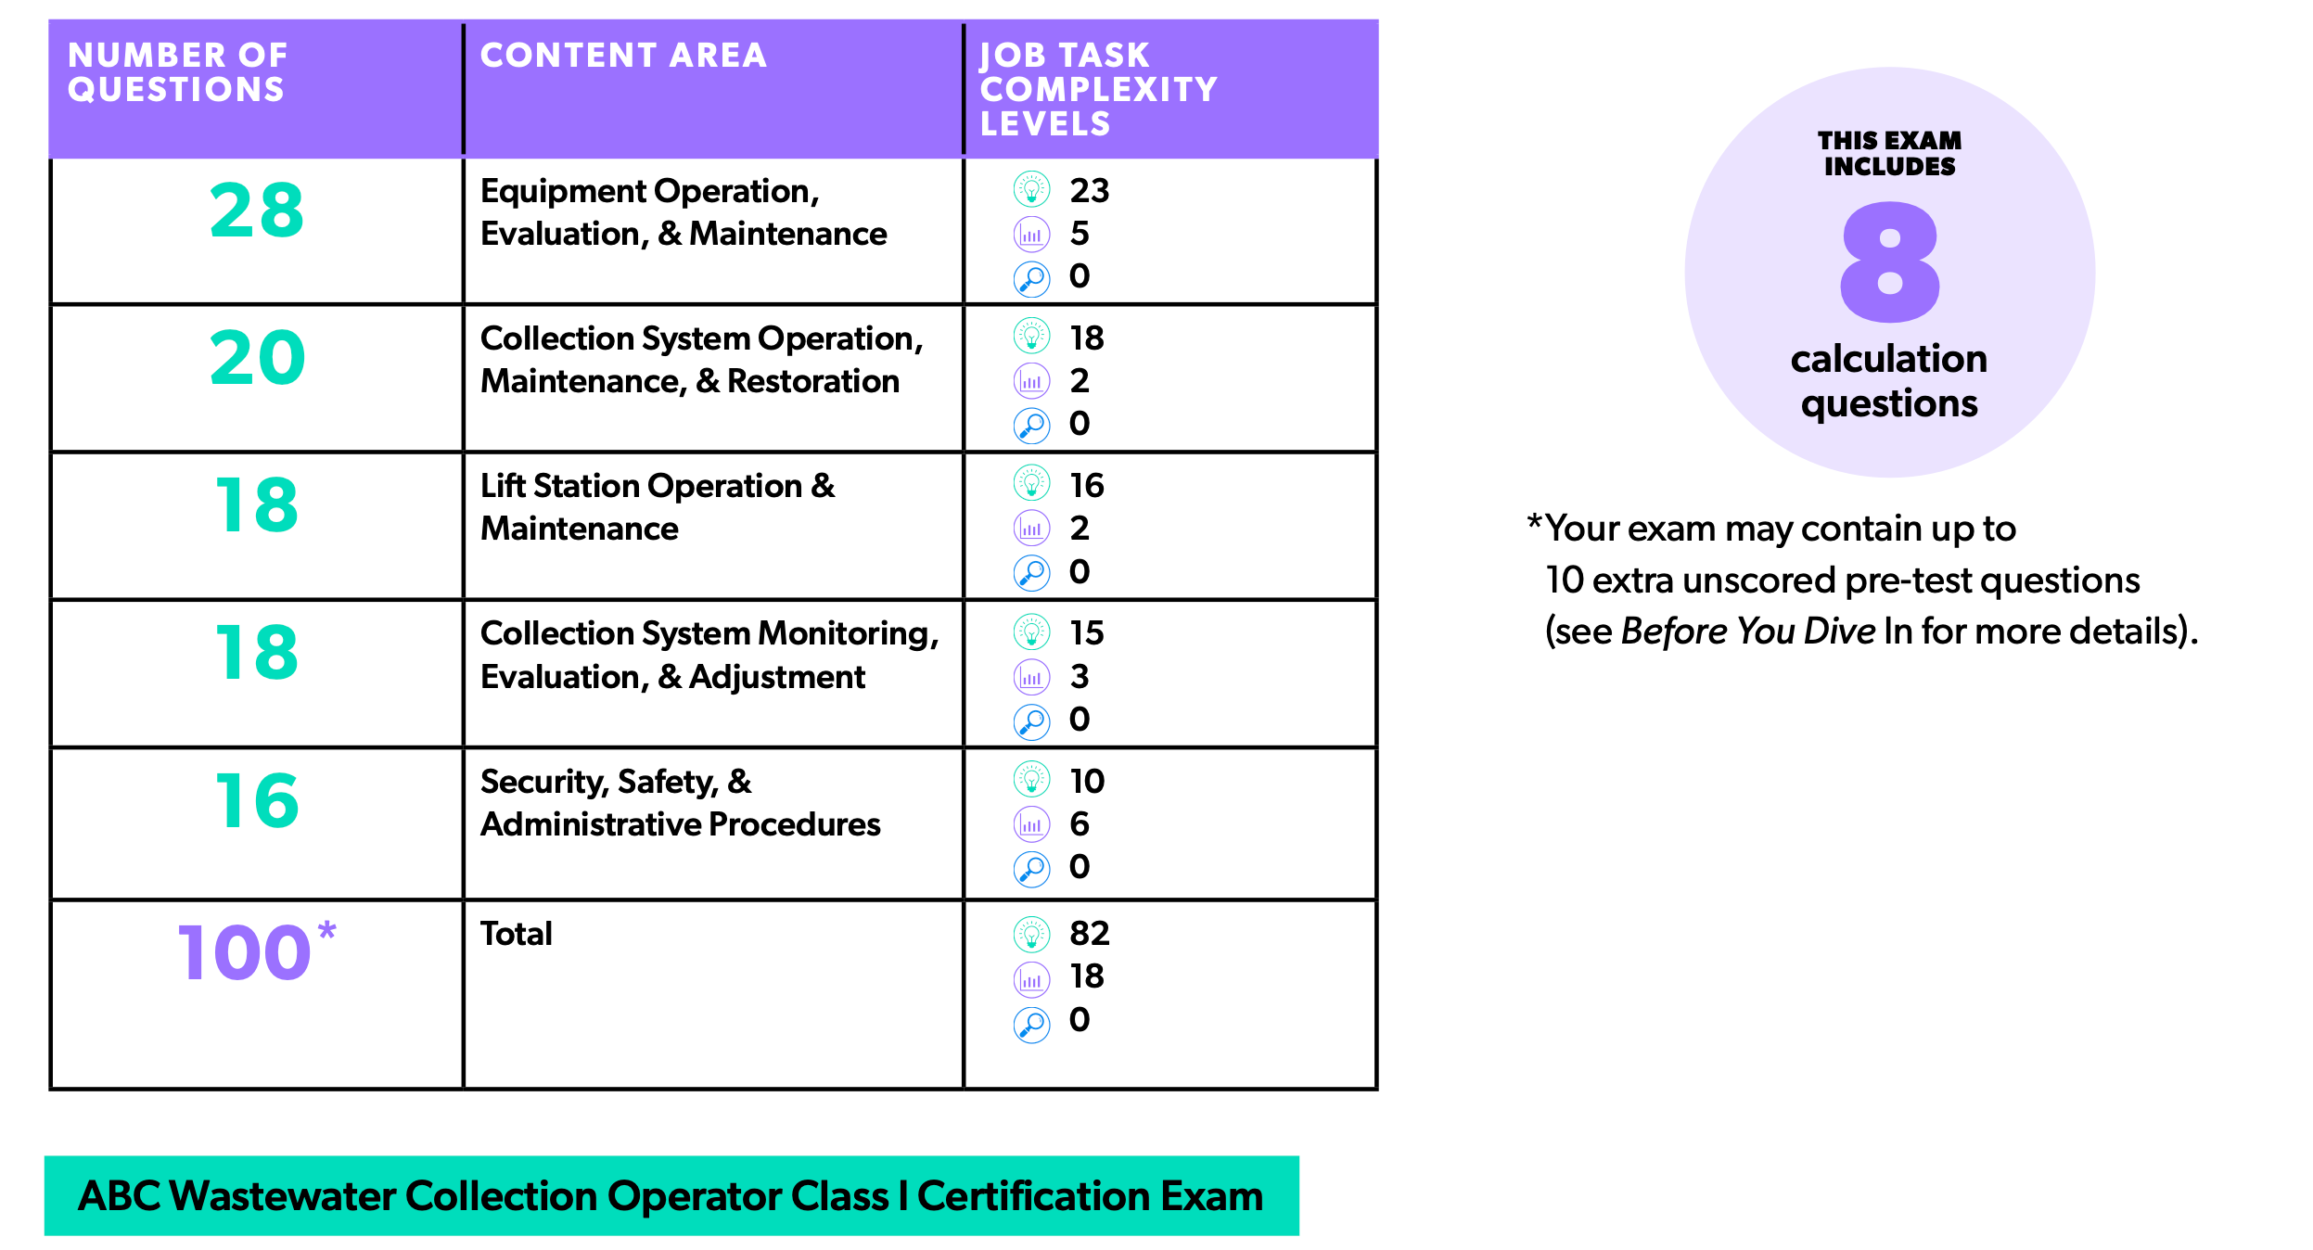
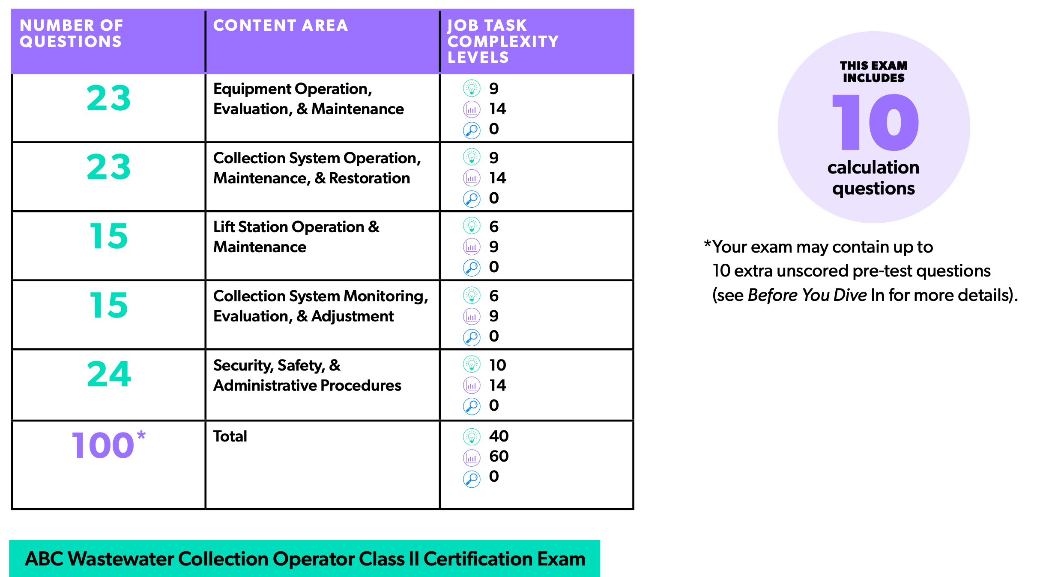
Collection Operator Exam Content

Slide 8
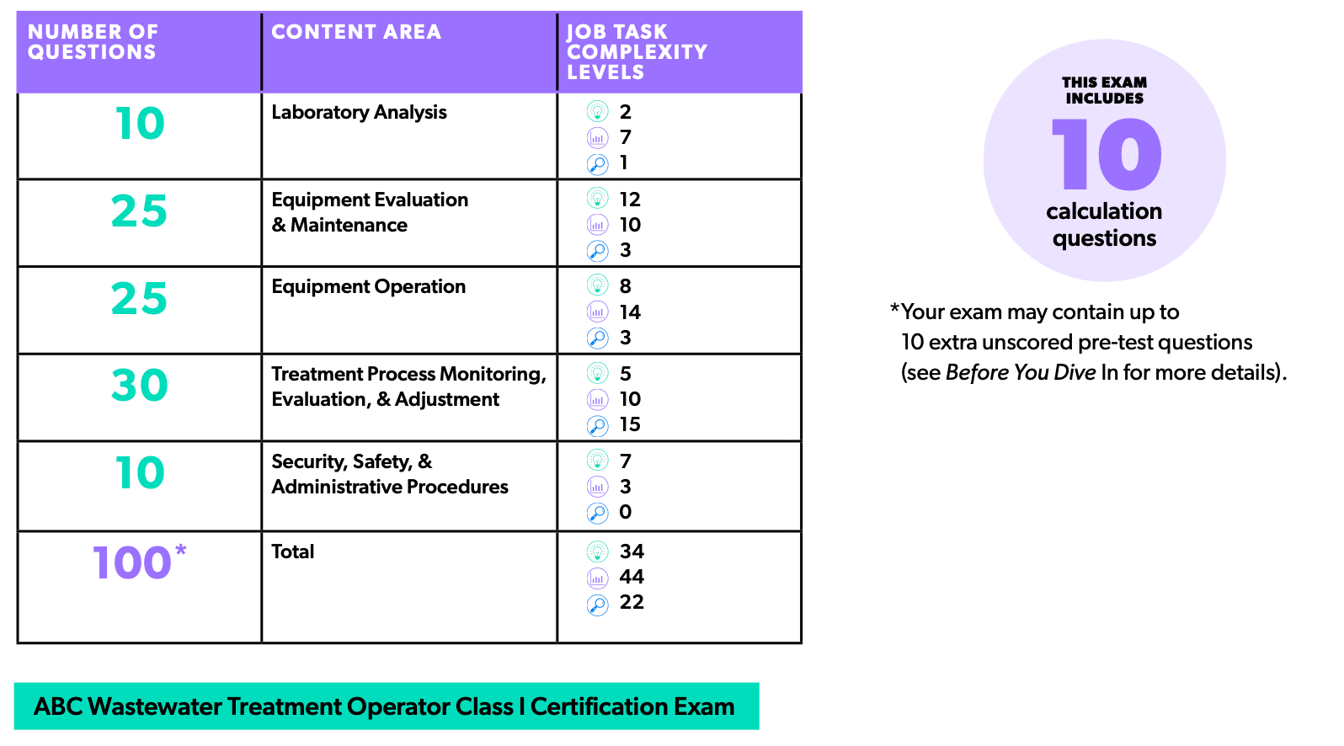
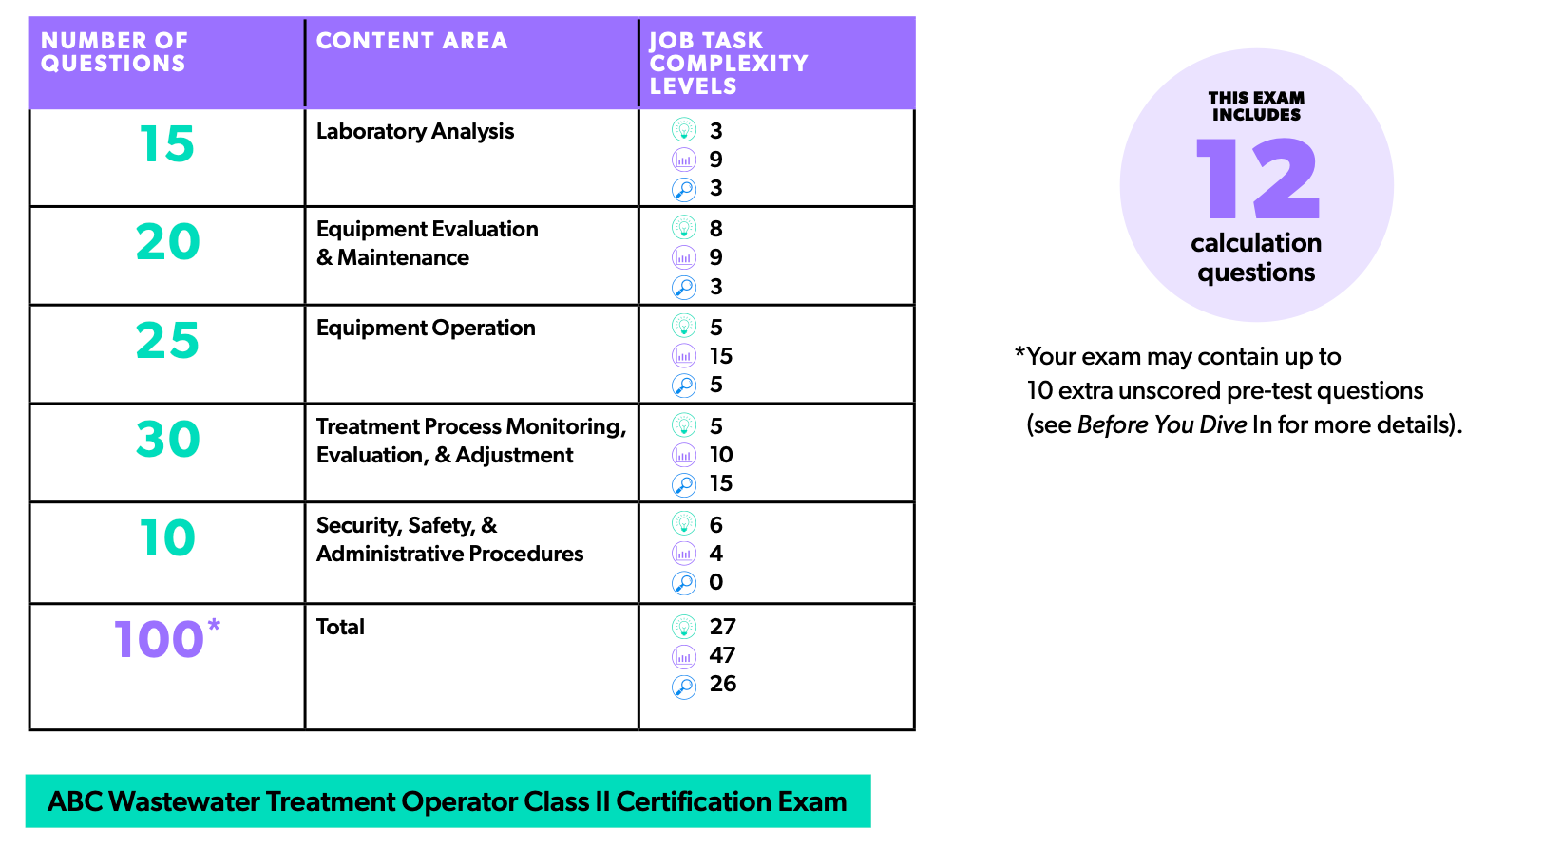
Treatment Operator Exam Content

Slide 9
Schedule for 2025:
Date | Topic
6/24/25 | Program Overview, Test Format, Study & Test Tips
7/8/25 | Treatment Overview - Reg history, overview
7/22/25 | WW Math Part 1 (Areas & Volumes)
8/5/25 | WW Math Part 2 (Flow Rates & Detention Times)
8/19/25 | Collection Systems - Gravity systems
9/2/25 | Collection Systems - Pumping & force mains
9/16/25 | Collection System Maintenance
9/30/25 | Operator Safety/OSHA/Chemical Safety & Inventory
10/14/25 | Preliminary Treatment
10/28/25 | Primary Treatment: Sedimentation
11/11/25 | Fixed-Film Media
12/2/25 | Activated Sludge Part 1
12/16/25 | Activated Sludge Part 2
Notes:
26 sessions total
1 hour each
This is the schedule for the remainder of this year,
The trainers will vary depending on the topic

Slide 10

https://swefc.unm.edu/home/op-cert-trainings/

Slide 11

Sign in for every session to ensure you get credit for attending
Notes:
Be sure to sign in if you are attending in a group. The facilitator at your location will forward these to us and we will keep track of your attendance hours for credits;

Slide 12
Today’s Agenda – Collection Systems
Lift Stations
  Purpose
  Types
  Components
  Operations
  Maintenance
Pumps
  Types
  Operations
  Pump Curves
Force Mains

Slide 13
Lift Stations

Slide 14
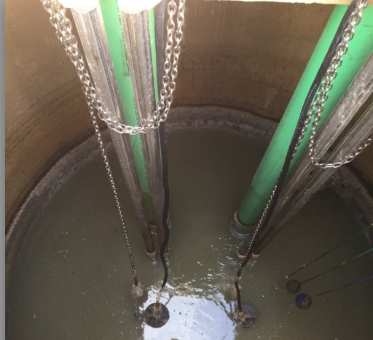
Lift Stations – Purpose
Raising wastewater from lower to higher elevation
Use pumps to move water into force mains
After the force main gravity takes over

Slide 15
Lift Stations – Locations
Terrain requires deep excavation for gravity, (backhoes limited to around 30 ft.)
Cost of excavation to maintain slope for scouring velocity
Soil instability
High ground water tables
Might be an economical solution for current flow levels

Slide 16
Lift Stations – Design Goals
Goal is moving wastewater with maximum efficiency
Pumps have to be selected to minimize surges and provide as constant a flow as possible to minimize surges
Should blend in, with surrounding area and odor, noise and rubbish should be dealt with immediately
Notes:
Goal is moving wastewater with maximum efficiency
Pumps have to be selected to minimize surges and provide as constant a flow as possible to minimize surges
Should blend in,

Slide 17
Lift Station Types
Wet Well – Single chamber
  Pumps might be submerged or above wastewater
  Cheaper to build
  Maintenance can be more problematic
  Confined space – may contain toxic gases
Dry Well - Two chambers
  one to collect wastewater, and
  another for pumps, motors, valves, controls and other equipment
  More expensive to build
  Machinery easier to access
  Confined space – may contain toxic gases
Notes:
There’s two basic design types
Dry Well - Two chambers
one to collect wastewater, and
another for pumps, motors, valves, controls and other equipment
Wet Well – Single chamber
Pumps might be above wastewater
Benefits and drawbacks to each design

Slide 18
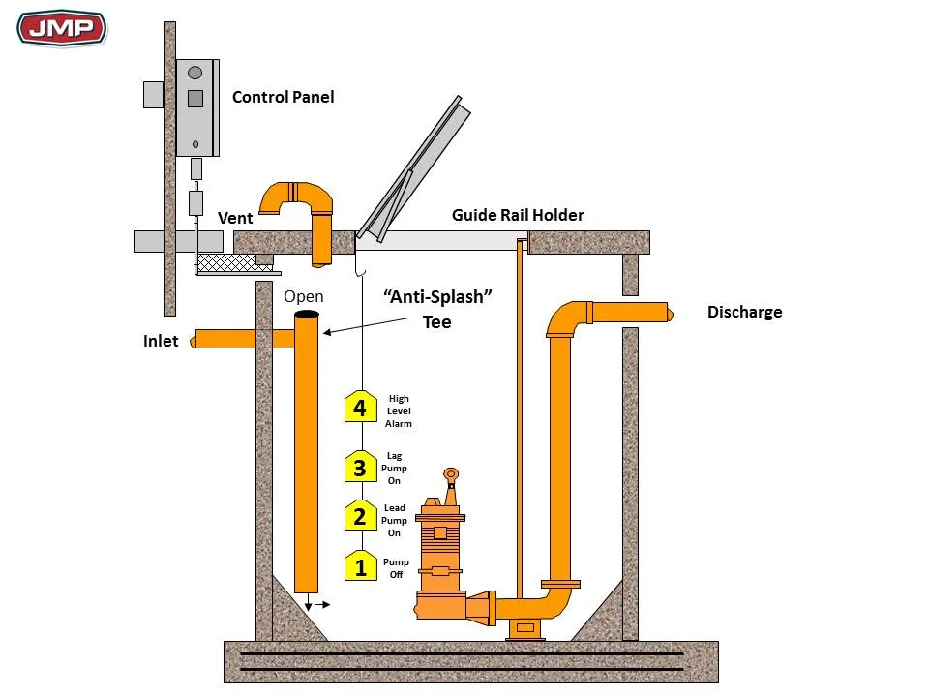
Lift Station Components
Pumps
Wet/Dry Well/Basin
Hardware
Bar Racks/Screens
Valves
Electrical Systems
Alarms
Motor Control Center
Pump Controls/Level Controls
Force Mains
https://jmpcoblog.com/hvac-blog/commercial-sewage-lift-stations-part-5-system-components
Notes:
There are a lot of parts:
Pumps
Wet Well/Dry Well
Hardware
Bar Racks
Valves
Electrical Systems
Alarms
Motor Control Center
Hours Recorder
Pump Controls
Force Mains
Know what these do, and how they work, and what’s required
For example, Lift station hardware has to be high grade aluminum or stainless steel to prevent corrosion
Most lift stations have 3 phase electrical service and backup generators

Slide 19
Lift Station Components
Pumps
  Depends on depth and type
  Will discuss in-depth in later slides
Wet Well/Basin
  Typically concrete, metal or fiberglass
  Size
    Not too small - so pumps don’t cycle too often
    Not too large – so wastewater doesn’t go septic
Hardware
  Should be corrosion resistant material
Bar Rack/Screen
  Prevents large debris from entering station to prevent pump clogging
  Must be cleaned regularly
Electrical Systems
  Typically 3 phase
  Often have generator back-up or transfer switch capabilities

Slide 20
Lift Station Components
Alarms
  Notify of high level to avoid overflows
  Can be visible and audible or part of control system
Motor Control Center / Pump Controls
  HOA switches
  Pump starters
  Alarms
  Lead/Lag Controls
  Other controls
Force Mains
  Flow under pressure – more later
Pump/Level Controls
  Based on water level
  Types include
    Floats
      Can stick in grease and debris
    Probes (electrodes)
      Problems caused by grease and rags
    Bubblers (pneumatic)
      Air pump failures and tube clogging lead to malfunctions
    Switches
      Must be kept clean to switch
    Pressure Transducer
      Can be fouled by rags and debris
    Ultrasonic
Notes:
Floats are one of the oldest pump control devices. As the water in the wet well rises, the float (a ball attached to a rod) rises with it until a switch is triggered which turns the pump on. When the pump lowers the level to a pre-set point an actuator shuts the pump off.
Electrode Controllers (probes). Electrode controllers utilize electrode probes or leads that are an open circuit until the water level rises, wetting both electrodes and allowing current to flow which enacts the control circuit on the pump to turn it on. When the water level drops and the upper probe becomes exposed, the circuit opens and the pump shuts off. This type of control is subject to problems caused by grease and rags.
Pneumatic Controllers (bubblers). Pneumatic controllers work by sensing the pressure required to force air bubbles out of a tube located near the bottom of the wet well. When the wet well is full, it takes more pressure to force bubbles out of the tube (due to the higher head created by the standing water). The on off set points for the pumps on this type of controller are actually pressure set points. Bubblers rely on an air pump, similar to a fish aquarium pump, to provide air so that the pressure can be measured as bubbles are forced out the tube near the bottom of the wet well. If the tube becomes clogged by a rag or grease, or the air pump fails the system will stop working. If the length of the bubbler line changes, (accidental damage while removing a pump for example), the system will function incorrectly, if at all.
Mercury Float Switches. Mercury float switches are one of the most common types of lift station controls. They consist of a float that contains a sealed chamber with two electrodes and a small amount of mercury (quicksilver). When the float is in one position (vertical, while hanging for example) the mercury is pooled away from the electrodes and the circuit is open. When the float is tilted to the other position (horizontal, while floating) the mercury flows down to the electrodes and the circuit is completed which triggers the pump control to turn the pump on. Mercury float switches can be purchased as either normally open (on switch) or normally closed (off switch) when in the vertical position. The floats must be kept clean so that they will tilt when
Pressure transducer: ➢Submerged ➢Pressure created by static head of water level sensed by flexible membrane. ➢Converted to electrical signal in control system. ➢Rags & debris foul unit ➢Grease may cover unit
Ultrasonic transducer: ➢Ultrasonic pulses hit the water surface & bounce back ➢Pulse travel time is converted to electrical signal in control system

Slide 21
Lift Station Components
Valves
  Isolation – gate, plug or knife
    Used to service pump
    Should not be throttled
    Plug valves have a restriction which may be easily clogged
  Check – swing or ball
    Prevent backflow
    If leaking, the pump will run longer
Other components may include
  Wet Well Cover/Lid (fiberglass or steel)
  Access Frames and Hatches (pump access “door”, aluminum)
  Removal System/Guide Rails
  Vent

Slide 22
Lift Station Operations – Pump Controls
Water flows into the pump station wet well and the water level rises
Once the water reaches the first set point the first pump turns on and the water level should start to decrease.
  If the water level continues to increase, a second set point will be reached and a second pump will come on (if equipped with lead/lag pumps)
The water is being pumped out faster than it enters. The level decreases and a low level set point is reached, turning the pump(s) off

Slide 23
Lift Station Maintenance
Grit
  Grit accumulation leads to reduced flow to pumps and loss of wet well capacity
Grease & Scum
  Causes odors & impairs functioning of equipment
  Removal:
    Manual
    Chemical/biological treatment of FOG
Odor Control
  Minimize wet‐well turbulence
  Treatment with scrubbers or biofilters
  Chemical addition: Chlorine, Hydrogen peroxide, Oxygen
    Chemicals should be closely monitored

Slide 24
Lift Station Maintenance
Daily
  Inspection
  Record flow and runtime (can also be weekly)
Monthly
  Check controls, gauges, alarms
  Check motor amperage
Annually
  Cleaning and inspection
  Check pumps and motors
  Check valves
Other
  Grit removal – as needed

Slide 25
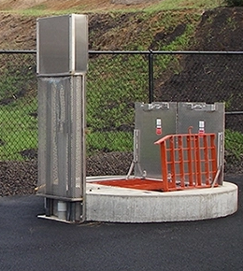
Lift Stations – Safety Hazards
Confined space
Hazardous atmospheres
Slippery ladders or stairs
Mechanical & electrical hazards
Insects, snakes & rodents
Infections & diseases
Inadequate drainage
Drowning
Notes:
Note there is a future session on safety. Operators should work in pairs, use radio communication for entry, understand how to use gas detectors, understand lock out tag out procedures

Slide 26
Lift Stations
Pumps

Slide 27
Lift Station Pumps – Quick Facts
Wastewater systems are usually large energy consumers
  Pumps typically account for 2nd largest energy use for wastewater systems (aeration equipment largest energy user)
  Important to operate and maintain properly to keep costs down
Centrifugal Pumps are most common for lift stations
Safety – Lockout/Tagout procedures necessary before any work completed
Pumps are rated by the flow they produce and the pressure they must work against

Slide 28
Lift Station Pumps - Types
Positive Displacement
  Low flow/high pressure
  Water Jet Pumps, Sludge Pumps, Chemical Feed Pumps
  Piston pumps, diaphragm pumps, progressive cavity screw pumps are the most common types of positive displacement pumps
  Constant flow rate regardless of discharge pressure
  May be used in very small lift stations
Centrifugal
  High flow/low pressure (head)
  Booster Pumps, Primary Service Pumps
  Flow changes when pressure changes
  Most common in lift stations
Notes:
Level 1 test: Inspect, Maintain, Operate
Centrifugal
Positive Displacement

Slide 29
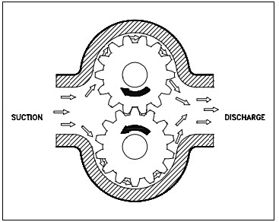
Lift Station Pumps – Positive Displacement Pumps
Positive Displacement
  Move set volume of fluid in each cycle
  Cannot operate against a closed discharge valve
Include
  Reciprocating piston pump
    Piston moves back and forth in a cylinder; liquid enters and leaves through check valves
  Rotary pump
    Uses lobes or gears to move liquid through pump
  Screw pump
    Screw(s) rotates in (angled) cylinder to lift liquid
  Diaphragm pump
    diaphragm moves by mechanical linkage, compressed air, or fluid from a pulsating, external source

Slide 30
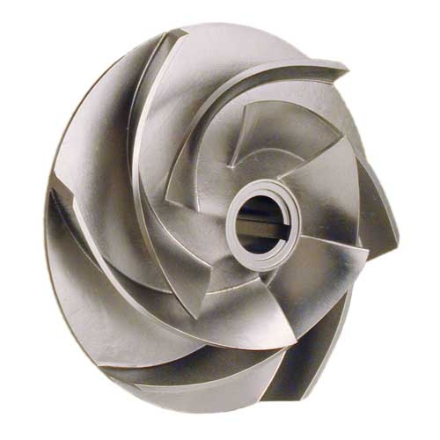
Lift Station Pumps – Centrifugal Pumps
Centrifugal Pumps
  Move fluid by use of a centrifugal force (moving something away from the center of a moving circle)
  Impeller spins to move water
  Water leaving impeller creates suction to bring more into the pump
  There are open and closed impellers – wastewater typically uses open impellers to prevent clogging
  Vertical orientations are typically used in lift stations

Slide 31
Lift Station Pumps – Centrifugal Pumps
Common Components
  Impeller – moves fluid
  Shaft
    Spins impeller
    Alignment critical
  Bearings
    Hold shaft in place
    Decrease friction
  Pump Casing
  Volute
    collect and direct the flow of water as it enters and leaves the impeller
Common Components
  Suction and Discharge Piping
  Wear rings
    replaceable rings allow a small running clearance between the impeller and the pump casing
    designed to be replaced periodically
    prevent the more costly replacement of the impeller or the casing

Slide 32
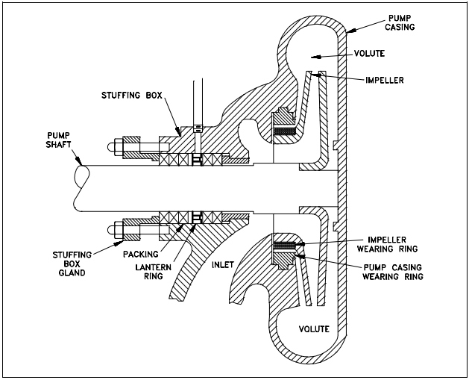
Lift Station Pumps – Centrifugal Pumps
Common Components
  Stuffing Box
    Seal between shaft and pump
    Uses packing rings and gland
    Packing glands may need to be adjusted periodically
  Lantern Ring
    Used to get water to the inside of the packing rings where the heat is being generated
  Mechanical Seal
    Pumps that do not have packing in the stuffing box will be equipped with a mechanical seal
Notes:
Not only should you be familiar with these pump components, but you should also be familiar with the general maintenance needs associated with these components. Bearing lubrication frequency, checking the seals for leakage, observing the pump for excessive vibration, understanding the suction and discharge pressures, understand packing spacing, and impeller placement

Slide 33
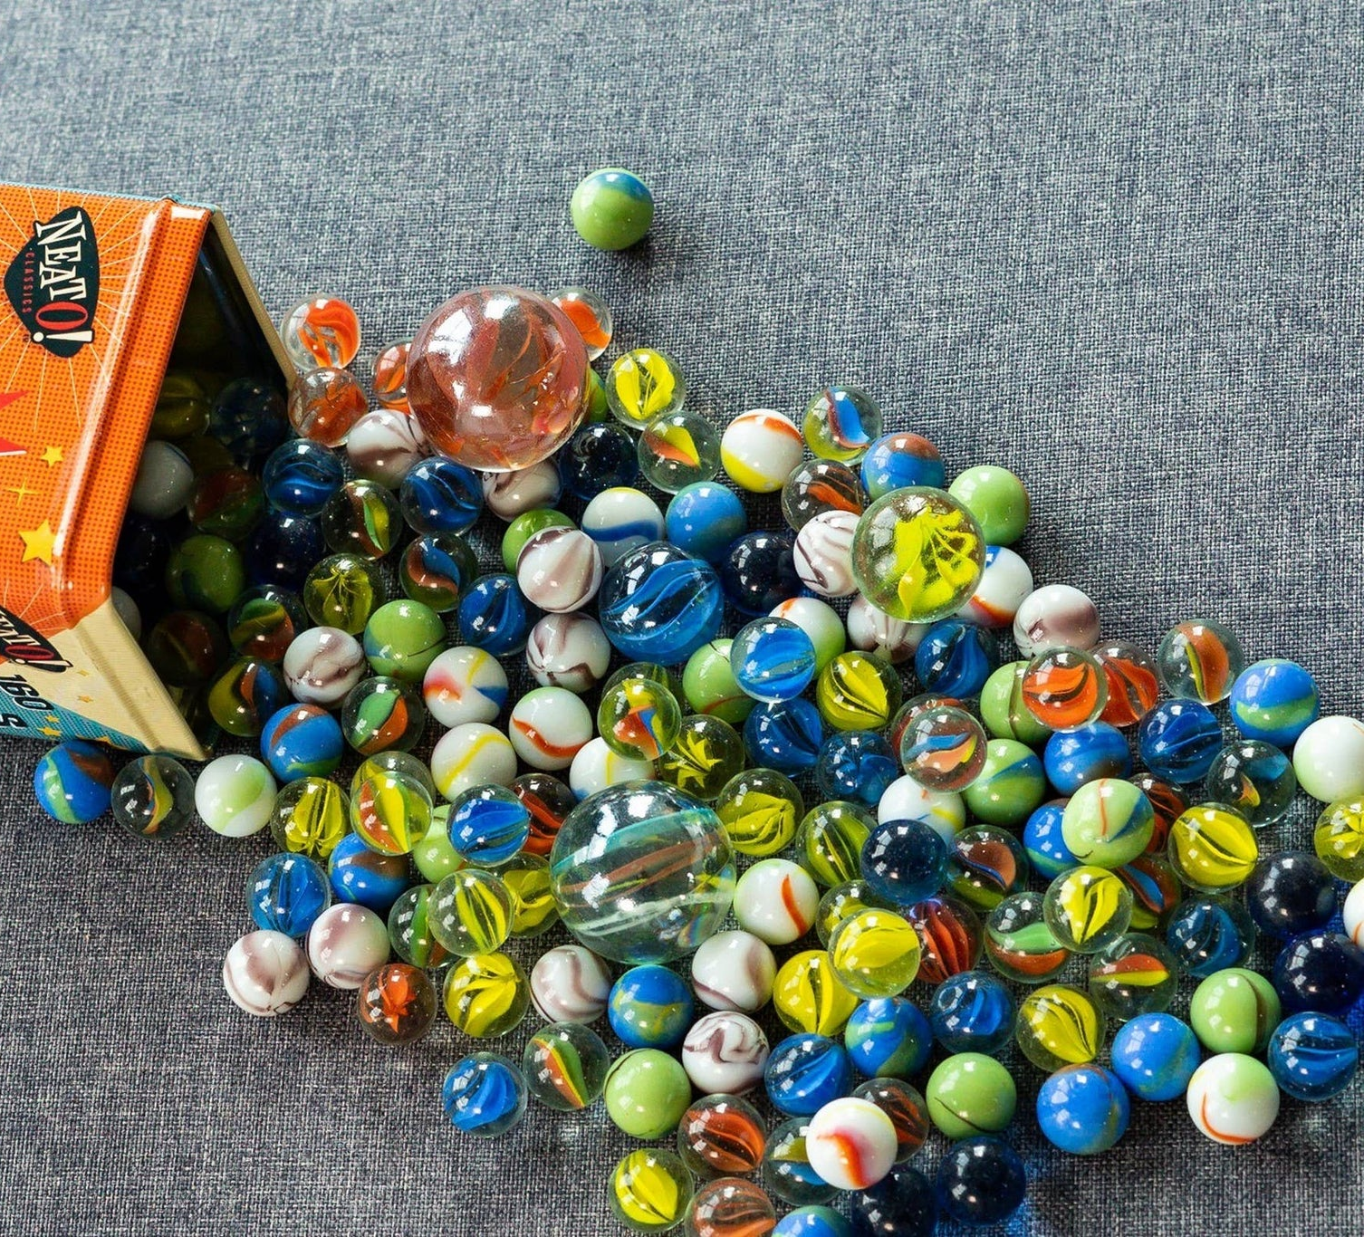
Lift Station Pumps – Centrifugal Pumps
Operations
  Pump should not be started or run dry – water used as lubrication
  Cavitation – pump not running at designed flow/pressure
    Creates a vacuum that vaporizes the liquid, when the vapor returns to liquid it reacts very quickly causing small amounts of damage to the pump, over time this leads to significant pump vibration and damage
    A cavitating pump can sound like a can of marbles being shaken. Other indications that can be observed from a remote operating station are fluctuating discharge pressure, flow rate, and pump motor current

Slide 34
Lift Station Pumps – Centrifugal Pumps
Causes of Cavitation
Suction Side
  Pump subjected to low pressure or high vacuum conditions
  Pump running too far right on pump curve
  High pumping speed
  Clogged suction pipe
  Poor suction conditions
  Closed or partially closed valves
  High inlet velocity
  Poor pipe design
Discharge Side
  Occurs when pressure is too high or efficiency drops very low
  Pump running too far left on the pump curve
  Clogged discharge pipe
  Poor pipe design

Slide 35
Lift Station Pumps – Centrifugal Pumps
Operations
  Net Positive Suction Head – is pressure adequate to avoid cavitation?
    Increase the pressure at the suction of the pump
      raising the level of the liquid in the tank
      or increasing the pressure in the space above the liquid
    Reduce head losses in the pump suction piping
      increasing the pipe diameter, reducing the number of elbows, valves, and fittings in the pipe, and decreasing the length of the pipe.
    Reduce flow rate
  Air Locking
    Air trapped in pump volute, creating increased pressure until shut off head is reached
    Pump will quickly overheat
  Energy use is highest during starting – motor and pump must start turning
Notes:
I’m providing a couple of resources on pumps for your reference.

Slide 36
Centrifugal Pump Curves
Pump performance and efficiency vary depending on
  Pump configuration
  Capacity/volume of lift station
  Flow rate needed
  Pressure
Selecting the right pump
  Extends pump life
  Saves energy
Pump Curve
  Graph
  Y axis = Total pressure or head
  X axis = Pump Flow Capacity
  Head capacity curve
  Brake horsepower curve
  or
  Net Positive Suction Head (NPSH) curve
  Efficiency curve
  Impeller sizes

Slide 37
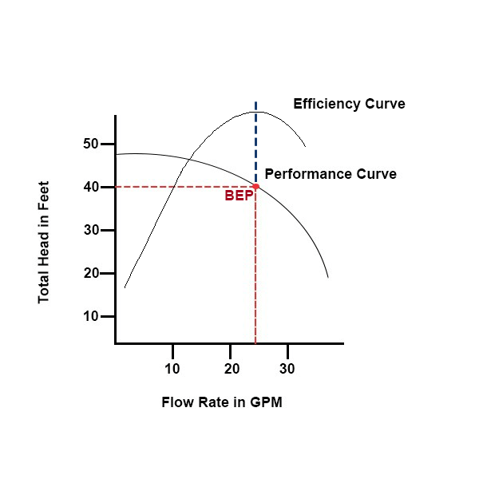
Centrifugal Pump Curves
1. Locate the System Operating Point:
Find where your system's head curve crosses the pump's main performance curve.
2. Determine the Head:
From the operating point, move horizontally to the left to find the pump's head capacity at that flow rate.
3. Determine the Flow Rate:
From the operating point, move vertically down to the X-axis to find the flow rate.
4. Find Efficiency:
Move horizontally from the operating point to the nearest efficiency line to find the pump's efficiency in percent at that duty point.
5. Check Horsepower:
Move horizontally to the horsepower line closest to your operating point to find the required brake horsepower.
6. Check NPSHr:
The pump curve also shows the Net Positive Suction Head Required (NPSHr) curve, which is the minimum pressure needed at the pump inlet to prevent cavitation.

Slide 38
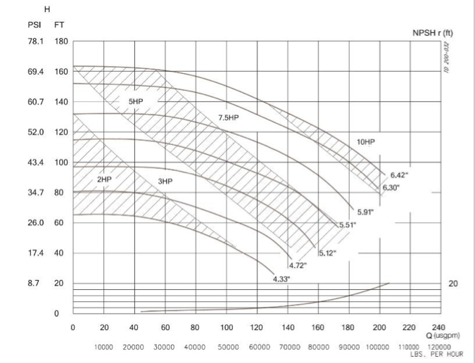
Centrifugal Pump Curves
Notes:
Resources – lots out there, I have a couple
I’ve provided a couple of tools on understanding pump curves. There are many out there. Find one you like and keep it handy.

Slide 39
Lift Stations
Force Mains

Slide 40
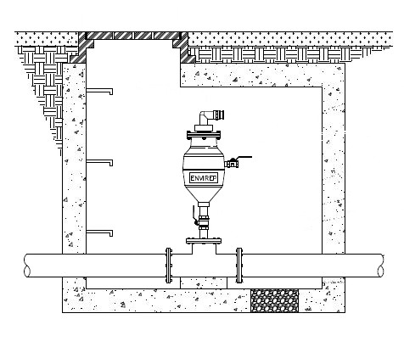
Lift Stations – Force Mains
Discharge pipe of the lift station
Under pressure until the next manhole or similar opening (where the system returns to gravity or the flow enters the treatment plant)
Trapped air can lead to water hammer – high pressure shock wave that moves in the pipe damaging the pipe and other equipment such as check valves that will slam repeatedly
Trapped air can also decrease flow rates/increase pressure and increase energy use
Air release valves can be installed at the pipe’s high point to allow air to escape automatically

Slide 41
Sample Questions
Let’s try a few…

Slide 42

Practice Questions
Notes:
Lifting of wastewater in a lift station is accomplished by:
Air lift pumps
Centrifugal pumps
Piston pumps
Turbine pumps
The discharge line from a lift station is called:
Return Line
Flow Vent
Force Main
Station Overflow
Accumulated air in force mains is blown off by:
Air release valves
Altitude control valves
Blowers
Check valve
What is the purpose of wear rings in a pump?
Hold the shaft in place
Hold the impeller in place
Control amount of water leaking from discharge to suction side
Prevent oil from getting into the casing of the pump
Which of the following does a lantern ring accomplish?
Lubricates the packing
Helps keep air from entering the pump
Both (a.) and (b.)
What is the term for the condition where small bubbles of vapor form and explode against the impeller, causing a pinging sound?
Corrosion
Cavitation
Aeration
Combustion

Slide 43

Questions?

