Slide 1





US Territories Water Operator Training Series
Session 5: Drinking Water Regulations
8/20/25
www.efcnetwork.org
This program is made possible under a cooperative agreement with US EPA.

Slide 2


Michelle Olson
Water Utility Trainer and Specialist meolson@unm.edu

Slide 3



This training series is funded by the US EPA

Slide 4
Attendee Meeting Controls
2. Chat
3. Leave meeting
1. Mute/unmute
Mute/unmute
  Click the microphone icon to unmute yourself to speak (if you are not speaking, don’t unmute)
Chat
  Click the chat icon and then use the dropdown next to send text instant messages to:
    Everyone publicly: messages will be visible to all participants
    Host only: messages will be sent only to the meeting host – Don’t send a chat to only me; I won’t have time to see it while presenting.
    Any attendee directly: message will be sent to the selected meeting participant only
Leave meeting
  Click on the leave icon to exit the ZOOM Meeting

Slide 5
Schedule for 2025:
Date | Topic
6/25/25 | Program Overview, Test Format, Study & Test Tips
7/9/25 | Drinking Water System Overview - (Source, Treatment, & Distribution)
7/23/25 | Basic Operator Math (+, -, /, x, Exponents and basic algebra)
8/6/25 | Applied Operator Math (Areas, Volume, Pressure)
8/20/25 | Drinking Water Regulations
9/3/25 | Source Water Characteristics
9/17/25 | Surface Water Intake Components, Well Components, and O&M
10/1/25 | Disinfection 1: Chloramines, UV, Chlorine Dioxide, Chlorine
10/15/25 | Disinfection 2: Chlorine Disinfection Application for Sodium Hypochlorite and Gas Chlorine (including storage and safety)
10/29/25 | Disinfection 3: Distribution System Application, Residual Measurement, Evaluation & Adjustment,
11/12/25 | Disinfection 4: Chlorine Disinfection Math
12/3/25 | Surface Water Treatment 1: Coagulation, Flocculation, Sedimentation (including chemistry, process controls, operations)
12/17/25 | Surface Water Treatment 2: Filtration
Links to recordings and material are available on our website at https://swefc.unm.edu/home/op-cert-trainings/

Slide 6

Safe Drinking Water Act (SDWA)
August 20, 2025

Slide 7


What is the Safe Drinking Water Act (SDWA)?
Treatment
Requirements
Monitoring
Requirements
Quality
Territories
States
Tribes
Suppliers
Localities
Standards

Slide 8

Purpose of SDWA
Ensures the safe delivery of drinking water to consumers by a Public Water System (PWS).
Protects the public from naturally occurring and human-made contaminants that may be found in drinking water.

Slide 9
History of SDWA
2024 – Revised LCR
PFAs
2016 – RTCR
2003 – S2DBPR & LT2ESWTR
2009 – GWR
FBRR – 2001
LT1ESWTR – 2002
SDWA Amendments – 1996
IESWTR and S1DBPR – 1998
TCR & SWTR – 1989
WI Crypto Outbreak – 1993
SDWA Amendments – 1986
THMs – 1979
SDWA – 1974

Slide 10

SDWA
Defines Public Water Systems.
Establishes Regulatory Programs.
Establishes National Primary & Secondary Drinking Water Regulations.
Requires Communication with Consumers.
Outlines Prevention Approaches.

Slide 11
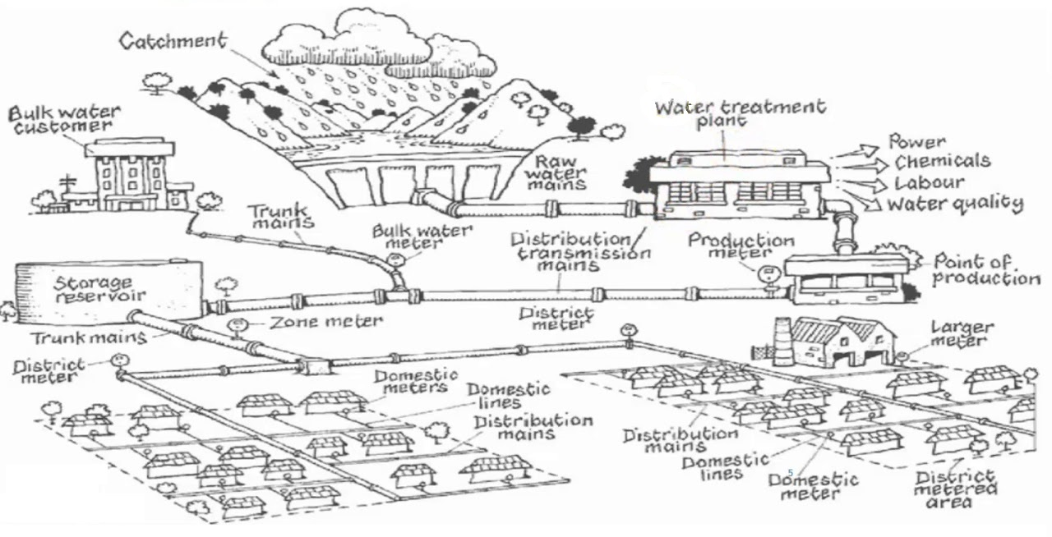
Public Water System (PWS) Definition
Serves ≥ 25 people for at least 60 days out of the year.
OR
Provides water to at least 15 service connections.

Slide 12
PWS Types
Community (C) – Serves at least 15 service connections or at least 25 residents year-round.
Non-Transient Non-Community (NTNC) – Serves at least 15 service connections or 25 of same people (not residents) for at least 6 months in the year (might not be year-round).
Transient Non-Community (TNC) – Serves at least 15 service connections or 25 people (not the same individuals) at least 60 days of the year.

Slide 13

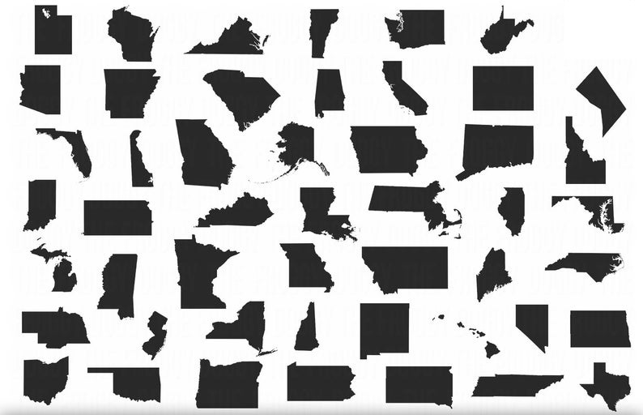

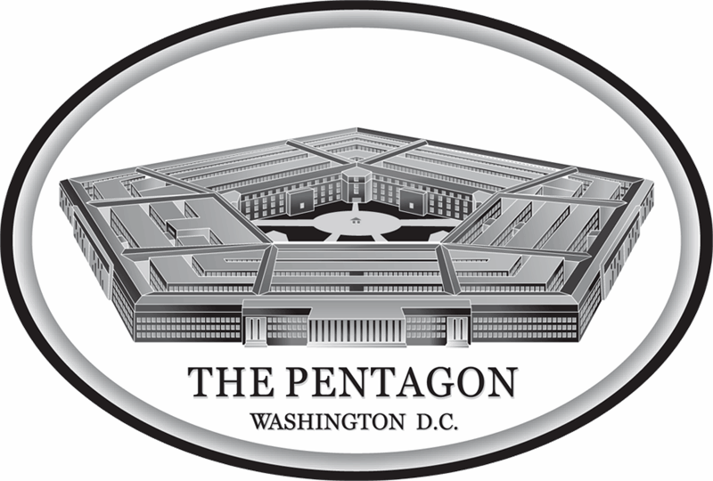
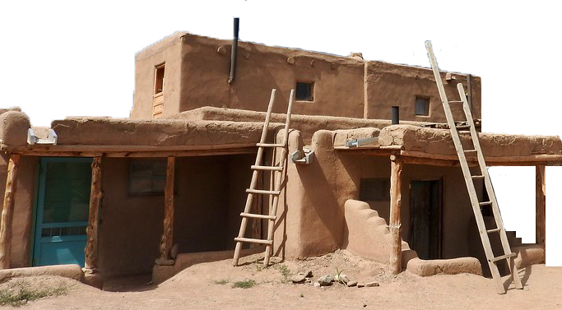


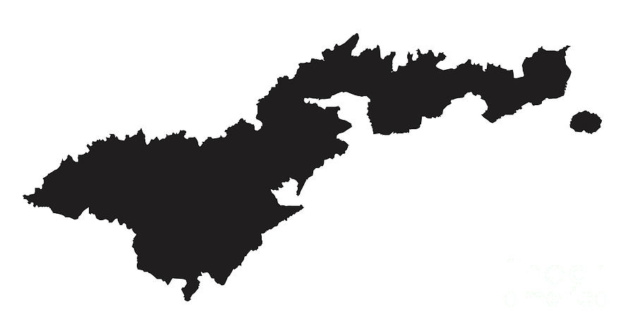
SDWA Regulatory Programs
Primacy
Direct Implementation

Slide 14
Drinking Water Regulations
National Primary Drinking Water Regulations
Standards
Health
Based
National Secondary Drinking Water Regulations
Standards
Aesthetic
Based

Slide 15
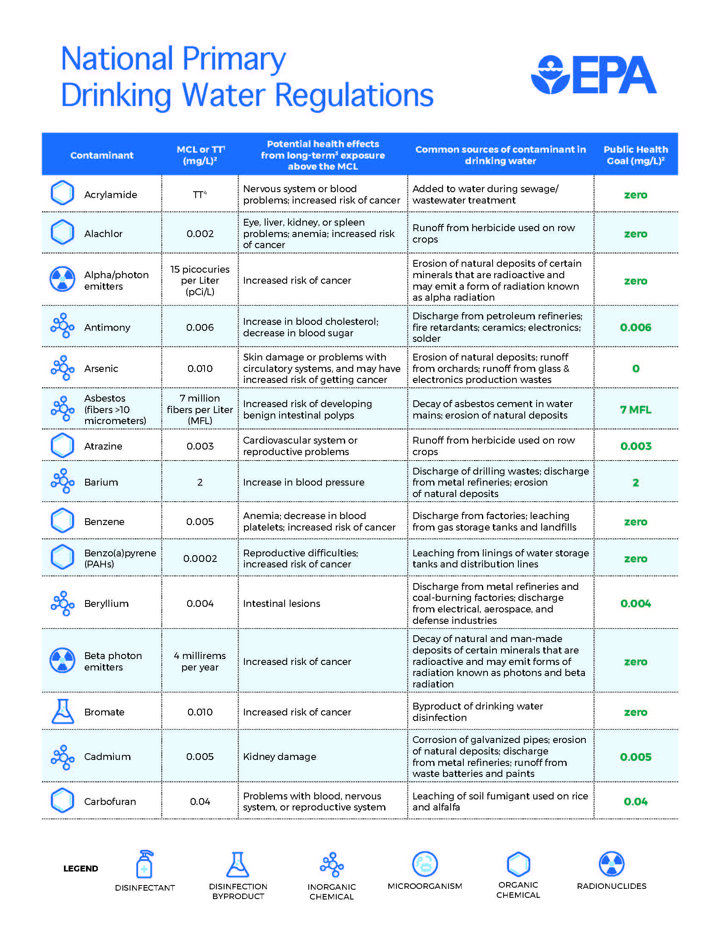
Maximum Contaminant
Level (MCL)

Slide 16
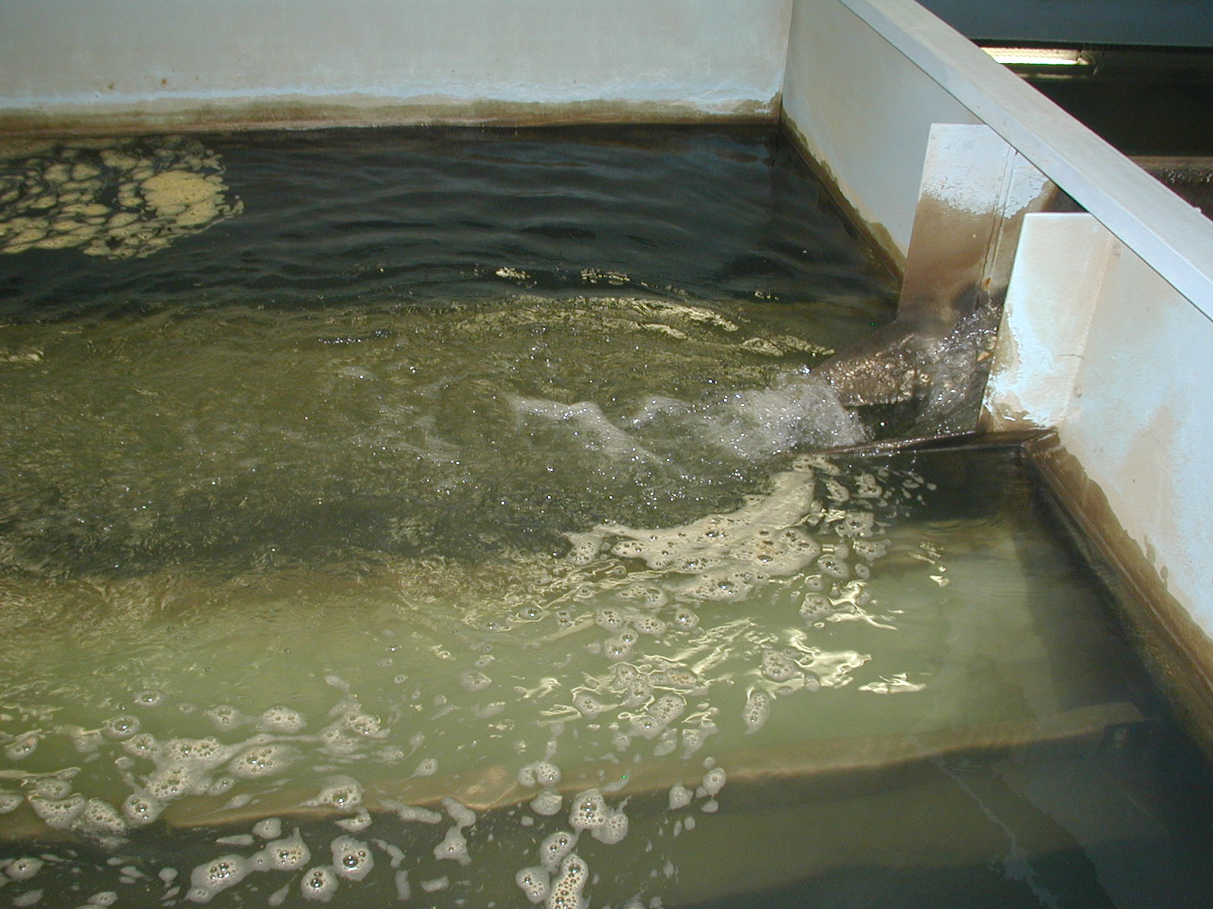
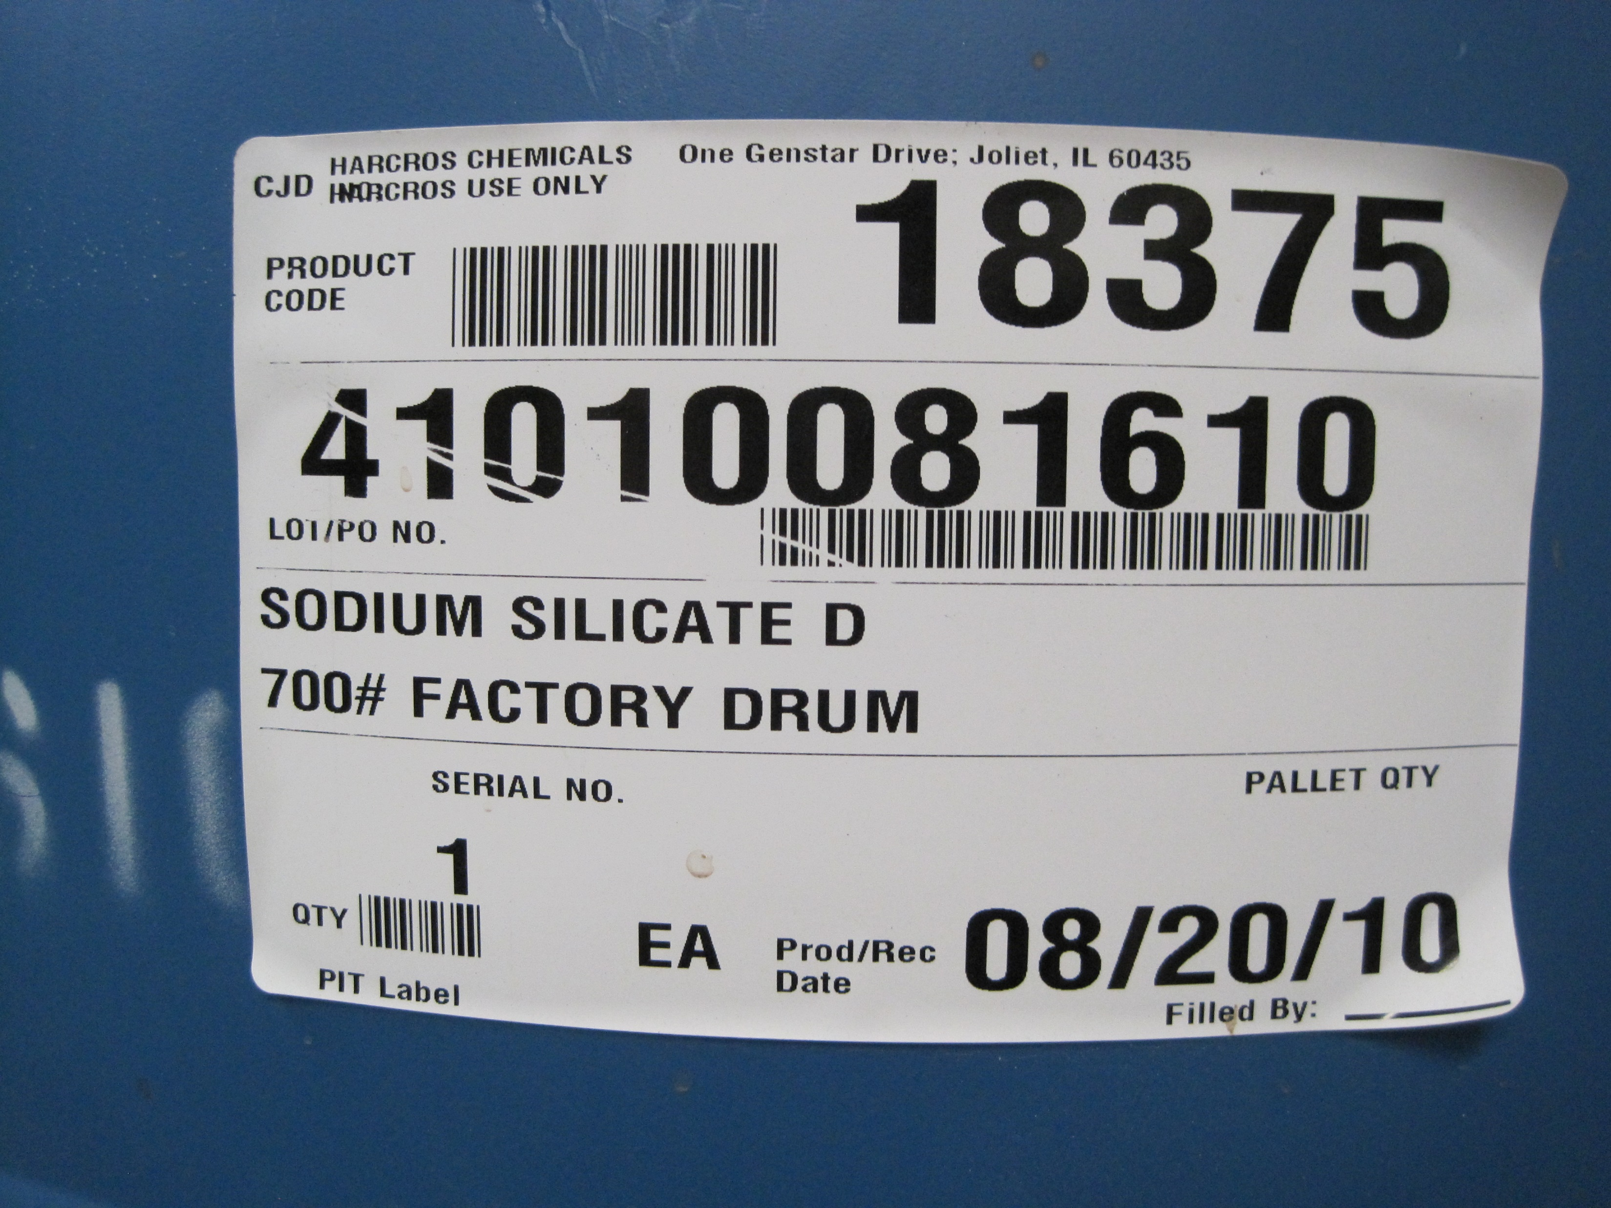
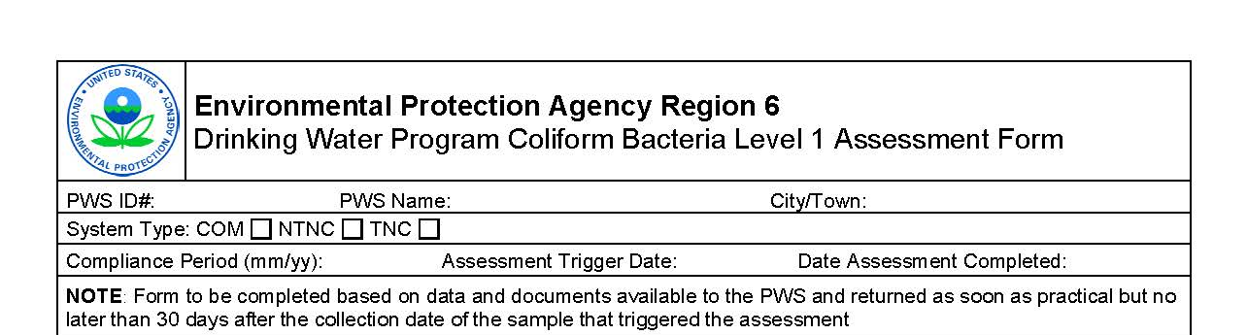
Treatment Techniques:
May only be set if it is not “economically or technologically feasible to ascertain the level of the contaminant.”
An enforceable procedure or level of technological performance that public water systems must follow to ensure control of a contaminant.

Slide 17
Ground Water Rule (GWR)
Filter Backwash Recycling Rule
Long Term 1 (LT1) and Long Term 2 (LT2) Enhanced Surface Water Treatment Rule
Chemical Contaminant Rule
Radionuclides Rule
Arsenic Rule
PFAS
Revised Total Coliform Rule (RTCR)
Stage 1 & 2 Disinfectants and Disinfection By-Products Rule (D/DBPR)
Lead & Copper Rule, Revisions, Improvements (LCR, LCRR, LCRI)
Know the Rules!

Slide 18
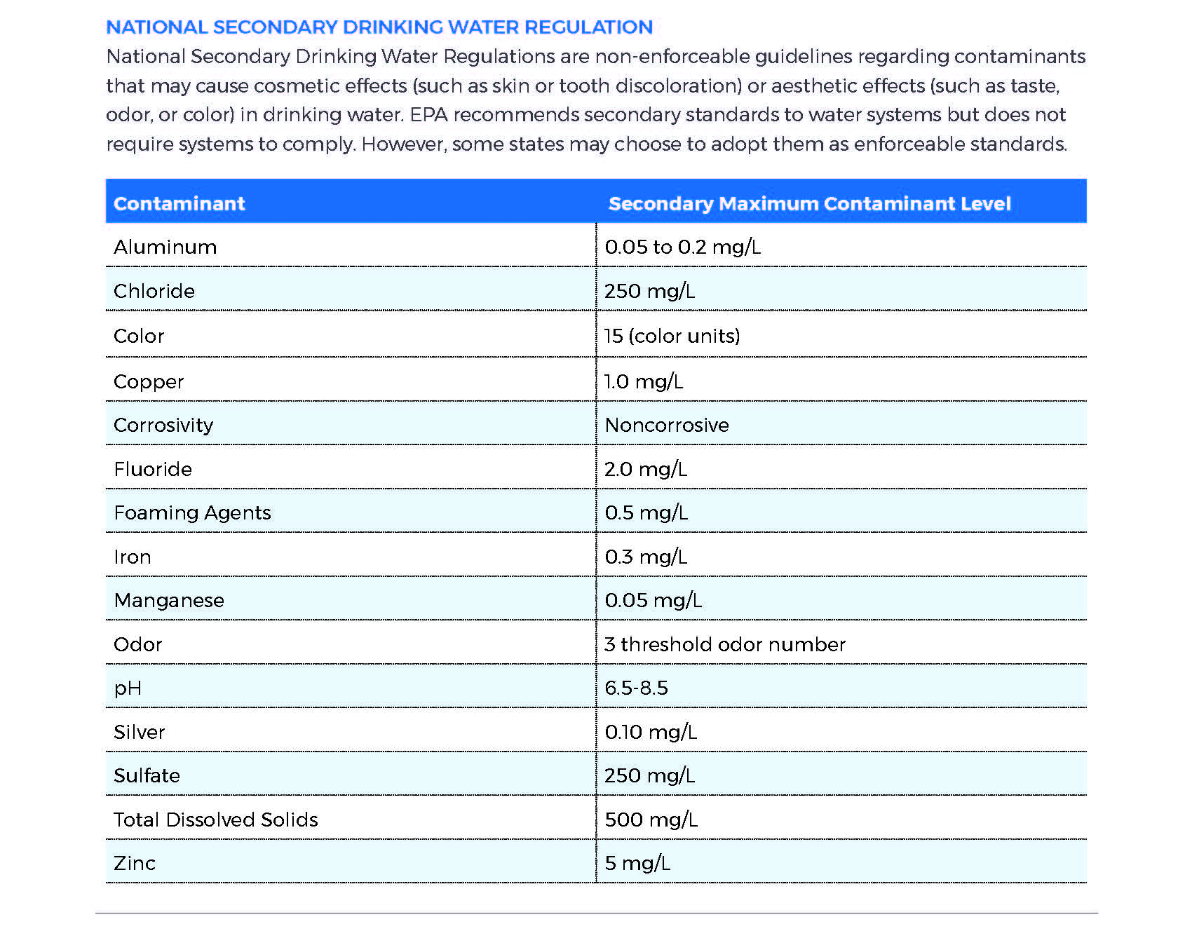
National Secondary Drinking Water Regulations
Not enforceable by EPA

Slide 19
Individual Contaminant Monitoring Schedules Are Based On:
System Type (C, NTNC, TNC)
Source Type (GW, SW, GUDI)
Treatment Type
Historical Water Quality Results

Slide 20
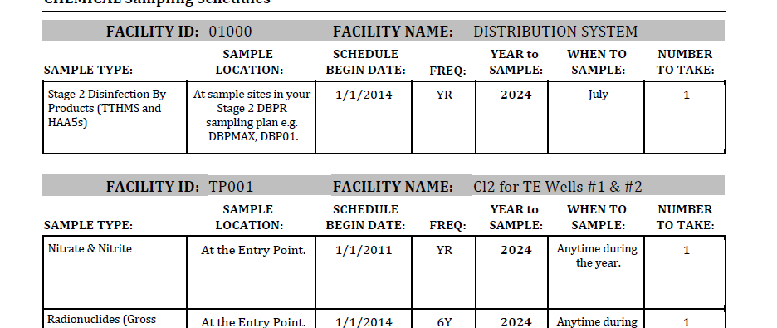
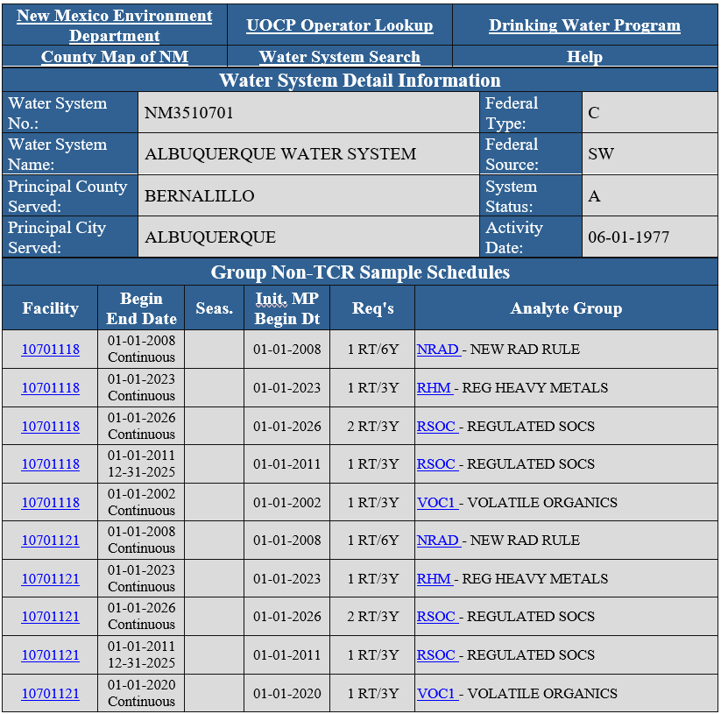
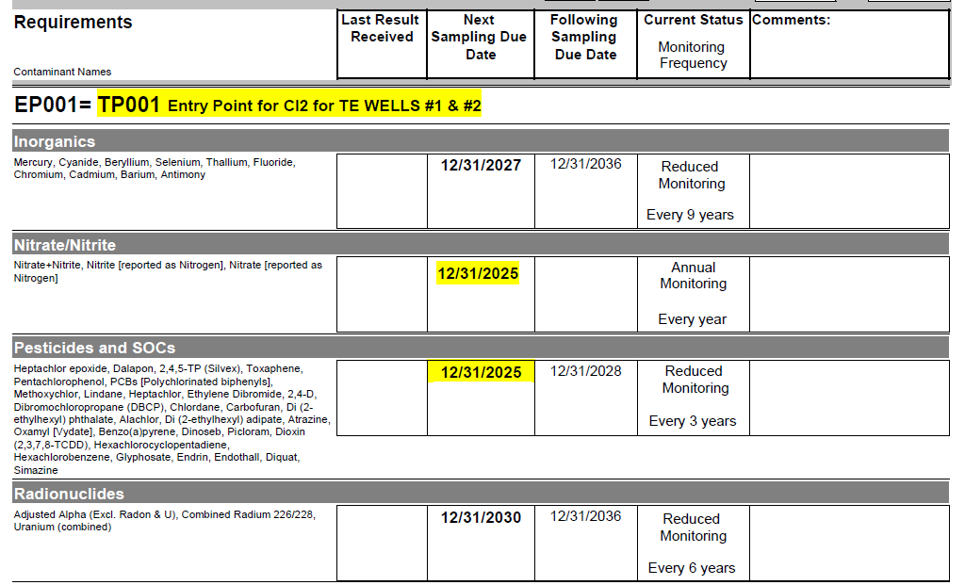

Slide 21
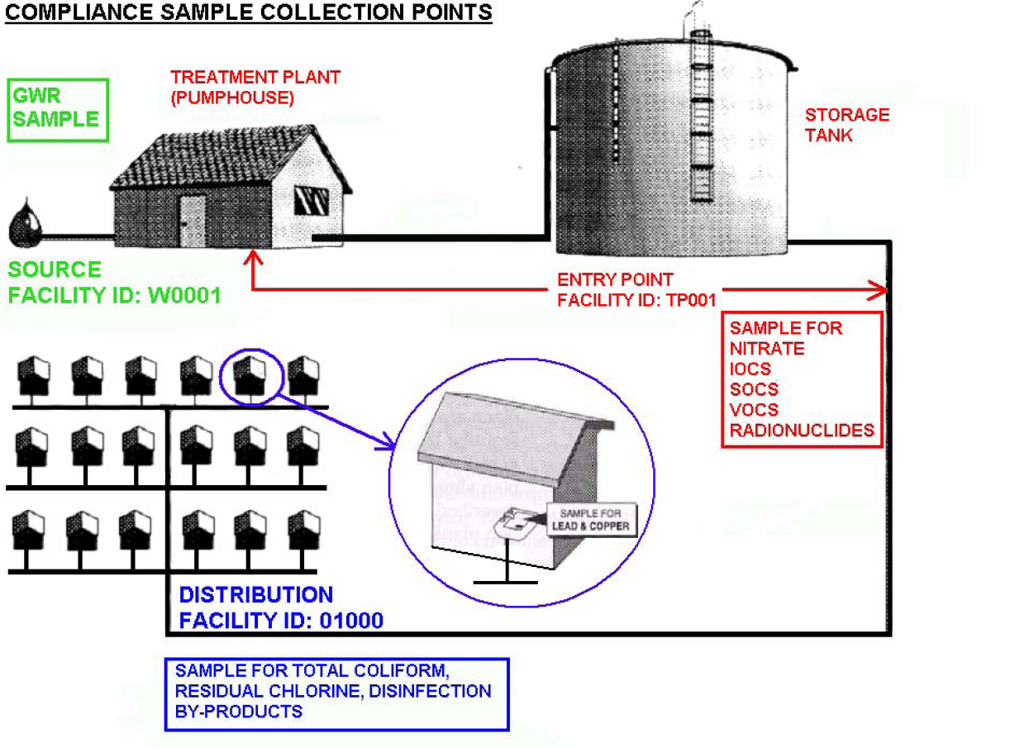
SDWA Compliance Sampling Locations

Slide 22
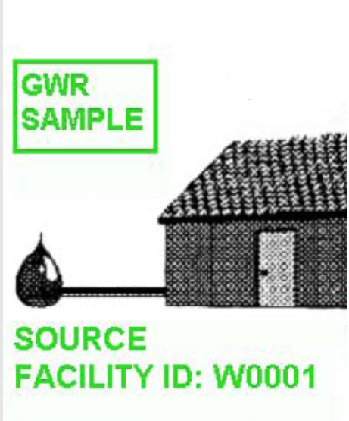
A) Source Water Monitoring

Slide 23
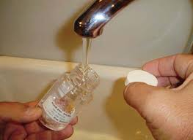
Ground Water Rule
Purpose – To target ground water systems that have E.coli contamination in their wells.
Requires sanitary surveys be conducted:
  Once every 3-years for Community water systems.
  Once every 5-years for Non-Community water systems.
Requires individual wells to be sampled
after a total coliform present sample or
fecal positive (E. coli) present sample.

Slide 24
Surface Water Treatment Rule
Purpose – To protect public health by reducing waterborne diseases caused by microbial pathogens in public water systems that use surface water or groundwater under direct influence of surface water (GUDI).
Filtration of water
Requires sanitary surveys be conducted:
  Once every 3-years for unfiltered systems (rare).
  Once every 5-years for filtered systems.

Slide 25
Surface Water Treatment Rule cont.
Disinfection Requirements:
  For the removal of protozoans and viruses.
  Chlorine, chloramine, ozone, UV.
Requires Cryptosporidium Monitoring (every 3-6 years)
Sets Turbidity Standards
  Filtered systems:
    Turbidity must be ≤0.3 NTU in ≥95% of monthly samples.
    Maximum turbidity = 1 NTU at any time.
  Unfiltered systems (rare, must meet strict criteria):
    Continuous turbidity monitoring required.

Slide 26
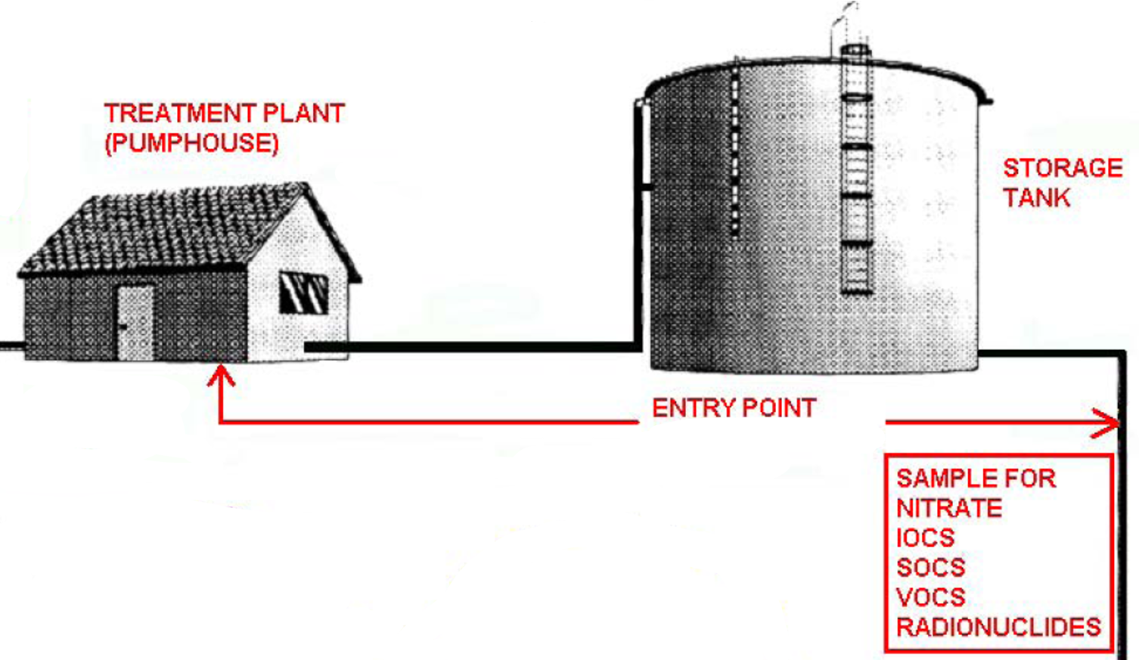
B) Entry Point Monitoring

Slide 27
B) Entry Point Monitoring
Chemical and Radionuclides Rules
Purpose – To protect public health by monitoring for source water contaminants that may cause disease.
Representative of water served to all customers.
**Water is monitored before public consumption**

Slide 28
Chemical and Radionuclides
Acute Health Effects
Nitrates & Nitrites
  From septics, animals waste, fertilizer
Inorganic Contaminants (IOCs)
  Heavy metals, sodium, fluoride, cyanide, asbestos
Volatile Organics Contaminants (VOCs)
  Gasoline, brake fluid, oil, hydraulic fluid
Synthetic Organic Compounds (SOCs)
  Herbicides, pesticides, PCBs
Radionuclides (Gross Alpha & Beta, Rad 226/228, Uranium)
  Mining, naturally occurring, human-made sources
PFAS (HFPO-DA, PFBS, PFHxS, PFNA, PFOA, PFOS)
  Human-made sources
Chronic Health Effects

Slide 29
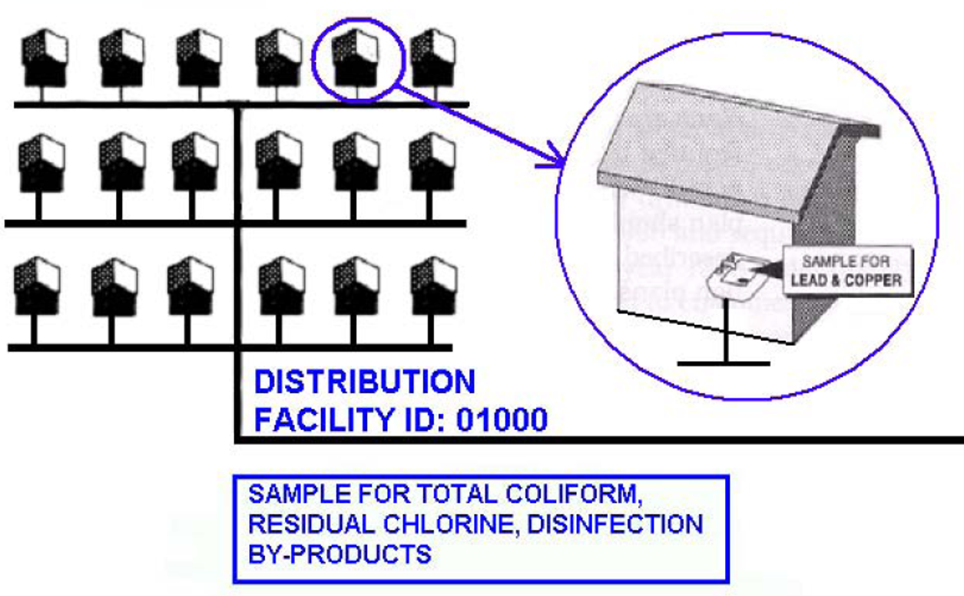
C) Distribution System Monitoring

Slide 30
C) Distribution System Monitoring
Purpose – To qualify water quality in the distribution system.
Revised Total Coliform Rule (RTCR)
Disinfectants/Disinfection Byproducts Rules (D/DBPR)
Lead & Copper Rule (LCR, LCRR, LCRI)

Slide 31
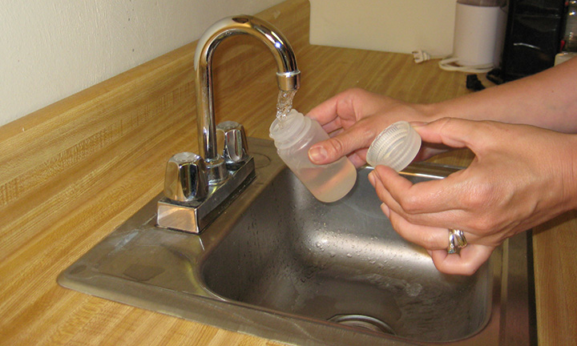



The Revised Total Coliform Rule (RTCR)
Which Systems Have to Sample?
Community
Non-Transient Non-Community
Transient
Non-Community

Slide 32
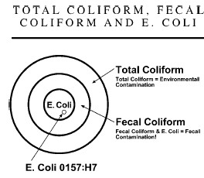
What are total coliforms?
Found in air, soil, and the intestinal tracts of warm-blooded animals.
Total coliform include all coliform bacteria:
  - Fecal Coliform (subset of total coliform)
  E.coli (subset of fecal coliform)
A group of mostly non-pathogenic bacteria.

Slide 33

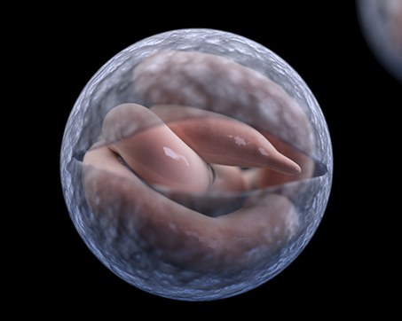
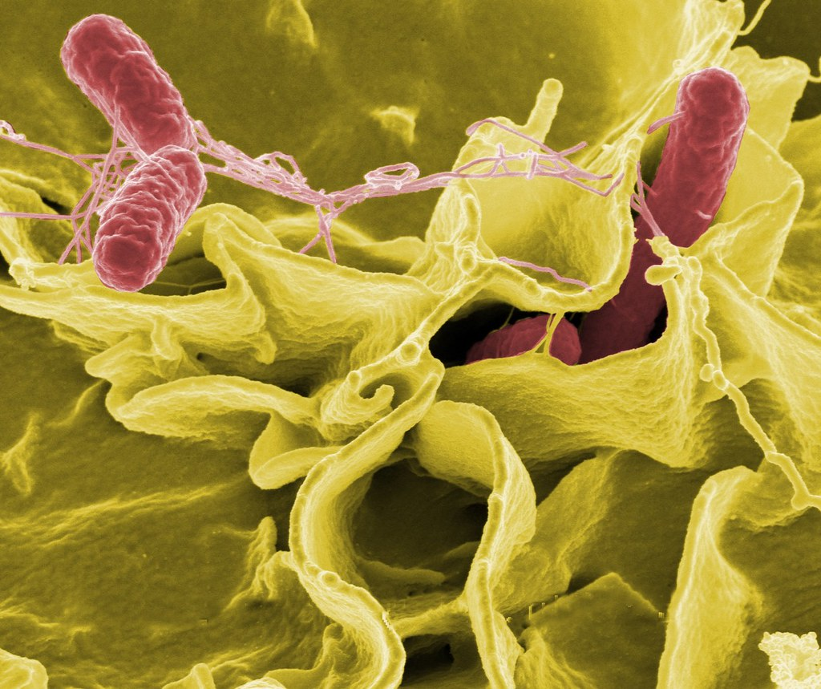
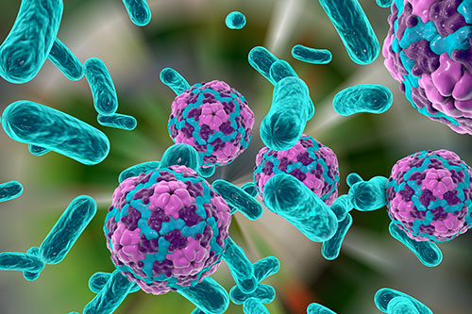
The presence of coliforms indicate that the water may be contaminated with pathogens (organisms that can cause disease).
How do total coliforms act as an indicator?
Cryptosporidium
Acute Health Effects
Types of Pathogens:
Protozoans (Giardia and Cryptosporidium)
Typhoid Fever
Bacteria (Gastroenteritis, Bacillary Dysentery, Typhoid Fever, Cholera, and Tuberculosis)
Hepatitis A
Viruses (Hepatitis A, Rotavirus, Norovirus)

Slide 34
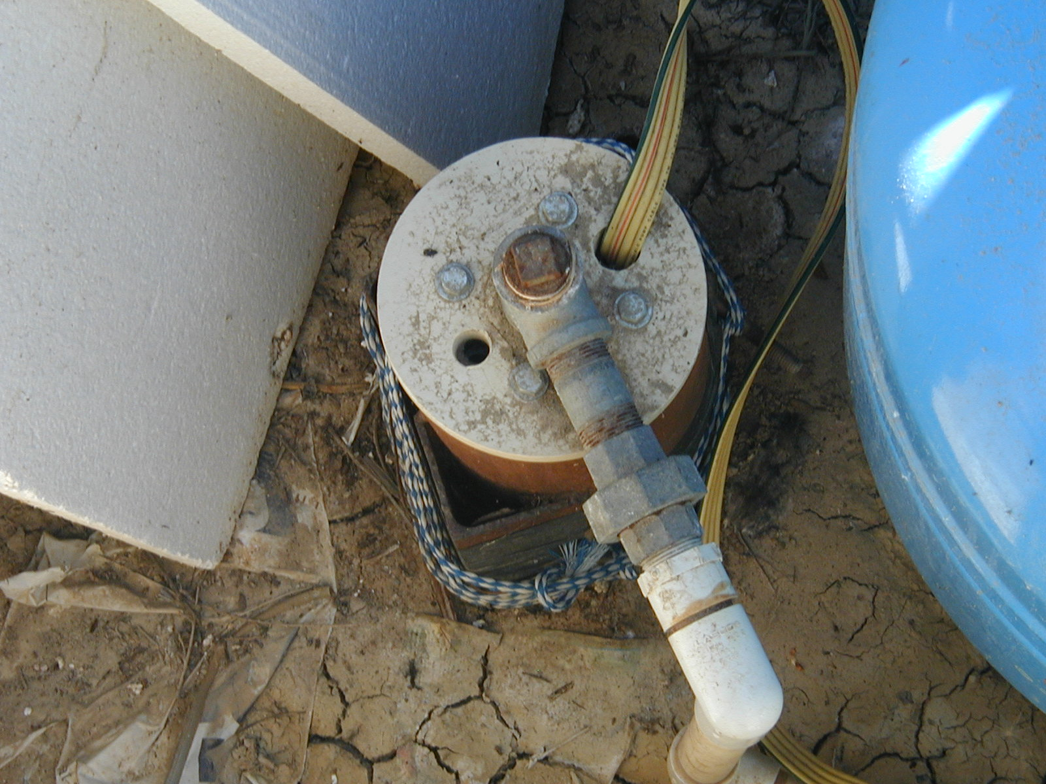
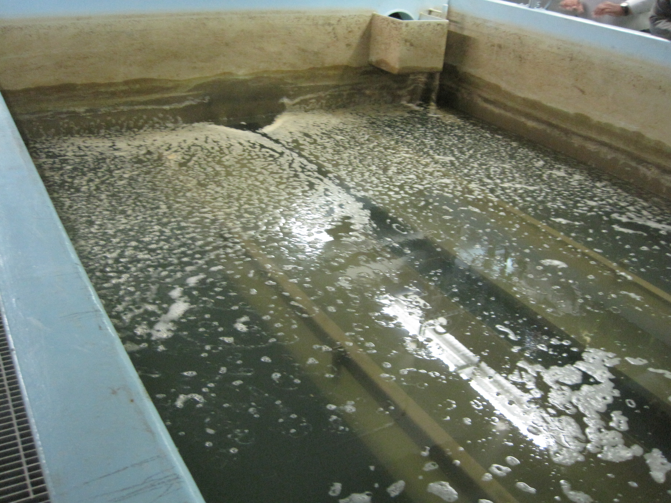
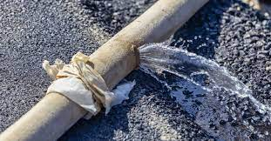
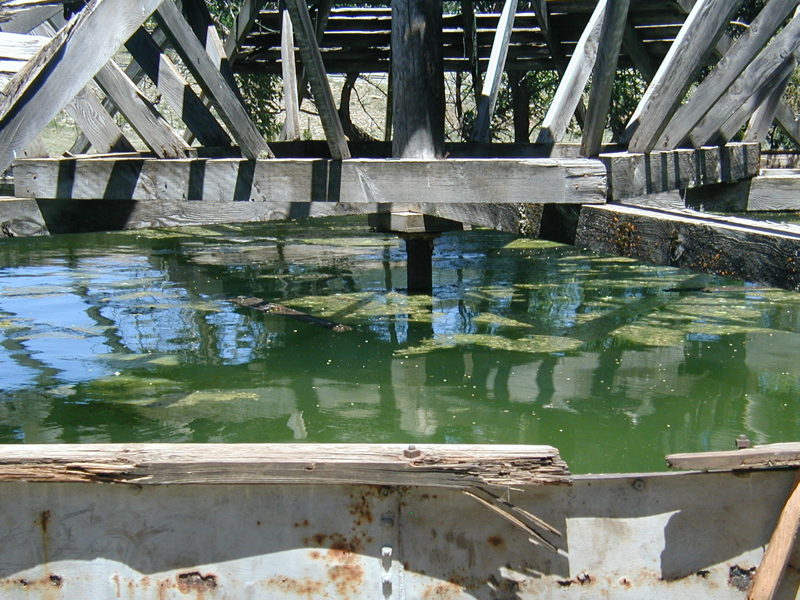
How can Pathogens enter our Drinking Water Systems?
Contamination
Source Contamination
Treatment Contamination
Distribution Contamination
Storage Contamination

Slide 35
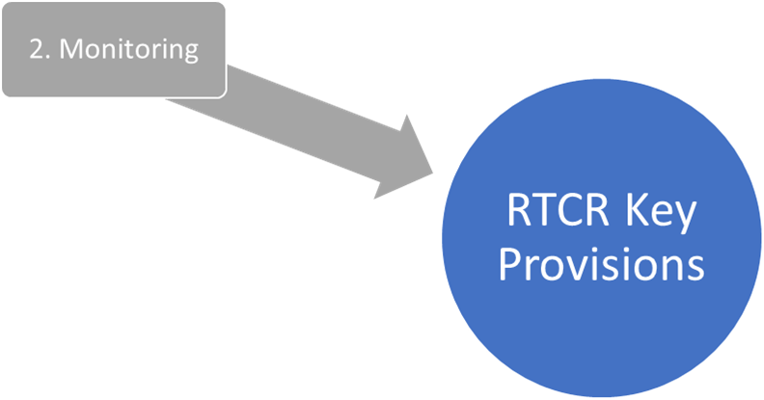
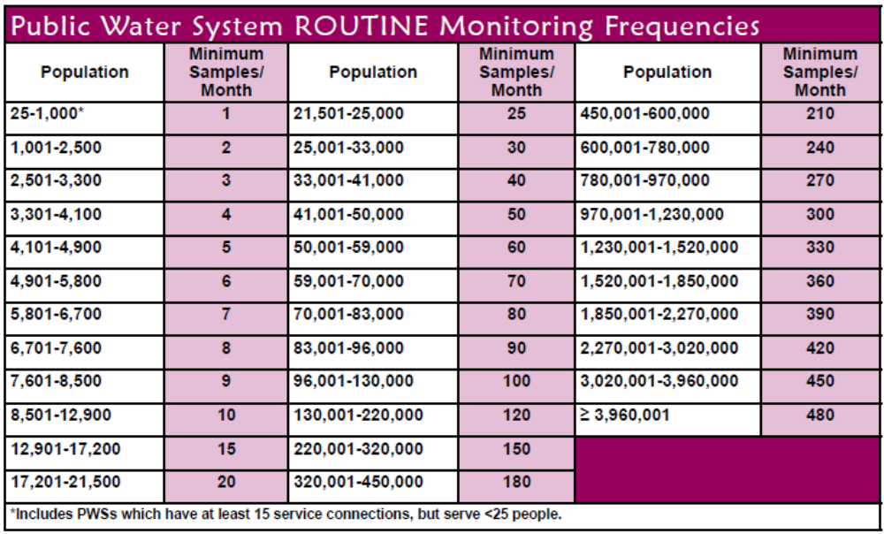
RTCR Monitoring
Number of routine samples based on size of population served.
Routine samples collected monthly in distribution at representative sites, no exemptions.
Sampling is done by the water system.

Slide 36
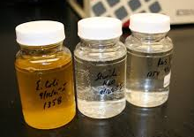
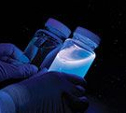
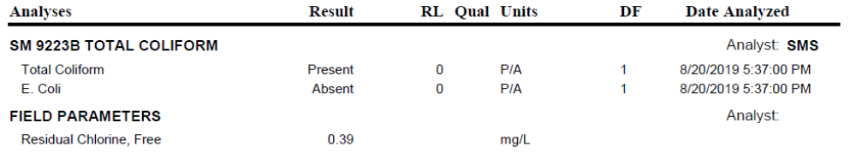
What do the Results Mean?
Total Coliform
Present or Absent (TC+ or TC -)
E. coli
Present or Absent (EC+ or EC-)

Slide 37

What if the Routine sample results are TC and/or EC “Present”?
PWS must collect 3 repeat samples for each positive routine sample within 24 hours of being notified.
Original location.
Upstream location within 5 service connections.
Downstream location within 5 service connection

Slide 38

Following Month:
Collect the regular number of routine samples

Slide 39
RTCR Assessments
Find & Fix
Level 1 Assessment: Evaluation of source water, treatment, distribution, and other operational practices that is completed by the system.
Level 2 Assessment: Detailed evaluation conducted by EPA or an approved third party. Additional sampling, inspections, etc. . . could be required.

Slide 40
Disinfectants/Disinfection Byproducts Rule (D/DBPR)
Which Systems Have to Sample?
*PWSs adding a disinfectant to the drinking water during any part of the treatment process.
Community
Non-Transient Non-Community

Slide 41
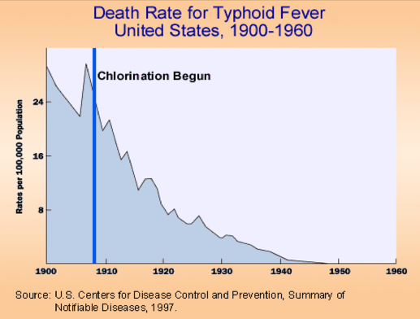
Public Heath & Disinfection
Disinfectants inactivate pathogenic microorganisms.
Disinfectants react with substances naturally in water to form harmful Disinfection Byproducts (DBPs).
Both Disinfectants and DBPs produce negative health effects when present in excessive levels.

Slide 42

Disinfectant Health Effects
Disinfection Byproducts Health Effects
Anemia
Other Short-Term Effects
Eye and Nose Irritation
Stomach Upset
Anemia
Reproductive Problems
Central Nervous System Problems
Liver & Kidney Problems
Cancer
Acute Health Effects
Chronic Health Effects
Microbials
Byproducts
Chronic Health Effect

Slide 43
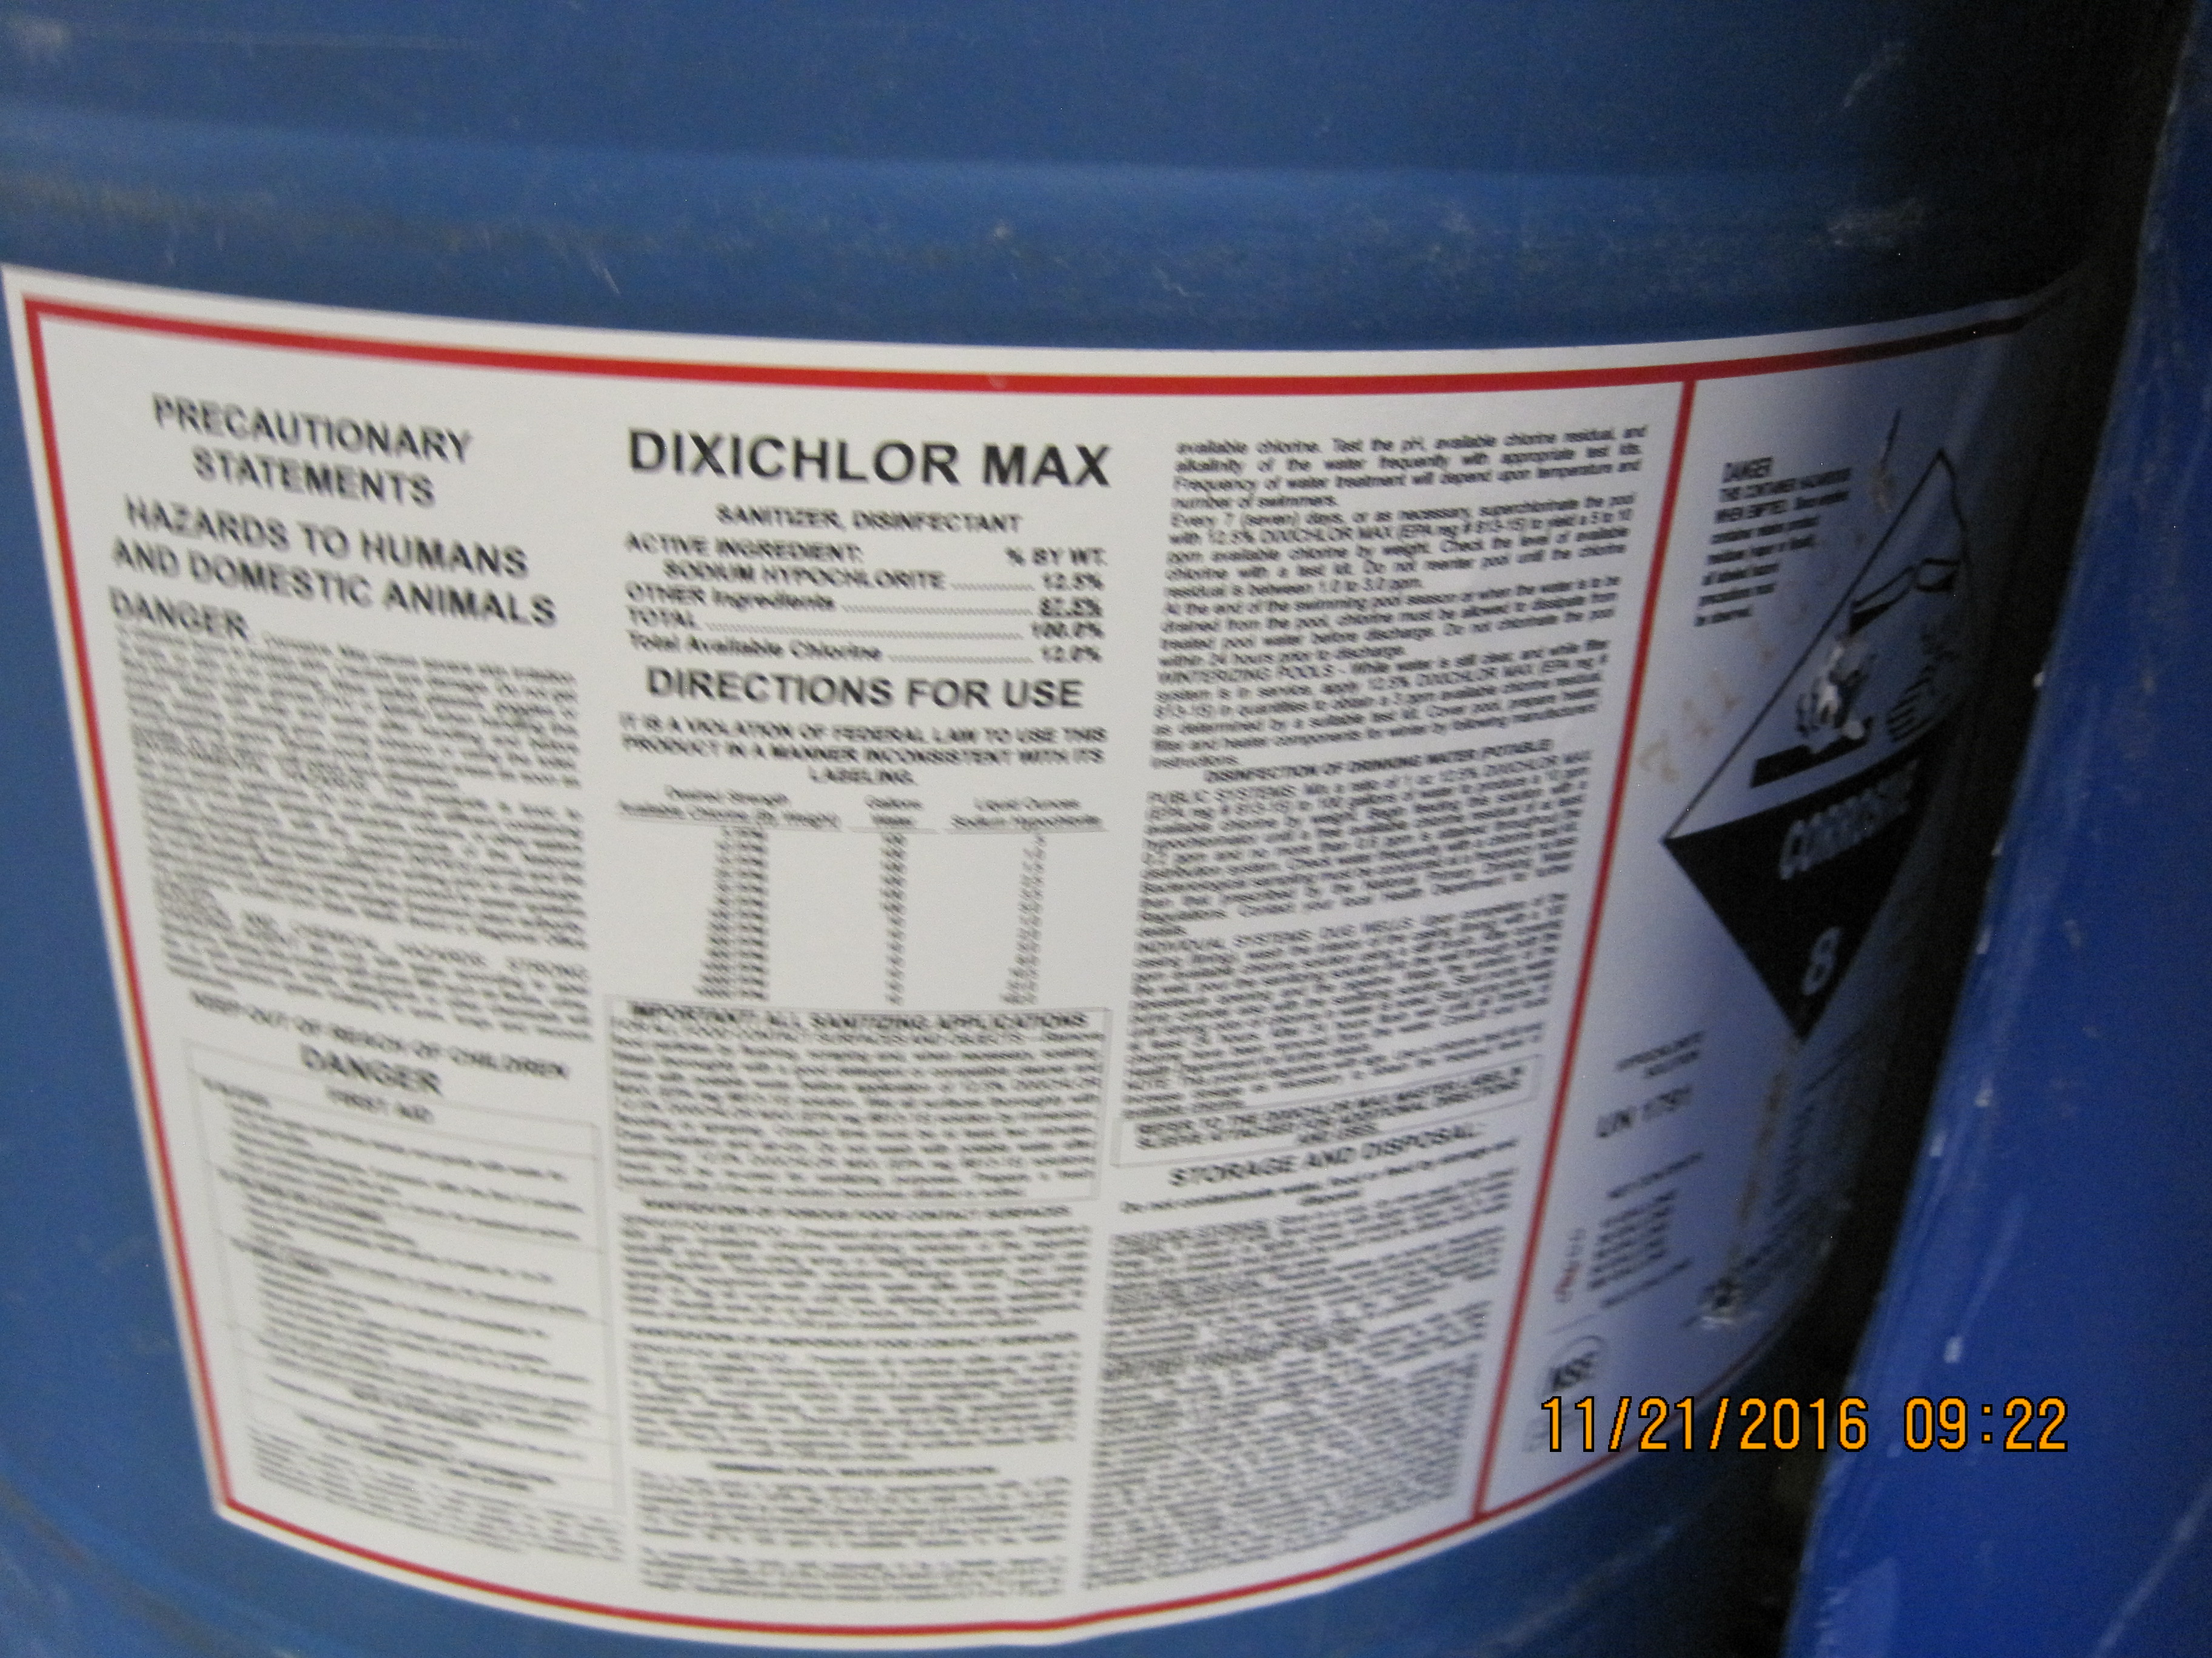
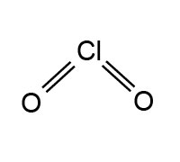
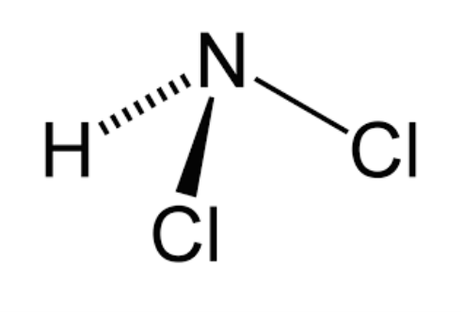
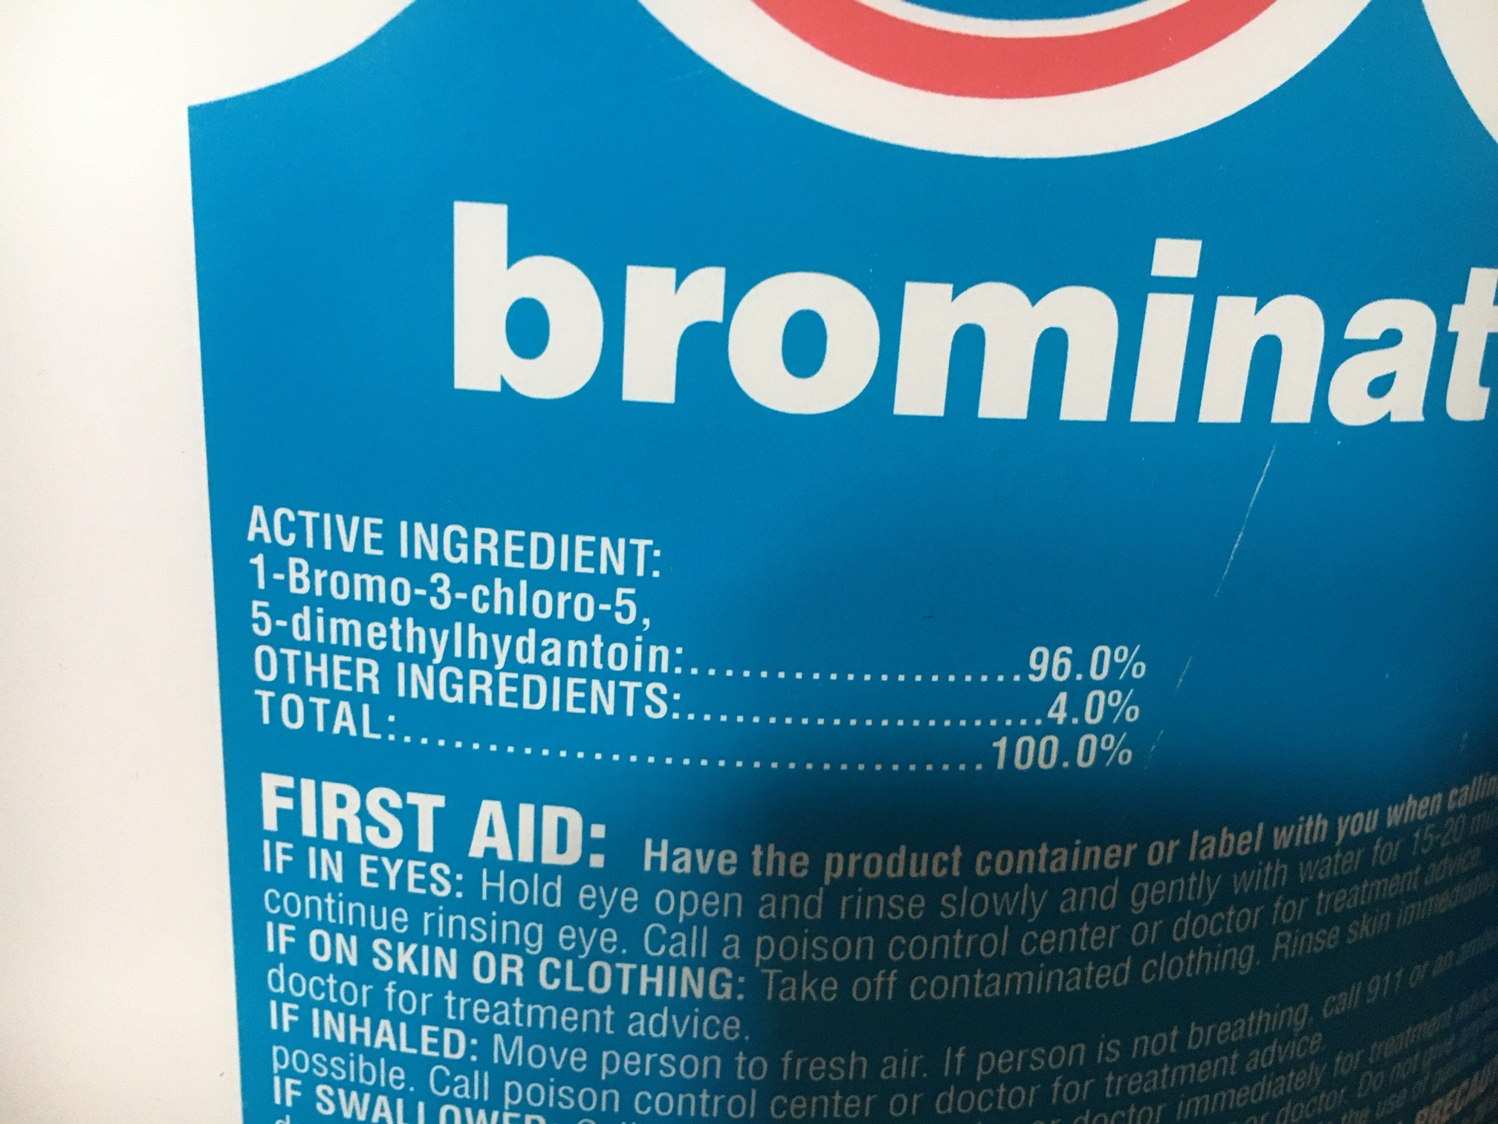
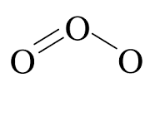
Types of Disinfectants
Most Widely Used
Physical
Ultraviolet Light (UV)
Chemical
Chlorine
Chlorine Dioxide
Chloramines
Bromine
Ozone

Slide 44
Disinfection Byproducts Formation
Add Disinfectant
DBPs
Precursor in Water
Chlorine
Chloramines
Ozone
Chlorine Dioxide
TTHMs & HAA5s
TTHMs & HAA5s
Bromate
Chlorite
+
=
Natural Organic Matter
Higher DBPs formation during the warmer months!

Slide 45
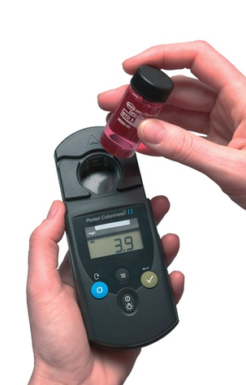
1.) Residual Disinfectant Level
The amount of disinfectant left in the system after it has reacted with precursors in the water (free chlorine residual).
  Maximum Residual Disinfectant Level (MRDL)
  Chlorine MRDL = 4.0 mg/L
  Calculated based on a running annual average (RAA) of RTCR monthly samples.
  Minimum Residual Disinfectant Level
    EPA recommends a minimum residual in distribution of 0.2 mg/L (required for surface water systems)

Slide 46

DBPs Maximum Contaminant Levels (MCLs)
Trihalomethanes (THMs)
  4 containments
  MCL = 0.080 mg/L
Haloacetic Acids (HAA5)
  5 contaminants
  MCL= 0.060 mg/L
Chlorite (only if PWS uses chlorine dioxide)
  MCL = 1.0 mg/L
Bromate (only if PWS uses ozone)
  MCL = 0.010 mg/L
46

Slide 47
The Lead & Copper Rule (LCR, LCRR, LCRI)
Which Systems Have to Sample?
Community
Non-Transient Non-Community

Slide 48
What are the Lead & Copper rules?
The OG Lead & Copper Rule (LCR)
The Lead & Copper Rule Revisions (LCRR)
The Lead & Copper Rule Improvements (LCRI)

Slide 49
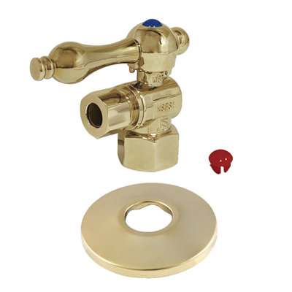
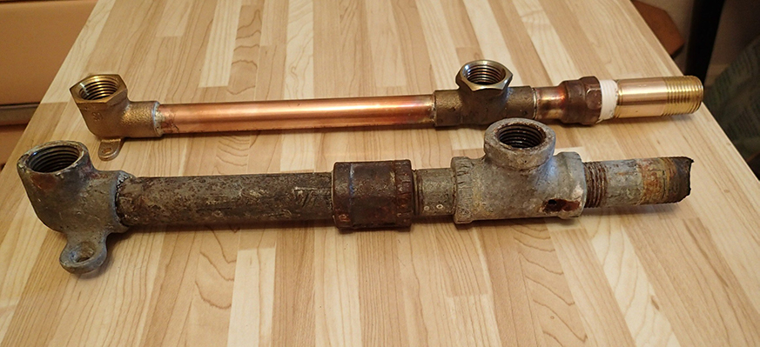
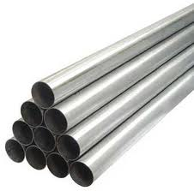
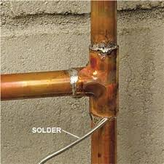
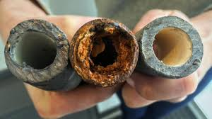
Sources of Lead & Copper in Drinking Water
The corrosion of household plumbing and fixtures
Brass Fittings
Lead and Copper Pipes
Galvanized Pipes
(in downstream locations of LSLs)
Lead Solder at Pipe Joints

Slide 50


Lead Health Effects
Copper Health Effects
Chronic Health Effect
High Blood Pressure
Attention Deficit Disorders
Physical & Developmental Problems
Central Nervous System Disorders
GI Distress
Wilkinson’s Disease Issues if above AL
Liver or Kidney Damage
Chronic Health Effects
Acute Health Effects

Slide 51
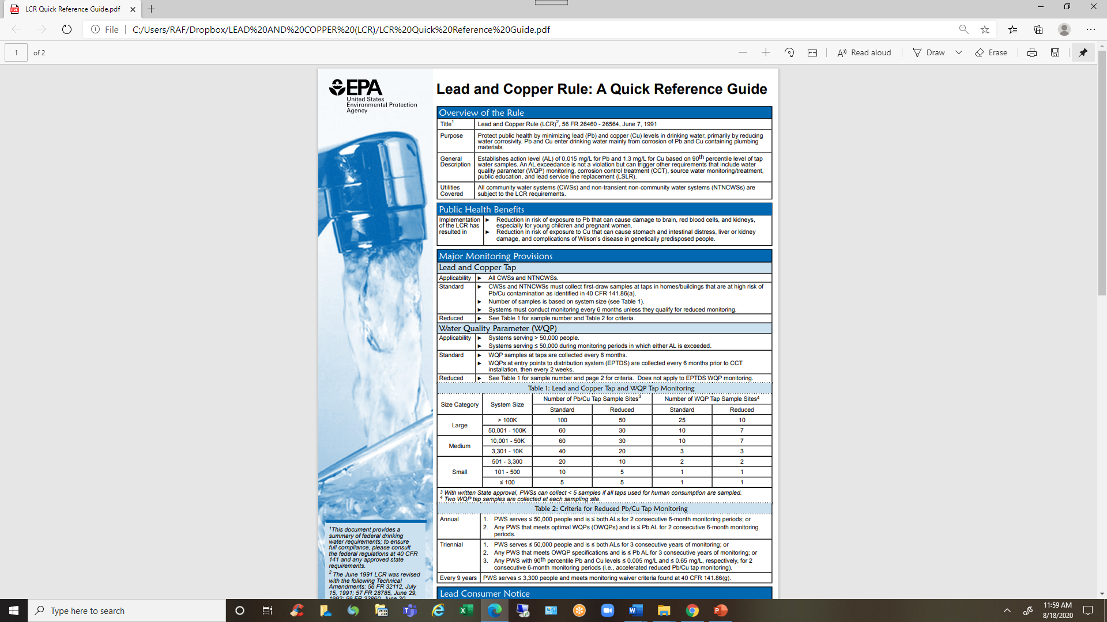
Sampling for Lead & Copper
Number of samples based on:
  Population size;
  Standard (6M) or Reduce (1/YR or 1/3YR) monitoring schedules.
Those on reduce schedules must collected June-September.
Number of samples required (LCR & WQP)

Slide 52
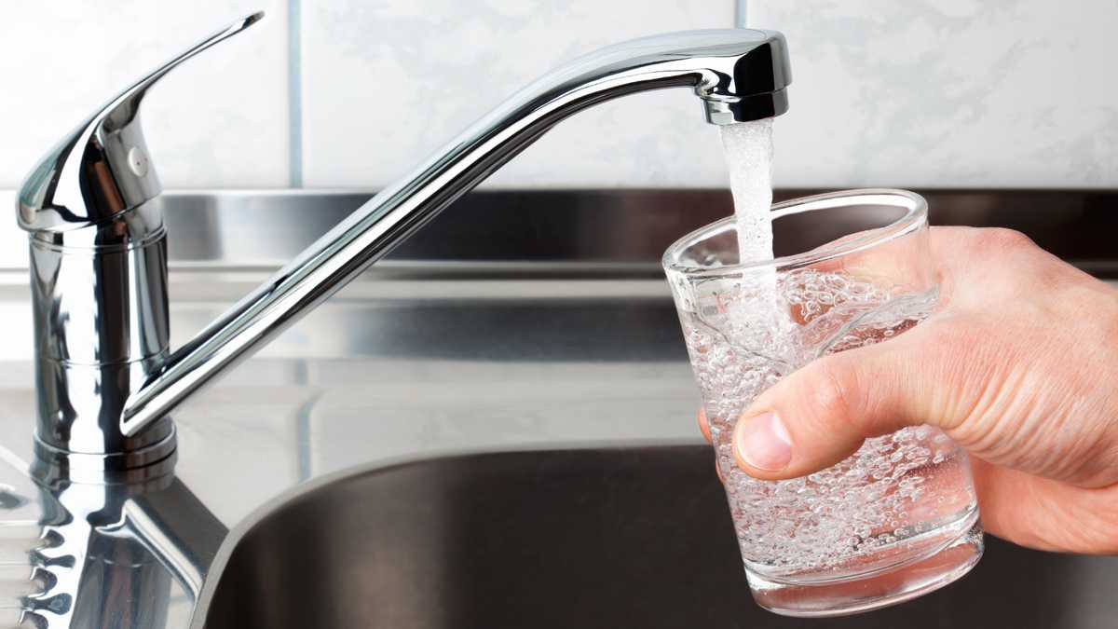
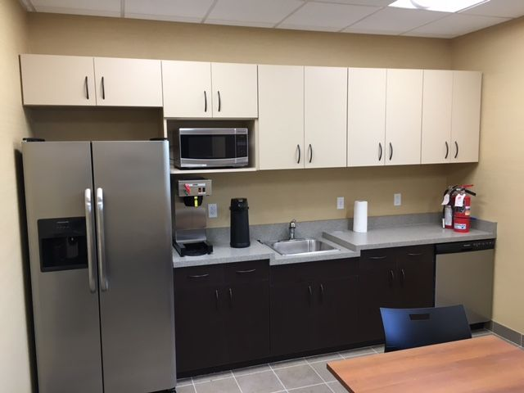

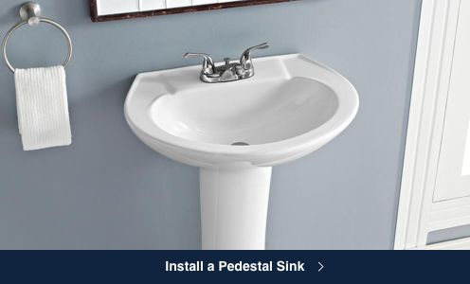


Where do we collect Lead & Copper samples?
At Consumers Taps: kitchen sinks breakroom sinks bathroom sinks
NOT at an entry point (EP).
NOT when sample locations are inactive.
NOT at abandoned homes.
Samples are collected after at least a 6-hour hold time.

Slide 53
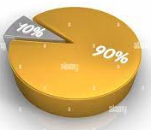
Understanding Lead & Copper Sample Results
Action Levels (AL) - based on 90th percentiles
  Lead - 0.015 mg/L (ppm)
  Copper - 1.3 mg/L (ppm)
  *If 90% of sample results are at
  or below the AL value, no exceedance.
GOAL = Zero for Lead

Slide 54
Understanding Lead & Copper Sample Results
Original Lead Results
Site A | 0.001 mg/L
Site B | 0.003 mg/L
Site C | 0.002 mg/L
Site D | non-detect
Site E | 0.006 mg/L
Site F | 0.001 mg/L
Site G | 0.001 mg/L
Site H | 0.002 mg/L
Site I | 0.022 mg/L
Site J | 0.001 mg/L
Lead = 0.015 mg/L

Slide 55

Understanding Lead & Copper Sample Results
1. Order the results from highest to lowest
Original Lead Results
Reordered Results
0.001 mg/L
0.003 mg/L
0.002 mg/L
non-detect
0.006 mg/L
0.001 mg/L
0.001 mg/L
0.002 mg/L
0.022 mg/L
0.001 mg/L
0.022 mg/L
0.006 mg/L
0.003 mg/L
0.002 mg/L
0.002 mg/L
0.001 mg/L
0.001 mg/L
0.001 mg/L
0.001 mg/L
non-detect
Highest Value
Lowest Value

Slide 56
Understanding Lead & Copper Sample Results
2. Number the results with 1 being the lowest value, 2 being the next higher value on up
Reordered Results
10 | 0.022 mg/L
9 | 0.006 mg/L
8 | 0.003 mg/L
7 | 0.002 mg/L
6 | 0.002 mg/L
5 | 0.001 mg/L
4 | 0.001 mg/L
3 | 0.001 mg/L
2 | 0.001 mg/L
1 | non-detect
Highest Value
Lowest Value

Slide 57
Understanding Lead & Copper Sample Results
3. Find the 90th percentile value
Reordered Lead Results
Lead = 0.015 mg/L
10 | 0.022 mg/L
9 | 0.006 mg/L
8 | 0.003 mg/L
7 | 0.002 mg/L
6 | 0.002 mg/L
5 | 0.001 mg/L
4 | 0.001 mg/L
3 | 0.001 mg/L
2 | 0.001 mg/L
1 | 0.001 mg/L
Highest Value
# of samples x 0.9
(Example: 10 samples x 0.9 = 9th sample)
  If 10 samples = 9th highest sample
  If 20 samples = 18th highest sample
  If 5 samples = avg 4th & 5th samples
Lowest Value

Slide 58
What if an Action Level is Exceeded?
Source water monitoring for Lead & Copper
Water quality parameter (WQP) monitoring at EP & DS (compliance monitoring)
Public education
Determine optimal corrosion control treatment
Lead service line replacement
Under-sink fixture replacement
ALE

Slide 59

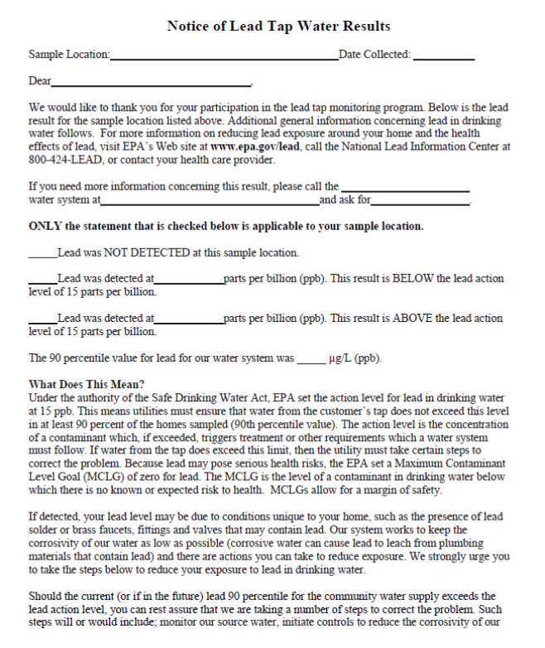

SDWA Requires Consumer Communication
Public Notification Rule
Water Utility Authority
Communicate

Slide 60
Public Notification (PN) Rule Types
Tier 1: Most Severe
Immediate health risk.
Public Notice must be issued within 24 hours.
Examples:
  Boil Water Advisory (Ecoli +).
  Nitrate exceedance (MCL=10mg/L).
  Lead exceedance (AL=15ug/L).
  TT violation.
Tier 2: Moderate Severity
Potential health risk.
Public Notice must be issued within 30 days.
Examples:
  Other MCLs not immediately affecting public health.
  Improperly treated water (TT failure).
  Failure to address deficiencies.
Tier 3: Important
No immediate health risk.
Public Notice must be issued within 1 year.
Examples:
  Administrative issues.
  Monitoring and reporting violations.

Slide 61

SDWA Requires Consumer Communication
Consumer Confidence Report Rule

Slide 62

Record Keeping Rule
Records include:
  Test results
  Mandates
  Other records
Records must be kept at or near the utility office (in close proximity).

Slide 63
Record Keeping Rule
Different rules under SDWA require different record retention times.
Public Notices and CCRs: 3 yrs
Bacteriological & Turbidity: 5 yrs
Sanitary Survey Reports: 10 yrs
ChemRad & DBP analyses: 10 yrs
Lead and Copper: 12 yrs

Slide 64
SDWA Summary
Establishes federal standards for safe levels of contaminants in public drinking water systems.
Includes measures to safeguard groundwater and surface water from contamination.
Requires water systems to monitor, test, and report water quality to authorities and the public.
The National Primary Drinking Water Regulations: https://www.ecfr.gov/current/title-40/chapter-I/subchapter-D/part-141

Slide 65
Questions?

Slide 66



CONTACT US
http://swefc.unm.edu/
Michelle Olson
meolson@unm.edu
Physical Address
SWEFC/Civil Engineering Dept.
MSC01 1070
1 University of New Mexico
Albuquerque, New Mexico 87131-0001

