Slide 1





US Territories Wastewater Operator Training Series
Session 4: Wastewater Math Part 2: Area, Volume, Pressure
8/5/25
www.efcnetwork.org
This program is made possible under a cooperative agreement with US EPA.
Notes:
Welcome to all of our participants from CNMI and Guam (we’ll be having a couple of attendees from American Samoa as well in the later sessions.

Slide 2


Shannon Sloane Pepper
Water Utility Trainer and Specialist spepper@unm.edu

Slide 3



This training series is funded by the US EPA
Notes:
Heather introduction

Slide 4


Slide 5

WPI/ABC Operator Certification
Notes:
This series is designed to supplement and reinforce the ABC Need to Know Criteria for the Wastewater Operator level 1 and 2 exams though there will be some higher level topics covered, and we won’t always follow the exact order listed in the NTKs
https://www.gowpi.org/services/abc-testing/standardized-exams/standardized-wastewater-treatment-operator-exams/

Slide 6
Schedule for 2025:
Date | Topic
6/24/25 | Program Overview, Test Format, Study & Test Tips
7/8/25 | Treatment Overview - Reg history, overview
7/22/25 | WW Math Part 1 (Basic Math)
8/5/25 | WW Math Part 2 (Areas & Volumes)
8/19/25 | Collection Systems - Gravity systems
9/2/25 | Collection Systems - Pumping & force mains
9/16/25 | Collection System Maintenance
9/30/25 | Operator Safety/OSHA/Chemical Safety & Inventory
10/14/25 | Preliminary Treatment
10/28/25 | Primary Treatment: Sedimentation
11/11/25 | Fixed-Film Media
12/2/25 | Activated Sludge Part 1
12/16/25 | Activated Sludge Part 2
Notes:
26 sessions total
1 hour each
This is the schedule for the remainder of this year,
The trainers will vary depending on the topic

Slide 7

https://swefc.unm.edu/home/op-cert-trainings/

Slide 8

Sign in for every session to ensure you get credit for attending

Slide 9
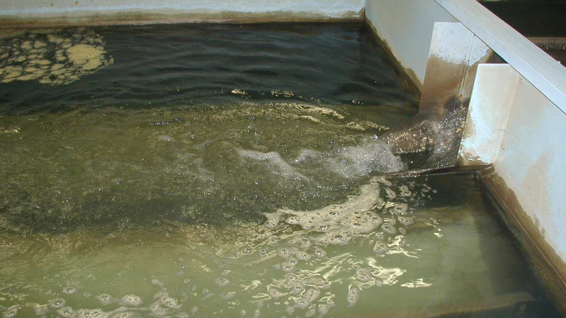

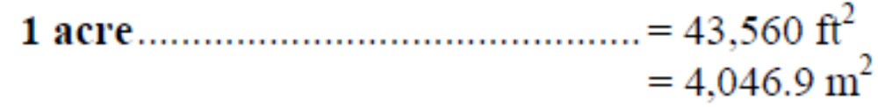
Surface Area Basics
A 2-dimensional space
Area Units
  inches²
  feet²
  miles²
  meters²
  acre
Where in water systems are surface areas important?
You can use conversion factors to convert between these different units.

Slide 10
Surface Area & Water System Operations
Wastewater Pond Liner
Weed Fabric
Paint
Building Material

Slide 11
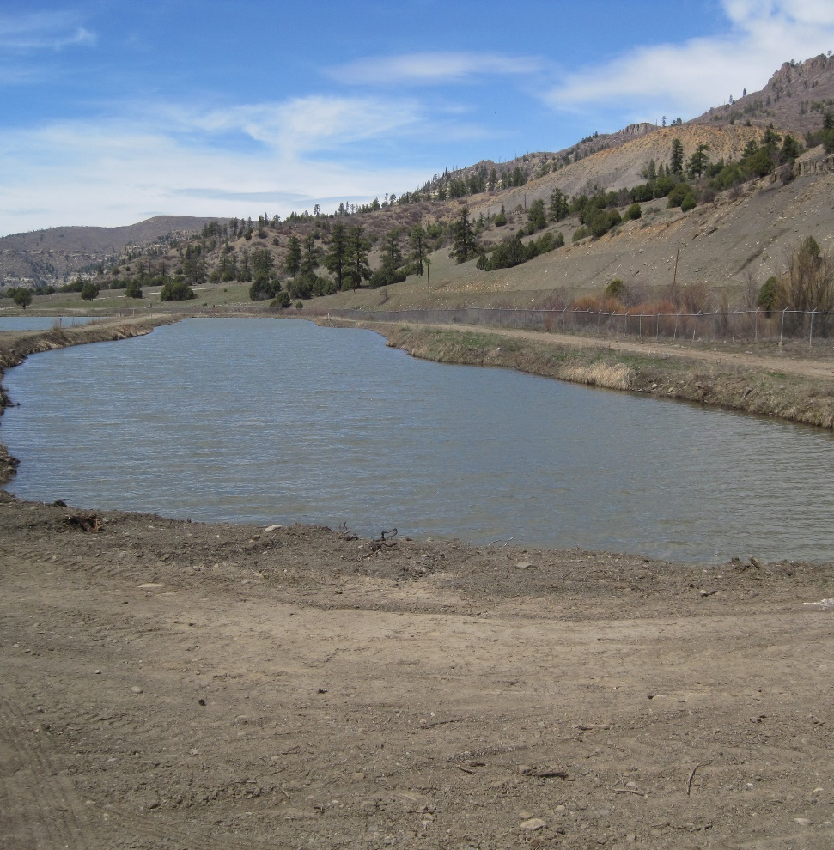
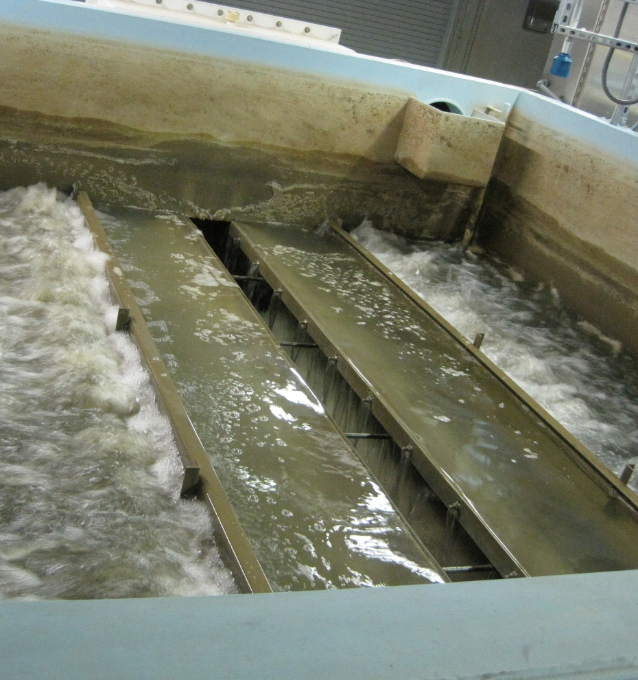
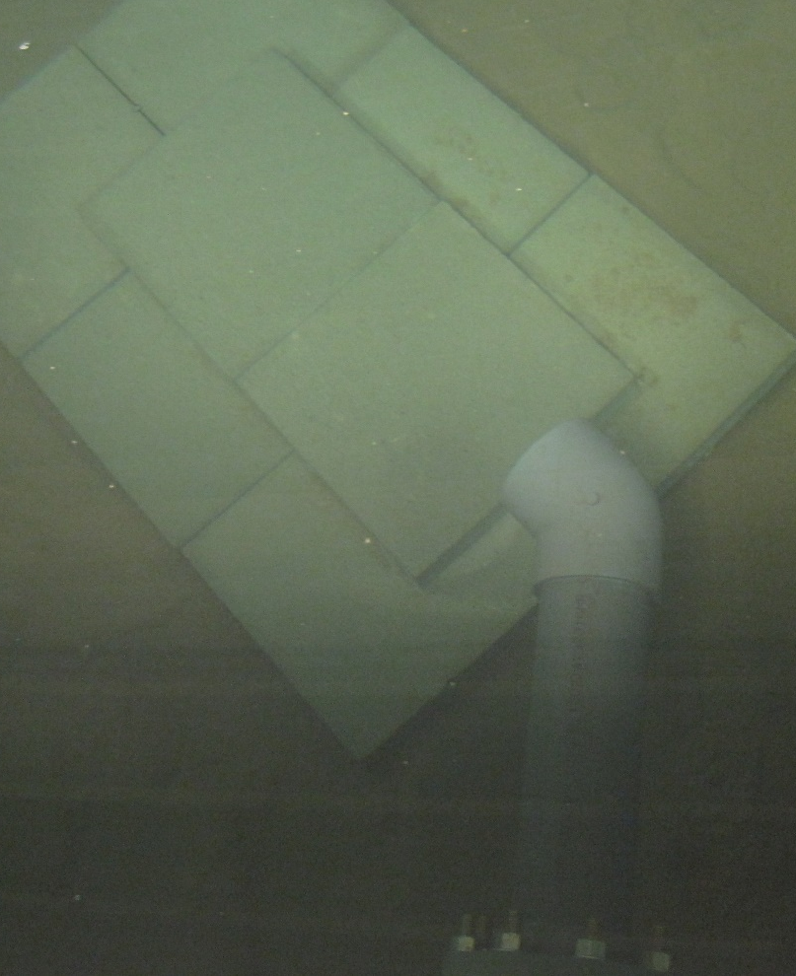
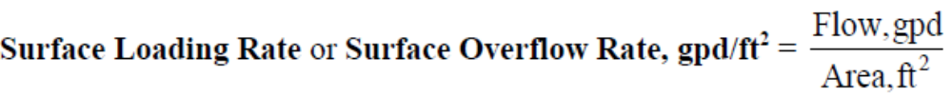
Surface Area & Water/Wastewater System Operations
Copper sulfate application for algae control lbs/acre

Slide 12
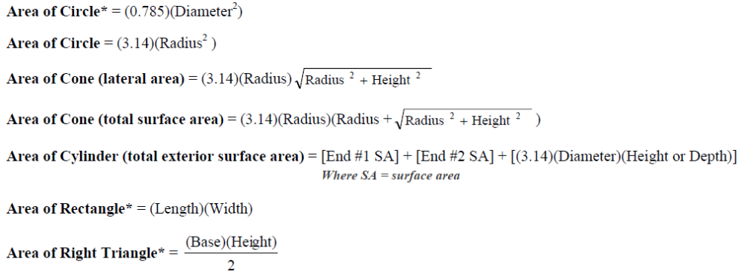
Surface Area Equations

Slide 13
Surface Area Example – Square or Rectangle
You need to buy some new liner for your RO reject water pond. The pond is 64’ long and 32’ wide. How many square feet do you need to order?
Area = (Length)(Width)
Area = (64 feet)(32 feet)
Area = 2,048 ft²
Length (l) = 64’
Width (w) = 32’

Slide 14
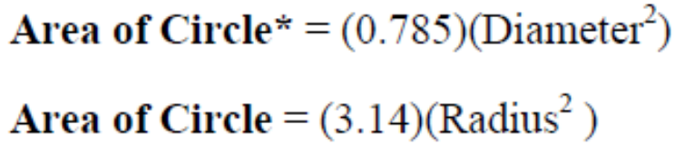
Surface Area Example - Circle
What is the surface area in square feet of a circular sedimentation basin that is 60 feet in diameter?
Radius = ½ Diameter
Area = 3.14(Radius²)
Area = (3.14)(30 ft²)
Area = (3.14)(900 ft²)
Area = 2,826 ft²
Diameter (d) = 60’
Radius (r)
= 30’

Slide 15

Surface Area Practice
1
How many square feet of weed cloth will you have to order to cover the fenced area around your 25’ diameter tank? The fenced area is 90’ x 90’.
2,250 ft²
7,610 ft²
8,100 ft²
14,220 ft²
Length (l) = 90’
Radius (r)
= 12.5’
Width (w) = 90’

Slide 16
Surface Area Practice
1
How many square feet of weed cloth will you have to order to cover the fenced area around your 25’ diameter tank? The fenced area is 90’ x 90’.
Length (l) = 90’
Area = (L)(W) – (3.14(Radius²))
Area = (90 ft)(90ft) - (3.14)(12.5 ft)²
Area = 8,100 ft² - (3.14)(156.25 ft²)
Area = 8,100 ft² – 490 ft²
Area = 7,610 ft²
Radius (r)
= 12.5’
Width (w) = 90’

Slide 17

Now let’s dive deep into some 3D water math!!!
Volume
Volume of a box (rectangular tank, trench) = (Length)(Width)(Height)
What is the volume in gallons of a rectangular tank with the dimensions of 30 feet long, 10 feel wide, and 15 feet high?
V = (Length)(Width)(Height)
V = (30ft)(10ft)(15ft)
V = 4500
1 cubic foot of water = 7.48 gal
4500 ft³ *$\left(\frac{7.48gal}{1ft3}\right)=$
^{4500 ft3 7.48 gal =}
^{1 1 ft3}
ft³
33,660 gal
Hold on! Do we actually know our volume that accurately?
Notes:
Be sure to include your units in the equations. They will determine what your final units will be.
What will be the units for this?
4500 cubic feet is the correct answer, but we usually measure tanks in gallons. How many gallons would the capacity of this tank be?

Slide 18
How precise is our input data?
How many significant figures did we start with?
Two significant figures in our initial data, three in our conversion factor
What is the volume in gallons of a rectangular tank with the dimensions of 30 feet long, 10 feel wide, and 15 feet high?
V = (Length)(Width)(Height)
V = (30ft)(10ft)(15ft)
V = 4500
1 cubic foot of water = 7.48 gal
4500 ft³ *$\left(\frac{7.48gal}{1ft3}\right)=$
^{4500 ft3 7.48 gal =}
^{1 1 ft3}
ft³
33,660 gal
34,000 gal
Notes:
Be sure to include your units in the equations. They will determine what your final units will be.
What will be the units for this?
4500 cubic feet is the correct answer, but we usually measure tanks in gallons. How many gallons would the capacity of this tank be?

Slide 19
Your turn: Volume of a box and conversion
2
Part 1: You dig a trench to put in a new section of pipe. The trench is four feet deep, two feet wide, and 200 ft long. How many cubic feet of dirt did you excavate?
160 ft³
206 ft³
1600 ft²
1600 ft³
V = (Length)(Width)(Height)
V = (200 ft)(2 ft)(4 ft)
V = 1600 ft³

Slide 20
Your turn: Volume of a box and conversion
2
Part 2: To fill in your 1600 ft³ hole, you need to order fill dirt that is sold by the truckload. How many truckloads of dirt do you need if one truck hold 10 cubic yards? 1 yard = 3 feet or 1 yrd³ = 27 ft³
1 truckload
6 truckloads
18 truckloads
53 truckloads
Conversion 1 yrd = 3 ft
V =1600 ft³ $\left(\frac{1yrd}{3ft}\right)\left(\frac{1yrd}{3ft}\right)\left(\frac{1yrd}{3ft}\right)$
V = 1600 (ft)(ft)(ft) 1 yrd 1 yrd 1 yrd
1 3 ft 3 ft 3 ft
V = 59 yrds³
Conversion 10 yards³ = 1 truckload
Number of truckloads needed = 59 yrds³ 1 truckload
1 10 yrds³
Number of truckloads needed = 6 truckloads

Slide 21
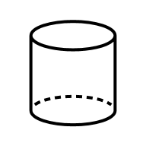
Volume of a cylinder (tank, pipe, well)
Area of Circle* = (0.785)(Diameter²)
Volume of a cylinder = (0.785)(Diameter²)(Height)
OR
Area of Circle = (3.14)(Radius²)
Volume of a cylinder = (3.14)(Radius²)(Height)
Diameter(d) = Radius(r) x 2
d
r
Notes:
First three are on the ABC formula sheet. Fourth formula not on sheet, but volume of a cylinder can also be measured as area of circle multiplied by height (third dimension), which is seen in the difference between the top two formulas and the third and fourth formula.

Slide 22
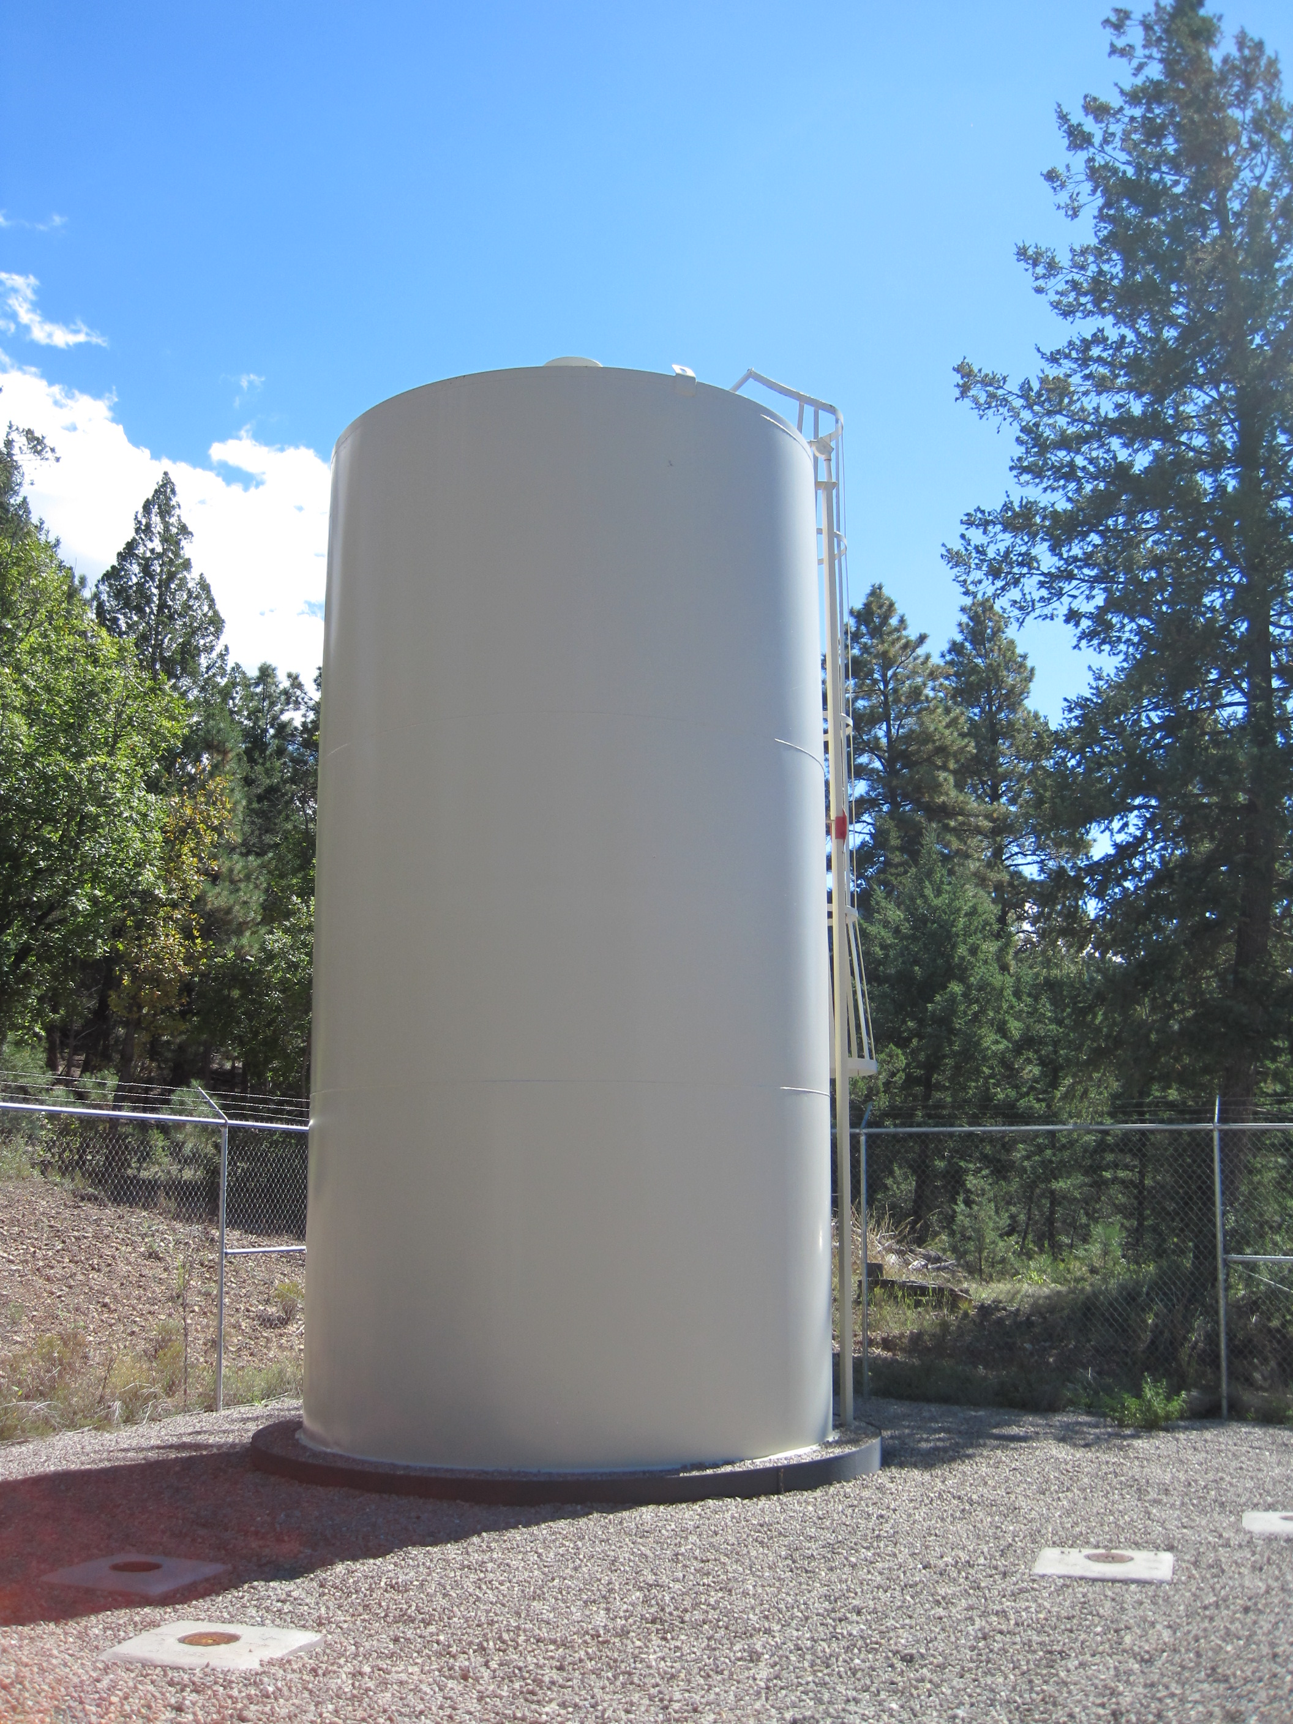
Example: calculating volume of cylinder
You are trying to figure out how much water is in your water system at any given time. You have one storage tank with a diameter of 10 feet and is 16 feet tall and 4000 ft of water lines that are 8 inches in diameter. What is the volume of water in the full tank and lines?
First let’s find the volume of the tank
V = $3.14 \left({radius}^{2}\right)(height)$
V = $3.14 \left({(\frac{10ft}{2})}^{2}\right)(16ft)$
V = $3.14 \left({(5ft)}^{2}\right)(16ft)$
V = $3.14 (25ft2)(16ft)$
V = $(78.5ft2)\left(16ft\right)$
V = $1260ft3$

Slide 23
Example: calculating volume of cylinder
You are trying to figure out how much water is in your water system at any given time. You have one storage tank with a diameter of 10 feet and is 16 feet tall and 4000 ft of water lines that are 8 inches in diameter. What is the volume of water in the full tank and lines?
First let’s find the volume of the tank
V = $3.14 \left({radius}^{2}\right)(height)$
V = $3.14 \left({(\frac{10ft}{2})}^{2}\right)(16ft)$
V = $3.14 \left({(5ft)}^{2}\right)(16ft)$
V = $3.14 (25ft2)(16ft)$
V = $(78.5ft2)\left(16ft\right)$
V = $1260ft3$
Now let’s calculate the volume in the pipes
Convert inches into feet (1 feet = 12 inches)
Diameter of pipe: $8in∗\left(\frac{1ft}{12in}\right)=0.67 ft$
V = $3.14 \left({radius}^{2}\right)(length)$
V = $3.14 \left({(\frac{0.67ft}{2})}^{2}\right)(4000ft)$
V = $3.14 \left({\left(0.33ft\right)}^{2}\right)(4000ft)$
V = $3.14 \left({0.11ft}^{2}\right)(4000ft)$
V = $\left(0.35{ft}^{2}\right)(4000ft)$
V= 1400 ft³
Total V = 1260 ft³+1400 ft³ =
2660 ft³
Total volume in system = 2700 ft³

Slide 24
Your turn: Volume of a Cylinder
3
You have a tank that is 42’ in diameter and has 56 feet of water in it? How many gallons of water are in the tank?
Diameter (d) = 42’
Volume of a Cylinder = π(radius²)(height)
10,400 gallons
27,600 gallons
77,500 gallons
580,000 gallons
Height (h) = 56’

Slide 25
Your turn: Volume of a Cylinder
3
You have a tank that is 42’ in diameter and has 56 feet of water in it? How many gallons of water are in the tank?
Diameter (d) = 45’
Volume of a Cylinder = π(radius²)(height)
Volume = 3.14(21 ft)²(56 ft)
Volume = 3.14(441 ft²)(56 ft) = 77,545 ft³
Volume = 77,545ft³ 7.48 gal
1 1 ft³
Height (h) = 56’
= 580,000 gal

Slide 26
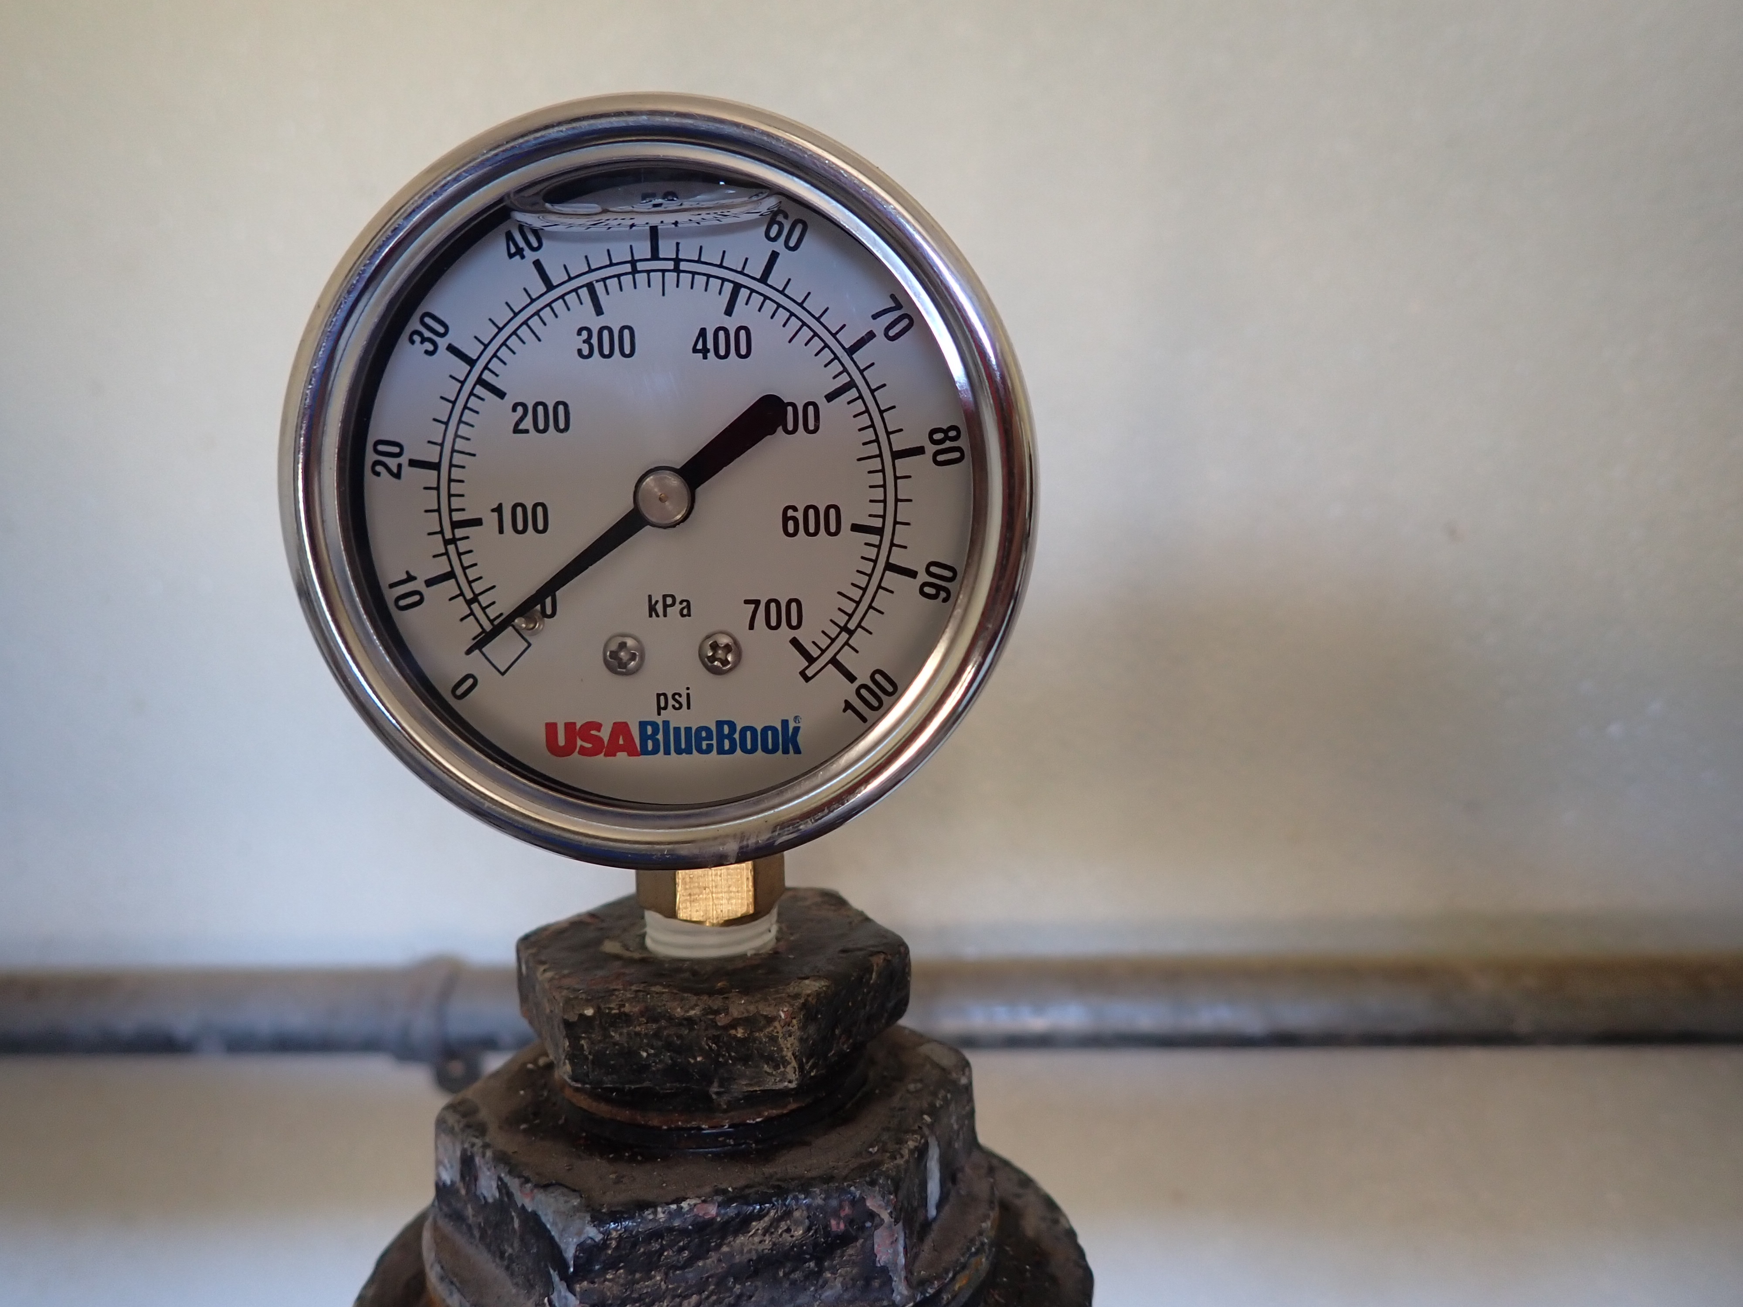


Water Pressure
Pressure Units
  Feet of head (feet)
  Pounds per square inch (psi)
  Torr
  Pascal
  bar
  mm of mercury
Minimum required in distribution = 20 psi
Maximum recommended in distribution = 100 psi

Slide 27
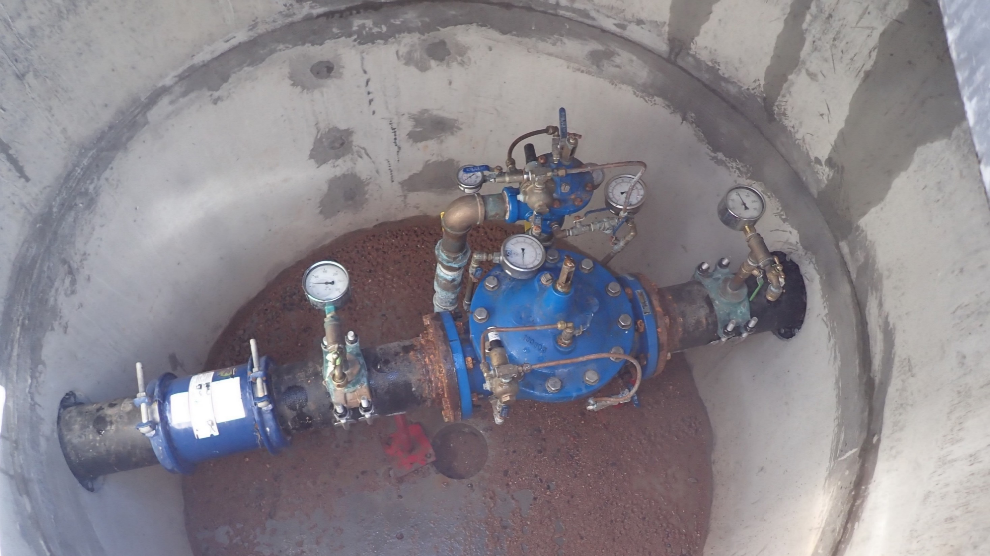
Water Pressure & System Operations
Understand how elevation changes affect pressure in your system.
Understand how water loss control can be optimized through good pressure management.
Understand and control tank levels to meet pressure goals for the distribution system.

Slide 28
Pressure and Feet of Head
B
Tank A is 5’ in diameter and 75’ tall and holds ~11,000 gallons of water.
Tank B is 50’ in diameter and 75’ tall and holds ~1.1 million gallons of water.
If each tank has a pressure gauge at its base, which tank has the highest pressure?
A
=

Slide 29
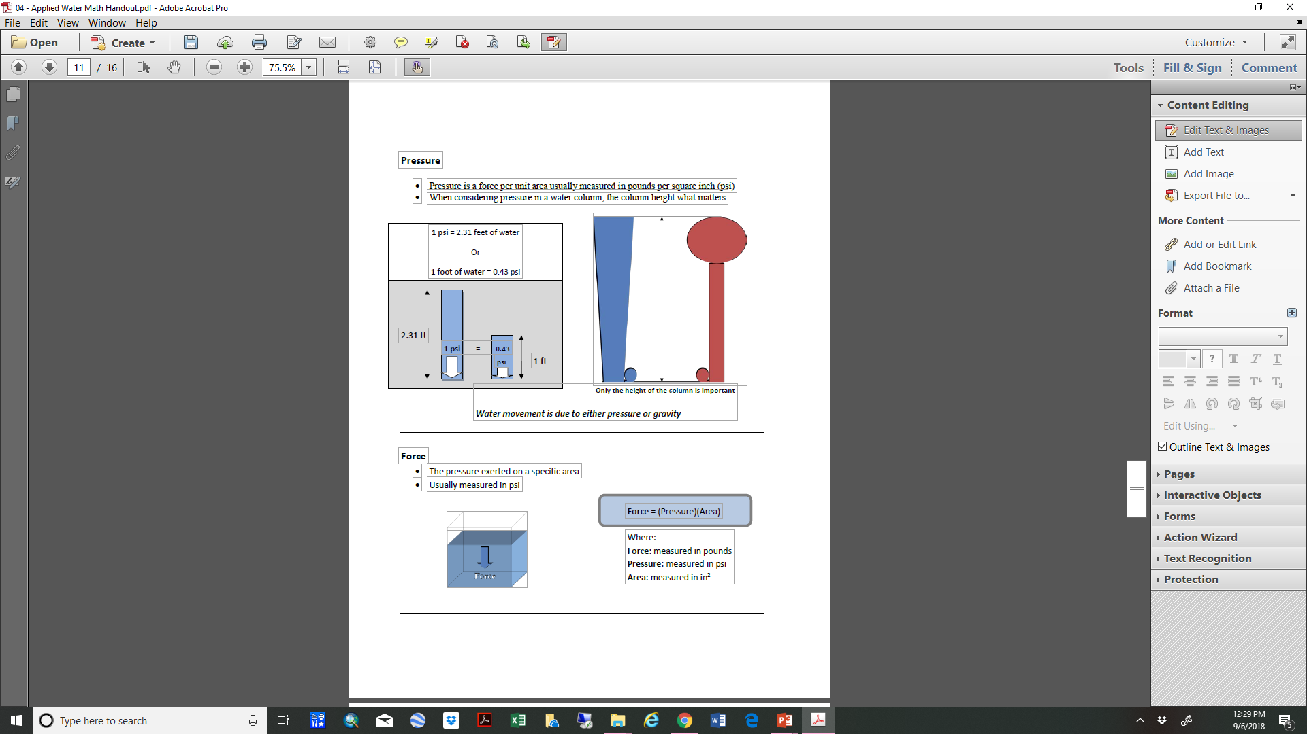
Pressure and Feet of Head
The volume of the water is not important, it’s the height of the water (feet of head) that matters.
There’s a direct relationship between feet of head (ft) and pressure (psi).

Slide 30
Calculating Pressure Example
Your storage tank has 53 feet of water in it, what is the water pressure in pounds per square inch at the base of your tank?
53 ft 0.433 psi
1 1 ft
53 feet = 23 psi
53 feet of water

Slide 31
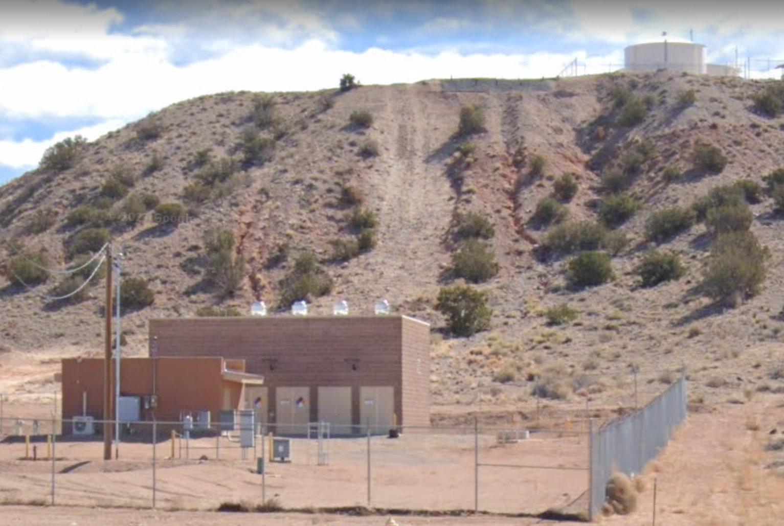
Calculating Pressure Practice
4
A storage tank is on a hill, 100’ above a pumphouse. It has 345,000 gal of water in it at a water height of 34’. Calculate psi in the pumphouse.
34 feet of water
15 psi
29 psi
58 psi
100 psi
+
100 feet of water
=
134 feet of water

Slide 32
Calculating Pressure Practice
A storage tank is on a hill, 100’ above a pumphouse. It has 345,000 gal of water in it at a water height of 34’. Calculate psi in the pumphouse.
Set up the conversion
134 feet 1 psi
1 2.31 feet
134 feet = 58 psi
34 feet of water
+
= 134 psi
2.31
100 feet of water
=
134 feet of water

Slide 33
Questions?

Slide 34

Thanks for attending!
Next webinar in the series:
Collections Systems – Gravity Systems
August 19, 2025
Shannon Sloane Pepper
spepper@unm.edu

