Slide 1





US Territories Wastewater Operator Training Series
Session 5: Collection Systems Part 1 – Gravity Systems
8/19/25
www.efcnetwork.org
This program is made possible under a cooperative agreement with US EPA.

Slide 2
Collection Systems
Things to know for the Op Cert test

Slide 3

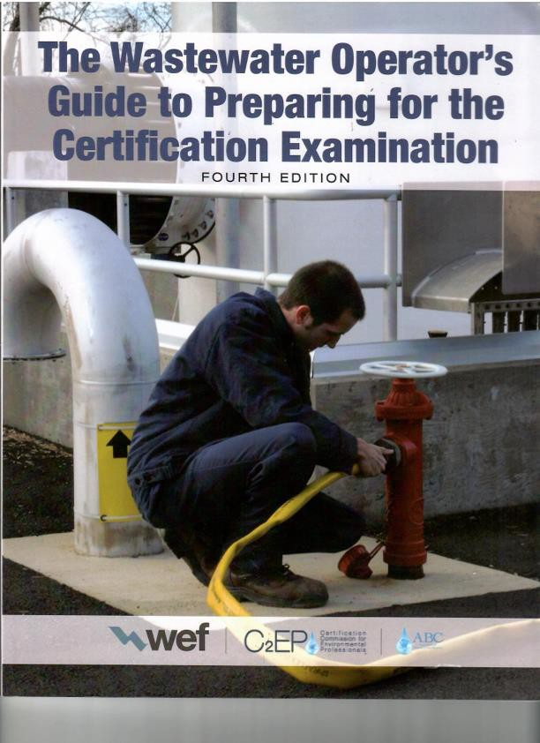
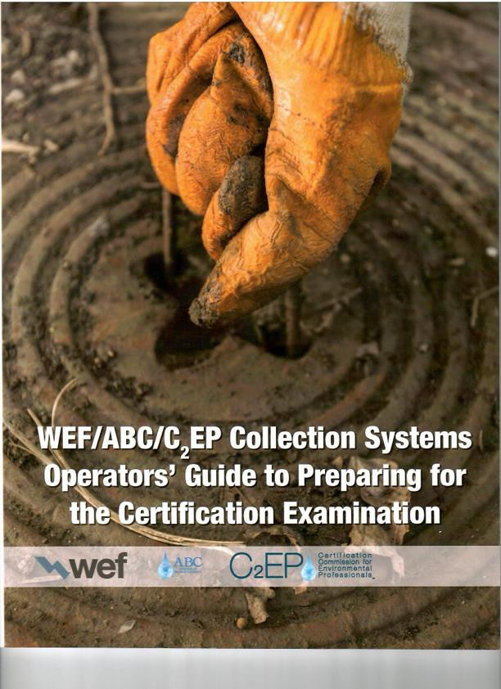
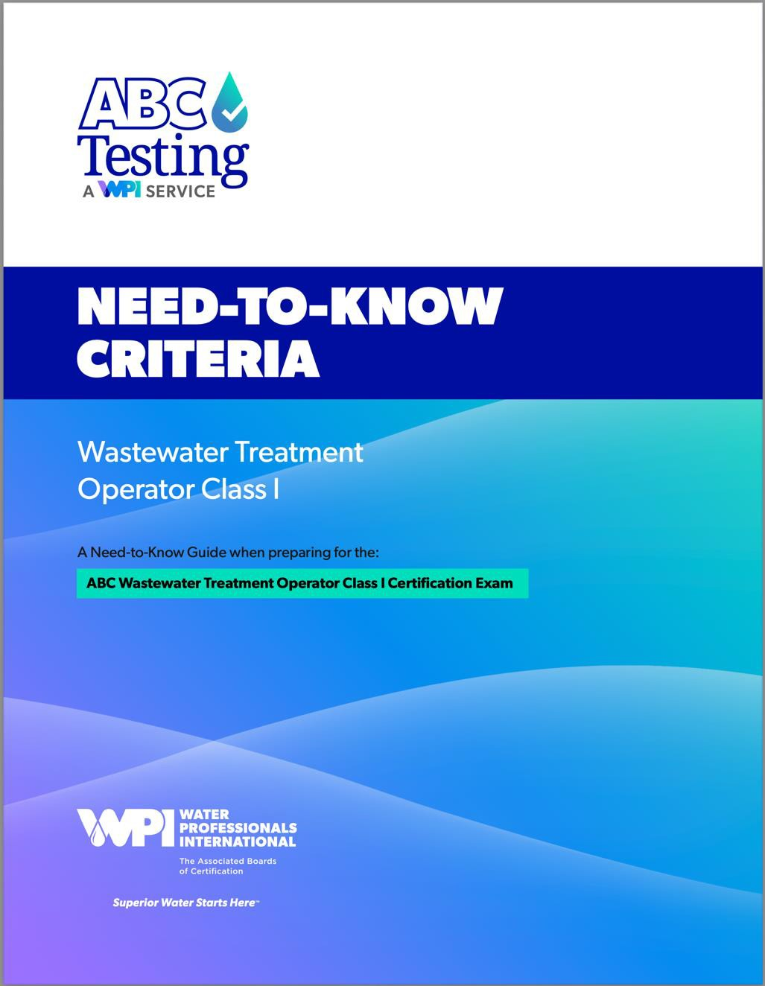
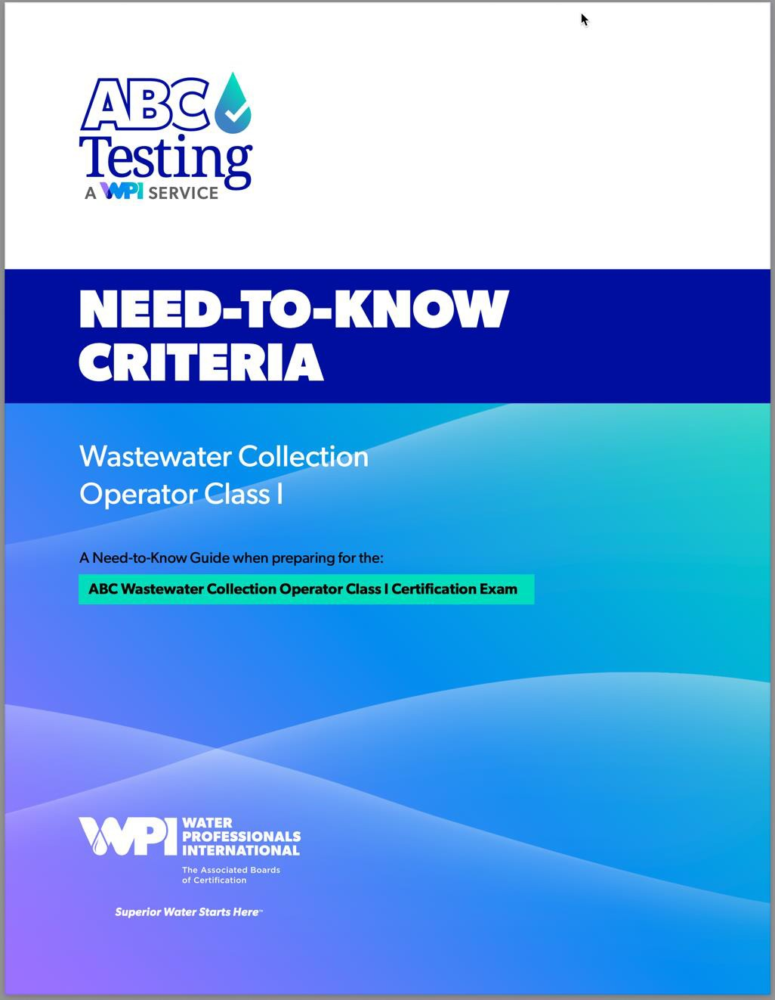

Slide 4
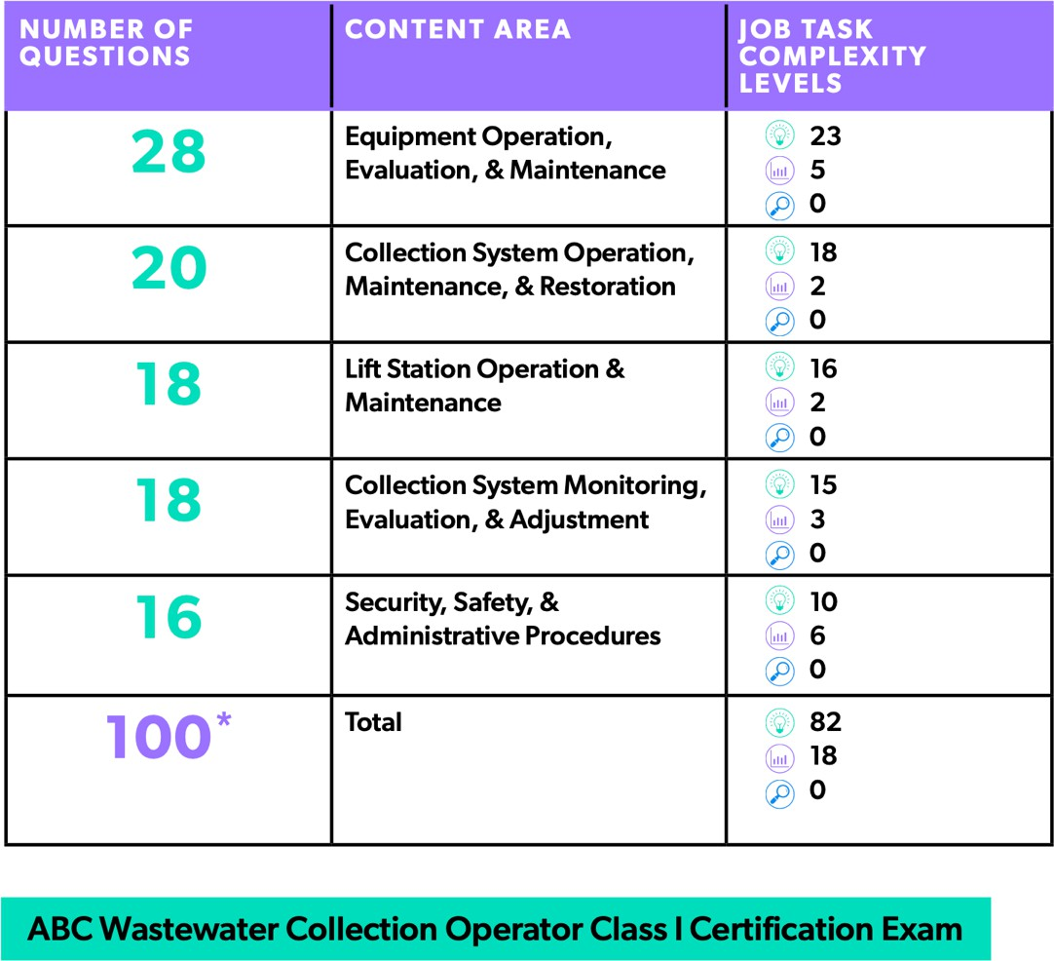



Collection Operator Exam Content

Slide 5
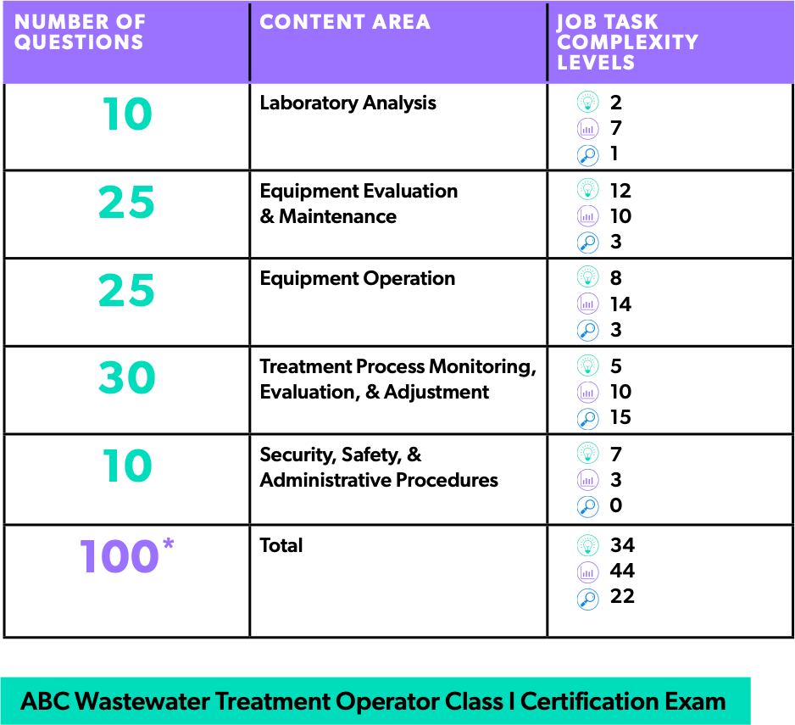
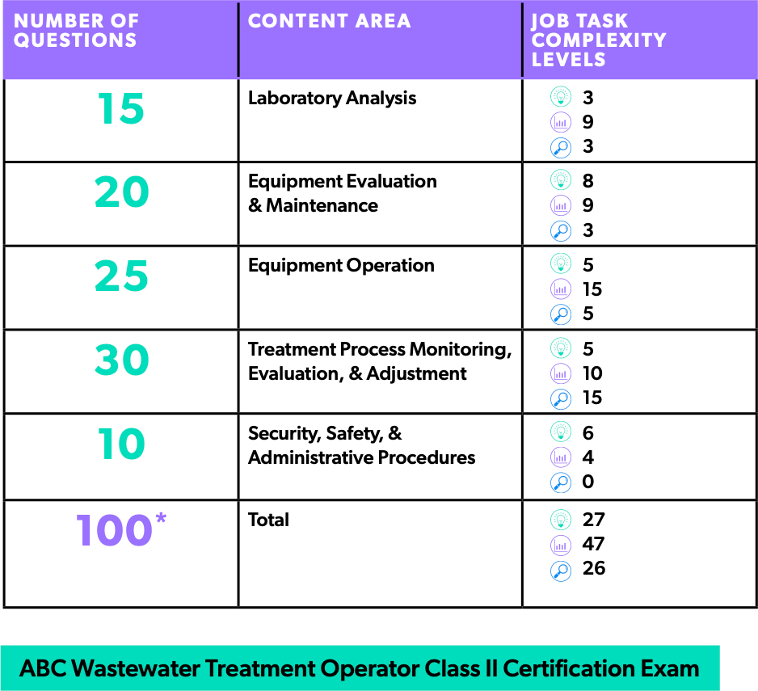


Treatment Operator Exam Content

Slide 6
Collection Topics Today
Design Basics, Terminology, Slope and Velocity
Pipe Materials and Joint Types
Installation: Pipe, Bedding, Backfill, Service Connections
Manholes
Maps
Lift Stations (more on 9/2)
Equipment Cleaning and Maintenance (more on 9/16)

Slide 7
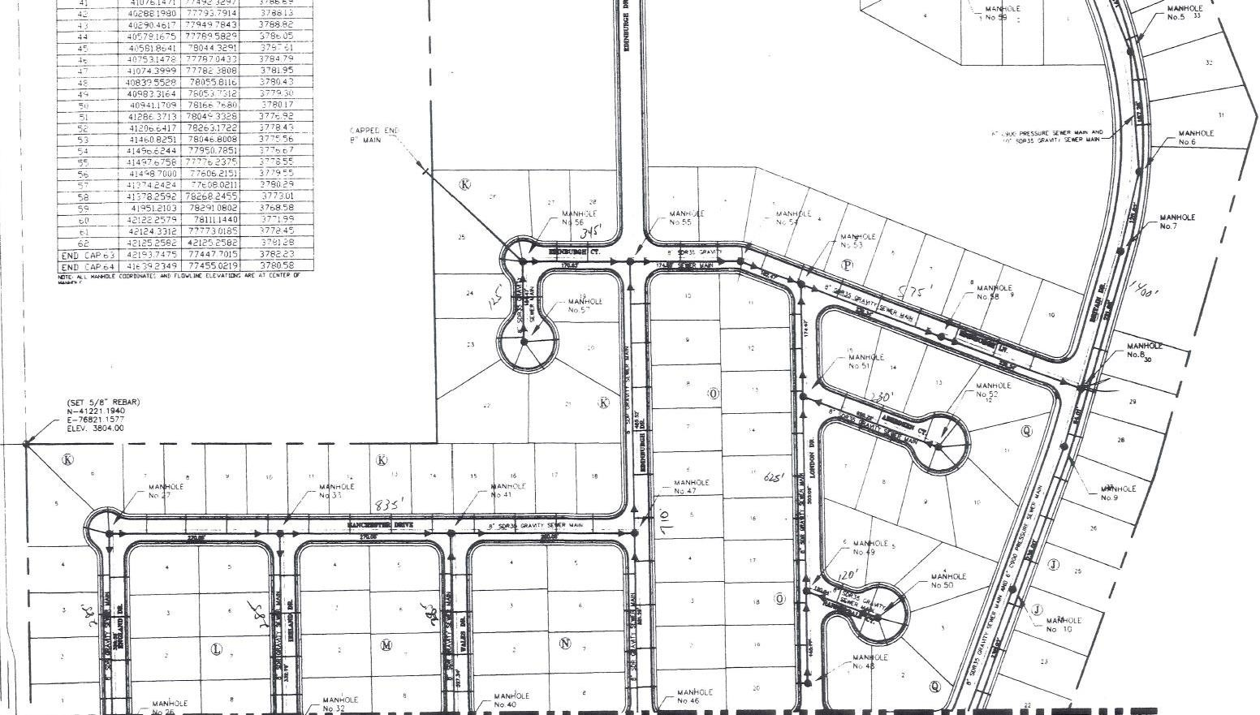
Basic Design Elements

Slide 8
Building
Building Sewer or Service Connection
Lateral or Branch Sewer Main Sewer
Trunk Sewer Lift Station Interceptor
Force Main
WWTP
Typical Gravity Wastewater Collection System

Slide 9
Gravity Sewers
Pipe diameter increases as you move from sources to treatment facilities
Gravity sewers are designed to be ½ to ¾ full at peak flow. That helps maintain aerobic conditions in the pipe.
Pipe networks are designed for maximum expected flow (peak flow) when maximum population density has been developed
Crown (top of the inside of the pipe)
Invert (bottom of the inside of the pipe)
Gravity Main

Slide 10

Gravity Sewer Flow
Gravity sewer flow velocity is determined by slope
Slope = drop/length (or rise/run) Example a 2’ drop over 100’ : 2ft/100ft = 0.02 slope
Force mains are pressurized.
Gravity Main flow is determined by gravity and slope.
They are designed to flow partially full and to maintain air space in the crown.
Force Main flow is determined by pumps. They are designed to be pressurized and flow full.
Gravity Main
Force Main

Slide 11
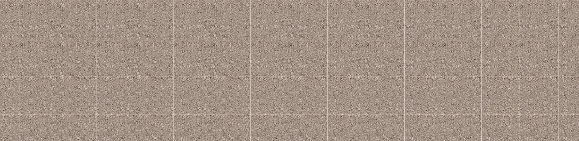
Sewer Slope & Velocity
Slope = drop/length = 0'/100’ = 0 slope which means no velocity
WWTP

Slide 12
Sewer Slope & Velocity
Minimum Velocity: 2 ft/sec
WWTP

Slide 13
Sewer Slope & Velocity
High Velocity is bad: > 8-10 ft/sec
WWTP

Slide 14
Sewer Slope
Minimum slope to meet that requirement will vary by pipe diameter:
Sewer Size | Min Slope in feet/100 feet
4” | 1.20
6” | 0.60
8” | 0.40
10” | 0.28
12” | 0.22
14” | 0.17

Slide 15
Slope Differences Visual
4” Pipe: 1.2’/100’
14” Pipe: 0.17’/100’

Slide 16
Design Considerations
Slope follows the lay of the land where possible
Designed for 2 to 8 ft/sec flow, 2.5 ft/sec is considered ideal
Slope should maintain a minimum velocity of 2 ft/sec at average or peak flows (flow that
prevents buildup in the pipe is called “scouring velocity”)
Collection systems are designed for maximum expected flow (peak flow) when maximum population density has been developed
Per capita flow can vary from location to location.
Max flow is typically around 10am to Noon
Peaking factors are used to size the WWTPs – typically 2.5 to 3.5 times total daily flow

Slide 17
More Design Considerations
Pipes should be sized for available cleaning equipment
Sewer should flow half full during average daily flows (to maintain aerobic
conditions and to have room for error)
Sewers are typically 4 to 8 feet deep but may be a LOT deeper.
Laterals, mains and trunks are typically in the center of streets but may not
be
Sewers typically must be at least 2 ft vertically below and 4 ft horizontally from water distribution pipes to avoid contamination

Slide 18
Know the local requirements
Design requirements can vary by jurisdiction: Know yours
In New Mexico, for example, per capita flow is typically 60 to 125 GPD
Michigan mobile home park sewers require design for
minimum of 200 GPD per home site.
What are the design requirements in your jurisdiction?

Slide 19
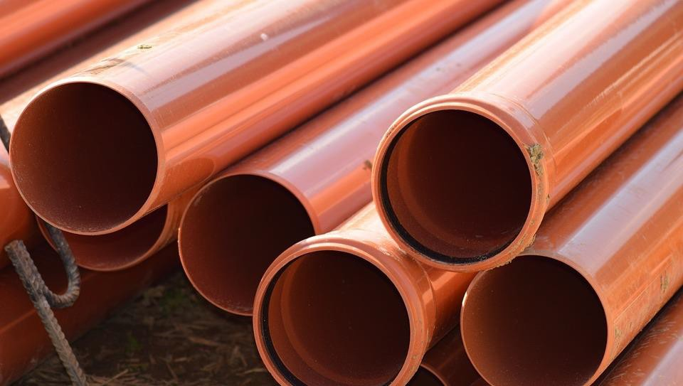
Piping and Joints

Slide 20
Some Pipe Selection Criteria
Resistance to deterioration
Ability to withstand surface loads
Resistance to root intrusion
Ability to minimize leakage
Cost
Service life span

Slide 21
Pipe Materials

Slide 22
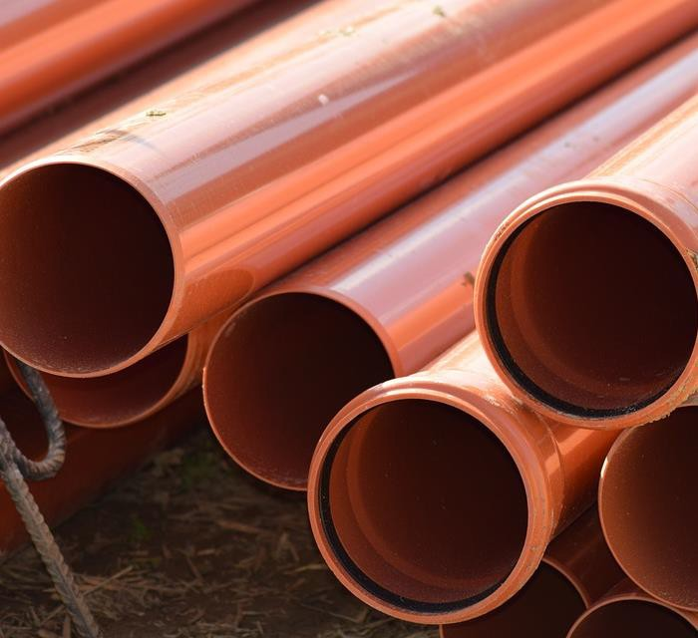
Pipe Materials
AC – Asbestos Cement
RC & C – Reinforced and Non-
reinforced Concrete
CI & DI – Cast Iron and Ductile Iron
VC- Vitrified Clay
FR – Fiberglass Reinforced Pipe
ABS – Acrylonitrile Butadiene
Styrene
HDPE – High Density Polyethylene
PVC – Polyvinylchloride

Slide 23
AC – Asbestos Cement
Rigid and resistant to deterioration by most wastewater
Subject to crown rot (corrosion by hydrogen sulfide that combines with moisture to form sulfuric acid)
Use restricted by OSHA because of asbestos content
Joints are sleeve and rubber gasket couplings

Slide 24
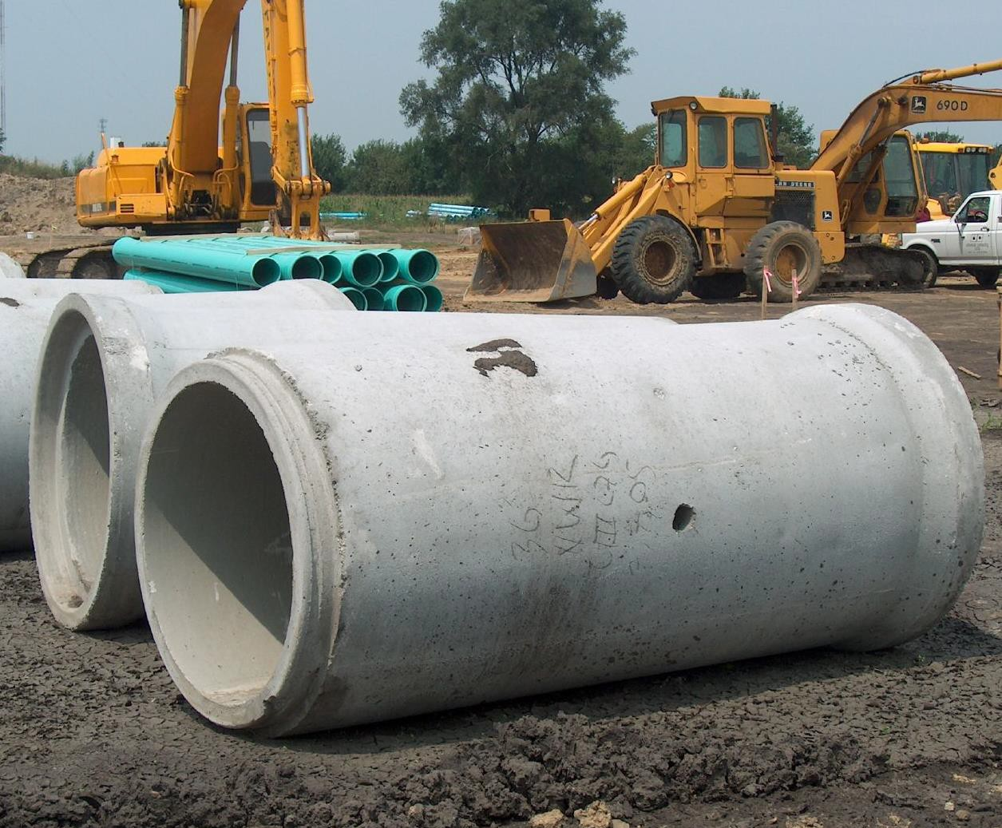
RC & C – Reinforced & Non- Reinforced Concrete
Very rigid and can withstand high surface loads
Subject to crown rot (might have coal tar epoxy or plastic lining)
Joints - Rubber gasketed bell & spigots or mortar or bituminous filled bell and spigots

Slide 25
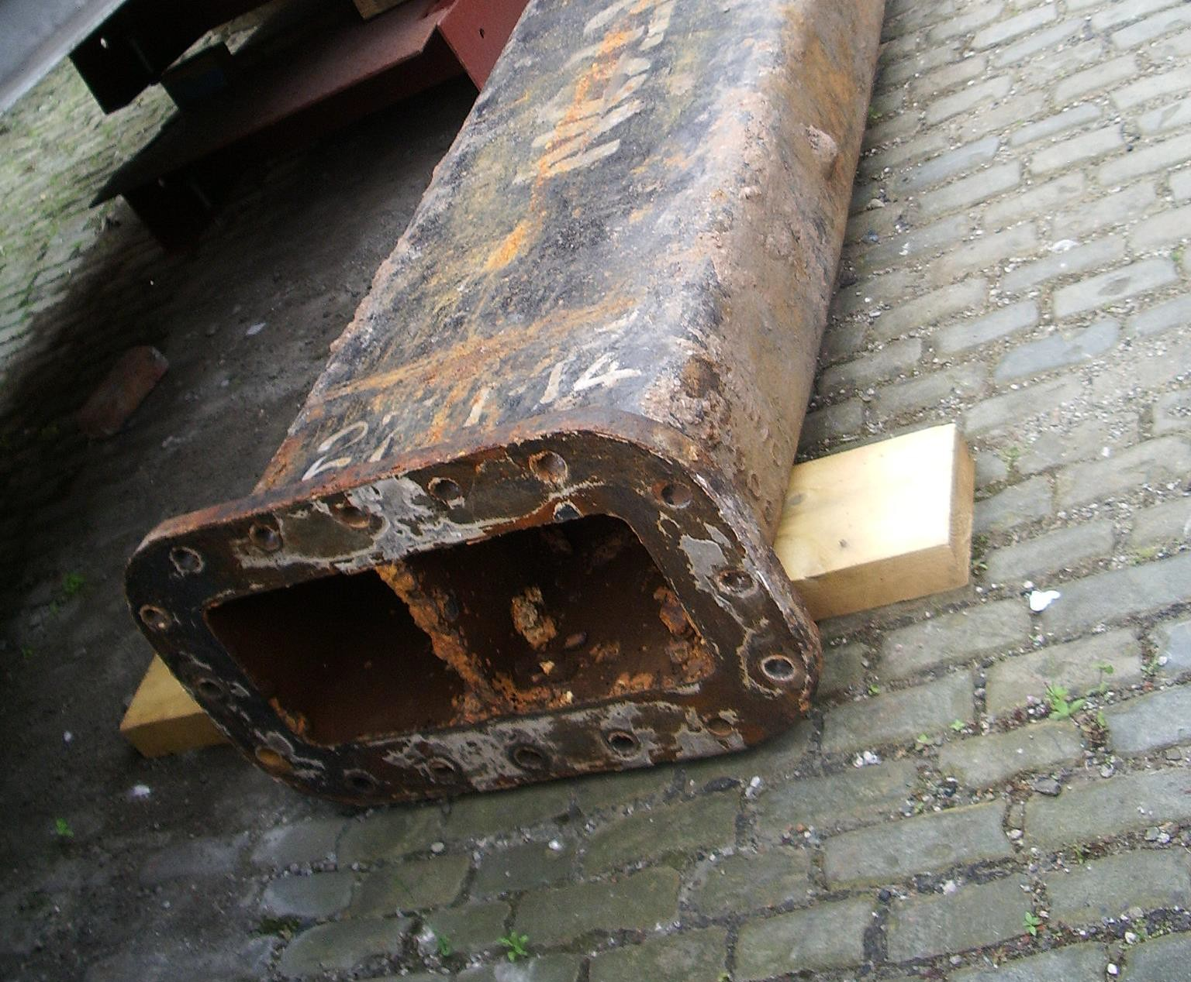
CI & DI – Cast & Ductile Iron
Very rigid – resists high surface loads
Costly
Should be used for bridge
crossings and where lines
are shallow
Joints are typically rubber
or caulk gasketed
mechanical push on
Joints might be leaded in
old installations

Slide 26
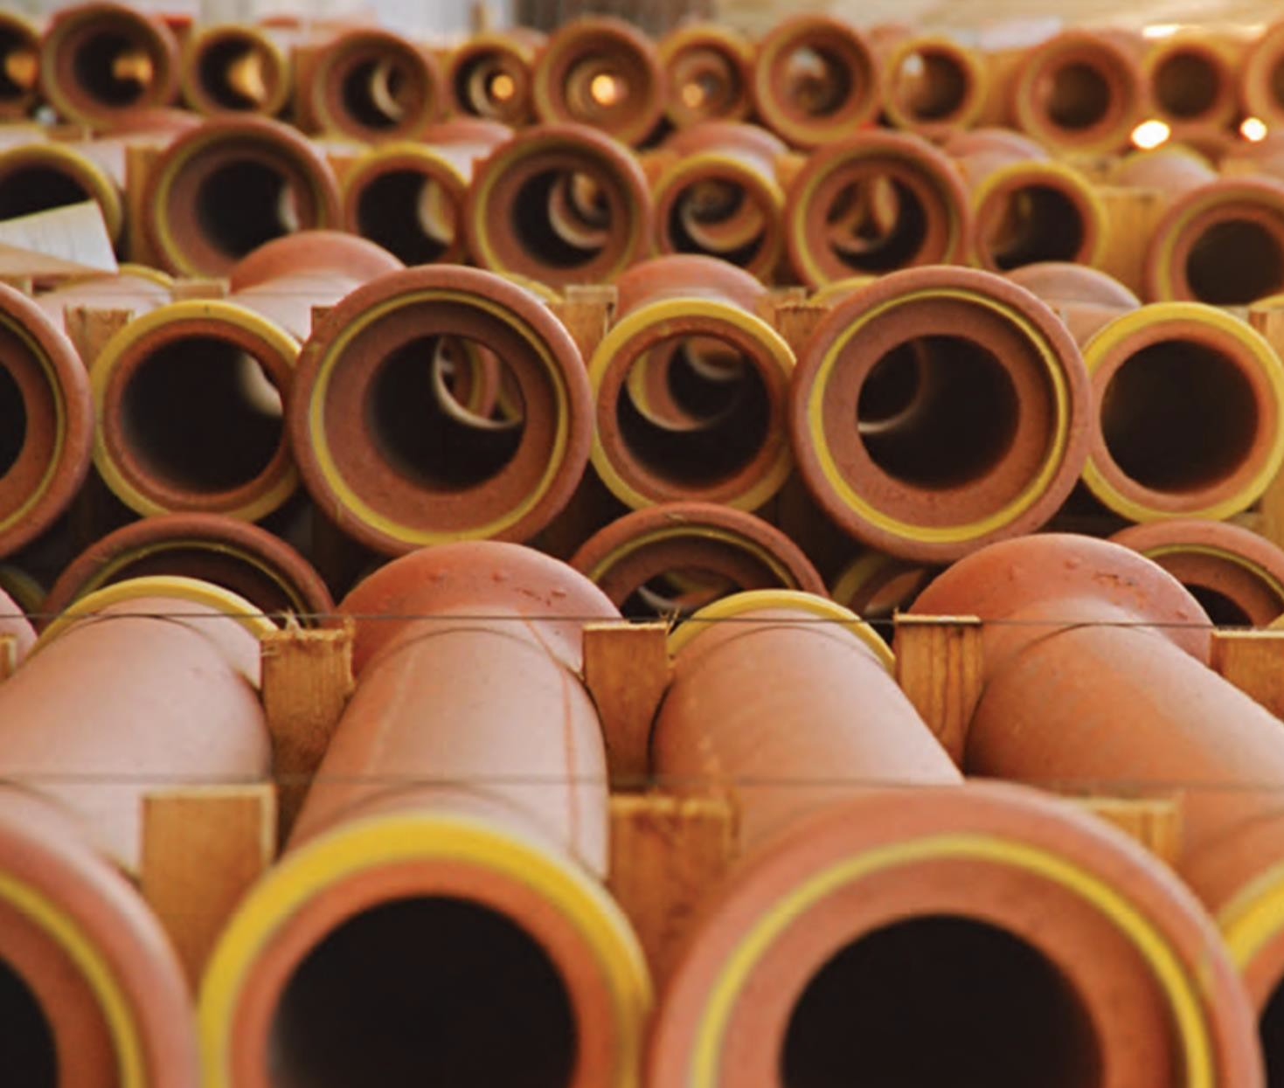
VC - Vitrified Clay
Rigid & Subject to cracking from root intrusion
Resistant to acid, caustics,
solvents, gasses
Joints – bells and spigots
with factory PVC or PU
compression joints or
rubber couplings
Older joints may be bell and spigots with mortar

Slide 27
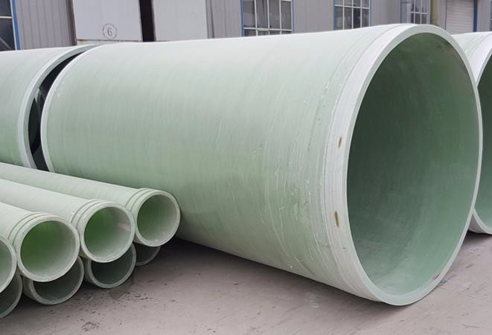
FR – Fiberglass Reinforced
Semi-flexible and corrosion resistant
May be subject to crown rot
Joints – rubber
gasketed bells and spigots
Subject to failure from
unanticipated surface loading

Slide 28
ABS - Acrylonitrile Butadiene Styrene
Flexible and resistant to most things found in wastewater, BUT
Petroleum products can soften and erode it
Joints are solvent weld or gasketed bell and spigot
Requires careful installation & inspection –
can deflect into an oval shape

Slide 29
HDPE – High Density Polyethylene
Flexible and durable
Resistant to most things in wastewater
Joints – Thermally welded butt joints
Often used in small diameter low pressure sewers and for force mains

Slide 30
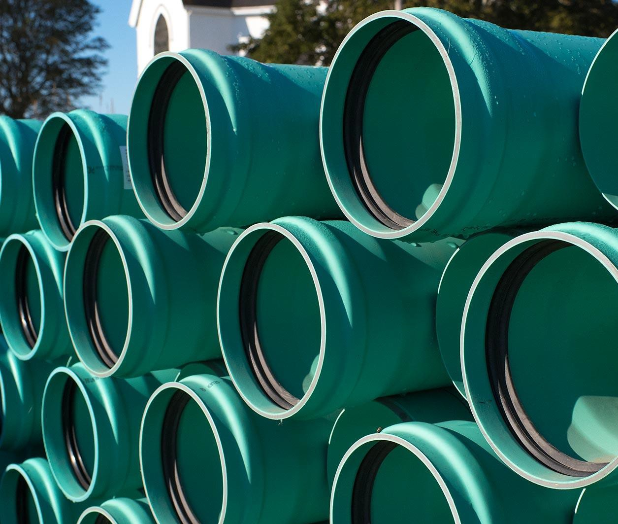
PVC - Polyvinylchloride
Flexible and resistant to
most things in wastewater
Joints are typically
rubber gasketed bell and
spigot joints
Solvent cement welding
used for pipe up to 8” in
diameter
Subject to damage from heavy loads

Slide 31
Pipe Joints
Joint # | Joint Description |  |  |  | Joint used with:
 |  | AC | CI/DI | RC | C | VC | FR | ABS | HDPE | PVC
1 | Caulked Bell and Spigot |  | X
2 | Band Seal Coupling |  | X |  |  | X |  |  |  | X
3 | Mortar or Bituminous Filled Bell and Spigot |  |  | X | X | X
4 | PVC/PU Preformed Gaskets |  |  |  |  | X
5 | Rubber Gasket Bell and Spigot |  | X | X |  | X | X |  |  | X
6 | Rubber Gasketed Coupling | X |  |  |  |  |  |  |  | X
7 | Sovent Cemented Coupling or Solvent Bell & Spigot |  |  |  |  |  |  | X |  | X
8 | Butt Welded |  |  |  |  |  |  |  | X

Slide 32
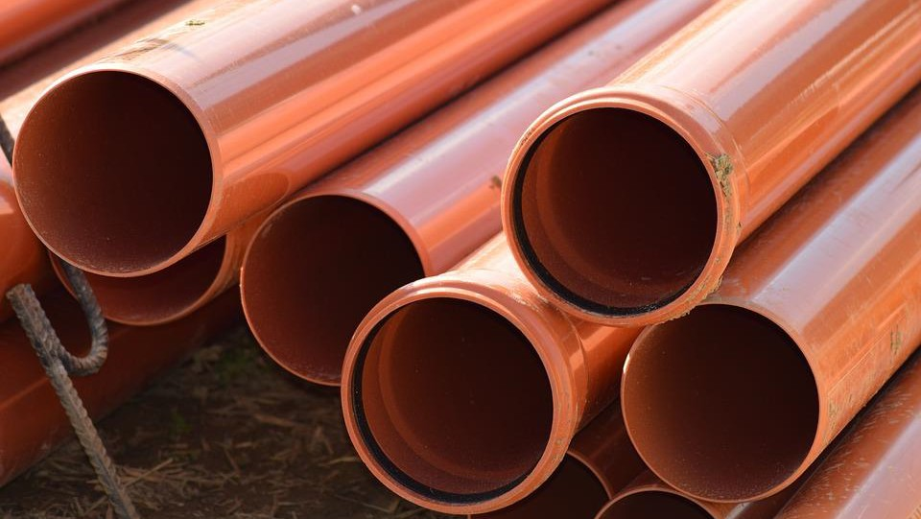
Bell
Spigot
Gasket

Slide 33
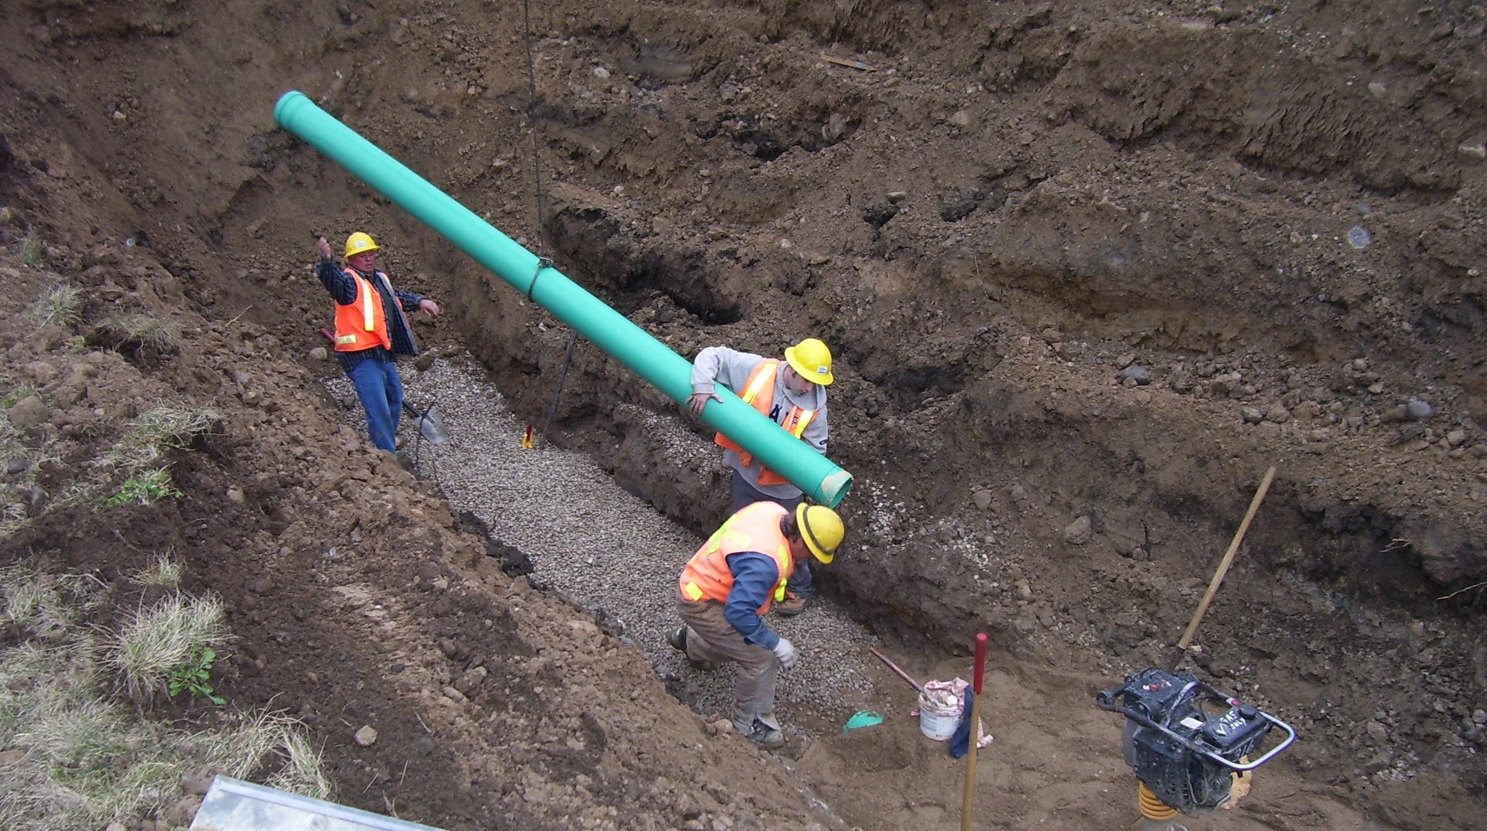
Installation

Slide 34
Components & Materials
Bedding
Backfill

Slide 35
Installation
Typically, in excavated trenches
Lots of safety rules around excavation – read up on safety regs
Nearby utilities have to be located before excavation (One Call)
48-hour notice is typically required (check your state)
You break it, you buy it. Digger and/or employer are liable for damages

Slide 36
Installation
Most excavation done with backhoes
Trench-less technologies becoming more common
  Pipe Liners
  Pipe bursting
  Boring
  Micro-tunneling

Slide 37
Installing Pipe
Read the manufacturer’s instructions
Small diameter pipe (<10”) can be moved by
hand
Larger pipe should be moved with machinery

Slide 38
Bells face UPSTREAM

Slide 39
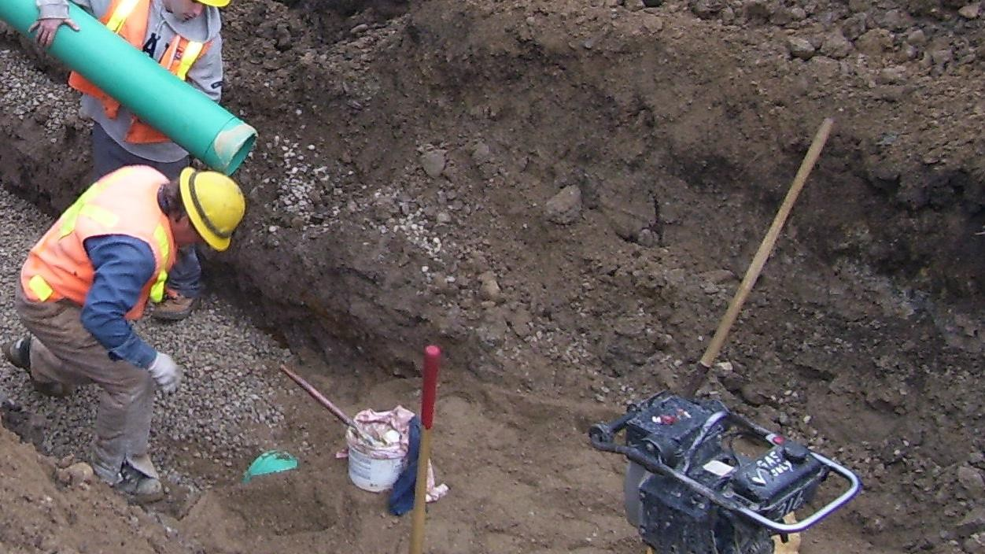
Bedding and Backfill

Slide 40
Bedding
Pipe has to be bedded
Compacted crushed rock aggregate is ideal
Sand and pea gravel can be used if compacted
If native material is used it has to be excavated to true grade with extra care

Slide 41
Bedding
Must be compacted on trench bottom and pipe sides
Compacting directly affects load pipe can carry
Small amounts of bedding must be removed to accommodate bells if bell and spigot joints are used.

Slide 42
Backfill
Three Elements:
  Pipe has to be protected from movement, breakage and crushing
  Backfill should be compacted in layers until the trench is full
  Then the ground surface gets restored.

Slide 43
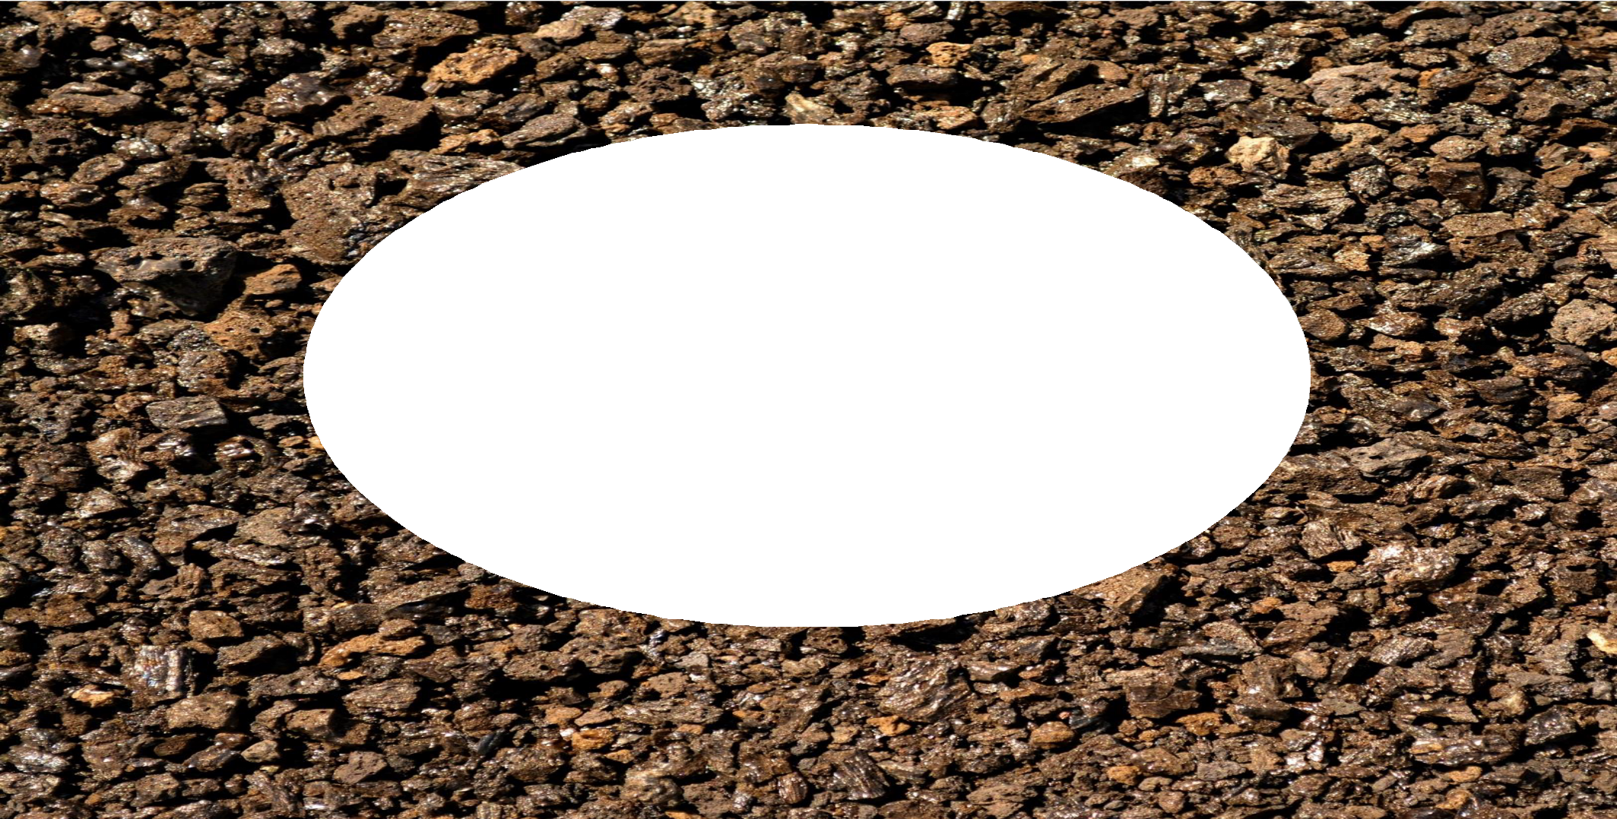

Correctly bedded pipe is supported and retains its circular cross section under load

Slide 44
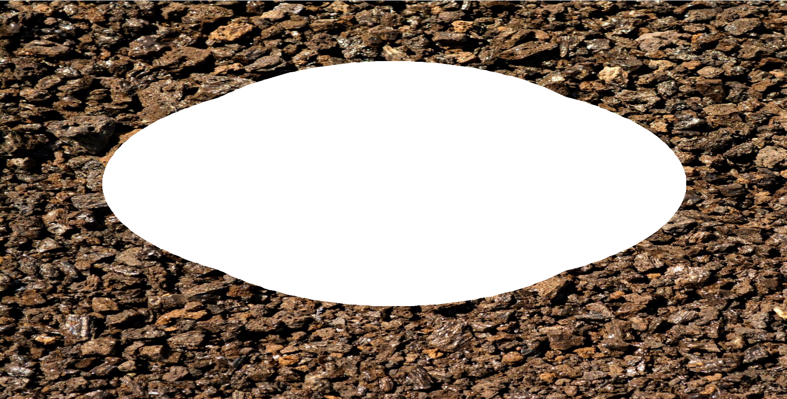
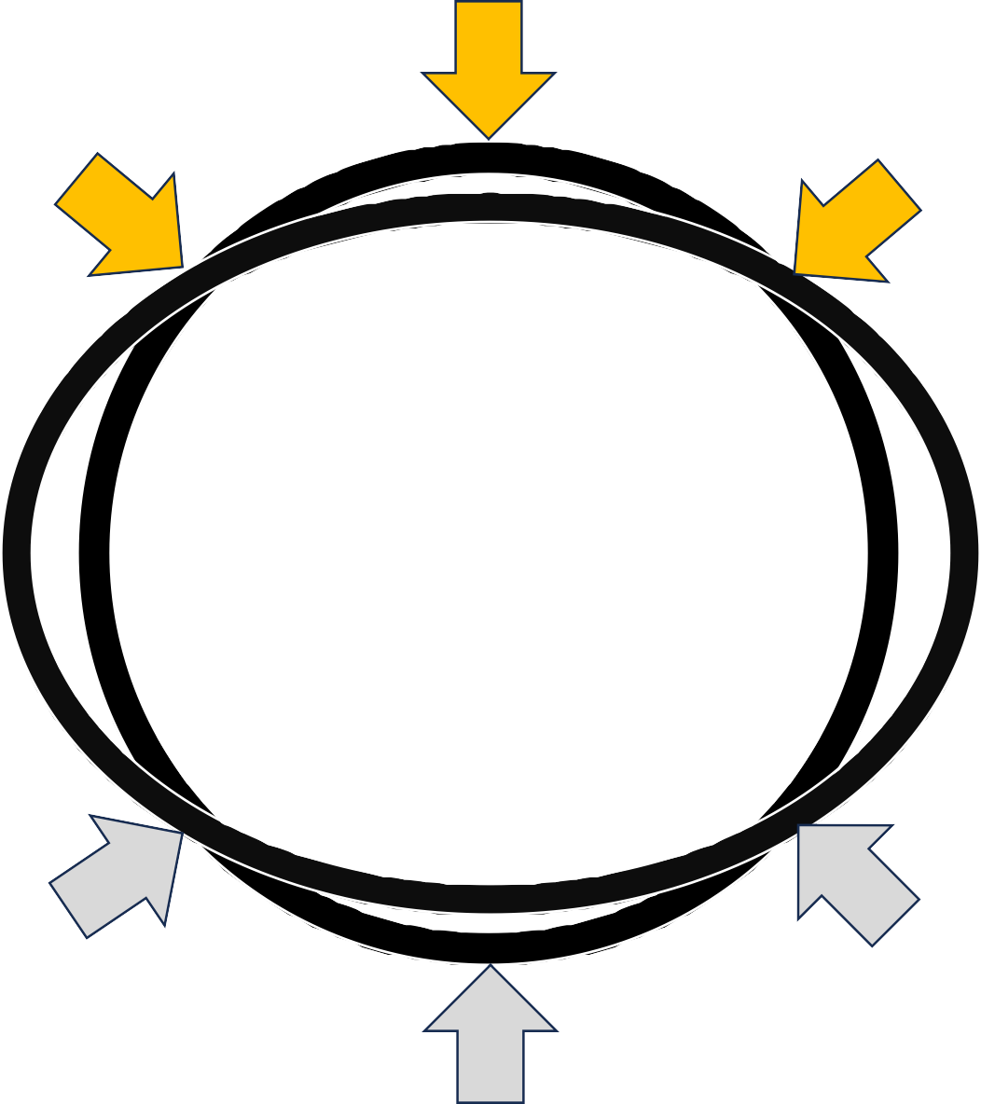
Incorrectly bedded pipe is not supported and may deform under load

Slide 45
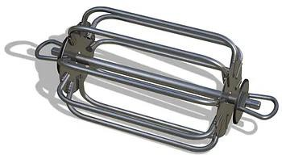
Deflection Testing
Mandrel tests or CCTV inspections are used to determine whether the newly installed pipe has deflected more than the acceptable design limit
Image: https://www.wrenvironmental.com/blog/2023/october/what-is-a-mandrel-test-/

Slide 46
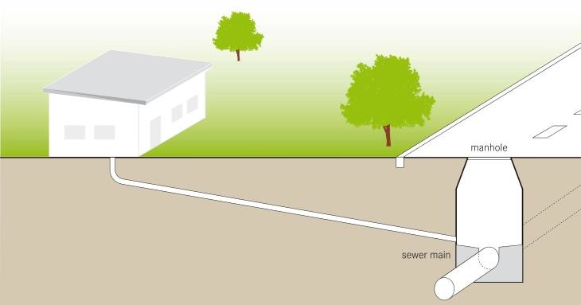
Service Connections

Slide 47
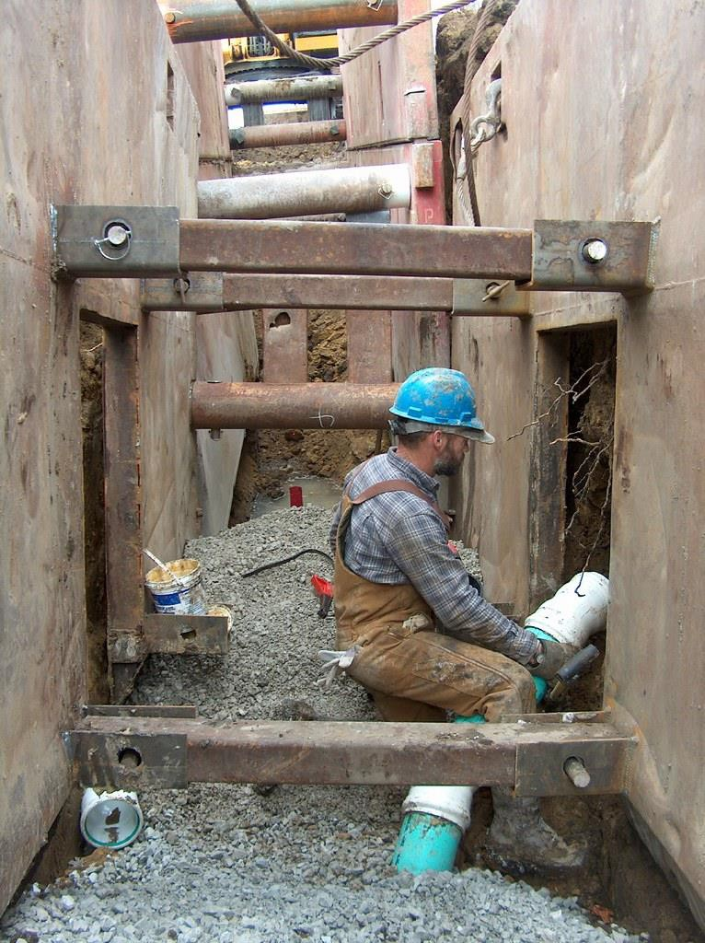
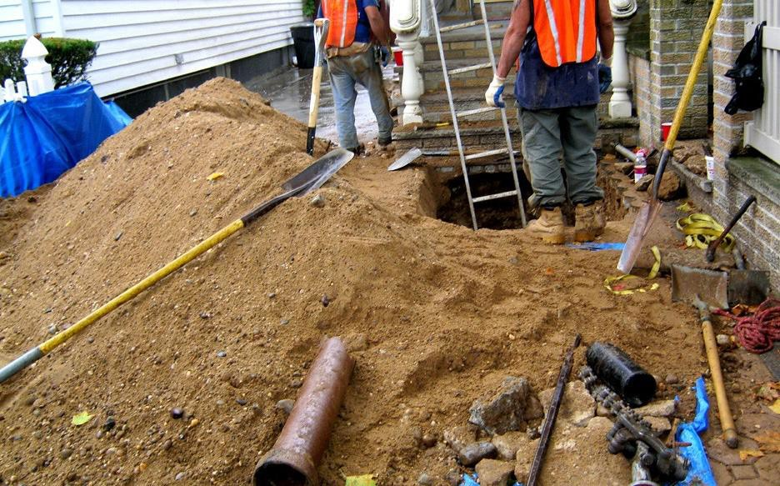
Service Connections

Slide 48
Service Connections
Aka “Taps”
  Clamp on Saddle Ts
  Insertion Wyes and Tees
  Epoxy Bonded Saddle Tees
  Synthetic Rubber Wedged inserts
Must have a tight seal to prevent infiltration and root intrusion
Building sewer MUST NOT protrude into main

Slide 49
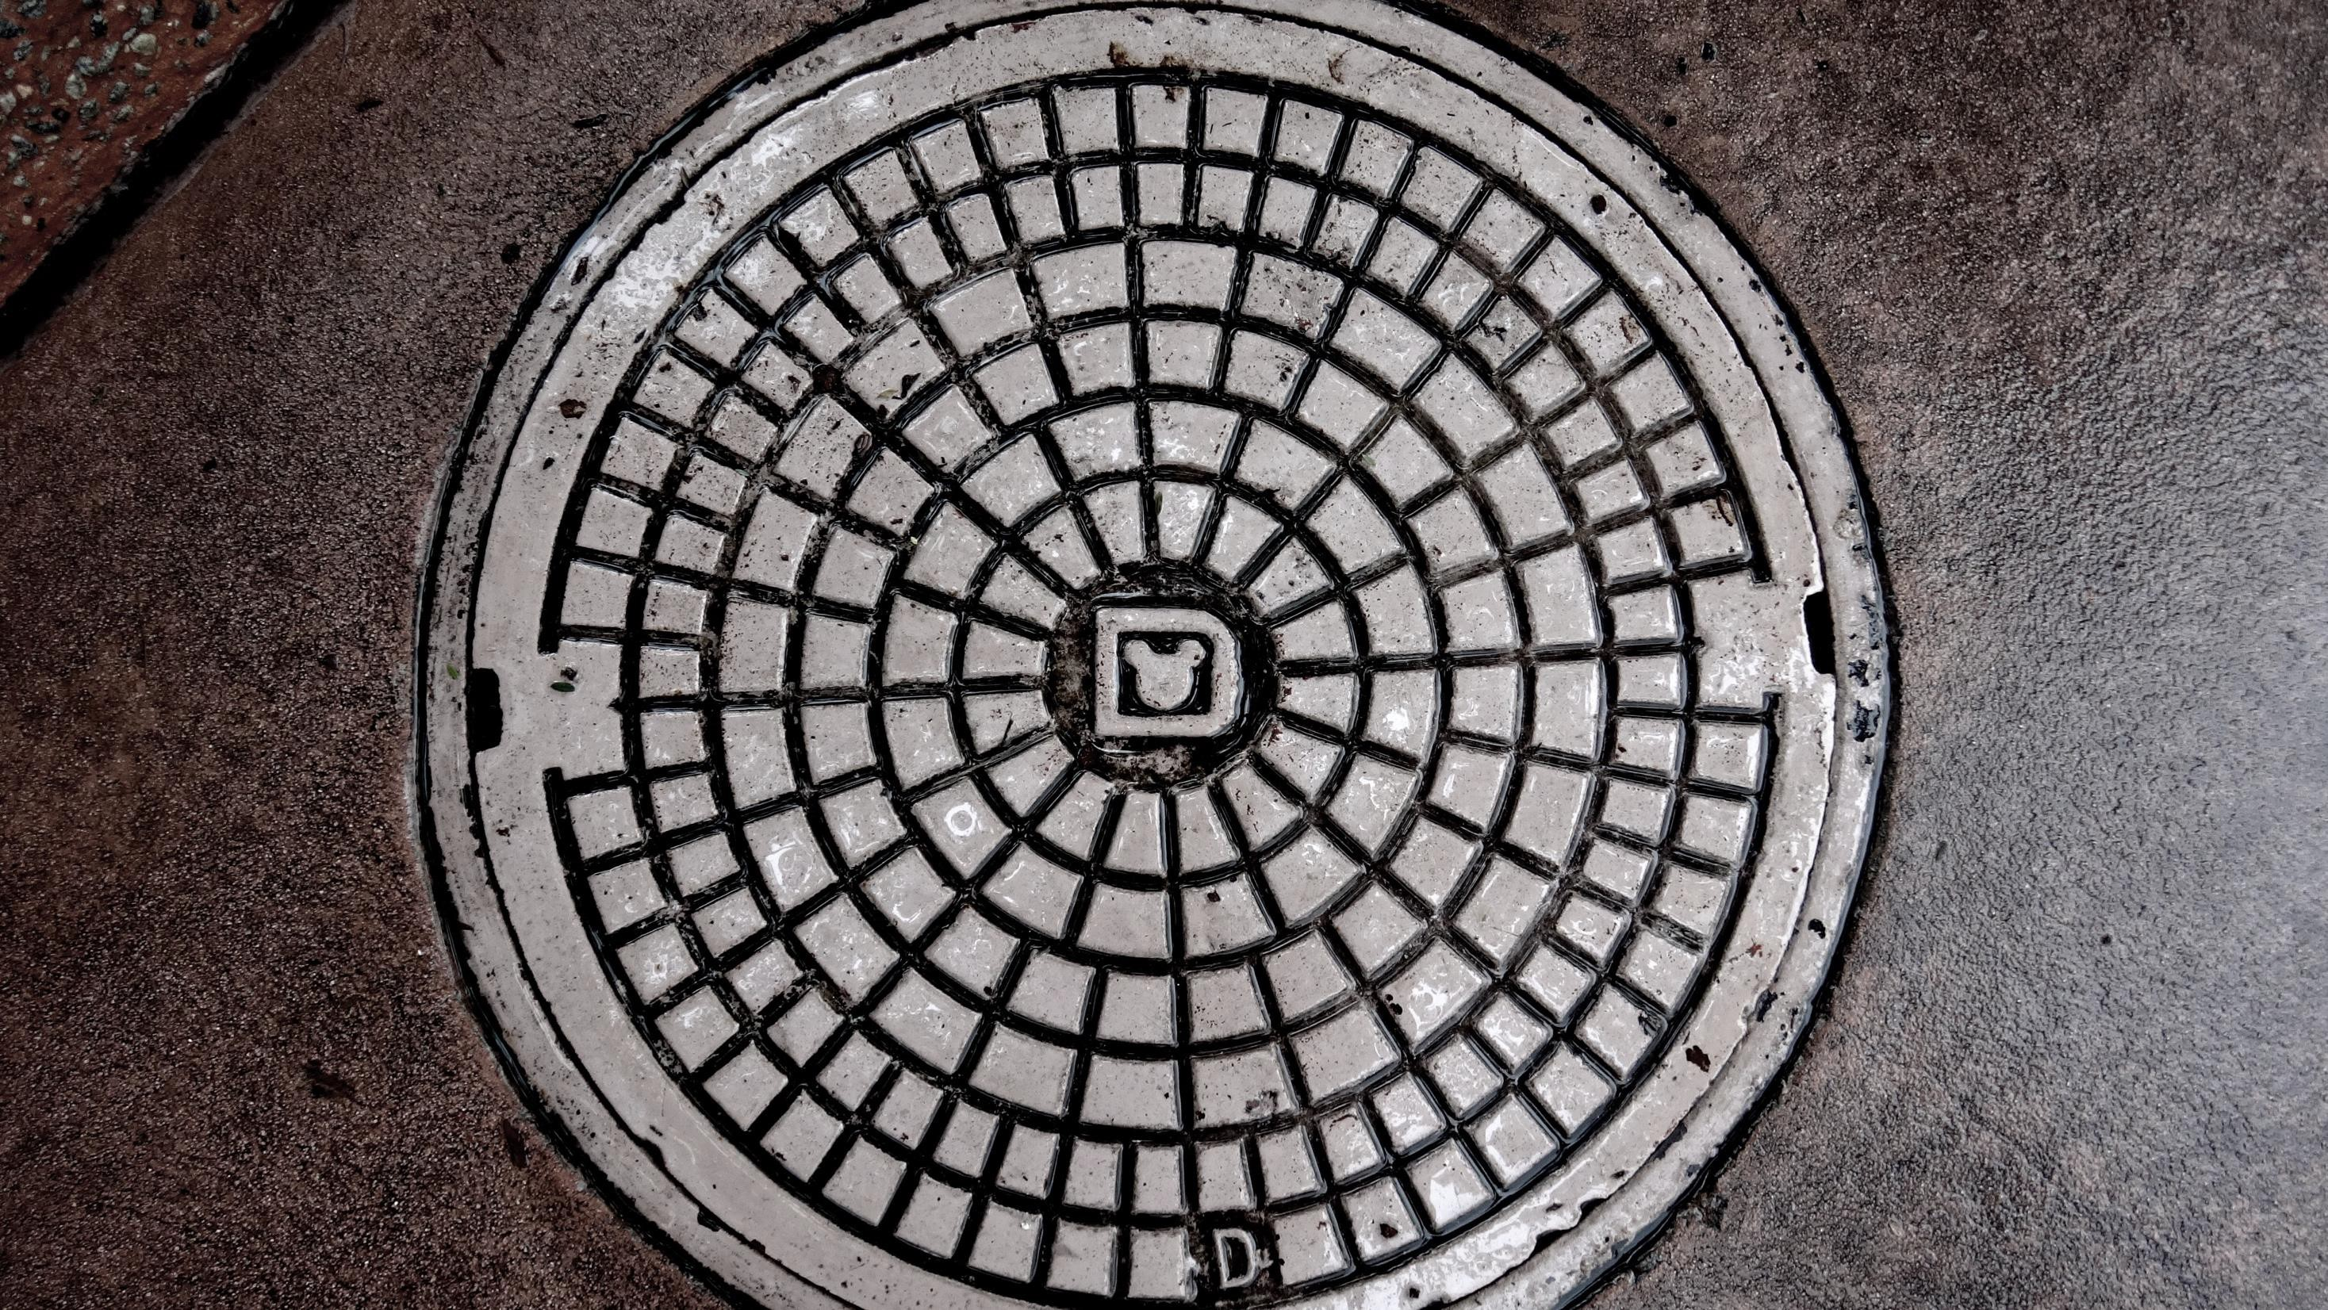
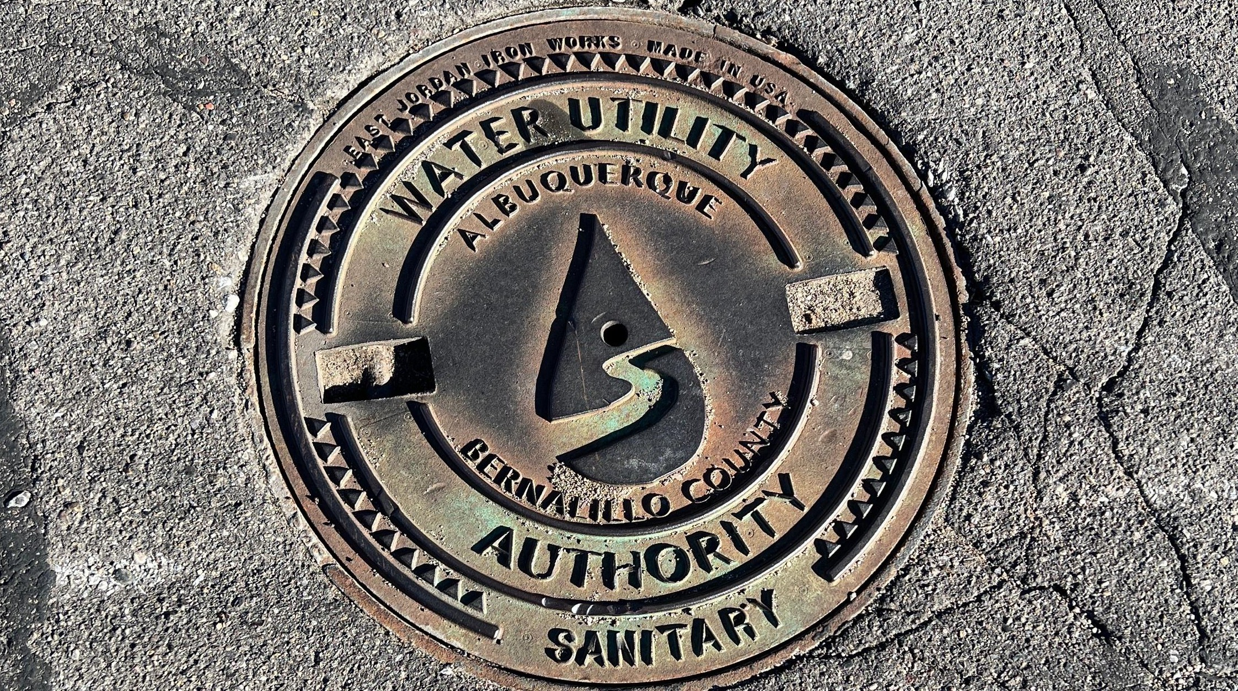
Manholes

Slide 50
Manholes: What they are
Installed in lateral, main trunk and interceptor sewers for maintenance and cleaning access

Slide 51
Manholes: Where they are
Can be placed where sewer changes direction elevation (drops), pipe size and at junctions
Straight runs usually no more than 300-500 feet apart – limited by length of cleaning equipment

Slide 52
Manhole Construction:
Can be brick, pre-cast concrete barrels or
fiberglass
Most common in NM: Precast concrete with poured in place base
Might have steps, might have a ladder

Slide 53
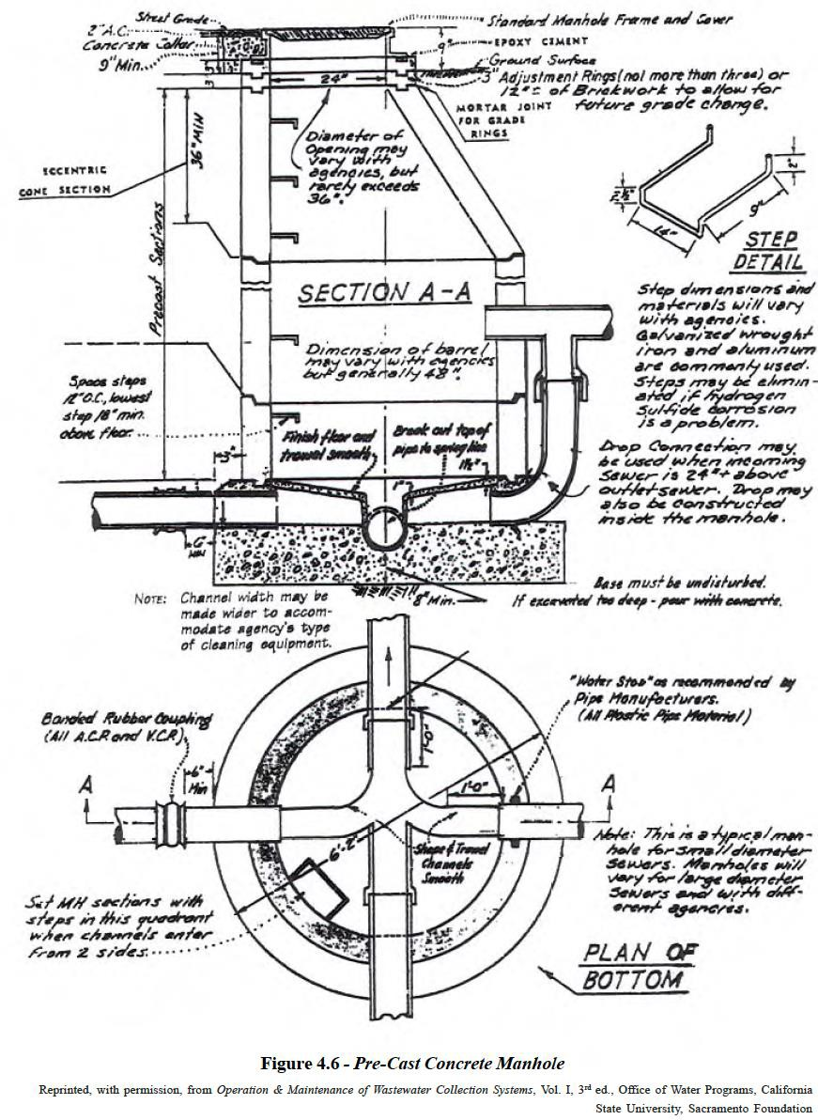
6 Pre-cast Concrete Manhole Parts:
Concrete poured in place with channels & sloped bench
Inlet/Outlet piping sealed where in penetrates the barrel
Precast concrete barrels fit together
and sealed with mortar or bituminous material
A concentric or eccentric cone section
Level Adjustment Rings
Standard tight-fitting, cast-iron ring and lid

Slide 54
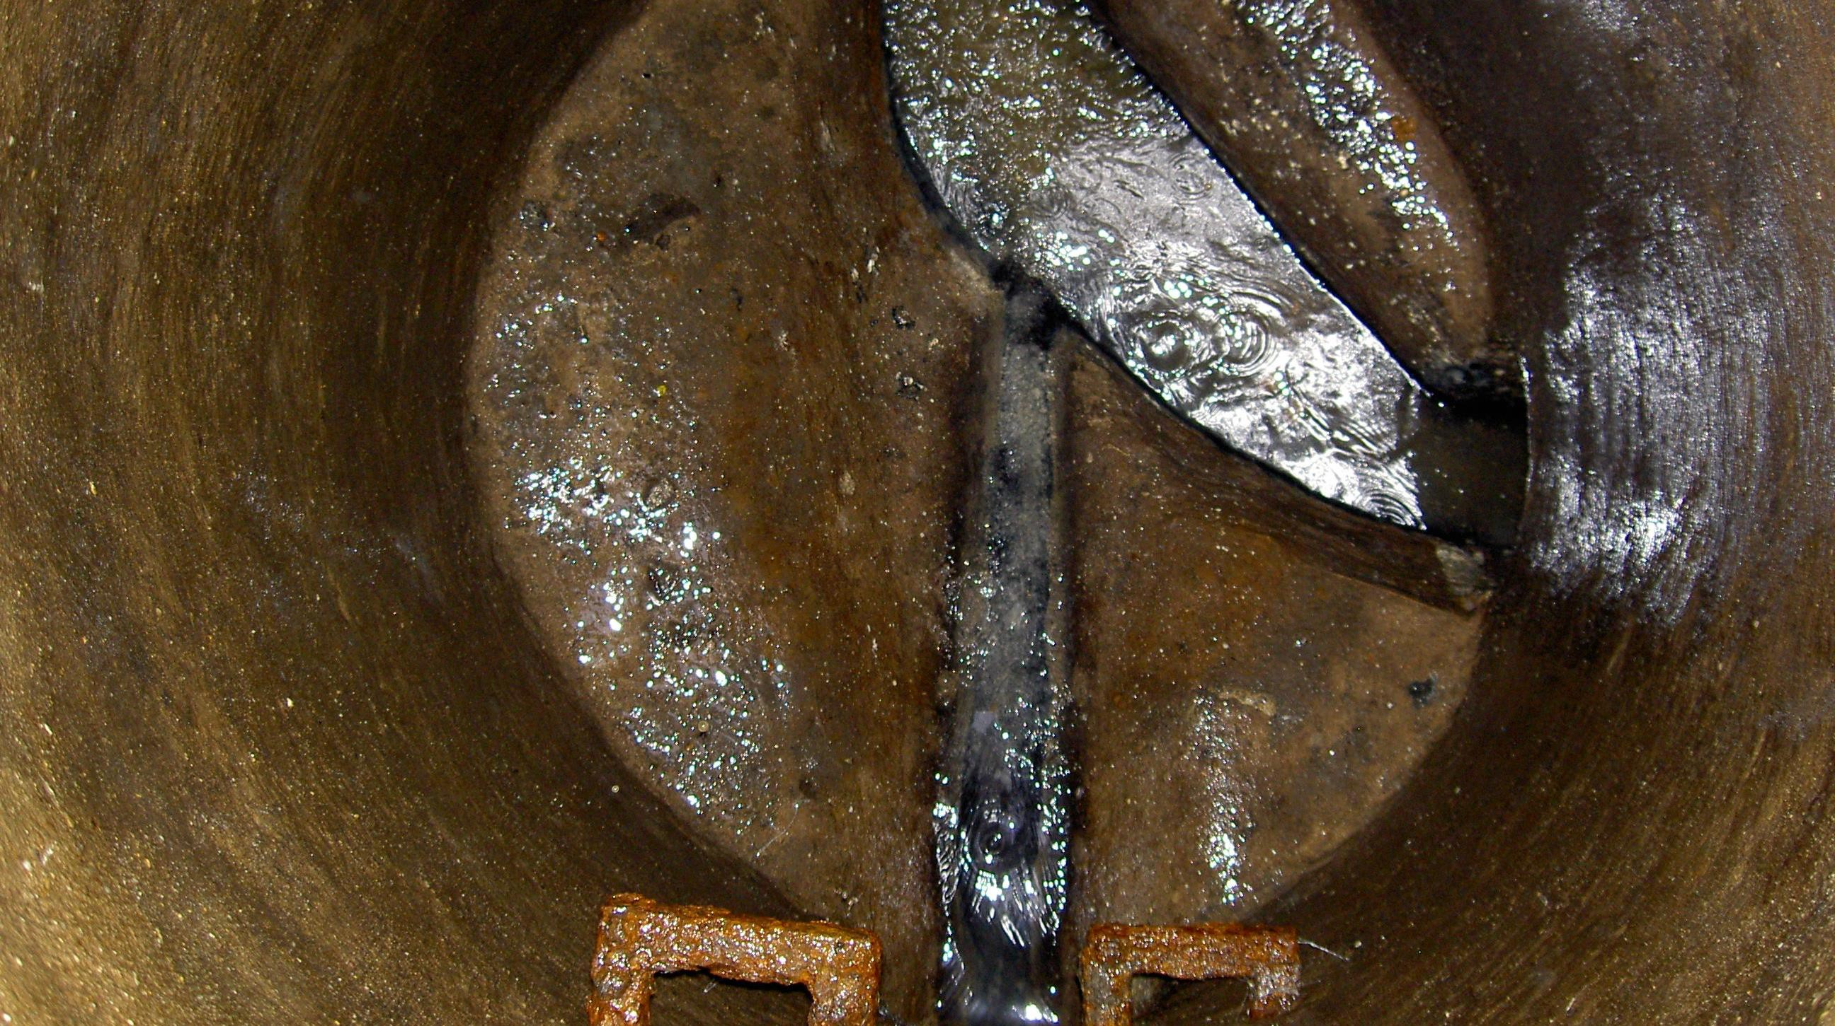

Slide 55
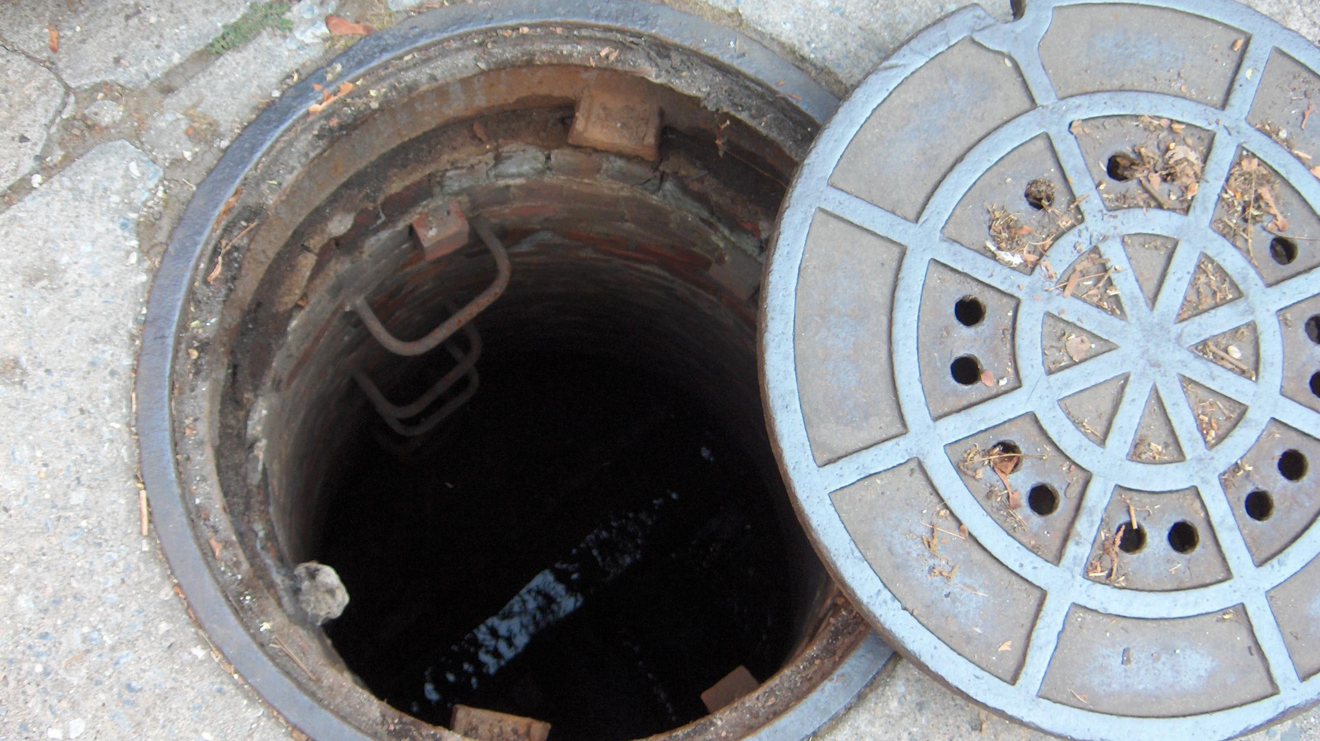
Manholes are
Confined Spaces

Slide 56
Manholes are Confined Spaces
They have limited openings for entry and exit.
Unfavorable natural ventilation. Deadly gasses can accumulate or oxygen can be displaced.
Not designed for continuous worker occupancy.

Slide 57

Manholes are Confined Spaces
Entry is covered by OSHA Regulations
OSHA regulations are covered under operator safety in NM Test guide

Slide 58
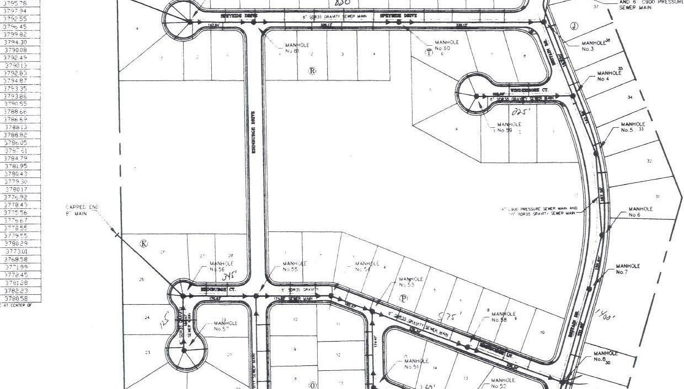
Maps (A quick plug)

Slide 59
Maps
Two sets of construction project plans
  Working plan that guides construction
  As-built plans that reflect deviations from the working plan
As-builts become the true record of where everything is actually located and should be made into revised final drawings
As-builts are your friends. Not having them leads to headaches

Slide 60
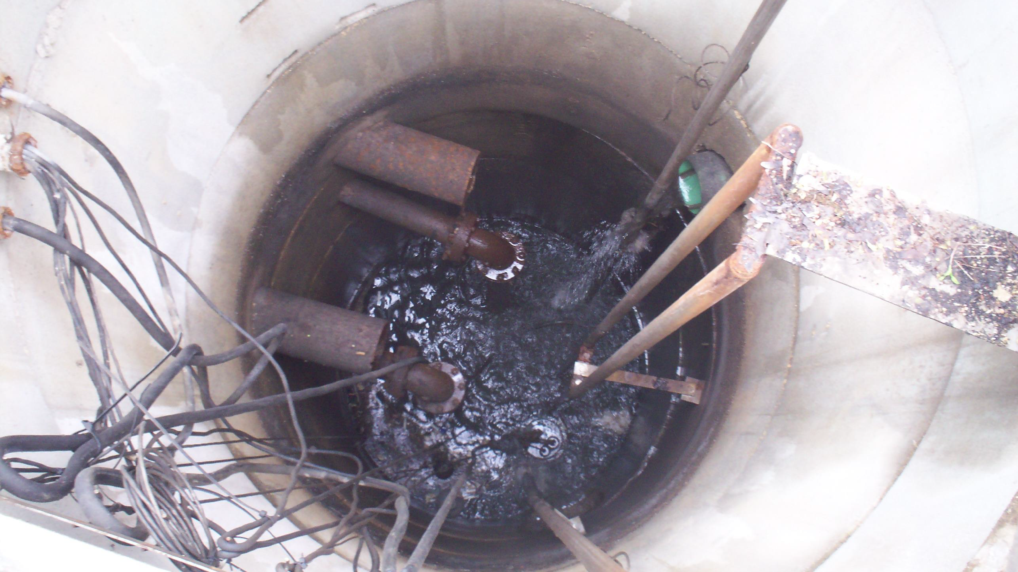
Lift Stations

Slide 61
Sewer Slope & Lift Stations
WWTP
P U M P
LIFT STATION

Slide 62
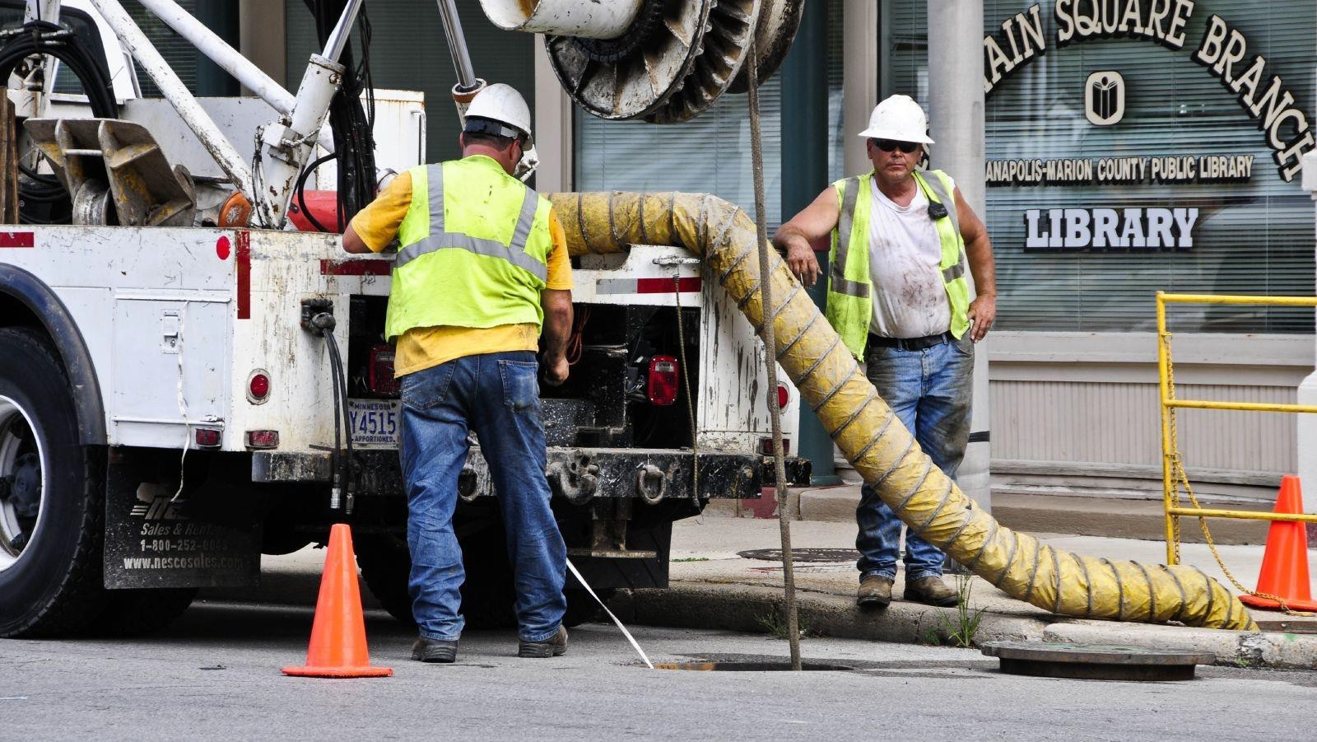
Sewer Cleaning & Maintenance

Slide 63
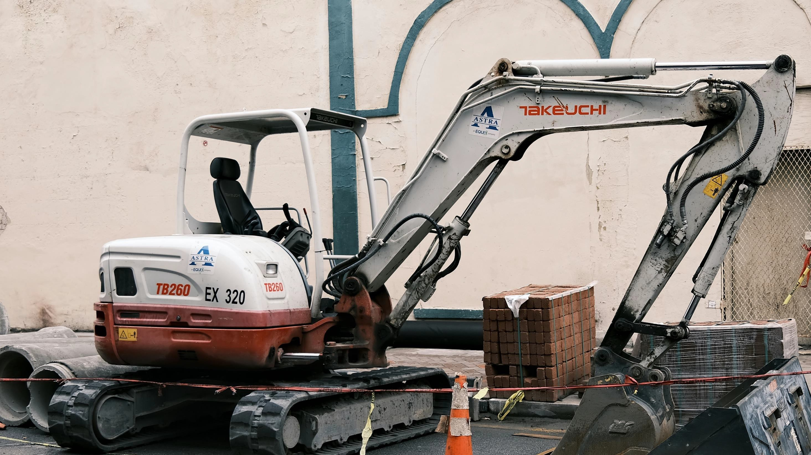
Equipment

Slide 64
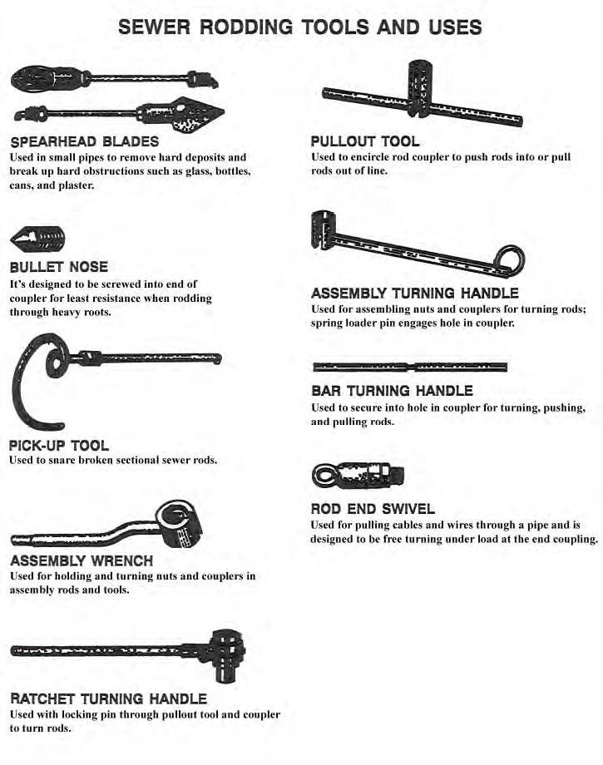
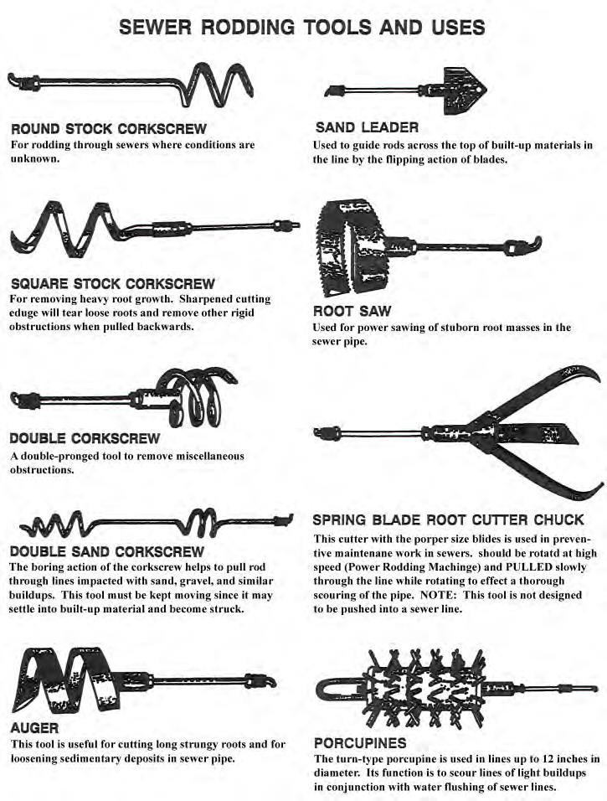
Rodding Tools

Slide 65
Blockage Types Manual Cleaning Hydraulic Cleaning
Preventive Maintenance Emergencies, etc.

Slide 66
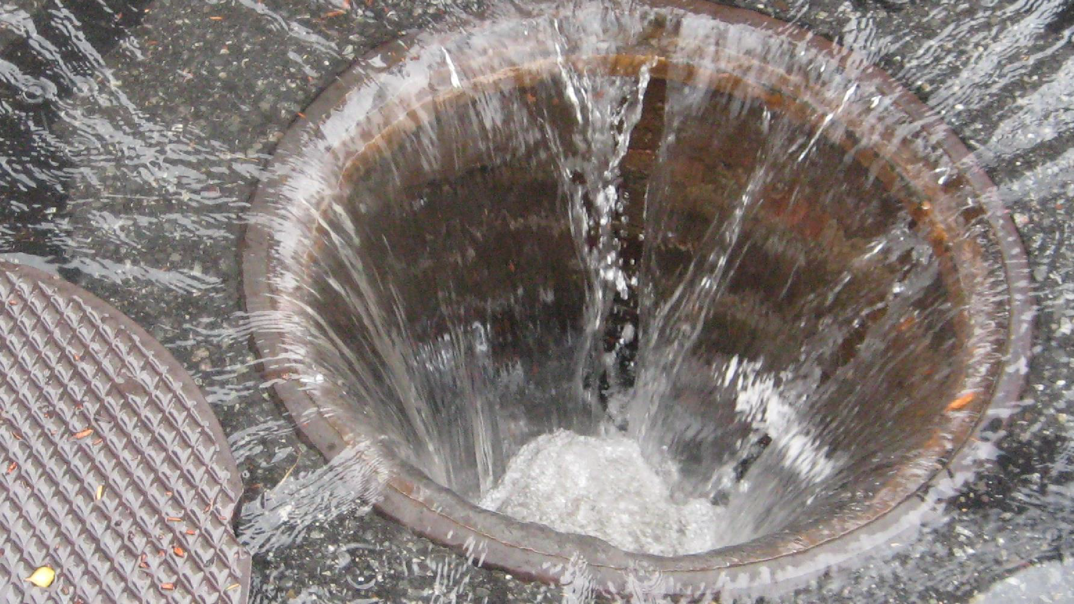
Inflow

Slide 67
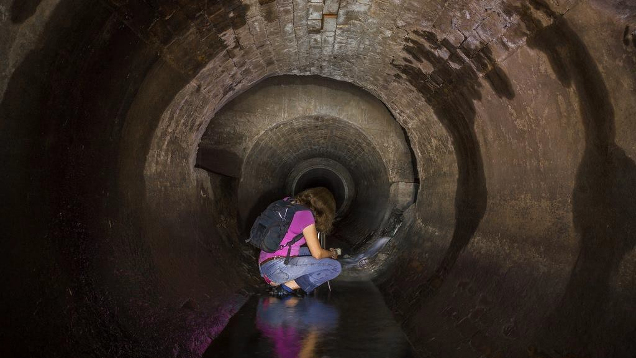
Infiltration

Slide 68
I & I – What they are
Inflow – Water entering through manholes and illegal connections
Infiltration – Groundwater entering sewer through breaks or joints or broken manhole barrels
Can cause hydraulic overload at the WWTP and should be limited whenever possible

Slide 69
Sample Questions
Let’s try a few…

Slide 70

Sample Questions

Slide 71

Attendee Questions?

Slide 72

CONTACT INFORMATION
Department of Civil Engineering MSC01 1070
1 University of New Mexico
Albuquerque, NM 87131
505-277-0644
swefc@unm.edu
http://swefc.unm.edu
James Markham: jmarkham@unm.edu

