Slide 1


Basic Water Math
Guam & CNMI Water Operator Certification Series
Wednesday July 22, 2025
Notes:
Introduce self

Slide 2

Shannon Sloane Pepper
Water Utility Trainer and Specialist spepper@unm.edu

Slide 3



This training series is funded by the EPA
Notes:
Heather introduction

Slide 4


Slide 5

WPI/ABC Operator Certification
Notes:
This series is designed to supplement and reinforce the ABC Need to Know Criteria for the Wastewater Operator level 1 and 2 exams though there will be some higher level topics covered, and we won’t always follow the exact order listed in the NTKs
https://www.gowpi.org/services/abc-testing/standardized-exams/standardized-wastewater-treatment-operator-exams/

Slide 6
Schedule for 2025:
Date | Topic
6/25/25 | Program Overview, Test Format, Study & Test Tips
7/9/25 | Drinking Water System Overview - (Source, Treatment, & Distribution)
7/23/25 | Basic Operator Math (+, -, /, x, Exponents and basic algebra)
8/6/25 | Applied Operator Math (e.g. Areas, Volume, Flow Rates, Detention Time, Pressure/Hydraulic Head)
8/20/25 | Drinking Water Regulations
9/3/25 | Source Water Characteristics
9/17/25 | Surface Water Intake Components, Well Components, and O&M
10/1/25 | Disinfection 1: Chloramines, UV, Chlorine Dioxide, Chlorine
10/15/25 | Disinfection 2: Chlorine Disinfection Application for Sodium Hypochlorite and Gas Chlorine (including storage and safety)
10/29/25 | Disinfection 3: Distribution System Application, Residual Measurement, Evaluation & Adjustment,
11/12/25 | Disinfection 4: Chlorine Disinfection Math
12/3/25 | Surface Water Treatment 1: Coagulation, Flocculation, Sedimentation (including chemistry, process controls, operations)
12/17/25 | Surface Water Treatment 2: Filtration
Notes:
26 sessions total
1 hour each
This is the schedule for the remainder of this year,
The trainers will vary depending on the topic

Slide 7

https://swefc.unm.edu/home/op-cert-trainings/

Slide 8

Sign in for every session to ensure you get credit for attending

Slide 9
Why is it important for water operators to have a good understanding of math?
Water usage
Storage capacity
Flow and retention rates
Chemical usage and dosage
Rate setting and budgeting
But first, we need to go over some math fundamentals

Slide 10
Today’s math topics
All About Equations:
  Order of Operations
  Rearranging Equations and Solving For The Unknown
Percentages
Units
Conversions

Slide 11

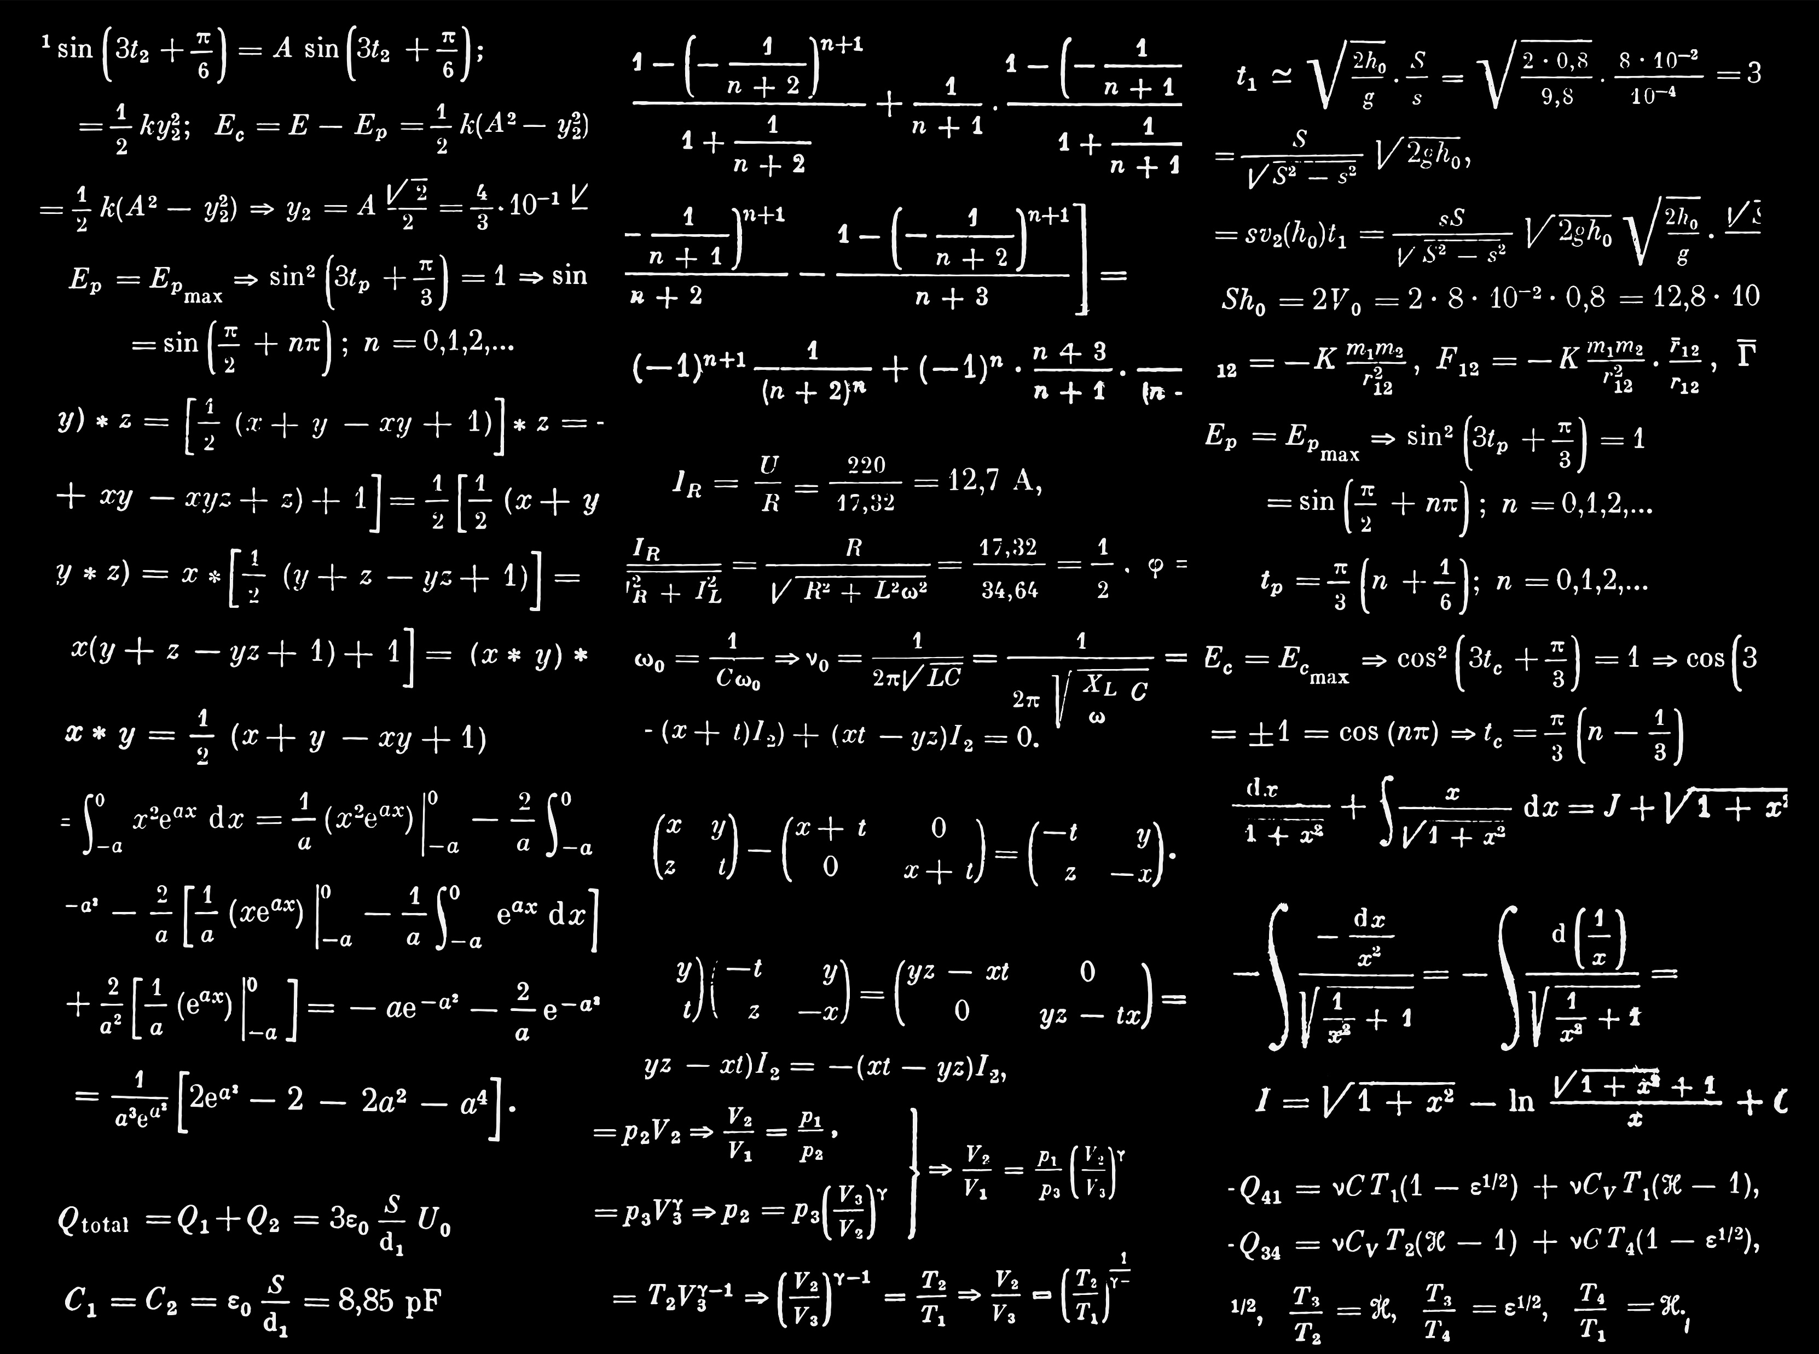
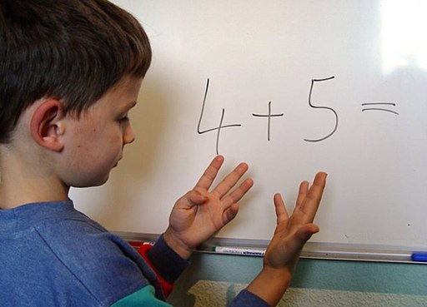
What would you say is your water math proficiency?

Slide 12

What is an Equation?
A technique for answering a question about how much, how long, or how fast
Equations are balanced math sentences
  Left Side = Right Side
Notes:
Math is like a language because it uses symbols to communicate, just like how we use words to communicate a thought. [CLICK] So if we think of math as a language, then equations are like sentences.

Slide 13
Order of Operations
Please (Parentheses)
Excuse (Exponents)
My Dear (Multiply and/or Divide)
Aunt Sally (Add and/or Subtract)
“PEMDAS"
Notes:
Before we start solving more complex math problems, we need to talk about the order in which we go about solving them.

Slide 14
Example (Please Excuse My Dear Aunt Sally)
(4)(2) + (6x5)² – 16 = ?
Parentheses
(4)(2) + (30)² – 16 = ?
Exponents
(4)(2) + 900 – 16 = ?
Multiply/Divide
8 + 900 – 16 = ?
Add/Subtract
8 + 900 – 16 = 892

Slide 15
Equations are balanced math sentences
  Left Side = Right Side
Rearranging equations makes them easier to handle before inserting known numbers and helps keep track of units

Slide 16
Solving for the Unknown and Rearranging Equations, aka Algebra
The unknown is the part of the equation that we are trying to find or solve for
Sometimes represented by a letter such as d, t, or x (variable)
When solving for an unknown, the variable/unknown must be by itself on one side of the equation
46 + x = 98

Slide 17
Solving for x
Addition and Subtraction
To get x alone, you have to move other numbers across the equal sign (=)
Remember an equation must be balanced
When a number crosses the equal sign, it does the opposite of what it was doing on the other side
If a number is positive on one side, it will be subtracted from both sides
If a number is negative from one side, it will added to both sides
Example
46 + x = 98
46 – 46 + x = 98 – 46
x = 52
Example
x – 12 = 25
x – 12 +12 = 25 +12
x = 37

Slide 18
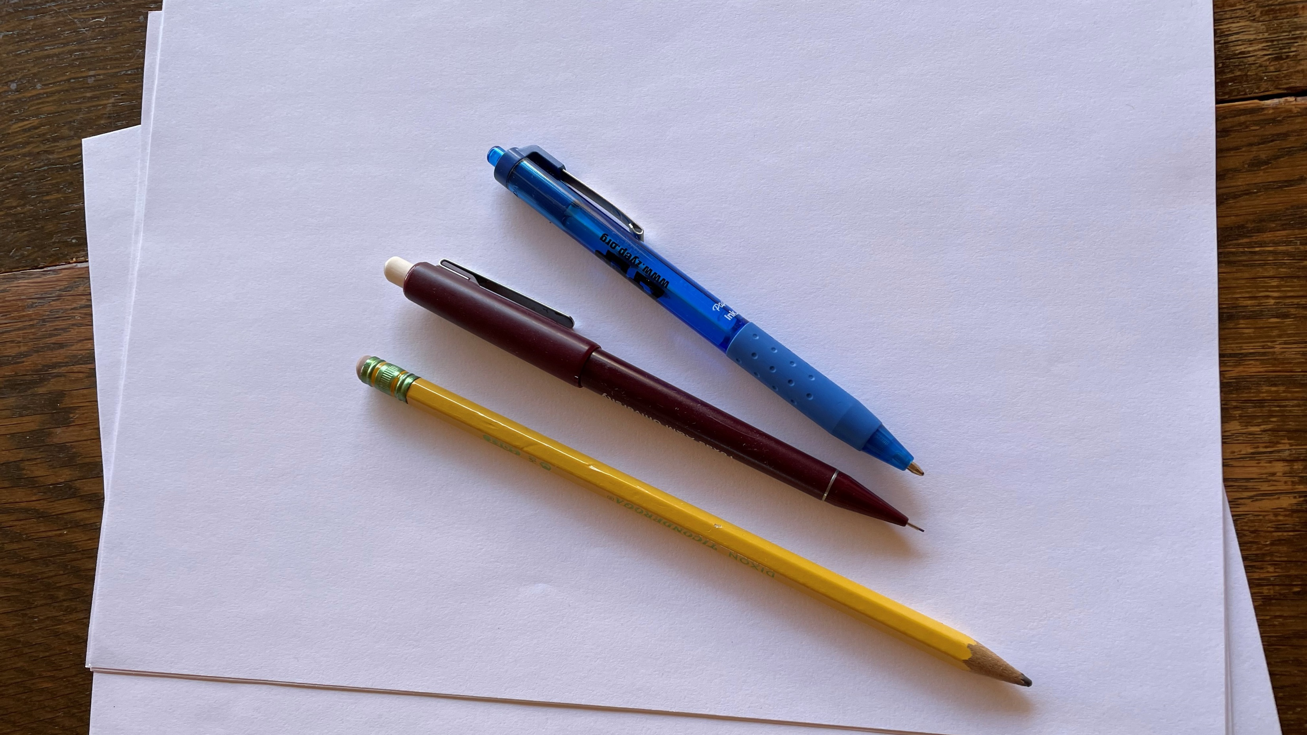
Solving for x
Addition and Subtraction Practice
Solve for x
2 + 15 – 8 + x = 50 + 8
Solve for x
8 + 6 – x + 5 + 2 = 29
-x = 29 – 8 – 6 – 5 – 2
x = 50 + 8 – 2 – 15 + 8
-x = 8
x = 49
x = -8

Slide 19
Solving for x
Multiplication and Division
To get x alone other numbers must cross the equal sign (=)
Remember an equation must be balanced
When a number crosses the equal sign, it does the opposite of what it was doing on the other side
If a number is multiplied on one side, it will be divided from both sides
If a number is divided on one side, it will be multiplied on both sides
Example
5x = 55
5 x = 55
5 5
x = 55
5
x = 11

Slide 20
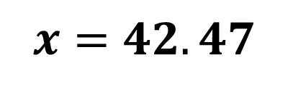
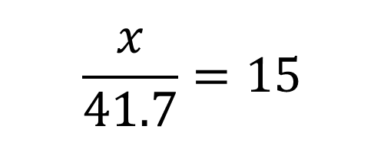
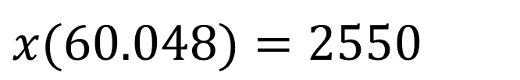
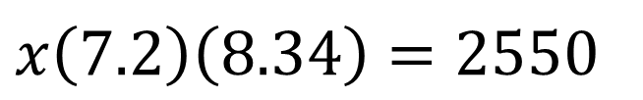
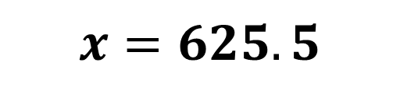
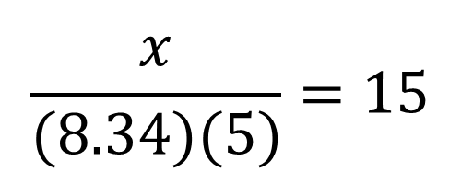
Solving for x
Multiplication and Division Practice
Solve for x
Solve for x
$$\frac{x}{(8.34)(5)}=15$$
$x\left(7.2\right)\left(8.34\right)=2550$
$$\frac{x}{41.7}=15$$
$x(60.048)=2550$
$$x=625.5$$
$$x=42.47$$

Slide 21
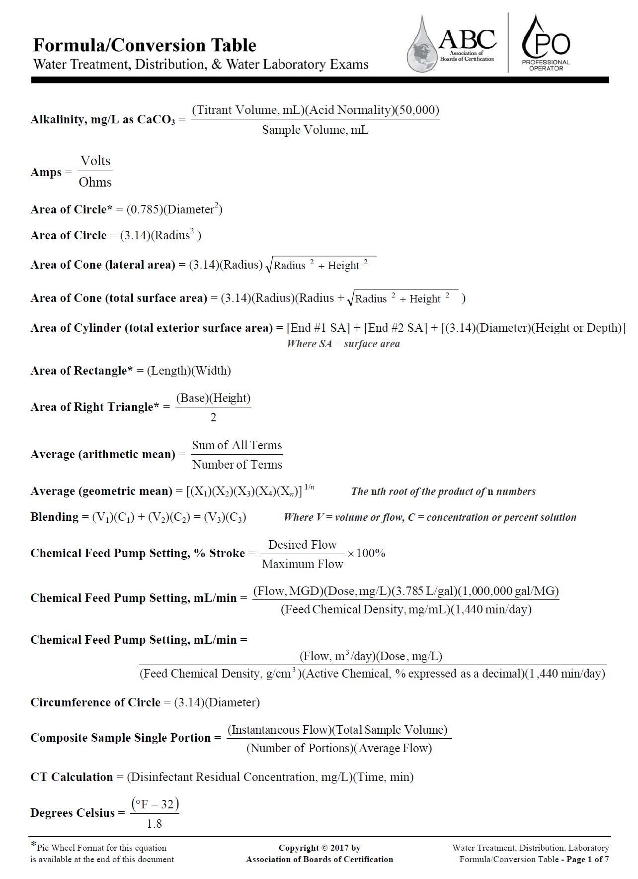
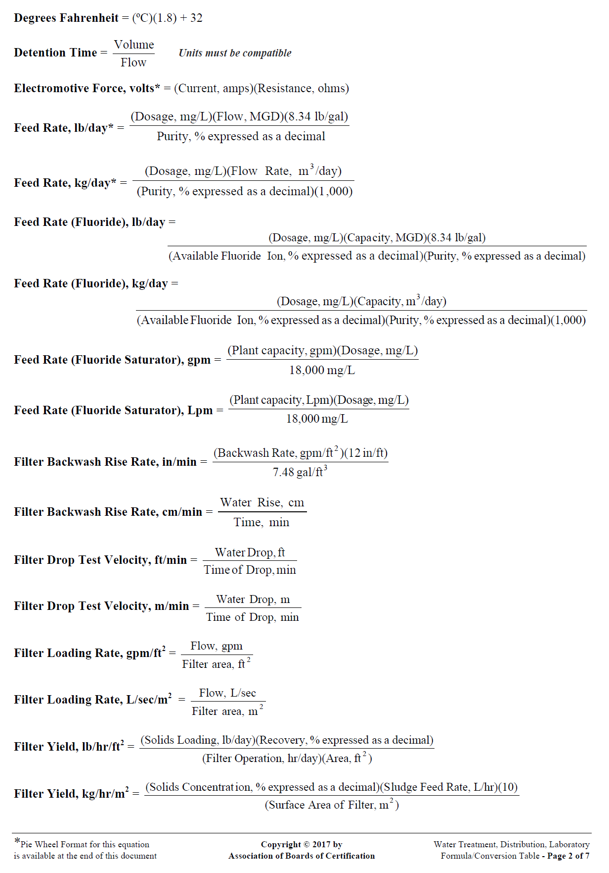
Notes:
On the ABC formula sheets, any equation can be altered to find other variables that may be missing.

Slide 22
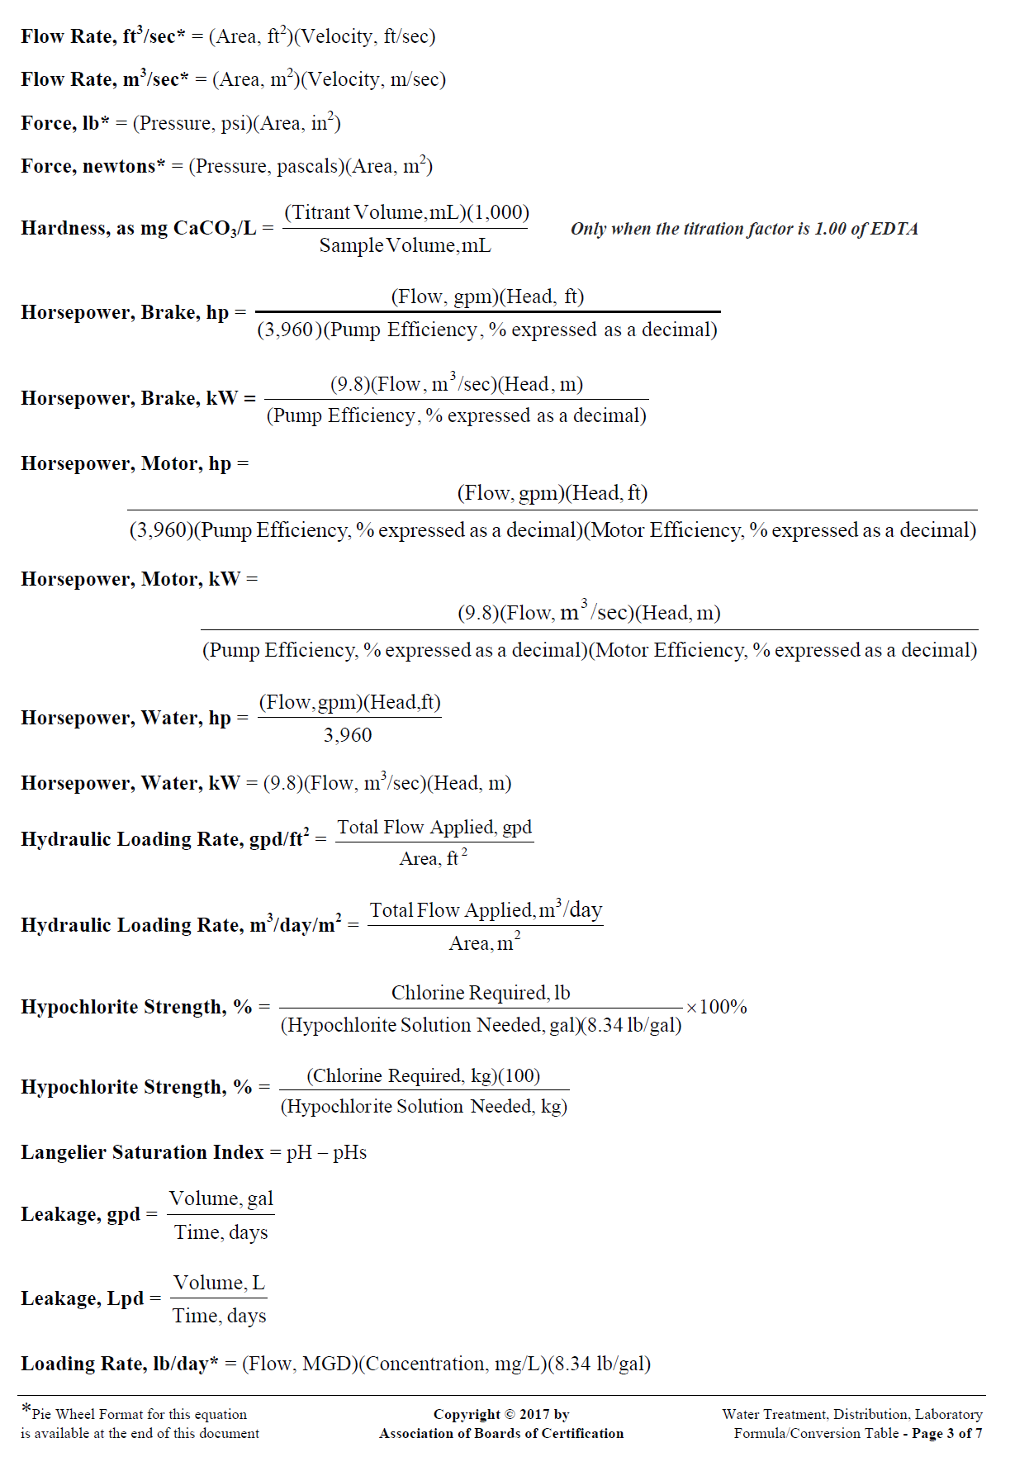
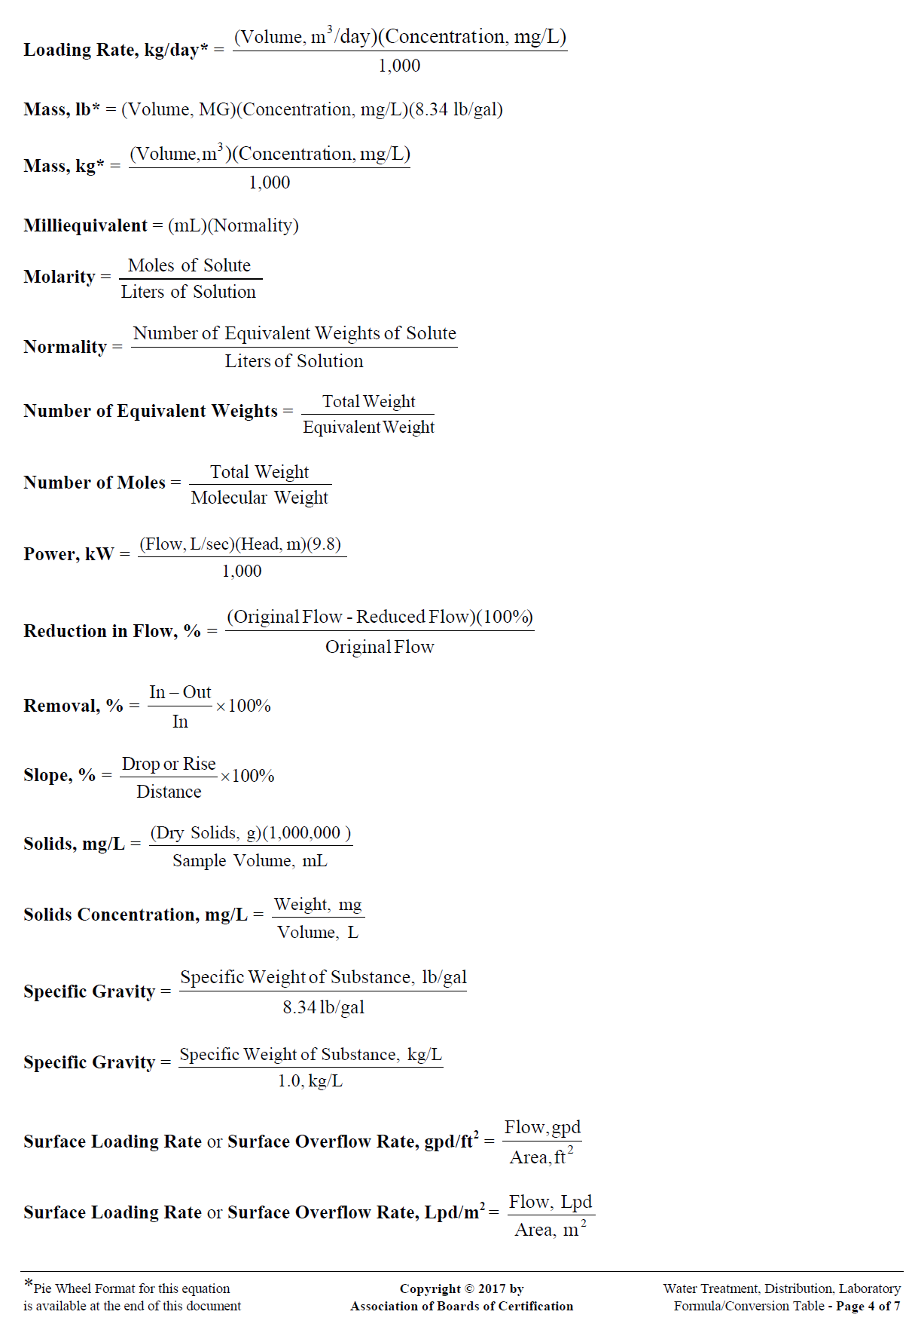

Slide 23
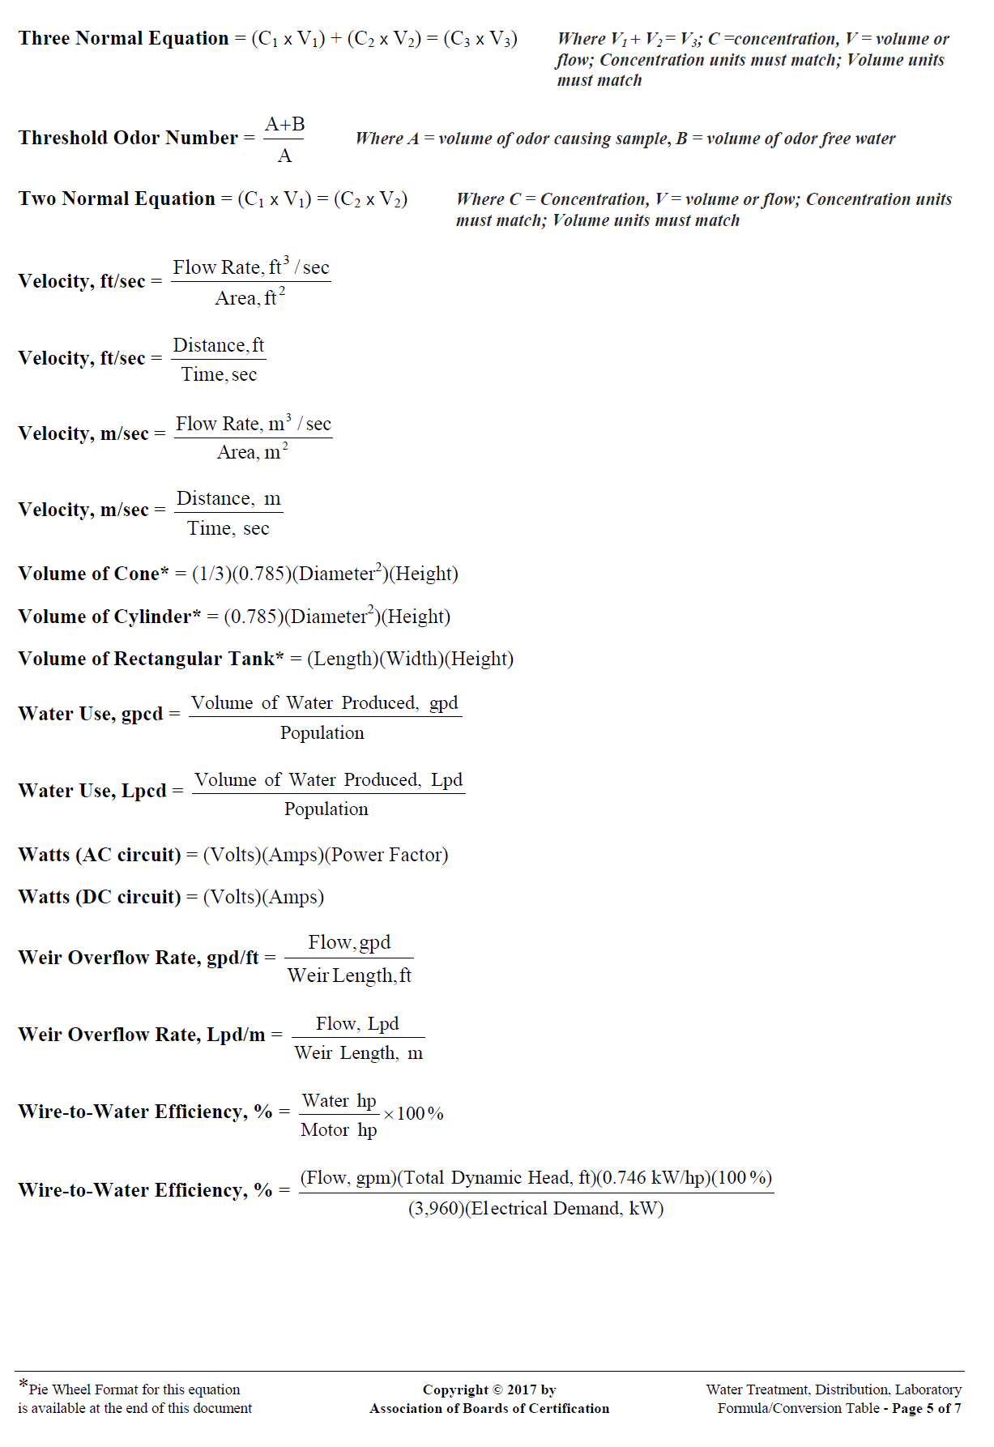
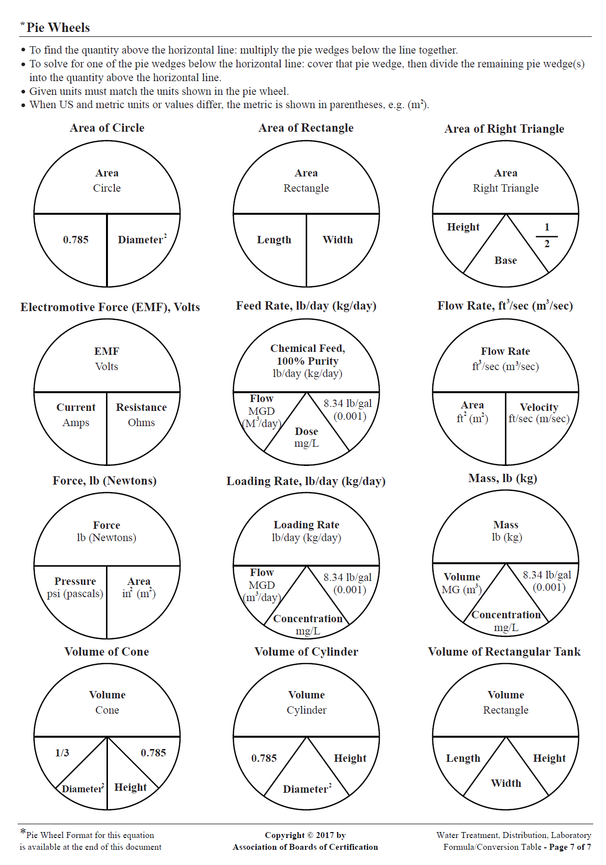
Notes:
Formulas are also presented as Pie Wheels if you’re into that kind of thing.

Slide 24

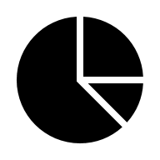
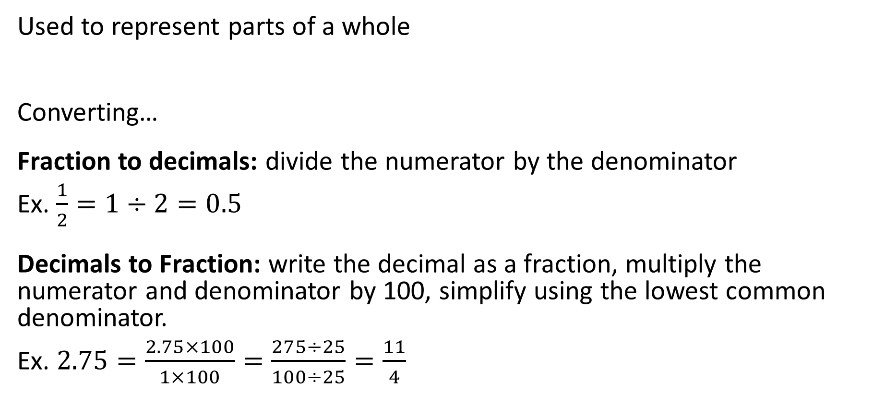
Fractions and Decimals
Used to represent parts of a whole
Converting…
Fraction to decimals: divide the numerator by the denominator
Ex. $\frac{1}{2}=1÷2=0.5$
Decimals to Fraction: write the decimal as a fraction, multiply the numerator and denominator by 100, simplify using the lowest common denominator.
Ex. $2.75=\frac{2.75×100}{1×100}=\frac{275÷25}{100÷25}=\frac{11}{4}$

Slide 25
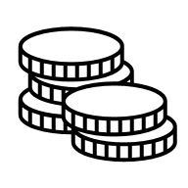
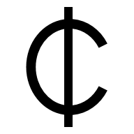
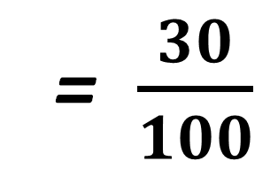
% Percentage: just another fraction
Per cent; parts per hundred
Fractions with 100 in the denominator
Can be converted to a fraction or a decimal
= $\frac{30}{100}$
30 percent
= 30%
= 0.3

Slide 26
Converting Percents into Decimals
65%
= 65/100
= 0.65
Drop the percent sign
Divide the number by 100
  (Move decimal left two places)
65%
= 0.65

Slide 27
Converting Decimals into Percents
0.65
= 0.65*100
= 65%
Multiply the number by 100
  (Move decimal right two places)
Add the percent sign
0.65
= 65%

Slide 28
Changing Between Percents and Decimals Practice
Change the Percents into decimals
3% = 25% =
0.05% = 135% =
Change the decimals into Percents
10.5 = 0.01 =
0.36 = 0.263 =
.03
.25
.0005
1.35
1050%
1%
36%
26.3%

Slide 29
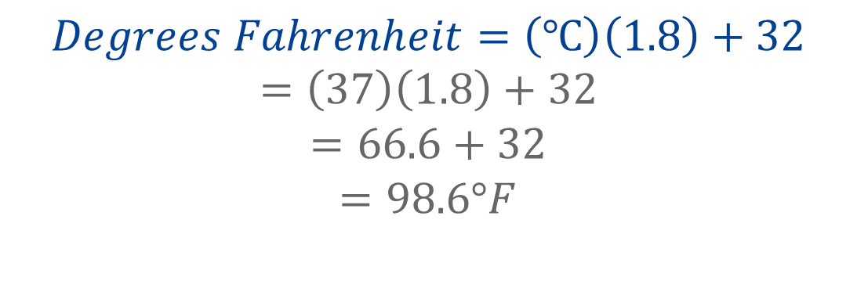
Rounding
The temperature of a digester that operates in the mesophilic range is measured to be 37°C. What is this temperature in degrees Fahrenheit?
55
80
99
107
$$Degrees Fahrenheit=\left(℃\right)\left(1.8\right)+32$$
$$=\left(37\right)\left(1.8\right)+32$$
$$=66.6+32$$
$$=98.6°F$$
Round up if the last digit is between 5 and 9
Round down if the last digit is between 1 and 4

Slide 30



Units
Temperature
  °F, °C, K
Distance/length
  Inches, feet, meters, miles, kilometers
Area
  inches², feet², meters², miles²
Volume
  ft³, m³, gallons, liters, acre-feet
Mass
  lbs; grams, kilograms, tons
Rate
  CFS, GPM
Rate measurements are a unit (e.g., volume, distance) divided by what variable/dimension?
Height
Weight
Time
Volume
Notes:
First, we have to know what we’re talking about and what were trying to find. How do we measure what we’re trying to find.
For a rate, what variable or measurement is added to one of the other units? Time
Cubic feet per second
Gallons per minute

Slide 31
Metric System
 | Meter (Length) | Liter (Volume) | Gram (Mass)
Milli- | 1 m = 1000 mm | 1 L = 1000 mL | 1 g = 1000 mg
Centi- | 1 m = 100 cm | 1 L = 100 cL | 1 g = 100 cg
Deci- | 1 m = 10 dm | 1 L = 10 dL | 1 g = 10 dg
Base | 1 m = 1 m | 1 L = 1 L | 1 g = 1 g
Deca- | 1 m = 0.1 dam | 1 L = 0.1 daL | 1 g = 0.1 dag
Hecto- | 1 m = 0.01 hm | 1 L = 0.01 hL | 1 g = 0.01 hg
Kilo- | 1 m = 0.001 km | 1 L = 0.001 kL | 1 g = 0.001 kg
Notes:
Some units that may be less familiar to you are units in the metric system, which is standard everyone in the world except the US. However, the US uses both the imperial system of measurement and the metric system. The metric system is used in many water operation processes.
You can convert from one metric unit to another by simply moving the decimal or adding zeros.

Slide 32
Metric System
 | Meter (Length) | Liter (Volume) | Gram (Mass)
Milli - | 1 m = 1000 mm | 1 L = 1000 mL | 1 g = 1000 mg
Centi- | 1 m = 100 cm | 1 L = 100 cL | 1 g = 100 cg
Deci- | 1 m = 10 dm | 1 L = 10 dL | 1 g = 10 dg
Base | 1 m = 1 m | 1 L = 1 L | 1 g = 1 g
Deca- | 1 m = 0.1 dam | 1 L = 0.1 daL | 1 g = 0.1 dag
Hecto- | 1 m = 0.01 hm | 1 L = 0.01 hL | 1 g = 0.01 hg
Kilo- | 1 m = 0.001 km | 1 L = 0.001 kL | 1 g = 0.001 kg
Notes:
Many of the matric system units are not commonly used.

Slide 33
Conversions
Common Conversion Factors
1 acre | = | 43,560 ft²
1 acre-foot | = | 326,00 gallons
1 cubic foot | = | 7.48 gallons
1 cubic foot | = | 62.4 pounds
1 cfs | = | 0.646 MGD
1 foot | = | 0.305 meters
1 ft of water | = | 0.433 psi
1 gallon | = | 3.79 liters
1 gallon | = | 8.34 pounds
1 mile | = | 5,280 feet
1 MGD | = | 1.55 cfs
1 pound | = | 0.454 kg
1 psi | = | 2.31 feet of water
1 ton | = | 2,000 pounds
1 year | = | 365 days
Notes:
Just like you can convert between metric system units, you can convert between imperial system units and between the two systems.

Slide 34
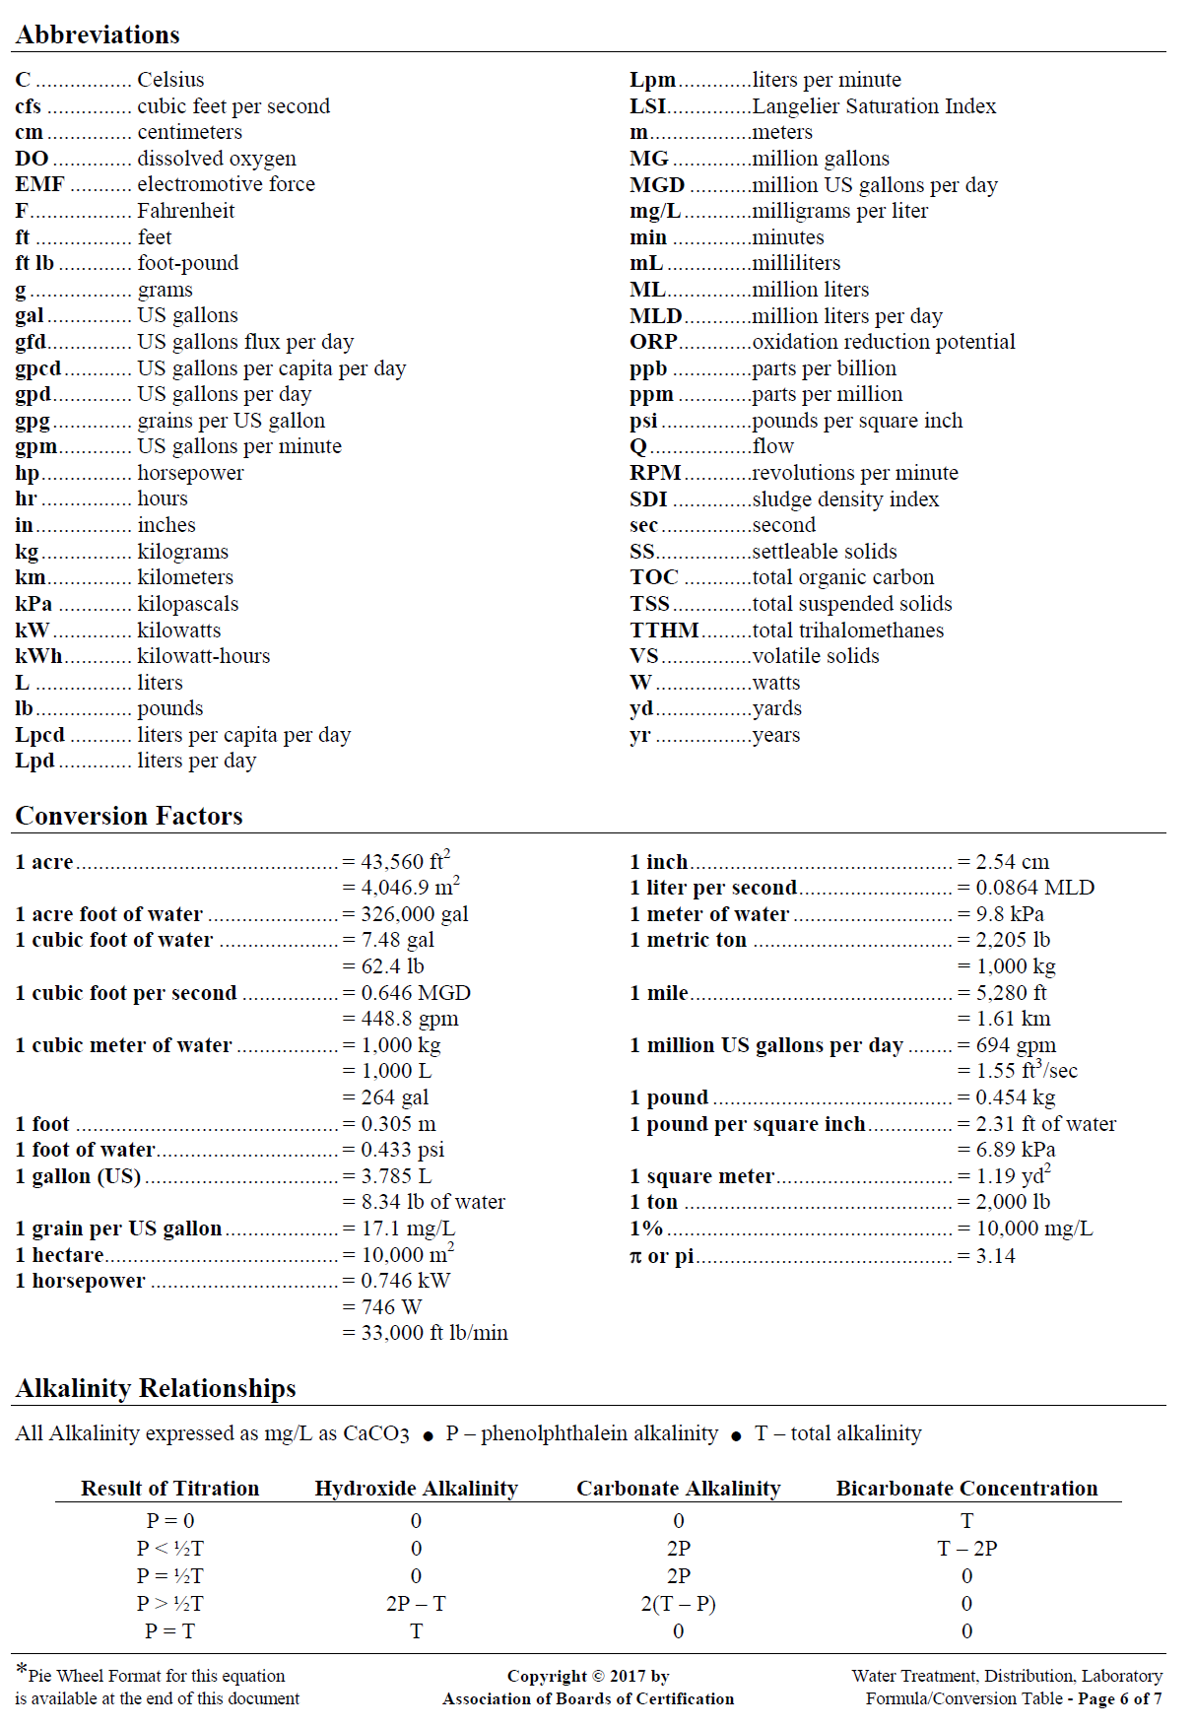
ABC Formula Sheet Abbreviations and Conversion factors
Notes:
Many conversion factors are included in your ABC formula sheet.

Slide 35
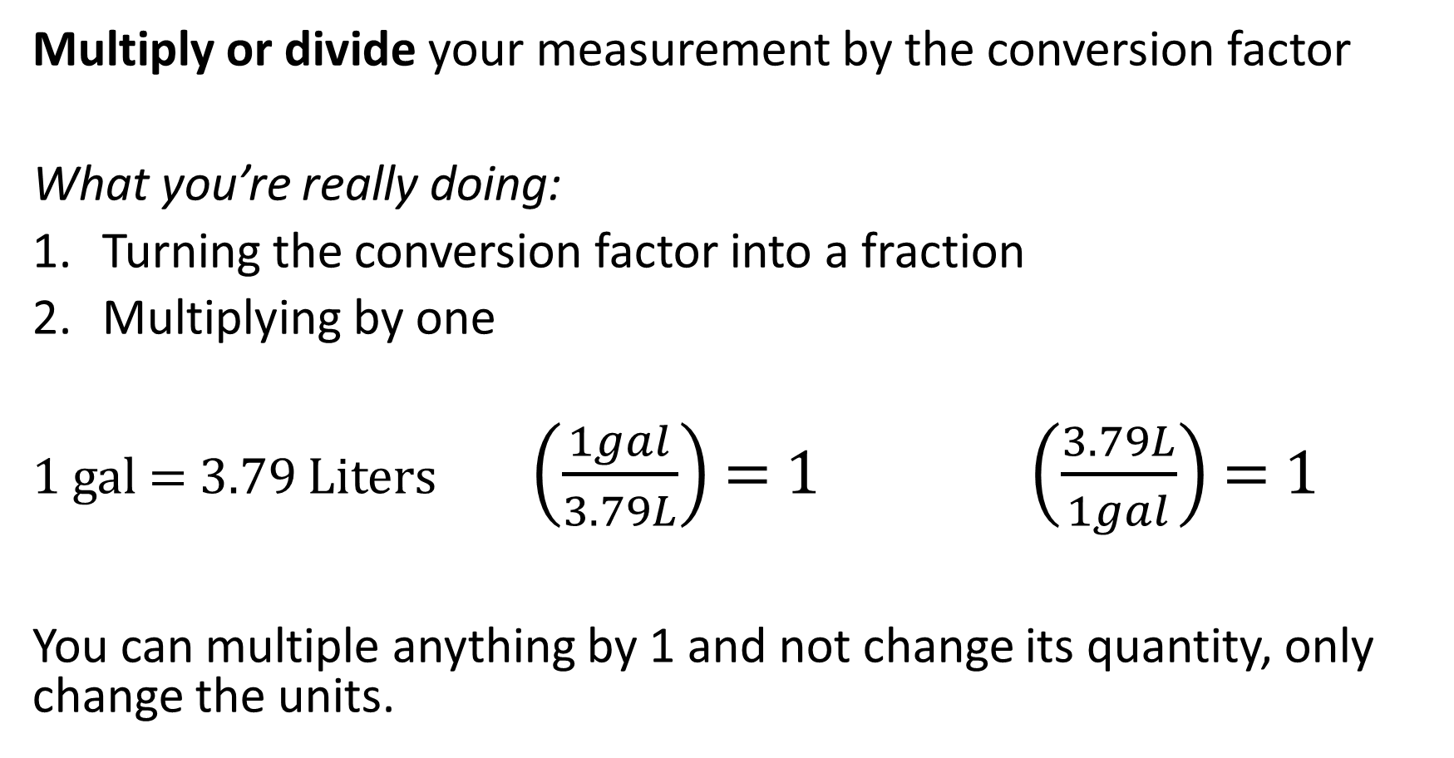
How do we use conversion factors?
Multiply or divide your measurement by the conversion factor
What you’re really doing:
Turning the conversion factor into a fraction
Multiplying by one
1 gal = 3.79 Liters $\left(\frac{1gal}{3.79L}\right)$ = 1 $\left(\frac{3.79L}{1gal}\right)$ = 1
You can multiple anything by 1 and not change its quantity, only change the units.

Slide 36
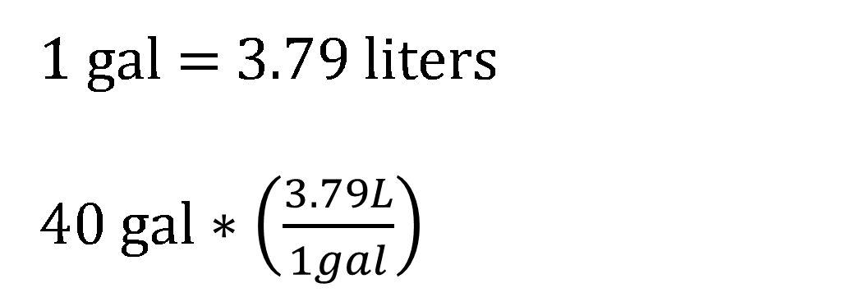
Example of unit conversion
Your Sodium Hypochlorite tank holds 40 gallons, but the store sells it by the liter. How many liters of Sodium Hypochlorite do you need to fill up your 40 gallon tank?
1 gal = 3.79 liters
40 gal $∗\left(\frac{3.79L}{1gal}\right)$
40 gal 3.79L
= ~ 150 L
1 1 gal
= ~ 150 L

Slide 37
Your turn: Unit Conversion
To figure out the volume of your clarifier, you measure it with your tape measure and determine it holds 46 cubic feet of water. How many gallons does your clarifier hold? 1 ft³ = 7.48 gal
6.1 gal
53 gal
344 gal
466 gal
46 ft³ 7.48gal
= 344 gal
1 1 ft³

Slide 38
Your turn: Order of Operations
To calculate your CT, you want to determine the volume of water after treatment and before your first customer, including water in mains that have a 1 ft diameter and are 860 ft long and a box shaped storage tank. You determine the below equation for calculating this. What is the volume in ft³?
π (1ft/2)² (860ft) + (20ft)(15ft)(25ft) =
π (1ft/2)² (860ft) + (20ft)(15ft)(25ft) =
π (0.5ft)² (860ft) + (20ft)(15ft)(25ft) =
π (0.25ft²)(860ft) + (20ft)(15ft)(25ft) =
(0.785 ft²) (860ft) + (300 ft²)(25ft) =
675 ft³ + 7500 ft³ = 8180 ft³
923 ft³
8180 ft³
11,740 ft³
5,060,00 ft³
Notes:
CT is used to evaluate the effectiveness of water treatment, and is the product of disinfectant concentration (C) and contact time (T).

Slide 39
Questions?

Slide 40
Thanks for attending!
Next webinar in the series:
Water Math pt. 2: Area, Volume, Pressure
August 6, 2025
Shannon Sloane Pepper
spepper@unm.edu

