Slide 1





US Territories Wastewater Operator Training Series
Session 2: Treatment Overview: Regulation History and Treatment Overview
7/8/25
www.efcnetwork.org
This program is made possible under a cooperative agreement with US EPA.
Notes:
Welcome to all of our participants from CNMI and Guam (we’ll be having a couple of attendees from American Samoa as well in the later sessions.

Slide 2


Your trainers for today:
A.J. Barney
Research Engineer
Valeria Cortes-Mora
Professional Intern

Slide 3



This training series is funded by the EPA
Notes:
Heather introduction

Slide 4


Slide 5

WPI/ABC Operator Certification
Notes:
This series is designed to supplement and reinforce the ABC Need to Know Criteria for the Wastewater Operator level 1 and 2 exams though there will be some higher level topics covered, and we won’t always follow the exact order listed in the NTKs
https://www.gowpi.org/services/abc-testing/standardized-exams/standardized-wastewater-treatment-operator-exams/

Slide 6
Schedule for 2025:
Date | Topic
6/24/25 | Program Overview, Test Format, Study & Test Tips
7/8/25 | Treatment Overview - Reg history, overview
7/22/25 | WW Math Part 1 (Areas & Volumes)
8/5/25 | WW Math Part 2 (Flow Rates & Detention Times)
8/19/25 | Collection Systems - Gravity systems
9/2/25 | Collection Systems - Pumping & force mains
9/16/25 | Collection System Maintenance
9/30/25 | Operator Safety/OSHA/Chemical Safety & Inventory
10/14/25 | Preliminary Treatment
10/28/25 | Primary Treatment: Sedimentation
11/11/25 | Fixed-Film Media
12/2/25 | Activated Sludge Part 1
12/16/25 | Activated Sludge Part 2
Notes:
26 sessions total
1 hour each
This is the schedule for the remainder of this year,
The trainers will vary depending on the topic

Slide 7

https://swefc.unm.edu/home/op-cert-trainings/

Slide 8

Sign in for every session to ensure you get credit for attending
Notes:
Be sure to sign in if you are attending in a group. The facilitator at your location will forward these to us and we will keep track of your attendance hours for credits;
(Heather - add in anything else you want here. I start on the next slide)

Slide 9
Wastewater Regulation History

Slide 10
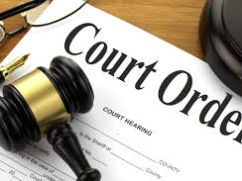
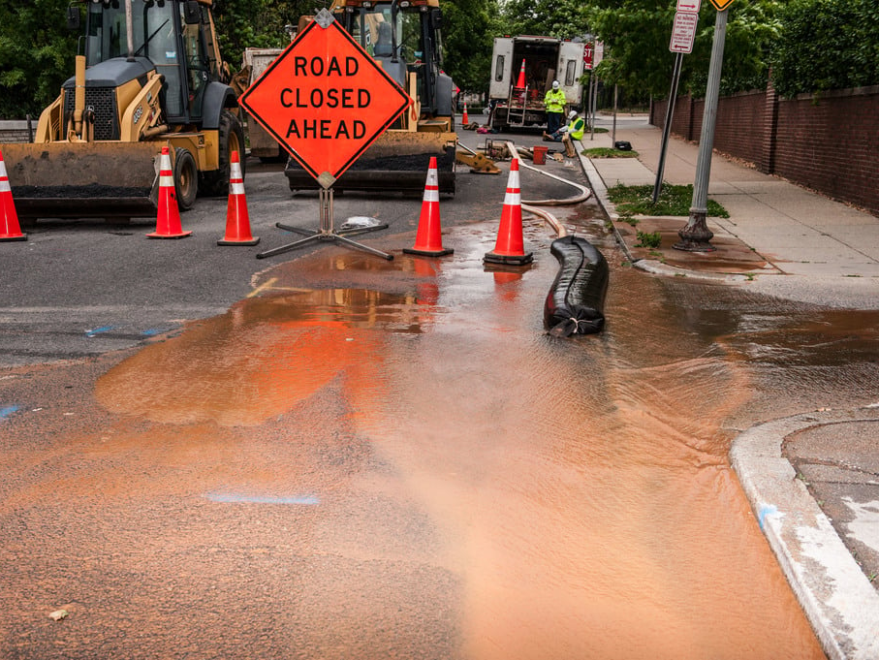
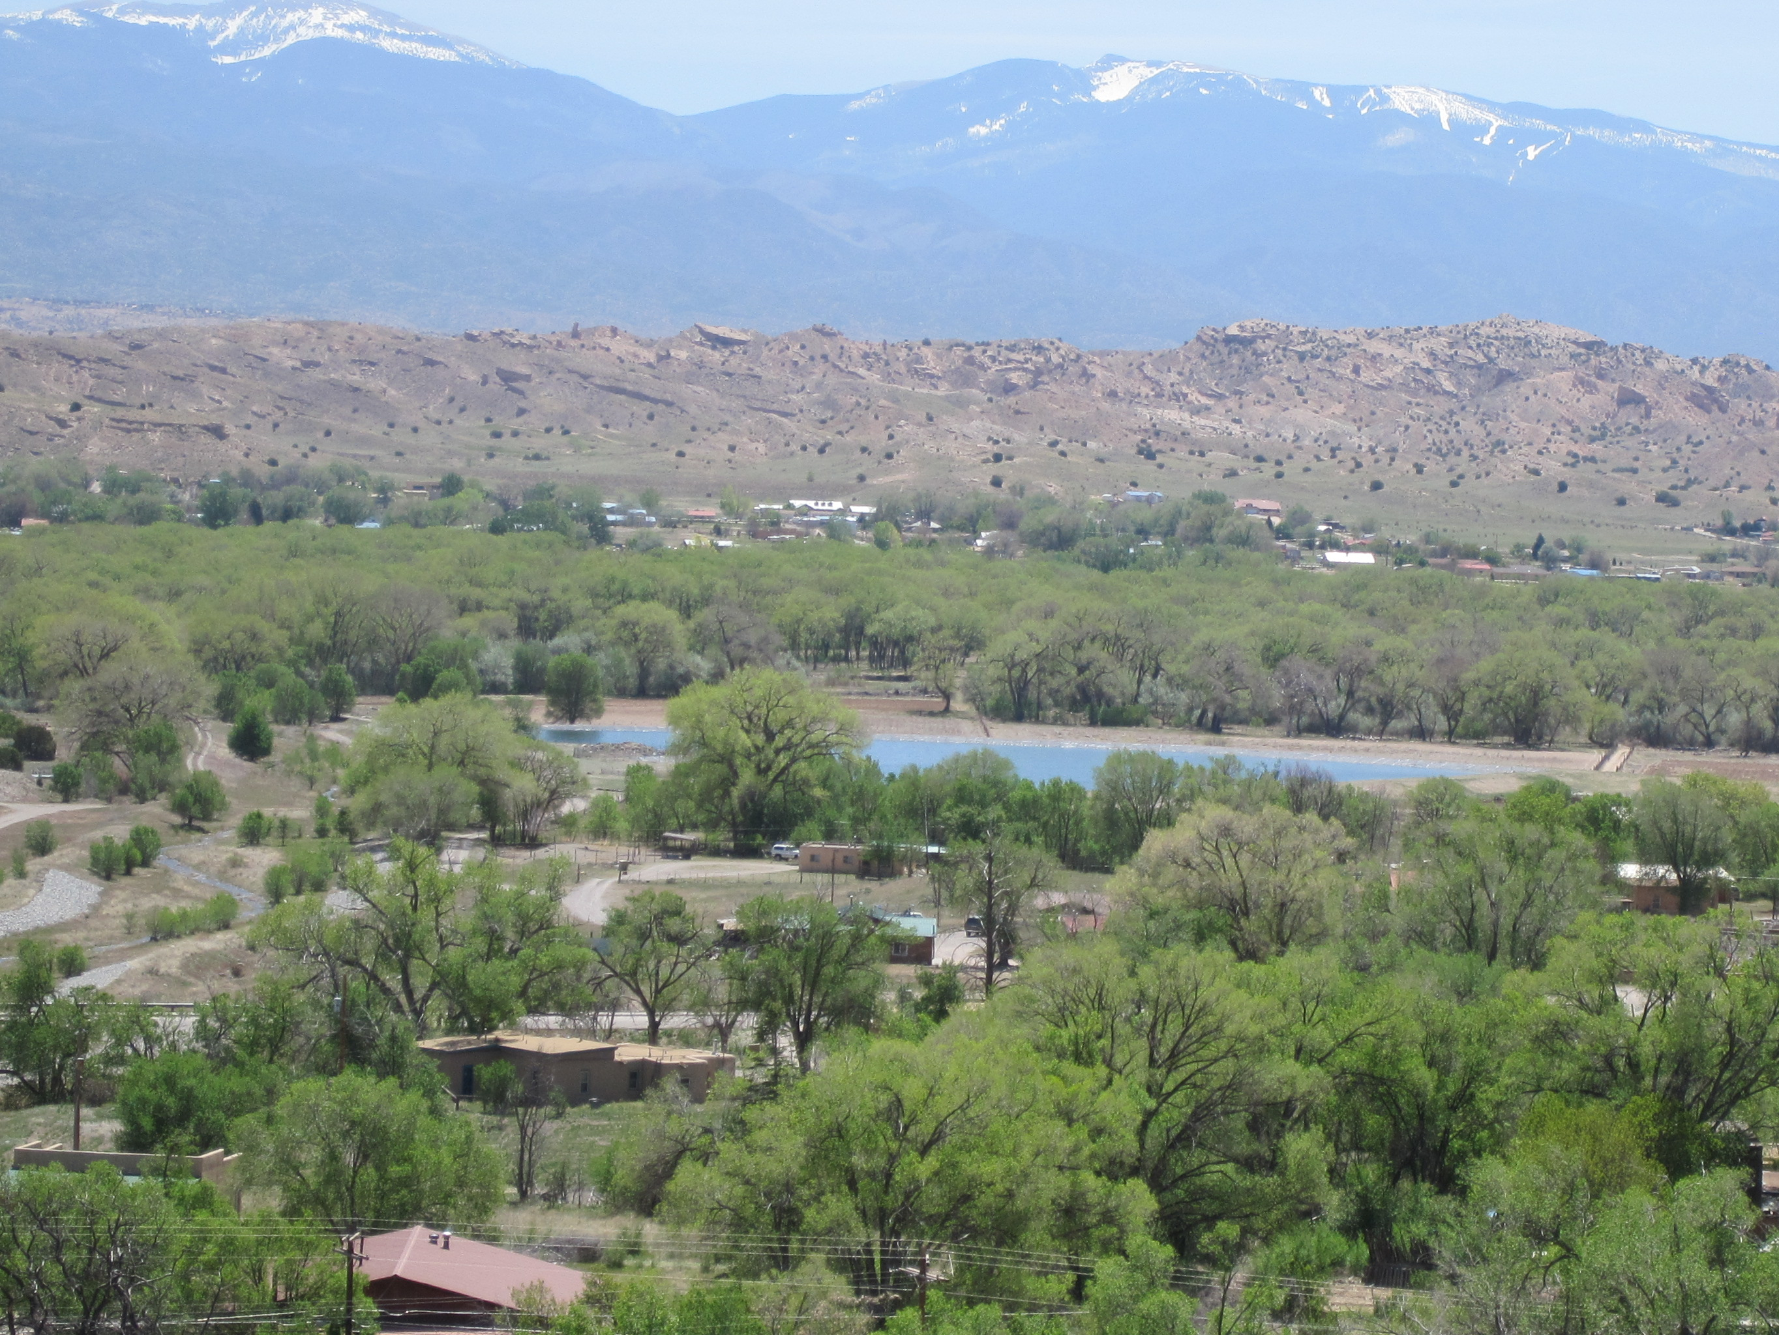
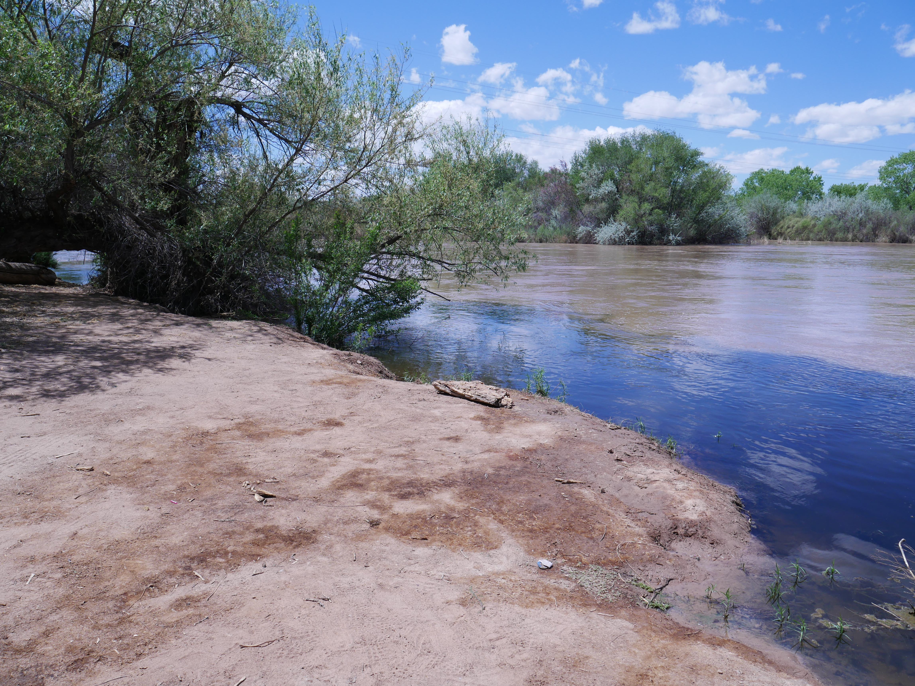
Why do we treat wastewater?
Protect fresh water supplies
Public health
Environmental health
Required by EPA regulations
Notes:
Remove pollution and contaminants that are known to cause damage to receiving bodies of water and disrupt the ability of other communities to treat drinking water
Improperly treated wastewater can cause human sickness in waters that are using for fishing, recreation, and as drinking water sources
Improperly treated wastewater that is discharged to the environment can immediately kill local wildlife and cause long term issues
It is also federally regulated. Any WWTP that discharges to a point source such as a river or lake is required to have an NPDES which sets loading limits on different contaminants in wastewater that WWTP’s have to treat for
Photos by
SWEFC
https://itoldya420.getarchive.net/amp/media/water-supply-treatment-2-412-dsp-2-watersupply_084jpg-0e0fe3
SWEFC
https://library.fiveable.me/legal-method-writing/unit-2/structure-legal-opinion/study-guide/yB41WjH2B1nYy0Nk

Slide 11
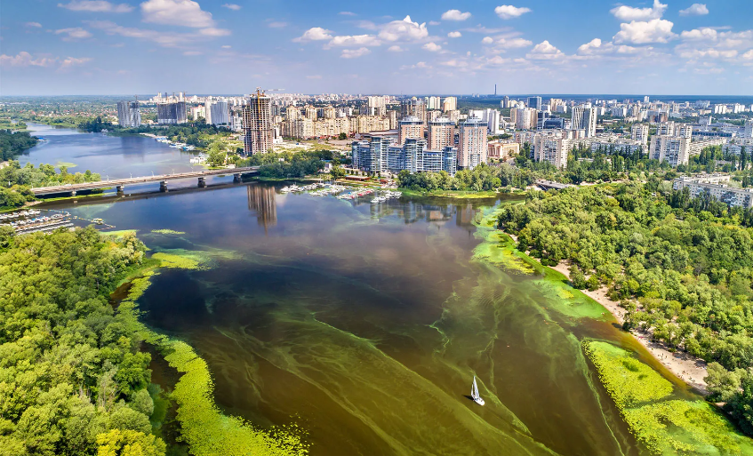
What do we treat wastewater for?
Excess nutrients (BOD, nitrogen and phosphorus)
Pathogens
Solids/ debris
Others (pH, metals, emerging contaminants)
Notes:
Excess nutrients lead to eutrophication. Algae thrive in these high nutrient environments and out compete other plans and wildlife in the effected area. They grow out of control and start to die off as nutrients and oxygen are consumed. When they die microorganisms consume them which depletes more of the oxygen in the water making it inhabitable for other wildlife. This creates dead zones or septic conditions essentially creating swamp conditions.
Pathogens in wastewater cause human diseases. Some important ones to know that frequently appear in certification exams are cholera, typhoid, hepatitis, dysentery, polio
Solids and debris add to current amounts of litter that are polluting the environment. Especially plastics that slowly breakdown and the ongoing concern of the effects of microplastics
Heavy metals can disrupt development in wildlife and humans, same with pharmaceuticals that can act as endocrine disrupters, and lots of other emerging contaminants that the extent of how they influence wildlife are barely understood
https://www.britannica.com/science/eutrophication

Slide 12

History of Wastewater Regulations
In 1854 Dr. John (not Jon) Snow identified a contaminated water pump as the source of a cholera outbreak
Contributed to the development of sewage systems
U.S. cities implemented sewer systems in the late 1800s
The Federal Water Pollution Control Act was created in 1948
First major federal legislation to address water pollution
Created water standards and funds for wastewater infrastructure
The Federal Water Pollution Control Act became the Clean Water Act in 1972
Where did it all start?
Notes:
In 1854 Dr. John (not Jon) Snow identified the contaminated Broad Street Water Pump in London as the source of a cholera outbreak
The contributed to the development of sewage systems and water cleaning systems
U.S. cities implemented sewer systems in the late 1800s in response to European developments
The Federal Water Pollution Control Act was created in 1948
First major federal legislation to address water pollution
Created water standards and provided funds for wastewater infrastructure that affect interstate waters
The Federal Water Pollution Control Act became the Clean Water Act in 1972
https://www.goodfon.com/films/wallpaper-download-2100x1398-vzglyad-bryunet-muzhchina-jon.html

Slide 13
Clean Water Act (CWA) of 1972
Before 1972 most of the US relied on septic tanks
The CWA of 1972:
Established the National Pollutant Discharge Elimination System (NPDES) permit program
Set Wastewater Standards and Water Quality Standards
Funds Wastewater Infrastructure
Provides the EPA authority to enforce water and wastewater regulations
Notes:
Prior to 1972 most the US utilized septic tanks to address their wastewater. Sewer systems were confined to cities and these systems typically only utilized primary treatment.
In response to growing concerns of pollution and national attention to the pollution observed in the nations waterways the Clean Water Act of 1972 (known as the CWA) was established to protect the nations water through the following efforts:
Established the National Pollutant Discharge Elimination System (NPDES) permit program, which control water pollution by limiting the discharge pollutants from point sources that discharge to US waters
Set technology-based (which means current available technology that are proven treatment methods) wastewater discharge limits and sets water standards that protect human and aquatic health for receiving waters
Provides funding for developing wastewater infrastructure
Provides the EPA authority to enforce wastewater regulations through inspections, monitoring and enforcement actions

Slide 14
National Pollutant Discharge Elimination System (NPDES) permit program
NPDES permits are required for facilities that discharge to surface waters
NPDES permits intended to make the nation’s waters suitable for fishing, swimming, and other uses
Industries that discharge to Municipal systems must meet pretreatment requirements
NPDES permits specify the effluent limits of the wastewater treatment plant (WWTP)
Regulates sewer overflows, stormwater, the National Pretreatment Program and biosolids
Notes:
NPDES permits are required for agricultural, industrial, municipal, and other facilities that discharge directly to surface waters
NPDES permits are required by the CWA to make the nation’s waters suitable for fishing, swimming, and other uses
NPDES permits are not required for industries that discharge to Municipal systems and not directly to surface waters but those industries must meet pretreatment requirements
The NPDES permit program also regulates a variety of other areas that affect how municipalities handle wastewater. This includes the prevention of combined sanitary overflows and sanitary sewer overflows, the management of separate stormwater systems, standards for establishing pretreatment programs across the country and how biosolids can be used for land application, surface disposal, incineration, or disposal at solid waste facilities

Slide 15
Effluent Discharge Limits
Monitored by the WWTP operator
NPDES permit specify parameters, schedule, frequency, methods, etc.
Determined by available technology and ability of receiving water to withstand contaminant loading
Technology-Based Effluent Limits (TBELs)
Water Quality-Based Effluent Limits (WQBELs)
Notes:
Effluent discharge limits are the most important aspect of the NPDES permit that operators monitor to ensure their wastewater is being treated to regulatory standards and to a quality that will not negatively impact receiving waters
The NPDES permits dictate what types of parameters a plant needs to test for, when and how often these samples are taken, this includes if things like a weekly or monthly average are used or just single grab results are sufficient, and many other aspects of required sampling protocols
The NPDES program determines effluent discharge limits based on the available technology and the ability of receiving waters to withstand a certain level of contaminants these are known as technology based effluent limits and water quality based-effluent limits
For technology based effluent limits the EPA publishes effluent limitations guidelines based on the best available technology economically achievable, which means the EPA will only require wastewater to be treated to a level that readily available technology can treat to. They will not set limits that facilities cannot reasonably acquire equipment to achieve.
Water Quality-Based Effluent Limits are based on the flow, existing pollution levels, and intended uses of the receiving waters.

Slide 16
Typical Influent Pollutant Concentrations
Parameter | Influent Concentration | Effluent Goal
BOD5 | 200 mg/L | < 30 mg/L
TSS | 200 mg/L | < 30 mg/L
TDS | 800 mg/L | < 1000 mg/L
Settleable Solids | 10 mL/L | < 0.1 mg/L
pH | 6- 9 | 6- 9
Fecal Coliform | Too numerous to count | < 500 cfu/ 100mL
TKN (Ammonia + Organic Nitrogen | 30 mg/L | < 10 mg/L Total Nitrogrn
Nitrate/ Nitrate (Inorganic Nitrogen) | < 1.0 mg/L
Phosphorus | 2.0 mg/L | < 1.0 mg/L
Fats, Oils, and Grease | Varies greatly | None Visible
30/45 Effluent Rule
Parameter | 30-day average | 7-day averge
BOD5 | 30 mg/L | 45 mg/L
TSS | 30 mg/L | 45 mg/L
Notes:
This chart can be a little hard to follow so notice for the first section the two columns with concentrations are influent concentration and effluent goal and the second section has 30 and 7 day averages. This is an important and easy rule to

Slide 17
NPDES Non-Compliance
Permitting agency responsible for NPDES enforcement
NPDES enforcement includes:
Notices of Violations (NOVs)
Administrative Orders
Fines
Criminal Prosecution
Notes:
NOVs act as a minor citation or warning that is intended to outline future actions or possible consequences for further non-compliance
Administrative orders are formal actions permitting agencies issue which outline specific requirements facilities have to meet to come back into compliance. This includes things like extra sampling and inspections, milestones schedules for compliance, and even the requirement of updated infrastructure.
There is of course fines that may be levied in corrective actions are not taken
And intentional non-compliance can even be viewed as a criminal violation and escalated non-compliance can result in legal consequences for the responsible operator

Slide 18
Wastewater Treatment Overview

Slide 19
General treatment processes
Collection
Preliminary treatment
Primary treatment
Secondary treatment
Tertiary treatment
Disinfection
Sludge handling
Notes:
Which is where much of the debris we talked about is removed
Primary treatment removes organic matter
Biological treatment to reduce nutrient loading
Secondary treatment to further remove organics already in the ww and those created during bio treatment
Tertiary treatment is the polishing stage and typically consists of disinfection but may also incorporate specialized contaminant removal such as the precipitation of mercury or phosphorus
Sludge handling is process where solids removed in other processes are treated and disposed of in a safe and healthy way

Slide 20
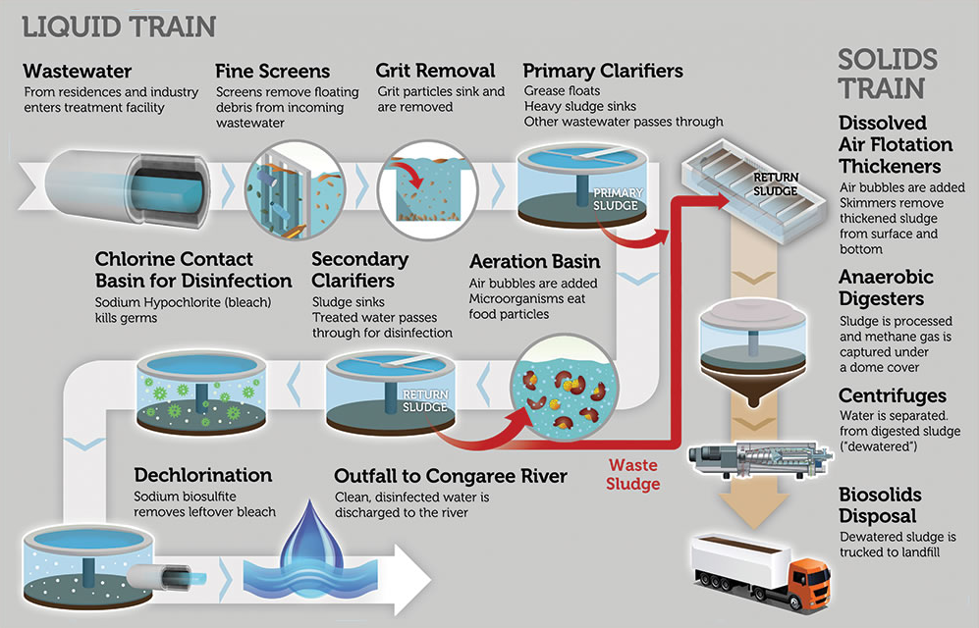
Notes:
Wastewater entering the WWTP is called influent
Wastewater that has been treated by the WWTP is called effluent

Slide 21
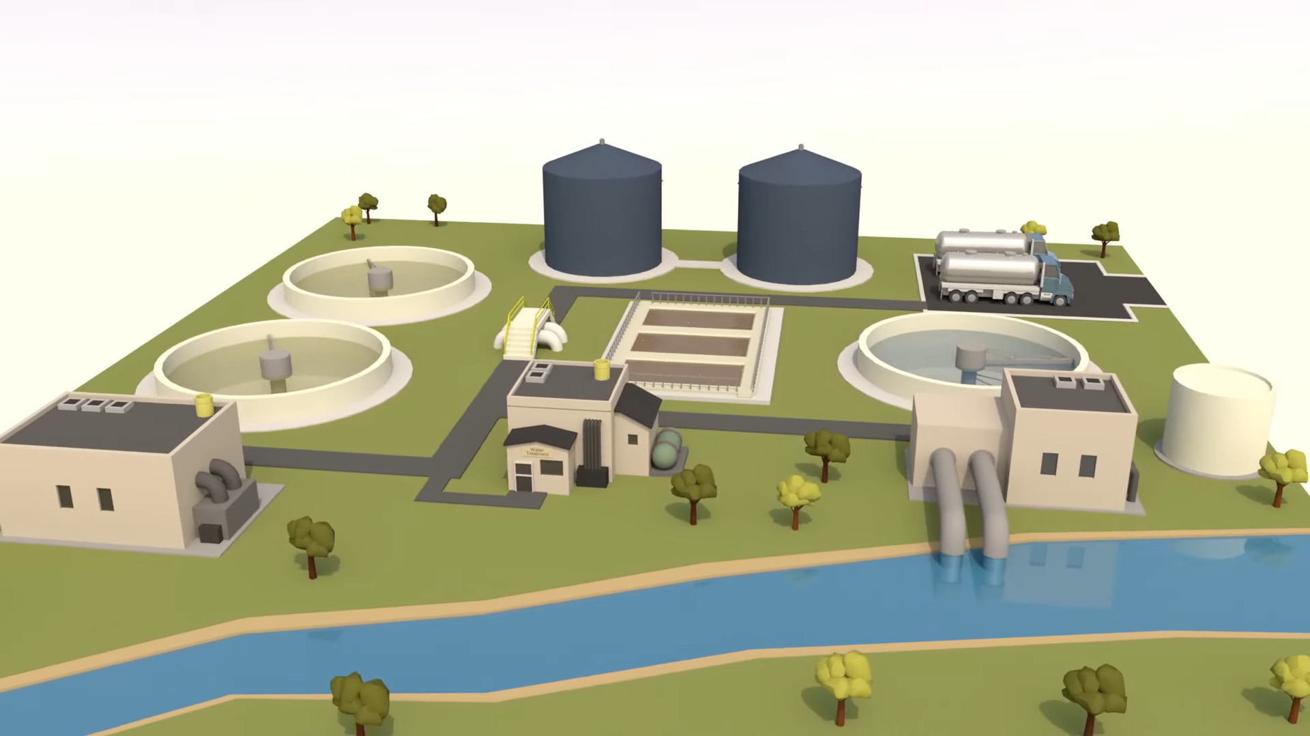
Digesters
Primary Clarifiers
Secondary Clarifiers
Biological Treatment
Disinfection
Pretreatment
Outfall

Slide 22
Important Wastewater Terms
BOD- Amount of oxygen consumed at 20°C
Carbon Cycle- Aerobic and anaerobic respiration
Nitrogen Cycle- Manipulated to removes ammonia (NH3) and nitrate (NO3)
Sulfur Cycle- Results in sulfuric acid and hydrogen sulfide (H2S) gas
Specific Gravity- Density of a substance compared to water. Used to create physical separation of solids from wastewater
Notes:
BOD- WW strength. This is important because this describes how much oxygen would be consumed by the raw wastewater
Carbon cycle is important to understand how organics are consumed in WW and the different pathways they can follow
N- To understand how these natural cycles are manipulated for nutrient removal
Sulfur cycle is important to understand how harmful substances form that can harm WW workers or deteriorate the collection system
SG- very important to understand how clarifiers work and grit removal typically occurs. 3 of the main processes of 7

Slide 23
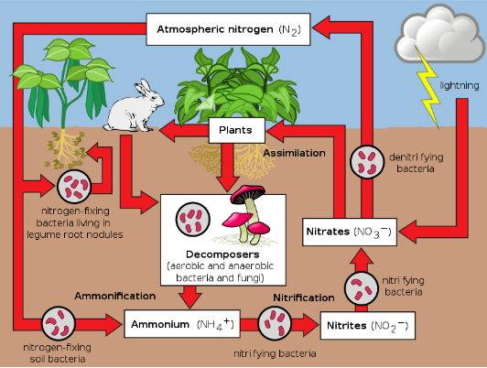
Nitrogen Cycle
Notes:
It is important to understand the different forms of N that are present throughout the plant and how it transforms during different processes and what conditions those processes create. It is also important to understand the different forms of N that are regulated by NPDES permits. Examples of this are total inorganic nitrogen which is comprised of nitrite, nitrate and ammonia or total Kjeldahl nitrogen which is composed of the organically bound nitrogen and ammonia
Basic N in atmosphere, fixed and incorporated into plants, consumed by humans and secreted as urea in urine which decomposes to ammonia, ammonia arrives at the WWTP where it is treated. NH3 > NO2 > NO3 > NO2 then N

Slide 24
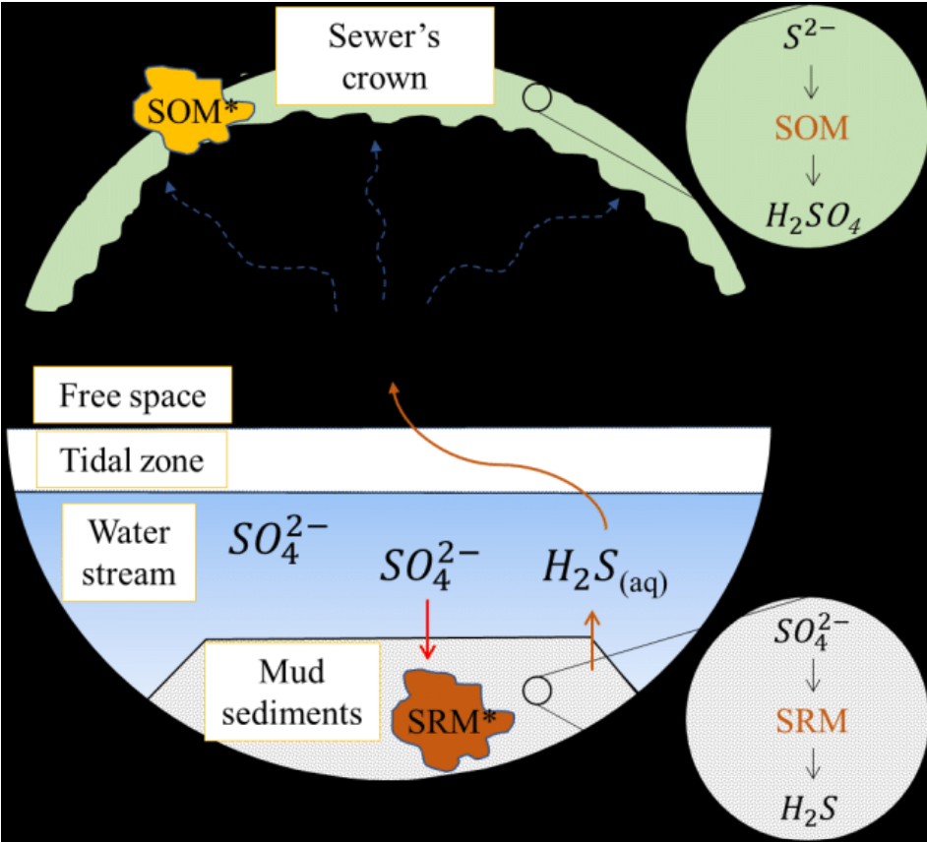
Sulfur Cycle
Notes:
Sulfates exist naturally in the collection system.
The anaerobic, or oxygen free conditions of the system cause sulfate reducing microbes to use the oxygen bound to sulfates, because free oxygen is not available due to the anaerobic conditions.
This process converts SO4 to H2S.
H2S is poisonous to humans. It smells like rotten eggs at very low levels, can cause nose blindness at slightly higher levels, and is deadly at higher levels.
This is especially hazardous for collection system workers and the operation of pretreatment process.
Odor control systems are utilized to reduce H2S issues.
It is also important to have gas detectors in receiving facilities to detect excessive levels. Proper ventilation can also help in these situations. Sulfur oxidizing bacteria is also present at the top of collection systems and oxidizes h2s to form sulfuric acid which creates crown rot and deteriorates the collection system or damages equipment in the WWTP.

Slide 25
Collection System
Conveys wastewater from homes and businesses to the WWTP
Consists of pipes and pumps
Pipe location and size determines hierarchy
Collection systems are typically gravity fed or pressurized
Wastewater collection may be combined with stormwater
Collection system concerns include infiltration and inflow, roots, corrosion, and FOG
Notes:
Consists of a complex system of pipes and pumps of varying sizes
Sewer pipes are typically categorized into a hierarchy system that explains the system like you would a tree.
Lateral, branch, trunk, mains
Wastewater systems are typically separate from stormwater systems, but sometimes these systems are combined.
Combined systems have different factors to consider such as increased fluctuations during storms and require different strategies to manage those fluctuations and potential pollution.
When managing collection systems it’s important to manage infiltration from groundwater, inflow from stormwater, root intrusion, pipe deterioration, debris, and other things like excessive fats, oils, and grease build-up

Slide 26
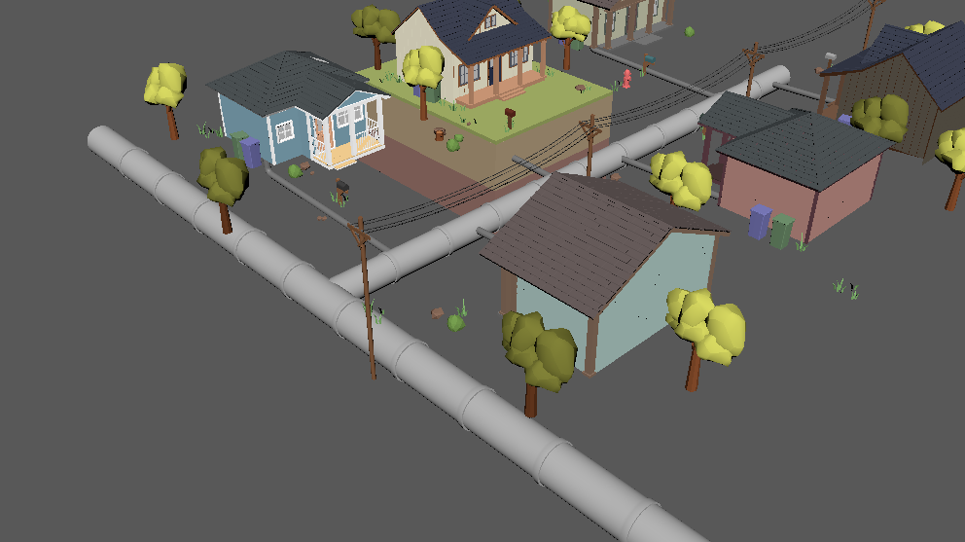
Sewer Pipes
Lateral Lines
Branch Lines
Trunk Lines/ Sewer Main
Notes:
Connections

Slide 27
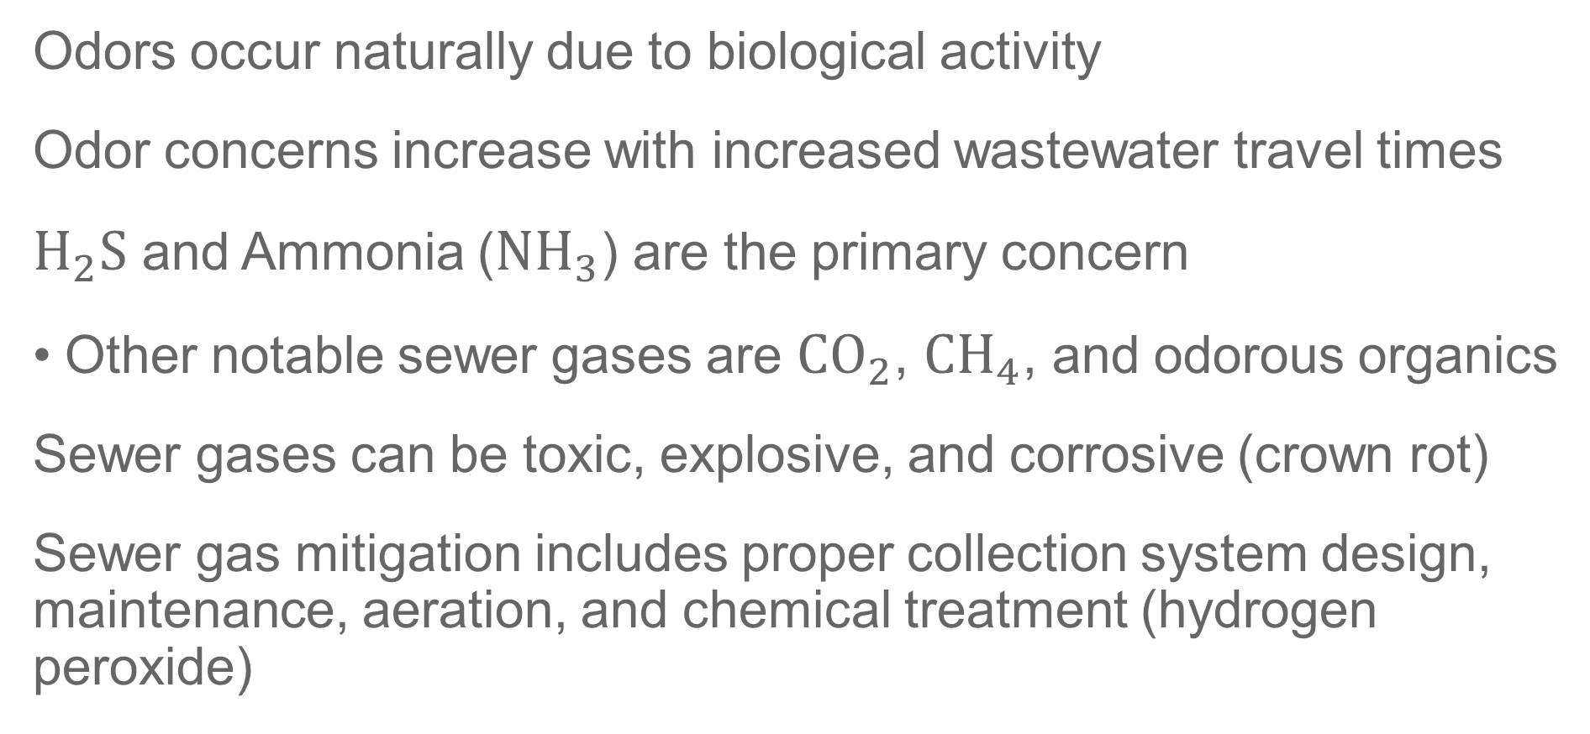
Odor Control
Odors occur naturally due to biological activity
Odor concerns increase with increased wastewater travel times
$H_{2}S$ and Ammonia (${NH}_{3}$) are the primary concern
Other notable sewer gases are ${CO}_{2}$, ${CH}_{4}$, and odorous organics
Sewer gases can be toxic, explosive, and corrosive (crown rot)
Sewer gas mitigation includes proper collection system design, maintenance, aeration, and chemical treatment (hydrogen peroxide)
Notes:
For collection systems odors are one of the biggest concerns.
Microbes in wastewater naturally produce gases as biproducts of their normal biological functions
These gases that lead to odors increase the more time wastewater spends in a collection system.
Travel times for wastewater in collection systems tend to increase as we increase the size of communities and need to extent collection systems our farther and farther.
$H_{2}S$ and Ammonia (${NH}_{3}$) are the primary concern
Other notable sewer gases are ${CO}_{2}$, ${CH}_{4}$, and odorous organics
Sewer gases can be toxic, explosive, and corrosive (crown rot)
Crown rot is the conversion of hydrogen sulfide gas to sulfuric acid in sewer pipes
Sewer gas mitigation includes proper collection system design, maintenance, aeration, and chemical treatment (hydrogen peroxide)
Such as ensuring a gravity system slope that creates a minimum wastewater travel velocity of 2 feet per second which is known as scouring velocity, proper sewer maintenance that removes blockages

Slide 28
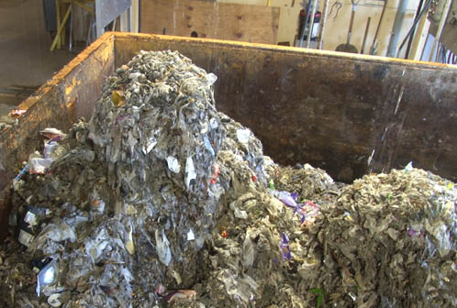
Pretreatment
Larger solids and rags
Grit removal
Flow measurement
Flow equalization
Notes:
Rags, wrappers, flushable wipes that aren’t flushable, all kinds of plastic and rubber products etc.
Grit must be removed to protect down stream equipment, especially pumps and other devices which have soft components integrated into hard metal or concrete components.
It is important for flow measurement to occur at the beginning of the plant to understand treatment requirements throughout the plant. Sampling may also occur here to understand the wastewater profile of the influent, which is also important for adjusting operations throughout the WWTP.
Flow equalization to account for fluctuations of flow throughout the day and to distribute flow equally throughout the day for treatment.
That’s also where WW can be freshened up with oxygen
https://metrocouncil.org/News-Events/Wastewater-Water/Newsletters/%E2%80%98Flushable%E2%80%99-wipes-clogging-up-sewer-pumps.aspx

Slide 29
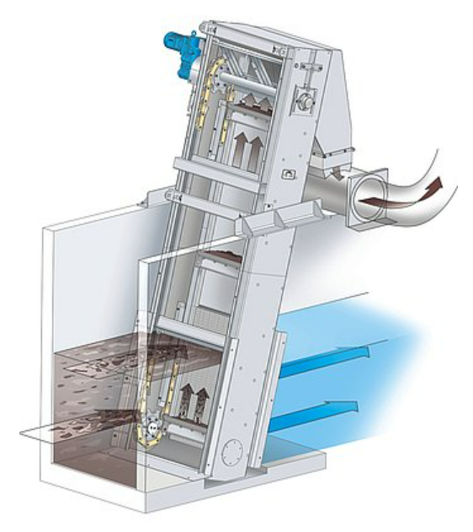
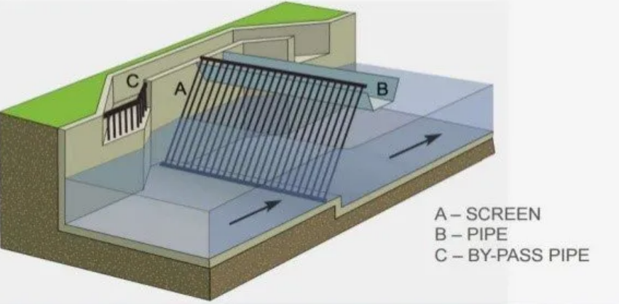
Bar Screens
Notes:
This is typically the first process that wastewater influent encounters when it enters the WWTP
Bar screens are comprised of multiple parallel slanted or vertical bars that are placed close together so that wastewater can flow through the barscreen while debris and course debris are trapped in the bars. Can be Manual or mechanical and are usually oriented so that screenings enter a conveyance device such as a trench or conveyor belt that conveys the screens to a disposal bin. Manual barscreens are usually present at smaller WW facilities and automatic barscreens are used at larger facilities where mechanical devices are more efficient than man power
Can be water triggered by the mechanism or conveyor belts
Bar screens should be constructed from stainless steel to resist corrosion caused by gases such as H2S formed in the collection system
There are two types of screen devices. When the opening between the stainless steel bars are 3/8-2 inches they are known as bar screens and when the openings are larger than 2 inches they are referred to as bar racks. Bar racks are usually utilized in by-pass channels to provide a small amount of screening treatment during maintenance.
Disposal bins or hoppers should be designed to minimize water content in rags to allow for efficient transport.
It is important that these devices stay well maintained through proper lubrication and frequent observation that there are no obstructions on the bar screens or converyor device that can permanently damage the equipment

Slide 30
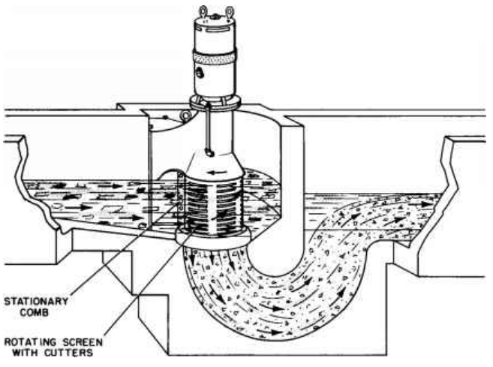
Comminutors
Rags and debris are shredded and left in the water
Can clog equipment and be labor intensive
Require electricity unlike manual bar screens
Notes:
Common in smaller systems and replace the need for bar screens

Slide 31
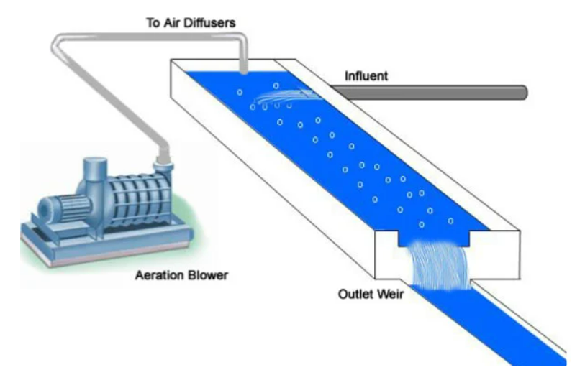
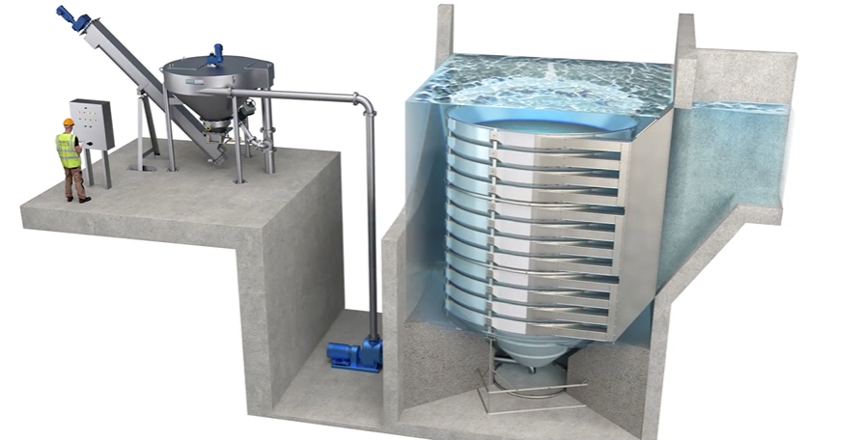
Grit Removal
Notes:
Grit is composed of sand, sediment, and eggshells that damage the impellers of plants or deposit in downstream basins, reducing their capacity and efficiency. The buildup can be so extreme that the flow may be stopped completely in certain treatment areas. The amount of grit present in WW influent depends on the plant and collection system, but typically 1-4 cubic feet of grit should be removed daily for every million gallon of WW treated.
Grit is separated from liquid water by a variety of methods but all tend to utilize the manipulation of specific gravity
A simple method is the usage of a long channel that is approximately 20-40 feet and slows down flow to 1 ft/s. This allows grit to settle and water to pass through. Baffles can be used to account for daily fluctuations in flow.
Aerated grit channels such as the one on the left utilized dissolved air to make the wastewater even less dense and causing grit to settle even more efficiently. This decreases the spatial footprint of the grit removal process and does not require the flow to be slowed down.
These process can either be done in a straight channel or in a serpentine to reduce land used. For both types system when too much grit is accumulated they must be bypassed and cleaned out or pumps must be installed to consistently removes grit before it can accumulate.
Or pumps must be installed to remove the grit on an interval or continuously
Right - Headcell right solids are moved to the center due to the centrifugal technology and light water moves to the outside where it passes to the next process. Grit classifiers also used.

Slide 32
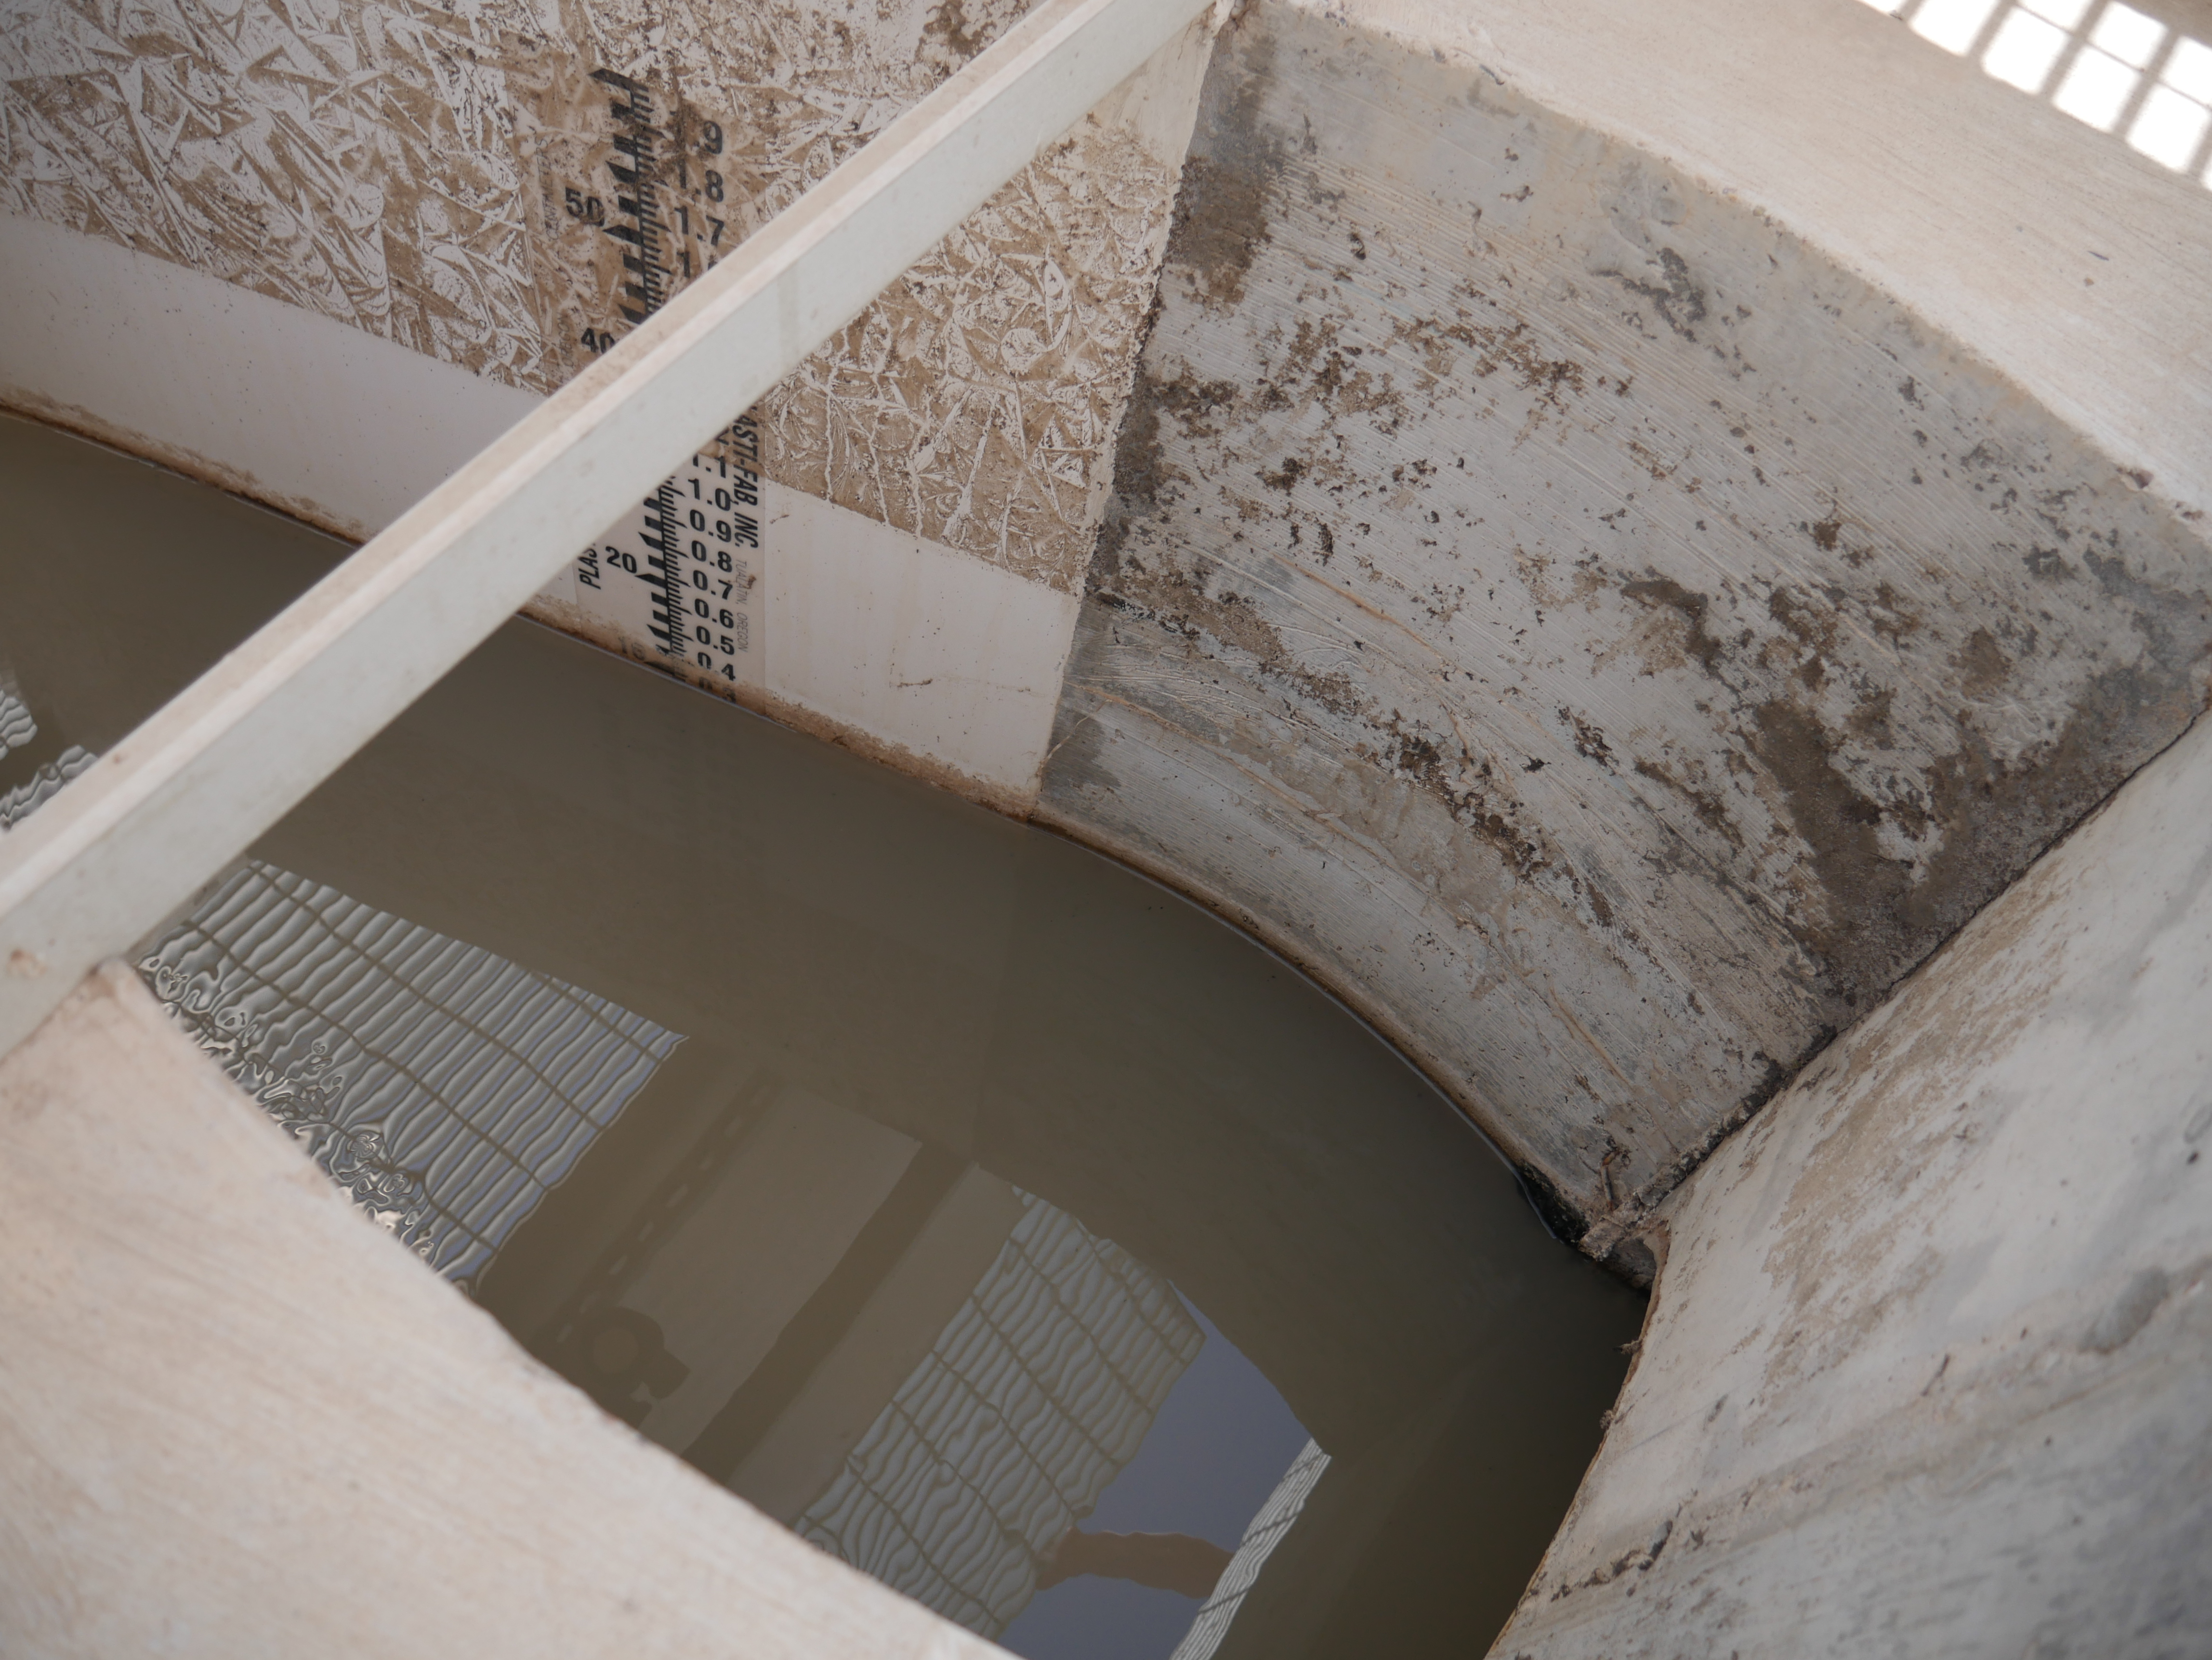
Flow Measurement
MGD, gpm, and cfs
Ultrasonic meter
Flume
Weir with staff gage
Bubbler
Venturi Meters or Magnetic for inline pipe
Notes:
Also at the headworks is our flow measurement data collection devices
Flumes and staff gauges are used in open channels.
Ventruri meters and magnetic flow meters are used for pumping systems that are closed.
These devices are examples of devices that show what that flow is at that instant
Bubblers and other probes are utilized to totalize flow readings and measure the total for a day or other increment of time

Slide 33
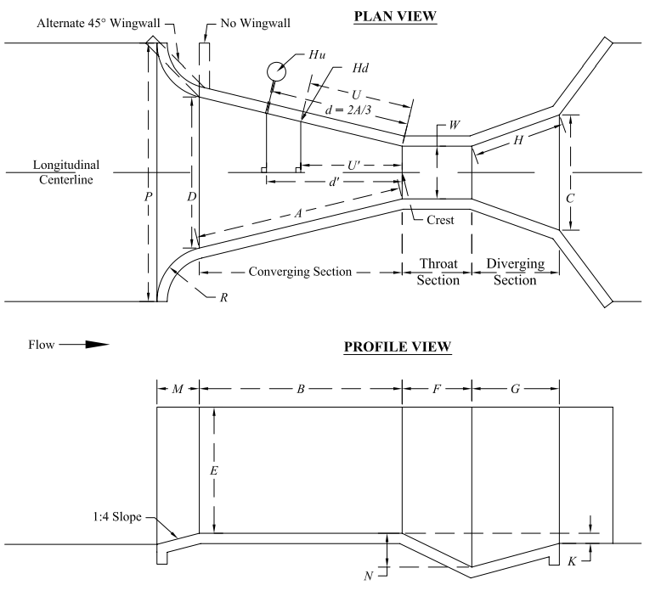
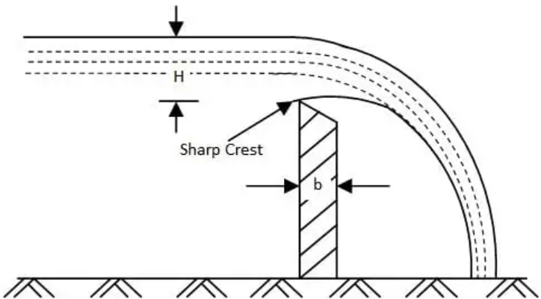
Flow Measurement Devices
Notes:
The flow is measured by a manual gauge that shows the flow based on how high on the gauge the water rises
Parshall flume- Head rise measurement is taken 2/3rds of the way up the approach channel.
Right staff gauge and these should be installed at least 4x the maximum head rise aware from the weir to prevent false readings caused by the turbulence of the water.

Slide 34
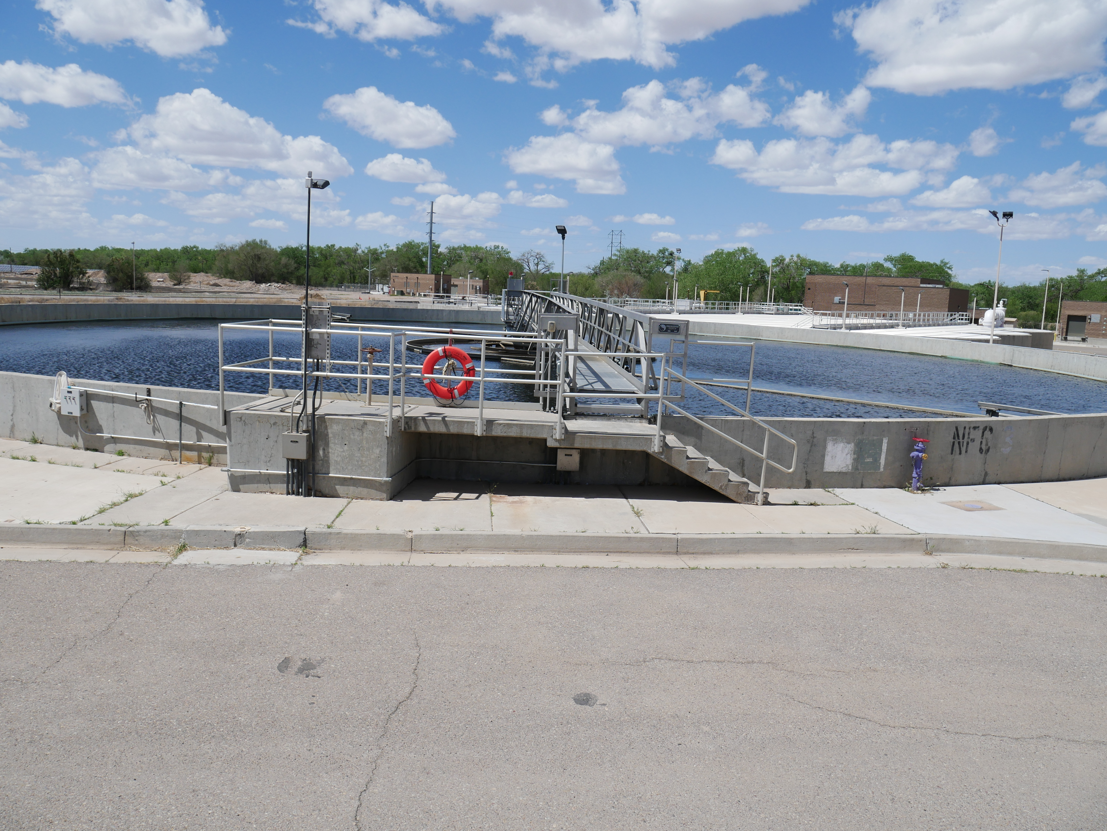
Primary Treatment
Primary clarification
  Removes 90-95% of settleable solids
  40-60% of suspended solids
  30-40% of BOD
Sludge removal
Notes:
Sedementation
The purpose of primary treatment is to removal material that will settle to the bottom or float to the top of WW when the flow is slowed down. This process also relies on specific gravity and allows the water that resides in the middle section of the WW to pass onto the next treatment process.
Sludge is typically send to the digesters for the first step of solids handling

Slide 35
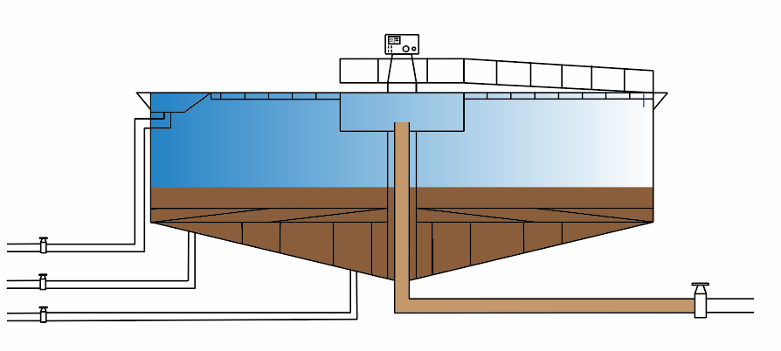
Primary Clarifier
Consists of a tank, scraper, drive unit, influent baffle, weir, and scum trey/trough
Primary sludge: 4-8% dry solids
Detention Time: 2-3 hours
Weir Overflow Rate: 10,000-20,000 gpd
Surface Loading Rate: 300-1,200 gpd/sq. ft
Notes:
Operators should understand how pumping occurs, how to alter pump piping to pump scum trays if necessary, and how to measure performance. This typically involves using a core measuring device to measure the depth of the sludge blanket with a core sampler also known as a sludge judge. For certification purposes the typical sludge blanket depth is 2-3 feet but this will vary from plant to plant. High detention times will result in sludge becoming septic due to a lack of oxygen. This interferes with solids handling since sludge will float and not settle properly and increase the difficulty of biological treatment.

Slide 36
Secondary Treatment
  Designed to remove BOD, NH3 and NO3
  Comes in many shapes and sizes
  Derived from naturally occurring microorganisms found in wastewater
  Can be fixed film or suspended growth
  Can require secondary clarification
Notes:
Biological treatment

Slide 37
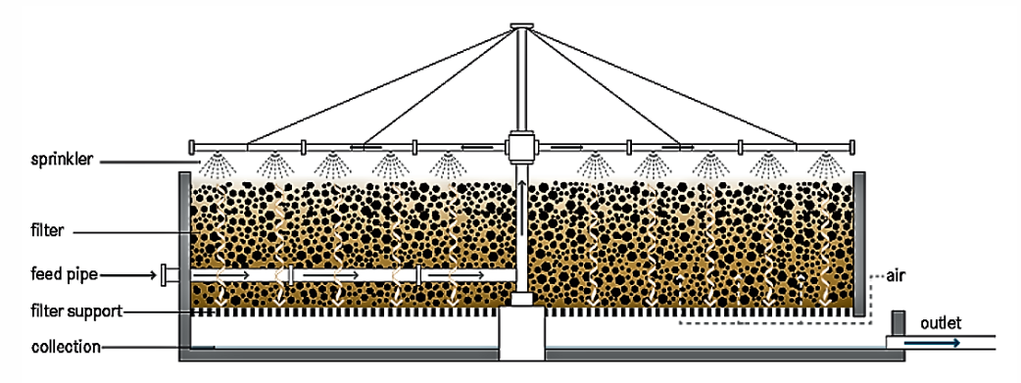
Trickling Filters
Similar structure to a clarifier filled with rocks.
Rocks covered in zoogleal film
Typical plant efficiency is 90% removal of BOD and suspended solids
Notes:
Constructed of specially designed media or rocks 2-4 inches in diameter.
Grow zoogleal film which mimics the natural environment
The distribution arm is controlled by how much flow is distributed by it
It is important to understand the design parameters, operation principles and troubleshooting for trickling filters. This includes Types of trickling filters and what they’re utilized for, recirculation and loading rates. Trickling filters can experience issues with ponding, odors, excessive sloughing, and filter flies.
Requires a secondary clarifier to handle regular sloughing.

Slide 38
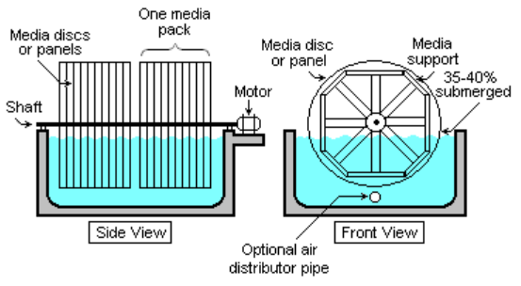
Rotating Biological Contactors (RBCs)
Same fixed-media concept as Trickling Filters
Cylinders made of plastic sheets that allow for media growth and air distribution
Rotates at 1.5 rpm and 40% of contactor is submerged
Notes:
Very similar to trickling filters by applying microorganisms typically found in WW.
These are rotates mechanically and wastewater is allow to collect in the contactor and trickle down through the media. The media is constructed of corrugated plastic sheets stacked over one another. They are cylinder shaped and typically 12 feet in diameter and 25 feet in length
It is important to understand the staging of RBCs, operation including seasonal adjustments and troubleshooting. Issues with RBCs can usually be identified through observation. The media may have a darkened appearance due to overloading or whitening may occur due to toxic shock

Slide 39
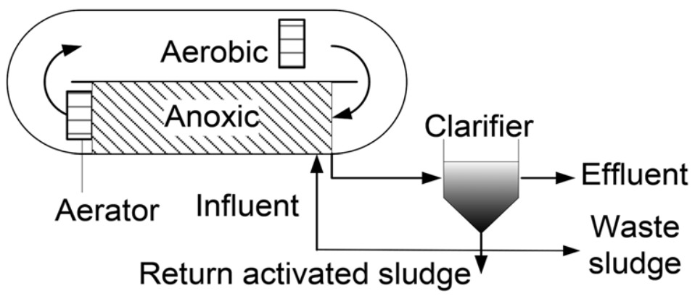
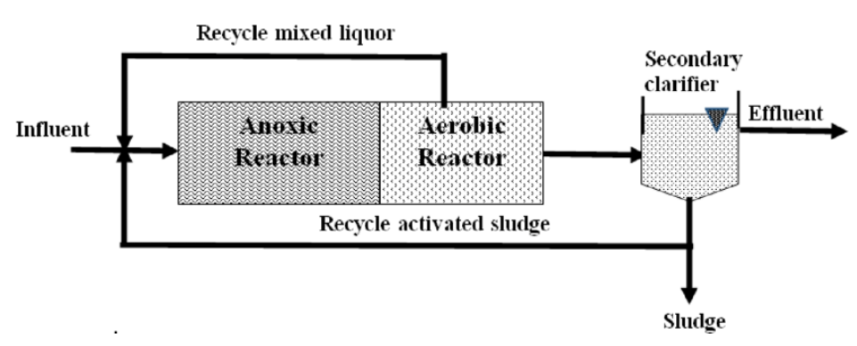
Activated Sludge
Notes:
Activated sludge is a suspended growth secondary treatment that in it’s most basic form is designed to remove dissolved organic and settleable and non-settleable solids.
Depending on the type of plant activated sludge can treat primary treated wastewater or direct raw wastewater
The combination of wastewater and microorganisms is called mixed liquor
Dissolved air must be used to provide complete waste stabilization and allow aerobic activity to function correctly
Reciruclation can be incorporated to also denitrify after the aerobic activity which results in nitrification
It is important to understand the ways to measure the time that microorganisms spend in the process, the ratio of food to microorganisms as well as operational characteristics such as DO levels, flow rate, and recirculation rate for activated sludge that passes to secondary clarification and for the mixed liquor in the basins and types of microorganisms in the flow and performing the process
This is an example of two activated sludge plants that utilize recirculation to effectively denitrify
The second diagram is a modified ludzak Ettinger process which I am most familiar with
Followed by secondary settling, which follows the same principles as primary clarification except this sludge contains useful microorganisms that can be recycled back to aeration basins where they are mixed with the incoming flow to keep up the nutrient removal processes. Some of the sludge is reused in the activated sludge process and some are wasted and combined with other solids that are disposed of from other processes.
The design parameters for secondary clarifiers can be similar to primary clarifiers, but usually vary slightly based on the process they follow

Slide 40
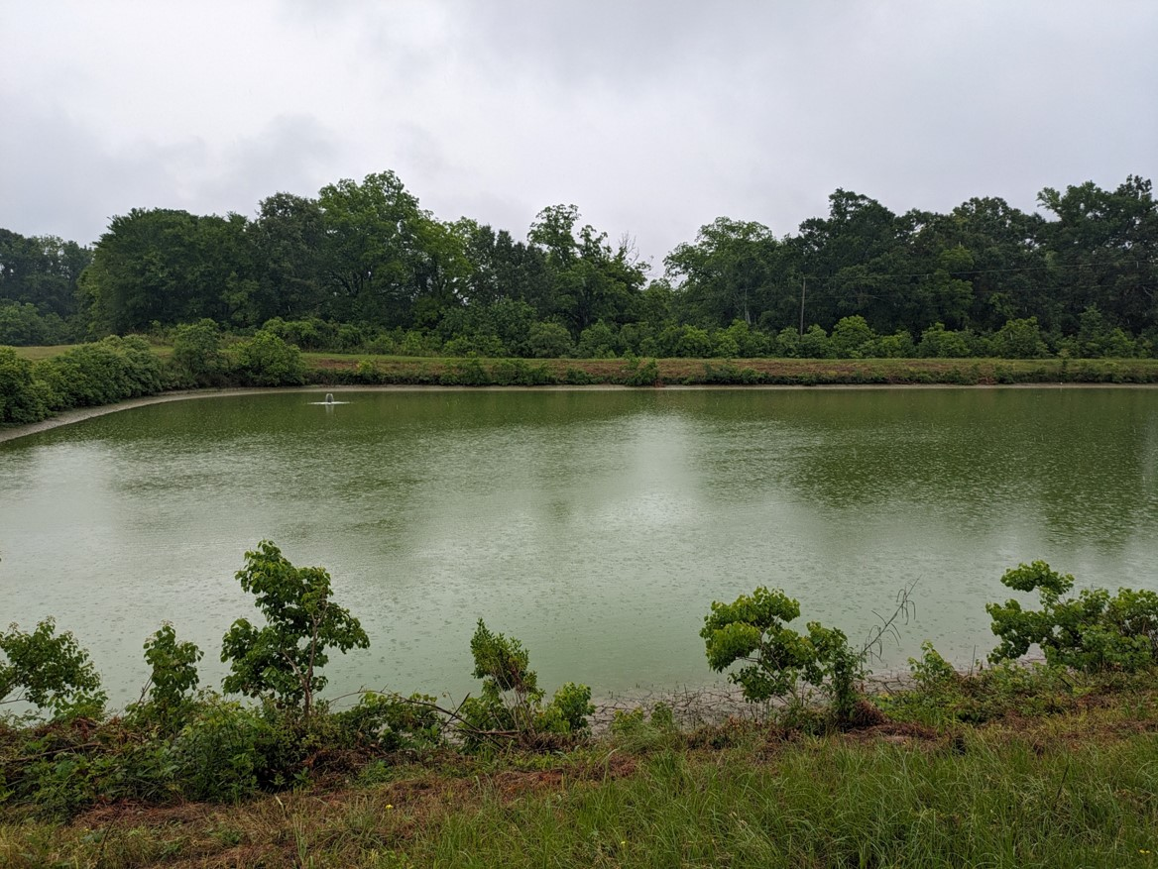
Wastewater Treatment Ponds
Combine sedimentation and biological treatment
Can be aerobic, anaerobic, or facultative
Can be mechanically aerated
Oxygen and pH should be monitored
Sludge, vegetation, liner and berms need to be maintained
Odors, nuisance animals, and land should be considered
Notes:
Wastewater treatment ponds are one of the earliest forms of wastewater treatment and are a well established method for treating wastewater since at least the 1800s.
Ponds or lagoons combine sedimentation and biological treatment to effectively treat wastewater.
Ponds are categorized by the type of microbes they utilize to treat wastewater.
This includes microbes that use oxygen, microbes that thrive in anerobic environments, or microbes that cycle between using free and bound oxygen.

Slide 41
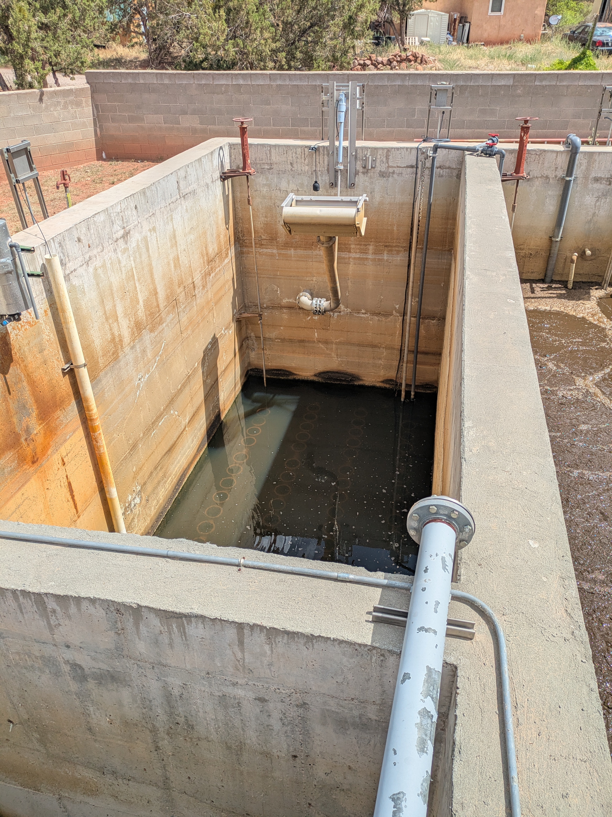
Package Plants
Combine WW treatment process into compact system
Useful for small applications
Can be premanufactured
Includes Sequencing Batch Reactors (SBRs) and other modified processes
Notes:
Like lagoons SBRs combine the treatment processes into one reactor tank.
They run on set sequence times to allow for processes like clarification, biological treatment and aeration, digestion, and decanting to allow clean water to

Slide 42
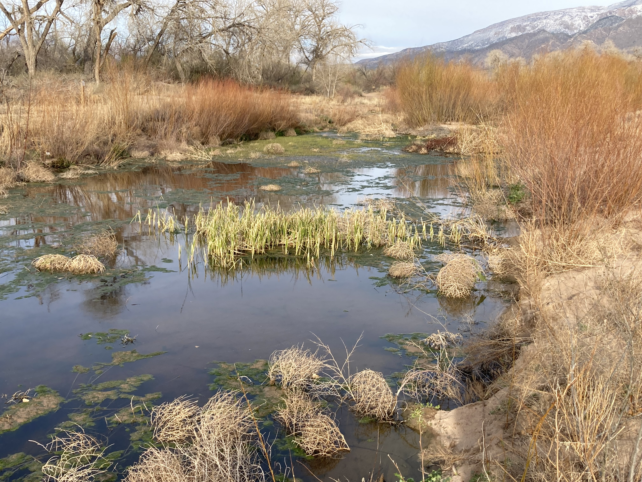
Tertiary Treatment
  Required for plants that have a higher effluent quality requirement
  Disinfection for removal of pathogens
  Specialized treatment to removal special contaminants such as mercury, microplastics, PPCPs, excess chlorine etc.
  Includes polishing ponds, constructed wetlands, advanced filtration, etc.
Notes:
Refers specifically to treatment that removes pollutants other than BOD and TSS.
These types of process typically refer to the removal of phosphorus and nitrogen if not removed through secondary treatment. A basic type of tertiary treatment is a constructed wetlands, which works like a trickling filter, but is more of a polishing process than a primary biological process. For certification exams I would recommend understanding the vegetation control of constructed wetlands
Disinfection is typically categorized separately, but is considered a type of tertiary treatment
Tertiary treatment can also be designed to target specific pollutants. Mercury is typically removed through precipitation by adding sulfide, alum, or other coagulant and adjusting the pH of the process.
Microplastics and pharmaceuticals and personal care products are a current area of concern due to their relatively recent emergence and still unknown environmental and public health impacts
These substances can be removed through advanced filtering techniques such as microfiltration, ultrafiltration, nanofiltration and reverse osmosis. These processes can be difficult to apply in wastewater due to there tendency for clogging or fouling and ongoing research to optimize them for wastewater

Slide 43
Disinfection
  Through chlorination, ozone or UV
  Prevents spread of water borne diseases
  Industry has been shifting from chlorination to UV to mitigate safety hazards

Slide 44
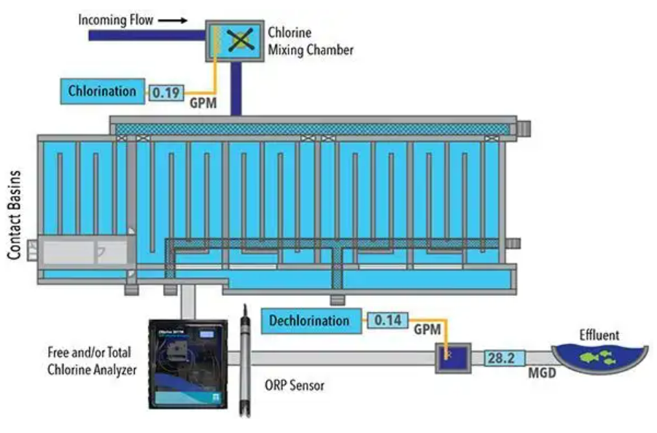
Chlorination
  Liquid, solid, and gas forms
  Requires chorine residual and occurrence of breakpoint chlorination
  Dechlorination must occur to prevent fish kills

Slide 45
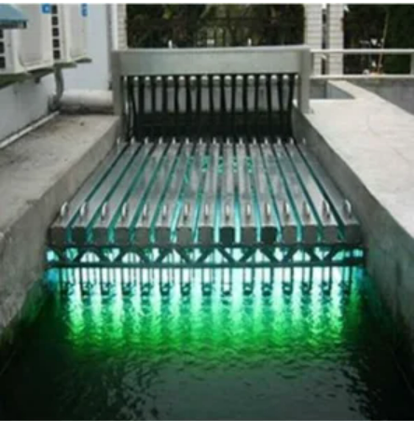
UV disinfection
  Safer than chlorination
  No residual required
  Less space intensive
  UV wavelength of 253nm disinfects bacteria
Notes:
Bacteria is sterilized and cannot reproduce and negatively impact the environment or public health.

Slide 46
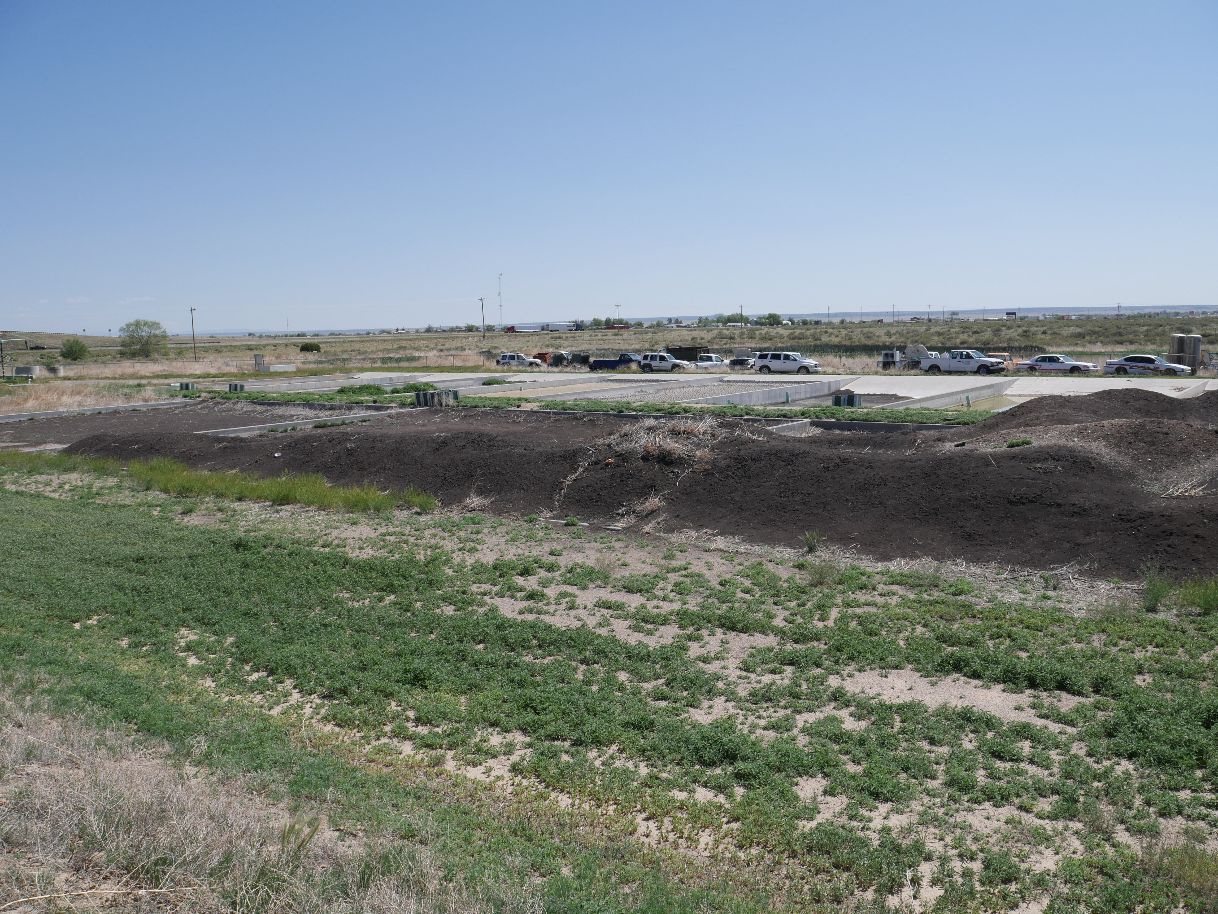
Solids Handling
  Pumped primary and secondary sludge must be disposed of properly
  Sludge disposal is regulated due to the presence of pathogens, heavy metals, etc.
  Water must be removed from sludge for transport
  Digestion used to stabilize solids
Notes:
Primary sludge is odorous and must be digested to prevent excessive odors. Secondary is dewatered and combined with the primary sludge to provide use microorganisms that increase digestion efficiency

Slide 47
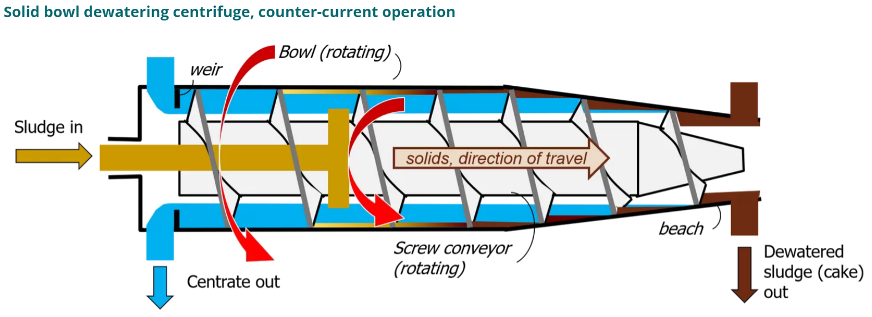
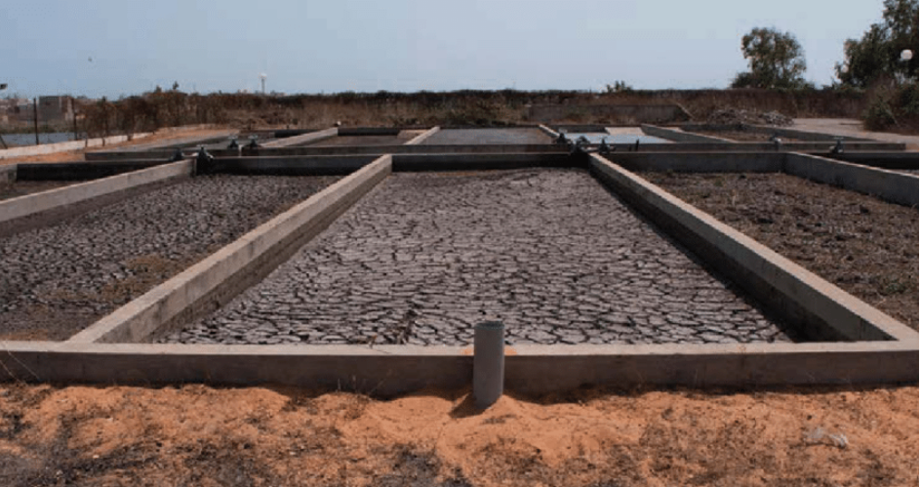
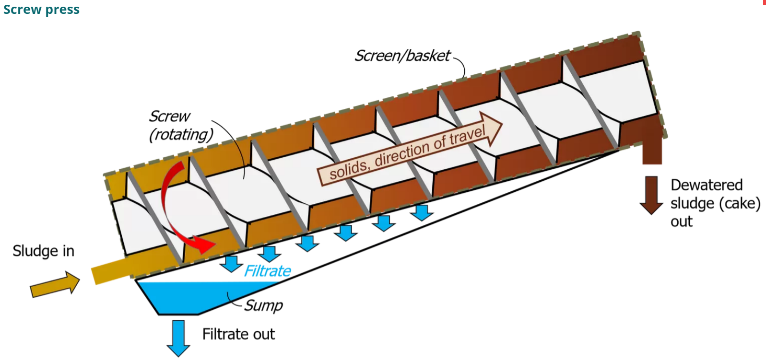
Solids Handling Technology
Notes:
Sludge drying beds, centrifuges, belt presses, and rotary drums

Slide 48
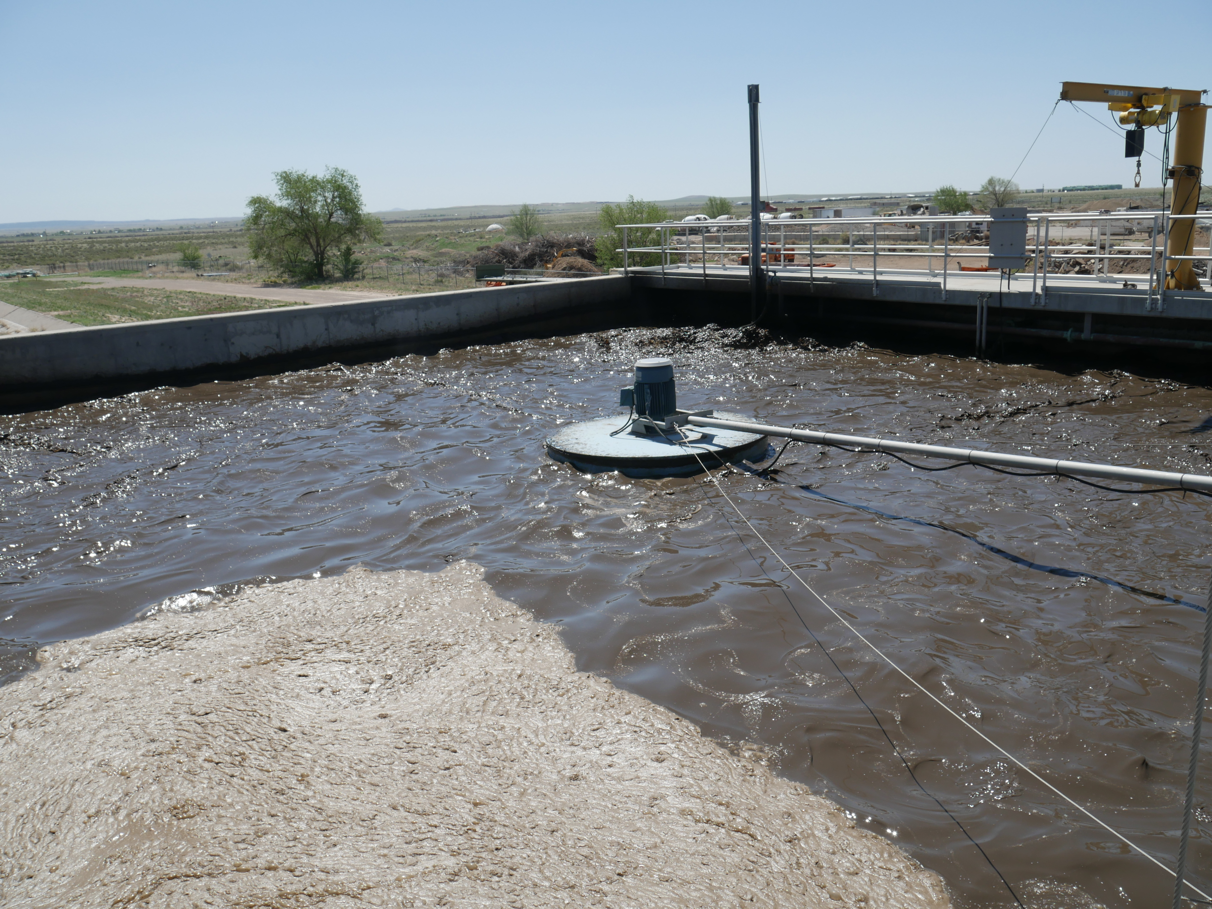
Digestion
Notes:
Digesters are used to stabilized sludge and remove pathogens.
Continuous mixing and temperature regulation allows biological activity to break down complex organics in sludge into simpler biological components.
This can be anaerobic or aerobic.
Anaerobic digesters produce methane gas, which can be reused as an alternative fuel source to power engines that produce electricity for the plant

Slide 49
Questions?

Slide 50

CONTACT INFORMATION
Department of Civil Engineering MSC01 1070
1 University of New Mexico
Albuquerque, NM 87131
505-277-0644
swefc@unm.edu
http://swefc.unm.edu
swefc@unm.edu

