Slide 1





US Territories Wastewater Operator Training Series
Session 1: Program Overview, Study Tips & Test Preparation
6/24/25
www.efcnetwork.org
This program is made possible under a cooperative agreement with US EPA.
Notes:
Welcome to all of our participants from CNMI and Guam (we’ll be having a couple of attendees from American Samoa as well in the later sessions.

Slide 2
The Training Program
Welcome & Overview
Notes:
Heather’s introduction

Slide 3

Your trainers for today:
A.J. Barney
Research Engineer
Valeria Cortes-Mora
Professional Intern

Slide 4
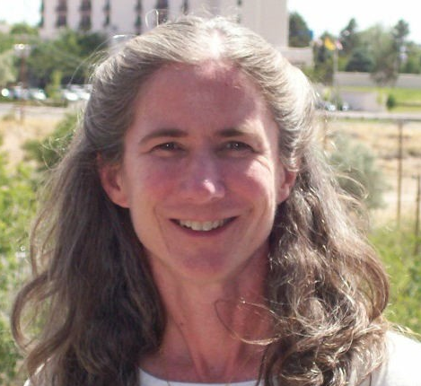
Your trainers for today:
A.J. Barney
Research Engineer
Heather Himmelberger
Director, SWEFC

Slide 5



This training series is funded by the EPA
Notes:
Heather introduction

Slide 6


Slide 7
WPI/ABC Operator Certification
Notes:
This series is designed to supplement and reinforce the ABC Need to Know Criteria for the Wastewater Operator level 1 and 2 exams though there will be some higher level topics covered, and we won’t always follow the exact order listed in the NTKs
https://www.gowpi.org/services/abc-testing/standardized-exams/standardized-wastewater-treatment-operator-exams/

Slide 8
Schedule for 2025:
Date | Topic
6/24/25 | Program Overview, Test Format, Study & Test Tips
7/8/25 | Treatment Overview - Reg history, overview
7/22/25 | WW Math Part 1 (Areas & Volumes)
8/5/25 | WW Math Part 2 (Flow Rates & Detention Times)
8/19/25 | Collection Systems - Gravity systems
9/2/25 | Collection Systems - Pumping & force mains
9/16/25 | Collection System Maintenance
9/30/25 | Operator Safety/OSHA/Chemical Safety & Inventory
10/14/25 | Preliminary Treatment
10/28/25 | Primary Treatment: Sedimentation
11/11/25 | Fixed-Film Media
12/2/25 | Activated Sludge Part 1
12/16/25 | Activated Sludge Part 2
Notes:
26 sessions total
1 hour each
This is the schedule for the remainder of this year,
The trainers will vary depending on the topic

Slide 9
Sign in for every session to ensure you get credit for attending
Notes:
Be sure to sign in if you are attending in a group. The facilitator at your location will forward these to us and we will keep track of your attendance hours for credits;
(Heather - add in anything else you want here. I start on the next slide)

Slide 10
Study Tips
Introduction
Notes:
James takes over here. Alright, let talk about some study and test tips
Tip one is:

Slide 11
Don’t Panic!
Notes:
Don’t panic if you’ve never taken the wastewater op cert test before, or if you have and didn’t pass.
Photo by Usman Yousaf on Unsplash

Slide 12
The operator tests cover knowledge you use (or could use) on the job.
Notes:
The operator tests cover knowledge you use or could use on the job. and I say "Could Use" because the test covers various wastewater treatment topics at different levels, but not all of that knowledge may be used in your day to day operations, but for the test at least you’ll need to know a broad range of treatment topics
Photo by Milad Fakurian on Unsplash

Slide 13
Certified Operator
“a certified operator is a person who is certified by a certifying agency or commission as being qualified to supervise or operate one of the classifications of water supply systems or wastewater facilities".
Notes:
“a certified operator is a person who is certified by a certifying agency or commission as being qualified to supervise or operate one of the classifications of water supply systems or wastewater facilities".
You're basically proving that you know how to do the job.

Slide 14

Operator Duties May Include
Inspecting equipment
Monitoring operating conditions, meters, and gauges
Collecting and testing water and sewage samples
Recording meter and gauge readings and operational data
Documenting and reporting test results to regulatory agencies
Operating equipment to purify and clarify water or to process or dispose of sewage
Cleaning and maintaining equipment, tanks, filter beds, and other work areas
Notes:
And that job consists of a lot of different activities, and requires knowedge about a variety of topics.
these are the kinds of things that the tests cover - your operator duties - things you do every day

Slide 15
Leverage your experience.
Notes:
So leverage your practical experience. By the time you take the exam you'll typically have been working in the field for a year. You can leverage your day to day experience on test day and for your studying
Photo by Milad Fakurian on Unsplash

Slide 16

Why study?
Notes:
Photo by Green Chameleon on Unsplash

Slide 17
To find out where your knowledge gaps are
Notes:
Well one reason is To find out where your knowledge gaps are

Slide 18

Basketball?
Notes:
I like metaphors so let’s think about the Op Cert Test as the big game day
Photo by Todd Greene on Unsplash

Slide 19
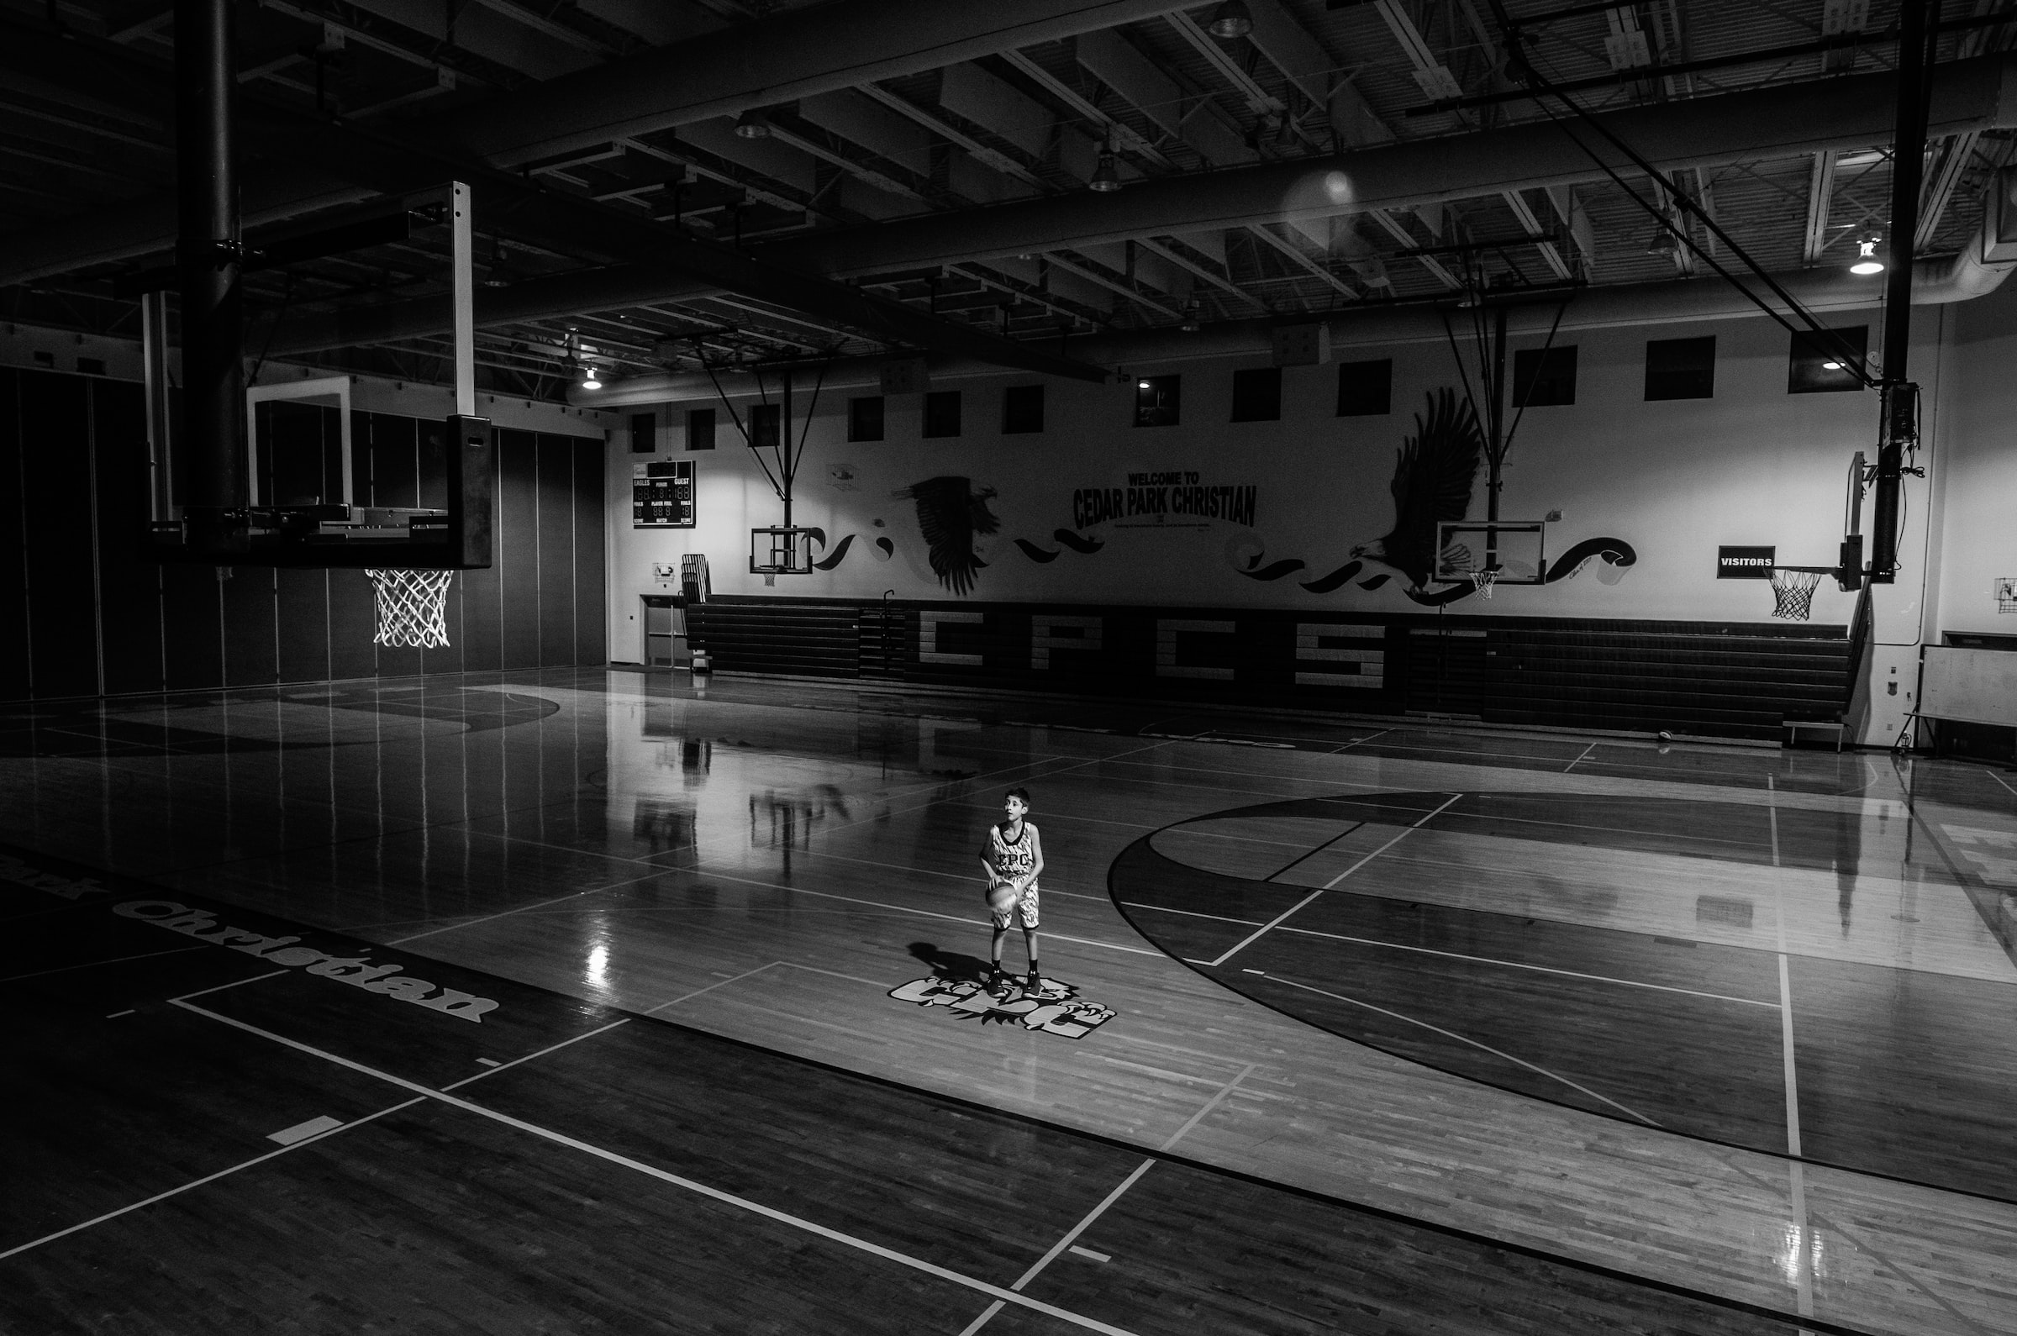
Study is practice
Notes:
So just like you shoot shots to develop the skills you study - you manuals, your problems, old tests. You do it different ways under different conditions and work hard at what you aren’t good at to get better
Photo by jesse orrico on Unsplash

Slide 20
People with better study methods and strategies score higher on exams
Notes:
People with better study methods and strategies score higher on exams
If the outcome isn’t what you’d like, then you probably need to change how you study!

Slide 21
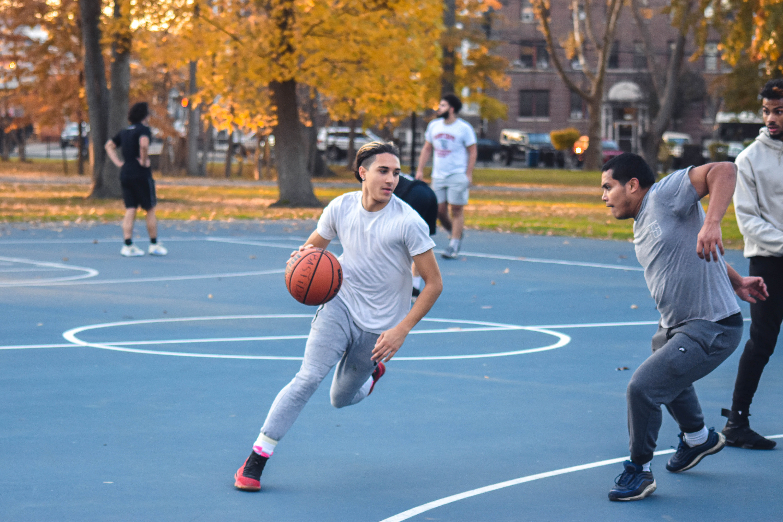
Pickup games are sample tests
Notes:
And then the team scrimmages or you play pick up games – that’s like the practice tests – it’s like the game but without the big consequences
It’s game conditions, but not the big game
It shows you what you’re good at and what still needs work
If you keep getting stripped you need to work on ball handling.
Photo by Kenny Eliason on Unsplash

Slide 22
Test areas you have trouble with may point to gaps in your practical knowledge
Notes:
Test areas you have trouble with may point to gaps in your practical knowledge
Photo by Milad Fakurian on Unsplash

Slide 23
Use that information to fill the gaps by rounding out your skill sets.
Notes:
Use that information to round out your skill sets.
By that I mean, areas you don’t do well on in the test might just be areas that you don’t have much practical experience with. It gives you a direction to follow when developing your study plan test plan and career
Photo by Milad Fakurian on Unsplash

Slide 24
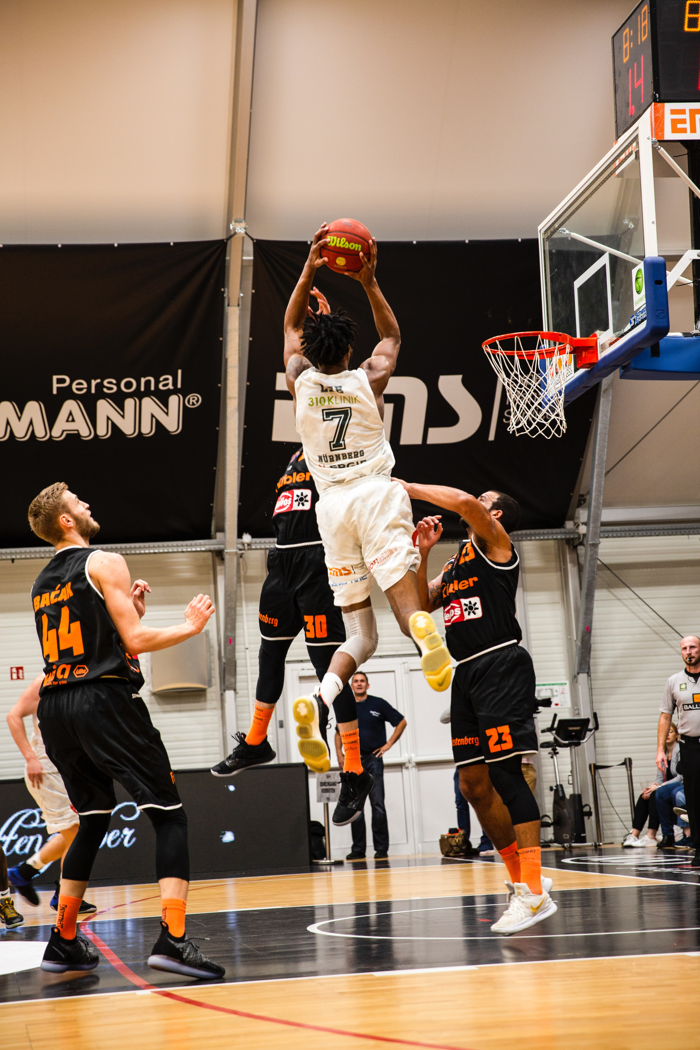
The OPCert Test is Game Day
Notes:
You wouldn’t expect to win a big game without ever practicing – at least not realistically

Slide 25
If your test outcome isn’t what you wanted, change how you study!
Notes:
People with better study methods and strategies score higher on exams
If the outcome isn’t what you’d like, then you probably need to change how you study!

Slide 26
Study Tips:
How to run good Practice

Slide 27
Make a study plan
Notes:
Make a study Plan – how you’re going to get from today, to passing the test.
do a self assessment and build a plan around that. and expect it to change over time.
When you can consistently make the hook shot you don't have to focus on it quite as hard. You still have to practice, but not at the same level as something you aren't as good at
PhoPhoto by Green Chameleon on Unsplash

Slide 28
Manage your time
Notes:
Set aside a reasonable amount of time for study so that you aren’t trying to cram everything in at the last minute – it’s a lot of material, you don’t want to be trying to learn it all the night before the exam. That rarely works out well.

Slide 29
Start studying early
Notes:
Start studying early – well before the exam date. If the exam is on the 30th you don’t want to start the weekend before. This is really just another way of saying manage your time (which is what we started this sequence with)
Think about where you are, and where you need to be on test day. and revaluate periodically - look at your progress and see whether you are on track to pass the test when you have planned to take it.
Photo by Towfiqu barbhuiya on Unsplash

Slide 30
Nail down the fundamentals
Notes:
Make a study Plan – how you’re going to get from today, to passing the test.
Remember you don't need a perfect game - you have to get 70 out of 100 right. That's all.
PhoPhoto by Green Chameleon on Unsplash

Slide 31
Build on your practical knowledge
Notes:
build on your practica;l knowledge - You have the Need to know list - what parts are you comfortable with that only need review - what is new material, or somthinh you have difficulty with
PhoPhoto by Green Chameleon on Unsplash

Slide 32
Work harder on weak spots
Notes:
Work harder on the weak spots. It’s great if you can always hit the free throw, but that’s not the only shot you’re gonna have to make
PhoPhoto by Green Chameleon on Unsplash

Slide 33
Ask questions. Learn on the job, from coworkers.
Notes:
leverage your study and practical work and knowledge your coworkers have
As you learn new things on the job, ask questions. Explain processes to each other. If you can explaing it -you understand it.
Lean on your buddies or co-workers.
Photo by Kate Trysh on Unsplash

Slide 34
Read training handouts and manuals
Notes:
Read available training materials, study guides and handouts.
Photo by Natalie Grainger on Unsplash

Slide 35
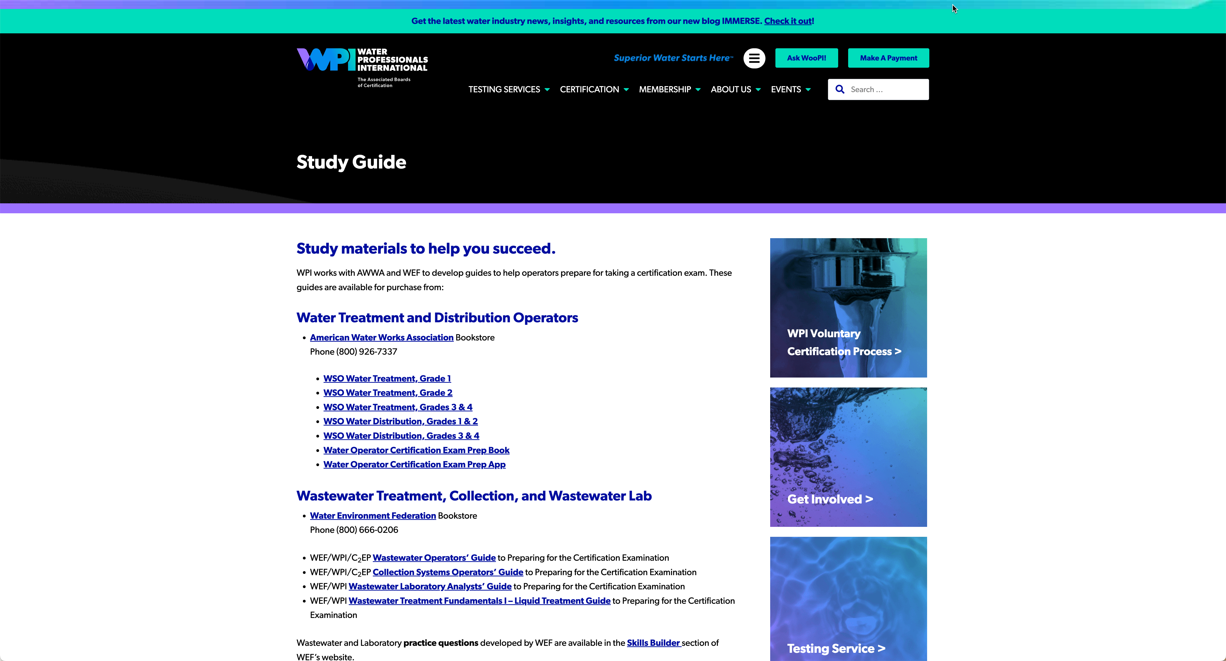
WPI/ABC Website: gowpi.org
Notes:
Get familiar with the WPI/ABC Website

Slide 36
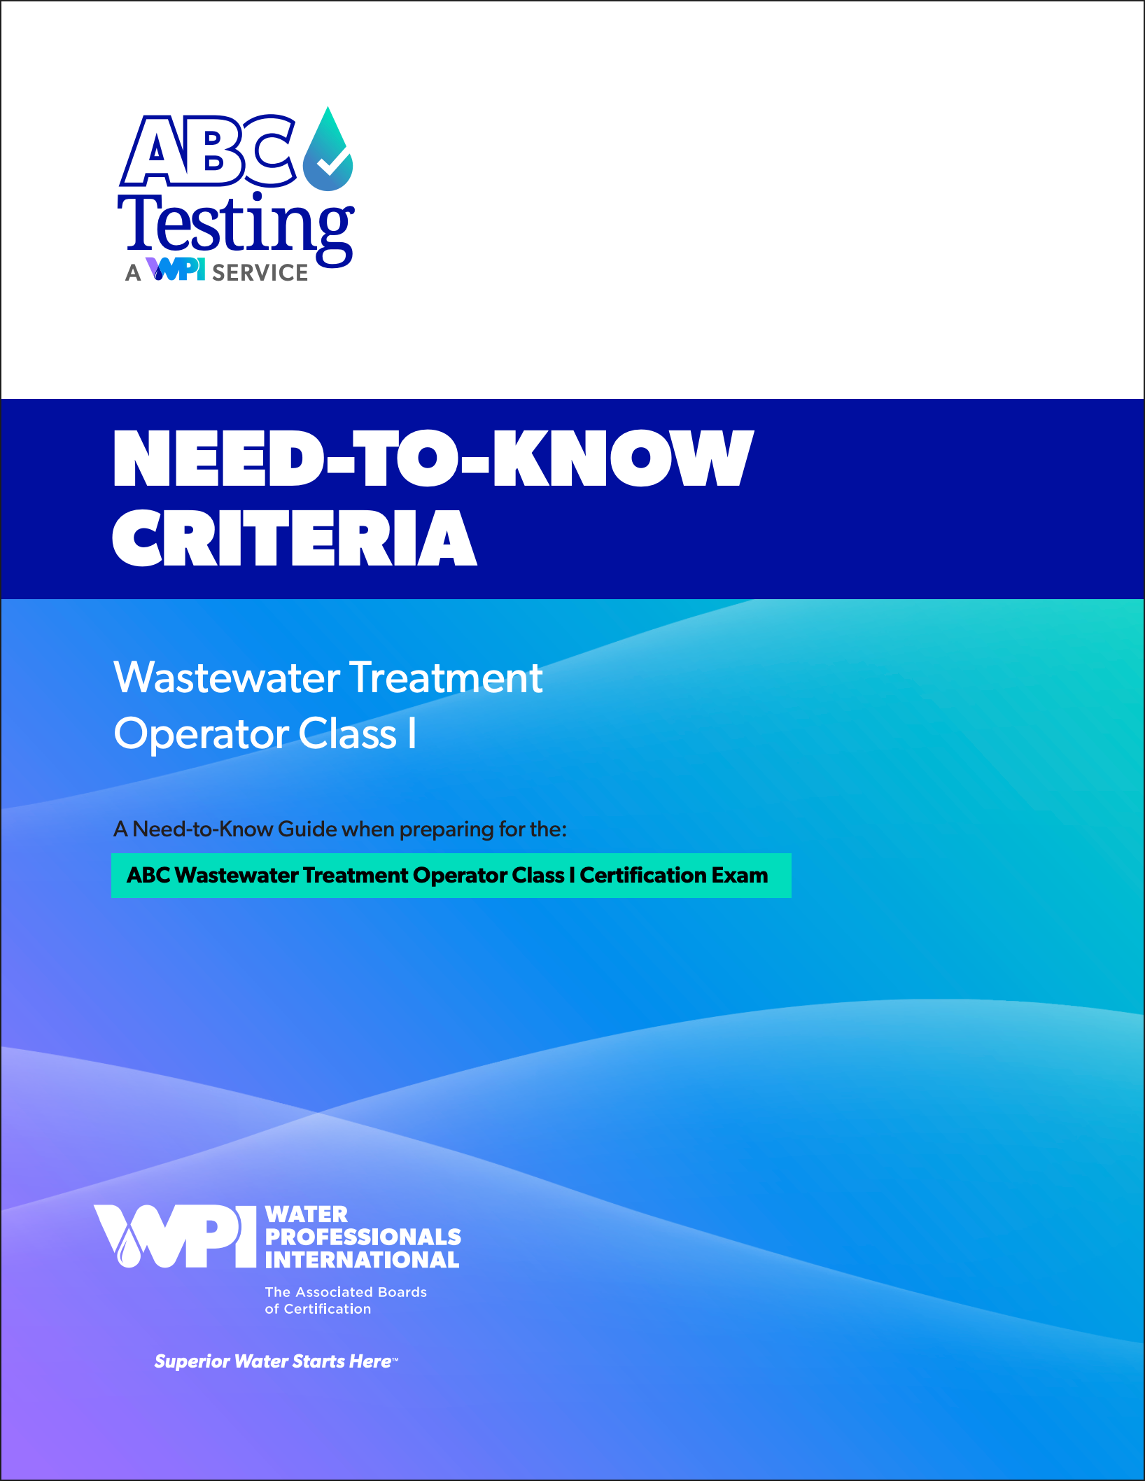

Need to Know Criteria
Notes:
This series is designed to supplement and reinforce the ABC Need to Know Criteria for the Wastewater Operator level 1 and 2 exams though there will be some higher level topics covered, and we won’t always follow the exact order listed in the NTKs
Please be aware that these training sessions are not your only training resource and attending these sessions alone will not get you through the test.
You will need to study your training materials outside of this webinar series and be able to apply the on-the-job training you receive as apprentices or trainee operators to pass the exam.
These documents are freely available on the ABC website, and we’ll be providing digital copies to you as well.

Slide 37

Need to Knows
Topic | WW Level 1 | WW Level 2 | WW Level 3 | WW Level 4
Security, Safety, & Administrative Procedures | 10% | 10% | 10% | 10%
Equipment Evaluation and Maintenance | 25% | 20% | 20% | 15%
Equipment Operation | 25% | 20% | 20% | 15%
Treatment Process Monitoring, Evaluation, & Adjustment | 30% | 30% | 30% | 35%
Laboratory Analysis | 10% | 15% | 15% | 20%
Total | 100% | 100% | 100% | 100%
For a complete list of each certification level:
https://www.gowpi.org/services/testing-services/
Notes:
The breakdown of topics varies a bit by certification level,particularly in the middle categories

Slide 38
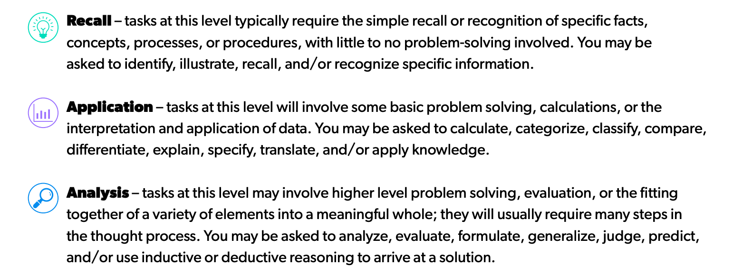
Question Formats
Notes:
Just as wastewater treatment operator job duties vary in their complexity, so will the questions you are asked on the exam. Some will be more simple and routine, whereas others will be more complex, or cognitively demanding. The following three levels are used to describe the complexity of the questions you will encounteron the exam:

Slide 39
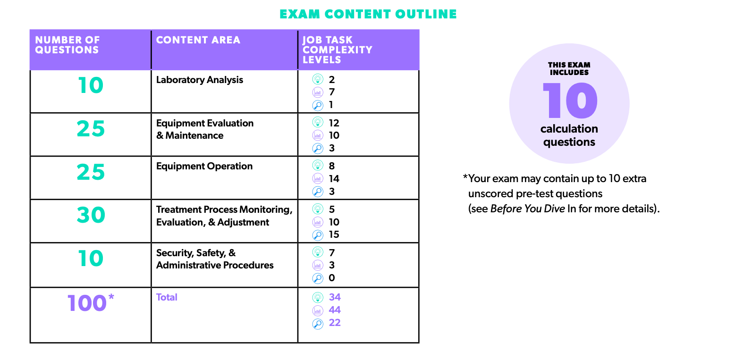
Wastewater Level 1:
Notes:
34 questions that are basic recall type questions
44 that are application questions
And 22 Analysis questions
Buried in there are 10 questions that require calculations

Slide 40
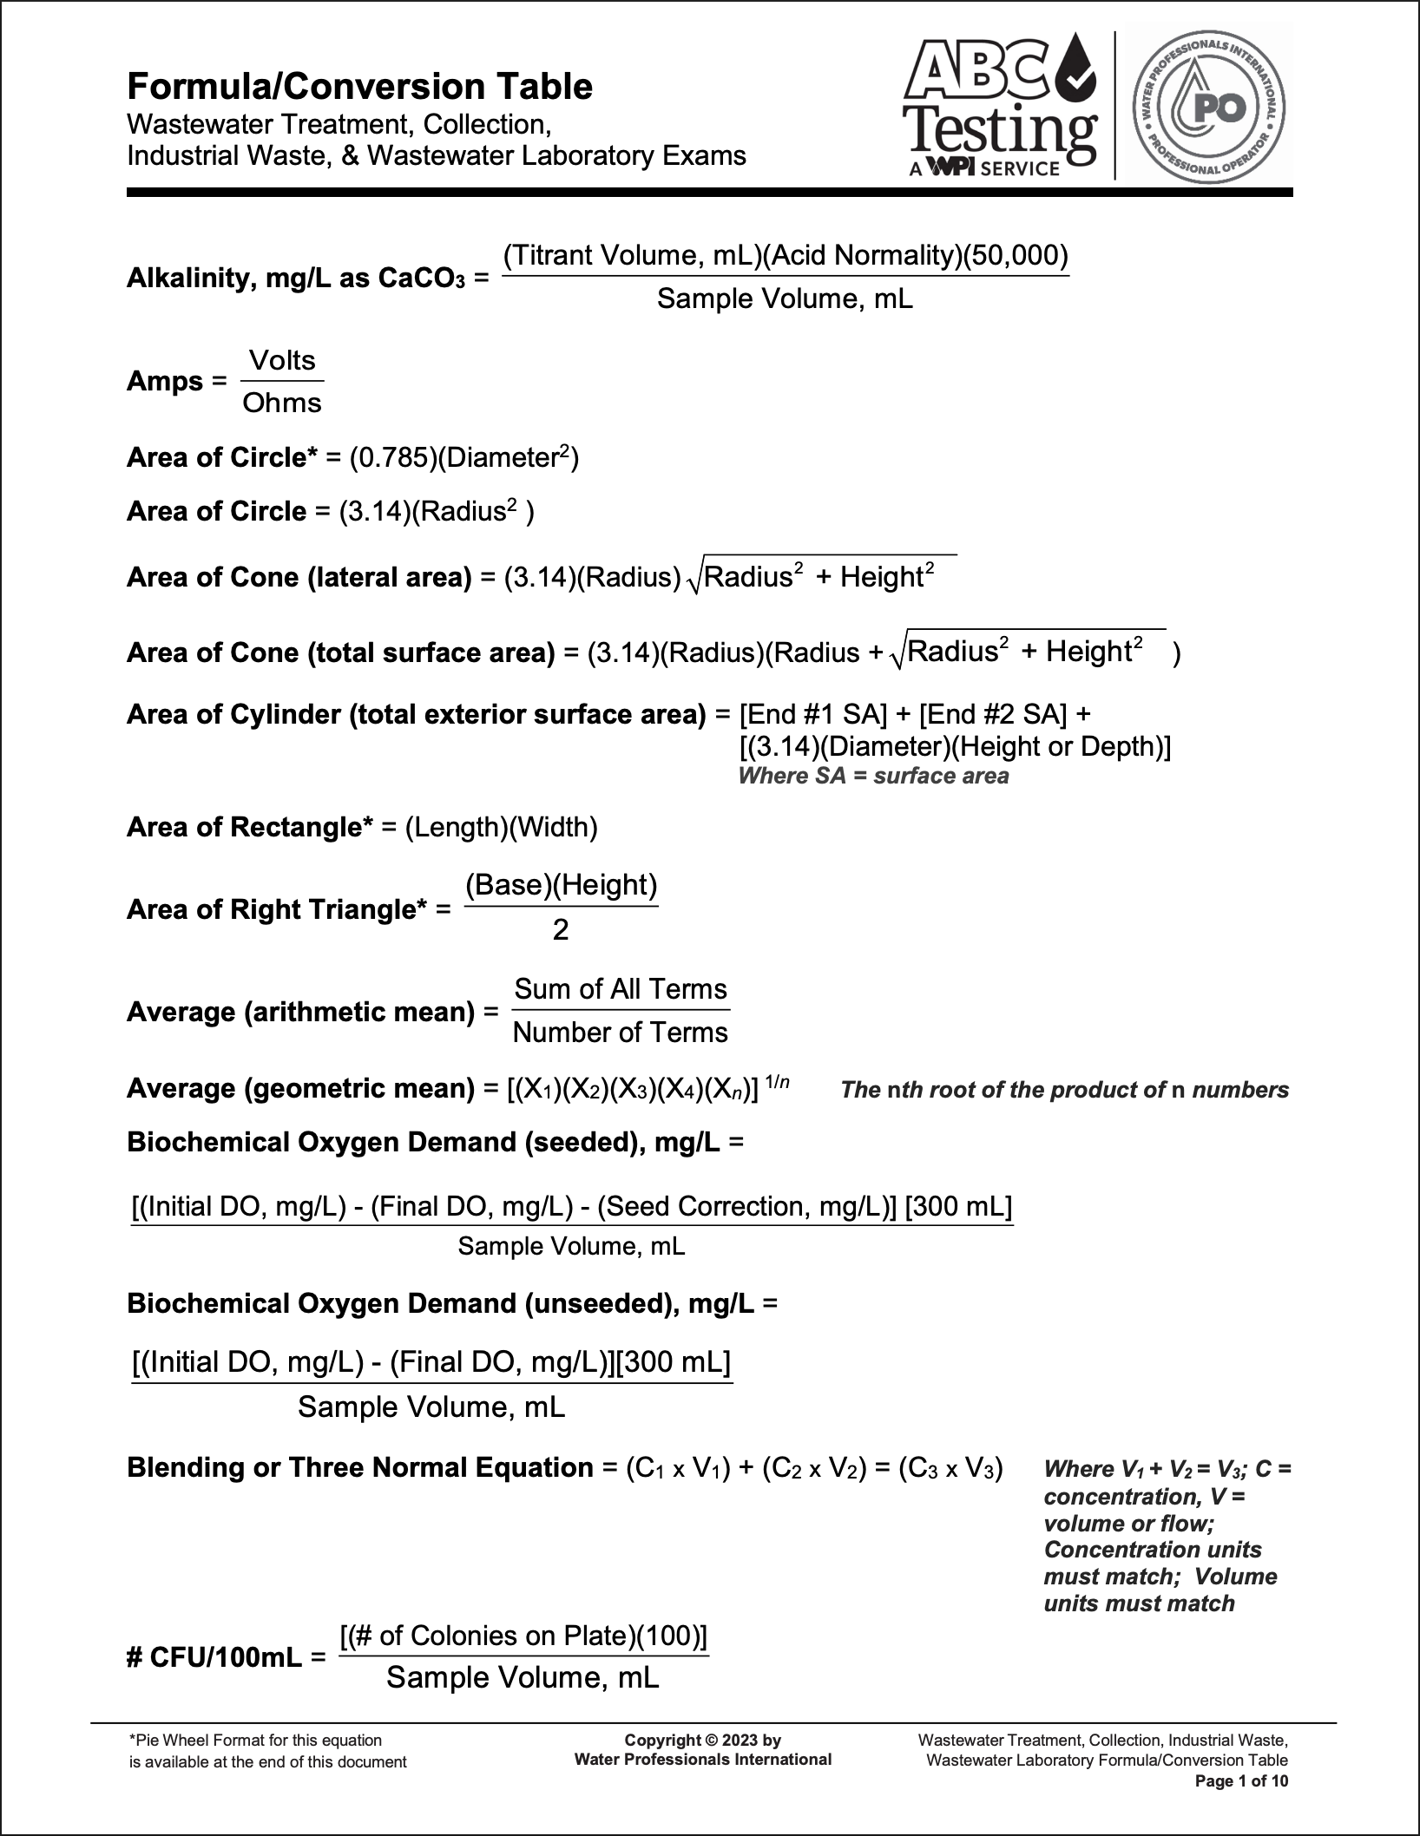
There will be math.
Learn the formula sheet
Notes:
Though there are only 10 math questions on the exam, but you don’t want to lose those points because you cant find the right formula, or don’t know how to apply it, and knowing the relationships can help you with the recall and analysis questions as well

Slide 41
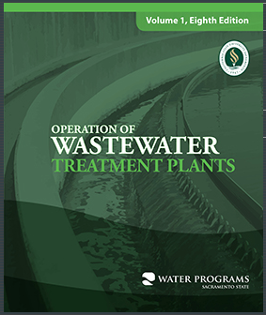
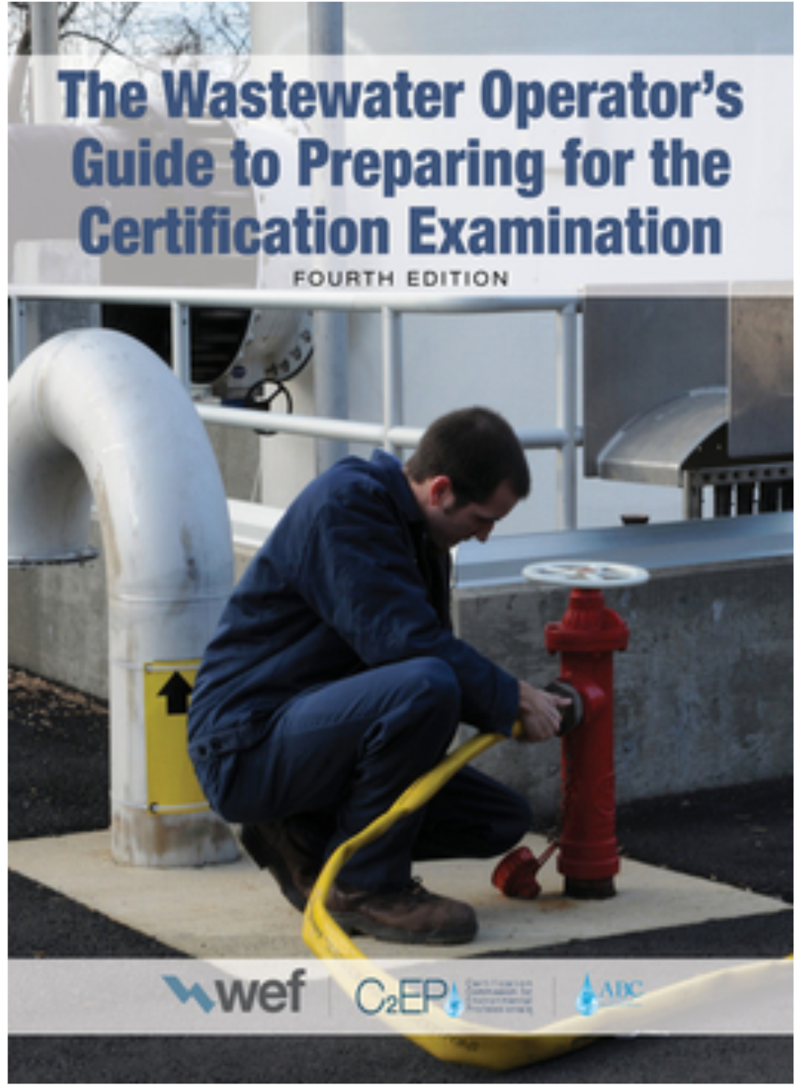
Study Guides
https://www.owp.csus.edu/
https://connect.wef.org/
Notes:
The study guide on the left is available from Sacramento State University for $90
There’s also a volume 2 focused on WWTP management

Slide 42
Other Study Guides and State State Websites can be useful
California State University, Sacramento
Association of Boards of Certification (ABC)
  Examination Study Resources
  Need to Know Criteria
  Formula Conversion Table
  Treatment Plant Operator (TPO) magazine
Water Environment Federation (WEF)
  Technical Resources
American Water Works Association (AWWA)
  Math
  WW operator certification
Notes:
There can be other resources besides official “Study Guides”

Slide 43
For Example:
The “Red Book”: https://apps.ecology.wa.gov/publications/SummaryPages/0410020.html
Notes:
For example, Washington State has its ”Redbook” Study guide available online for free

Slide 44
Take good notes for study and reference
Notes:
Use the need to know guide as a way of keeping track of what you're comfortable with and what you arent
Photo by Glenn Carstens-Peters on Unsplash

Slide 45
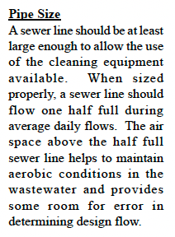


Review for facts and figures
Question: How full should a sewer line flow if it is sized properly?
Answer: half full during average daily flows
Question: What does the airspace in the sewer do?
Answer: Helps maintain aerobic conditions and provides room for error in design flow.
Notes:
There is a lot of information in here. This is one paragraph about pipe size. There are at least 3 questions embedded in here. You can turn these statements into questions

Slide 46
Draw sketches
if they help
Notes:
Draw if it helps = some people are visual – I am. The drawing and the formula can really help you see what you’re after -
I’m a terrible artist – as you can see – but drawing the problem can really be a useful way of making sure you understand what's being asked.
Image by J Markham, SW EFC

Slide 47

Memorization
Dos and Don’ts
Notes:
This is kind of tricky – there are some things you can and maybe should memorize – both for the test and work like – formulas you’ll use all the time for example – volume of a cube is Lxwxh
What you don’t want to memorize is that there was a volume question on the sample test, or last time I took it and the answer was a million gallons
Don’t memorize the answers to individual math problems – but remember the process.
Or you might have to memorize material in areas that you aren’t familiar with though your work experience like maybe what section a specific regs are in
There are a lot of processes you have to know but those are going to be processes you use in your day to day work
If you know the formula you don’t have to look it up.
If you remember that there are 7.481 gallons in a cubic foot of water, that's one less thing you have to look up and might help you rule out some obviously wrong answers
Photo by Milad Fakurian on Unsplash

Slide 48

Test yourself – or have someone test you
Notes:
I had to retake a college math class because I walked into the final with a B+ and walked out with an F because I bombed the final.
I hadn’t been taking practice tests, and I could solve a lot of the homework problems but I couldn’t solve them fast enough and I panicked
Photo by Nguyen Dang Hoang Nhu on Unsplash

Slide 49

Index (Flash) Cards
Notes:
Index cards can be your best friend for memorizing stuff
And a great way to test yourself or have someone test you. They don’t even need to know the topic to ask you questions
I make my notes on cards so that I effectively create my own. exam questions as I learn the material
Mix up the order every time.
Set aside the ones you get right consistently – don’t stop reviewing them, but focus on what you are having trouble with.
Also, don’t throw them away when you pass the test. You may want to get a higher level later on. You’re still responsible for the lower level knowledge.
You can also loan them to your buddies or new co-workers to make the process easier for the staff coming up behind you.
Photo by Kate Trysh on Unsplash

Slide 50
Study with a partner if it helps
Notes:
Partner study can be really helpful – helps with accountability – so you actually study during the time you’ve set aside and also it gives you someone to bounce stuff off of
I usually find that if I can’t explain something to someone else, I don’t really understand it.
Photo by Alissa De Leva on Unsplash

Slide 51
Test Tips:
What to do on Game Day
Notes:
Photo by Kenny Eliason on Unsplash

Slide 52
Know Your Testing Format
Different jurisdictions use different formats

Slide 53
Notes:
WPI has three different ways that tests are given, but the choice of format is usually up to the jurisdiction you are testing for – find out how you will be tested.
For example, here in NM where we are the tests are all computer based and if it’s your first time taking a test that way, the format can be intimidating
Its not cheap either - its $110 to take the exam in Guam with the Guam EPA .
But, part of your strategy might be to schedule a “test exam” for yourself in order to familiarize yourself with the process, and the interface
Kind of like a pre-season game.
If you can and you’ve been studying you might pass just because there’s less pressure on you./

Slide 54
Reference Guides
Know your test tools

Slide 55
Reference Guides
Notes:
There are only about a dozen questions that require calculation but you don't want to loose points becuase you cant find the right formula, or don't know how to correctly apply it.

Slide 56

Monitor your time during the test
Notes:
Wear a watch or keep an eye on the test timer.
Photo by Tsvetoslav Hristov on Unsplash

Slide 57
Time for test:
3 hrs
Notes:
You’ve got 100 questions and four hours to answer at least 70 right.
240 minutes (Click)

Slide 58
Time per question:
1:48
Notes:
You’ve got 100 questions and four hours to answer at least 70 right.
180 minutes – that’s an oaverage of only 1 minute and 48 seconds per question – it’s not a lot of time so you don’t want to burn time struggling on a question you don’t know the answer to and miss one you do because you ran out of time.
You’ve got 100 questions and 3 hours to answer at least 70 right
Even if you only answer 70 (and I don’t recommend that as a strategy) that’s only a bit over 2 and a half minutes –
My point is it’s not a lot of time and you want to get as many right as possible The questions are designed to be answered quickly.
The calcuations are typically basic – but the answers are sometimes designed to trip you up.

Slide 59
If you get stuck,
don’t kill too much time.
Circle the question and come back to it later.
Notes:
So, get used to working efficiently - and if you can't answer something - move on and come back later
Again, you only have to pass – you don’t have to get 100. Don't kill a bunch of time on a question you can't answer.
It’s ok to circle through the exam skipping over questions you don’t know off the top of your head and answering the easy ones first.

Slide 60
Don’t fight the premise
Notes:
In other words – don’t try to outthink the test. Answer the question they asked, not what you think it should be
Photo by Johann Walter Bantz on Unsplash

Slide 61
Funny answers are usually wrong
Notes:
Funny answers are usually wrong - if the answer has you cracking up – it’s probably not right – it might, be, but probably isn’t

Slide 62

The best way for a manager to transmit information that is important to all employees is:
      Tell your mom
      Send a memorandum
      Have a face-to-face meeting
      Put a notice on the plant’s website
Notes:
So first off – why don’t I have the answers showing?
Read the question first to make sure you under stand what they're asking for – if you know the answer (or think you do) see if it’s on the list – looking at the answers first might confuse you. And you can already start to think about the set up here
(CLICK)
Telling your mom is funny, but kind of a silly answer, even if your mom is the town gossip - which mine definitely was, its unlikely to be the correct answer. if you can eliminate 1 of ffour answers, even if you guess you have a better chance of getting it right 33% vs 25%

Slide 63
Eliminate answers with knowledge and common sense
Notes:
Photo by jose aljovin on Unsplash

Slide 64
A chlorine cylinder is thought to be leaking. If aqueous ammonia vapor is passed over the valve, the presence of a leak would cause what?
      A loud noise
      An odor of hydrogen sulfide
      Red smoke
      White smoke
Notes:
Again – why don’t I have the answers showing?
Read the question first – if you know the answer (or think you do) see if it’s on the list – looking at the answers first might confuse you. And you can already start to think about the set up here.
(CLICK)
Leaking chlorine gas. – what do you know about that? – it’s a disinfectant right, but it’s also? Poison. Its what they used in trench warfare to kill each other in WWI.
Ok so what are the answer options – (don’t call it out if you know it)
Alright, lets apply some knowledge and common sense to these answers
What causes loud noises? Explosions – so that woud be suggesting you do something that could cause an explosion – possibly in a confined space. Doesn’t make any sense. Cross that off. Literally, cross it out, because you may end up coming back and you don’t want to do the same work twice.
B – an odor – do you want to be smelling chlorine? Would you ever put yourself in a position to smell chlorine gas? No – it’s poison. Its what they used in trench warfare to killeach other in WWI. You would be wearing PPE while doing this so there’s no way you could smell it.
So that leaves us with 2 options red and white smoke – those are both visual, theres no implication you have to smell or hear – it’s probably one of these
At this point even if you cant remember you’ve already made this a 50/50 chance. instead of a 25% onme
Which is it?

Slide 65
Leverage your work experience
Notes:
Photo by jose aljovin on Unsplash

Slide 66
What units are used to measure settleable solids?
      mg/l
      ml/g
      ml/l
      L/g
Notes:
Read the question first – so what does that tell you its asking about -“settleable” means it’s not settled yet – in other words its still in whatever it is (a solid) is going to settle out of something else – what? – the liquid.
Where would this get measured? Clarifier maybe ? And what’s in there? Small amount of solids in a lot of liquid.
So how would you measure solids? Probably mass right – and what’s left in the tank once the solids are settled? Liquid.
So we’re looking for something that’s mass over volume
Ok so what are the answer options – (don’t call it out if you know it)
Alright, lets apply some knowledge and common sense to these answers
A – that’s a small mass divided by a volume – that looks good, but it might not the the right one so keep looking
B - that’s volume divided by mass (backward)
C - that’s small volume divided by large volume (nope)
D – volume divided by mass (same as B with different units)
Gotta be A

Slide 67
“Not” Questions
Reframe them if it makes them easier to answer.

Slide 68
Which of the following is not a measure of volume?
      Cubic ft (ft³)
      Cubic meters (m³)
      Gallons (gals)
      Square inches (in²)
Notes:
Reading the question without looking at the answer:
So what do we know from the question? Were working with Chlorine (CL2) and water which is? (Open question) H2O. So I know my answer probably only has these elements in it. They said chlorine, not __________.
So I have two CLs, 2 Hs and one O in my answer,

Slide 69
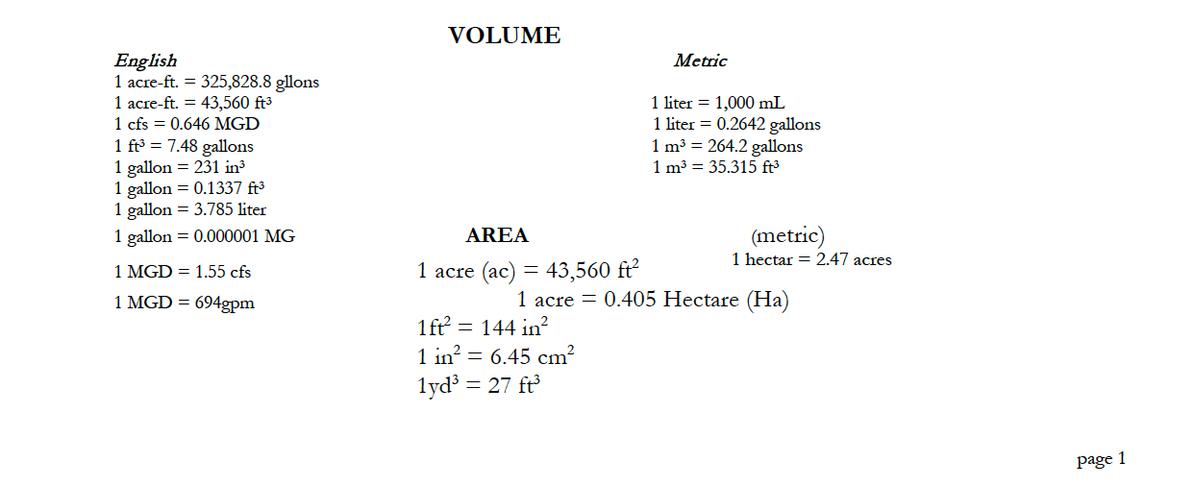
Which of the following is not a measure of volume?
      Cubic ft (ft³)
      Cubic meters (m³)
      Gallons (gals)
      Square inches (in²)
Notes:
Reading the question without looking at the answer:
So what do we know from the question? Were working with Chlorine (CL2) and water which is? (Open question) H2O. So I know my answer probably only has these elements in it. They said chlorine, not __________.
So I have two CLs, 2 Hs and one O in my answer,

Slide 70
Sketch the problem. Visuals can help you
Notes:
Photo by Kelly Sikkema on Unsplash

Slide 71
Which of the following is not a measure of volume?
      Cubic ft (ft³)
      Cubic meters (m³)
      Gallons (gals)
      Square inches (in²)
Height
Width
Length
Length x width x height = units cubed (for example ft³)
Notes:
Reading the question without looking at the answer:
So what do we know from the question? Were looking for volumes
Well a tank has volume – so draw one. It’s got length width and height.
And the formula is LxWxH so it’s goonna be something cubed. What units are irrelevant
Units are irrelevant
I can pour gallons into a box right?

Slide 72
In Summary…
Notes:
We want you to succeed with your training, your testing and your career. Wastewater and Water Operators keep us safe. Wastewater treatment and clean water are crucial for our communities.
So dig in!
Photo by Kelly Sikkema on Unsplash

Slide 73
Have a study plan
Manage your time
Read training handouts and manuals
Take good notes at training and during study to reference later
Draw sketches of problems – visuals can help
Notes:
Photo by Mira Kireeva on Unsplash

Slide 74
Test yourself – or have someone test you to find your strengths and weaknesses
Focus on the weak points
Memorize what you need to
Study with a partner – if it helps
Start studying early – well before exam date
Notes:
Photo by Mira Kireeva on Unsplash

Slide 75
Reciprocity
If certified in one jurisdiction you may be able to get certification without testing. For example, Washington State has full reciprocity agreements with:
    Alabama,
    Alaska,
    Arizona,
    Georgia,
    Guam,
    Hawaii,
    Idaho,
    Iowa,
    Inter-Tribal Council of Arizona,
    Massachusetts, Ohio, and
    Wyoming
And conditional reciprocity with Oregon, Nevada, Colorado, Utah and New York
Notes:
If certified in one jurisdiction you may be able to get certification without testing. For example, Washington State has reciprocity agreements with:
Alabama,
Alaska,
Arizona,
Georgia,
Guam,
Hawaii,
Idaho,
Iowa,
Inter-Tribal Council of Arizona,
Massachusetts, Ohio, and
Wyoming
Typically you have to have a score that would pass in the state you are applying to, must be current in your certification and have to pay a fee

Slide 76
Questions?

Slide 77
CONTACT INFORMATION
Department of Civil Engineering MSC01 1070
1 University of New Mexico
Albuquerque, NM 87131
505-277-0644
swefc@unm.edu
http://swefc.unm.edu
swefc@unm.edu

